Slide 1
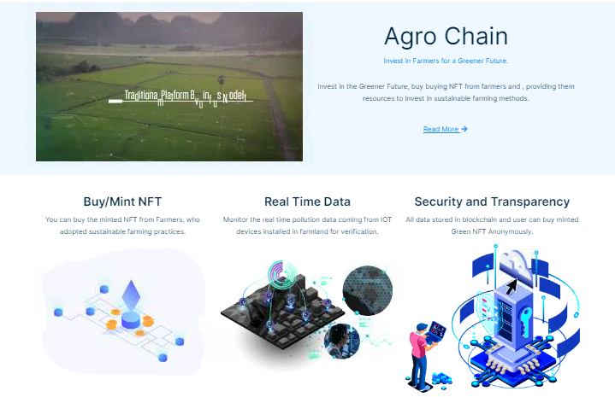
Agro Chain

Slide 2
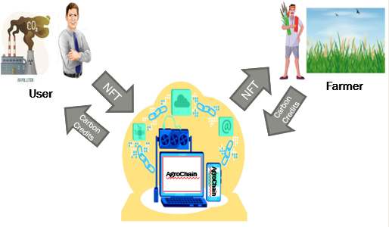
Problem Statement
The United States Environmental Protection Agency (EPA) estimates that 10% of CO2 is emitted by the Agri sector. On one hand Agri companies have sustainable products and services to offer to the growers. On the other hand, without proper economic incentives, farmers are reluctant to adopt sustainable practices. Centralized platform business models have so far not succeeded in creating economic value for the farmers, even while the demand for voluntary carbon market is increasing. What technologies and business models can enable financially incentivize farmers for implementing climate smart practices? What are the ways the buyer has proof of authenticity? What ways the participants including investors can derive economic value?

Slide 3
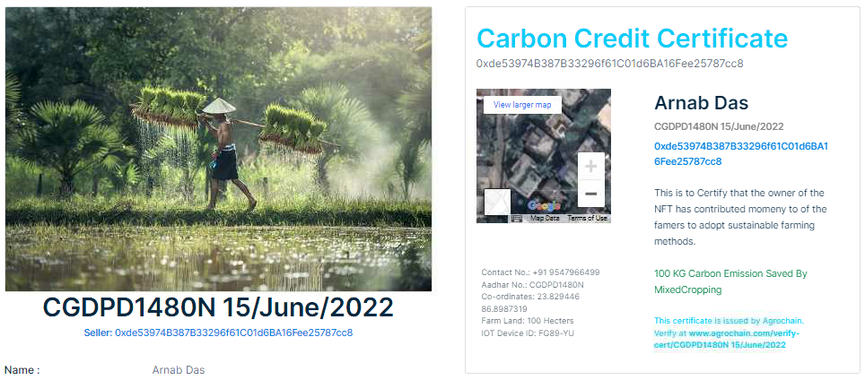
Introduction
ArgoChain is an NFT application Based on Ethereum Blockchain written in Solidity Smart Contract, and using the power of React Frontend, and ether.js to interact
with the Smart Contract present in the
Ethereum Blockchain, a user can
Upload & Mint (In IPFs), buy and
Sell NFT, in the ArgoChain NFT
marketplace. It provides a way for farmers to sell
carbon credits in the form of NFT to
industrial buyers who needs to buy
carbon credits in order to achieve
sustainability goals, thus giving farmers money to invest in more sustainable farming practices, and a win-win situation for all, the Air Quality verification is done using IOT devices, thus acting as a verification mechanism to ensure, that money is invested by farmers to adopt more sustainable farming methods.

Slide 4

Features
User Registration.
Selling.
Buying.
Buy NFT from Marketplace.
User Dashboard to view all the
NFT Minted, sold, and Purchased.

Slide 5
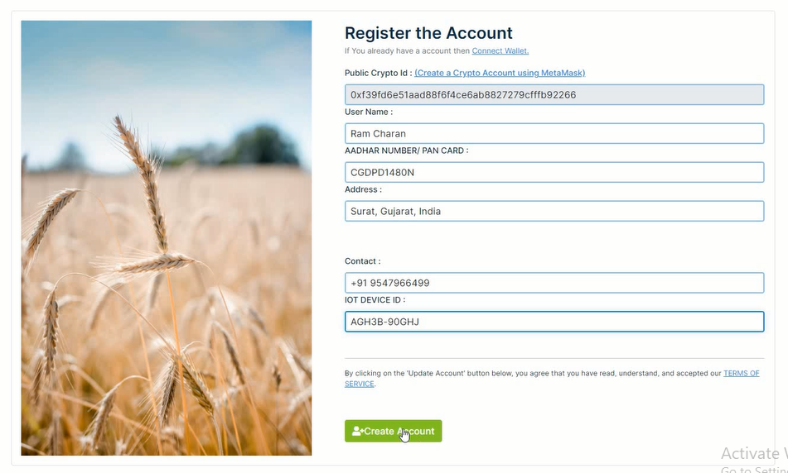
User Registration
User registration.
The personas supported are the
farmers
buyers of voluntary carbon credit
During registration,
Farmers give their full details (name, address, and other KYC details to register).
The buyers connect to their Web 3.0 wallet (such as Metamask). They do not need to register or give their personal details.

Slide 6
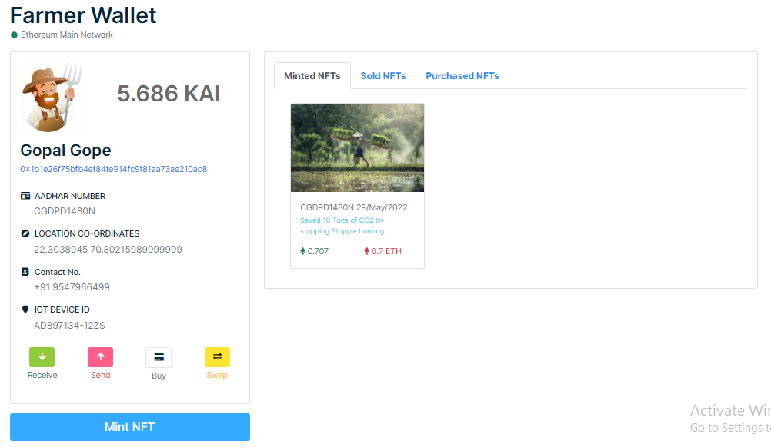
Profile
User Dashboard

Slide 7
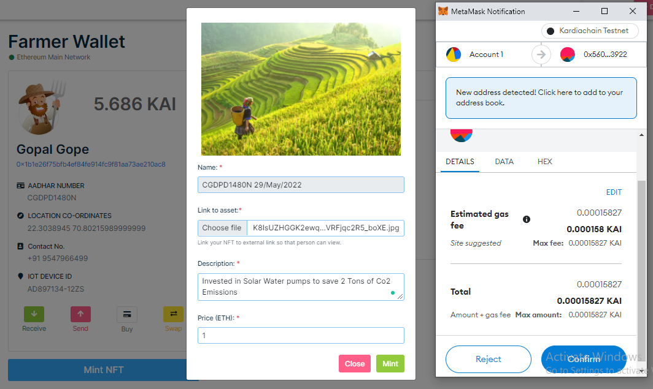
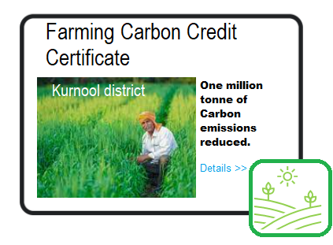
Selling
Selling
Farmers can post their verified “farming carbon
credits” in the voluntary carbon marketplace for
a price.
When the farmer posts their details, the system “mints” a unique NFT with details of farm image, the farmers property geocoded, amount of carbon emissions reduced displayed in it.
To ensure the farmer cannot submit the same data twice for sale? Who verifies if their reduction in carbon emissions? Including a human-in-the loop is always prone to corruption.
This is where a IoT based solution will be augmented in real-life.
For instance, take the stubble burning. There will be field sensors in the farm that will measure CO2 and other air quality periodically in the farm. The air quality data collected so collected in the farm will be pushed with a timestamp. This data becomes the foundation for computing the reduction in emissions.
Where will you store this data? This source of truth data also needs to be immutable. For this purpose, you could store this data in IPFS or other scalable ledgers.

Slide 8
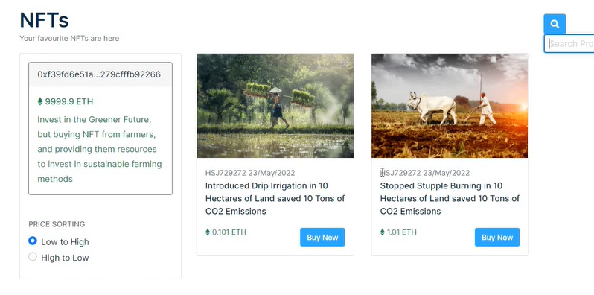
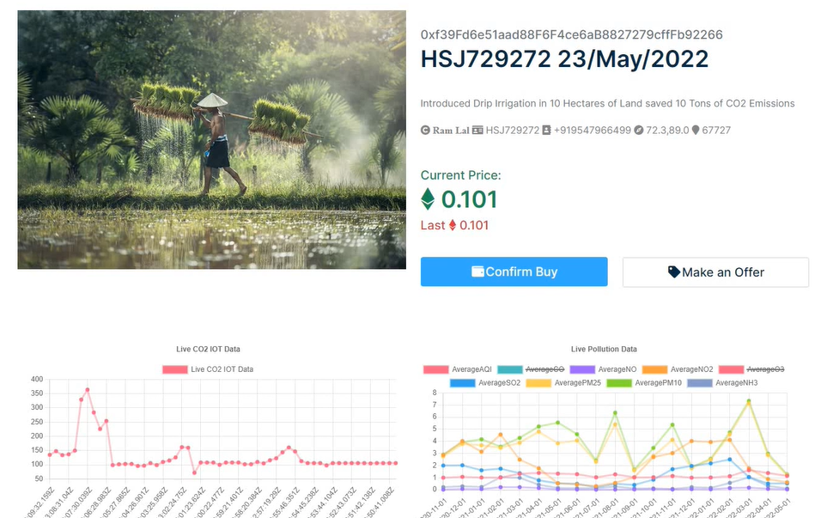
Buying
Buying
Buyer can view and buy “farming carbon credits” from the marketplace.
Designed a simple marketplace that lets the buyer view and filter (price etc.) what the farmers have posted.
To buy “farming carbon credits” they use a crypto currency native to the public blockchain i.e. Ethereum.
Upon buying the farmer’s Carbon Certificate, the NFT (digital asset) is transferred to the buyer using logic in smart contract.
After a purchase, the “farming carbon credit” is automatically removed from the marketplace.

Slide 9
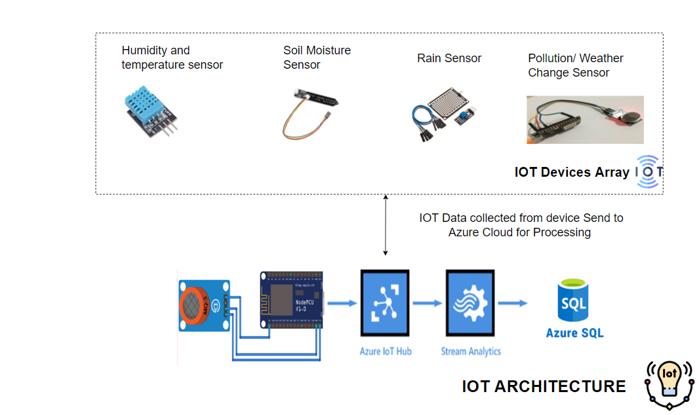
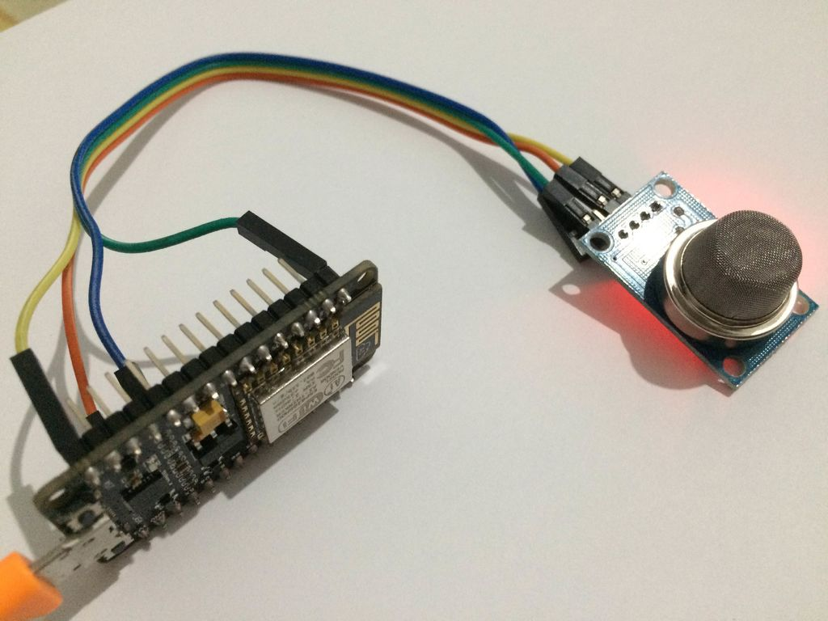
Verification Using IOT
Monitor Carbon Emission from field
Hardware Used
Node MCU ESP8266
MQ135 Sensor
Software Used
Once the Data is Captured using IOT Device It is processed using Azure IOT Hub and Stream Analytics Job, to be send to the bank so that bank can make a quick decision of settling the insurance claims of farmers.
Arduino IDE
Azure IOT Hub
Stream Analytics Job
SQL Database

Slide 10
IOT Usage Explanation
First, we need to write code based on our requirements & flash into Nodemcu memory.
MQ135 sensor read Co2 level from atmosphere and send it to Nodemcu device.
Nodemcu send Co2 value to Azure IOT hub.
By using Stream Analytics Job, we are sending our data to SQL database.
Using Restful API, we are fetching Co2 data to our webpage

Slide 11
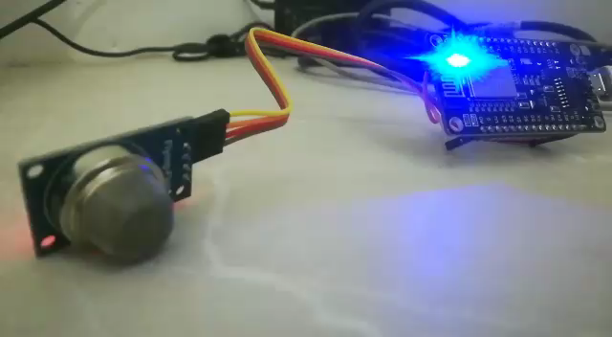

Slide 12
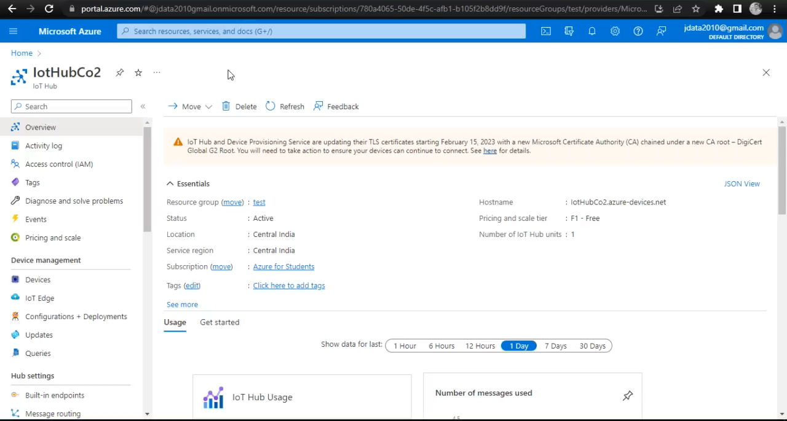

Slide 13
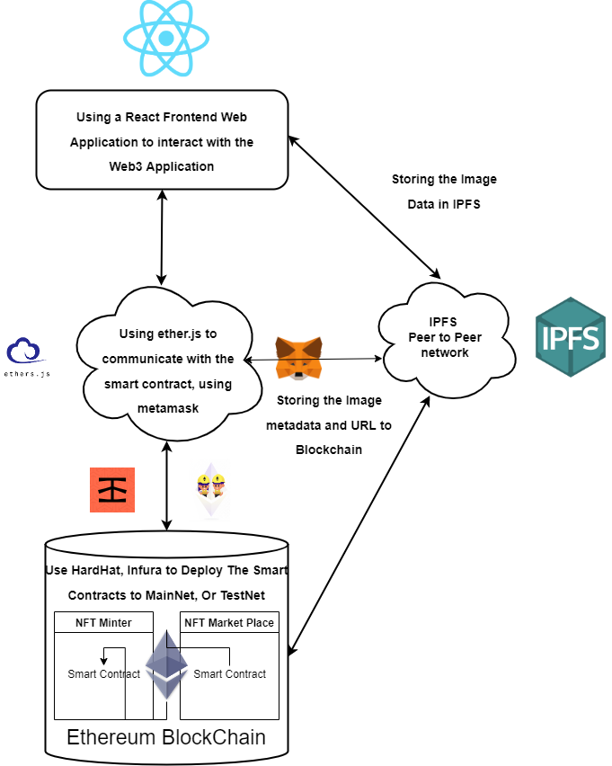
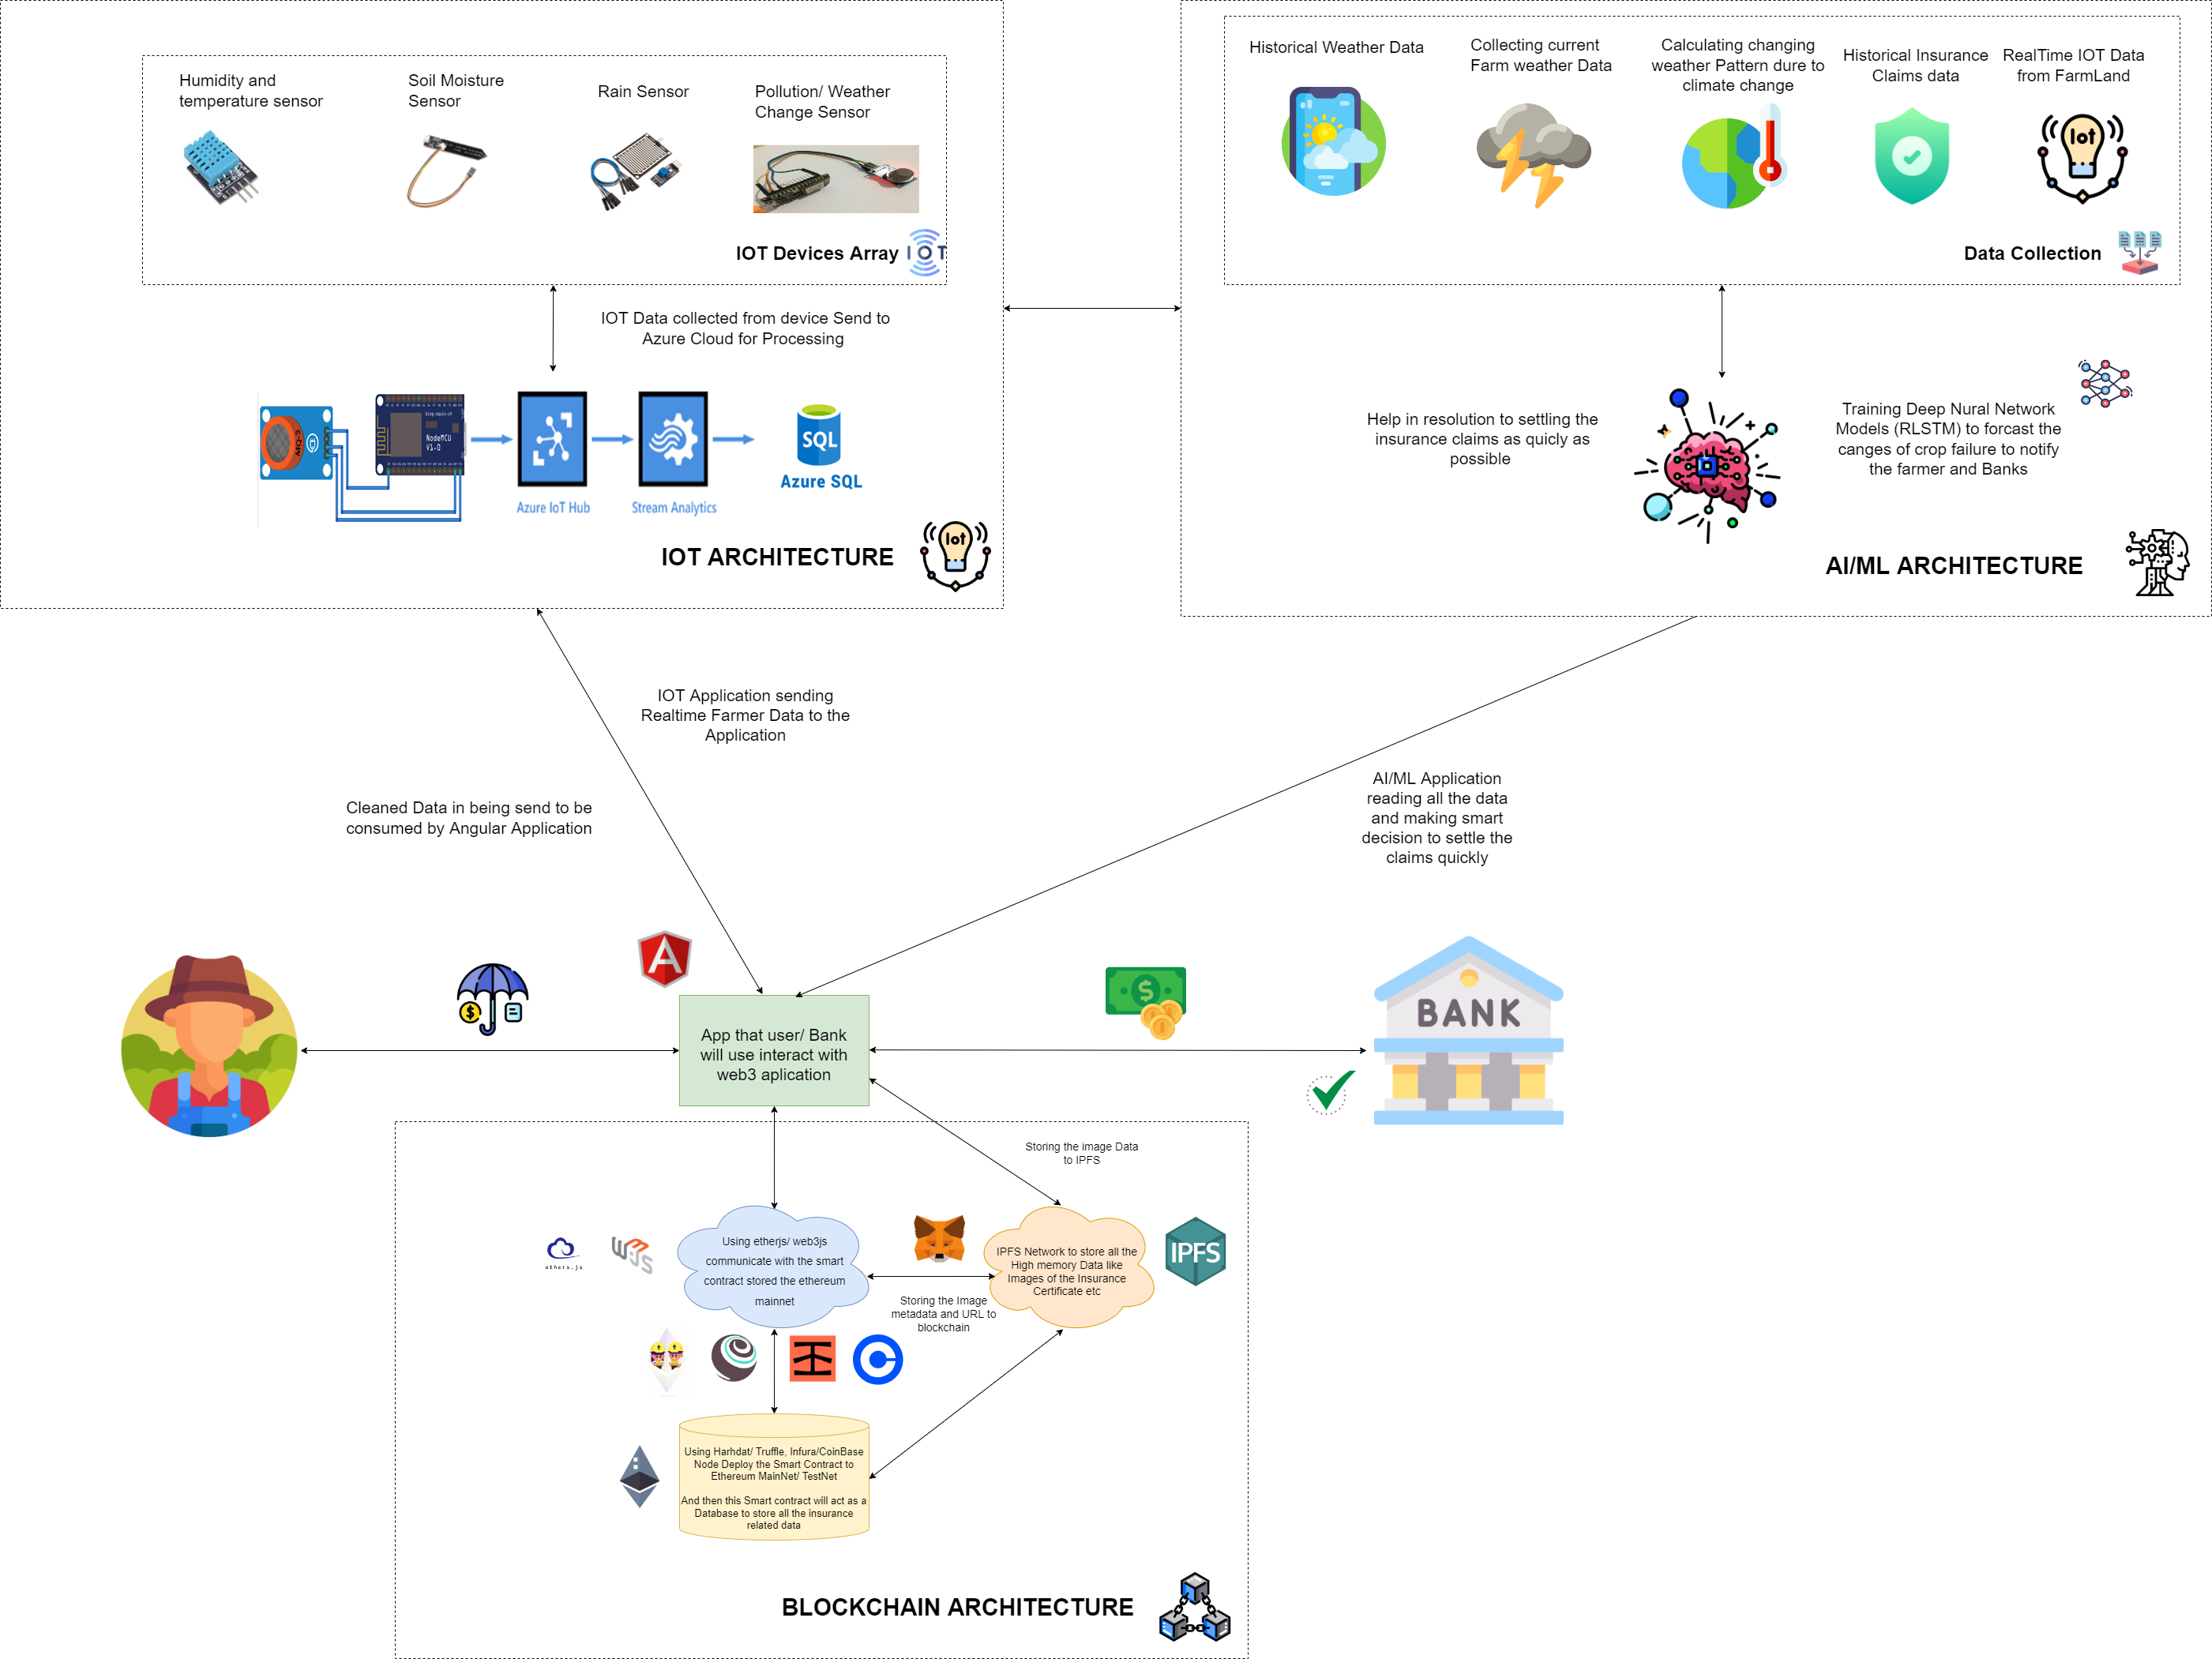
Architecture

Slide 14

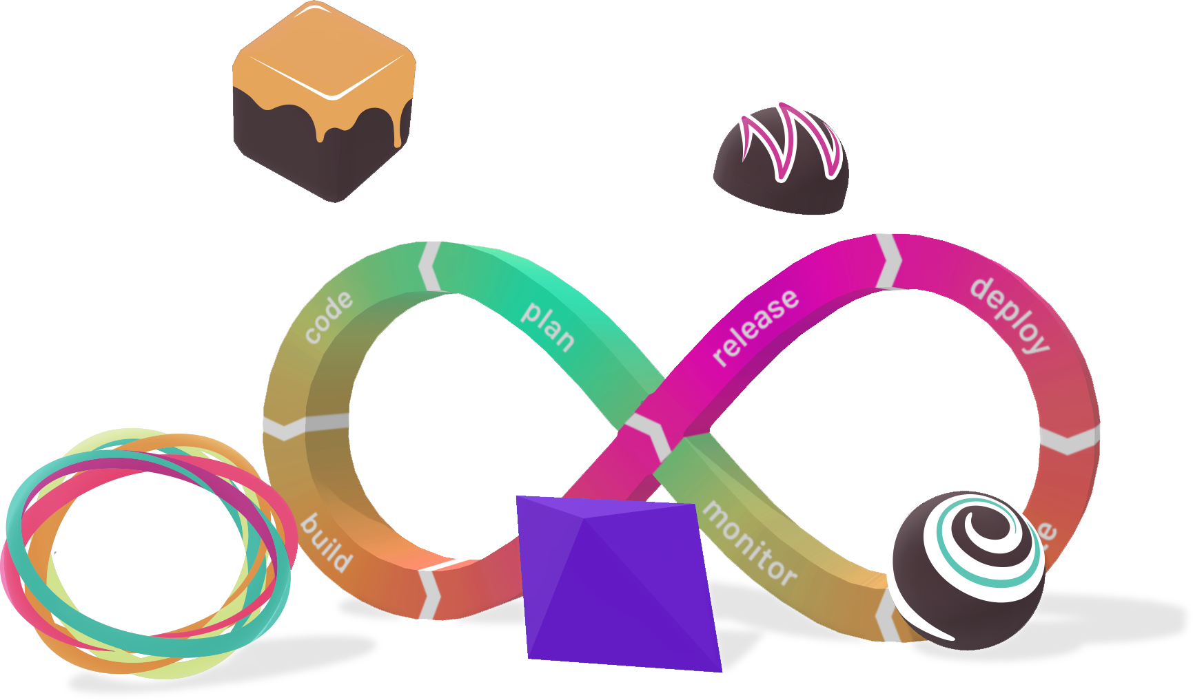
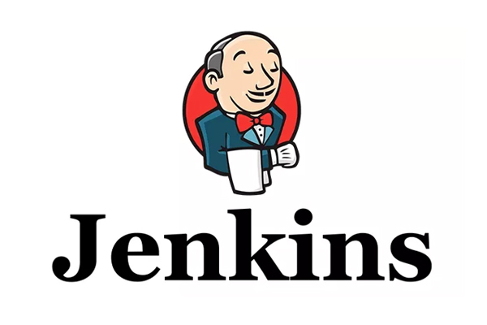
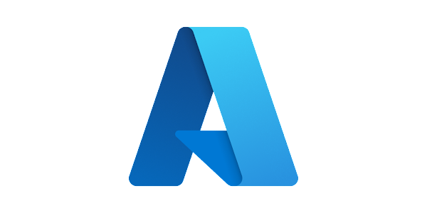
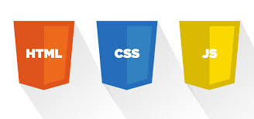
TECHNOLOGIES USED IN THE APPLICATION
FRONT END
REACT
HTML
CSS
JAVASCRIPT
DEPLOYMENT
BACKEND
ether.js
Hardhat
Infura
ETHEREUM
Azure Cloud
Jenkins

Slide 15

Thank You !
https://www.youtube.com/watch?v=ODzVe-6mRfQ

