Slide 1
ET AutoTech Hackathon
2026
AI for Circular Economy & Sustainability
base234
Arnab Das & Sayan Sinha

Slide 2
Theme Chosen - Brief Summary & Proposed Solution/Idea
CircuVolt AI: Vehicle Material Passport and Recovery Optimizer
Brief Summary: CircuVolt AI is an agentic AI platform that predicts EV battery State of Health (SOH), assigns second-life/recycling grades, generates EU-compliant, QR-based material passports, and recommends the safest, highest-value circular-economy pathway for all vehicle components.
This represents a complete paradigm shift from the traditional "scrap management" model. Instead of relying on manual, post-mortem sorting where vehicles are shredded into mixed, low-value scrap, this is a new predictive circularity engine. It utilizes LangGraph, MCP, and A2A protocols to intelligently route materials (reuse, repair, second-life, or recycle) at the intake stage, before value is destroyed.

Slide 3
IMPACT OF PROPOSED SOLUTION
Impact: Maximizes the economic and carbon-saving value of End-of-Life Vehicles (ELVs). By transitioning to an AI decision system, the platform ensures reusable parts are harvested effectively, EV batteries are confidently graded for stationary storage, and closed-loop material recycling is optimized.
Scalability: Highly scalable due to its software-first, interoperable architecture. By exposing tools via the Model Context Protocol (MCP) and implementing Google's Agent-to-Agent (A2A) standard, the solution can easily scale to integrate with varied OEM databases, RVSFs (Registered Vehicle Scrapping Facilities), and external LLM APIs globally.
Feasibility: The solution is entirely feasible today. It runs on a proven tech stack (FastAPI, React) and utilizes existing Battery Management System (BMS) logs, visual inspection data, and standard machine learning (XGBoost) to evaluate components against tangible metrics like resale value and avoided CO2e.

Slide 4
PROPOSED TECH STACK/ARCHITECTURE
Frontend Layer: React, Vite, CopilotKit (AG-UI Protocol for streaming AI state), React Three Fiber (for explorable 3D car models), Recharts (degradation analytics).
Backend Layer: Python, FastAPI, SQLite (SQLAlchemy ORM).
AI/ML Core: LangGraph (ReAct agent pattern), LangChain, Scikit-learn, GradientBoosting (SOH Inference with SHAP explainability).
Protocols: MCP (Model Context Protocol), A2A (Agent-to-Agent Protocol), AGUI (Agentic UI) Protocol.

Slide 5
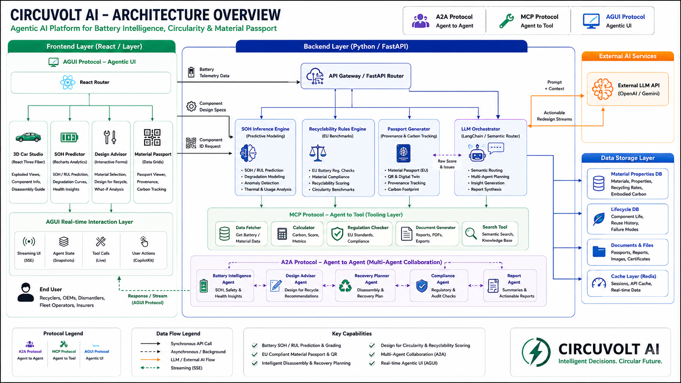
Architecture Diagrams, Screenshots/Video Demo of Application

Slide 6
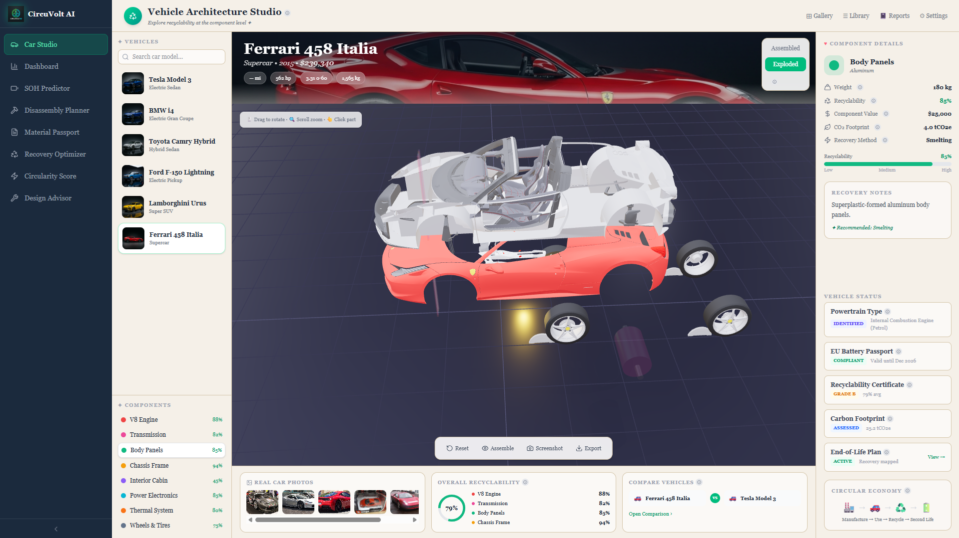
Architecture Diagrams, Screenshots/Video Demo of Application

Slide 7
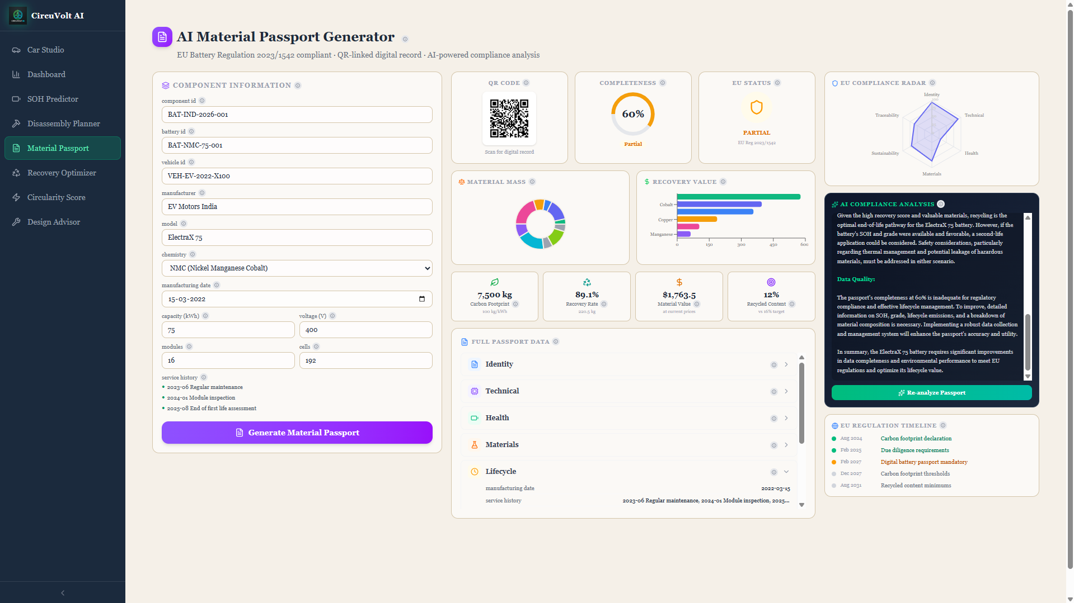
Architecture Diagrams, Screenshots/Video Demo of Application

Slide 8
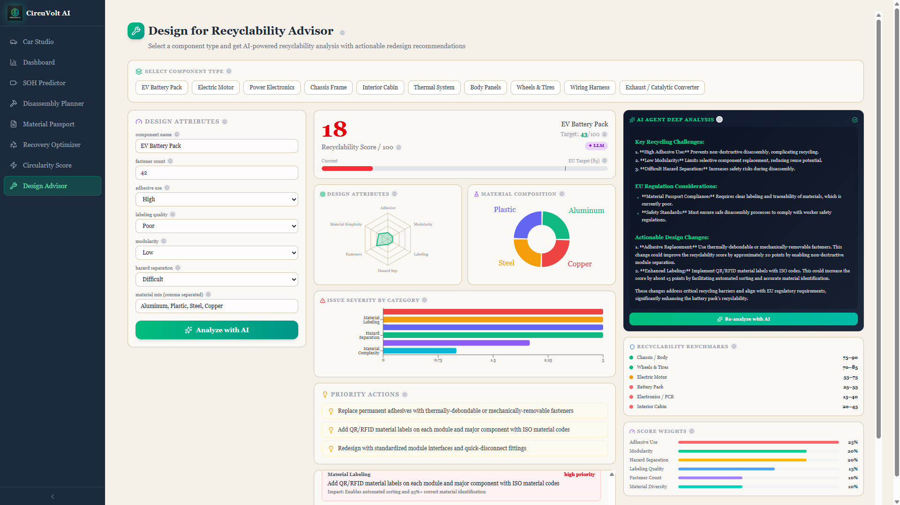
Architecture Diagrams, Screenshots/Video Demo of Application

Slide 9
Why your solution must be considered?
Regulatory Compliance: Digital material passports and SOH transparency are rapidly becoming strict, unavoidable legal requirements (e.g., EU Battery Regulation 2023/1542, India's Battery Waste Management Rules 2022).
Highest Value Capture: Most vehicle recycling starts too late after shredding. This solution captures maximum revenue by optimizing the hierarchy of circularity: reuse as-is, repair, second-life use, and closed-loop recycling.
Agentic Interoperability: By building natively with the newest agentic protocols (A2A, MCP), this platform doesn't just run predictions; it allows future automotive and supply chain AI agents to autonomously query and interact with CircularDrive AI.

Slide 10
Any Additional Information/References
Haraz, A., Abualsaud, K. and Massoud, A. (2024) 'State-of-Health and State-of-Charge estimation in electric vehicles batteries: A survey on machine learning approaches', IEEE Access, 12, pp. 158110–158139. doi: 10.1109/access.2024.3486989.
Jafari, S. and Byun, Y.-C. (2022) 'XGBoost-based remaining useful life estimation model with extended Kalman particle filter for lithium-ion batteries', Sensors, 22(23), p. 9522. doi: 10.3390/s22239522.
Xiao, Z., Jiang, B., Zhu, J., Wei, X. and Dai, H. (2024) 'State of health estimation for lithium-ion batteries using an explainable XGBoost model with parameter optimization', Batteries, 10(11), p. 394. doi: 10.3390/batteries10110394.
Second-Life Batteries & Circular Economy Repurposing
Akram, M.N. and Abdul-Kader, W. (2024) 'Repurposing second-life EV batteries to advance sustainable development: A comprehensive review', Batteries, 10(12), p. 452. doi: 10.3390/batteries10120452.
Mekhmonov, R., Alawadi, A.H., Abbas, A.H.R., Jayashree, S., Santhi, G.B. and Raja Kumar, J.R. (2024) 'Second-life applications of electric vehicle batteries in energy storage', E3S Web of Conferences, 540, p. 02011. doi: 10.1051/e3sconf/202454002011.
Intelligent Disassembly & AI Vision Systems
Beghi, M., Braghin, F. and Roveda, L. (2023) 'Enhancing disassembly practices for electric vehicle battery packs: A narrative comprehensive review', Designs, 7(5), p. 109. doi: 10.3390/designs7050109.
Li, J., Barwood, M. and Rahimifard, S. (2018) 'Robotic disassembly for increased recovery of strategically important materials from electrical vehicles', Robotics and Computer-Integrated Manufacturing, 50, pp. 203–212. doi: 10.1016/j.rcim.2017.09.013.
Zorn, M., Ionescu, C., Klohs, D., Zähl, K., Kisseler, N., Daldrup, A., Hams, S., Zheng, Y., Offermanns, C., Flamme, S., Henke, C., Kampker, A. and Friedrich, B. (2022) 'An approach for automated disassembly of lithium-ion battery packs and high-quality recycling using computer vision, labeling, and material characterization', Recycling, 7(4), p. 48. doi: 10.3390/recycling7040048.

Slide 11
THANK YOU

