Slide 1
INVESTOPIA
One Stop Financial Tools For Investment

Slide 2
INVESTOPIA
Hackathon : Online
AZURE DEVELOPERS LEAGUE
THEME 1
AZURE FOR INDUSTRIES
https://www.hackerearth.com/challenges/hackathon/azure-developer-league-hackathon/
by
TEAM : base234
Arnab Das & Sayan Sinha

Slide 3

INVESTOPIA
Objective
To reduce the risk of life from useless monetary loss.
Avoid Dependent on other during old age.
Help in investments to reduce the risk factors.
Proper fund management even on inflation.
Helps you to understand the factors affecting due to expenditure with visuals.
Understand every day's loss amount to improve your savings and investments.

Slide 4

INVESTOPIA
Goals
To make finance management easy from one place.
One-tap and everything’s on your hand.
To show assumed data and calculated data with accuracy.
Easy display and visually understanding.
Current Updated investments in Real-time.
To go for smart retirement plans confidently.

Slide 5
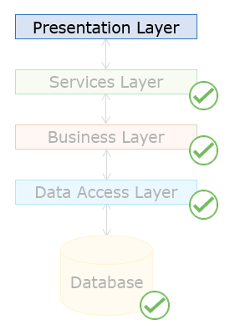

INVESTOPIA
Features and Applications
Data Base Layer–
Microsoft SQL Server, TSQL
Business Layer–
C#, .NET, Entity Framework Core
Service Layer–
C#, ASP.NET CORE WEB API
Presentation Layer–
Angular, HTML,CSS, Typescript

Slide 6
INVESTOPIA
Features and Applications
Life Expectancy (Machine Learning) –
Used Decision Tree Regression Algorithm on WHO Health Data to predict Life Expectancy Of a Person.
Investment Distribution (Deep Neural Network)–
Used convolutional Neural Nets using TensorFlow To calculate the best wealth distribution to minimize risk and maximize profits.

Slide 7
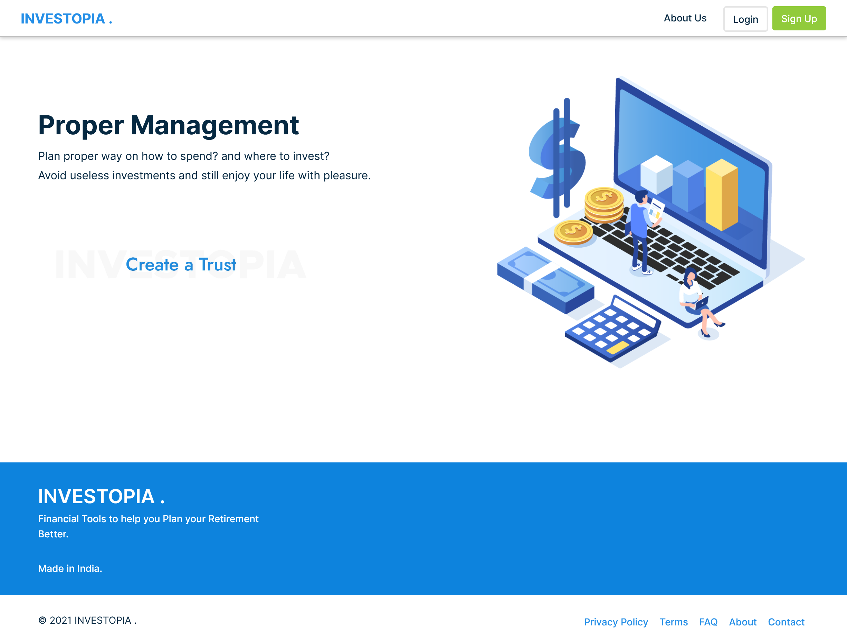
INVESTOPIA
Screenshots

Slide 8
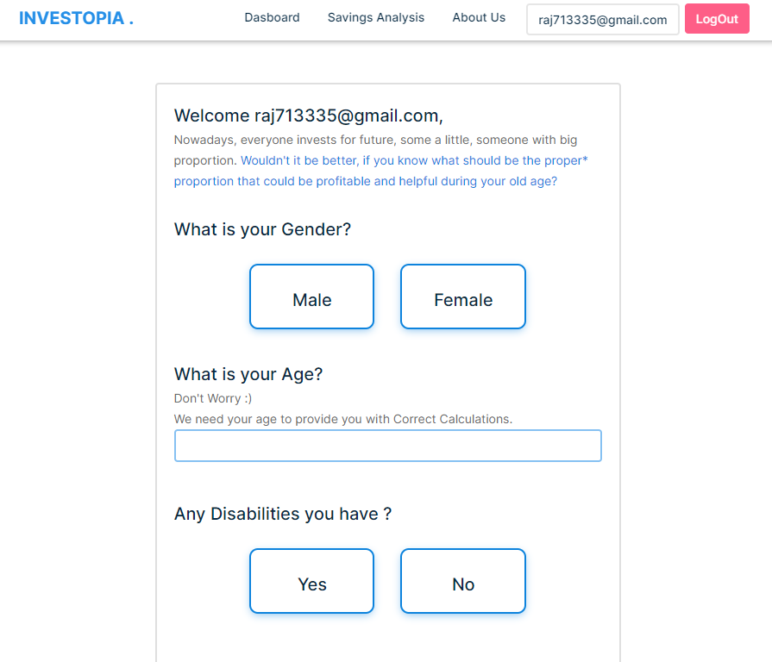
INVESTOPIA
Screenshots

Slide 9
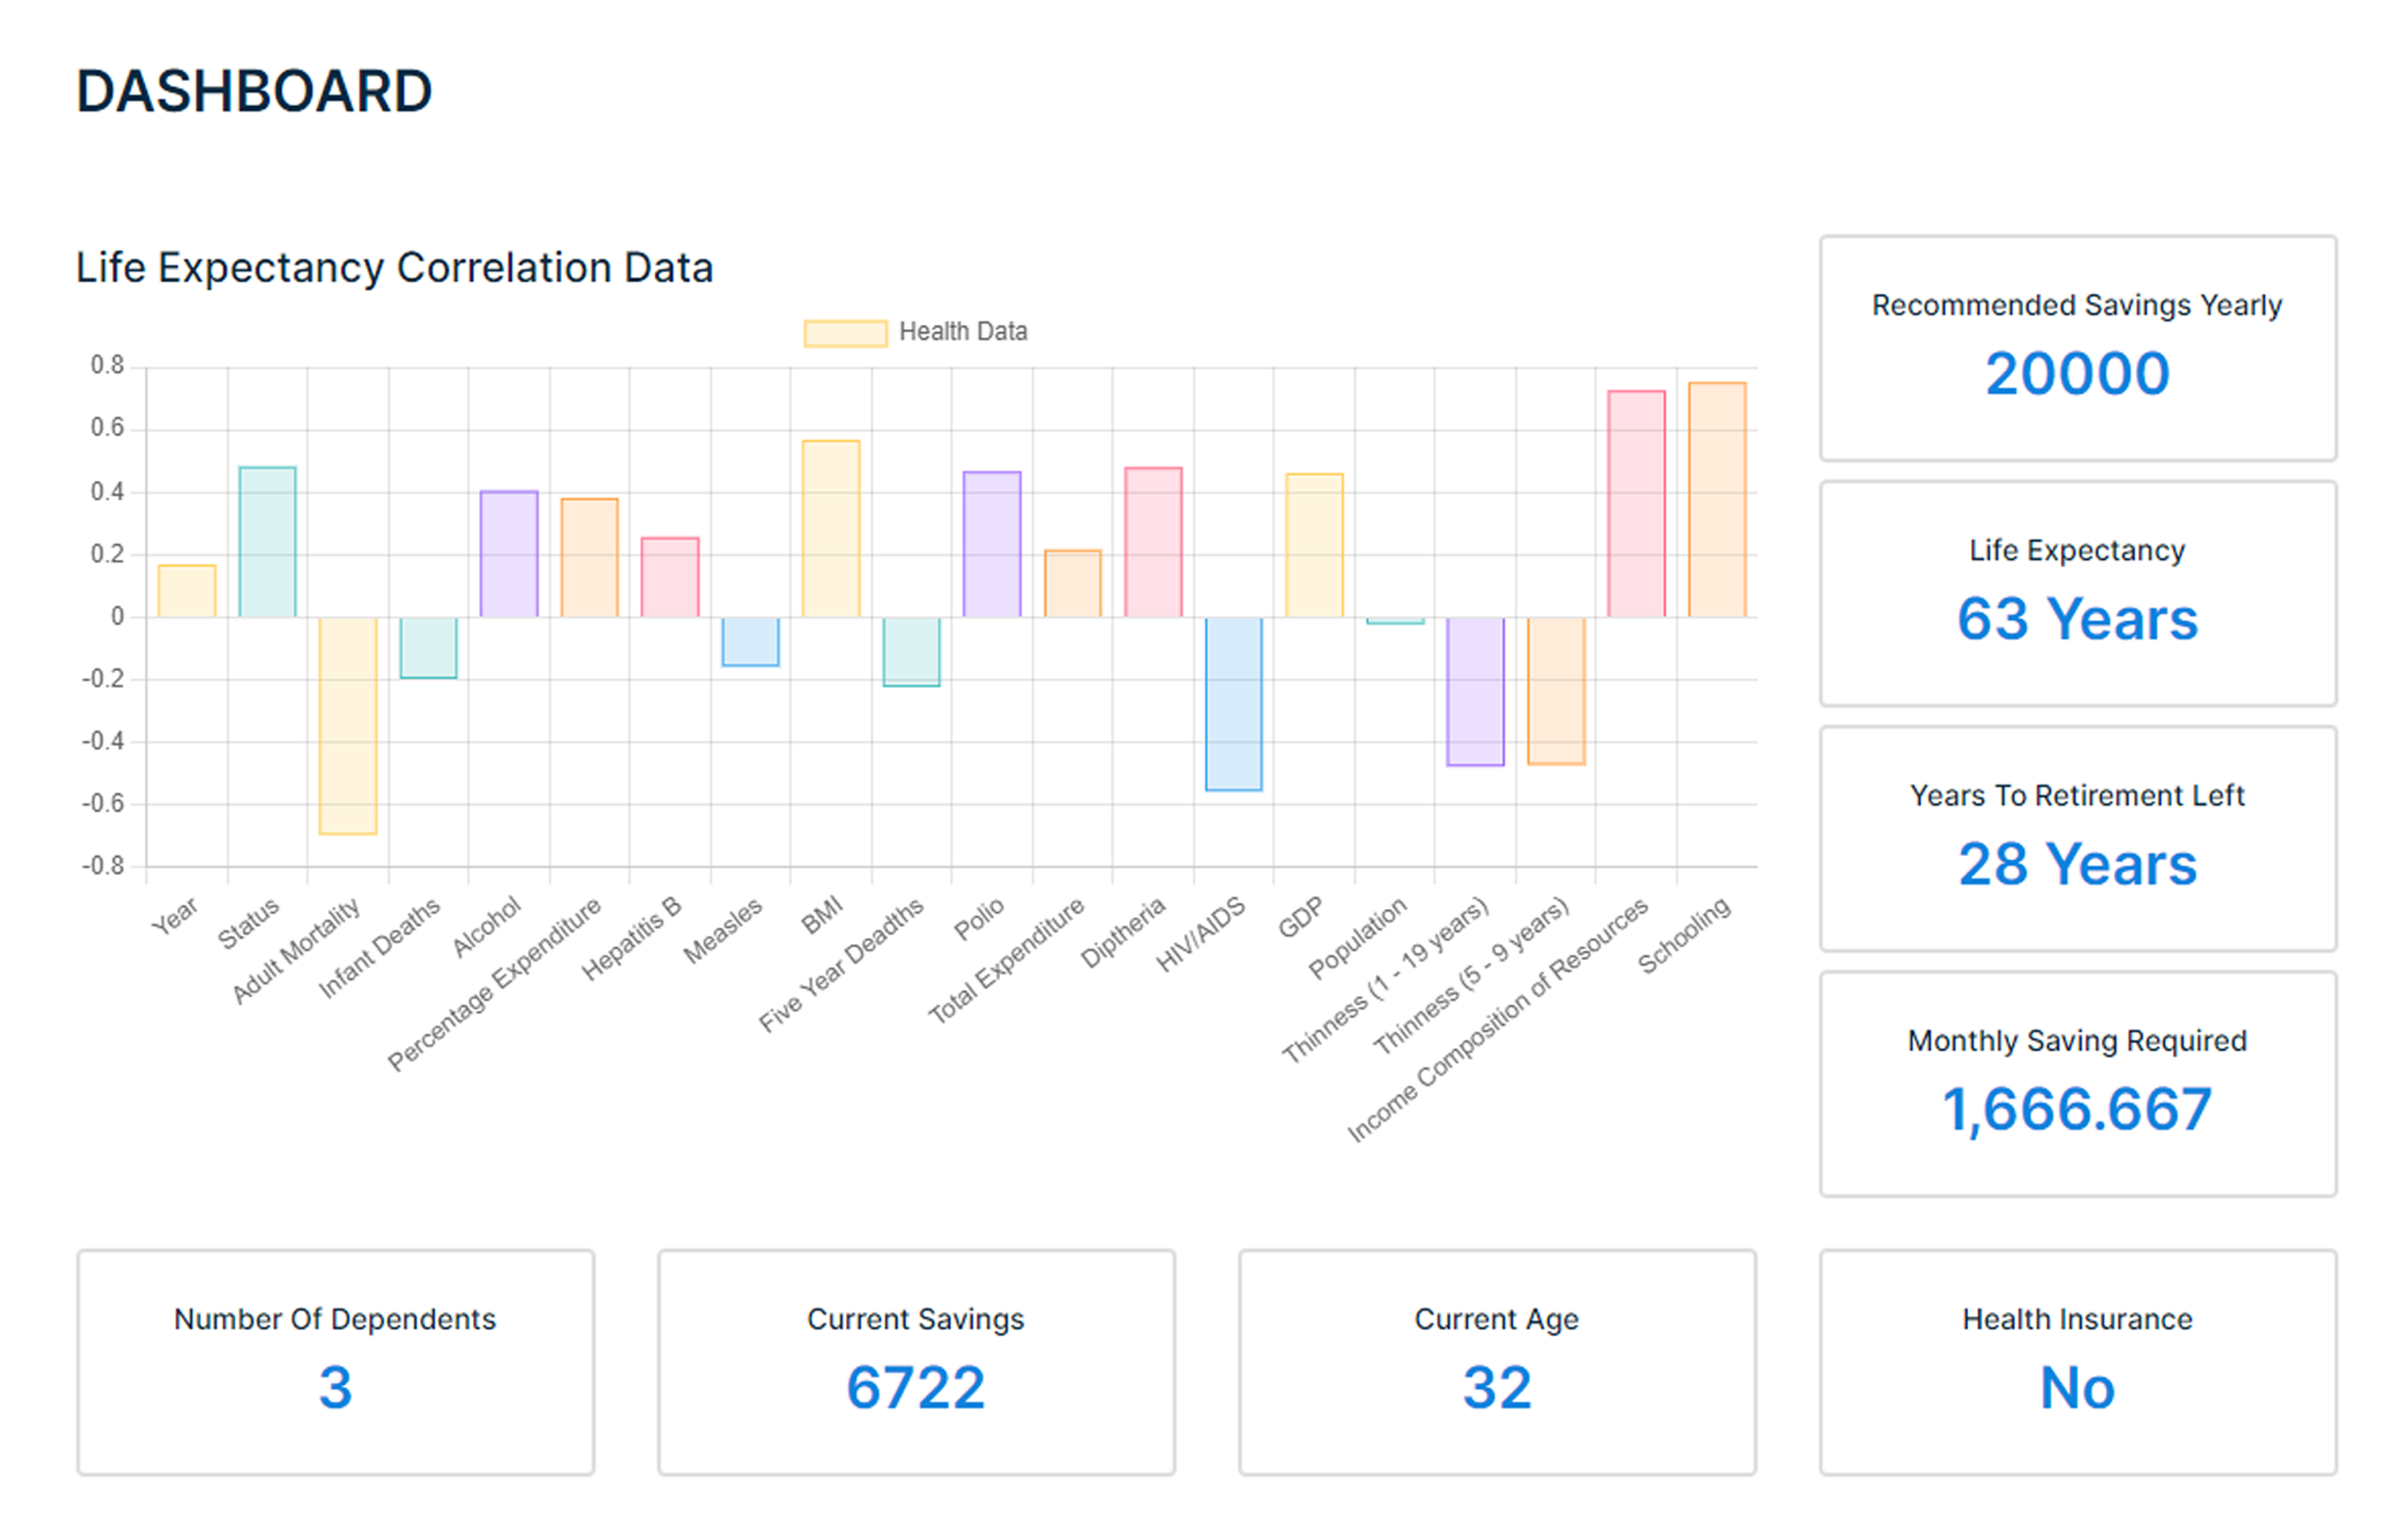
INVESTOPIA
Screenshots

Slide 10
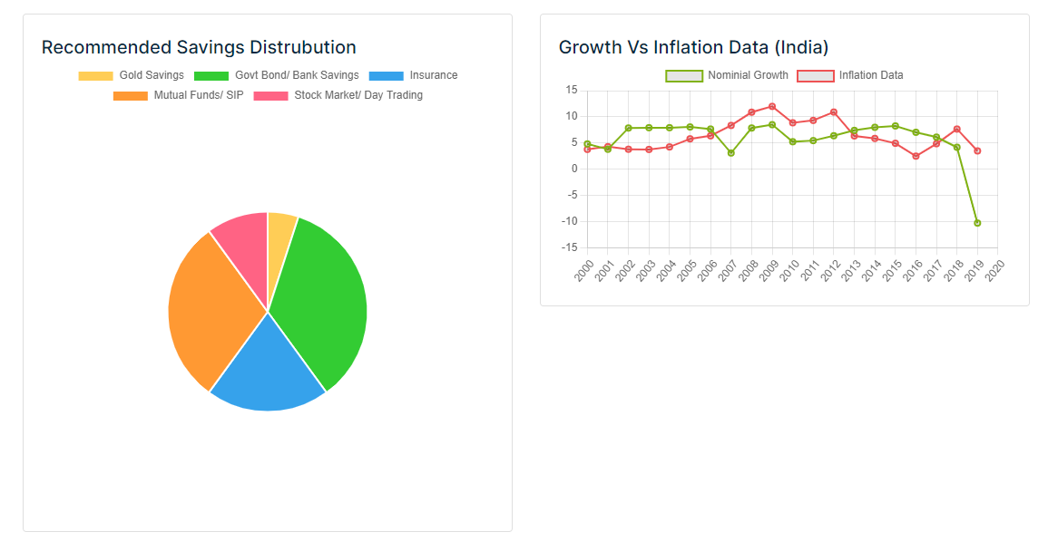
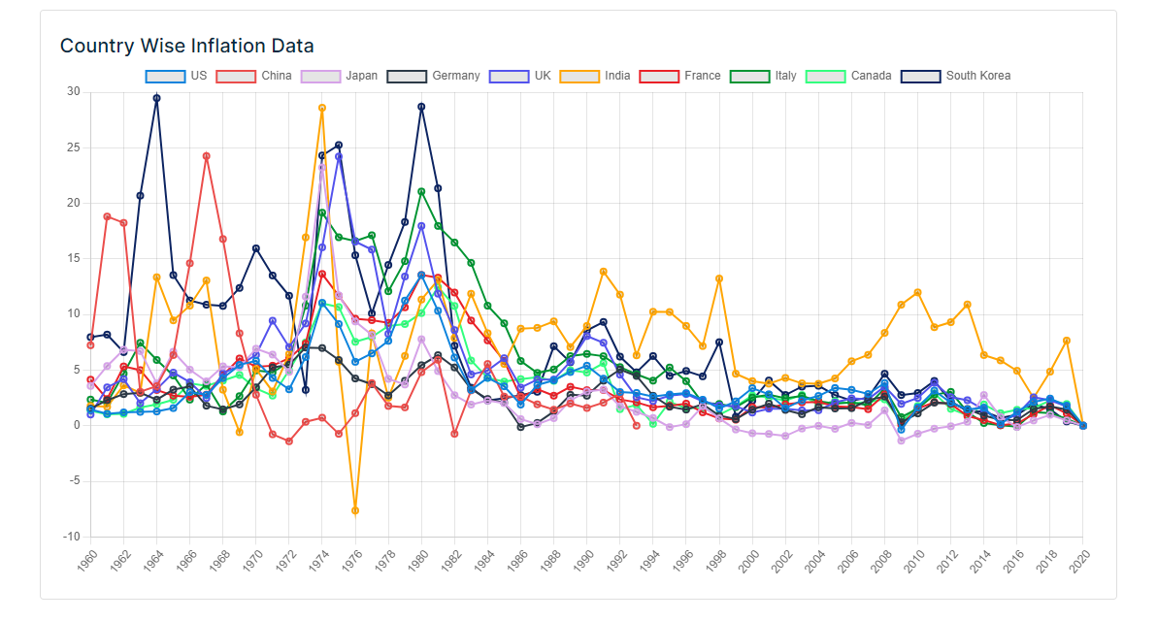
INVESTOPIA
Screenshots

Slide 11
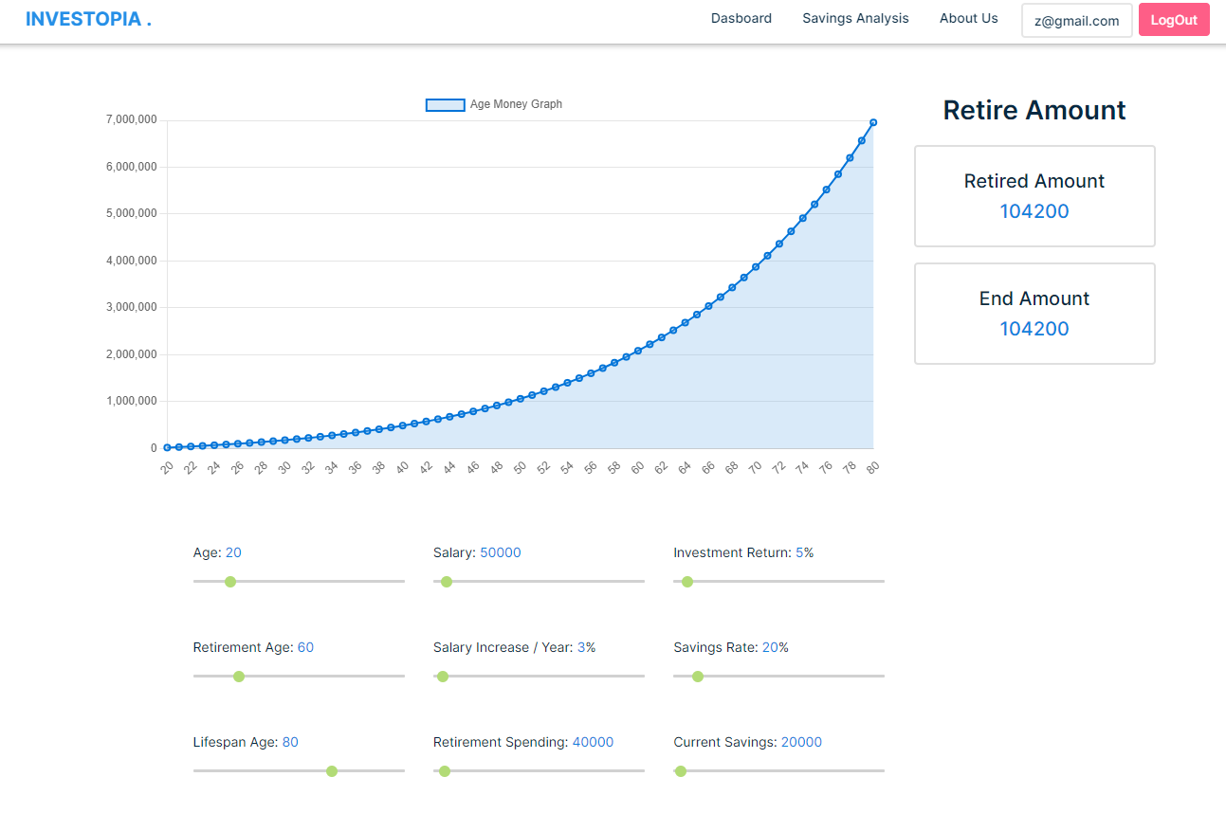
INVESTOPIA
Screenshots

Slide 12
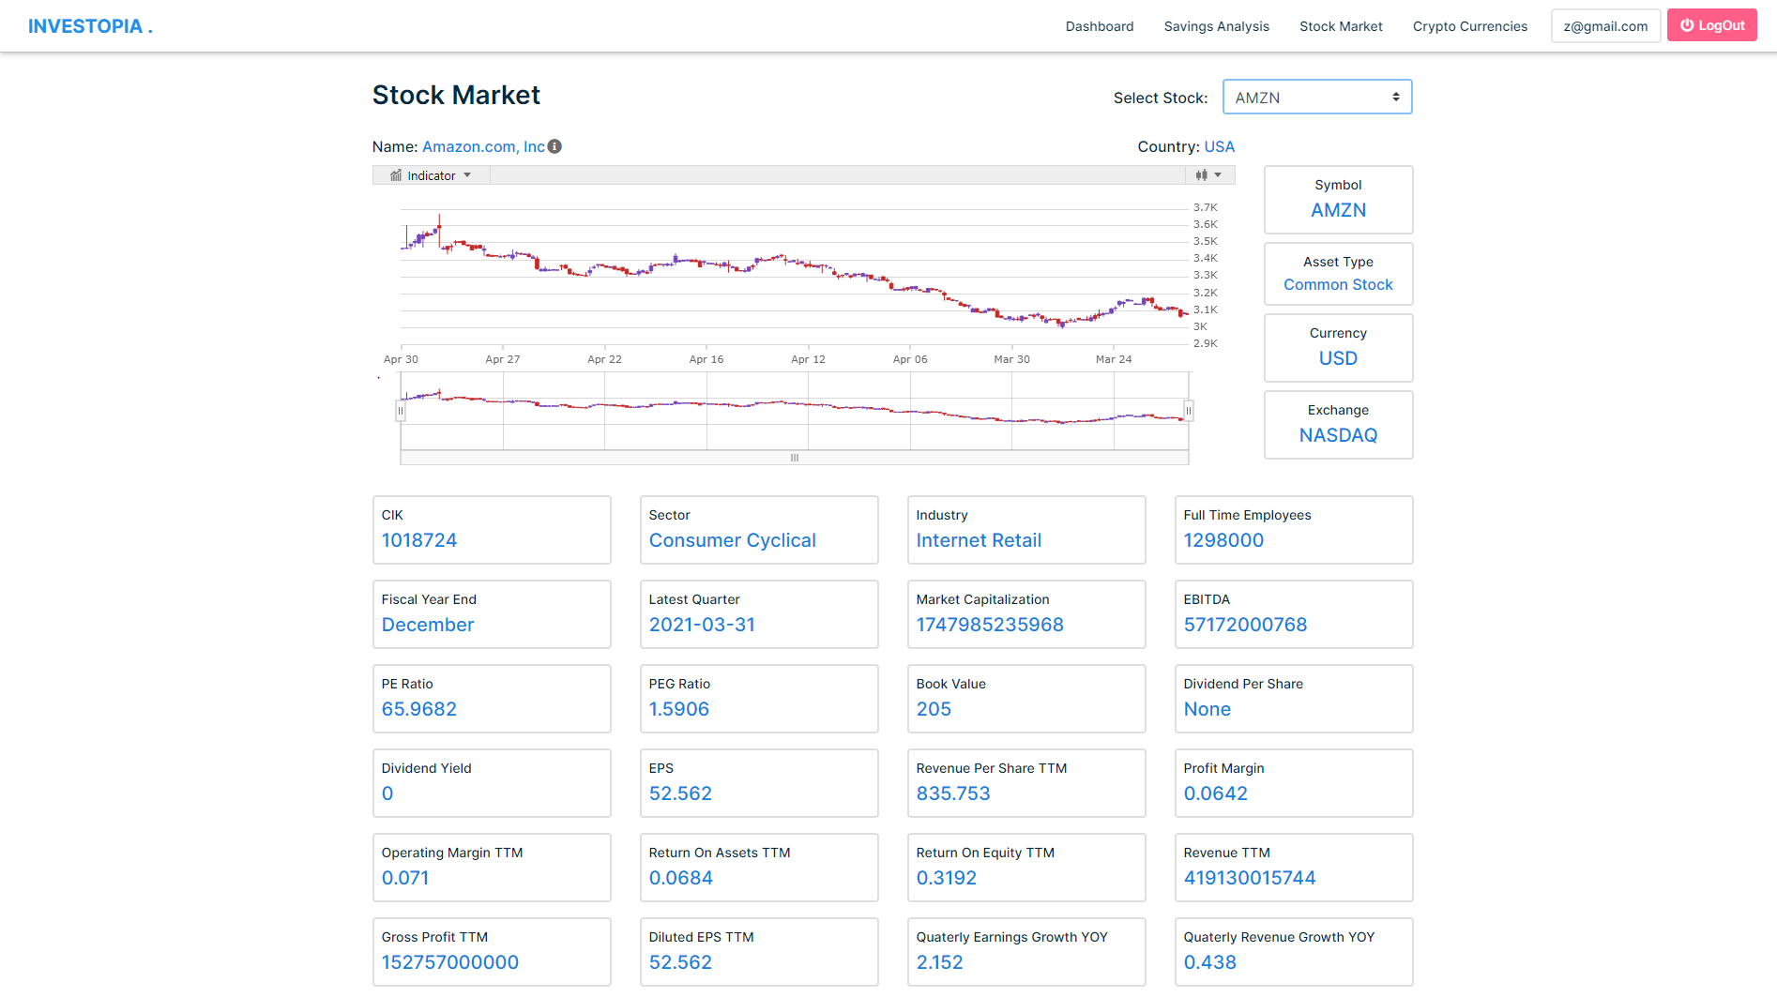
INVESTOPIA
Screenshots

Slide 13
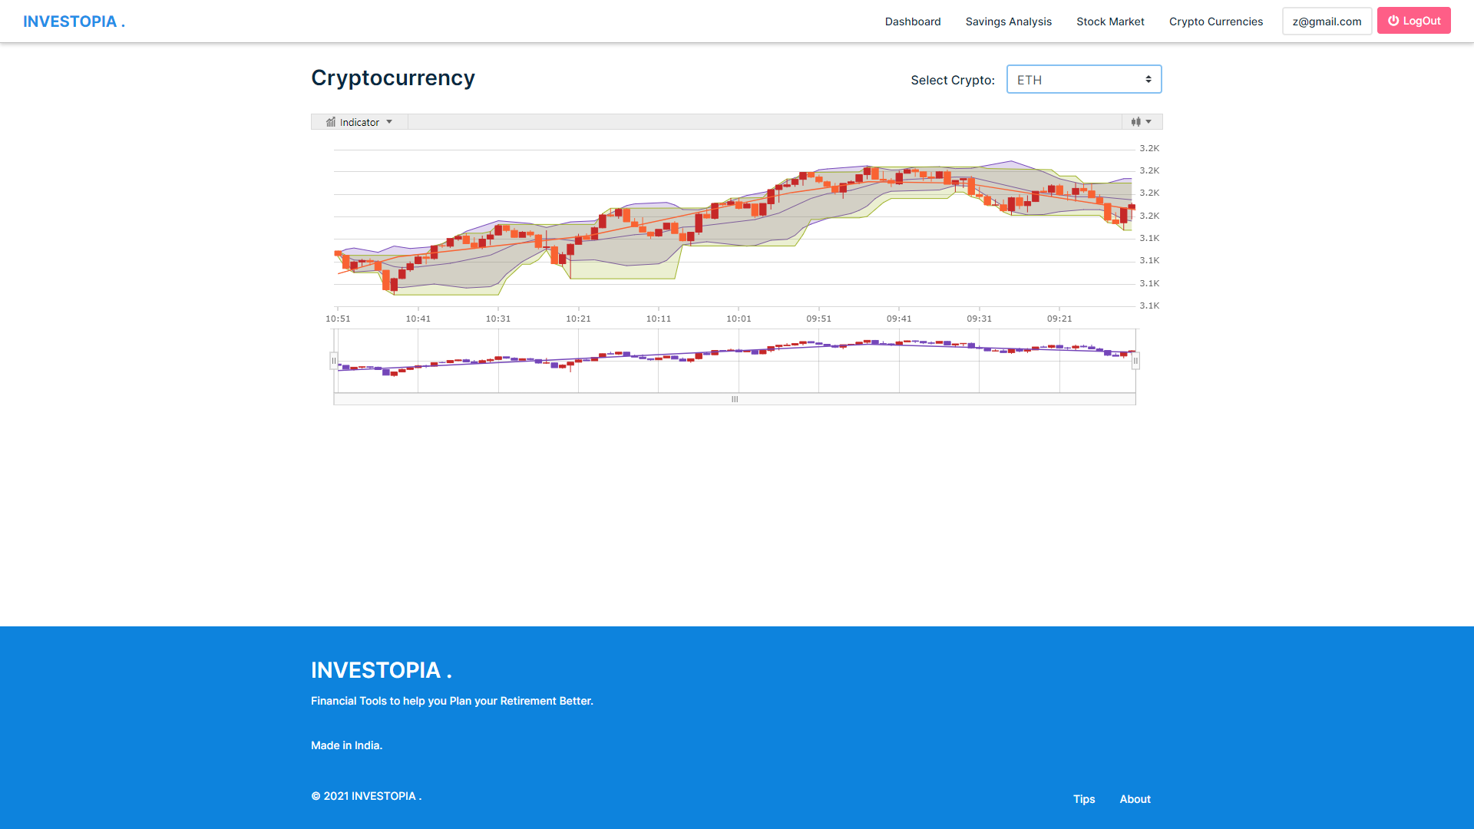
INVESTOPIA
Screenshots

Slide 14
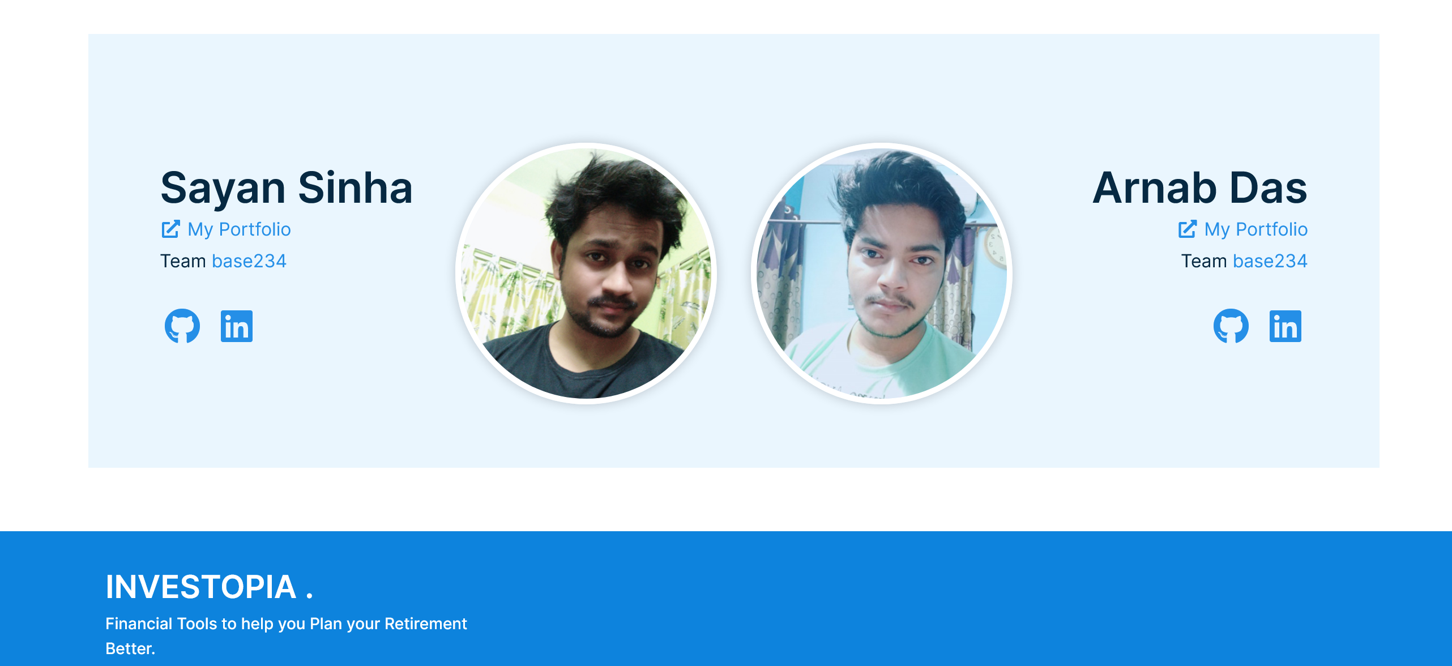
INVESTOPIA
Screenshots

Slide 15
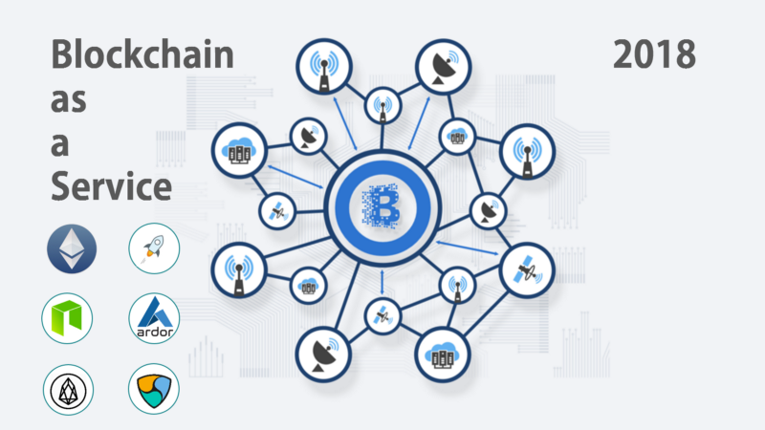
INVESTOPIA
Future Scope
Create a Block Chain to Store user Data in a decentralised System

Slide 16
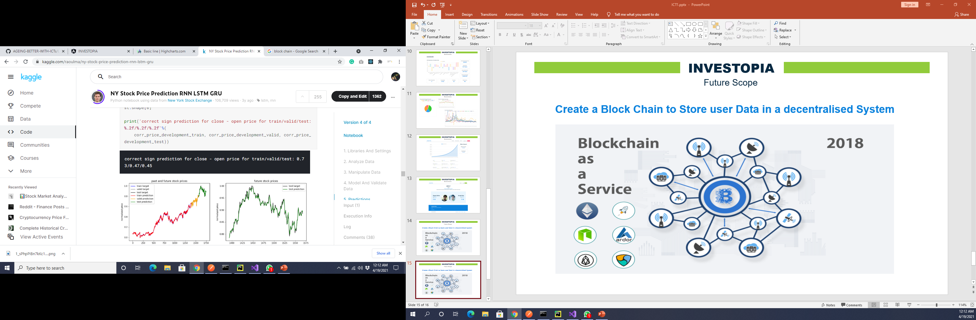
INVESTOPIA
Future Scope
A Recommendation System to make prediction on best Stock to invest in , best mutual funds to purchase and invest in automatically using a bot.
* Screenshot of my Jupyter Notebook.

Slide 17
INVESTOPIA
THANK
YOU

