Slide 1

UniSphere
Smart University
Digital Campus
Solution presentation
Concept, approach, innovation and prototype evidence
Vikram University use case | 1 October 2026
Notes:
UniSphere is a unified campus platform connecting administration, students and linked parents. This presentation shows a working Windows prototype and its operating workflows. The cover is a concept illustration, not a photograph of the university.
Evidence: EXECUTIVE_SUMMARY.md; assets/submission/unisphere-campus-cover.png. App screenshots captured from the local Windows prototype on 1 October 2026; demo records, not production deployment evidence.

Slide 2
The Campus Service Problem
Routine student work crosses disconnected offices and records.
Fragmented services
Admissions, academics, residence and transport often operate separately.
Repeated office visits
Students need staff assistance to learn status, request services or correct records.
Limited visibility
Students and parents cannot easily see who owns the next action.
Late support
Attendance and performance signals are difficult to turn into timely follow-up.
UniSphere | Working prototype | 02
Notes:
The challenge is not just putting forms online. It is connecting ownership, status and authenticated records across the student lifecycle. These are the problem-statement assumptions, not findings from a quantified campus survey.
Evidence: User-supplied Smart University Digital Campus problem statement. App screenshots captured from the local Windows prototype on 1 October 2026; demo records, not production deployment evidence.

Slide 3
One Platform, Three Accountable Roles
Shared institutional records with different permissions and views.
Administrator
Creates the university structure, enrolls students and operates services.
Student
Views personal records, asks questions and tracks service requests.
Parent
Views only students linked by authorized university staff.
Admin action > Persisted record > Authorized portal view
UniSphere | Working prototype | 03
Notes:
All portals use a shared backend. A student is resolved from the authenticated user, rather than a hardcoded demo name. Parent access depends on an active parent-student link. Record updates appear when the view loads or refreshes; do not claim that every view is automatically pushed in real time.
Evidence: lib/features/admin/admin_shell.dart; lib/services/auth_service.dart; backend/app/api/v1/parent_v2.py. App screenshots captured from the local Windows prototype on 1 October 2026; demo records, not production deployment evidence.

Slide 4
Student Lifecycle Workflow
University staff own the data that becomes the student experience.
01 Configure
University, department, programme, session and curriculum.
02 Register
Student account, unique Uni-ID and institutional identifiers.
03 Provision
Assign semester; enroll courses; prepare timetable and examination plan.
04 Operate
Record attendance/results; allocate residence and transport; issue certificates.
05 Support
Link parents; surface warnings; assign interventions and follow up.
UniSphere | Working prototype | 04
Notes:
A new account is not automatically a complete student record. Administrators first configure master data and then provision an academic plan. Service allocations and parent registration are explicit operations. The demo curriculum may provision sample timetable, fee invoice and examination records; it is not an official syllabus.
Evidence: lib/features/admin/admin_academic_plans_screen.dart; EXECUTIVE_SUMMARY.md. App screenshots captured from the local Windows prototype on 1 October 2026; demo records, not production deployment evidence.

Slide 5
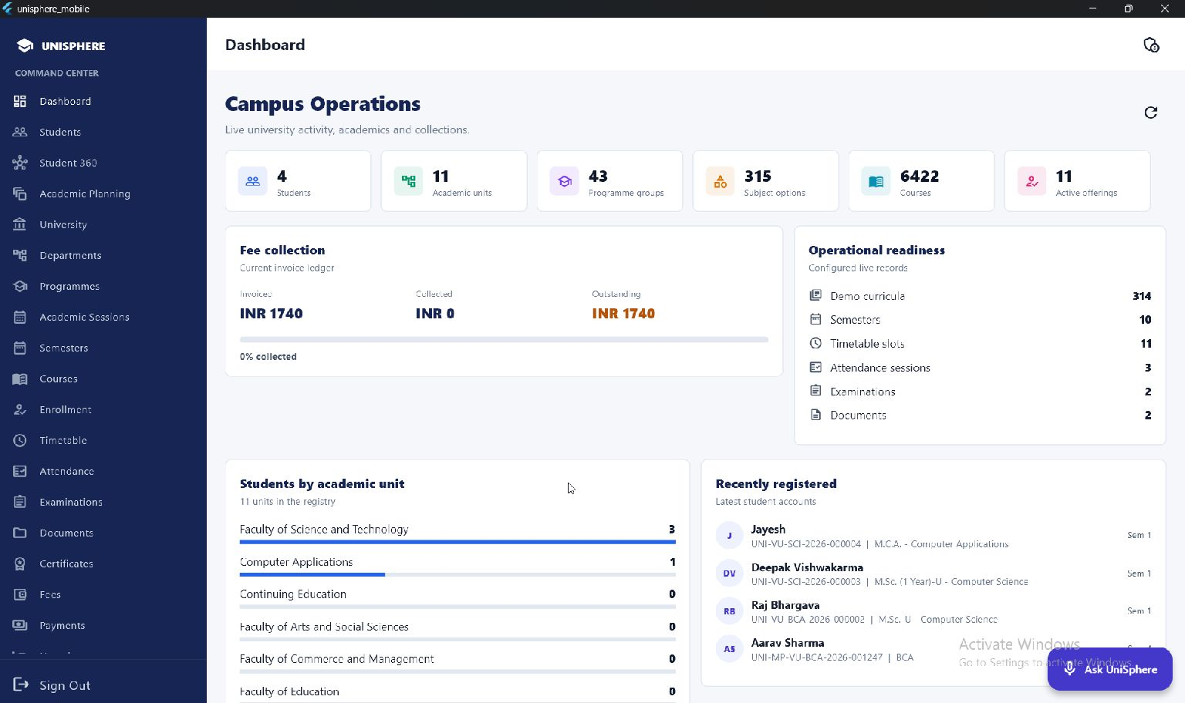
Administration and Governance
A live operating view, not a separate static dashboard.
Registry, academic readiness and collection status in one place.
UniSphere | Working prototype | 05
Notes:
Explain how dashboard counts are calculated from configured records. The screenshot contains a small demonstration cohort and imported catalogue data; the counts are not proof of deployment scale. The catalogue includes demo curriculum papers.
Evidence: lib/features/admin/admin_dashboard_screen.dart. App screenshots captured from the local Windows prototype on 1 October 2026; demo records, not production deployment evidence.

Slide 6
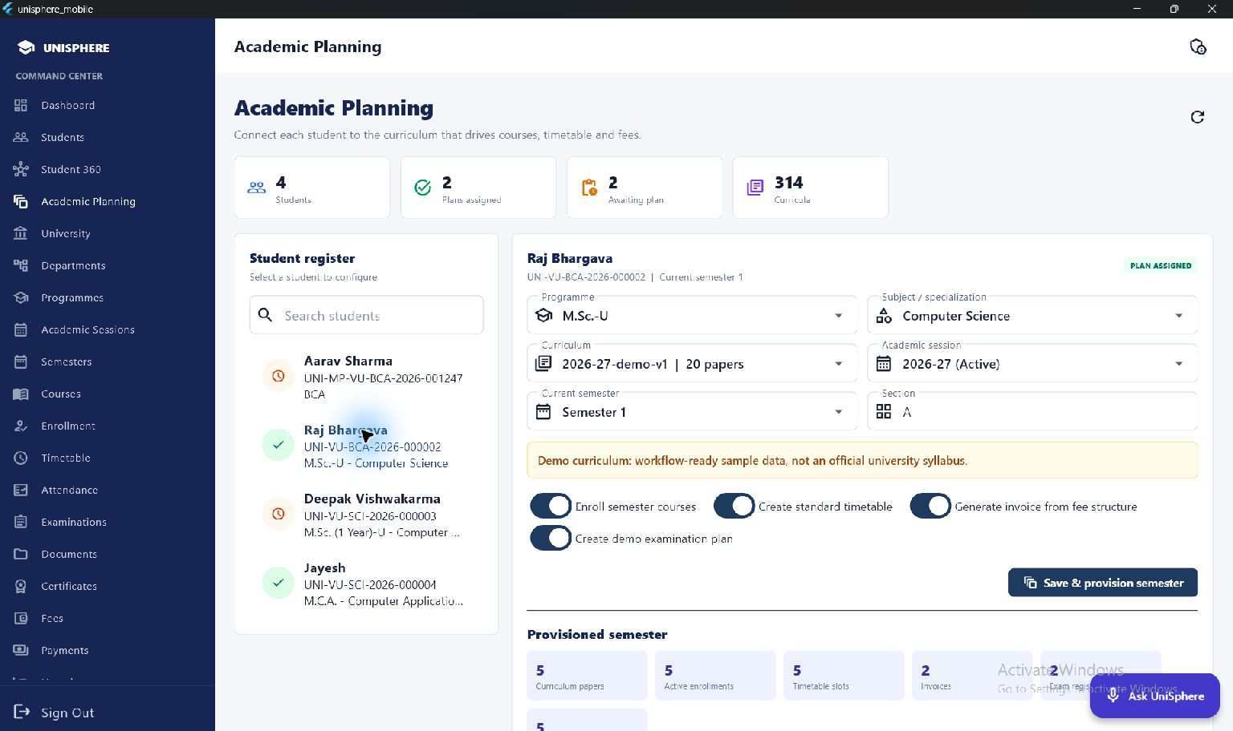
Academic Planning
Programme and curriculum assignment drives the semester workflow.
Raj has a configured plan with course and timetable provisioning.
UniSphere | Working prototype | 06
Notes:
Show Raj selected in the register. The programme, specialization, curriculum, session and semester are connected. Optional provisioning covers courses, standard timetable, fee invoice and demo examination plan. The visible demo-curriculum warning is an important disclosure.
Evidence: lib/features/admin/admin_academic_plans_screen.dart. App screenshots captured from the local Windows prototype on 1 October 2026; demo records, not production deployment evidence.

Slide 7
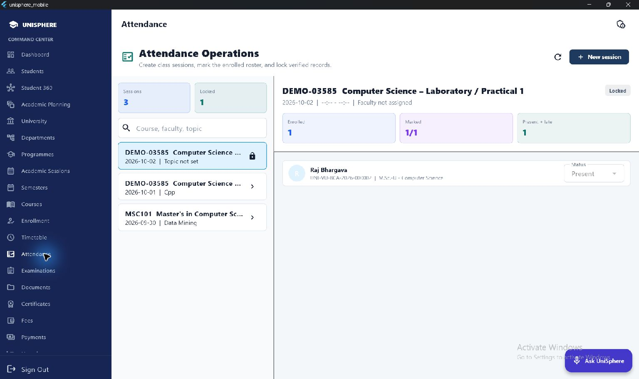
Attendance Operations
Course sessions connect to the enrolled roster.
Create a session > Mark attendance > Lock the verified record
UniSphere | Working prototype | 07
Notes:
The screenshot shows a locked session and Raj in its roster. Recording is controlled by administrators in the current prototype. Attendance contributes to student visibility and risk signals. Aggregate metric consistency across views remains an acceptance-test item; do not describe any screenshot percentage as an audited institutional KPI.
Evidence: lib/features/admin/admin_attendance_screen.dart. App screenshots captured from the local Windows prototype on 1 October 2026; demo records, not production deployment evidence.

Slide 8
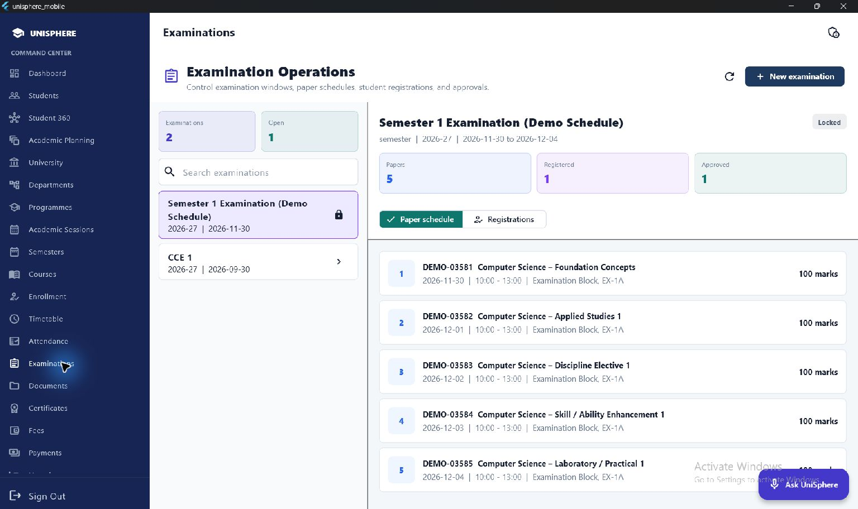
Examination Operations
Schedule papers and manage student registration.
Examination windows, paper dates, venues and approvals are linked.
UniSphere | Working prototype | 08
Notes:
Show the examination window and five-paper schedule. Explain the registration/approval workflow and publication of results against students and courses. The visible plan is explicitly a demonstration schedule.
Evidence: lib/features/admin/admin_examinations_screen.dart. App screenshots captured from the local Windows prototype on 1 October 2026; demo records, not production deployment evidence.

Slide 9
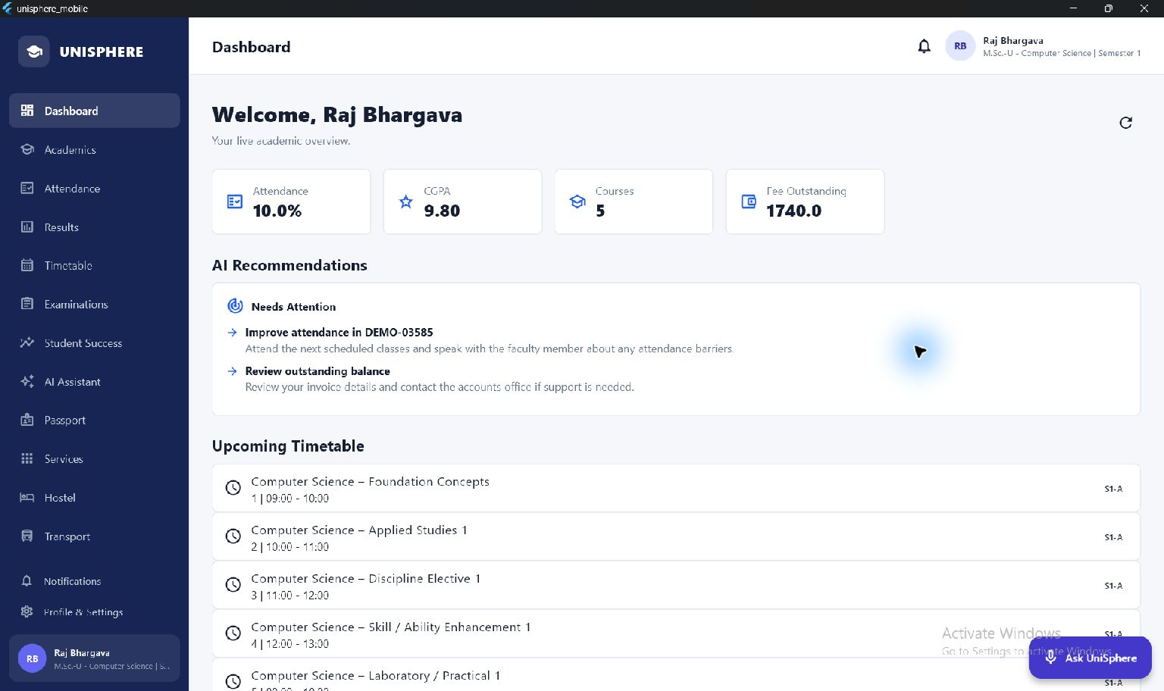
The Personalized Student Portal
Raj sees his own identity, academics and service position.
Personal overview, recommendations and timetable share the student identity.
UniSphere | Working prototype | 09
Notes:
Raj is the logged-in student, with programme and semester in the header. The dashboard links to academics, attendance, results, exams, success, AI, passport and services. Demo percentages are illustrative records, not measured impact; the dashboard and risk pages currently expose different attendance aggregation scopes, requiring reconciliation before a production pilot.
Evidence: lib/features/dashboard/dashboard_screen.dart; lib/app/app_shell.dart. App screenshots captured from the local Windows prototype on 1 October 2026; demo records, not production deployment evidence.

Slide 10
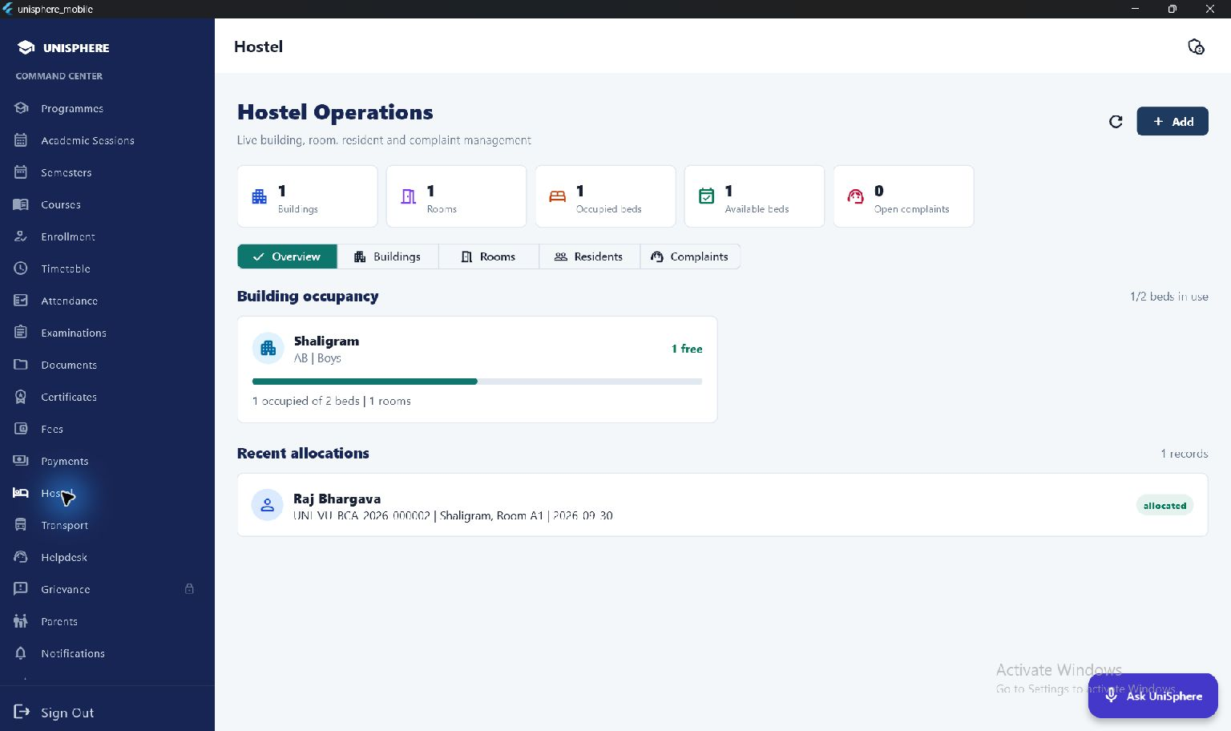
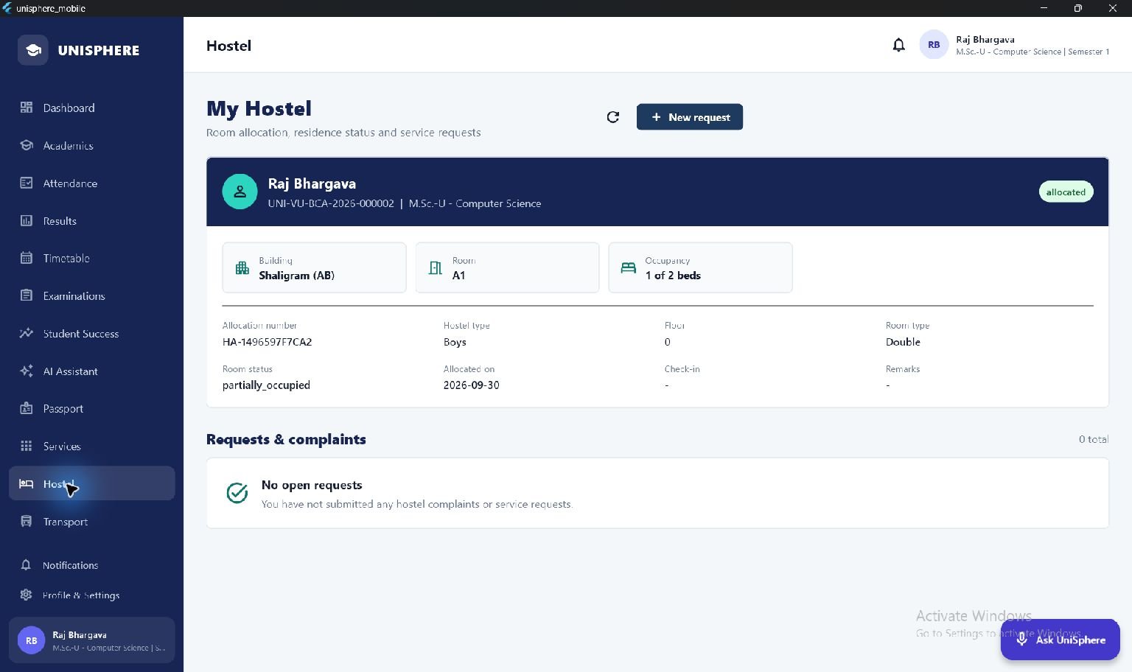
Hostel Allocation: Admin to Student
Building capacity and the student residence record stay connected.
ADMIN: OCCUPANCY AND RESIDENTS
STUDENT: PERSONAL ALLOCATION
Building > Room and capacity > Allocation > Student details and requests
UniSphere | Working prototype | 10
Notes:
These are two authentic views of Raj's existing allocation to Shaligram, room A1. Occupancy is one of two beds. Admin sees the available bed; Raj sees his building, room, allocation number and residence status. Complaints have a separate request workflow. No new allocation was created for the deck.
Evidence: lib/features/admin/admin_hostel_screen.dart; lib/features/hostel/hostel_screen.dart. App screenshots captured from the local Windows prototype on 1 October 2026; demo records, not production deployment evidence.

Slide 11
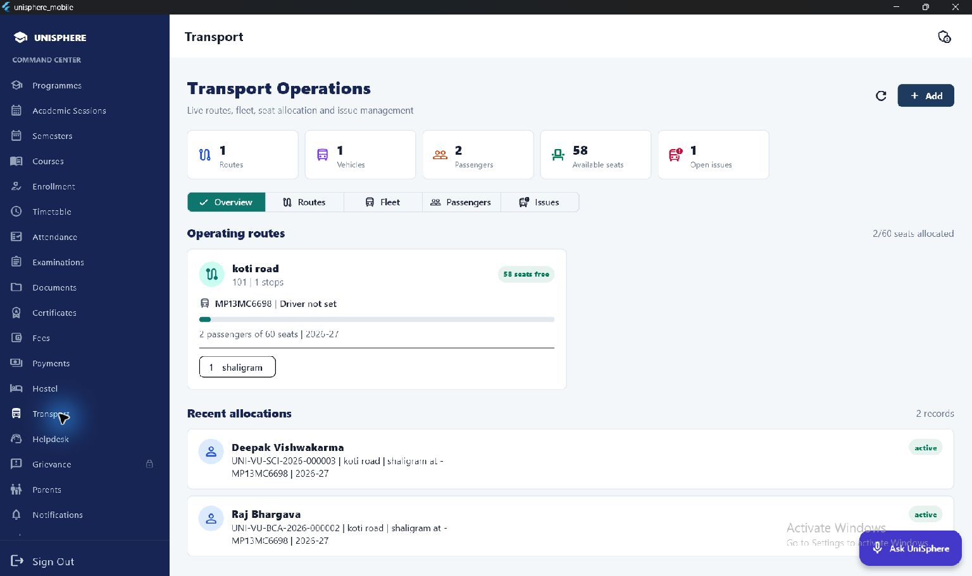
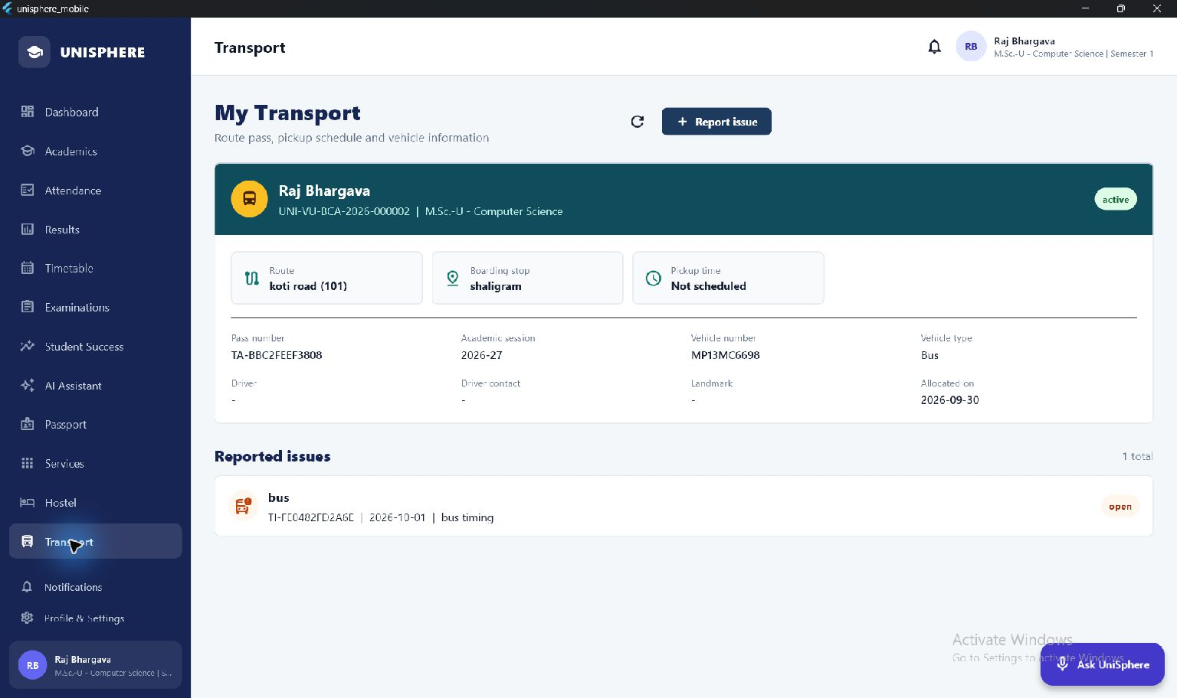
Transport Allocation: Admin to Student
Route capacity and the student pass share one service record.
ADMIN: ROUTE AND PASSENGERS
STUDENT: ROUTE AND PASS
Route and stops > Vehicle > Allocation > Pass and issue tracking
UniSphere | Working prototype | 11
Notes:
Admin sees the route, vehicle, seat position and passengers. Raj sees the linked route, stop, pass and vehicle and can report an issue. The current demonstration record has no pickup time or driver configured: the UI explicitly shows missing values instead of inventing information. GPS tracking is not an implemented claim.
Evidence: lib/features/admin/admin_transport_screen.dart; lib/features/transport/transport_screen.dart. App screenshots captured from the local Windows prototype on 1 October 2026; demo records, not production deployment evidence.

Slide 12
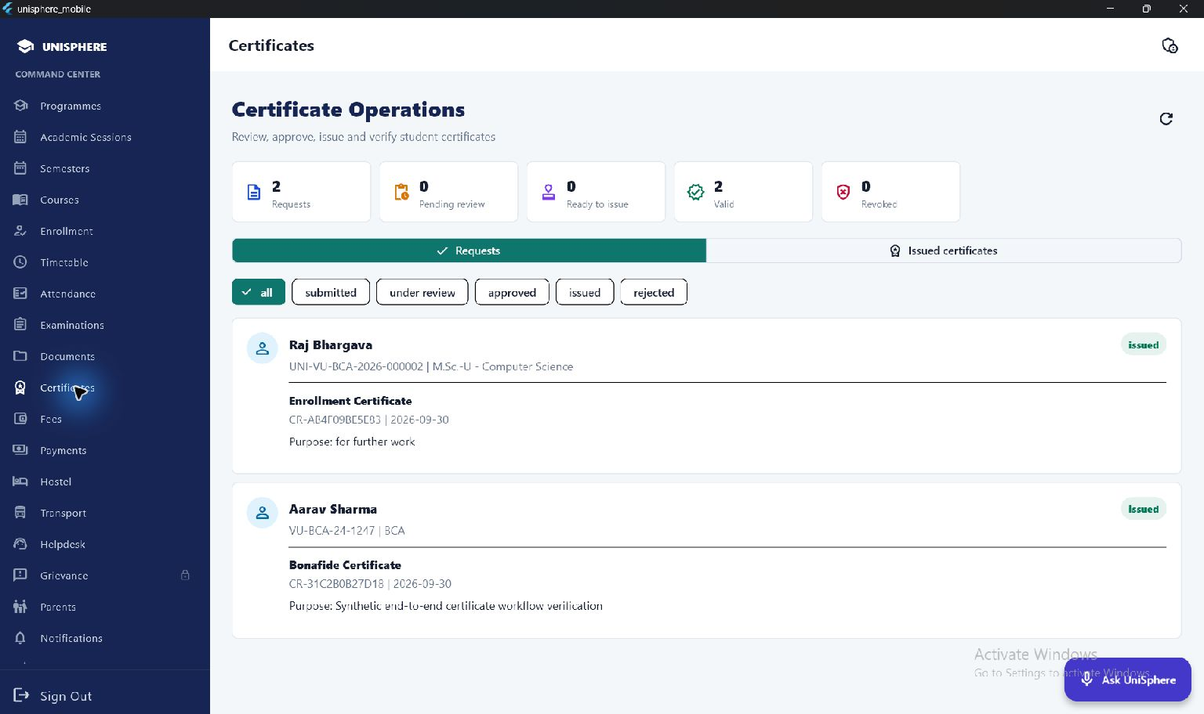
Digital Certificate Operations
Requests become issued, downloadable and verifiable records.
Request > Review > Issue numbered PDF with QR > Verify or revoke
UniSphere | Working prototype | 12
Notes:
The screenshot shows issued requests belonging to Raj and Aarav. Describe purpose, approval/rejection, certificate number, PDF, QR verification and revocation. Focus on service certificates such as bonafide, residence and no-dues. No blockchain, DigiLocker or government identity integration is claimed. The loopback verification URL needs a public deployment URL before institutional use.
Evidence: lib/features/admin/admin_certificates_screen.dart; backend/app/api/v1/certificates.py. App screenshots captured from the local Windows prototype on 1 October 2026; demo records, not production deployment evidence.

Slide 13
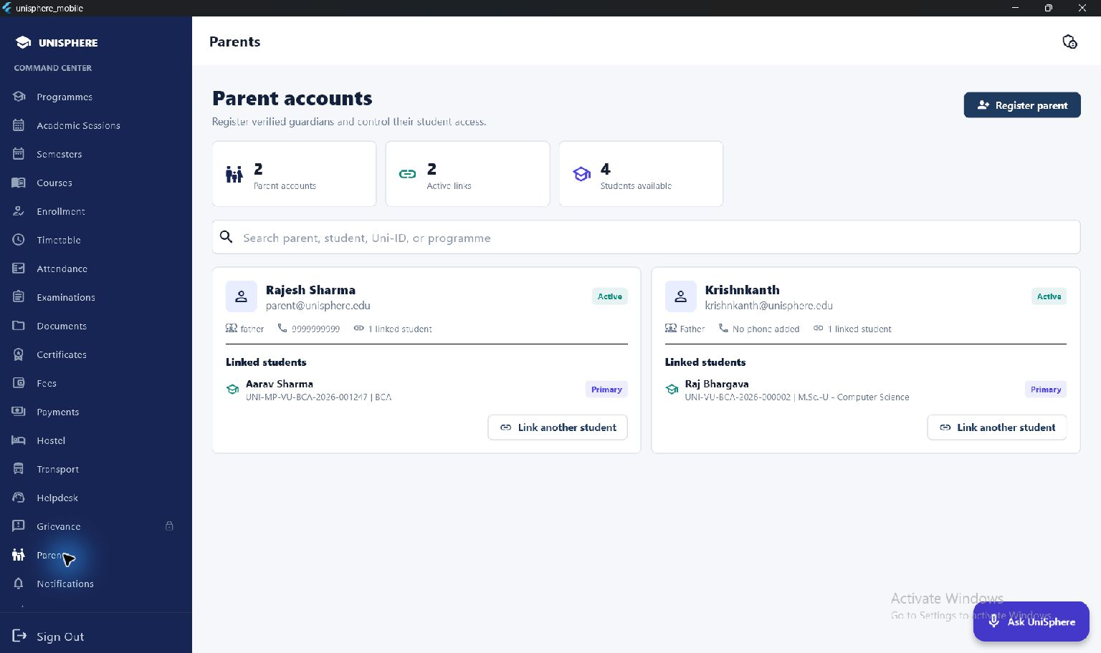
Parent Account Registration
University staff establish the relationship before granting access.
Parent user + profile + active student link are created together.
UniSphere | Working prototype | 13
Notes:
The administrator registers a parent with name, contact, password, relationship and selected student. An additional student may be linked to an existing parent. Registering a student does not silently create a parent account. Credential delivery by verified email/SMS is a future integration.
Evidence: lib/features/admin/admin_parents_screen.dart; backend/app/api/v1/parent_v2.py. App screenshots captured from the local Windows prototype on 1 October 2026; demo records, not production deployment evidence.

Slide 14
The Parent Portal
Controlled visibility into linked-student academic and financial status.
Authorized relationship
Staff register the account and establish the active student link.
Linked-student selection
Parents can switch only among students attached to their account.
Relevant visibility
Attendance, fee position, examination status and attention indicators.
Session control
Refresh current data and sign out from the visible header control.
UniSphere | Working prototype | 14
Notes:
The parent experience uses live V2 profile, student-link and dashboard APIs. The demonstration parent is linked to Aarav; Raj has a separate parent relationship. This slide describes the implemented workflow from source code; it is not a screenshot of the parent portal. Results detail, hostel and transport are not claimed as parent features.
Evidence: lib/features/parent/parent_portal_screen.dart; backend/app/api/v1/parent_v2.py. App screenshots captured from the local Windows prototype on 1 October 2026; demo records, not production deployment evidence.

Slide 15
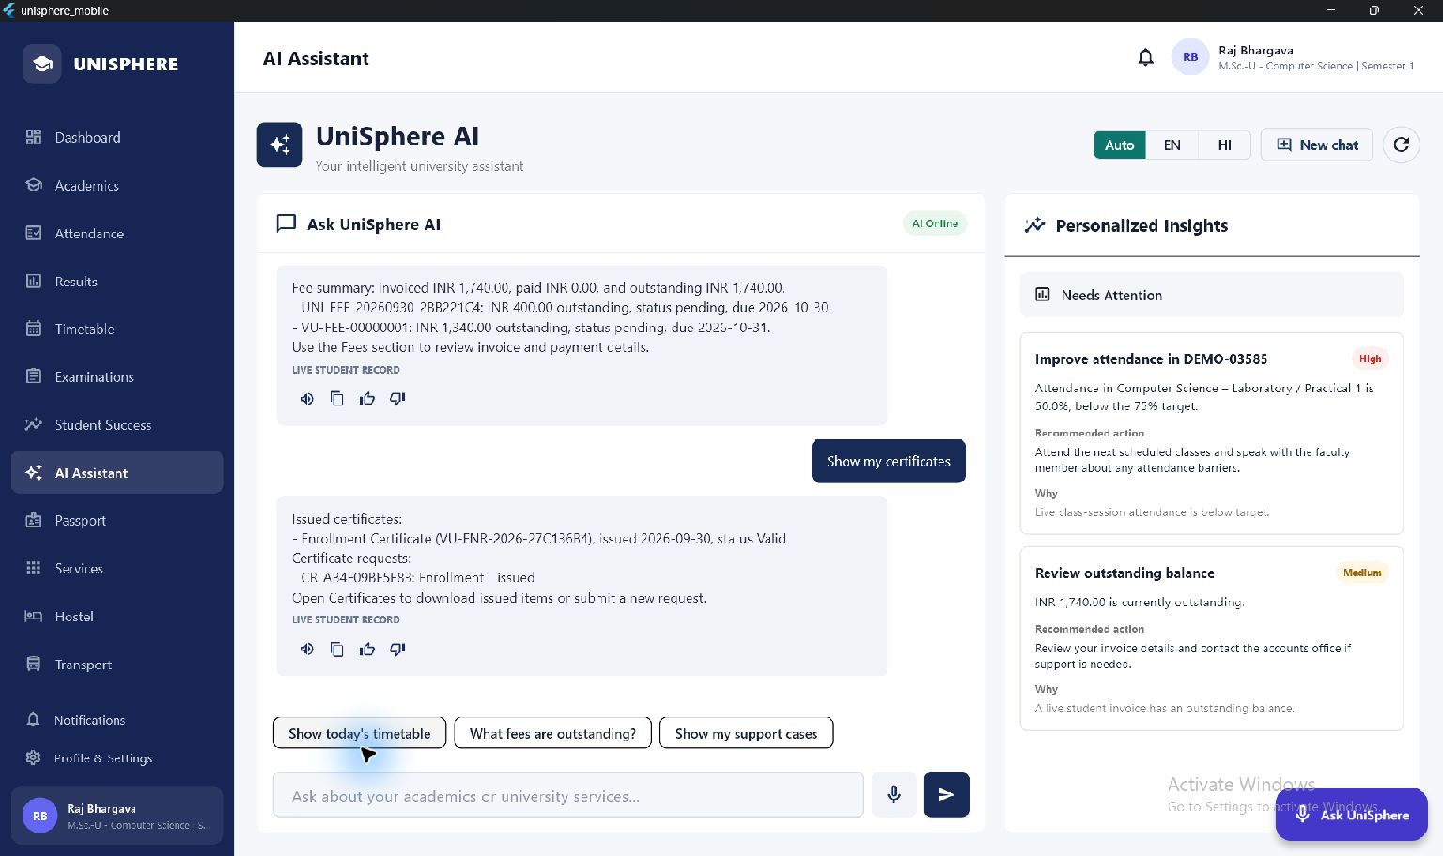
Student AI Assistance
Personal campus answers alongside general conversational help.
English/Hindi, follow-ups, voice input and spoken responses.
UniSphere | Working prototype | 15
Notes:
Explain the answer routing: authenticated personal records first, approved campus knowledge, curated general facts and Gemini for open-ended general questions. The screen demonstrates a grounded answer and recommendations; it is not a screenshot of model training. Direct student-context payloads are excluded from Gemini requests, but conversation history requires privacy review/redaction before production. Additional Indian-language and Bhashini integrations remain future work.
Evidence: backend/app/api/v1/ai_v2.py; backend/app/services/ai_prompt_service.py; lib/features/ai/ai_screen.dart. App screenshots captured from the local Windows prototype on 1 October 2026; demo records, not production deployment evidence.

Slide 16
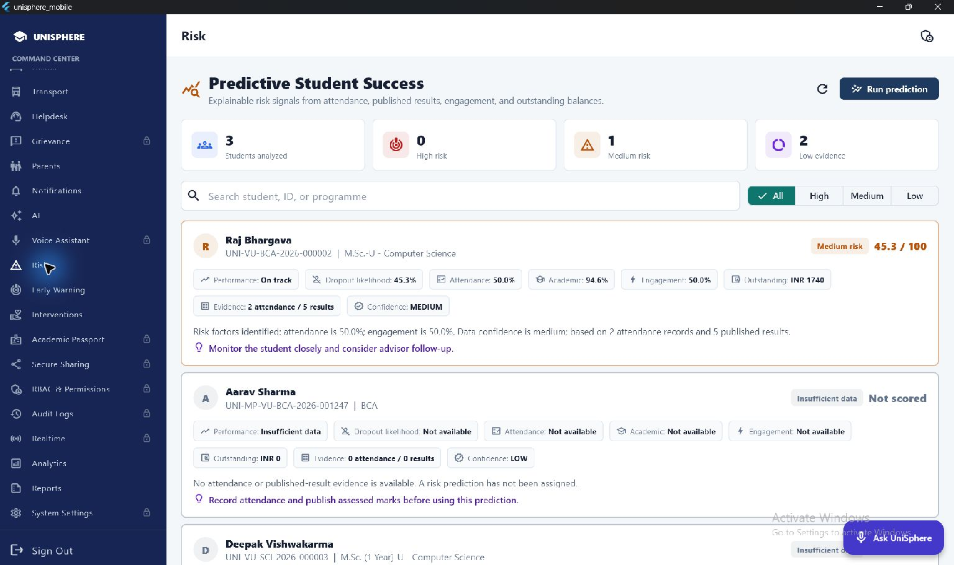
Explainable Student Risk
An actionable indicator built from available records.
Rules-based score: attendance 40%, academics 30%, fees 15%, engagement 15%.
UniSphere | Working prototype | 16
Notes:
The current RiskEngine uses explicit weighted rules. High >=70; medium >=40; low <40. Missing evidence can produce an insufficient-data state. The UI's dropout-likelihood value currently mirrors the risk score: it is NOT a calibrated probability, a trained dropout model or a measured accuracy result. Human review is required; no punitive automated decisions are proposed.
Evidence: backend/app/services/risk_engine.py; backend/app/api/v1/risk.py; lib/features/admin/risk_analytics_screen.dart. App screenshots captured from the local Windows prototype on 1 October 2026; demo records, not production deployment evidence.

Slide 17
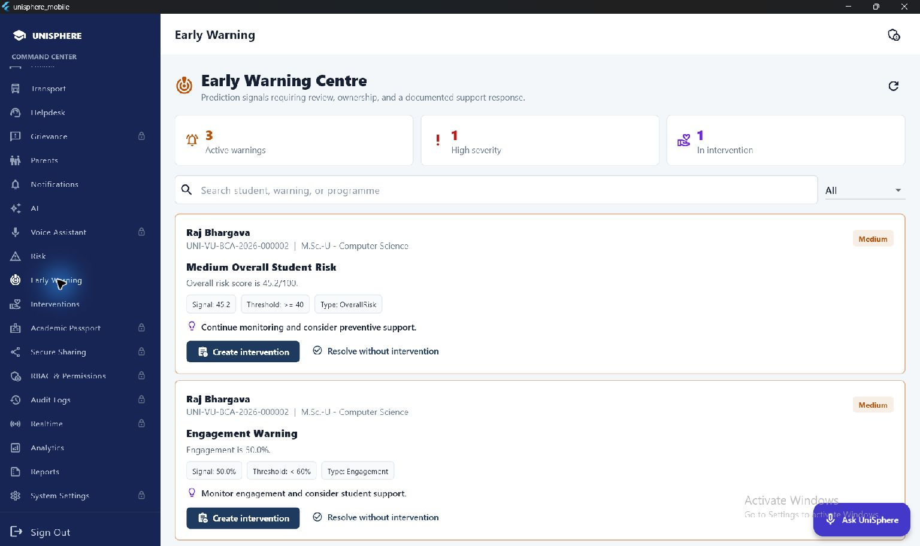
Early Warning and Intervention
Prediction signals have an operating response, not just a score.
Review a warning > Assign support > Track intervention > Follow up
UniSphere | Working prototype | 17
Notes:
The screenshot shows existing warnings and a case already in intervention. Staff can decide whether support is needed, document the intervention and track status. Creating a warning is not the same as proving a student will drop out. Outcome measurements and false-positive review belong in the pilot.
Evidence: lib/features/admin/admin_early_warning_screen.dart; lib/features/admin/intervention_screen.dart. App screenshots captured from the local Windows prototype on 1 October 2026; demo records, not production deployment evidence.

Slide 18
Innovation in the Overall Solution
The contribution is connected operations, not another isolated chatbot.
Connected identity
An administrative change becomes a named student record across services.
Grounded assistance
Personal campus questions use authenticated data; general help uses Gemini.
Explainable support
Visible evidence and reasons lead to a staff-owned intervention.
Controlled family access
Explicit links give parents relevant visibility without unrestricted lookup.
UniSphere | Working prototype | 18
Notes:
Describe these as design differentiators in this implementation, not world-first inventions. The strongest example is a named student whose academic plan, allocations, assistant and support workflow share the same identity. General language assistance and deterministic institutional records are intentionally different responsibilities.
Evidence: EXECUTIVE_SUMMARY.md; backend/app/api/v1/ai_v2.py; backend/app/services/risk_engine.py. App screenshots captured from the local Windows prototype on 1 October 2026; demo records, not production deployment evidence.

Slide 19
Technical Architecture
A shared backend serves role-specific Flutter experiences.
Experience layer
Flutter / Dart: admin, student and parent portals; Windows prototype.
API and access
FastAPI + Pydantic; JWT authentication; backend role and ownership checks.
Records and workflows
SQLAlchemy models; local SQLite demo; PostgreSQL deployment configuration.
Intelligence and output
Local record answers + campus knowledge + Gemini; rules-based risk; PDF/QR certificates.
UniSphere | Working prototype | 19
Notes:
Read this top to bottom as request and ownership layers. API keys stay on the backend, not in the Flutter client or slides. PostgreSQL is the deployment configuration, whereas the screenshot instance uses SQLite. A Flutter codebase targets mobile/web, but this deck evidences Windows only; device acceptance testing remains. Production controls require explicit testing, not inference from framework choice.
Evidence: backend/app/main.py; backend/app/core; backend/docker-compose.production.yml; pubspec.yaml. App screenshots captured from the local Windows prototype on 1 October 2026; demo records, not production deployment evidence.

Slide 20
Expected Impact and Pilot Measures
Benefits are hypotheses to test, not fabricated achievement figures.
Student experience
Measure office visits per request, completion time and portal task success.
Governance
Measure unresolved cases, ownership gaps and record corrections.
Transparency
Measure status visibility, certificate turnaround and verification success.
Student support
Measure alert usefulness, staff follow-up and intervention outcomes.
UniSphere | Working prototype | 20
Notes:
Collect a baseline before a limited institutional pilot, then compare the same tasks after adoption. Record both successful completions and errors. Do not claim percentage reductions, prediction accuracy, student satisfaction or government compliance without data. Alignment is with Digital Campus, Ease of Governance, Smart Universities and Viksit Bharat; this is not an official endorsement.
Evidence: User-supplied expected outcome and strategic alignment; EXECUTIVE_SUMMARY.md. App screenshots captured from the local Windows prototype on 1 October 2026; demo records, not production deployment evidence.

Slide 21
Current Readiness and Remaining Work
Working demonstration workflows are not the same as production readiness.
AVAILABLE IN THE PROTOTYPE
BEFORE AN INSTITUTIONAL PILOT
Role portals and linked-parent access
Academic plans, attendance and exams
Hostel and transport allocations
Certificate requests and issuance
AI assistance, warnings and interventions
Reconcile cross-view metric aggregation
Privacy review and conversation redaction
Payment gateway and credential delivery
Complete unavailable admin workflows
Security, backups and device acceptance
Demo curricula are sample data. Predictive risk is a rules-based indicator.
UniSphere | Working prototype | 21
Notes:
Unavailable admin modules include grievance, dedicated voice administration, admin passport, secure sharing, permission configuration, audit-log UI, realtime administration and settings. Backend foundations do not establish full UI support. Existing fee invoices and recorded payments are not evidence of live gateway settlement. Campus records shown are demonstration data. Audit aggregate consistency, refresh behavior, authorization, AI history handling, public certificate URLs and operational recovery before pilot approval.
Evidence: lib/features/admin/admin_shell.dart; EXECUTIVE_SUMMARY.md; captured demo screens. App screenshots captured from the local Windows prototype on 1 October 2026; demo records, not production deployment evidence.

Slide 22
Evaluator Demonstration Sequence
A focused route through the working application.
01 Admin
Open dashboard; select Raj in Academic Planning; show attendance and exams.
02 Services
Compare Raj's hostel and transport allocations with the student portal.
03 Student AI
Ask about a personal record; then ask a general question in English or Hindi.
04 Governance
Show an issued certificate; linked-parent access; warning and intervention.
UniSphere | Working prototype | 22
Notes:
Use existing demo records. Avoid creating duplicate students or allocating a second room during the presentation. Load each screen once before the session and confirm the backend/provider are available. If a model call fails, explain fallback behavior and use the captured UI as evidence rather than asserting an external result. All demo credentials should remain private. Allow 6-8 minutes for this route and keep the technical material for Q&A.
Evidence: Captured Windows prototype screens; EXECUTIVE_SUMMARY.md. App screenshots captured from the local Windows prototype on 1 October 2026; demo records, not production deployment evidence.

Slide 23
Evaluation Summary
Evidence for concept, approach, innovation and the overall solution.
Concept
One digital campus replaces fragmented student-facing office workflows.
Approach
Staff-owned records, shared APIs, explicit permissions and linked identities.
Innovation
Grounded assistance plus explainable support inside operational workflows.
Overall solution
Three usable portals, connected service evidence and a transparent pilot roadmap.
UniSphere | Working prototype | 23
Notes:
Close with the connected journey, not a feature count. Invite evaluation against the actual screenshot workflows and the live demo. The strongest evidence is the same Raj identity visible in academic planning, attendance, exams, residence, transport and student assistance. State the limitations clearly and request a controlled pilot, not an unrestricted production rollout.
Evidence: EXECUTIVE_SUMMARY.md; captured Windows prototype screens. App screenshots captured from the local Windows prototype on 1 October 2026; demo records, not production deployment evidence.

