Slide 1
cloudwatch
Velocity training institute
Shantanu Mahajan (sr engg devops)

Slide 2
What is cloudwatch?
Amazon CloudWatch monitors your Amazon Web Services (AWS) resources and the applications you run on AWS in real time.
You can use CloudWatch to collect and track metrics, which are variables you can measure for your resources and applications.
The CloudWatch home page automatically displays metrics about every AWS service you use.
You can additionally create custom dashboards to display metrics about your custom applications, and display custom collections of metrics that you choose.
You can create alarms that watch metrics and send notifications or automatically make changes to the resources you are monitoring when a threshold is breached.
Regions specific service.

Slide 3
Resources monitored by cloud watch
EC2
RDS
S3
ELB
Auto-scaling
Custom metrics generated by your applications and services, and any log files your applications generate.

Slide 4
Types/levels of monitoring in cloudwatch
Basic monitoring (Free) – Every 5 mins.
Detailed monitoring (paid) – chargeable and some additional wide range of metrics and services available from AWS.
PRICING
https://aws.amazon.com/cloudwatch/pricing/

Slide 5
Amazon cloudwatch concepts
Metric
Dimensions
Resolution
Namespace
Statistics
Alarms
https://docs.aws.amazon.com/AmazonCloudWatch/latest/monitoring/cloudwatch_concepts.html

Slide 6
metric
Metrics are the fundamental concept in CloudWatch.
A metric represents a time-ordered set of data points that are published to CloudWatch.
Think of a metric as a variable to monitor, and the data points as representing the values of that variable over time.
For example, the CPU usage of a particular EC2 instance is one metric provided by Amazon EC2.
The data points themselves can come from any application or business activity from which you collect data.

Slide 7
dimensions
A dimension is a name/value pair that is part of the identity of a metric.
You can assign up to 10 dimensions to a metric.
Every metric has specific characteristics that describe it, and you can think of dimensions as categories for those characteristics.
Because dimensions are part of the unique identifier for a metric, whenever you add a unique name/value pair to one of your metrics, you are creating a new variation of that metric.
For example, you can get statistics for a specific EC2 instance by specifying the InstanceId dimension when you search for metrics.

Slide 8
dimensions
CloudWatch treats each unique combination of dimensions as a separate metric, even if the metrics have the same metric name.
Dimensions: Server=Prod, Domain=Frankfurt, Unit: Count, Timestamp: 2016-10-31T12:30:00Z, Value: 105
Dimensions: Server=Beta, Domain=Frankfurt, Unit: Count, Timestamp: 2016-10-31T12:31:00Z, Value: 115
Dimensions: Server=Prod, Domain=Rio, Unit: Count, Timestamp: 2016-10-31T12:32:00Z, Value: 95
Dimensions: Server=Beta, Domain=Rio, Unit: Count, Timestamp: 2016-10-31T12:33:00Z, Value: 97

Slide 9
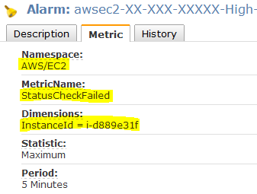

Slide 10
resolution
Each metric is one of the following:
Standard resolution, with data having a one-minute granularity
High resolution, with data at a granularity of one second
Metrics produced by AWS services are standard resolution by default.
When you publish a custom metric, you can define it as either standard resolution or high resolution. When you publish a high-resolution metric, CloudWatch stores it with a resolution of 1 second, and you can read and retrieve it with a period of 1 second, 5 seconds, 10 seconds, 30 seconds, or any multiple of 60 seconds.
Eg:- High-Resolution Alarms allow you to react and take actions faster, and support the same actions available today with standard 1-minute alarms

Slide 11
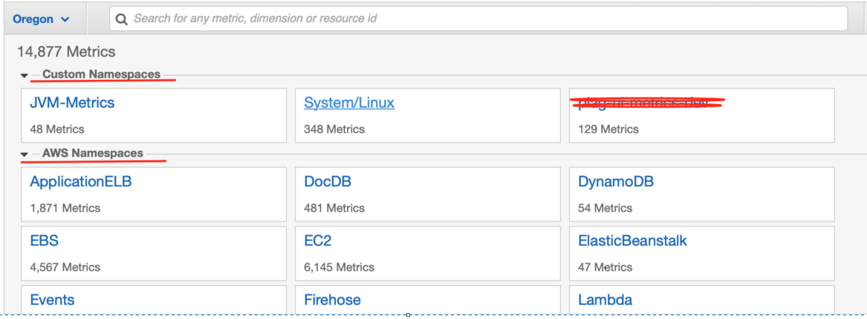
Namespaces
A namespace is a container for CloudWatch metrics.
Metrics in different namespaces are isolated from each other, so that metrics from different applications are not mistakenly aggregated into the same statistics.

Slide 12
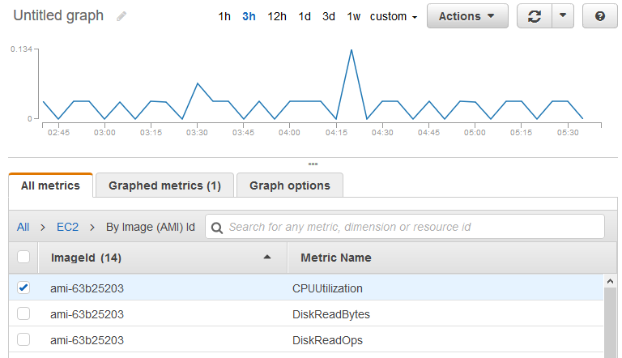
Statistics
Statistics are metric data aggregations over specified periods of time.
CloudWatch provides statistics based on the metric data points provided by your custom data or provided by other AWS services to CloudWatch.

Slide 13
alarms
You can use an alarm to automatically initiate actions on your behalf.
An alarm watches a single metric over a specified time period, and performs one or more specified actions, based on the value of the metric relative to a threshold over time.
The action is a notification sent to an Amazon SNS topic or an Auto Scaling policy.
You can also add alarms to dashboards.

Slide 14
Amazon cloudwatch events
Amazon CloudWatch Events delivers a near real-time stream of system events that describe changes in Amazon Web Services (AWS) resources.
using simple rules that you can quickly set up, you can match events and route them to one or more target functions or streams.
CloudWatch Events becomes aware of operational changes as they occur.
CloudWatch Events responds to these operational changes and takes corrective action as necessary, by sending messages to respond to the environment, activating functions, making changes, and capturing state information.

Slide 15
Concepts of CW events
Events ---- An event indicates a change in your AWS environment. AWS resources can generate events when their state changes. For example, Amazon EC2 generates an event when the state of an EC2 instance changes from pending to running, and Amazon EC2 Auto Scaling generates events when it launches or terminates instances.
Rules ---- A rule matches incoming events and routes them to targets for processing. A single rule can route to multiple targets, all of which are processed in parallel.
Targets ---- A target processes events. Targets can include Amazon EC2 instances, AWS Lambda functions, Kinesis streams, Amazon ECS tasks, Step Functions state machines, Amazon SNS topics, Amazon SQS queues, and built-in targets. A target receives events in JSON format.

Slide 16
Amazon cw logs
You can use Amazon CloudWatch Logs to monitor, store, and access your log files from Amazon Elastic Compute Cloud (Amazon EC2) instances, AWS CloudTrail, Route 53, and other sources.
CloudWatch Logs enables you to centralize the logs from all of your systems, applications, and AWS services that you use, in a single, highly scalable service.
You can then easily view them, search them for specific error codes or patterns, filter them based on specific fields, or archive them securely for future analysis.
CloudWatch Logs enables you to see all of your logs, regardless of their source, as a single and consistent flow of events ordered by time, and you can query them and sort them based on other dimensions, group them by specific fields, create custom computations with a powerful query language, and visualize log data in dashboards.

Slide 17
features
Query your log data – You can use CloudWatch Logs Insights to interactively search and analyze your log data. You can perform queries to help you more efficiently and effectively respond to operational issues.
Monitor logs from Amazon EC2 instances – You can use CloudWatch Logs to monitor applications and systems using log data. For example, CloudWatch Logs can track the number of errors that occur in your application logs and send you a notification whenever the rate of errors exceeds a threshold you specify.
Log retention – By default, logs are kept indefinitely and never expire. You can adjust the retention policy for each log group, keeping the indefinite retention, or choosing a retention period between 10 years and one day.
All the cloud watch data is stored in s3. The logs are stored on S3 using the native CloudWatch export S3 export functionality.
https://aws.amazon.com/cloudwatch/pricing/

Slide 18
Concepts of CW logs
Log events
A log event is a record of some activity recorded by the application or resource being monitored.
The log event record that CloudWatch Logs understands contains two properties: the timestamp of when the event occurred, and the raw event message.
Log streams
A log stream is a sequence of log events that share the same source.
Log groups
Log groups define groups of log streams that share the same retention, monitoring, and access control settings. Each log stream has to belong to one log group.

Slide 19
Concepts
Retention settings
Retention settings can be used to specify how long log events are kept in CloudWatch Logs.

