Slide 1

Case Study ATM Cash Flow Forecasting

Slide 2
DATASET CAPTURED
Feature Description
Bank: ATM belongs to which bank
ATMID: ID of the ATM
Cal date: Date
Dispense: Amount dispensed from an ATM on a particular day
DT: Time in minutes when ATM was down on a particular day
MaxCapacity: Maximum amount which can be loaded in the ATM
CountTotalTxn: Count of total number of transactions

Slide 3

Our analysis is based on the following data available to us
PROBLEM STATEMENT
predict/forecast dispense amount for each ATM for next 7 days. These predictions can be shared with the team and accordingly cash loading can happen.
ATM dataset for respective banks
TOTAL RECORDS: 14K
7 FEATURES
ALL FEATURES have GOOD FILL RATE

Slide 4
FEATURE ENGINEERING & EDA
Derived features-
Day : Days of a week.
IsWeekend : If the given day is Saturday or Sunday.
Remaining Cash: MaxCapacity – Dispense
DispensePerTransaction : Dispense / CountTotalTxn
Data insights-
1. Average dispense per transaction was around 3800 Rs.
2. Maximum transaction which took place was of 20,000 Rs.
3. On average, 105 transactions happened in a single day.
4. on average an ATM was down for approximately 2.5 hours in a single day.
5. PQR has dispensed highest Cash as compared to ABC and XYZ.
6. Top ATM for cash dispense is of ABC bank -- TPCN10269.
7. Weekday cash dispense is cumulatively higher than weekend.
8. During 2021 May the average amount which was dispensed during a certain transaction is beyond 10k & reaching up to 17k.
9. During the end of 2021, we can see the maximum dispense which took place & the amount is of 20k.
10. Since last quarter of 2022 till current day, we can see the maximum dispensed amount in a certain transaction to be less than 12.5k.
11. An atm can be down for more than 3 hours on a particular day.
12. An atm generally can have 100 total transactions on any given day.

Slide 5
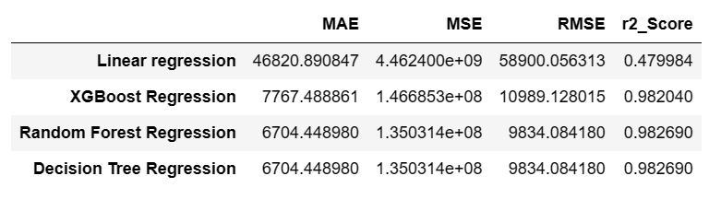
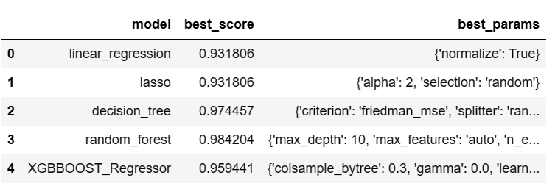
Model building results:
10-fold cross validation
array([0.99178494, 0.99050815, 0.99373932, 0.9744123 , 0.99037658, 0.98483613, 0.99267717, 0.98681065, 0.98180704, 0.98646497])
Grid search CV results

Slide 6
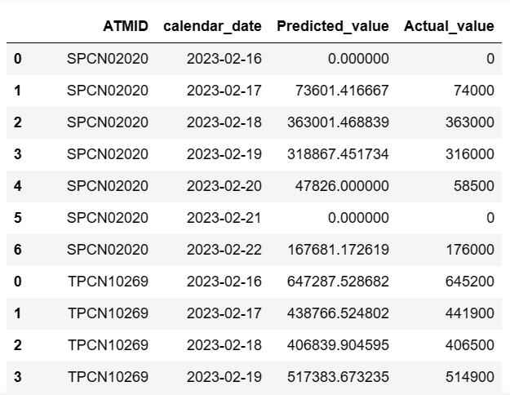
PREDICTION RESULTS
regressor = RandomForestRegressor(n_estimators = 100, random_state = 0, max_depth= 10, max_features= 'auto')
regressor.fit(X_train,y_train)
pred = regressor.predict(X_test)

