Slide 1
Analysis of a Computerized Choice Selection System: The Case of a Public Sector General Univerisity
By Rajesh Kumar Tharwani
Institute of Mathematics and Computer Science
University of Sindh, Jamshoro
Under Supervision
Dr Yasir Arfat Malkani
1 / 50

Slide 2
Contents
1
Introduction
Objectives
Problem Description
The Approach
Case Study
The Choice Selection Meta Model
The Choice Selection Algorithm
Online Interactive Secure Model
Proposed Model
Seat Utlization
Analysis of Algorthim with Respect to Space and Time
Comparison With Others Models
Summary and Future Work
2
3
4
5
6
7
8
9
10
11
12
13
14
References
2 / 50

Slide 3
Introduction Objectives Problem Description Approach Case Study Meta Model Algorithm Objectives Model Summary
Introduction
Choice Selection System
Choice selection of courses in large public sector universities
has always remained a critical matter. It is evident that, in such universities, thousands of prospective students compete for a limited number of seats allocated for specific undergraduate and postgraduate courses.
The choice selection systems allows for the purposeful choices between multiple items (Aygu¨nyand et al., 2013; Bo, 2014; Kamada et al., 2013; Fragiadakis et al., 2015)
Course
Category (e.g., Merit, Self-finance, Femal-quota, Employee-quota, etc.)
Shift/Session (e.g., Morning, Noon, and Evening)
Campus
3 / 50

Slide 4
Introduction Objectives Problem Description Approach Case Study Meta Model Algorithm Model Summary
Introduction (Cont’d): Choice Selection System
Choice Selection System (Cont’d)
There are many types of choice selection systems.
College/University Choice Selection System (A.Pathak et al.,
2013)
School Choice Selection System (Dur et al., 2013) Doctor Distribution (Abdulkadiroglu et al., 2003)
4 / 50

Slide 5
Introduction Objectives Problem Description Approach Case Study Meta Model Algorithm Model Summary
Introduction (Cont’d): Choice Selection System
Choice Selection System (Cont’d)
Global Public Sector General Universities
The global public sector universities have no restriction on disciplines.
Pakistan Public Sector Universities
According to HEC, it excludes Medical and Engineering disciplines.
5 / 50

Slide 6
Introduction Objectives Problem Description Approach Case Study Meta Model Algorithm Model Summary
Introduction (Cont’d): Public Sector Universities in Pakistan
Public Sector Universities in Pakistan
According to HEC policies, funding depends on total number
of students
The main goal of universities is to achieve maximum seat utlization.
Employment ratio is determined by the number of students enrollled.
Public sector universities are supposed to mainly operate in their prescirbed jurisdictions.
Each Univerity has its own jurisdiction
According to HEC, total number of public sector general universities are 80.
Many sub-campuses are associated with these universities.
6 / 50

Slide 7
Introduction Objectives Problem Description Approach Case Study Meta Model Algorithm Model Summary
Introduction (Cont’d): Challenges for the (PSU)
Challenges for the Public Sector Universities (PSU) in Pakistan
Proper discemination of the prospectus to the target
candidates in rural areas.
The candidates are unaware of ICT.
Need for easy to use security/privacy-aware online admission systems.
7 / 50

Slide 8
Introduction Objectives Problem Description Approach Case Study Meta Model Algorithm Model Summary
Introduction (Cont’d): Selection of a PSU in Pakistan
Selection of a PSU in Pakistan
University of Sindh is a large public sector general university.
It has 6 sub-campuses.
It offered 69 undergraduate degree programs (in year 2018).
It had 6901 seats in these disciplines (in year 2018).
2/3 seats were reserved for Hyderbad and Mirpurkhas divisions.
1/3 seats were reserved for Sukkur and Larkana divisions.
8 / 50

Slide 9
Introduction Objectives Problem Description Approach Case Study Meta Model Algorithm Model Summary
Introduction (Cont’d): Challenges of Sindh University
Challanges of SU’s Choice Selection System (Case study)
Alligning schedule with the engineering and medical universities.
Timely candidate registration.
Transforming computerized admission system into interactive online system.
Maximum seat utilization with fully automated admission system.
Auditable students admisssion records to resisit forgeries and frauds.
9 / 50

Slide 10
Introduction Objectives Problem Description Approach Case Study Meta Model Algorithm Model Summary
Objectives
Study of the existing computerized choice selection system of selected public sector general university.
Identify the strengths and weaknesses of the selected system.
Modify the existing algorithm to overcome the weaknesses (if
any).
Implement the new/modified system as a prototype.
Providing implementation guidelines.
Presenting the results and discussions.
10 / 50

Slide 11
Introduction Objectives Problem Description Approach Case Study Meta Model Algorithm Model Summary
Problem Description
Study the reasons behind under seat utlization
Study the exisiting constraints over the choice selection system.
Identifying the key constraints to maximize seat utilization.
Adding more constraints over choice selections for improveing
the seat utilization.
A prototype development of an online interactive choice selection system.
11 / 50

Slide 12
Introduction Objectives Problem Description Approach Case Study Meta Model Algorithm Model Summary
The Approach
Case study: undergrudate courses’ admissions in the
University of Sindh
Online interactive Prototype Design
Compare with other polices
Algorithm (Cormen et al., 2001) Design and Implementation
Suggestion Changing in algorthim
Analysis of algorthim with respect to space and time utlization
Analysis of the seat utlization.
Propose the candidate solution to automate the admission process in order to maximize the efficency in seat utlization.
Object modeling
Meta Model: UML 2 (Fowler, 2004) class diagram
Code generation using the class diagram .
13 / 50

Slide 13
Introduction Objectives Problem Description Approach Case Study Meta Model Algorithm Model Summary
Case Study
Table : Faculties and morning undergraduate courses
Faculty
Inst./Dept
Undergrad Courses
Seat Allocation
Arts
06
10
1037
Commerce and Business
02
02
377
Education
04
01
111
Islamic Studies
03
03
308
Law
01
01
183
Natural Sciences
19
25
3403
Pharmacy
04
01
111
Social Sciences
14
13
1665
Total
51
69
6901
14 / 50

Slide 14
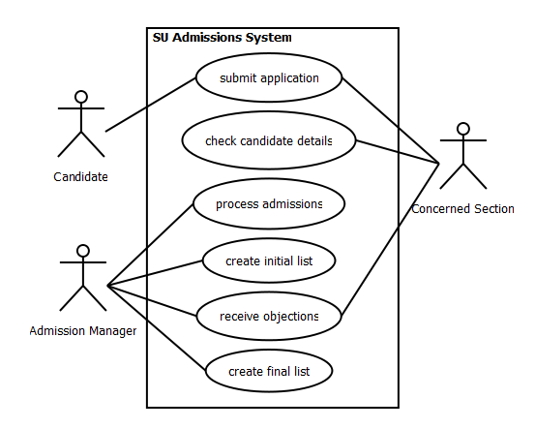
Introduction Objectives Problem Description Approach Case Study Meta Model Algorithm Objectives Model Summary
Case Study (Cont’d)
Highe-level admissions management use cases
Figure 1: Highe-level admissions management use cases
15 / 50

Slide 15
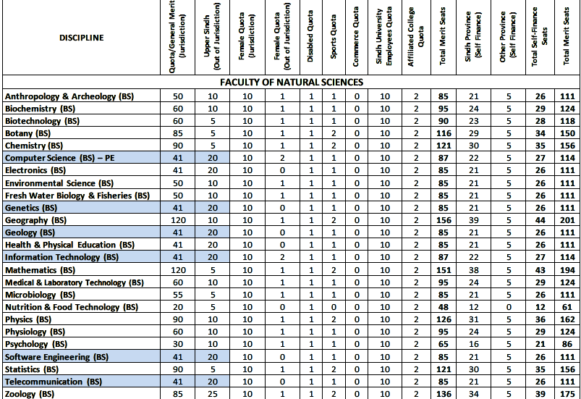
Introduction Objectives Problem Description Approach Case Study Meta Model Algorithm Objectives Model Summary
Case Study (Cont’d)
Highe-level admissions management use cases
Figure : Highe-level admissions management use cases
15 / 50

Slide 16
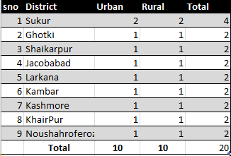
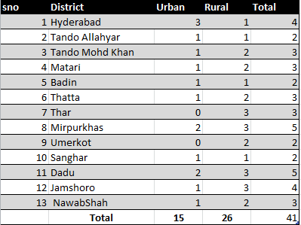
Introduction Objectives Problem Description Approach Case Study Meta Model Algorithm Objectives Model Summary
Case Study (Cont’d)
Out of Jurisdiction
Jurisdiction
Figure2 : Highe-level admissions management use cases
15 / 50

Slide 17
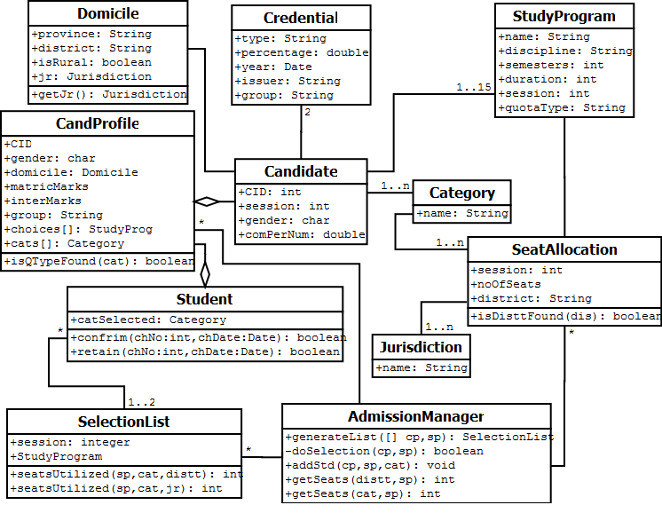
Introduction Objectives Problem Description Approach Case Study Meta Model Algorithm Objectives Model Summary
The Choice Selection Meta Model
Figure 3 : Meta model of the choice selection system
16 / 50

Slide 18
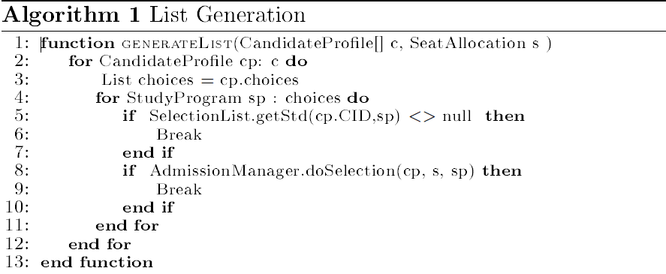
Introduction Objectives Problem Description Approach Case Study Meta Model Algorithm Model Summary
The Choice Selection Algorithm
Figure4 : List Generation
17 / 50

Slide 19
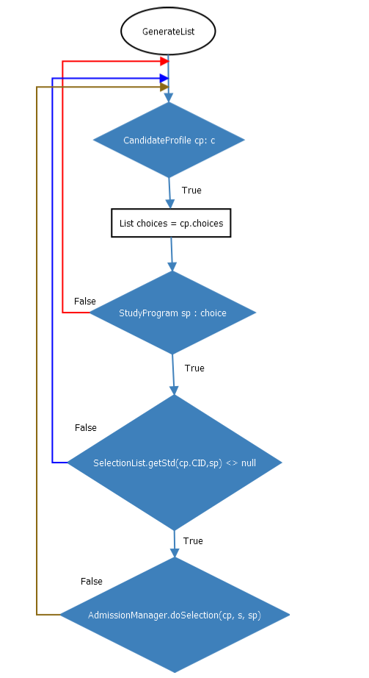
Introduction Objectives Problem Description Approach Case Study Meta Model Algorithm Model Summary
The Choice Selection Algorithm
Figure 5: List Generation
17 / 50

Slide 20
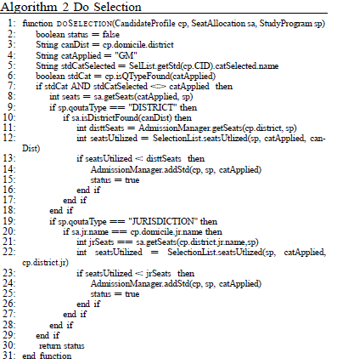
Introduction Objectives Problem Description Approach Case Study Meta Model Algorithm Model Summary
The Choice Selection Algorithm (Cont’d)
18 / 50

Slide 21
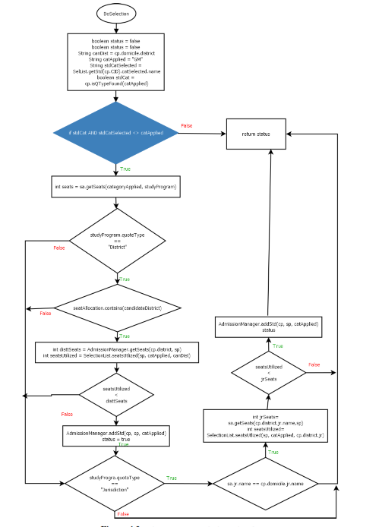
Introduction Objectives Problem Description Approach Case Study Meta Model Algorithm Model Summary
The Choice Selection Algorithm (Cont’d)
18 / 50

Slide 22
Introduction Objectives Problem Description Approach Case Study Meta Model Algorithm Model Summary
Online Interactive Secure Model
In this proposed model seat are more utilized.
After Entry Test student fill the choices.
In this protoype student already know the last year CPN
The Results are more accurated.
20 / 50

Slide 23
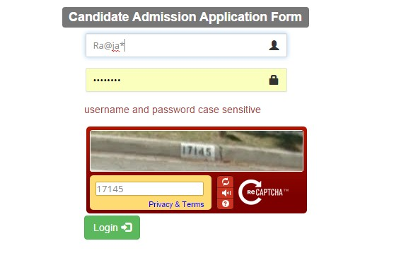
Introduction Objectives Problem Description Approach Case Study Meta Model Algorithm Model Summary
Online Interactive Secure Model
Secure Login
Figure 7: Secure Login
21 / 50

Slide 24
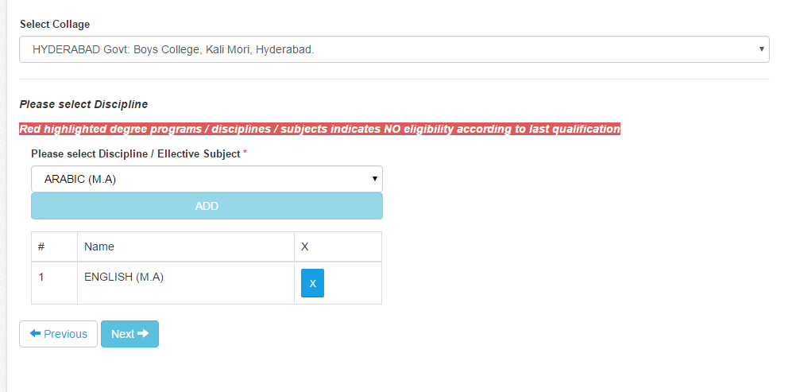
Introduction Objectives Problem Description Approach Case Study Meta Model Algorithm Model Summary
Online Interactive Secure Model
Fill Choices
Figure 8 : Secure Login
22 / 50

Slide 25
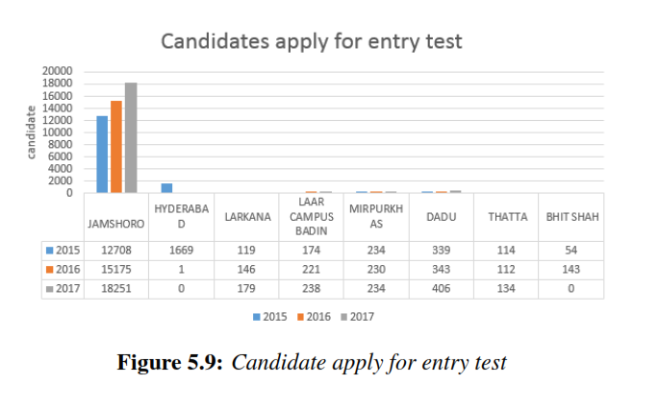
Introduction Objectives Problem Description Approach Case Study Meta Model Algorithm Model Results Summary
Candidate Apply For Entry Test Trend
Figure : Total seat allocation and utilization
The data preparation and selection process involves a dataset of Jamshoro Campus
12708, 15175 and 18251 student records from 2015, 2016 and 2017 academic years.
Thus, it was observed that the ratio of applying in entry test is increased.
25 / 50

Slide 26
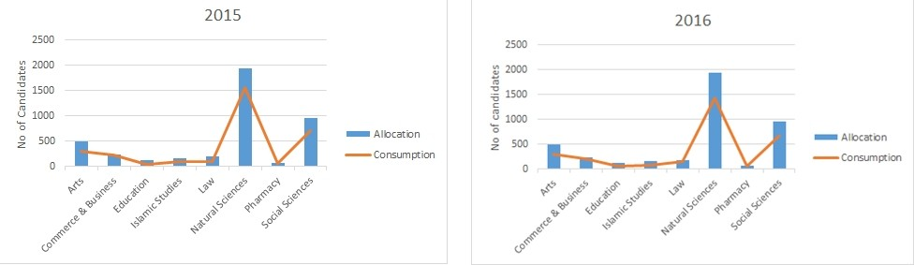
Introduction Objectives Problem Description Approach Case Study Meta Model Algorithm Model Results Summary
Total Seat Allocation and Utilization
Figure 10 : Total seat allocation and utilization
2015- 60% seats are consumed in Arts faculty, 74% seats in Commerce and Business,
93% in Education, 29% in Islamic Studies, 61 % in Law, 80% in Natural Sciences,
99% Pharmacy and 73% in Social Sciences.
2016- It was observed that 60% seats are consumed in Arts faculty, 90% seats in
Commerce and Business, 50% in Education, 51% in Islamic Studies, 76 % in Law,
73% in Natural Sciences, 99% Pharmacy and 70% in Social Sciences.
25 / 50

Slide 27
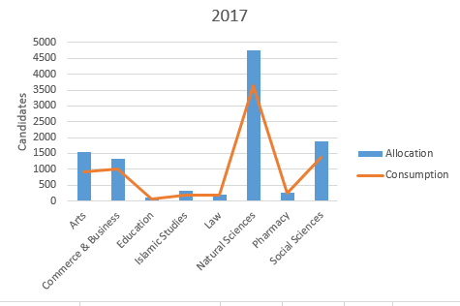
Introduction Objectives Problem Description Approach Case Study Meta Model Algorithm Model Results Summary
2017 Total Seat Allocation and Utilization
Figure 11 : Total seat allocation and utilization
2017- 60% seats are consumed in Arts faculty, 74% seats in Commerce and Business,
93% in Education, 29% in Islamic Studies, 61 % in Law, 80% in Natural Sciences,
.
26 / 50

Slide 28
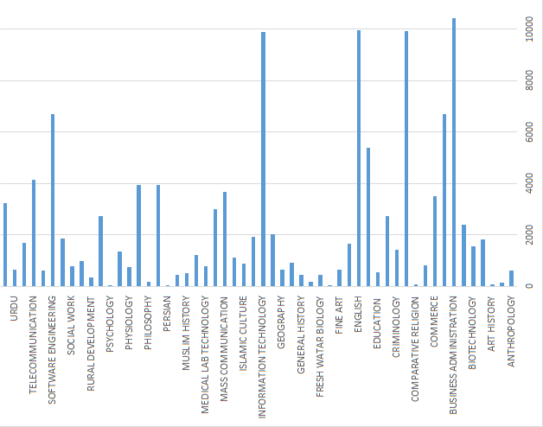
Introduction Objectives Problem Description Approach Case Study Meta Model Algorithm Model Results Summary
Candidates’ Choice Selection Trend in 2015 to 2018
Figure 12: Candidates’ choice selection trend in 2015 to 2018
University of Sindh offered 69 courses in 2015/16/17.A large number of students applied
in market-oriented courses. The results of academic sessions 2015 and 2016 show that on average students specified maximum of 8 and 9 choices respectively.
28 / 50

Slide 29
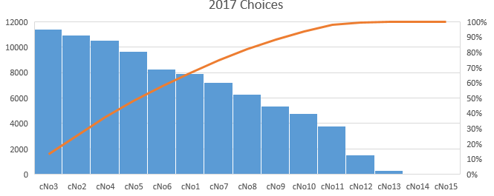
Introduction Objectives Problem Description Approach Case Study Meta Model Algorithm Model Results Summary
Candidates’ Choice Selection Trend 2017
Figure 13: Candidates’ choice selection trend in 2017
It was observed 2015 and 2016 that the 10 is the maximum
selection of program of study but in 2017 the policy was changed. Admission ofﬁce offerd 15 choices of program of study
29 / 50

Slide 30
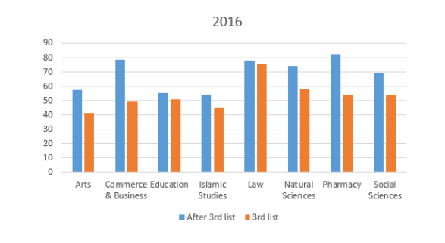
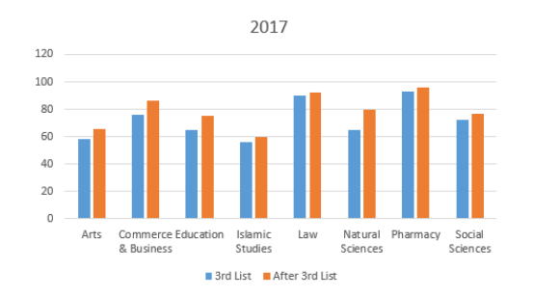
Introduction Objectives Problem Description Approach Case Study Meta Model Algorithm Model Results Summary
Left Over Seats 2016-2017
Figure 14 : Left Over Seats 2016-2017
2017achieve better results compare to 2016. From the experiment it was observed that 8% seats are more consumed in Arts faculty, 8% seats are more increase Commerce and Business, 10% increase in education, 10% in Islamic Studies, 2 % in Law, 15% in Natural Sciences, 3% Pharmacy and 5% in Social Sciences.
29 / 50

Slide 31
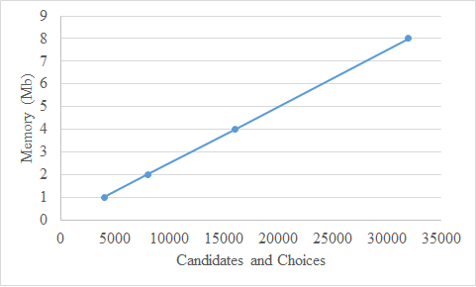
Introduction Objectives Problem Description Approach Case Study Meta Model Algorithm Model Results Summary
Analysis of Algorthim with Respect to Space
Figure 15: Total seat allocation and utilization
It observed that 5000 records takes 1 mb memory, 1000 records takes 2 MB , it
is linear
30 / 50

Slide 32
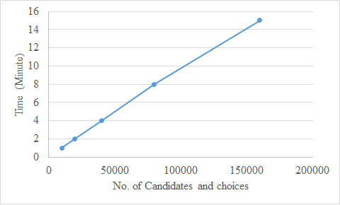
Introduction Objectives Problem Description Approach Case Study Meta Model Algorithm Model Results Summary
Analysis of Algorthim with Respect to Time
Figure 16 : Candidates’ choice selection trend in 2015-2016
31 / 50

Slide 33
Introduction Objectives Problem Description Approach Case Study Meta Model Algorithm Model Results Summary
Literature Review
Difference between other Systems
O. Aygu¨n and I. Bo [1], | seats are distributed according to district where each district has its own fixed quota
A. Bhatia et al | seats are distributed according to their realms
University Of Sindh adopted both polices
The authors [1,2,3,5,7,13, 6], developed the mathematical models.
We used the object modeling approach to structure the system that dominates the programming paradigm. To the best of our knowledge, such an approach has not been used for the said purpose.
31 / 50

Slide 34
Introduction Objectives Problem Description Approach Case Study Meta Model Algorithm Model Results Summary
Literature Review
Difference between other Systems
Atila et al. [2] describe the selection of 8th and 9th grade
A. Bhatia et al | seats are distributed according to their realms
University Of Sindh do not adopted this policy
Dur et al. [10] mention seat distribution where 50% seats are assigned to neighborhood school priority and remaining 50% are on choice-base priority
University Of Sindh do not adopted this policy
50% Academic Perfomance |  |  | 50% Test Score
16 % Lower | 16 % Middle | 16 % High
31 / 50

Slide 35
Literature Review
Students(Sn) | Percentage | Preferences Coerces (Ci) order (>)
S1 | 71 | C3,C1,C2
S2 | 72 | C1,C3,C2
S3 | 73 | C2,C1,C3
S4 | 75 | C2,C1,C3
S5 | 76 | C1,C3,C2
Choice Based
Score Based
C1 2(seats) | C2 1(seats) | C3 1(seats)
S5 | S4 | S1
S2
C1 2(seats) | C2 1(seats) | C3(seats)
S5 | S4 | S1
S3

Slide 36
Introduction Objectives Problem Description Approach Case Study Meta Model Algorithm Model Results Summary
Comparison With Other Admission Systems
University of Sindh (UoS) for general public sector university is more complex than other universities.
We compare admission system of “Mehran University of Engineering and Technology” (MUET) with our admission system in terms of complexity in admission procedure and policies.
UoS offers degree programs in different disciplines for students having different type of educational background (such as, pre-medical, pre-engineering, commerce)
32 / 50

Slide 37
Introduction Introduction Introduction Introduction Introductionr Introduction Introduction Objectives Problem Description
Comparison With Other Admission Systems
However, MUET accepts students for applying who belong to pre-engineering in intermediate (or FSc).
UoS offer more degree programs than MUET. Each degree program of every discipline have different pre-requisites in terms of educational background and previous academic score of the student.
UoS admission system is the complex structure of seat distribution in each degree of every discipline. In MUET admission system, seat in each discipline is distributed by the district/area of student.
32 / 50

Slide 38
Introduction Objectives Problem Description Approach Case Study Meta Model Algorithm Model Results Summary
Comparison With Other Admission Systems (Cont’d)
special quotas seats are also available but comparatively, a student in UoS can compete more than one category of seats distribution.
UoS offer Morning/Evening shift
32 / 50

Slide 39
Introduction Objectives Problem Description Approach Case Study Meta Model Algorithm Model Related Work Summary
Related Work (Cont’d)
Marriage Stability
Boys Group
Preferences Girls
Girls Group
Preferences Boys
B1
G1, G2, G3
G1
B2, B1
B2
G4, G5
G2
B5, B2
B3
G3
G3
B3
B4
G2, G1
G4
B2, B1
B5
G1, G3, G5
G5
B4, B5
39 / 50

Slide 40
Introduction Objectives Problem Description Approach Case Study Meta Model Algorithm Model Related Work Summary
Related Work (Cont’d)
Doctor Distribution
Many governments are concerned about access to health care in rural communities and trying to implement policies to balance the distribution of doctors in urban and rural areas [13].
The study in [15], focuses on a problem of doctors distribution in Japan.
40 / 50

Slide 41
Introduction Objectives Problem Description Approach Case Study Meta Model Algorithm Model Summary
Summary and Future Work
Summary
Modeling the existing choice selection system for public sector universities in Pakistan.
The underlying model of the system is represented as a metamodel using UML class diagram notations. Such a model is exploited while designing the algorithm that generates the selection list.
Analysis of the seat utlization
The implemantation reveals that the number of choices affect seat utilization. For instance, avarage choices were 8 and 9 in
2015 and 2016 respectivey.
41 / 50

Slide 42
Introduction Objectives Problem Description Approach Case Study Meta Model Algorithm Model Summary
Summary and Future Work (Cont’d)
Summary (Cont’d)
Theoretical Model (i.e., Choice selection Metamodel and the Algorithms) of the proposed System has been developed.
Prototype has been developed for the maximum seat utilization.
Compering proposed model of choice selections with existing ones.
42 / 50

Slide 43
Introduction Objectives Problem Description Approach Case Study Meta Model Algorithm Model Summary
Summary and Future Work (Cont’d)
Future Work
Study the reasons behind under seat utlization.
Identifying the more constraints to maximize seat utilization.
Adding more constraints over choice selections for improveing
the seat utilization.
Guidelines for further implementation.
43 / 50

Slide 44
Introduction Introduction Introduction Introduction Introductionr Introduction Introduction Objectives Problem Description
References
C Sharma A. Bhatia and R. Goyal. Development of an agent
based model illustrating the usage of deferred acceptance algorithm in the admission process. Technical report, PeerJ PrePrints, 2017
A. Abdulkadiroglu, P.A. Pathak, and A.E. Roth. The new york city high school match. American Economic Review, pages 364{367, 2005}
A. Abdulkadiroglu and T. Sonmez. School choice: A
mechanism design approach. The American Economic Review,
93(3):729{747, 2003.
O.S. Adewale, A.B. Adebiyi, and O.O. Solanke. Web-based neural network model for university undergraduate admission selection and placement. The Pacic Journal of Science and
Technology, 2:367{384, 2007.
44 / 50

Slide 45
Introduction Introduction Introduction Introduction Introductionr Introduction Introduction Objectives Problem Description
References (Cont’d)
A.Pathak and T. Sonmez. School admissions reform in
chicago and england: Comparing mechanisms by their vulnerability to manipulation. The American Economic Review, 103(1):80{106, 2018.
O. Ayg unyand and I. Bo. College admissions with multidimensional reserves: the brazillian armative action case. Technical report, Mimeo. 1, 2013.
A. Bhatia, C. Sharma, and R. Goyal. Development of an agent based model illustrating the usage of deferred acceptance algorithm in the admission process. Technical Report 2167-9843, PeerJ PrePrints, 2015.
I. Bo. Fair implementation of diversity in school choice. Technical report, Budapesti Corvinus Egyetem, 2014.
45 / 50

Slide 46
Introduction Introduction Introduction Introduction Introductionr Introduction Introduction Objectives Problem Description
References (Cont’d)
J. Coldron. Secondary school admissions. Technical report,
2008.
T.H. Cormen, C.E. Leiserson, C. Eric., R.L. Rivest, and Cliord. Introduction to algorithms, volume 6. MIT press Cambridge,
2001.
U.M. Dur, S.D. Kominers, P.A. Pathak, and T. Sonmez. The demise of walk zones in boston: Priorities vs. precedence in school choice. Technical report, National Bureau of Economic Research, 2013.
S. Fong and R.P. Biuk-Aghai. An automated university admission recommender system for secondary school students. In proceeeding of the 6th International Conference on Information Technology and Applications, 2009.
46 / 50

Slide 47
Introduction Introduction Introduction Introduction Introductionr Introduction Introduction Objectives Problem Description
References (Cont’d)
Martin Fowler. UML distilled: a brief guide to the standard
object modeling language. Addison-Wesley Professional, 2004.
D. Fragiadakis and P. Troyan. Improving matching under hard
distributional constraints. Technical report, Mimeo, Texas
A&M University, 2017.
D. Gale and L. S. Shapley. College admissions and the
stability of marriage. The American Mathematical Association of America, 69(1):9{15, 2009.
Isa E Hafalir, M Bumin Yenmez, and Muhammed A YildirimEective armative action in school choice. Theoretical Economics, 8(2):325{363, 2016.
47 / 50

Slide 48
Introduction Introduction Introduction Introduction Introductionr Introduction Introduction Objectives Problem Description
References (Cont’d)
Y. Kamada and F. Kojima. Ecient matching under
distributional concerns: Theory and application. Technical report, Stanford University, Stanford, 2013.
Scott Duke Kominers and Tayfun Sonmez. Designing for diversity in matching. In EC, pages 603{604, 2013.
Wegner. M and Teuhola. J . I. The external heapsort. IEEE Transactions on Software Engineering, 15(7):917{925, 1989.
Mauricio dos Santos Matos, Selma Garrido Pimenta, Maria
Isabel de Almeida, and Maria Amelia de Campos Oliveira.
The impact of the social inclusion program of the university of s˜ao paulo on the access of public school students to free public higher education. Revista Brasileira de Estudos Pedagogicos, 93(235):720{742, 2012
48 / 50

Slide 49
Introduction Introduction Introduction Introduction Introductionr Introduction Introduction Objectives Problem Description
References (Cont’d)
Ashenfelter. O, Collins W.J, and Yoon.A. Evaluating the role
of brown v. board of education in school equalization, desegregation, and the income of african americans. American Law and Economics Review, 8(2):213{248, 2006.
Jeff Parker. Snakes and ladders: patterns in heapsort. Journal of Computing Sciences in Colleges, 24(2):85{91, 2008.
A.E. Roth. Deferred acceptance algorithms: History, theory, practice, and open questions. International Journal of Game Theory, 36(3-4):537{569, 2008.
Leandros Tassiulas and Anthony Ephremides. Stability properties of constrained queueing systems and scheduling policies for maximum throughput in multihop radio networks. IEEE transactions on automatic control, 37(12):1936{1948,
1992.
49 / 50

Slide 50
Introduction Introduction Introduction Introduction Introductionr Introduction Introduction Objectives Problem Description
References (Cont’d)
F. Wabwoba and F.M. Mwakondo. Students selection for
university course admission at the joint admissions board (kenya) using trained neural networks. Journal of information technology education, 10:333{347, 2011.
Finis Welch et al. New evidence on school desegregation.
1987.
50 / 50

