Slide 1
Inheritance
Inheritance is a mechanism where in a new class is derived from an existing class.. A class derived from another class is called a subclass, whereas the class from which a subclass is derived is called a superclass. A subclass can have only one superclass, whereas a superclass may have one or more subclasses.
The keyword “extends” is used to derive a subclass from the superclass
In Java, a subclass inherits the characteristics (properties and methods) of its superclass (ancestor). For example, a vehicle is a superclass and a car is a subclass. The car (subclass) inherits all of the vehicle’s properties. The inheritance mechanism is very useful in code reuse.

Slide 2
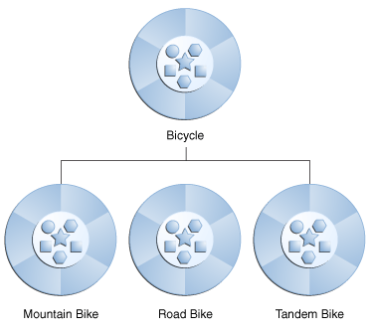
Inheritance
Object-oriented programming allows classes to inherit commonly used state and behavior from other classes. In this example, Bicycle now becomes the superclass of MountainBike, RoadBike, and TandemBike. In the Java programming language, each class is allowed to have one direct superclass, and each superclass has the potential for an unlimited number of subclasses:

Slide 3
Inheritance is-a relationship
Inheritance enables programmers to define an "is-a" relationship between a class and a more specialized version of that class. For example, if a Student class extends a Person class, then it should be the case that Student is-a Person.
Syntax:-
//superclass
public class Person{
}
//subclass
public class Student extends Person{
}

Slide 4
Inheritance is-a relationship
IS-A is a way of saying : This object is a type of that object. Let us see how the extends keyword is used to achieve inheritance.
public class Animal{
}
public class Mammal extends Animal{
}
public class Reptile extends Animal{
}
public class Dog extends Mammal{
}

Slide 5
Now based on the above example, In Object Oriented terms following are true:
Animal is the superclass of Mammal class.
Animal is the superclass of Reptile class.
Mammal and Reptile are sub classes of Animal class.
Dog is the subclass of both Mammal and Animal classes.
Now if we consider the IS-A relationship we can say:
Mammal IS-A Animal
Reptile IS-A Animal
Dog IS-A Mammal
Hence : Dog IS-A Animal as well With use of the extends keyword the subclasses will be able to inherit all the properties of the superclass except for the private properties of the superclass.

Slide 6
What You Can Do in a Subclass
A subclass inherits all of the public and protected members of its parent, no matter what package the subclass is in. If the subclass is in the same package as its parent, it also inherits the package-private members of the parent. You can use the inherited members as is, replace them, hide them, or supplement them with new members:
The inherited fields can be used directly, just like any other fields.
You can declare a field in the subclass with the same name as the one in the superclass, thus hiding it (not recommended).
You can declare new fields in the subclass that are not in the superclass.
The inherited methods can be used directly as they are.
You can write a new instance method in the subclass that has the same signature as the one in the superclass, thus overriding it.
You can write a new static method in the subclass that has the same signature as the one in the superclass, thus hiding it.
You can declare new methods in the subclass that are not in the superclass.
You can write a subclass constructor that invokes the constructor of the superclass, either implicitly or by using the keyword super.
A subclass cannot inherit private members of its superclass.
A subclass can have only one superclass.

Slide 7
Private Members in a Superclass
A subclass does not inherit the private members of its parent class. However, if the superclass has public or protected methods for accessing its private fields, these can also be used by the subclass.
A nested class has access to all the private members of its enclosing class—both fields and methods. Therefore, a public or protected nested class inherited by a subclass has indirect access to all of the private members of the superclass.

Slide 8
Casting Objects
We have seen that an object is of the data type of the class from which it was instantiated. For example, if we write
public MountainBike myBike = new MountainBike();
then myBike is of type MountainBike.
MountainBike is descended from Bicycle and Object. Therefore, a MountainBike is a Bicycle and is also an Object, and it can be used wherever Bicycle or Object objects are called for.
The reverse is not necessarily true: a Bicycle may be a MountainBike, but it isn't necessarily. Similarly, an Object may be a Bicycle or a MountainBike, but it isn't necessarily.
Casting shows the use of an object of one type in place of another type, among the objects permitted by inheritance and implementations. For example, if we write

Slide 9
Casting Object
Object obj = new MountainBike();
then obj is both an Object and a MountainBike (until such time as obj is assigned another object that is not a MountainBike). This is called implicit casting.
If, on the other hand, we write
MountainBike myBike = obj;
we would get a compile-time error because obj is not known to the compiler to be a MountainBike. However, we can tell the compiler that we promise to assign a MountainBike to obj by explicit casting:
MountainBike myBike = (MountainBike)obj;
This cast inserts a runtime check that obj is assigned a MountainBike so that the compiler can safely assume that obj is a MountainBike. If obj is not a MountainBike at runtime, an exception will be thrown.

Slide 10
is a' relationship and a 'has a' relationship in Java
The is a relationship is expressed with inheritance and has a relationship is expressed with composition.
Both inheritance and composition allow you to place sub-objects inside your new class. Two of the main techniques for code reuse are class inheritance and object composition.
e.g.,
class Building {
.......
}
class House extends Building {
.........
}
is a --- House is a Building
has a -- House has a Kitchen
class House {
Kitchen kit = new Kitchen() ; ....
}

Slide 11
class A {
int i, j;
void showij() {
System.out.println("i and j: " + i + " " + j);
}
}
// Create a subclass by extending class A.
class B extends A {
int k;
void showk() {
System.out.println("k: " + k);
}
void sum() {
System.out.println("i+j+k: " + (i+j+k));
}
}
class SimpleInheritance {
public static void main(String args[]) {
A superOb = new A();
B subOb = new B();
// The superclass may be used by itself.
superOb.i = 10;
superOb.j = 20;
System.out.println("Contents of superOb: ");
superOb.showij();
System.out.println();
/* The subclass has access to all public members of its superclass. */
subOb.i = 7;
subOb.j = 8;
subOb.k = 9;
System.out.println("Contents of subOb: ");
subOb.showij();
subOb.showk();
System.out.println();
System.out.println("Sum of i, j and k in subOb:");
subOb.sum();
}
}

Slide 12
Define Last Example
The output from this program is shown here:
Contents of superOb:
i and j: 10 20
Contents of subOb:
i and j: 7 8
k: 9
Sum of i, j and k in subOb:
i+j+k: 24
As you can see, the subclassB includes all of the members of its superclass, A. This is why subObcan access i and j and call showij( ). Also, inside sum( ) , i and j can be referred to directly, as if they were part of B

Slide 13
When Constructors Are Called
// Create a super class.
class A {
A() {
System.out.println("Inside A's constructor.");
}
}
// Create a subclass by extending class A.
class B extends A {
B() {
System.out.println("Inside B's constructor.");
}
}
// Create another subclass by extending B.
class C extends B {
C() {
System.out.println("Inside C's constructor.");
}
}
class CallingCons {
public static void main(String args[]) {
C c = new C();
}
}

Slide 14
METHOD OVERRIDING
Sub class can override the methods defined by the super class.
Overridden Methods in the sub classes should have same name, same signature , same return type and may have either the same or higher scope than super class method.
Java implements Run Time Polymorphism/ Dynamic Method Dispatch by Method Overriding.
Call to Overridden Methods is Resolved at Run Time.
Call to a overridden method is not decided by the type of reference variable Rather by the type of the object where reference variable is pointing.
While Overriding a Method, the sub class should assign either same or higher access level than super class method.

Slide 15
EXAMPLE METHOD OVERRIDING
class A
{
void show()
{
System.out.println("Hello This is show() in A");
}// End of show() Method
} // End of class A
class B extends A
{
void show()
{
System.out.println("Hello This is show() in B");
}// End of show() Method
} // End of class B
B class overrides show() method from super class A
class override
{
public static void main(String args[])
{
// super class reference variable
// can point to sub class object
A a1 = new A();
a1.show();
a1 = new B();
a1.show();
}
}
Call to show() of A class
Call to show() of B class

Slide 16
Is this Method
Overriding
class A
{
void show(int a)
{
System.out.println("Hello This is show() in A");
}
}
class B extends A
{
void show()
{
System.out.println("Hello This is show() in B");
}
}
class override1
{
public static void main(String args[])
{
/*
A a1 = new B();
a1.show(); */
A a1 = new A();
a1.show(10);
B b1 = new B();
b1.show(10);
b1.show(); }
NO
OUTPUT
Hello This is show() in A
Hello This is show() in A
Hello This is show() in B

Slide 17
Dynamic Method Dispatch
Super class reference variable can refer to a sub class object.
Super class variable if refers to sub class object can call only overridden methods.
Call to an overridden method is decided by the type of object referred to.
A
A a1 = new B();
a1.show(); // call to show() of B
a1 = new C();
a1.show(); // call to show() of C
a1 = new D();
a1.show(); // call to show() of D
B
C
D
Assume show() Method is
Overridden by sub classes

Slide 18
class A { void show() { System.out.println("Hello This is show() in A"); } } class B extends A { void show() { System.out.println("Hello This is show() in B"); } }
DYNAMIC METHOD DISPATCH
class C extends A { void show() { System.out.println("Hello This is show() in C"); } } class D extends A { void show() { System.out.println("Hello This is show() in D"); } }
CONTINUED…..

Slide 19
class override2
{
public static void main(String args[])
{
A a1 = new A();
a1.show();
a1 = new B();
a1.show();
a1 = new C();
a1.show();
a1 = new D();
a1.show();
}
}
Hello This is show() in A
Hello This is show() in B
Hello This is show() in C
Hello This is show() in D

Slide 20
class override3
{
public static void main(String args[])
{
A a1 = new B();
B b1 = (B) a1;
/*
A a1 = new B();
C c1 = (C) a1;
Exception in thread "main"
java.lang.ClassCastException: B
at override3.main(override3.java:39)
*/
}
}

Slide 21
Examples Overriding
class A
{
void show() { …. }
}
class B extends A
{
void show() { …. }
void show(int x) { … }
void print() { … }
}
A a1 = new B();
a1.show() ; // Valid
// a1.show(10); // Invalid
//a1.print(); // Invalid
When a super class variable points to a sub class object, then it can only call overridden methods of the sub class.

Slide 22
class A
{
protected void show()
{
System.out.println("Hi");
}
}
class B extends A
{
void show()
{
System.out.println("Hi");
}
}
D:\Java1>javac AB.java
AB.java:10: show() in B cannot override show() in A; attempting to assign weaker
access privileges; was protected
void show()
^
1 error

Slide 23
IS THIS METHOD OVERRIDING
class A
{
private void show()
{
System.out.println("Hi");
}
}
class B extends A
{
int show()
{
System.out.println("Hi");
return 10;
}
}``1A?.,MNB
NO
CODE WILL COMPILE & RUN SUCESSFULLY

Slide 24
class A
{
static int show()
{
System.out.println("class A");
return 0;
}
}
class B extends A
{
void show()
{
System.out.println("class B");
}
}
What’s Wrong Here00
sample.java:12: show() in B cannot override show() in A; overridden method is st
atic
void show()
^
1 error

Slide 25
Dynamic Method Dispatch
This is a unique feature in JAVA.as the name itself suggests that it is related with run time. In this classes has methods with same method name and signature. However which method will b executed will be decided during run time.
Dynamic method dispatch is the mechanism in which the call to a overriden method is resolved at run-time rather than compile time.
Dynamic method dispatch provides run-time polymorphism in Java.
Overriding is the concept that supports dynamic method dispatch.
A super class variable can refer a subclass object like
SuperClass obj = new SubClass();
When a superclass variable is used to refer a subclass object the following characteristics hold:
The superclass variable can access only the members of the superclass. It cannot access the members specific to the subclass. That is the members that can be accessed is determined by the type of reference.

Slide 26
class A {
void callme() {
System.out.println("Inside A's callme method");
}
}
class B extends A {
void callme() {
System.out.println("Inside B's callme method");
}
}
class C extends A {
void callme() {
System.out.println("Inside C's callme method");
}
}
class Dispatch {
public static void main(String args[]) {
A a = new A(); // object of type A
B b = new B(); // object of type B
C c = new C(); // object of type C
A r; // obtain a reference of type A
r = a; // r refers to an A object
r.callme(); // calls A's version of callme
r = b; // r refers to a B object
r.callme(); // calls B's version of callme
r = c; // r refers to a C object
r.callme(); // calls C's version of callme
}
}

Slide 27
Dynamic Method Dispatch
The output from the program is shown here:
Inside A’s callme method
Inside B’s callme method
Inside C’s callme method
This program creates one superclass called A and two subclasses of it, called B and C. Subclasses B and C override callme( ) declared in A. Inside the main( )method, objects of type A, B, and C are declared. Also, a reference of type A, called r, is declared. The program then assigns a reference to each type of object to r and uses that reference to invoke callme( ) .As the output shows, the version of callme( ) executed is determined by the type of object being referred to at the time of the call. Had it been determined by the type of the reference variable, r, you would see three calls to A’s callme( ) method.

Slide 28
class Flower {
void which() {
System.out.println("A Beautiful flower.");
}
}
class Rose extends Flower {
void which() {
System.out.println("Rose");
}
}
class Lotus extends Flower {
void which() {
System.out.println("Lotus.");
}
}
class Test {
public static void main(String[] args) {
Flower ref1 = new Flower();
Flower ref2 = new Rose();
Flower ref3 = new Lotus();
ref1.which();
ref2.which();
ref3.which();
}
}

Slide 29
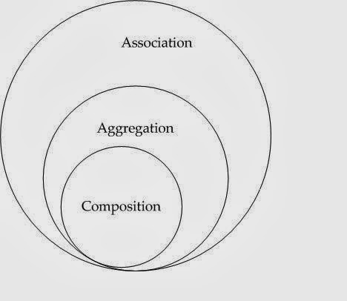
Association
Association is a relationship between two or more objects where all objects have their own life cycle. In other words, association defines the multiplicity between objects. You may be aware of one-to-one, one-to-many, many-to-one, many-to-many all these words define an association between object
Example:-
Multiple students can associate with single teacher
Single student can associate with multiple teachers
There is no ownership between both student and teacher can deleted and created independently
5, 1600

Slide 30
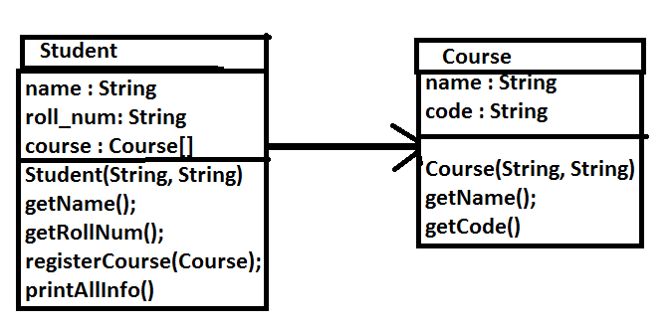
Association Example

Slide 31
Aggregation & Composition
Both are very long words for simple ideas. And they describe an obvious relationship between our objects that one object can often be built of other objects.

Slide 32
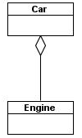
Aggregation
Aggregation is a specialize form of Association where all object have their own lifecycle but there is ownership and child object can not belongs to another parent object. Let’s take an example. We can think about “has-a” relationship
The part may have an independent lifecycle, it can exist independently. When the whole is destroyed the part may continue to exist.
Example 1 , a Car and Engine. A Engine can be removed from one car and installed into a different car. If we consider a salvage business, before a car is destroyed, they remove all saleable parts. Those parts will continue to exist after the car is destroyed
Example 2 of Department and teacher. A single teacher can not belongs to multiple departments, but if we delete the department teacher object will not destroy

Slide 33
Aggregation Example
public class Car {
private String make;
private int year;
private Engine engine;
public Car(String make, int year, Engine engine) {
this.make = make;
this.year = year;
this.engine = engine;
}
public String getMake() { return make; }
public int getYear() { return year; }
public Engine getEngine() { return engine; }
}
public class Engine {
private int engineCapacity;
private int engineSerialNumber;
public Engine(int engineCapacity, int engineSerialNumber) {
this.engineCapacity = engineCapacity;
this.engineSerialNumber = engineSerialNumber;
}
public int getEngineCapacity() {
return engineCapacity;
}
public int getEngineSerialNumber() {
return engineSerialNumber;
}
}

Slide 34
Aggregation Example
class CallMain{
public static void main(String ar[]){
Engine eng = new Engine(5, 1600);
Car car = new Car("Honda", 2010, eng);
}
}

Slide 35
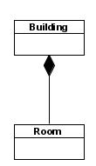
Composition
Composition is a stronger form of aggregation and we can call this as a “death” relationship
The lifecycle of the part is strongly dependent on the lifecycle of the whole. When the whole is destroyed, the part is destroyed too.
For example
Let’s take relationship between House and rooms. House can contain multiple rooms there is no independent life of room and any room can not belongs to two different house if we delete the house room will automatically delete.
Let’s take between Questions and options. Single questions can have multiple options and option can not belong to multiple questions. If we delete questions options will automatically delete.

Slide 36
public class Car {
private String make;
private int year;
private Engine engine;
public Car(String make, int year, int engineCapacity, int engineSerialNumber) {
this.make=make;
this.year=year;
engine = new Engine(engineCapacity, engineSerialNumber);
}
public String getMake() { return make; }
public int getYear() { return year; }
public int getEngineSerialNumber() { return engine.getEngineSerialNumber(); }
public int getEngineCapacity() { return engine.getEngineCapacity(); }
}

Slide 37
Composition Example
class CallMain{
public static void main(String ar[]){
Car car = new Car("Honda", 2010, 5, 1600);
}
}

