Slide 2
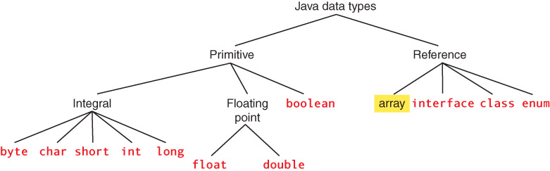
Java Data Types

Slide 3
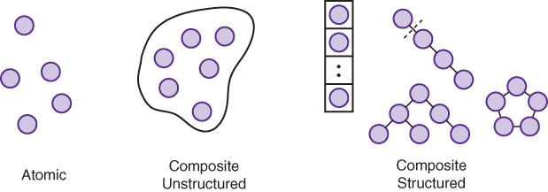
Java Data Types
Try expressing these definitions in words

Slide 4
Java Data Types
Composite data type
A data type that allows a collection of values to be associated with an identifier of that type
Unstructured data type
A collection of components that are not organized with respect to one another
Structured data type
An organized collection of components; the organization determines the means used to access individual components
Is a class structured?

Slide 5
Java Data Types
class Example
{
int field1;
int field2;
double field3;
}
class Example
{
double field3;
int field2;
int field1;
}
Changing the order does not change the access
Is a class structured?
Did you change your answer?

Slide 6
One-Dimensional Arrays
Data structure
The implementation of a composite data type
Note the difference between a data structure (implementation of any composite type) and a structured data type (a composite type that is structured)

Slide 7
One-Dimensional Arrays
One-dimensional array
A structured collection of components, all of the same type, that is given a single name; each component is accessed by an index that indicates the component's position within the collection
Class
  composite, unstructured
  heterogeneous
  access by field name
Array
  composite, structured
  homogeneous
  access by position

Slide 8
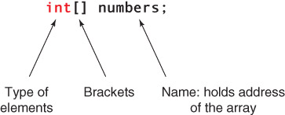
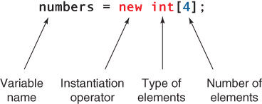
One-Dimensional Arrays
Declare
Instantiate

Slide 9
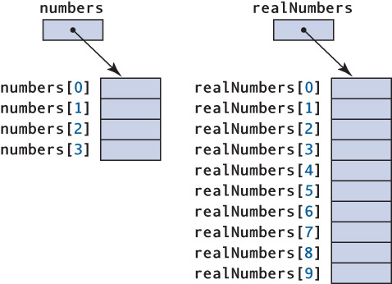
One-Dimensional Arrays
int[] numbers = new int[4];
What
type of
values
can be
stored in
each cell
?

Slide 10
One-Dimensional Arrays
float[] realNumbers = new float[10];
How
do you
get
values
into the
cells
?

Slide 11
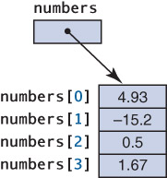
One-Dimensional Arrays
Array Initializers
int[] numbers = {4.93, -15.2, 0.5, 1.67};
Initializers
do the
instantiation
and
storing in
with the
declaration

Slide 12
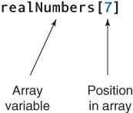
One-Dimensional Arrays
Accessing Individual Components
Indexing expression

Slide 13
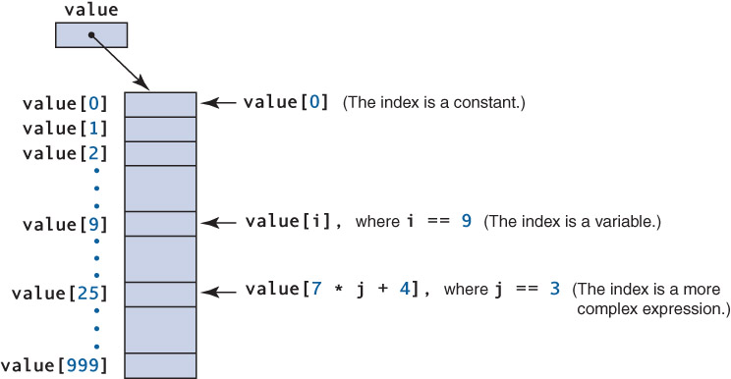
One-Dimensional Arrays
What
happens
if you
try to
access
value[1000]
?

Slide 14
One-Dimensional Arrays
Out-of-bounds array index
An index that is either less than 0 or greater than the array size minus 1, causing an ArrayIndexoutOfBoundsException to be thrown
Length
A public instance variable associated with each instantiated array, accessed by array name .length
Use length to avoid out-of-bounds indexes

Slide 15
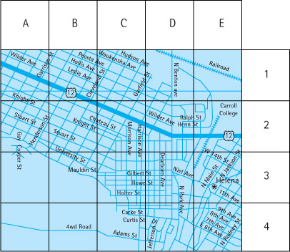
Two-Dimensional Arrays
Two-
dimensional
arrays
can be
used to
represent
tables
such as
this map

Slide 16
Two-Dimensional Arrays
Two-dimensional array
A collection of homogeneous components, structured in two dimensions (referred to as rows and columns); each component is accessed by a pair of indexes representing the component’s position within each dimension

Slide 17
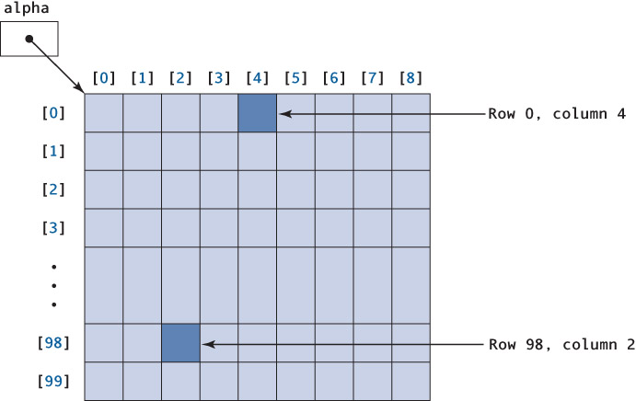
Two-Dimensional Arrays

Slide 18
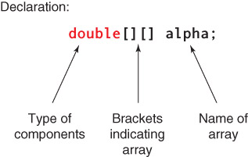
Two-Dimensional Arrays

Slide 19
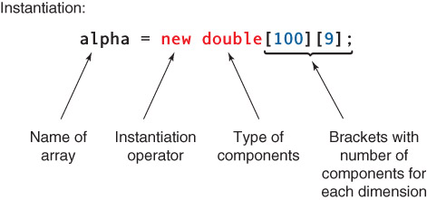
Two-Dimensional Arrays
Can you predict how each item is accessed?

Slide 20
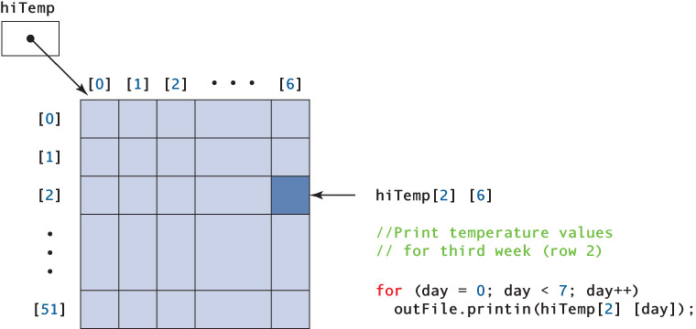
Two-Dimensional Arrays

Slide 21
Two-Dimensional Arrays
Initializer Lists
int[][] hits = {{ 2, 1, 0, 3, 2 },
{ 1, 1, 2, 3 },
{ 1, 0, 0, 0, 0 },
{ 0, 1, 2, 1, 1 }};
hits
[0] [1] [2] [3] [4]
2 1 0 3 2
1 1 2 3
1 0 0 0 0
0 1 2 1 1

Slide 22
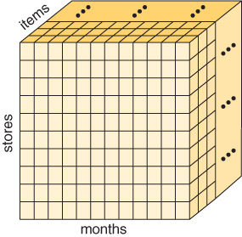
Three-Dimensional Arrays
Array
A collection of homogeneous components ordered on N dimensions (N>=1); each component is accessed by N indexes, each of which represents the component's position within that dimension

