Slide 1

Network Security

Slide 2
Chapter 5
Electronic mail security

Slide 3
Outline
Pretty good privacy
S/MIME
Recommended web sites

Slide 4
What is PGP Encryption
PGP Encryption (Pretty Good Privacy) is a computer program that provides cryptographic privacy and authentication.

Slide 5
PGP History -Early History
Phil Zimmermann created the first version of PGP encryption in 1991.
No license was required for non-commercial use.
PGP encryption found its way onto Usenet and from there onto the Internet, and it rapidly acquired a considerable following around the world.

Slide 6
PGP History -Criminal investigation
Shortly after its release, PGP encryption found its way outside the US, and in February 1993 Zimmermann became the formal target of a criminal investigation by the US Government for "munitions export without a license".

Slide 7
PGP History -Criminal investigation
Cryptosystems using keys larger than 40 bits were then considered munitions within the definition of the US export regulations; PGP has never used keys smaller than 128 bits so it qualified at that time.

Slide 8
PGP History - PGP 3
This new version was to have considerable security improvements, including a new certificate structure which fixed small security flaws in the PGP 2.x certificates as well as permitting a certificate to include separate keys for signing and encryption.

Slide 9
PGP History - PGP 3
PGP 3 introduced use of the CAST-128 (a.k.a. CAST5) symmetric key algorithm, and the DSA and ElGamal asymmetric key algorithms.

Slide 10
PGP History-OpenPGP
In July 1997, PGP Inc. proposed to the IETF that there be a standard called OpenPGP. They gave the IETF permission to use the name OpenPGP to describe this new standard as well as any program that supported the standard.

Slide 11
PGP History-Network Associates acquisition
In December, 1997 PGP Inc. was acquired by Network Associates, Inc. Zimmermann and the PGP team became NAI employees

Slide 12
PGP History-Network Associates acquisition
NAI continued to pioneer export through software publishing, being the first company to have a legal export strategy by publishing source code. Under its aegis, the PGP team added disk encryption, desktop firewalls, intrusion detection, and IPsec VPNs to the PGP family

Slide 13
PGP History-Current situation
In August 2002, several ex-PGP team members formed a new company, PGP Corporation, and bought the PGP assets from NAI.
In 2003 PGP Corporation created a new server-based product offering called PGP Universal.

Slide 14
PGP History-Current situation
In mid-2004, PGP Corporation shipped its own command line version called PGP Command Line, which integrates with the other PGP Encryption Platform applications.

Slide 15
PGP History-Current situation
In 2005 PGP Corporation made its first acquisition - the German software company Glueck and Kanja Technology AG which is now the German headquarters in Frankfurt

Slide 16
How PGP encryption works
PGP encryption uses public-key cryptography and includes a system which binds the public keys to user identities.
Current versions of PGP encryption include both alternatives through an automated management server.

Slide 17
How PGP encryption works -Encryption/decryption
PGP message encryption uses both asymmetric key encryption and symmetric key encryption algorithms

Slide 18
How PGP encryption works -Digital signatures
A similar strategy is used to detect whether a message has been altered since it was completed, and whether it was actually sent by the person/entity claimed to be the sender.

Slide 19
How PGP encryption works -Web of Trust
A given public key may be digitally signed by a third party to attest the association between the person and the key.

Slide 20
How PGP encryption works-Certificates
Trust signatures can be used to support creation of certificate authorities. A trust signature indicates both that the key belongs to its claimed owner and that the owner of the key is trustworthy to sign other keys at one level below their own.

Slide 21
PGP encryption applications
PGP products have been diversified since 2002 into a set of encryption applications which can be managed by an optional central policy server. The applications include email and attachments, digital signatures, laptop full disk encryption, file and folder security, protection for IM sessions, batch file transfer encryption, and protection for files and folders stored on network servers.

Slide 22
PGP encryption- Security quality
To the best of publicly available information, there is no known method for any entity to break PGP encryption by cryptographic, computational means regardless of the version being employed.

Slide 23
Operational Description
Consist of five services:
  Authentication
  Confidentiality
  Compression
  E-mail compatibility
  Segmentation

Slide 24
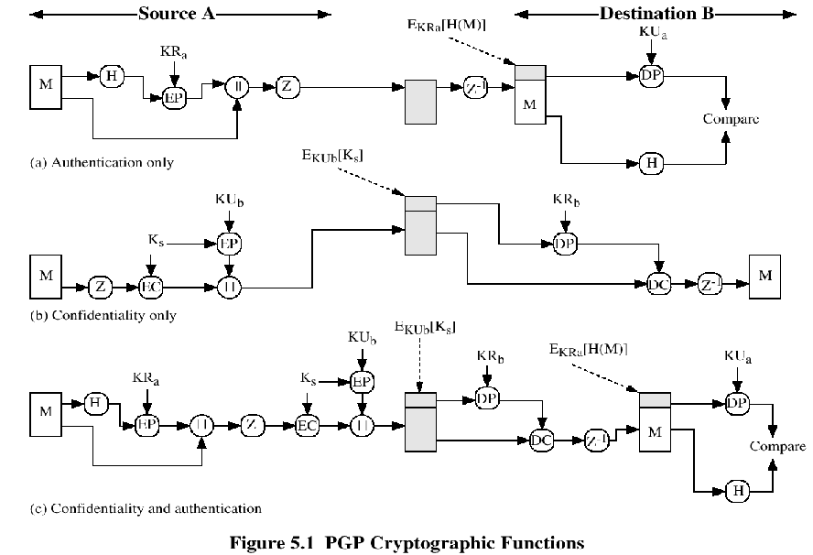

Slide 25
Compression
PGP compresses the message after applying the signature but before encryption
The placement of the compression algorithm is critical.
The compression algorithm used is ZIP (described in appendix 5A)

Slide 26
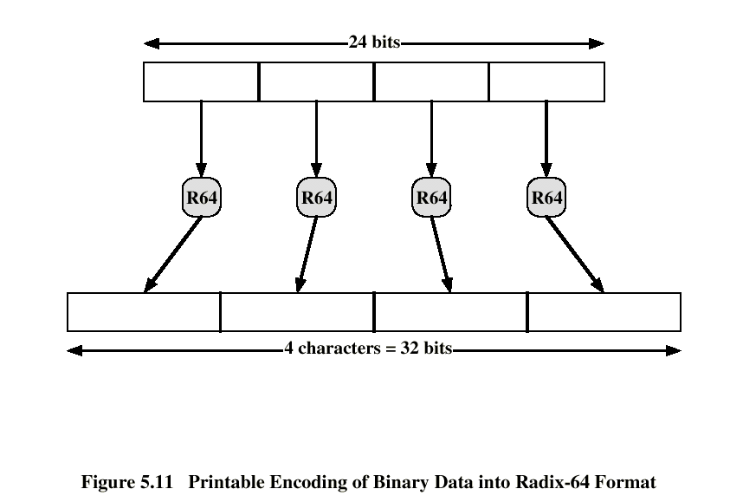
E-mail Compatibility
The scheme used is radix-64 conversion (see appendix 5B).
The use of radix-64 expands the message by 33%.

Slide 27
Segmentation and Reassembly
Often restricted to a maximum message length of 50,000 octets.
Longer messages must be broken up into segments.
PGP automatically subdivides a message that is to large.
The receiver strip of all e-mail headers and reassemble the block.

Slide 28
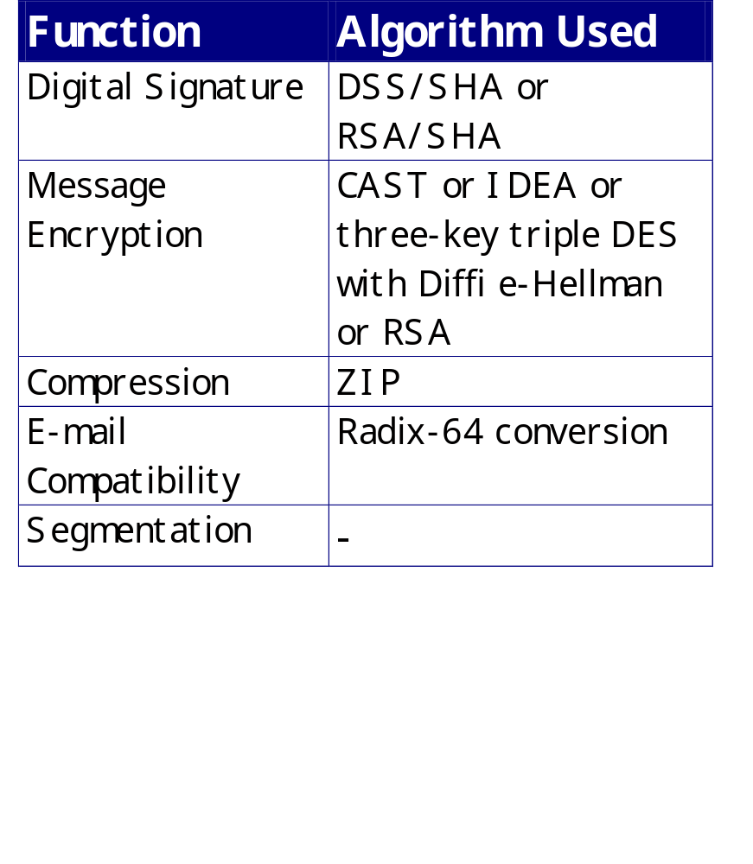
Sumary of PGP Services

Slide 29
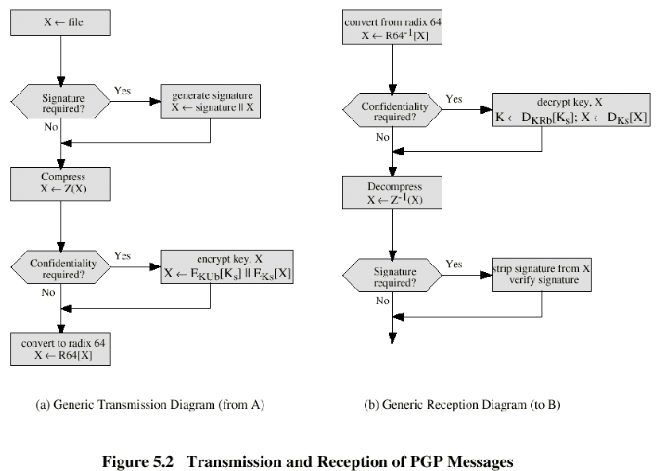

Slide 30
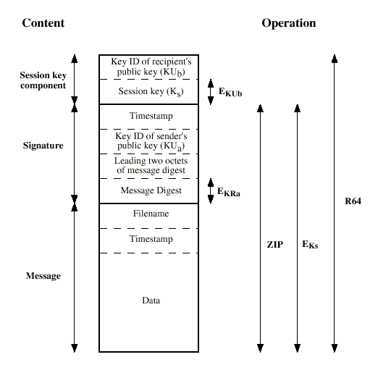
Format of PGP Message

Slide 31
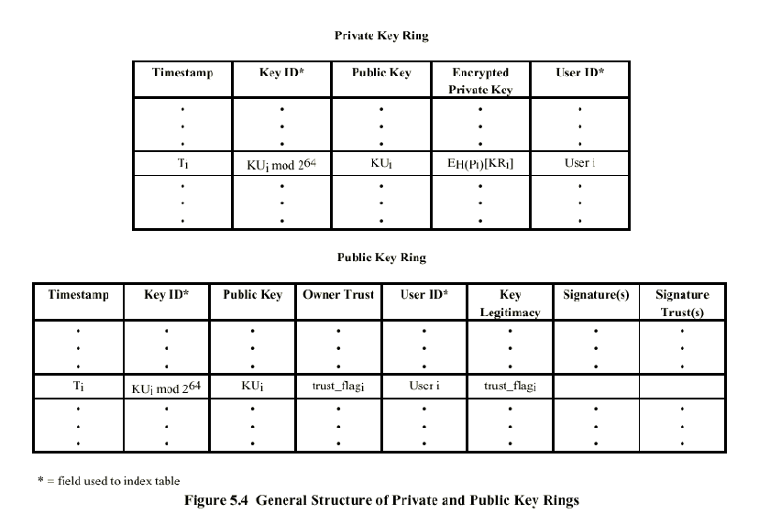

Slide 32
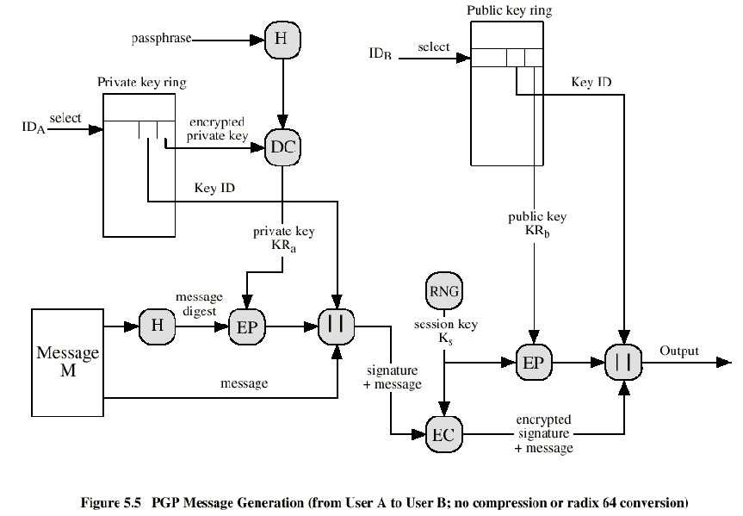

Slide 33
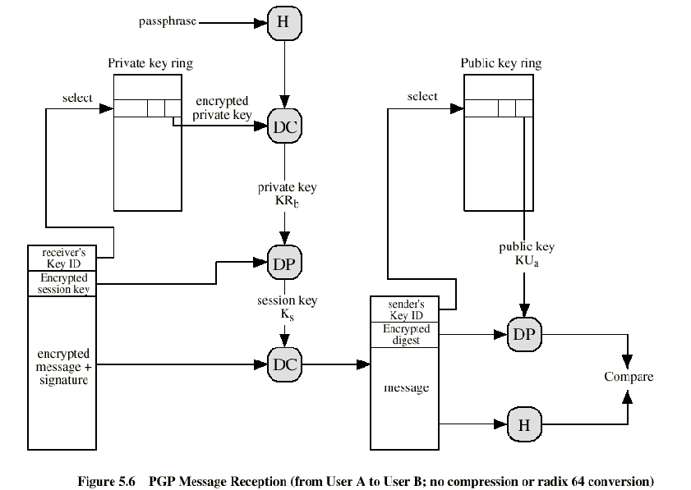

Slide 34
The Use of Trust
Key legitimacy field
Signature trust field
Owner trust field
See Table 5.2 (W. Stallings)

Slide 35
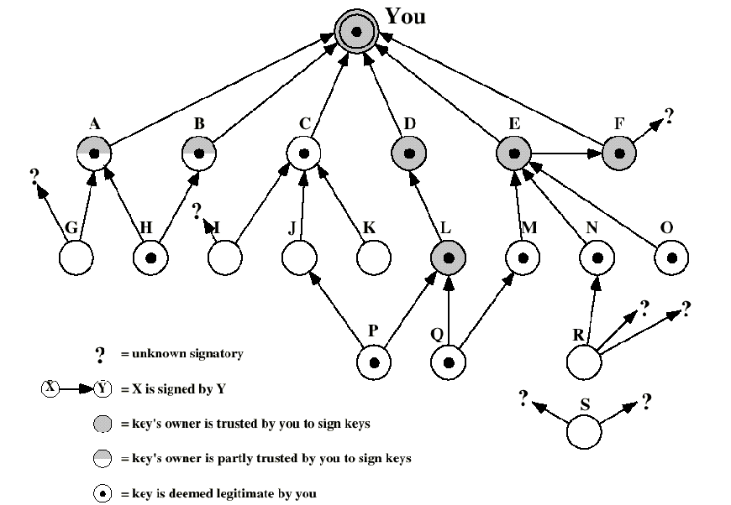

Slide 36
Revoking Public Keys
The owner issue a key revocation certificate.
Normal signature certificate with a revote indicator.
Corresponding private key is used to sign the certificate.

Slide 37
Pretty Good Privacy (PGP)
Basic Usage & Key Management
To encrypt file with recipent's pubkey: pgp -e textfile her_userid [other userids]
To sign a file with your secret key:
pgp -s textfile [-u your userid]
To sign a file with your secret key, and encrypt it with recipent's pubkey:
pgp -es textfile her_userid [-u your_userid]
To decrypt or check a signature for a ciphertext (.pgp) file: pgp ciphertextfile
To produce encryption/signature output in ASCII for email, add the -a option to above options.
To generate your own unique public/secret key pair: pgp -kg
To add a key file's contents to your public or secret key ring:pgp -ka keyfile [keyring]

Slide 38
Pretty Good Privacy (PGP)
Basic Use & Key Management (Continued)
To remove a key or a user ID from your public or secret key ring: pgp -kr userid [keyring]
To edit your user ID or pass phrase:
pgp -ke your_userid [keyring]
To check signatures on your public key ring:
pgp -kc [userid]
To sign someone else's public key on your public key ring:
pgp -ks her_userid
To view the contents of your public key ring:
pgp -kv

Slide 39
Pretty Good Privacy (PGP)
Generating a Key
To create a new key: pgp -kg
Select option 3: 1024 bits-"Military" grade, slow, highest security
Enter a user ID for the new key (usually name followed by email address: Joe Public <jpublic@public.com>
Enter a pass phrase. This phrase is used to encrypt your secret key.
* do not use the same password or pass phrase that is
used on another system
* do not use common words or proper names
* do not use any single word that may be contained in a
dictionary

Slide 40
Pretty Good Privacy (PGP)
Generating a Key
Use an actual phrase and not just a single password.
Example of a good pass phrase: “Sew ewe theenk ewe kan haq mie passfraze bye heereeng mee saye it 2 tymez?”
NOTE: passphrases are case-sensitive!
Do not use lines from history, popular movies or books!
The last step is to input random text in order to generate a series of random bits. This is done by measuring the time intervals between keystrokes.
The random bits are used to create the user’s keys.
The generated keys will be placed on your public and private keyrings.

Slide 41
Pretty Good Privacy (PGP)
PGP Public Key Certificates
PGP stores each public key in a key certificate which contains:
  The public key itself.
  The ID of the key’s creator (usually name & email address).
  The date the key was created & expiration date.
  A list of digital signatures provided by people who attest to the key’s authenticity.

Slide 42
Pretty Good Privacy (PGP)
Encrypting & Decrypting Files
To encrypt a file with a recipient’s public key:
pgp -e <filename> <user ID>
This will produce the file filename.pgp Only the recipient can decrypt the file using their private key.
The recipient can decrypt the file with:
pgp filename.pgp
They will then be prompted to enter their private key pass phrase.
Note: Whenever encrypting text files to send via the Internet also use the ‘a’ option for ASCII output

Slide 43
Pretty Good Privacy (PGP)
Digital Signatures
To add a digital signature to a file:
pgp -sta filename
The user will be prompted to enter their pass phrase.
The file <filename.asc> will be created which contains the digital signature of the sender.
The recipient can verify the digital signature to ensure the files contents have not changed: pgp filename.asc

Slide 44
Pretty Good Privacy (PGP)
Digital Signatures
The recipient will be notified if the file has a good signature:
Good signature from user "Joe Public<jpublic@public.com>".
Signature made 1998/07/27 04:29 GMT
If the file had been modified even by one byte the recipient would be advised that the signature was not valid:
Bad signature from user "Joe Public <jpublic@public.com>".
Signature made 1998/07/27 04:29 GMT

Slide 45
PGP Enhancements
General Notes
Utilities and filters are available that make PGP easier to use for the end-user. (Please see http://techreports/~jdyson/pgp4pine/index.html)
NAI PGP functions as a plug-in to Eudora and other popular Mail User Agents (MUAs). NAI PGP also has a number of disk utilities for digital signatures and encryption.
There is also PGPfone for voice communications, but that’s another story altogether...

Slide 46
Public Key Crypto & PGP
Suggested Reading
Applied Cryptography (Bruce Schneier)
John Wiley & Sons, 1996 - ISBN: 0-47111-709-9
Attrition.Org Cryptography Archives
http://www.attrition.org/~wrlwnd/crypto/
International PGP Home Page
http://www.pgpi.org/
MIT PGP Home Page
http://web.mit.edu/network/pgp.html
NAI PGP Home Page
http://www.pgp.com/
PGP - Pretty Good Privacy (Simson Garfinkel)
O’Reilly & Associates, 1995 - ISBN: 1-56592-098-8
PGP RSA vs. PGP DH/DSS FAQ
http://www.scramdisk.clara.net/pgpfaq.html

Slide 47
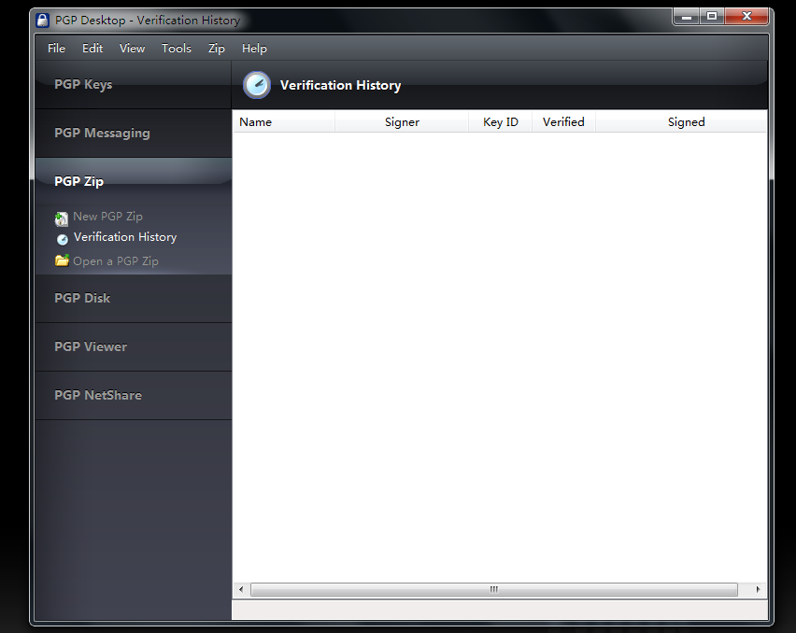

Slide 48
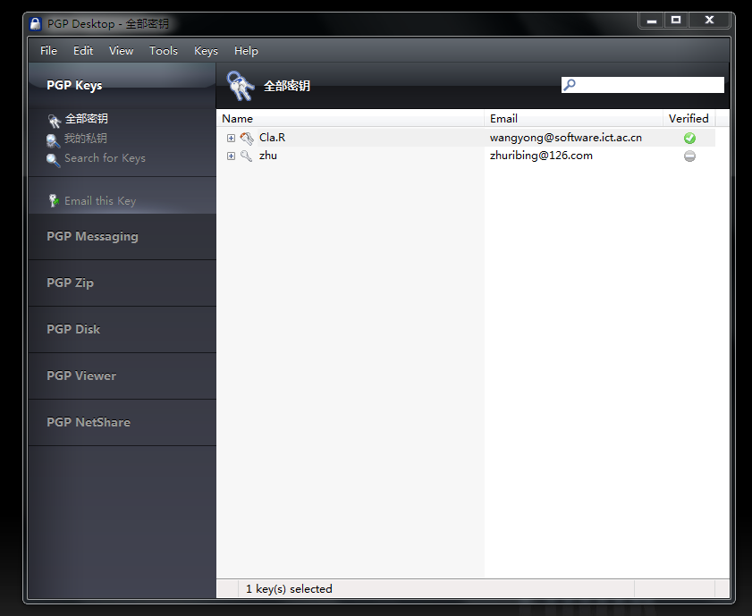

Slide 49
S/MIME
Secure/Multipurpose Internet Mail Extension
S/MIME will probably emerge as the industry standard.
PGP for personal e-mail security

Slide 50
Simple Mail Transfer Protocol (SMTP, RFC 822)
SMTP Limitations - Can not transmit, or has a problem with:
  executable files, or other binary files (jpeg image)
  “national language” characters (non-ASCII)
  messages over a certain size
  ASCII to EBCDIC translation problems
  lines longer than a certain length (72 to 254 characters)

Slide 51
Header fields in MIME
MIME-Version: Must be “1.0” -> RFC 2045, RFC 2046
Content-Type: More types being added by developers (application/word)
Content-Transfer-Encoding: How message has been encoded (radix-64)
Content-ID: Unique identifying character string.
Content Description: Needed when content is not readable text (e.g.,mpeg)

Slide 52
S/MIME Functions
Enveloped Data: Encrypted content and encrypted session keys for recipients.
Signed Data: Message Digest encrypted with private key of “signer.”
Clear-Signed Data: Signed but not encrypted.
Signed and Enveloped Data: Various orderings for encrypting and signing.

Slide 53
Algorithms Used
Message Digesting: SHA-1 and MDS
Digital Signatures: DSS
Secret-Key Encryption: Triple-DES, RC2/40 (exportable)
Public-Private Key Encryption: RSA with key sizes of 512 and 1024 bits, and Diffie-Hellman (for session keys).

Slide 54
User Agent Role
S/MIME uses Public-Key Certificates - X.509 version 3 signed by Certification Authority
Functions:
  Key Generation - Diffie-Hellman, DSS, and RSA key-pairs.
  Registration - Public keys must be registered with X.509 CA.
  Certificate Storage - Local (as in browser application) for different services.
  Signed and Enveloped Data - Various orderings for encrypting and signing.

Slide 55
User Agent Role
Example: Verisign (www.verisign.com)
  Class-1: Buyer’s email address confirmed by emailing vital info.
  Class-2: Postal address is confirmed as well, and data checked against directories.
  Class-3: Buyer must appear in person, or send notarized documents.

Slide 56
Recommended Web Sites
PGP home page: www.pgp.com
MIT distribution site for PGP
S/MIME Charter
S/MIME Central: RSA Inc.’s Web Site

