Slide 1

Network Security

Slide 2
Chapter 5
Study on the behavior-based spam filtering techniques

Slide 3
Outline
Survey on spam filtering
Physical path based spam filtering
Research on similarity of spams
Anomalous analysis of spam flows

Slide 4
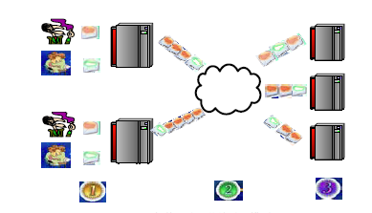
Survey on spam filtering
Procedures of email transfering

Slide 5
Roles in email system
USER
MUA-Mail User Agent, e.g. outlook
MTA-Mail Transfer Agent, e.g. sendmail, qmail, gmail
MDA-Mail Delivery Agent

Slide 6
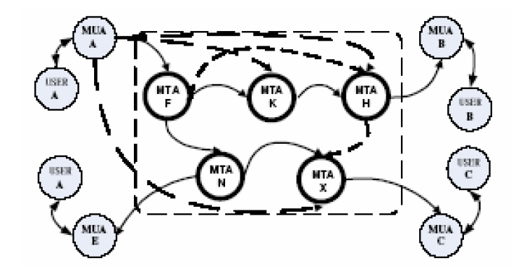
The e-mail system

Slide 7
SMTP protocol commands
Non-case sensitive
14 comands
Helo, mail, rcpt, data, rset, noop, quit

Slide 8
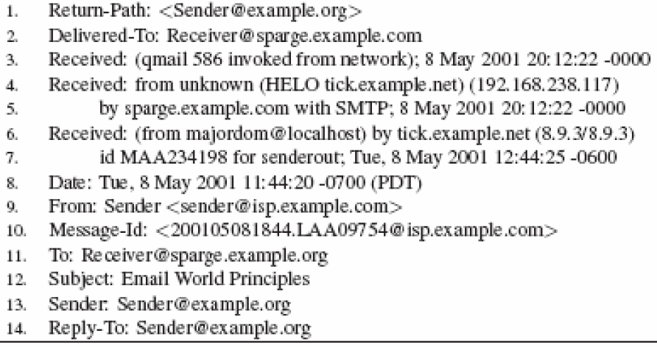
The header of a email

Slide 9
Definition (features) of spam
Sending to the user without permission
Sending out with automatic tools or using botnets, with large amount
With fabricated sender ID, address, title

Slide 10
Survey on spam filtering
Contents based filtering
  Decision tree based filtering
  Statistics based (machine learning based) filtering
    SVM, naïve bayes
  immunology based filtering
Protocol based filtering
  Patching, ID verify, delaying, pay for sending
  Protocol modification, SPF, domain keys, sender ID
Email behavior based filtering
  Email flow analysis
  Topology analysis
  Malicious email tracking

Slide 11
Comparison of spam filtering
 | Tech. duration | fitness | Recall rate | fp
Contents based filtering | short | Receiving phrase | high | high
Protocol based filtering | long | Recv. Sending. Trans. | medium | no
Email Flow analysis | long | Trans. Recv, snd. | low | high
Notes:
召回率(Recall)和精度(Precise)是广泛用于信息检索和统计学分类领域的两个度量值，用来评价结果的质量。其中召回率是是检索出的相关文档数和文档库中所有的相关文档数的比率

Slide 12
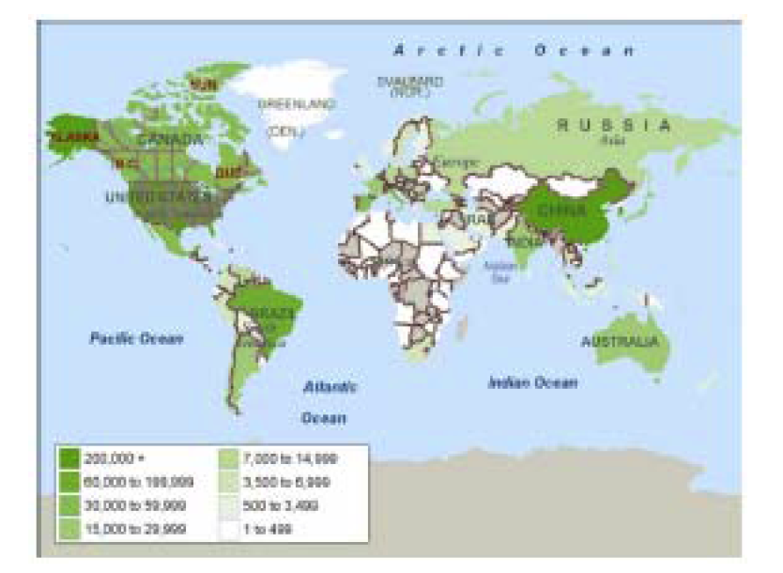
Physical path based spam filtering
Email sender locations globally

Slide 13
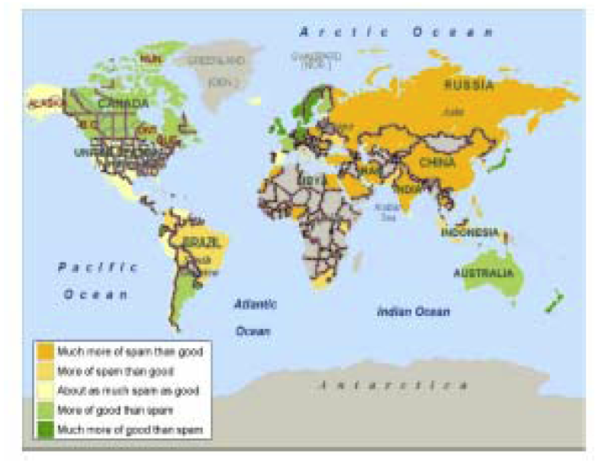
Spam sender locations

Slide 14
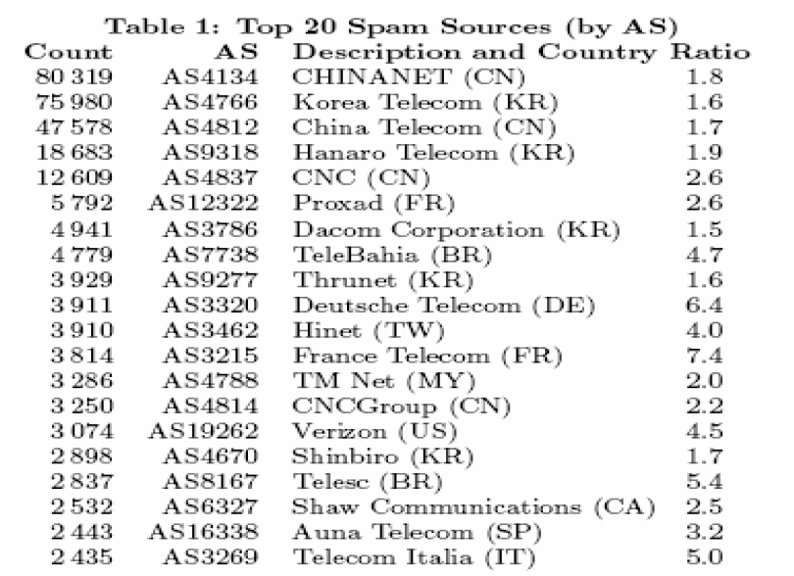

Slide 15
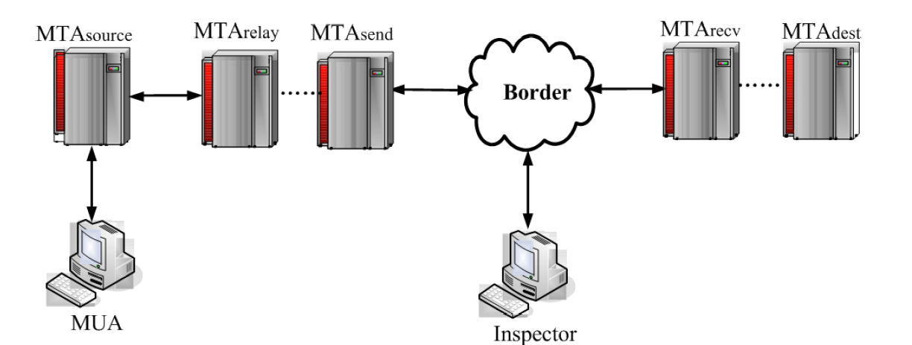
Algorithms on GEPA
Sending path of international email

Slide 16
Parameters for GEPA
parameters
M,R,P | Set of mail, path info. Routing info
Bs | Geographical relation set
Bd | Sender info. Deviated from email info
Br | Path deviated
Bc | Domain name deviated
Be | Node deviated

Slide 17
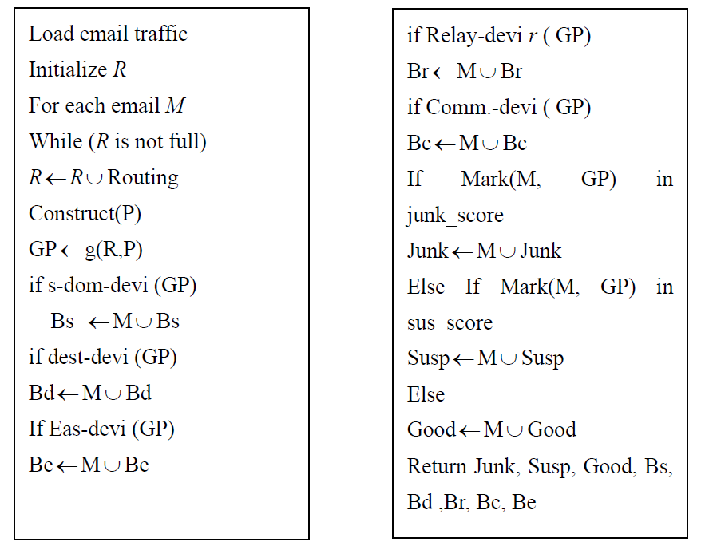

Slide 18
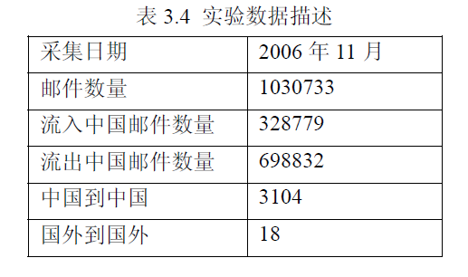
experiments
Data sets

Slide 19
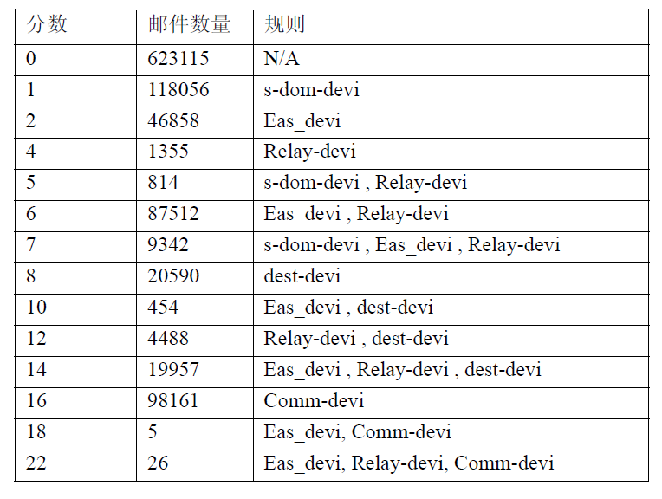
Results

Slide 20
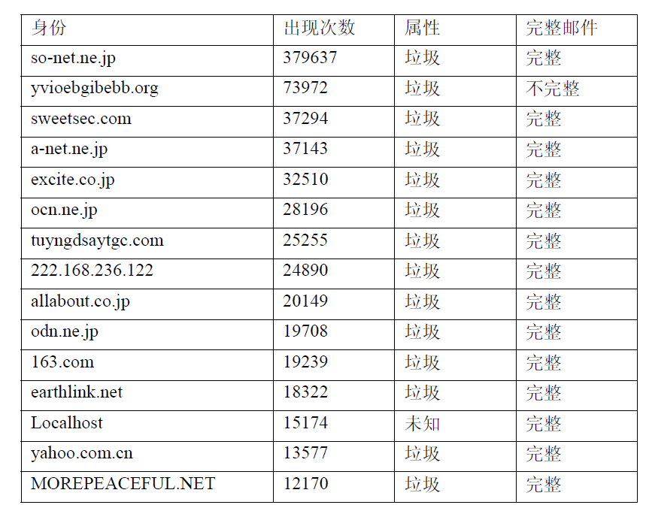
Top 15 domain name

Slide 21
Spam similarity analysis
BMTC alg.
Definitions
  Window, m long chart flow
  Finger-print
  Feature patern

Slide 22
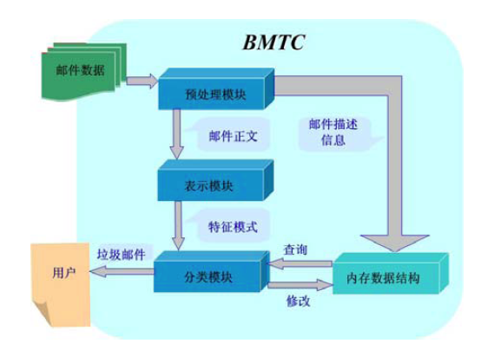
BTMC model

Slide 23
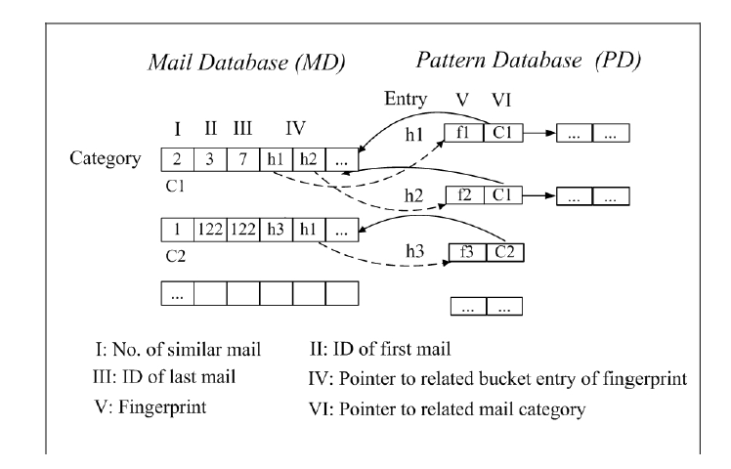
Data structure of RAM

Slide 24
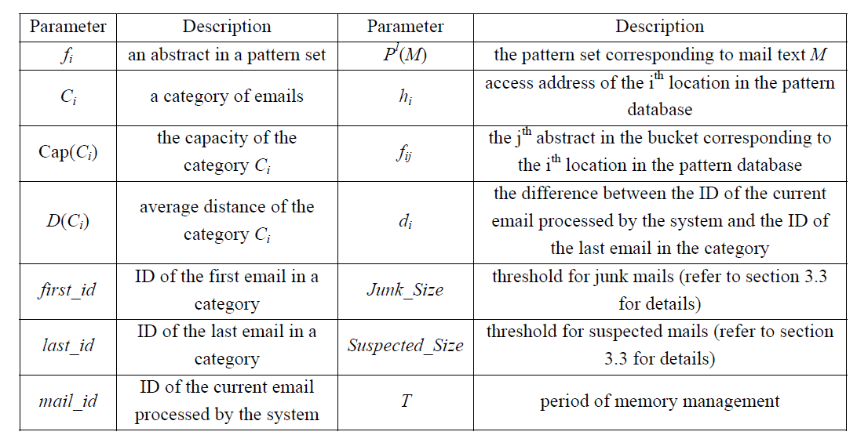
Parameters

Slide 25
BTMC steps
Initialize
Email flow re-organize
Feature pattern construct
Email classification
Spam filtering
Mem management
output

Slide 26
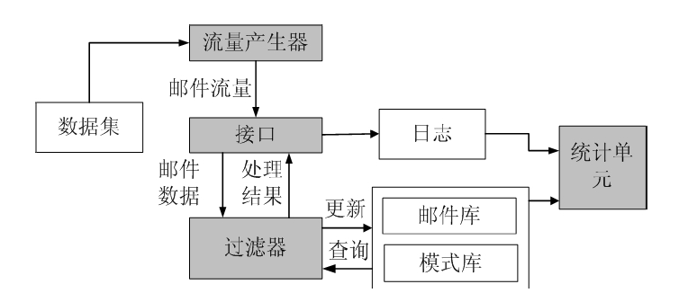
Simulating platform

Slide 27
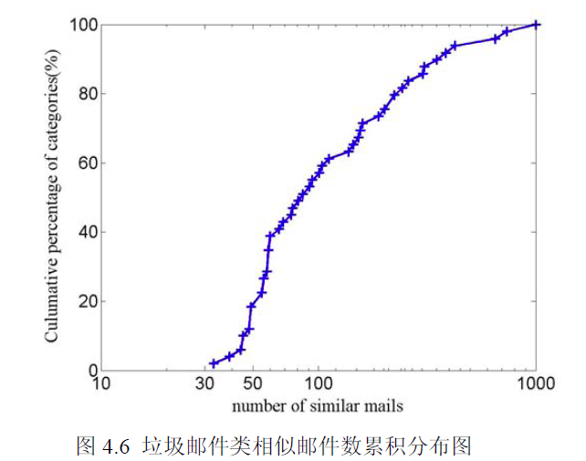
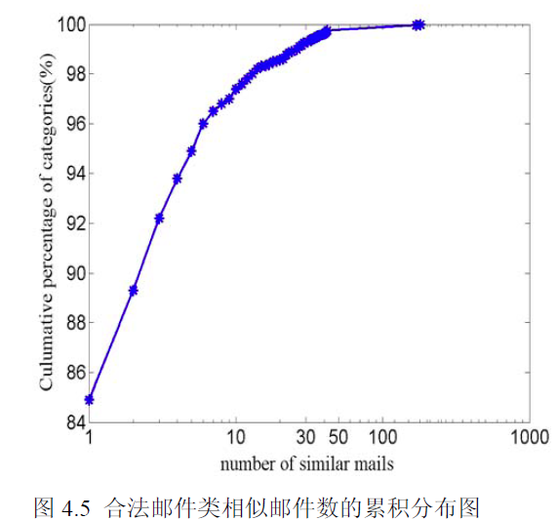
Results

Slide 28
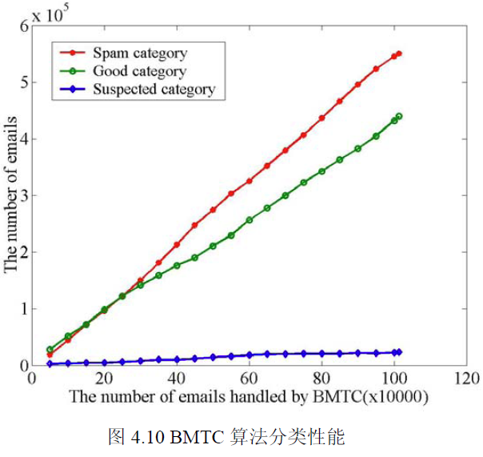
Results

Slide 29
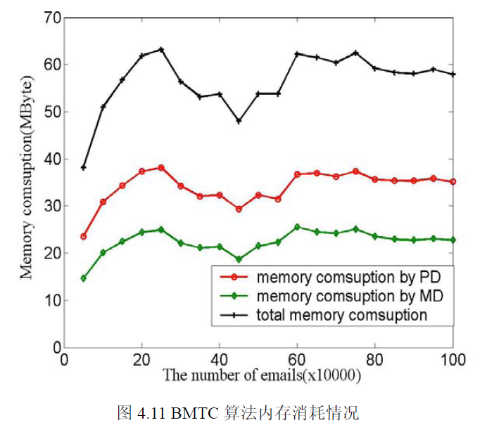
Results

Slide 30
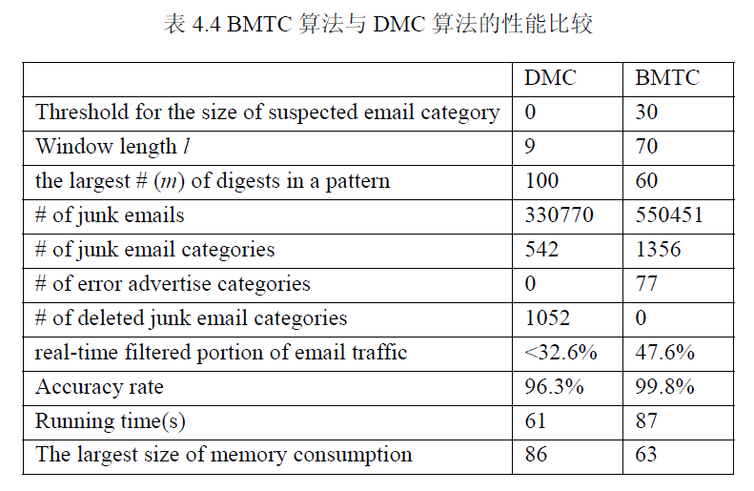
Comparison of BTMC &DMC

