Slide 1

Network Security

Slide 2
A course review
About the assigned homework
  201024010604 Solomon Haile
  Berhanu – DMC ?

Slide 3
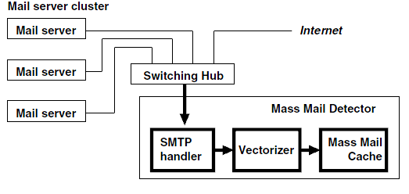
A discussion on DMC
Density-Based Spam Detector

Slide 4
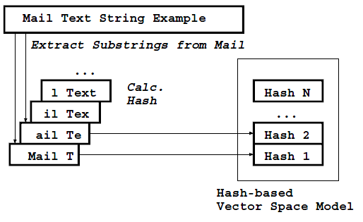
Hash cal.

Slide 5
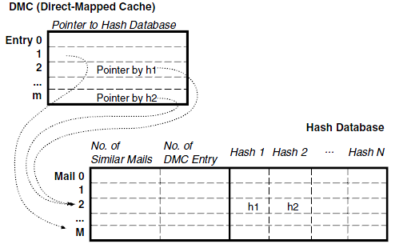
Data struc. of mass mail caching

Slide 6
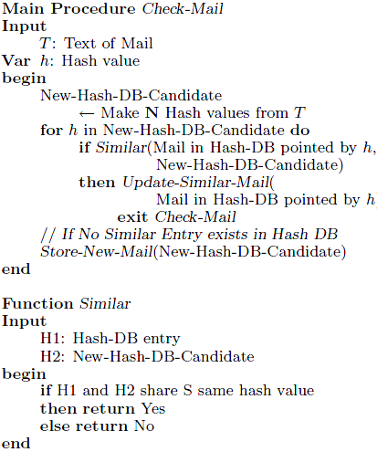
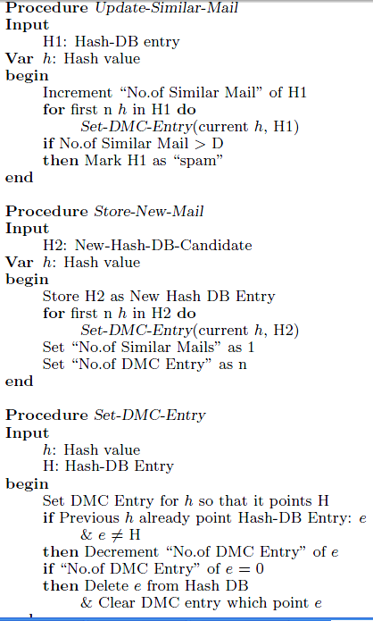

Slide 7
Conclusions
According to the study and the result it presented on the paper the DBSD system met its objective.
The method can handle and process over 13,000 e-mails per second (1.25 billion e-mails per day).
It exhibited 98% recall rate and 100% precision. Moreover, it protects the users privacy using hash based text representation and an unsupervised learning framework .

Slide 8
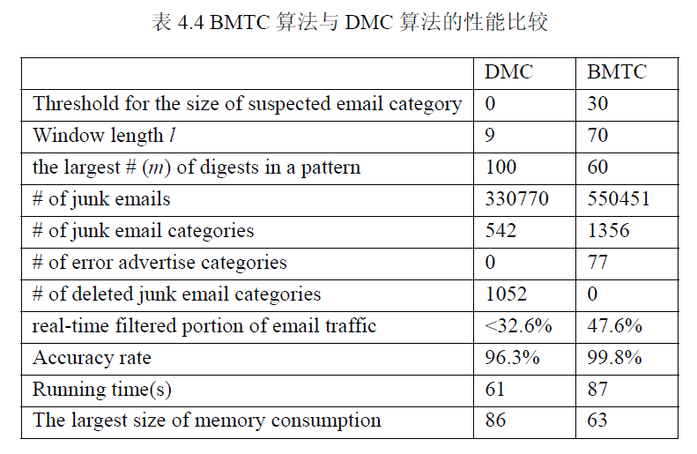
Comparison of BTMC &DMC

Slide 9
Chapter 6
IP Security

Slide 10
Outline
Internetworking and Internet Protocols (Appendix 6A)
IP Security Overview
IP Security Architecture
Authentication Header
Encapsulating Security Payload
Combinations of Security Associations
Key Management

Slide 11
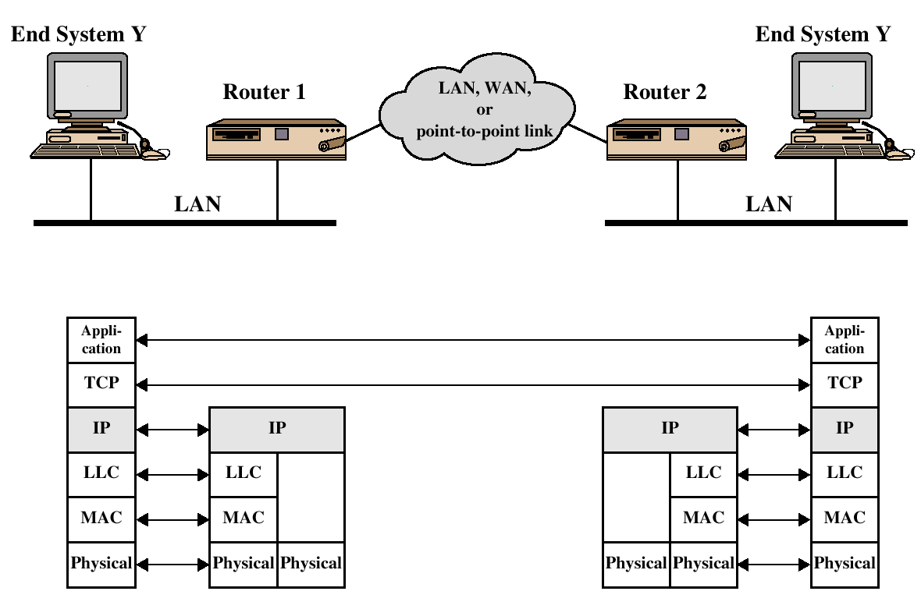
TCP/IP Example

Slide 12
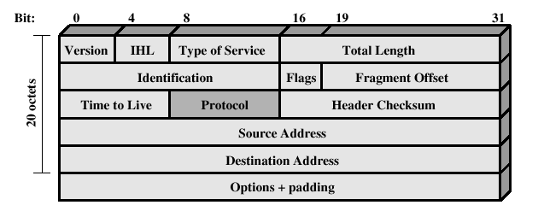
IPv4 Header

Slide 13
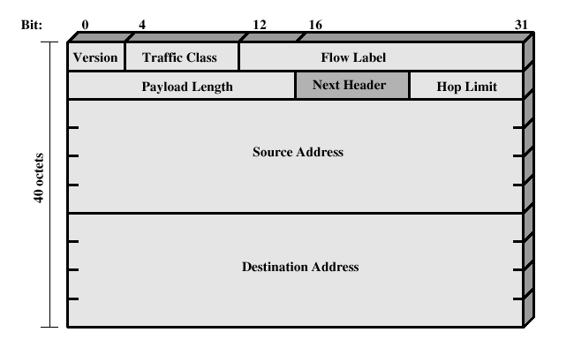
IPv6 Header

Slide 14
IP Security Overview
IPSec is not a single protocol. Instead, IPSec provides a set of security algorithms plus a general framework that allows a pair of communicating entities to use whichever algorithms provide security appropriate for the communication.

Slide 15
IP Security Overview
Applications of IPSec
  Secure branch office connectivity over the Internet
  Secure remote access over the Internet
  Establsihing extranet and intranet connectivity with partners
  Enhancing electronic commerce security

Slide 16
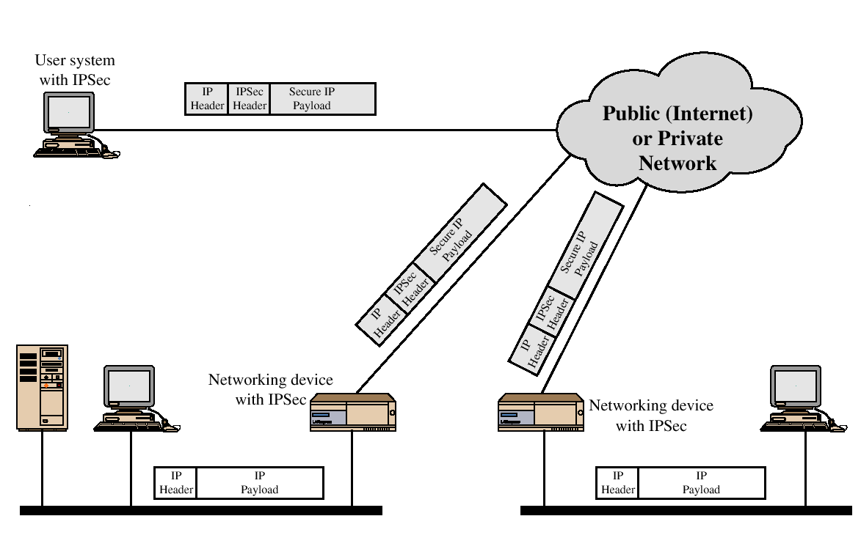
IP Security Scenario

Slide 17
IP Security Overview
Benefits of IPSec
  Transparent to applications (below transport layer (TCP, UDP)
  Provide security for individual users
IPSec can assure that:
  A router or neighbor advertisement comes from an authorized router
  A redirect message comes from the router to which the initial packet was sent
  A routing update is not forged

Slide 18
IP Security Architecture
IPSec documents:
  RFC 2401: An overview of security architecture
  RFC 2402: Description of a packet encryption extension to IPv4 and IPv6
  RFC 2406: Description of a packet emcryption extension to IPv4 and IPv6
  RFC 2408: Specification of key managament capabilities

Slide 19
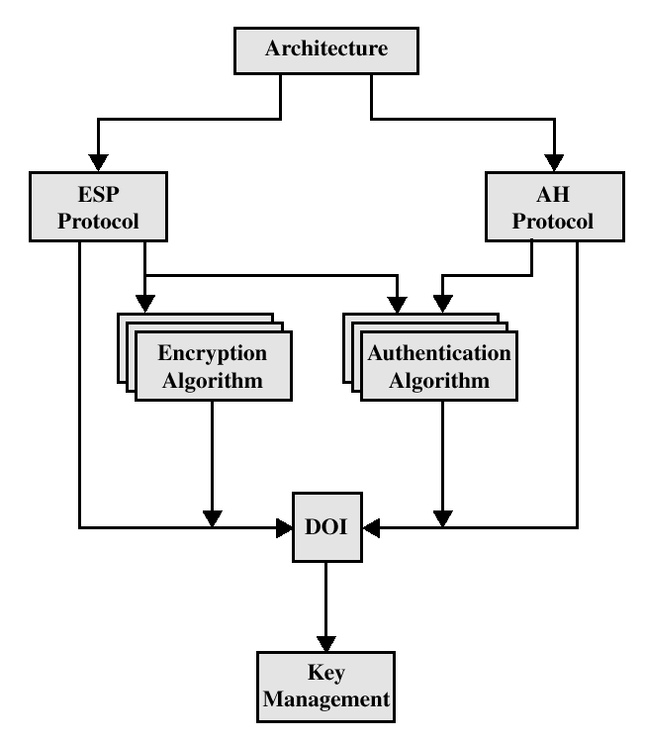
IPSec Document Overview

Slide 20
IPSec Services
Access Control
Connectionless integrity
Data origin authentication
Rejection of replayed packets
Confidentiality (encryption)
Limited traffic flow confidentiallity

Slide 21
Security Associations (SA)
A one way relationsship between a sender and a receiver.
Identified by three parameters:
  Security Parameter Index (SPI)
  IP Destination address
  Security Protocol Identifier

Slide 22
 | Transport Mode SA | Tunnel Mode SA
AH | Authenticates IP payload and selected portions of IP header and IPv6 extension headers | Authenticates entire inner IP packet plus selected portions of outer IP header
ESP | Encrypts IP payload and any IPv6 extesion header | Encrypts inner IP packet
ESP with authentication | Encrypts IP payload and any IPv6 extesion header. Authenticates IP payload but no IP header | Encrypts inner IP packet. Authenticates inner IP packet.

Slide 23
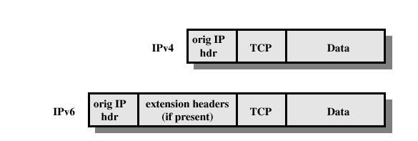
Before applying AH

Slide 24
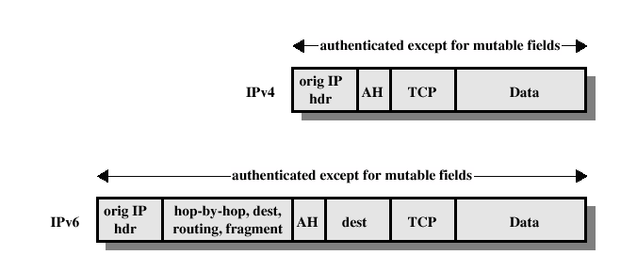
Transport Mode (AH Authentication)

Slide 25
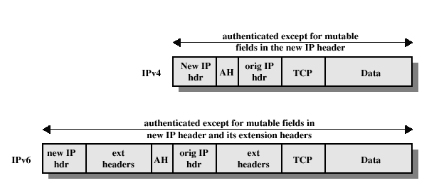
Tunnel Mode (AH Authentication)

Slide 26
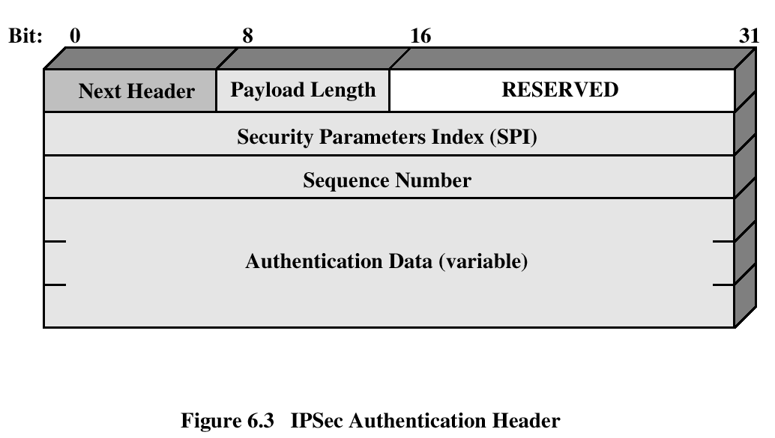
Authentication Header
Provides support for data integrity and authentication (MAC code) of IP packets.
Guards against replay attacks.

Slide 27
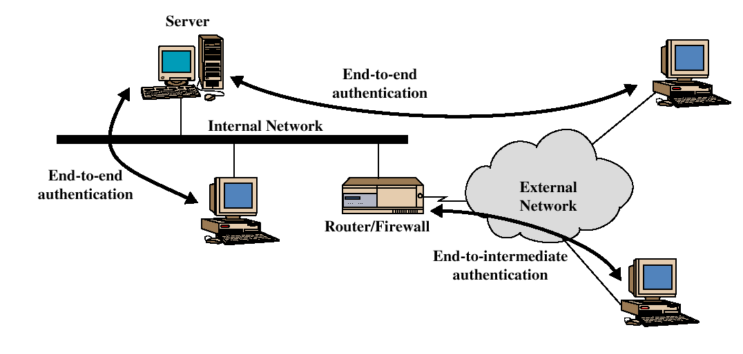
End-to-end versus End-to-Intermediate Authentication

Slide 28
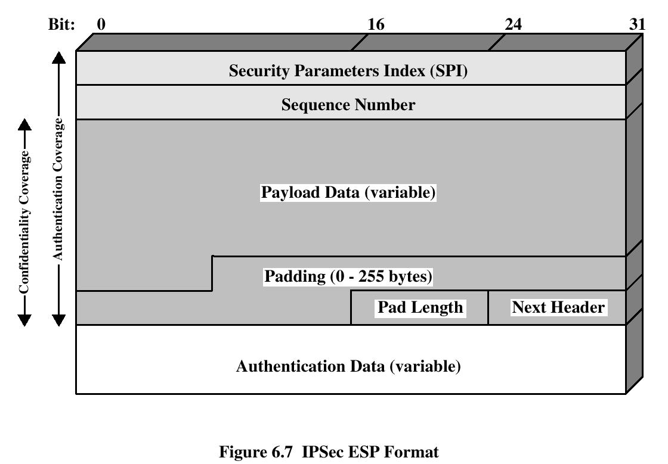
Encapsulating Security Payload
ESP provides confidentiality services

Slide 29
Encryption and Authentication Algorithms
Encryption:
  Three-key triple DES
  RC5
  IDEA
  Three-key triple IDEA
  CAST
  Blowfish
Authentication:
  HMAC-MD5-96
  HMAC-SHA-1-96

Slide 30
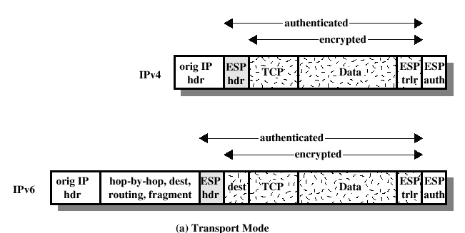
ESP Encryption and Authentication

Slide 31
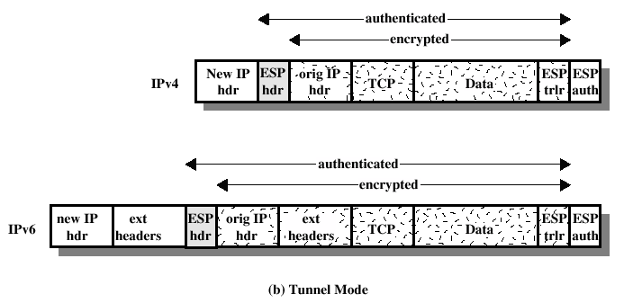
ESP Encryption and Authentication

Slide 32
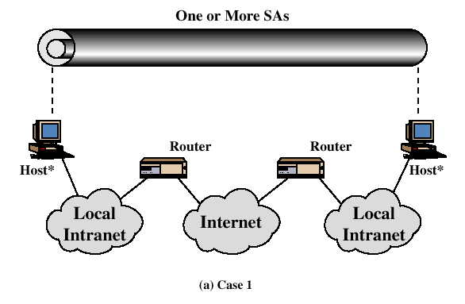
Combinations of Security Associations

Slide 33
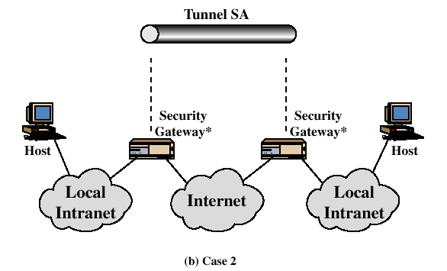
Combinations of Security Associations

Slide 34
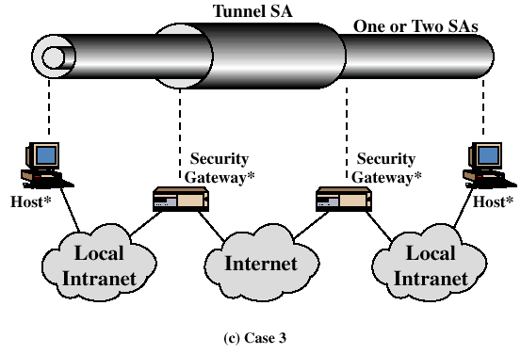
Combinations of Security Associations

Slide 35
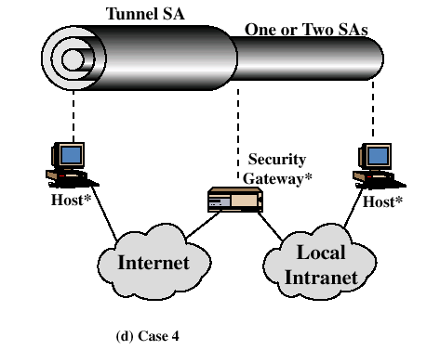
Combinations of Security Associations

Slide 36
Key Management
Two types:
  Manual
  Automated
    Oakley Key Determination Protocol
    Internet Security Association and Key Management Protocol (ISAKMP)

Slide 37
Oakley
Three authentication methods:
  Digital signatures
  Public-key encryption
  Symmetric-key encryption

Slide 38
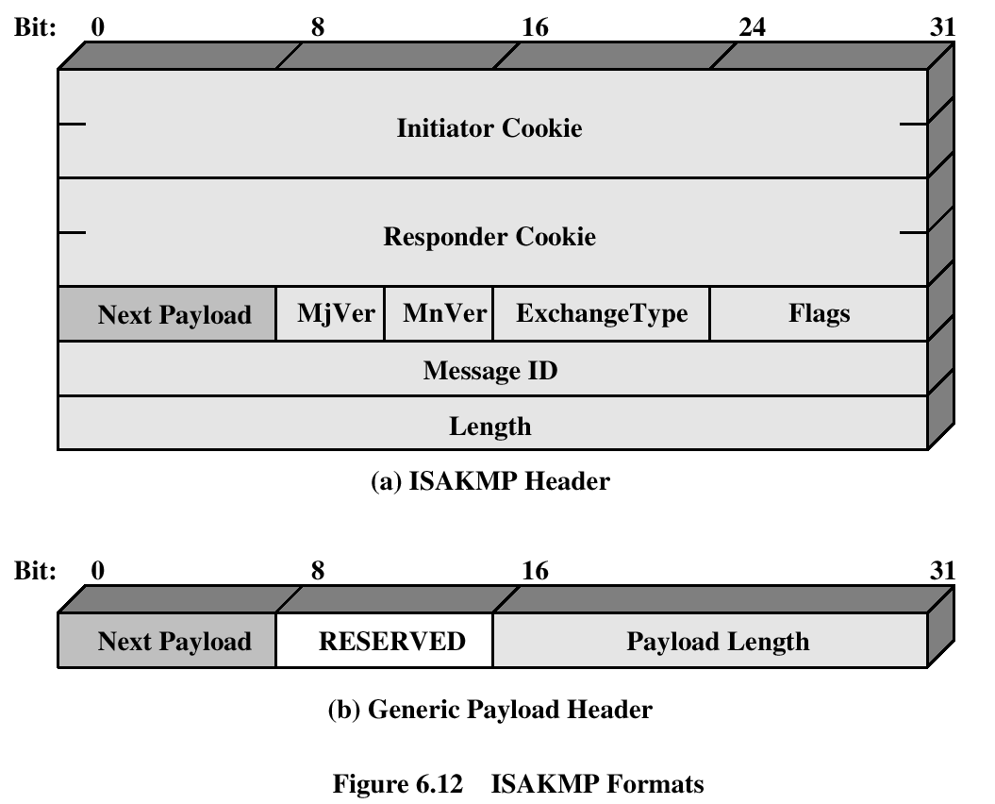
ISAKMP

Slide 39
Recommended Reading
Comer, D. Internetworking with TCP/IP, Volume I: Principles, Protocols and Architecture. Prentic Hall, 1995
Stevens, W. TCP/IP Illustrated, Volume 1: The Protocols. Addison-Wesley, 1994

