Slide 1

Network Security

Slide 2
Notice
Because of the Chinese Spring Festival, we have to add 4 more classes from next Fri. to finish the course.
The added class schedule is
  2:30pm-5:00pm, 7:30-9:05, 30/12/2011
  2:30pm-5:00pm, 7:30-9:05, 06/01/2011

Slide 3
Chapter 6
IP SECURITY

Slide 4
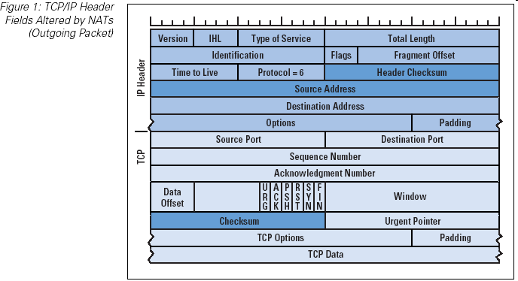
TCP/IP header

Slide 5
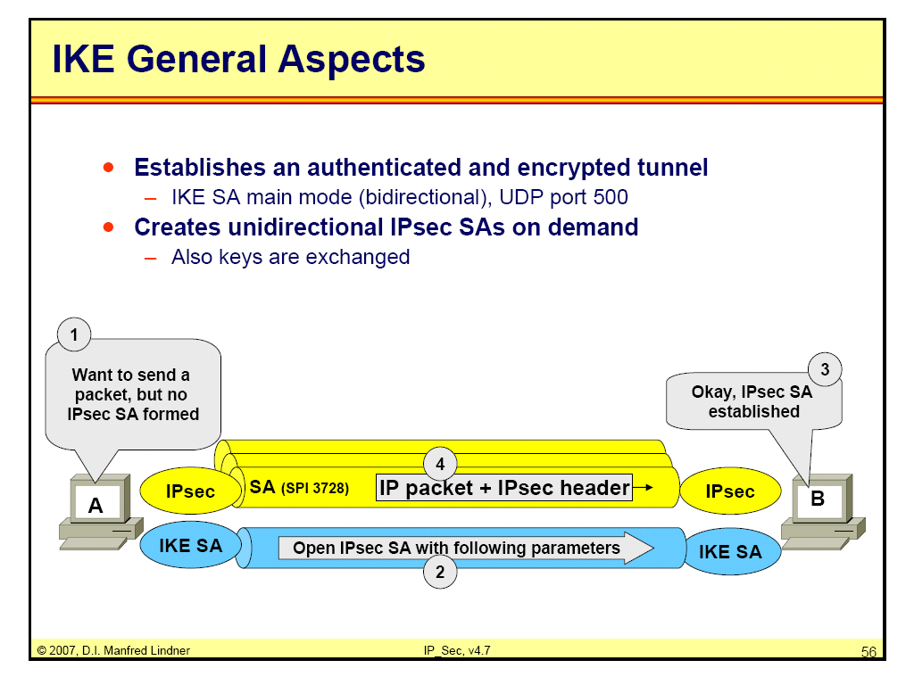
IP SEC

Slide 6
IKE/ISAKMP Phases
Phase 1:
  does authenticated DH, establishes session key & “ISAKMP SA”
  two possible modes: Main & Aggressive
  two keys are derived from the session key:
  SKEYID_e: to encrypt Phase 2 messages
  SKEYID_a: to authenticate Phase 2 messages
Phase 2:
  IPsec SA & session key established; messages encrypted & authenticated with Phase 1 keys
  Additional DH exchange is optional (for PFS)

Slide 7
Phase 1 Exchange
Two possible modes:
  Main mode: 6 rounds; provides identity hiding
  Aggressive mode: 3 rounds
Types of authentication:
  MAC with pre-shared secret key
  digital signatures
  public key encryption
    original: all public key encryption
    revised: public + secret key encryption
(Each type has its benefits; but is it worth the complexity?)

Slide 8
Phase 1 – Main Mode (generic)
crypto offered
crypto selected
gª mod p
Alice
g^{b} mod p
Bob
(K = g^{ab} mod p)
K{“Alice”, proof I’m Alice}
K{“Bob”, proof I’m Bob}

Slide 9
Phase 1 – Aggressive Mode (generic)
gª mod p, “Alice”, crypto offered
Alice
g^{b} mod p, crypto selected, proof I’m Bob
Bob
proof I’m Alice

Slide 10
Phase 1 Issues & Problems
Crypto parameters:
  Alice presents all algorithm combinations she can support
  (may be too many combinations)
Authentication:
  certain fields (why not all?!) of the protocol messages are hashed & signed/encrypted in the final rounds
  not included: Bob’s accepted parameters (problematic)
Cookies & Statelessness:
  Cookie protection: similar to Photuris cookies
  Bob is no longer stateless (problematic) since “crypto offered” must be remembered from message 1.

Slide 11
Phase 1 Issues (cont’d)
Session Keys:
  2 session keys (1 for enc. & 1 for auth.) are generated.
  Better to generate 4 keys; 2 for each direction. (may be subject to reflection attack)
Complexity:
  8 different protocols are defined (2 modes, each with 4 types of authentication)
  Unnecessarily flexible and complex

Slide 12
Phase 2 Exchange
Establishes IPsec SA & session key
Runs over the IKE SA established in Phase 1. (message are encrypted/authenticated with Phase 1 keys)
Key generation: based on Phase 1 key, SPI,
DH exchange: Optional (for PFS).
IPsec Traffic Selector: Established optionally. Specifies what traffic is acceptable. (e.g., What port numbers are allowed to use this SA.)

Slide 13
Phase 2
Phase1 SA
X, Y, CP, SPI_{A}, nonce_{A}, [traffic], [gª mod p]
Alice
Bob
X, Y, CPA, SPI_{B}, nonce_{B}, [traffic], [g^{b} mod p]
X, Y, ack
X: pair of cookies generated in Phase 1
Y: session identifier
traffic: IPsec traffic selector (optional)

Slide 14
A discussion about phases

Slide 15
How IPSec works: Phase 1
Internet Key Exchange (IKE) is used to setup IPSec.
IKE Phase 1:
  Establishes a secure, authenticated channel between the two computers
  Authenticates and protects the identities of the peers
  Negotiates what SA policy to use
  Performs an authenticated shared secret keys exchange
  Sets up a secure tunnel for phase 2
  Main Mode or Aggressive mode

Slide 16
How IPSec works: Phase 1
Main Mode IKE
  Negotiate algorithms & hashes.
  Generate shared secret keys using a Diffie-Hillman exchange.
  Verification of Identities.
Aggressive Mode IKE
  Squeezes all negotiation, key exchange, etc. into less packets.
  Advantage: Less network traffic & faster than main mode.
  Disadvantage: Information exchanged before a secure channel is created. Vulnerable to sniffing.

Slide 17


Establishing IPsec Security Associations Using IKE
Internet Key Exchange
Security Association
UDP Port 500
Party A
Party B
First establish IKE association and
protected session
Then create IPsec SAs within the
Protection of the IKE session.
IPsec SAs

Slide 18
How IPSec works: Phase 2
  An AH or ESP packet is then sent using the agreed upon “main” SA during the IKE phase 1.
  IKE Phase 2
    Negotiates IPSec SA parameters
    Establishes IPSec security associations for specific connections (like FTP, telnet, etc)
    Renegotiates IPSec SAs periodically
    Optionally performs an additional Diffie-Hellman exchange

Slide 19
How IPSec works: Communication
Once Phase 2 has established an SA for a particular connection, all traffic on that connection is communicated using the SA.
IKE Phase 1 exchange uses UDP Port 500.
AH uses IP protocol 51.
ESP uses IP protocol 50.

Slide 20
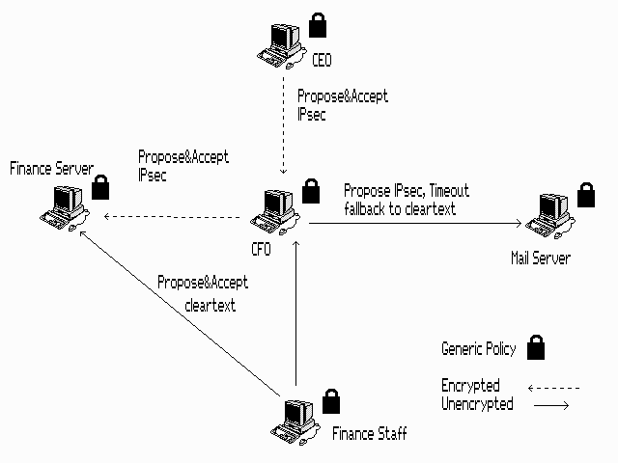
3-phase strategy in general terms that can be applied to many different enterprises
Phase One: A Simple, Generic Policy

Slide 21
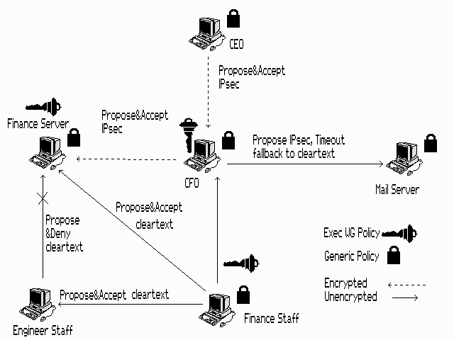
3-phase strategy in general terms that can be applied to many different enterprises
Phase Two: Custom Workgroups

Slide 22
Phase Three: Adding Trust Infrastructure
Replacing pre-shared keys with credentials enabling strong authentication.
In homogenous Windows environments, Kerberos tickets might be used.
In all other environments, including mixed Windows networks; a Public Key Infrastructure should be used.
IPSec partners can be authenticated with “raw” public keys, but most enterprises will prefer X.509 digital certificates verified by a trusted CA.
PKI combines strong access control with scalable administration through the use of CA hierarchies, cross-certification, and delegation.

Slide 23
IP SEC
Goal: to provide security for a packet at the network level.
It works in two modes:
Transport mode
Tunnel mode

Slide 24
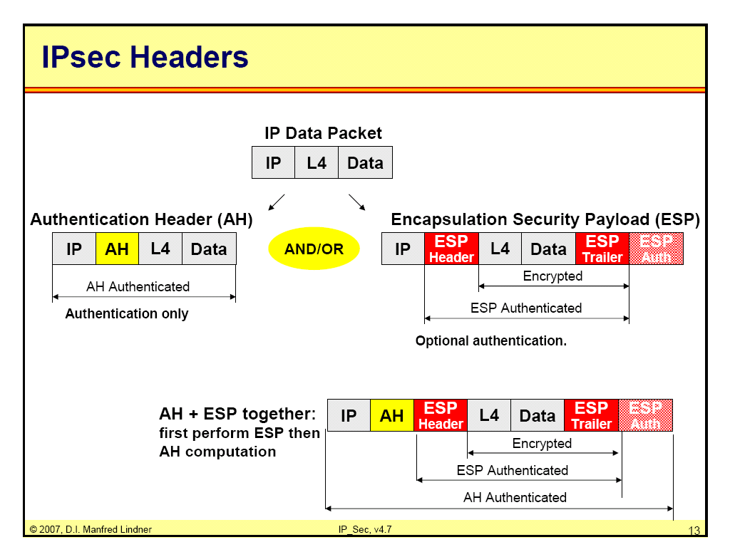
IP SEC

Slide 25
IP SEC
Transport mode:
IPSEC protects the payload delivered from the transport layer to the network layer.
IPSEC, in this mode, does not protect the IP Header.
Used for end-to-end (host-to-host) protection of data.

Slide 26
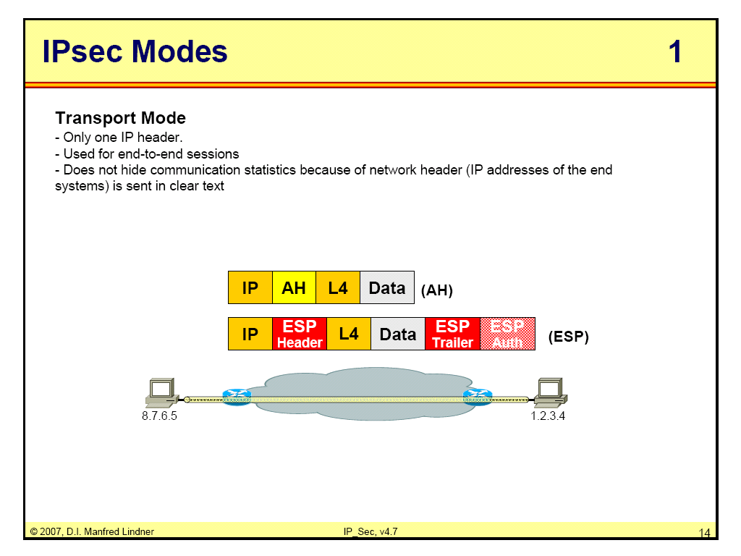
IP SEC

Slide 27
Transport mode
Site
Network
Site
Network
Secure Connection
Extra
Software
Required
Security
in Site
Network
Security
in Site
Network
Extra
Software
Required
Secure on
the WAN e.g. Internet

Slide 28
IP SEC
Tunnel Mode:
IPSEC in this mode protects the entire data
- takes an IP packet including IP Header
- applies IP security methods to the entire packet
- adds a new IP header
Tunnel mode used between
- host to router
- router to host
- router

Slide 29
Tunnel mode
IPsec
Server
IPsec
Server
Site
Network
Site
Network
Tunneled
Connection
No
Security
in Site
Network
No
Security
in Site
Network
No
Extra
Software
No
Extra
Software
Secure on
the WAN e.g. Internet

Slide 30
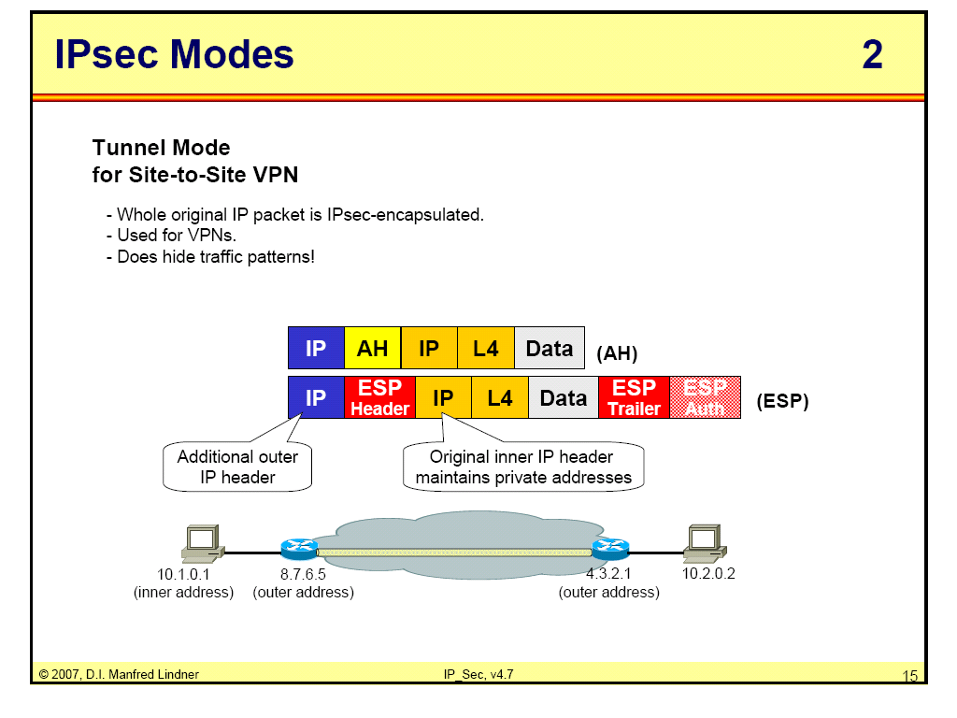
IP SEC

Slide 31
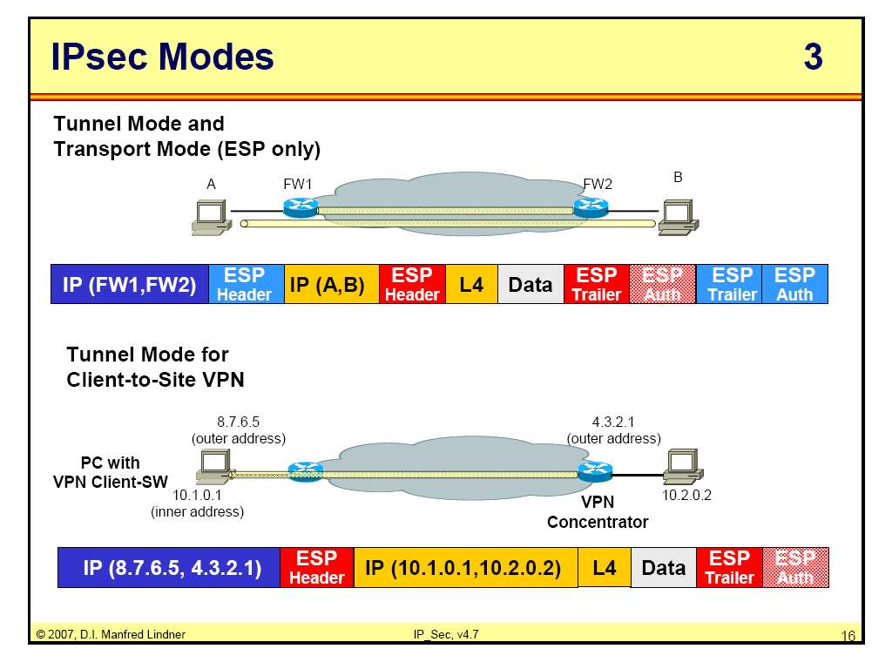
IP SEC

Slide 32
IP SEC
Two security protocols:
Authentication header (AH)
Encapsulating Security Payload (ESP)

Slide 33
IP SEC
Authentication Header:
Designed to
- authenticate the source host
- provide integrity of the payload in IP packet
It uses a hash function and a symmetric key to generate a message digest
The digest is inserted in the authentication header

Slide 34
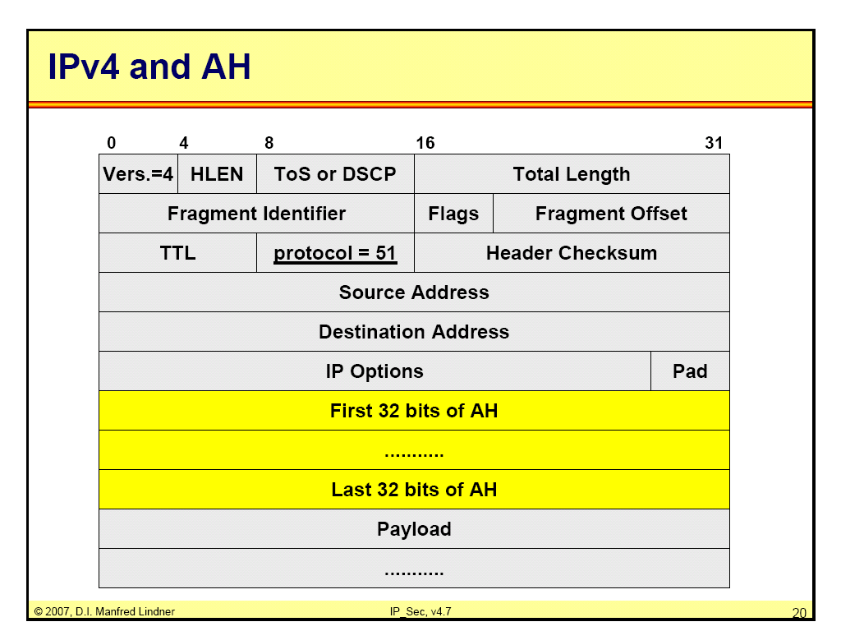
IP SEC

Slide 35
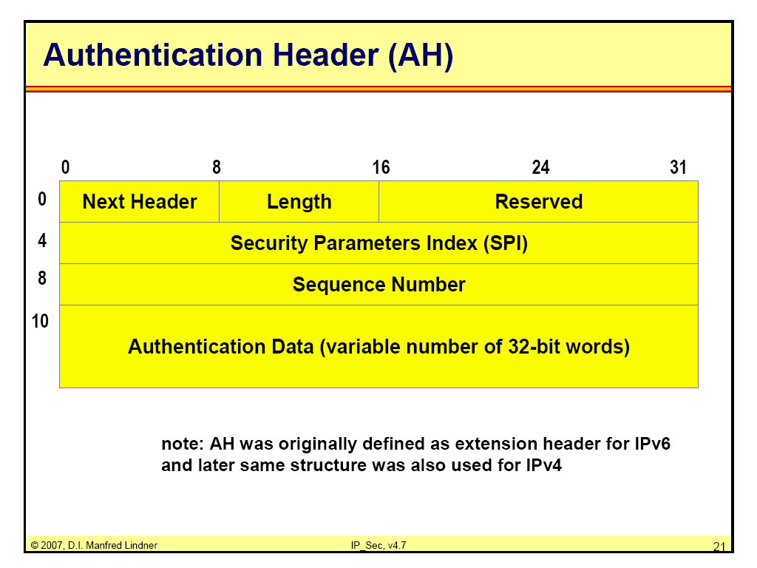
IP SEC

Slide 36
IP SEC
STEPS:
An authentication header is added authentication data field set to zero.
Padding done to make the total length even for a particular hashing algorithm.
Hashing is based on the total packet, including only those fields of the IP Header which does not change.
Authentication data is inserted in the AH
IP header is added after the protocol is changed to 51

Slide 37
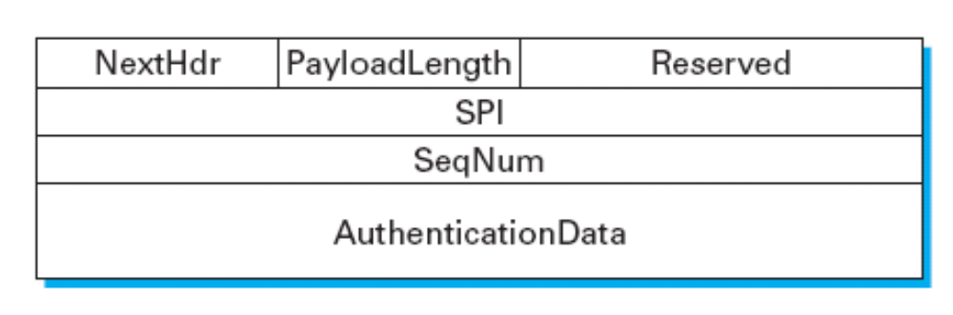
IP SEC
Description of the header fields:
Next header:
It defines the type of payload carried by the IP datagram
Equivalent to protocol field in IP header before encryption
New header IP protocol value is set to 51 to show that it carries authentication header

Slide 38
IP SEC
Description of the header fields:
Payload length:
Name misleading.
It defines the length of the authentication header

Slide 39
IP SEC
Description of the header fields:
Security Parameter Index (SPI):
It is a virtual circuit identifier
Value is same for all packets sent during a connection called security association.

Slide 40
IP SEC
Header fields …
Sequence Number:
32 bit.
Provides ordering information for a sequence of datagrams.
Sequence number is not repeated even if a packet is retransmitted.
It does not wrap around, a new connection is established.

Slide 41
IP SEC
Header fields …
Authentication data:
Result of applying a hash function to the entire IP datagram except for the fields changed during transit (TTL etc.)

Slide 42
IP SEC
Encapsulating Security Payload:
AH does not provide privacy, only source authentication and data integrity.
ESP adds a header and trailer.
The value of the protocol field is 50.
Authentication data is added at the end of the packet to make the calculation easier.

Slide 43
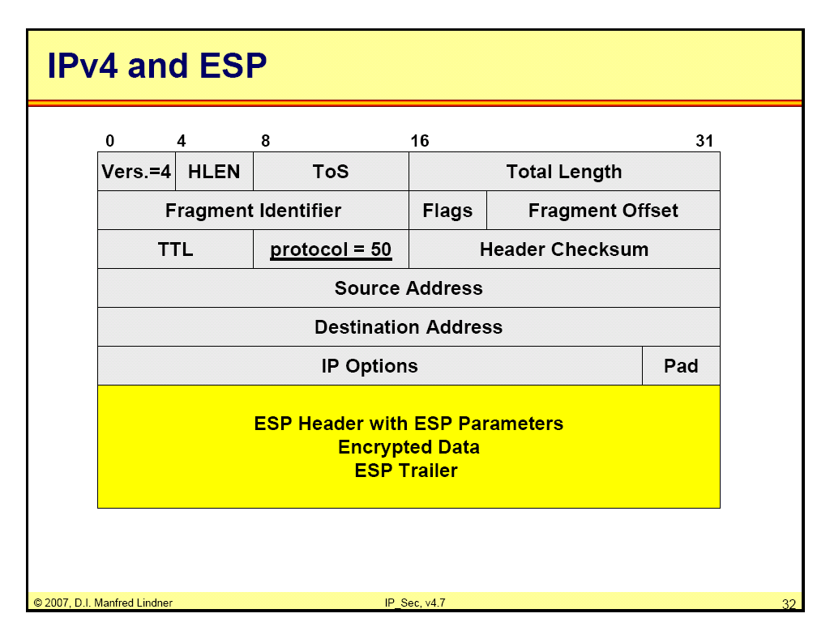
IP SEC

Slide 44
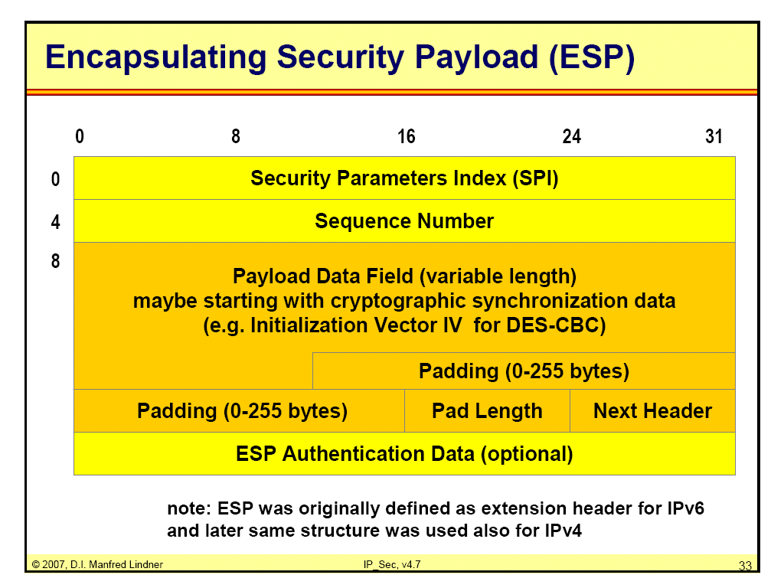
IP SEC

Slide 45
IP SEC
STEPS:
ESP trailer is added to the payload.
Payload and the trailer are encrypted.
ESP header is added
ESP header + payload + trailer => authentication data
Authentication data is added to the end of the ESP trailer.
IP header is added after the protocol value is changed to 50.

Slide 46
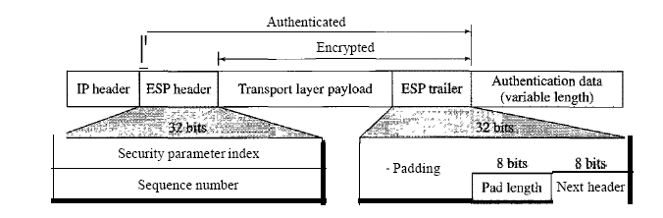
IP SEC

Slide 47
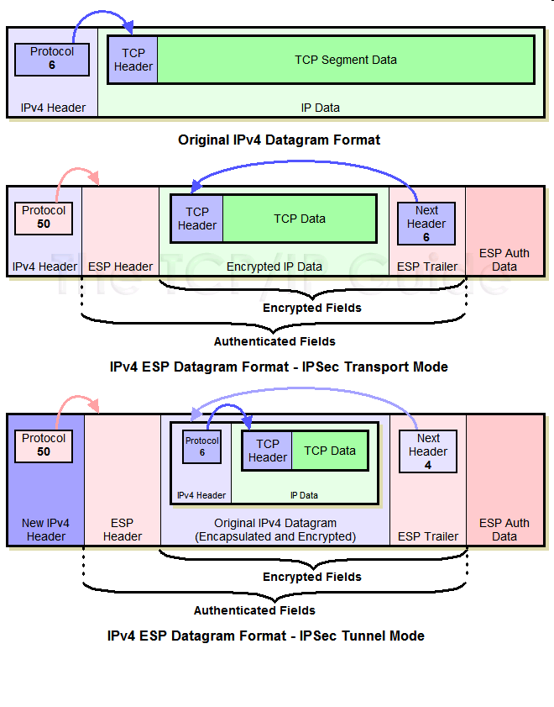
IP SEC

Slide 48
IP SEC
Access Control:
IPSEC provides access control indirectly by using a SADB (Security Association Database)
Message Authentication:
By creating the digest.
Entity authentication:
SA and key hashed digest.
Confidentiality: ESP encryption.

Slide 49
IP SEC
Replay attack protection:
By using the sequence number
and a sliding window at the receiver.

Slide 50
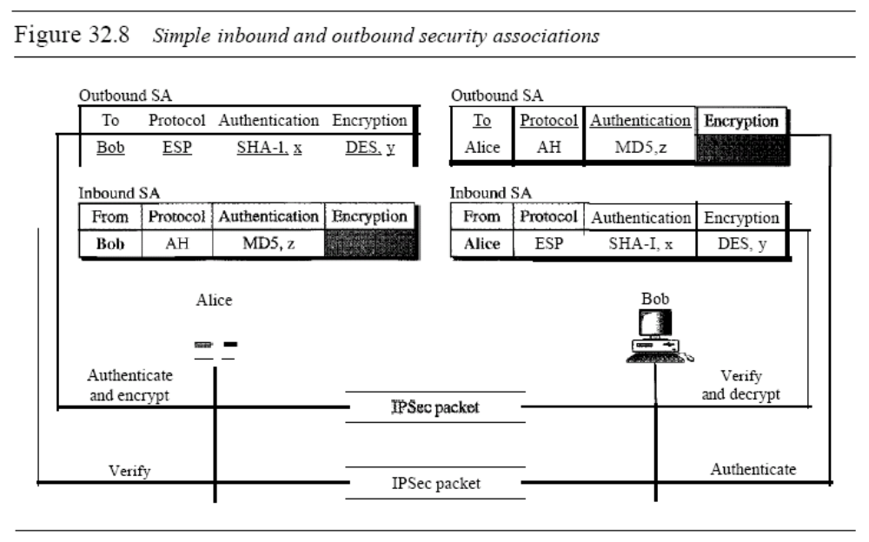
IP SEC

Slide 51
IP SEC
Alice to Bob
She uses ESP protocol of IPSEC.
Authentication is done by SHA-1 with x.
Encryption by DES with y.
Bob to Alice
AH protocol of IPSEC.
Authentication by MD 5 with key z.

Slide 52
IP SEC
Using SA IPSEC changes a connectionless protocol IP to connection oriented.

Slide 53
IP SEC
Alice to Bob
She uses ESP protocol of IPSEC.
Authentication is done by SHA-1 with x.
Encryption by DES with y.
Bob to Alice
AH protocol of IPSEC.
Authentication by MD 5 with key z.

Slide 54
IP SEC
These fields are broken into pieces like this.
The first is that some encryption algorithms require the data to be encrypted to have a certain block size, and so padding must appear after the data and not before it. That's why padding appears in the ESP Trailer.
The second is that the ESP Authentication Data appears separately because it is used to authenticate the rest of the encrypted datagram after encryption. This means it cannot appear in the ESP Header or ESP Trailer.

Slide 55
IP SEC
IPSEC consists of two parts:
Two protocols implement the security services
  Authentication Header (AH)
  Encapsulating Security Payload (ESP)
Support for key management – the protocol known as ISAKMP – Internet Security Association Key Management Protocol

Slide 56
IP SEC
AH provides:
Access control
Connectionless message integrity
Authentication
Anti-replay protection

Slide 57
IP SEC
Security Association (SA):
This binds the above two ideas together.
SA is a simplex (one-way) “connection” that is protected by one or more of the available security services.
An SA might be established to ensure the integrity of every packet sent from one security gateway to another; these packets are in effect tunneled between the security gateways.

Slide 58
IP SEC
Securing a bidirectional communication between a pair of hosts—corresponding to a TCP connection, for example—requires two security associations, one in each direction.
When created, an SA is assigned a security parameters index (SPI) by the receiving machine. A combination of this SPI and the destination IP addresses uniquely identifies a security association.

Slide 59
IP SEC
Both AH and ESP put the SPI in their header. The receiving host then uses this information to determine which SA an incoming packet belongs to, and hence, what algorithms to apply to the packet.

Slide 60
IP SEC
ISAKMP’s role is to define procedures and packet formats to establish, negotiate, modify, and delete security associations.
It defines packet formats for exchanging key generation and authentication data.

Slide 61
IP SEC
AH:
provides connectionless integrity and data origin authentication for IP datagrams.
provides protection against replays.

Slide 62
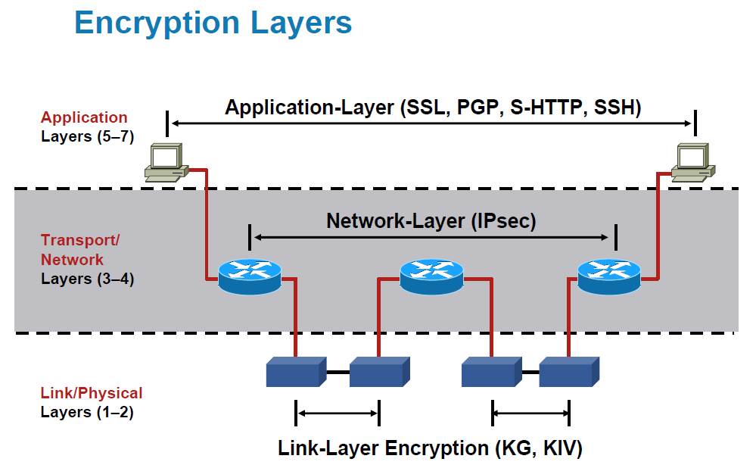
Configuration of IPSEC

Slide 63
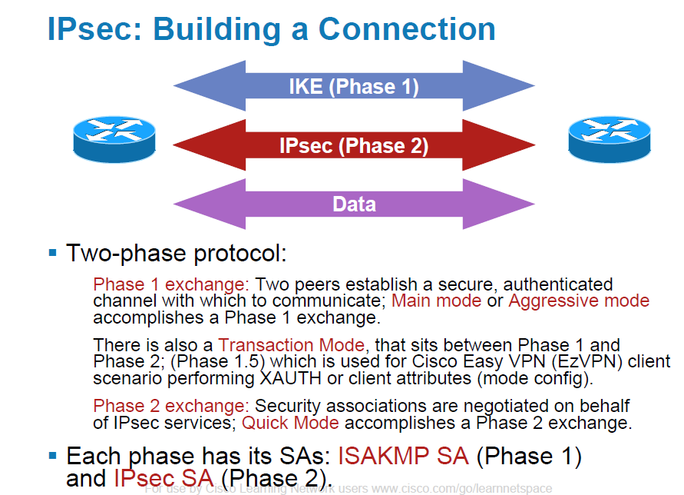

Slide 64
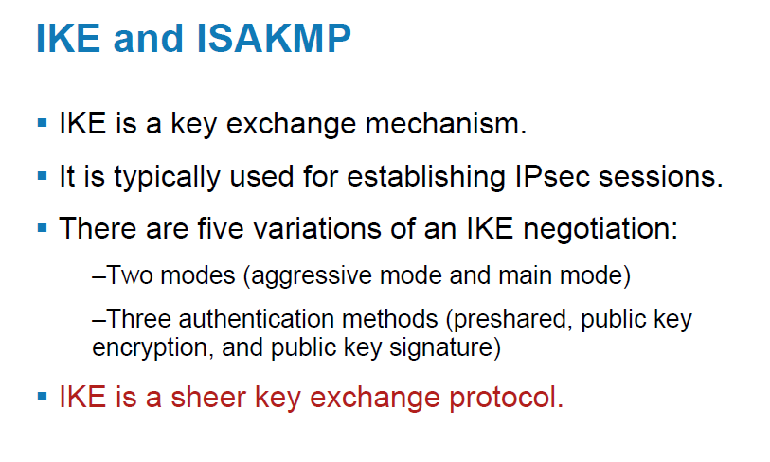

Slide 65
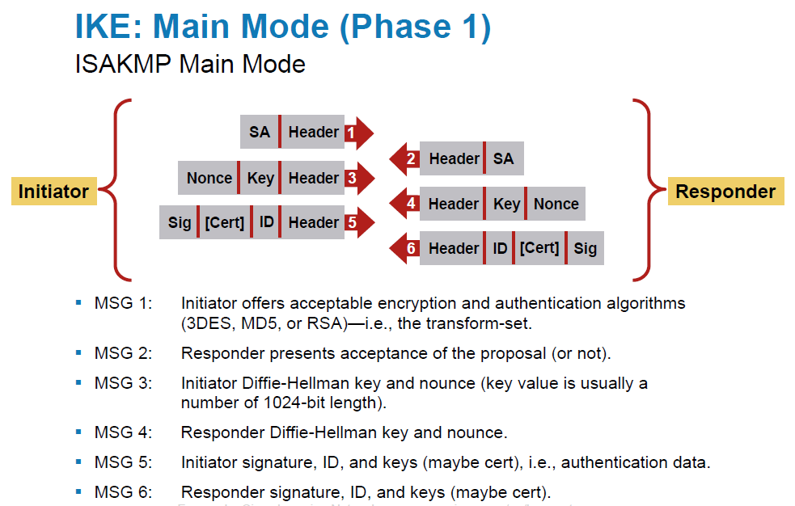

Slide 66
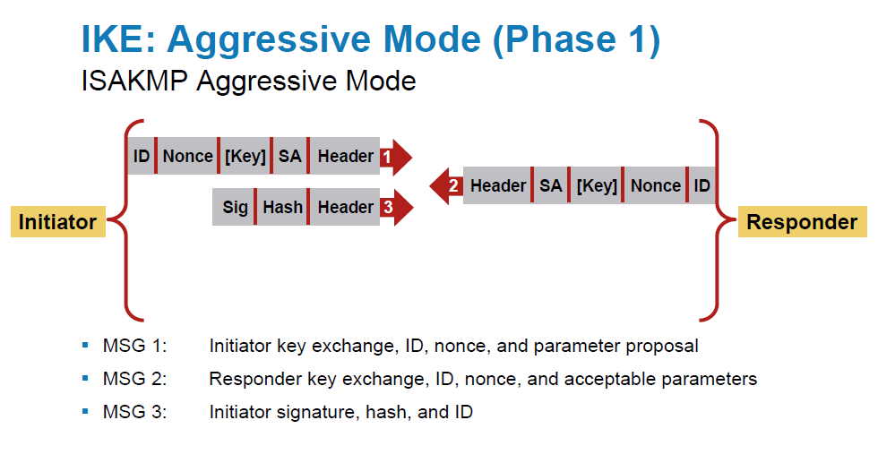

Slide 67
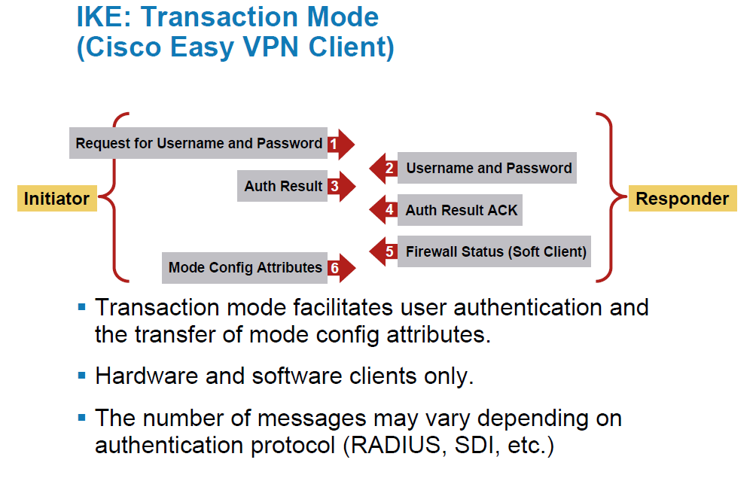

Slide 68
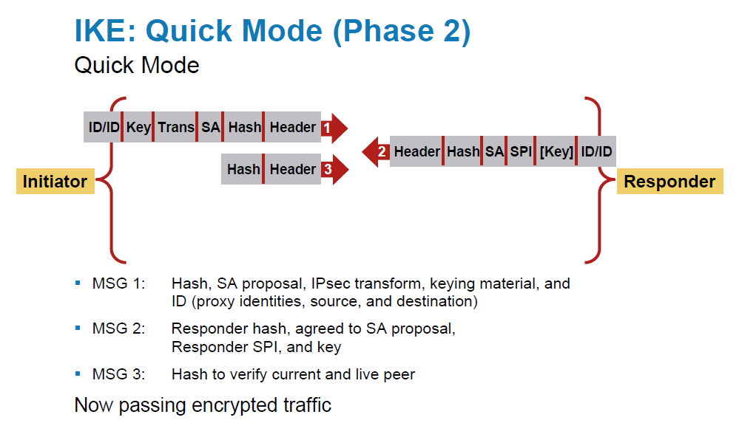

Slide 69
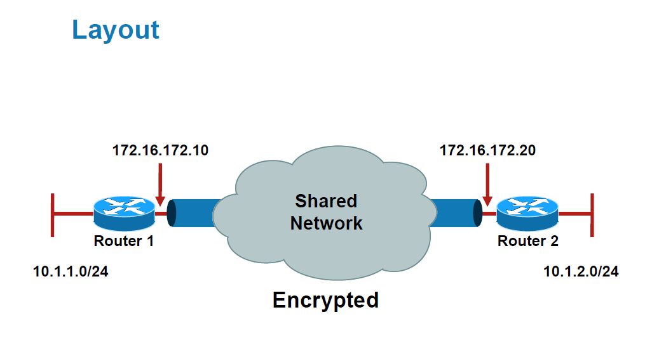
Configuration

Slide 70
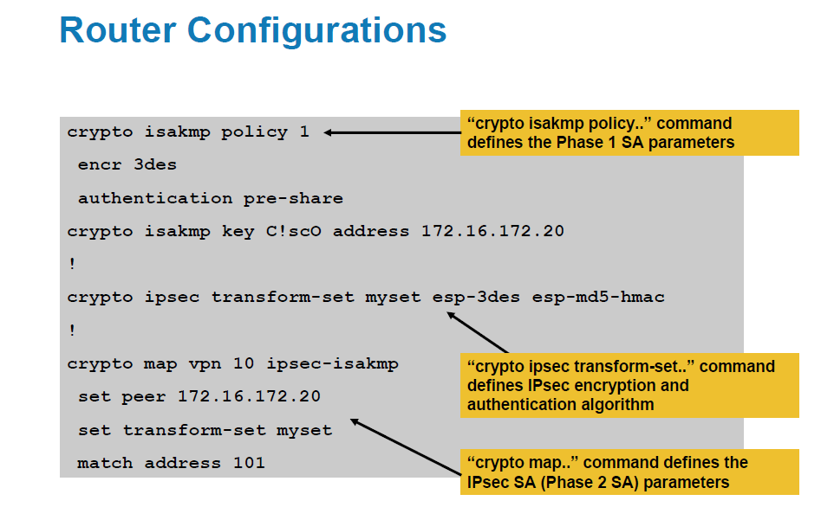

Slide 71
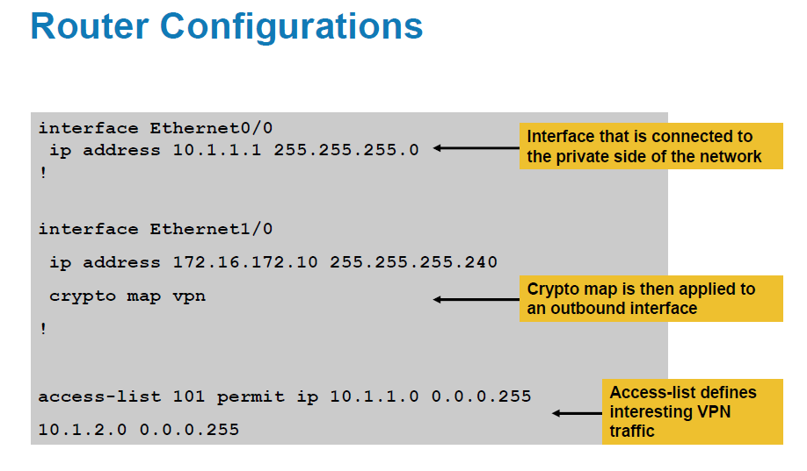

Slide 72
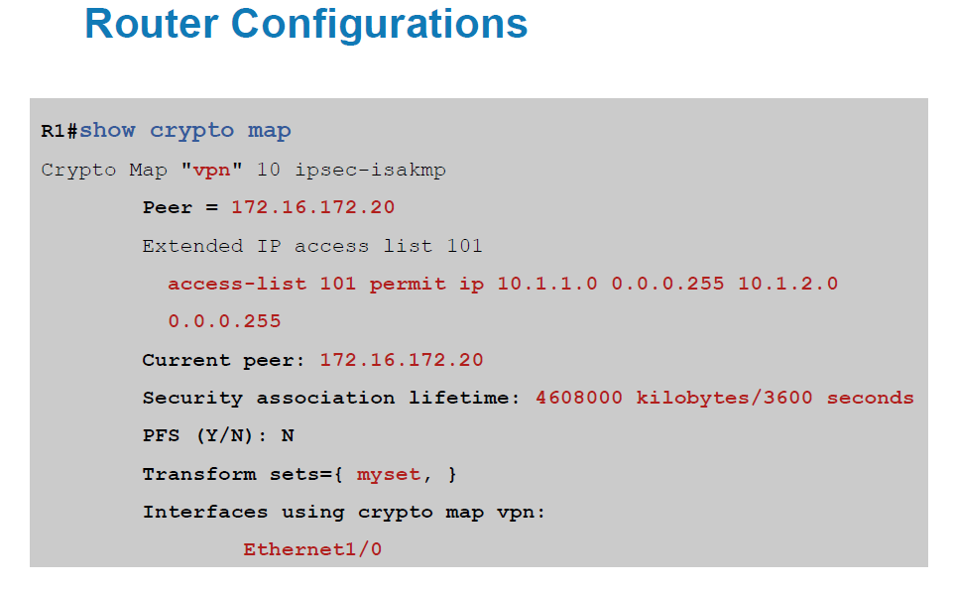

Slide 73
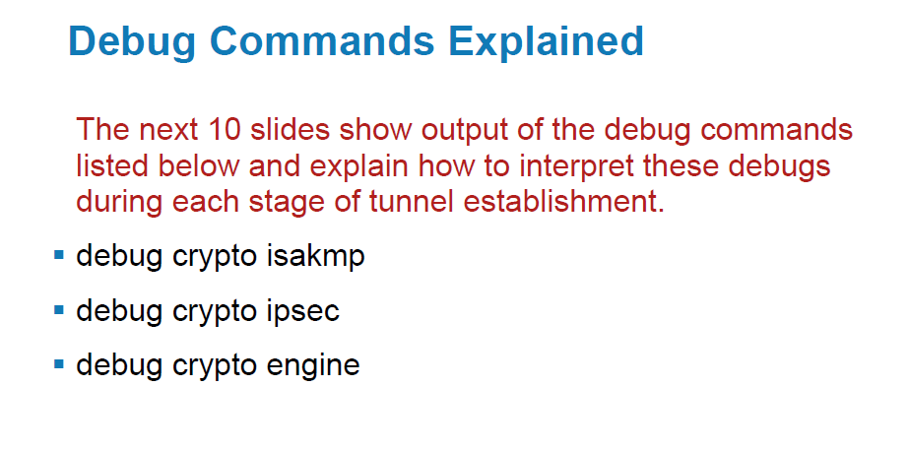

Slide 74
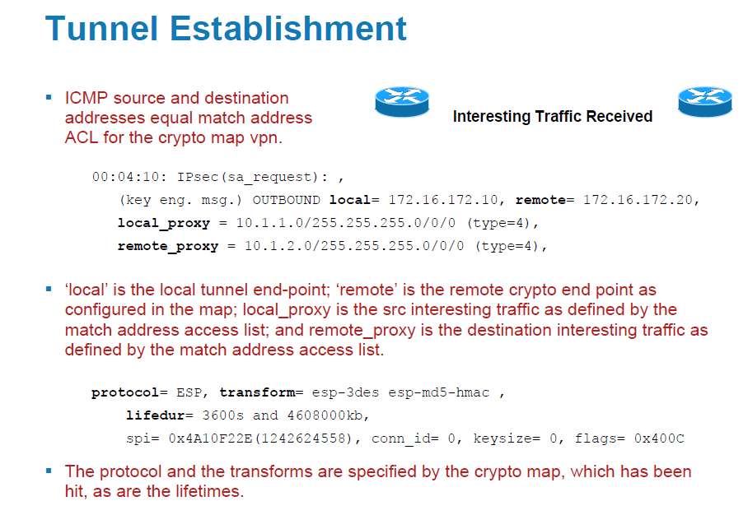

Slide 75
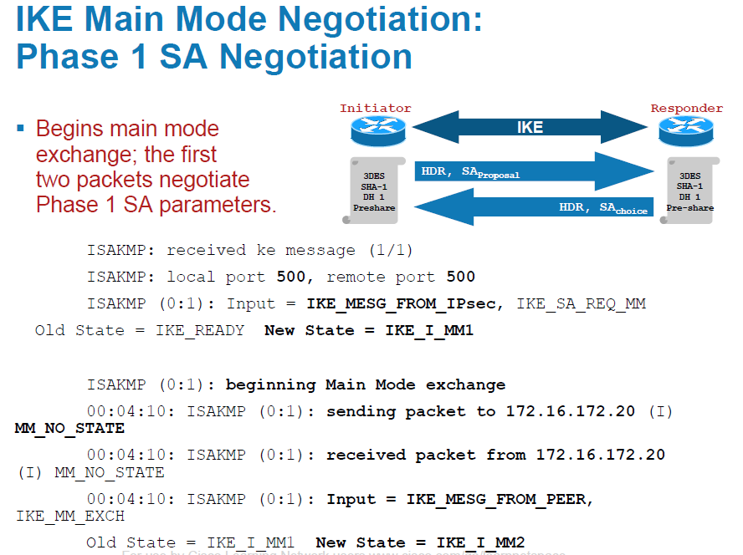

Slide 76
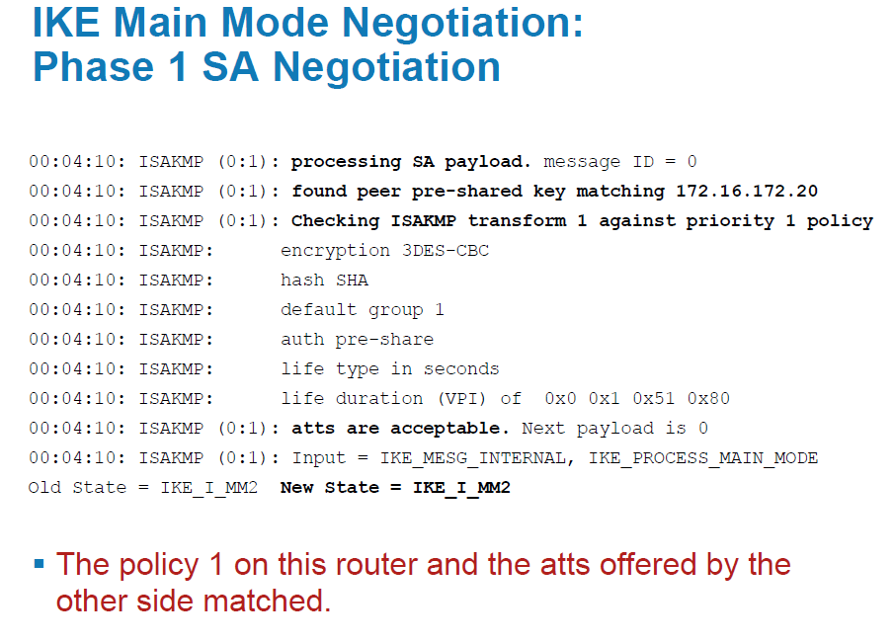

Slide 77
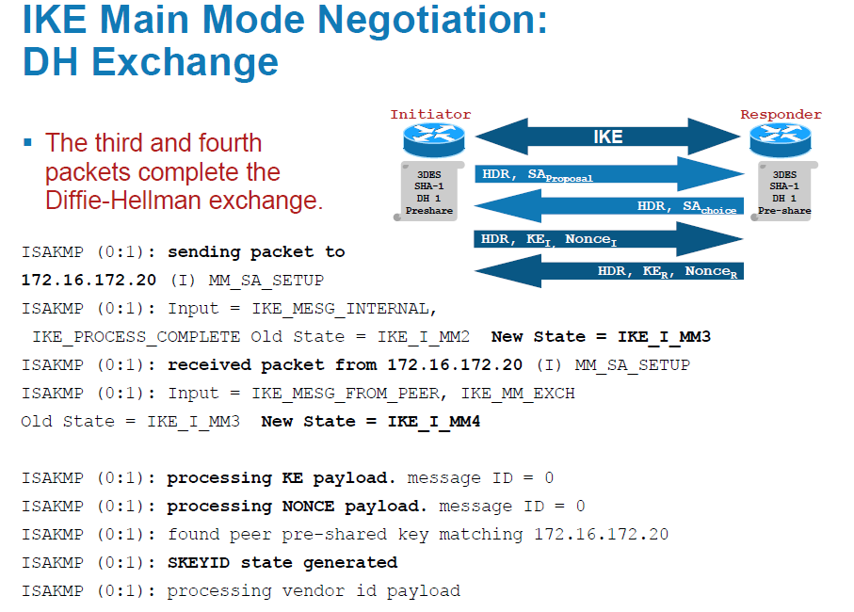

Slide 78
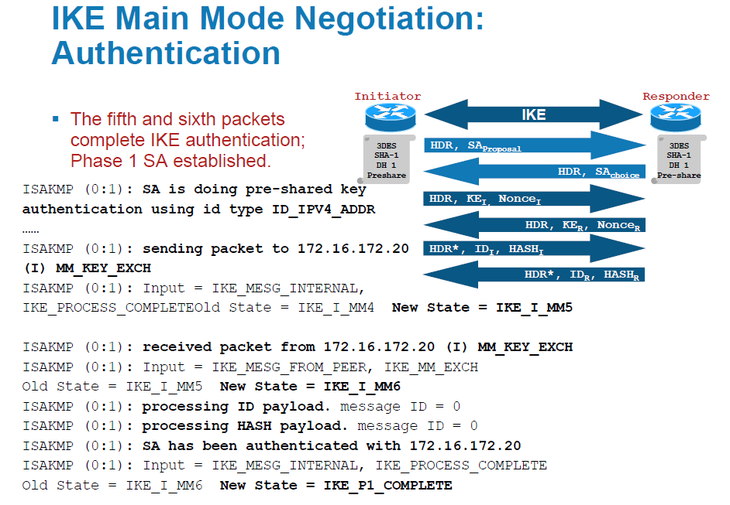

Slide 79
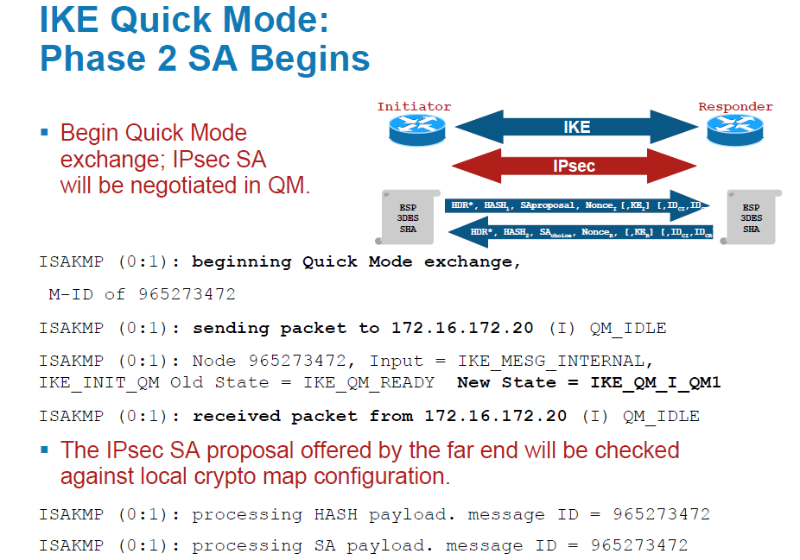

Slide 80
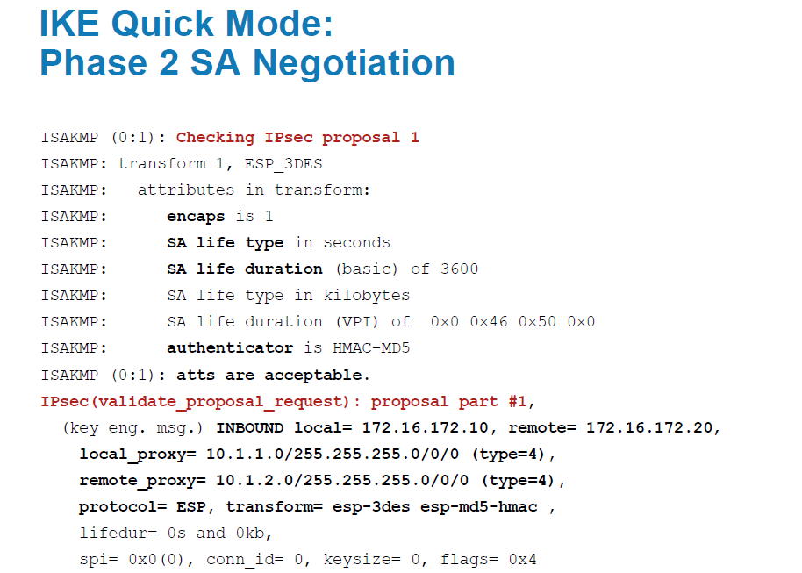

Slide 81
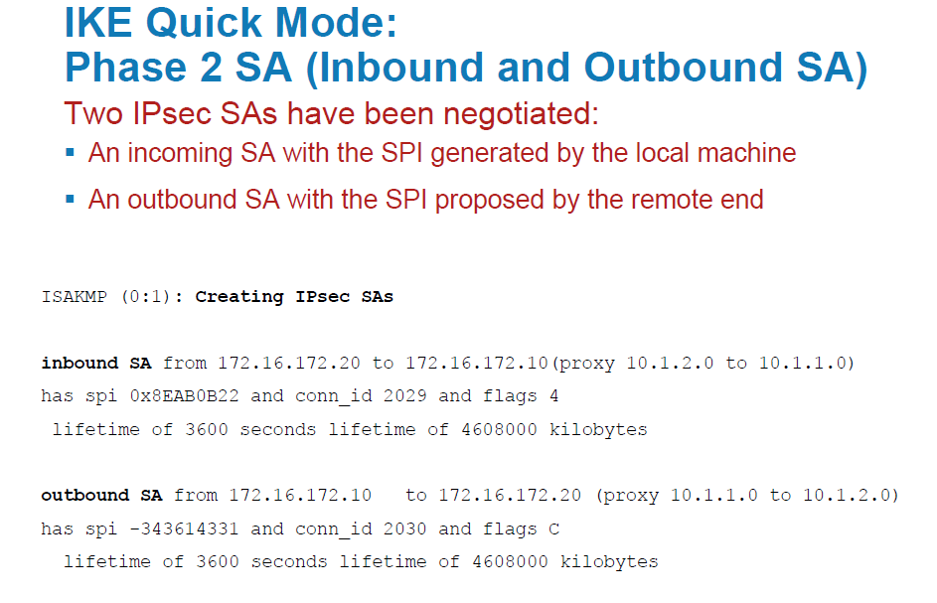

Slide 82
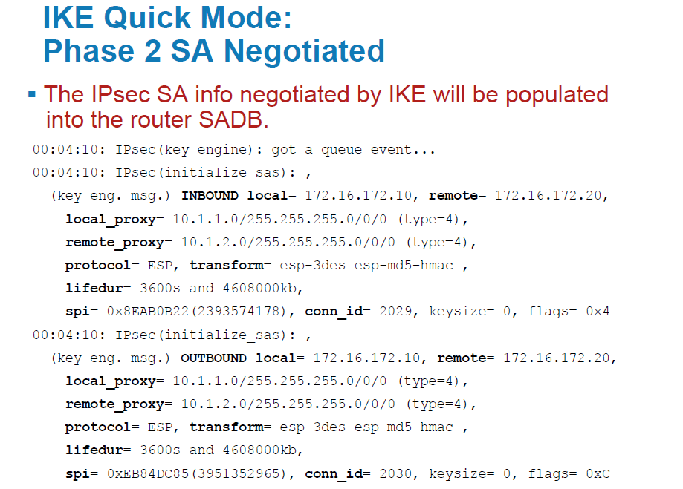

Slide 83
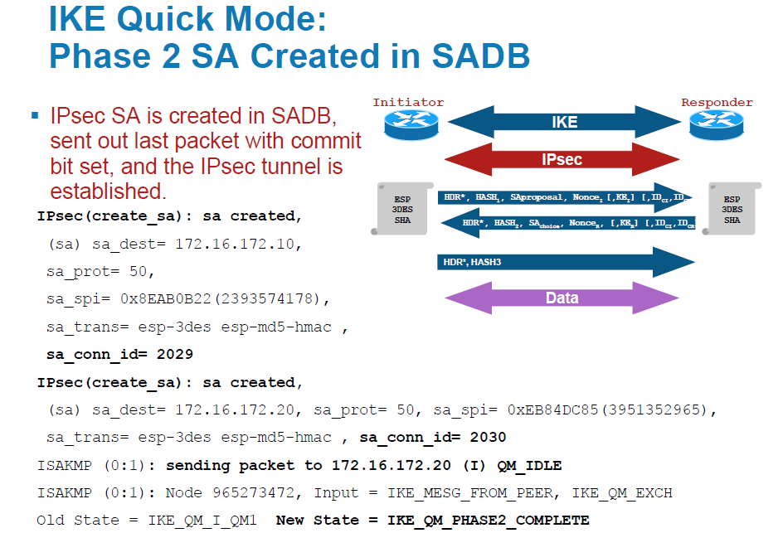

Slide 84
Thanks!

