Slide 1

Network Security

Slide 2
Presentation list
Following the order in the course registration form
  Starting from Nayeem Hasan
  Ending at Mohammed khalil

Slide 3
Chapter 7
WEB SECURITY

Slide 4
Outline
Web Security Considerations
Secure Socket Layer (SSL) and Transport Layer Security (TLS)
Secure Electronic Transaction (SET)
Recommended Reading and WEB Sites

Slide 5
Web Security Considerations
The WEB is very visible.
Complex software hide many security flaws.
Web servers are easy to configure and manage.
Users are not aware of the risks.

Slide 6
Protocol Stack at Outset
What we have to start with
HTTP
FTP
SMTP
TCP
IP
Can be at just about any point

Slide 7
Where can we put security?
HTTP
FTP
SMTP
HTTP
FTP
SMTP
TCP
SSL/PCT/TLS
AH
ESP
TCP
IP
IP
Network approach
Transport approach
SET
PGP
S-HTTP
S/MIME
HTTP
FTP
SMTP
TCP
TCP
IP
IP
Application approach
Presentation approach

Slide 8
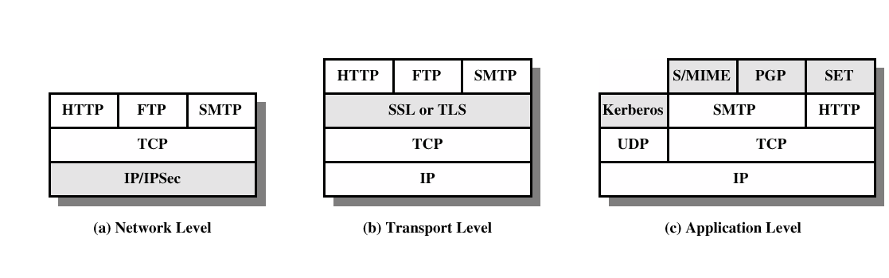
Security facilities in the TCP/IP protocol stack

Slide 9
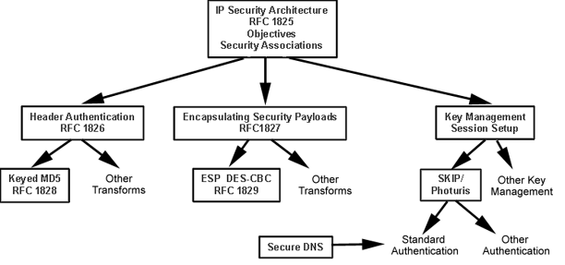
IPSec - Network Approach
Sponsored by IETF IPSec working group
Scheduled to be integral component of IPv6
Supports strong authentication and encryption at layer 3
Bi-directional tunnel
Packet filtering is primary access control method
Requires Public Key Infrastructure (PKI)

Slide 10
IP Layer Security
Functionality
  AH (Authentication Header): integrity and authenticity
  ESP (Encrypted Security Payload): confidentiality, optional authentication & integrity
Security Association (for each pair of hosts): determined by destination IP address and the SPI (Security Parameters Index)
  Specification of the crypto methods to be used by SPI
  Keys to be used by the crypto methods for that SPI
  The hosts and other entities associated with this traffic
Key Management
  Manual Keying (required)
  Key Management Protocols (in flux)

Slide 11
IPSec AH Packet Format
IPv4 AH Packet Format
IPv4 Header Authentication Header Higher Level
Protocol Data
IPv6 AH Packet Format
IPv6 Header
Hop-by-Hop
Routing
Authentication
Header
Other Headers
Higher Level
Protocol Data
IPv6 AH Header Format
Next Header
Length
Reserved
Security Parameters Index
Authentication Data (variable number of 32-bit words)

Slide 12

IPSec Authentication
SPI: identifies the security association to use for this packet
  type of crypto checksum, how large it is, and how it is computed
authentication data
  hash of packet contents include IP header as as specified by the transform indicated by the SPI
  treat fields which change hop-by-hop (TTL, header checksum) as zero
Keyed MD5 Hash is default
MD5 Hash
Secret Key
Key
Headers and data being sent
Key

Slide 13
IPSec ESP Packet Format
IPv4 ESP Packet Format
Unencrypted
Encrypted
IP Header
Other IP
Headers
ESP Header
Encrypted Data
ESP Header Format
Security Association Identifier
Opaque Transform Data, variable length
DES + MD5 ESP Format
Security Parameters Index (SPI)
Initialization Vector (optional)
Replay Prevention Field (incrementing count)
Payload Data (with padding)
Authentication checksum

Slide 14
IPSec Encryption
ESP Modes
  Tunnel-mode: payload in a whole IP datagram, mobile-IP
  Transport Mode: payload is a higher level IP protocol, e.g., TCP/UDP
DES with CBC is default
Key Management
  ISAMKP/Oakley (mandatory)
    ISAMKP - association management protocol
    Oakley - key management
    exchange message(s) to establish long-lived context
  Simple Key-Management for Internet Protocols -SKIP (elective)

Slide 15
Header Usage and Security
IPSec standards recommend using the AH to protect the ESP
    AH validates both the IP addresses and the message contents
Omitting the ESP
    without the ESP, it is possible to eavesdrop on the authenticated data (this is a threat when resusable, secret passwords are used)
  Omitting the AH
    ESP does not generally protect against modification
    ESP is vulnerable to header cut-and-paste attack
      attacker takes out the ESP out of packets and inserts a new ESP destined for another machine (when IPSec proxy is used)
      another solution is to assign unique security associations to different pairs of communicating hosts (burden on administrators)

Slide 16
IPSec Issues
Benefits:
Integrated directly into IP stack
Uses public key technology
Proposed IETF standard
Security model for IPv6
Supports strong authentication and encryption mechanisms
Expected to be widely deployed in internetworking devices
Supports only IP traffic
Concerns:
IETF working group slow to establish consensus
Client deployment dependent on Microsoft
Competing key management standards
Requirement for public key infrastructure
Router Vendors are central to deployment
Users vs Addresses

Slide 17
Transport Approach - SSL/TLS
SSL: Secure Sockets Layer TLS: Transport Layer Security
SSL Version 1: Was quickly replaced by SSL v2. Not in use today.
SSL Version 2: Has some security problems. Still supported.
PCT: Microsoft’s response to SSL 2.0. Fixes some problems, but has been supplanted by SSL 3.0.
SSL Version 3: Complete redesign of SSL. Fixed the problems in previous versions and added many features
TLS: Under development IETF standard based on SSL 3.0 with enhancements.

Slide 18
What problem does SSL Solve?
Allows secure communications between two computers, provided that at least one has a certificate trusted by the other (avoids man-in-the-middle when possible).
Isolates application developers from the complexities and dangers of cryptosystem design.
Supports authentication, encryption, and key exchange
Reliable connections via various secure hash functions
Efficient, extendible, easy to integrate, not ASN.1 based, secure, open, interoperable.
End-to-end armored pipe only, not signed letter and sealed envelope model.

Slide 19
A simple SSL-like protocol
Problem: A user wants to shop at a merchant’s server -- but the server doesn’t know anything about the user.
Phase 1: Handshake to produce a shared secret K.
1. User requests, obtains, and verifies Server’s certificate
2. User creates a 160-bit value K at random
3. User computes K encrypted with server’s public key and sends the result to S.
4. Server decrypts with its private key to recover K.
5. Server hashes K and sends the result to user.
6. User also hashes K and verifies the value from server.

Slide 20
Simple SSL-like protocol, cont
Phase 2: Secure communications using a shared secret K.
Data to be exchanged is broken into packets.
Prior to transmission, each packet of data is encrypted and MAC’ed (Message Authentication Coded):
  Communications are encrypted using K to ensure that data are private from eavesdropping
  Communications are MAC’ed using K to ensure that data are secure against tampering and modification
The recipient decrypts the packet and verifies the MAC. An incorrect MAC indicates a fatal error.

Slide 21
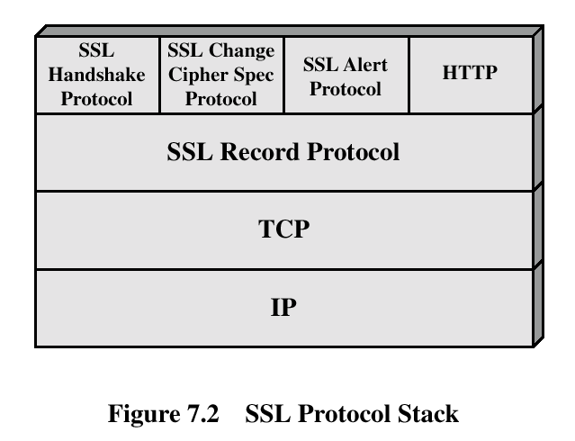
SSL Architecture

Slide 22
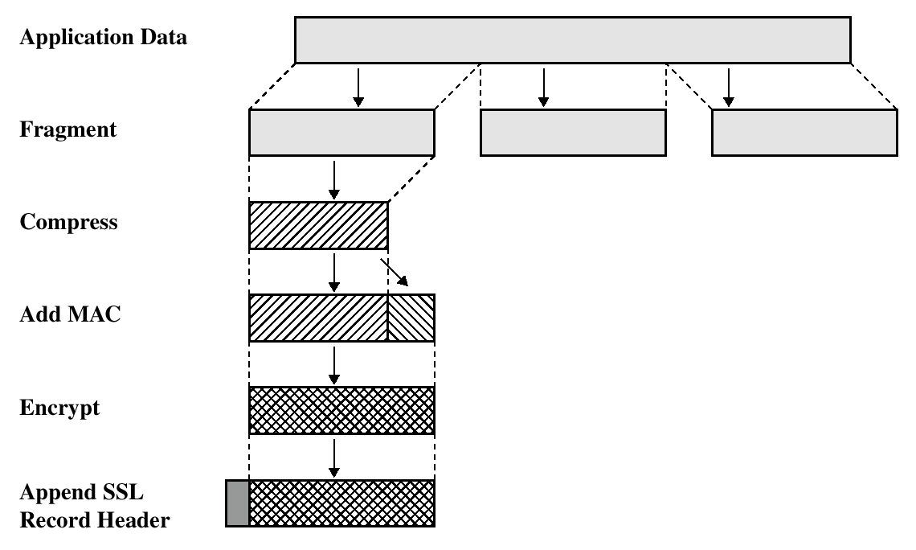
SSL Record Protocol Operation

Slide 23
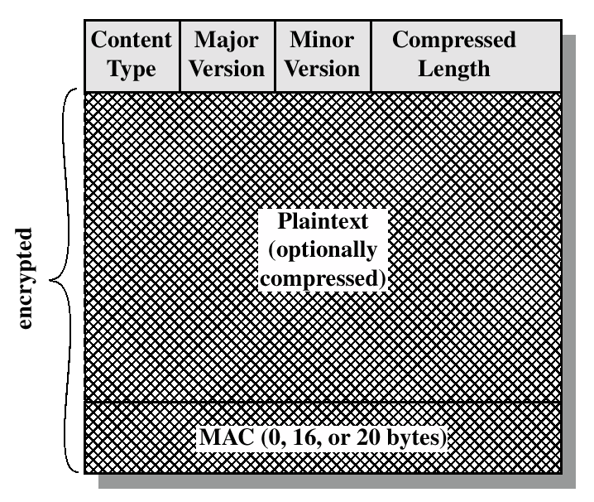
SSL Record Format

Slide 24
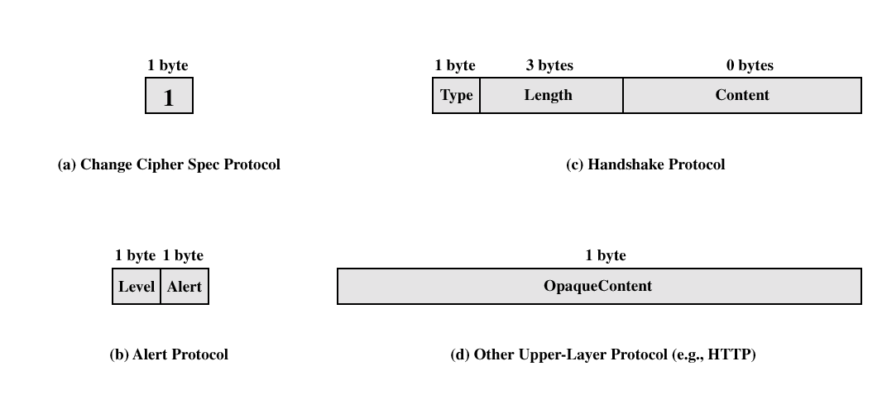
SSL Record Protocol Payload

Slide 25
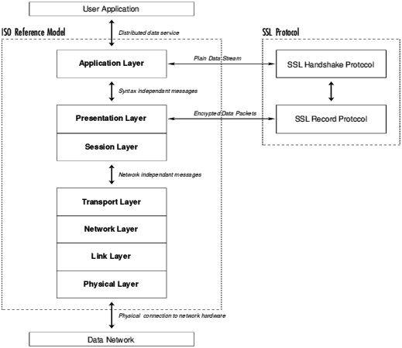
SSL Protocols
The handshake Protocol: negotiates the use of new crypto algorithms and keys.
The record protocol: functions as a layer beneath all SSL messages and indicates the encryption and integrity protection being applied to the data.
The alert protocol: when errors have occurred or when a session is being ended.

Slide 26
SSL Handshake: Protocol
Handshake Protocol Goals:
  Negotiate security parameters,
  Authenticate server to client (server name must match name in certificate to prevent man-in-the-middle attacks)
  Authenticate client to server (if requested by server),
  Create a secret (the “Master Secret” shared between the participants)
Negotiated protocol parameters
  Protocol version (e.g., SSL 3.0, TLS 3.1, etc.)
  CipherSuite (crypto algorithms, etc. )
  Compression method (e.g., none)

Slide 27
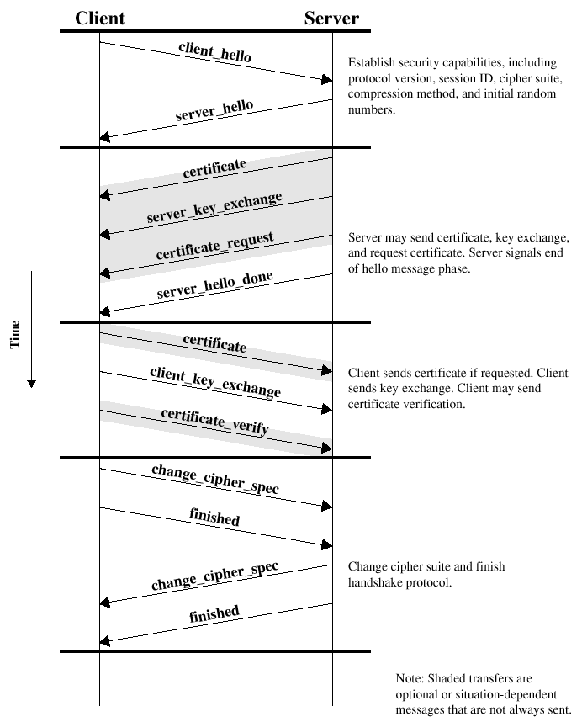
Handshake Protocol Action

Slide 28
SSL Handshake: CipherSuite
The CipherSuite defines the cryptographic algorithms, key sizes, etc
CipherSuite Parameters:
  Encryption Algorithm: none, RC4-40, RC4-128, RC2-40, IDEA-128, DES-40, DES, TripleDES
  Public Key algorithm: RSA, Fortezza, or Diffie-Hellman (with RSA, DSS, or, no certificates* )
  Hash Function: MD5, SHA
Certificate-less handshakes are vulnerable to man-in-the-middle attacks. In some environments, anonymous Diffie-Hellman is helpful -- but in most cases, any support for anonymous ciphersuites would be a massive security flaw

Slide 29








SSL Handshake: Steps
Client
Server
1. Client sends ClientHello message.
2. Server acknowledges with ServerHello message.
3. Server sends its certificate.
4. Server requests client’s certificate
5. Client sends its certificate.
6. Client sends ClientKeyExchange message
7. Client sends a Certificate Verify message.
8. Both send ChangeCipherSpec messages.
9. Both send Finished messages.
Server Certificate
MasterSecret
Server’s Private Key
Server’s Public Key
Digital Signature

Slide 30
SSL Handshake:Resuming Sessions
Goal: minimize the number of SSL handshakes since:
  Private key operations take server time
  Network round trips are slow (2 per handshake)
If two parties have recently communicated, they already have a shared master. If both parties agree, the old master secret can be reused. This is called resuming a session.
A Hack: Adding state to a stateless protocol (http)
Resuming can be done even if the parent session is still alive to split sessions (e.g., to have 4 simultaneous connections, do the handshake once then “resume” three new sessions).

Slide 31
SSL Record Layer
Defines how application data (payload) is:
  broken into packets
  encrypted and decrypted
  MAC’ed and verified
Record Layers:
  SSL Plaintext - type, SSL version, length, data
  SSL compressed - compressed (SSL plaintext)
  SSL Ciphertext - encrypted (MAC and SSLcompressed)
SSL ciphertext
MAC Content Padding
SSL compressed
SSL Plaintext
Real application data
Four keys are used and derived from the MasterSecret:
  Server write key
  Client write key
  Server write MAC secret
  Client write MAC secret

Slide 32
Strengths of the SSL
Bruteforce Attack
  128 bits or more can be said to be safe in the foreseeable future.
Dictionary Attack
  for instance, take HTTP “get” command and use every possible key to precompute encrypted form of the plaintext.
  SSL protects by having very large key spaces (even export version is actually 54 bit with 88 bits disclosed)
Replay Attack
  Attack works by rerunning the messages sent earlier
  SSL defeats it by using a 128-bit nonce value that is unique to that connection
Man-In-the-Middle Attack
  SSL uses signed certificates to authenticate the server’s public key

Slide 33
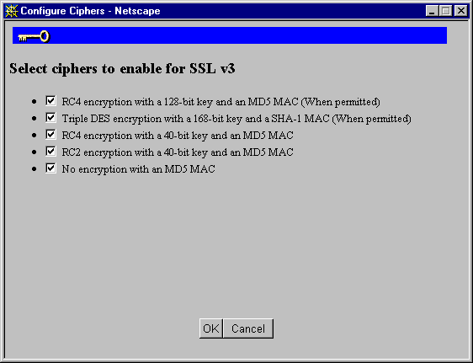
Weaknesses of the SSL
Using weak encryption when strong is required
Does not work with export version

Slide 34
Weaknesses of the SSL, cont
Certificate problems
  not signed by a trusted Certificate Authority
  expired certificates (No certificate revocation list (CRL) in spec!)
  Only real server authentication is that the DNS name in the URL matches the name in the certificate
  if you are fooled into using a wrong name (www.isbankasi.com.tr instead of www.isbank.com.tr) you’ll never know
Only using SSL for forms not all or most of your site
  no caching of SSL by default therefore performance issues
  what’s wrong with this picture:
https://www.company.com/order_form.cgi
<FORM ACTION=http://www.company.com/process_order.cgi METHOD=POST>

Slide 35
Web Spoofing
Web spoofing is pretending to be somebody else’s web site
Allows traffic to be intercepted and changed
All Web traffic must pass through attacker’s proxy
  somebody puts a false link in a popular Web page
  by choosing DNS name very close to the real one (www.isbankasi.com.tr instead of www.isbank.com.tr)
Users must be careful to detect it
Can NOT be stopped -- even with SSL
  unless you are using client side certificates (which hardly anybody is)

Slide 36
Web Spoofing
you.com
good.com
Browser
WWW Server
Link
2
4
bad.com
http://bad.com/http://good.com/file
7
WWWserver
5
Modified URL
1
Call good.com to get file
3
Change data in the copy of file
http://good.com/file
Normal URL
6
Return to you.com

Slide 37
Web Transaction Security
Security Objectives
  Protect transactions against attack on the Internet
  ensure security without prior arrangements between customers and vendors
  Apply crypto protections selectively as needed
  The receiving host must be protected from attack by incoming messages
Basic issues
  Widely available, user-friendly transaction protocol (HTTP)
  Authenticating the customer and vendor
  Key management with naive users
  Liability with bogus transactions

Slide 38
Web Transactions
Three key elements
  forms: Web pages with HTML functions to collect data from the user
  the POST command: transmits the collected data values to the server
  CGI Scripts: programs that process submitted data and return a Web page
Web Form Security Services
  Transaction Integrity
  Customer Authentication
  Vendor Authentication
  Transaction Secrecy

Slide 39
Security Alternatives for Web forms
Alternative security techniques:
  Protection with passwords
  Network Security (IPSec)
  Connection Security (SSL)
  Application Security (secure HTTP)
  Java Applets with SSL
Protection with passwords
  no crypto protection, must be restricted to low-risk applications
  vulnerable to password sniffing
  but available and easy to implement
  provides only customer authentication

Slide 40
Security Alternatives, cont
Network-level security (IPSec):
  provides all-or-nothing security
    it is inefficient to apply crypto to all Web traffic
    increases the risk of bogus transactions if it encrypts everything
  blocks access to hosts that don’t support it or don’t have a security association with the server
  key management is problem for arbitrary Internet customers and vendors
    both client and server are assumed to have their own public keying material and that it has been validated by a third party
  client authentication relies on user’s IP address

Slide 41
Security Alternatives, cont
Transport-level Security (SSL):
  better control over when security measures are used
    a Web browser can choose whether a particular connection is going to use SSL
    using separate port number gives both the client and server some control over what traffic is protected and what traffic moves fast
  all four of the protections are provided
  transport layer crypto can pose architectural problems in some applications
    crypto activities will be hidden from the application by an interface
    SSL software must be integrated into the application for better crypto monitoring
  everything that passes through SSL connection is encrypted
    crypto security measures are only applied to the data in transit and are lost once a connection is closed

Slide 42
Security Alternatives, cont
Application-level Security (SHTTP)
  all four of the protections are provided
  application protocol yields the best security results
    the protocol can define security very specifially in terms of the application’s activities e.g., an application could handle a message containing digital signatures by several different agents and make decisions based on who signed what, or optimize the application of crypto services to different parts of a large message
  SHTTP can define crypto services for individual Web pages
    each page can carry its own crypto checksum or digital signature
    individually encrypted pages can be published on any Web server and still be read by those with authorized keys
    signed pages can be reliably authenticated regardless of how they are replicated and distributed

Slide 43
SSL-enabled Client
1. Implement the latest version of the SSL protocol.
2. Implement a good RSA key exchange.
3. Support a few effective secret key ciphers.
4. Disable any inadequate crypto (e.g., 40 bits or 56 bits).
5. Ensure interoperability with SSL servers.
6. Provide a clear indication when SSL is working.
7. Protect against theft.
8. Support hardware crypto modules as well as software.
9. Block or restrict downloaded executable contents.
10. Use pre-installed public keys to validate server certificate.
11. SSL client authentication.
12. Support additional server authority keys.

Slide 44
SSL-enabled Server
1. Security on the server host must be as tight as possible.
2. Implement the latest version of the SSL protocol.
3. Implement a good RSA key exchange.
4. Support a few effective secret key ciphers.
5. Configure the secret key length to the application.
6. Provide server event logging.
7. Protect against host subversion.
8. Enforce SSL client authentication.
9. Do not share directories and files between http and https server.
10. If more than one option is available, always choose the latest version and strongest ciphersuite.

Slide 45
Secure Electronic Transactions
An open encryption and security specification.
Protect credit card transaction on the Internet.
Companies involved:
  MasterCard, Visa, IBM, Microsoft, Netscape, RSA, Terisa and Verisign
Not a payment system.
Set of security protocols and formats.

Slide 46
SET Services
Provides a secure communication channel in a transaction.
Provides tust by the use of X.509v3 digital certificates.
Ensures privacy.

Slide 47
SET Overview
Key Features of SET:
  Confidentiality of information
  Integrity of data
  Cardholder account authentication
  Merchant authentication

Slide 48
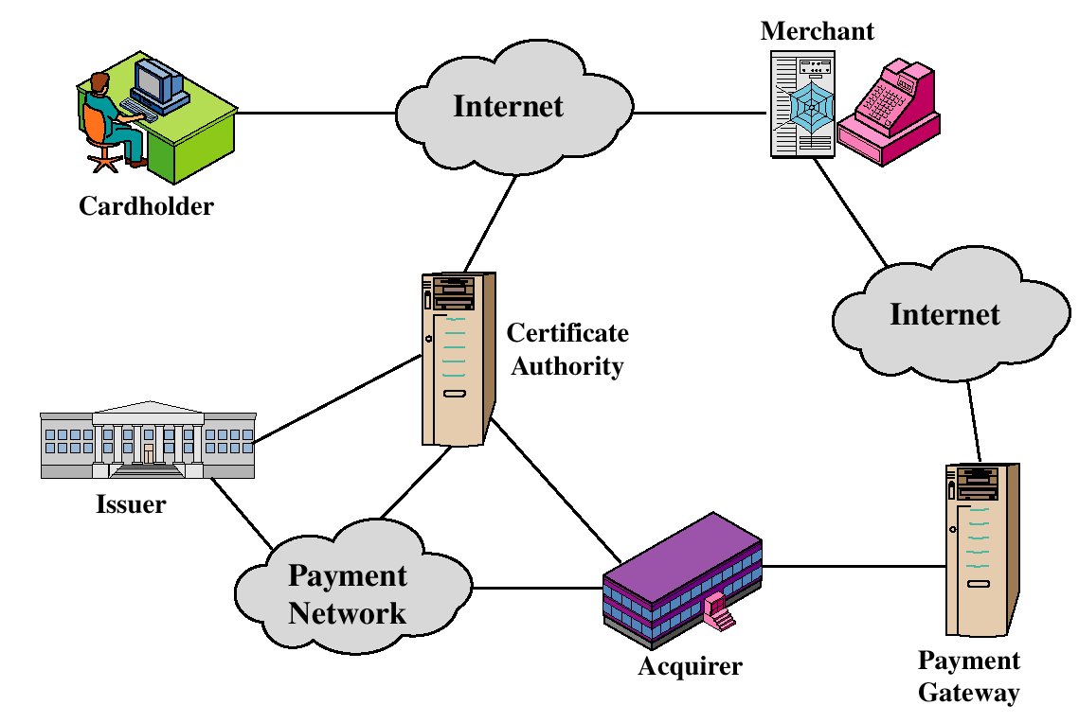
SET Participants

Slide 49
Sequence of events for transactions
The customer opens an account.
The customer receives a certificate.
Merchants have their own certificates.
The customer places an order.
The merchant is verified.
The order and payment are sent.
The merchant request payment authorization.
The merchant confirm the order.
The merchant provides the goods or service.
The merchant requests payments.

Slide 50

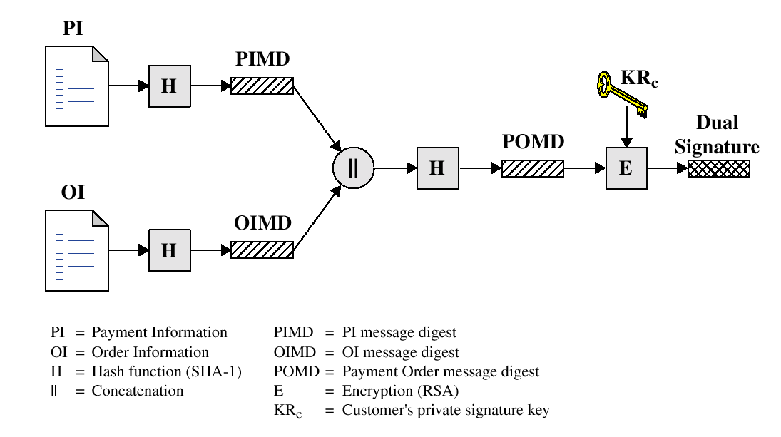
Dual Signature

Slide 51
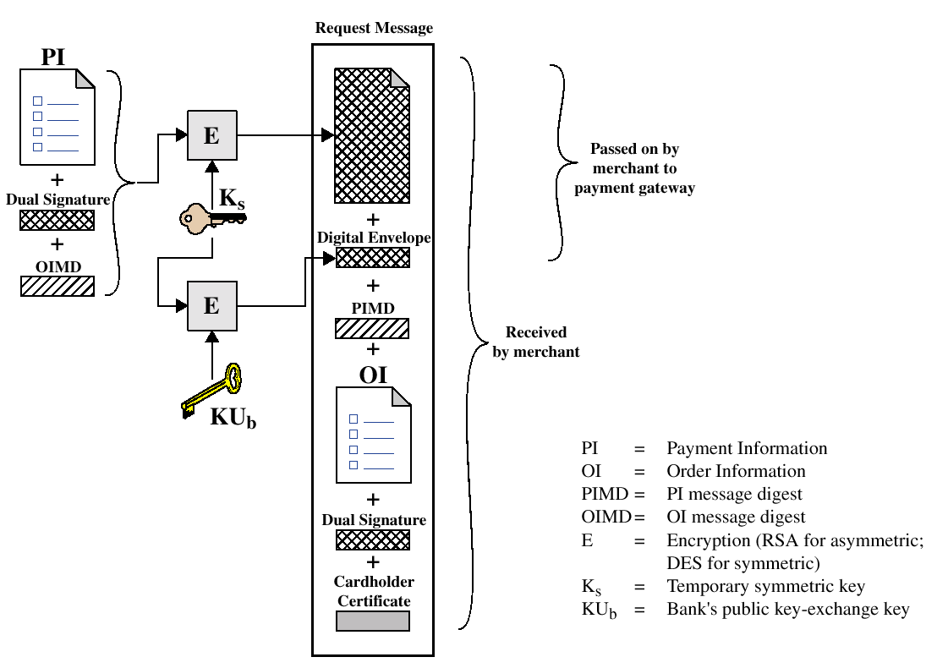
Payment processing
Cardholder sends Purchase Request

Slide 52
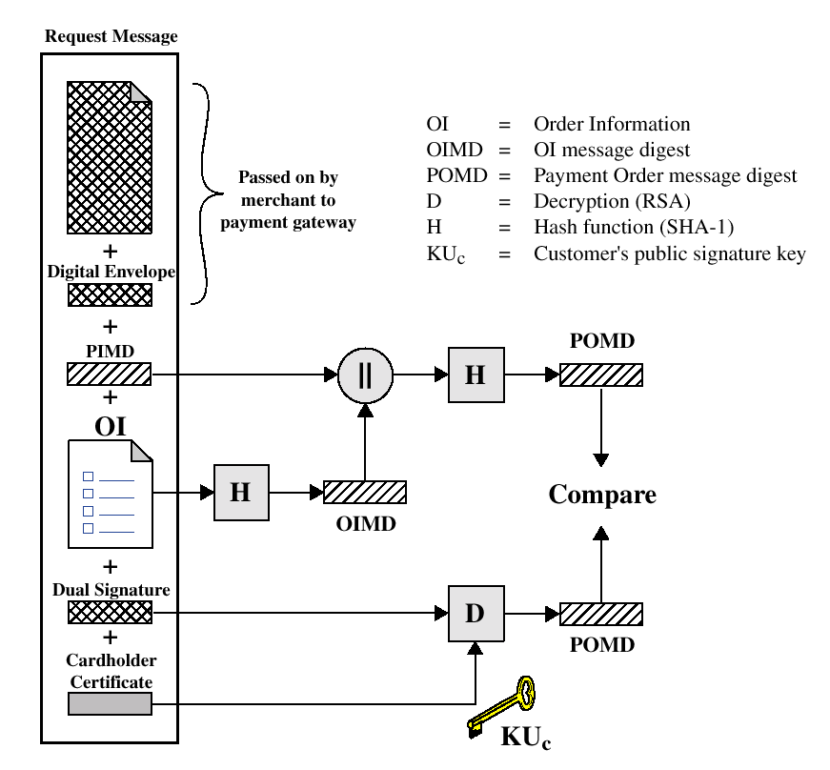
Payment processing
Merchant Verifies Customer Purchase Request

Slide 53
Payment processing
Payment Authorization:
  Authorization Request
  Authorization Response
Payment Capture:
  Capture Request
  Capture Response

Slide 54
Recommended Reading and WEB sites
Drew, G. Using SET for Secure Electronic Commerce. Prentice Hall, 1999
Garfinkel, S., and Spafford, G. Web Security & Commerce. O’Reilly and Associates, 1997
MasterCard SET site
Visa Electronic Commerce Site
SETCo (documents and glossary of terms)

Slide 55
Thanks!

