Slide 1
Web Security

Slide 2
Where can we put security?
HTTP
FTP
SMTP
HTTP
FTP
SMTP
TCP
SSL/PCT/TLS
AH
ESP
TCP
IP
IP
Network approach
Transport approach
SET
PGP
S-HTTP
S/MIME
HTTP
FTP
SMTP
TCP
TCP
IP
IP
Application approach
Presentation approach

Slide 3
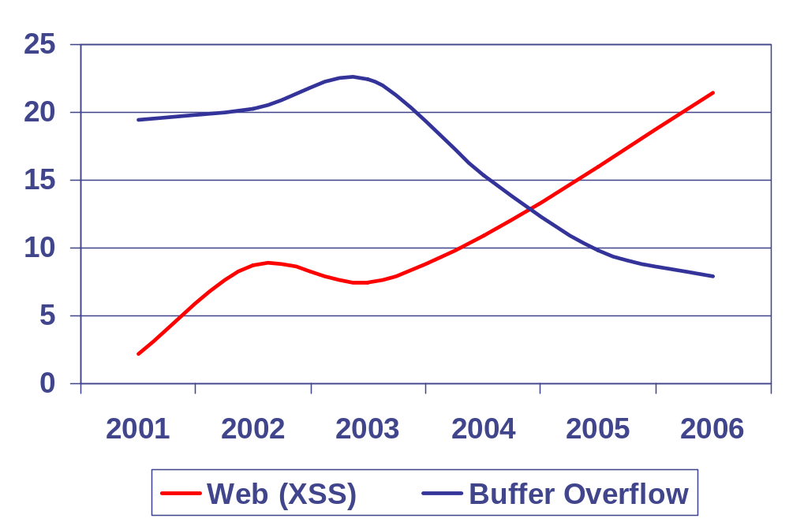
Vulnerability Stats: web is “winning”
Majority of vulnerabilities now found in web software
Source: MITRE CVE trends
Notes:
XSS is overtaking traditional buffer overflows as the most common vulnerability.

Slide 4
Web security: two sides
Web browser (this and next lecture)
  Can be attacked by any web site it visits
  Attacks result in:
    Malware installation (keyloggers, bot-nets)
    Document theft from corporate network
    Loss of private data
Web application code: (next Thursday)
  Runs at web site, e.g. banks, e-merchants, blogs
  Written in PHP, ASP, JSP, Ruby, …
  Many potential bugs: XSS, XSRF, SQL injection
  Attacks lead to stolen CC#, defaced sites, mayhem

Slide 5
Web Threat Models
Web attacker
  Control attacker.com
  Can obtain SSL/TLS certificate for attacker.com ($0)
  User visits attacker.com
Network attacker
  Passive: Wireless eavesdropper
  Active: Evil router, DNS poisoning
Malware attacker
  Attacker escapes browser sandbox

Slide 6
Malware attacker
Browsers (like any software) contain exploitable bugs
  Often enable remote code execution by web sites
  Google study: [the ghost in the browser 2007]
    Found Trojans on 300,000 web pages (URLs)
    Found adware on 18,000 web pages (URLs)
NOT OUR FOCUS THIS WEEK
Today: even if browsers were bug-free, still lots of vulnerabilities on the web

Slide 7
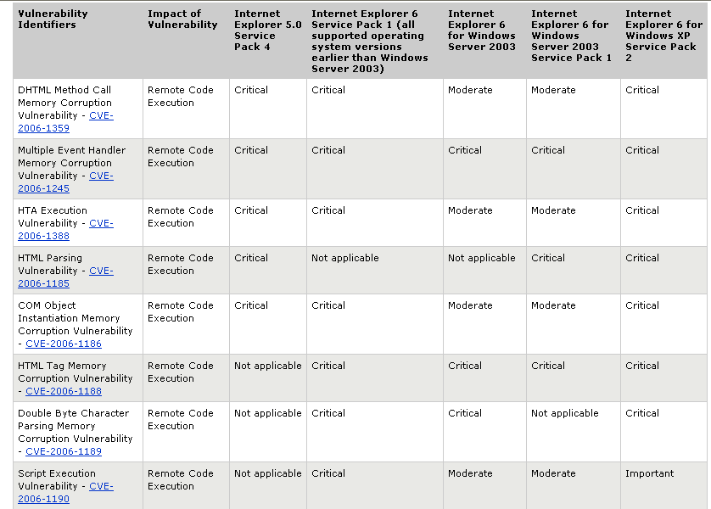
Microsoft Security Bulletin MS06-013, April 2006

Slide 8
Malware distribution
Via vulnerable web servers:
<!-- Copyright Information -->
<div align=’center’ class=’copyright’>Powered by … </div>
<iframe src=’http://wsfgfdgrtyhgfd.net/adv/193/new.php’></iframe>
Via ad networks:
  User visits a reputable web site containing banner ad
    Banner ad hosted in iframe from 3rd party site
    3rd party serves ad exploiting browser bug
    often involves 4th and 5th parties
  Example: feb. 2008:
    ad serves PDF file that exploits adobe reader bug
    Installs Zonebac: modifies search engine results
Notes:
http://blog.washingtonpost.com/securityfix/2008/02/hackers_exploiting_adobe_reade.html

Slide 9
Security User Interface

Slide 10
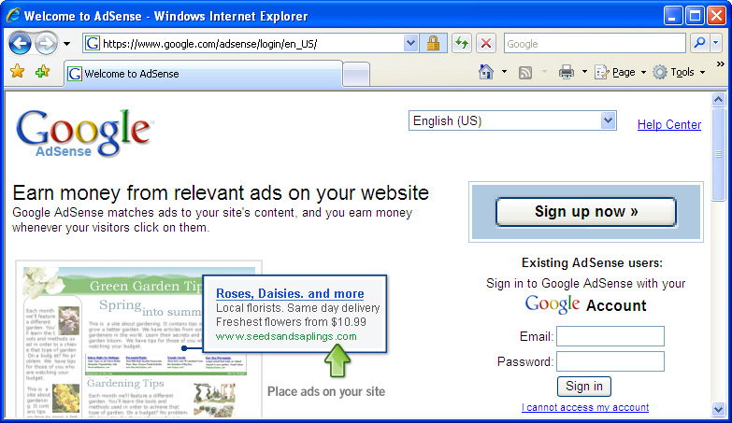
Address Bar
Where this page came from
But not where the embedded content came from
awglogin

Slide 11
URLs
Global identifiers of network-retrievable documents
Example:
http://stanford.edu:81/class?name=cs155#homework
Special characters are encoded as hex:
  %0A = newline
  %20 or + = space, %2B = + (special exception)
Protocol
Fragment
Hostname
Port
Path
Query

Slide 12
HTTP Request
Method
File
HTTP version
Headers
GET /index.html HTTP/1.1
Accept: image/gif, image/x-bitmap, image/jpeg, */*
Accept-Language: en
User-Agent: Mozilla/1.22 (compatible; MSIE 2.0; Windows 95)
Connection: Keep-Alive
Host: www.example.com
Blank line
Data – none for GET
GET: no side effect. POST: possible side effect.

Slide 13
HTTP Response
HTTP version
Status code
Reason phrase
Headers
HTTP/1.0 200 OK
Date: Sun, 21 Apr 1996 02:20:42 GMT
Server: Microsoft-Internet-Information-Server/5.0
Connection: keep-alive
Content-Type: text/html
Last-Modified: Thu, 18 Apr 1996 17:39:05 GMT
Content-Length: 2543
<HTML> Some data... blah, blah, blah </HTML>
Data

Slide 14
Mixed Content: HTTP and HTTPS
Page loads over HTTPS, but contains content over HTTP
IE: displays mixed-content dialog to user
  Flash files over HTTP are loaded with no warning (!)
  Note: Flash can script the embedding page
Firefox: displays a red slash over lock icon (no dialog)
  Flash files over HTTP do not trigger the slash
Safari: does not attempt to detect mixed content

Slide 15
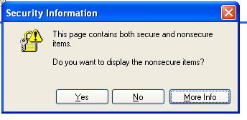
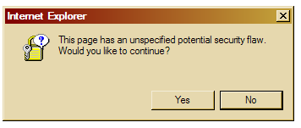
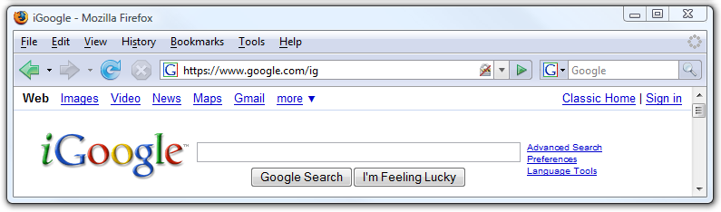
Mixed Content: HTTP and HTTPS
silly dialogs

Slide 16
Mixed content and network attacks
banks: after login all content served over HTTPS
Developer error: Somewhere on bank site write
  <script src=http://www.site.com/script.js> </script>
  Active network attacker can now hijack any session
Better way to include content:
<script src=//www.site.com/script.js> </script>
served over the same protocol as embedding page

Slide 17

Lock Icon 2.0
Extended validation (EV) certs
Prominent security indicator for EV certificates
note: EV site loading content from non-EV site does
not trigger mixed content warning

Slide 18
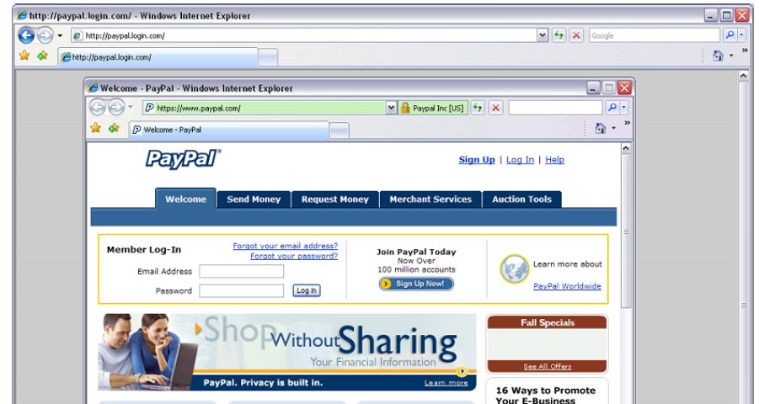
Picture-in-picture attacks
Trained users are more likely to fall victim to this [JSTB’07]
Notes:
Both inner and outer windows are focused

Slide 19
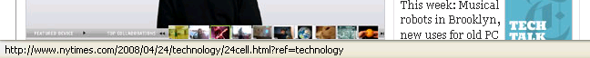
Finally: the status Bar
Trivially spoofable
  <a href=“http://www.paypal.com/”
  onclick=“this.href = ‘http://www.evil.com/’;”>
  PayPal</a>

Slide 20
Same Origin Policy

Slide 21
Document Object Model (DOM)
Object-oriented interface used to read and write docs
  web page in HTML is structured data
  DOM provides representation of this hierarchy
Examples
  Properties: document.alinkColor, document.URL, document.forms[ ], document.links[ ], document.anchors[ ]
  Methods: document.write(document.referrer)
Also Browser Object Model (BOM)
  window, document, frames[], history, location, navigator (type and version of browser)

Slide 22
Browser Same Origin Policy (SOP)
Applies to:
  Cookies: cookie from origin A not visible to origin B
  DOM: script from origin A cannot read or set properties for origin B
For DOM access, two origins are the same iff
  ( domain-name, port, and protocol ) are equal
Safari note: until 3.0 SOP was only (domain-name, port)
Web sites from different domains cannot interact
except in very limited ways

Slide 23
SOP Examples
Example HTML at www.site.com
Disallowed access:
<iframe src="http://othersite.com"></iframe>
alert( frames[0].contentDocument.body.innerHTML )
alert( frames[0].src )
Allowed access:
<img src="http://othersite.com/logo.gif">
alert( images[0].height )
Navigating child frame is allowed (but reading frame[0].src is not):
frames[0].location.href = “http://mysite.com/”
Notes:
Access to frame would be permitted if origin was http://www.site.com

Slide 24
document.domain
Setting document.domain changes origin of page
  Can only be set to suffix of domain name
  checkout.shop.com ⇒ shop.com
  login.shop.com ⇒ shop.com
  shop.com: to join “origin” shop.com must do:
  document.domain = document.domain
Origin is actually the tuple
<domain, port, protocol, hasSetDocumentDomain>
same
origin

Slide 25
Web Browser: the new OS
Origins are “similar” to processes
  One origin should not interfere with another
Cooperation: often sites want to communicate
  Google AdSense:
  <script src="http://googlesyndication.com/show_ads.js">
  Mash-ups
  Gadget aggregators (e.g. iGoogle or live.com)
  To communicate with B, site A must give B full control:
  <script src=http://siteB.com/script.html>
  now script from site B runs in origin of site A
Notes:
Two choices: create a new origin frame – no communication. Or give new origin script full control.
MashupOS: Howell, Jackson, Wang, Fan

Slide 26
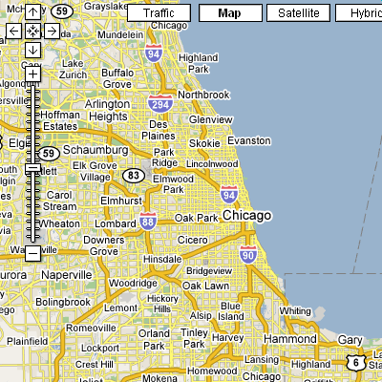
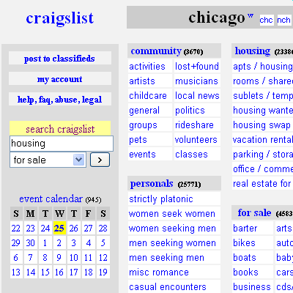
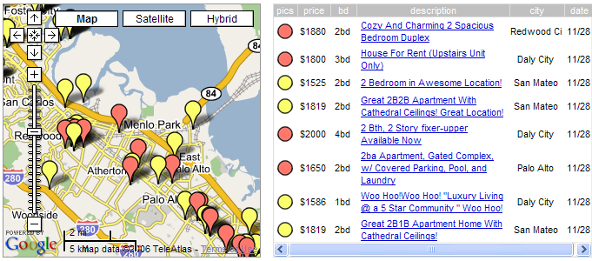
Mashups
Notes:
So JavaScript and AJAX help make standalone web services more interactive.
The next step was to build mashups of those services. One of the first combined
# Craigslist housing listings service and
# Google maps to make
# housingmaps.com, which plots the locations of rentals on a map.

Slide 27
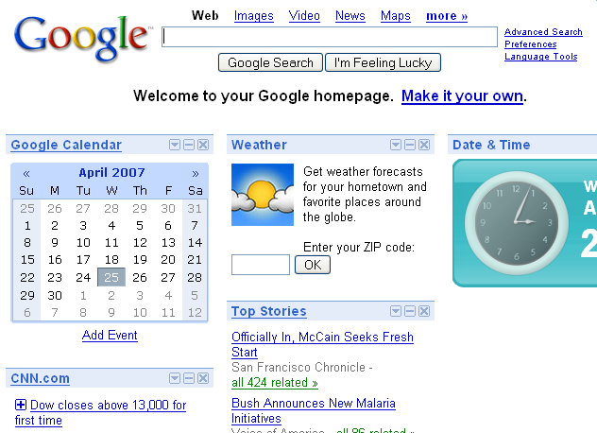
iGoogle

Slide 28
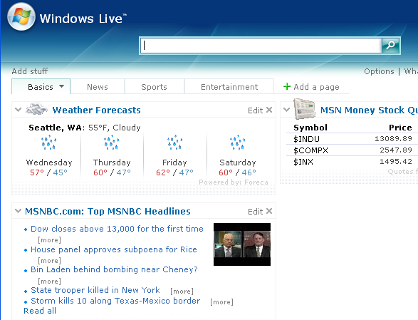
Windows Live.com

Slide 29
Network access from browser sandbox
Send anywhere
  (but some ports are inaccessible, e.g. SMTP)
Read response only from your origin

Slide 30
Same Origin Requests with XMLHttpRequet
<script>
var xhr = new XMLHttpRequest();
xhr.open("POST", "http://www.example.com:81/foo/example.cgi", true); // asynchronous
xhr.send("Hello world!");
xhr.onload = function() {
if (xhr.status == 200) {
alert(xhr.responseText);
}
}
</script>
prepare request
read response

Slide 31
Sending a Cross-Domain GET
Data must be URL encoded
<img src="http://othersite.com/file.cgi?foo=1&bar=x y">
Browser sends:
  GET file.cgi?foo=1&bar=x%20y HTTP/1.1
  Host: othersite.com
  …
Can’t send to some restricted ports, like 25 (SMTP)
Denial of Service (DoS) using GET:
  a popular site can DoS another site [Puppetnets ’06]

Slide 32
Sending a Cross-Domain POST
<form method="POST" action="http://othersite.com/file.cgi" encoding="text/plain">
<input type="hidden" name=“Hello world!\n\n2¥+2¥" value=“4¥">
</form>
<script>document.forms[0].submit()</script>
Hidden iframe can do this in background
⇒ user visits a malicious page, browser submits
form on behalf of user
⇒ e.g. page re-programs user’s home router (XSRF)
Can’t send to some restricted ports, like 25 (SMTP)
submit
post

Slide 33
Cookies: client state

Slide 34
Cookies
Used to store state on user’s machine
GET …
Server
Browser
HTTP Header:
Set-cookie: NAME=VALUE ;
domain = (who can read) ;
expires = (when expires) ;
secure = (only over SSL)
If expires=NULL:
this session only
Server
Browser
GET …
Cookie: NAME = VALUE
HTTP is stateless protocol; cookies add state

Slide 35
Cookie authentication
Browser
Web Server
Auth server
POST login.cgi
Username & pwd
Validate user
Set-cookie: auth=val
auth=val
Store val
GET restricted.html
Cookie: auth=val
restricted.html
auth=val
Check val
If YES,
restricted.html
YES/NO

Slide 36
Weak authenticators: security risk
Predictable cookie authenticator
  Verizon Wireless - counter
  ⇒ user logs in, gets counter, can view sessions of other users
Weak authenticator generation: [Fu et al. ’01]
  WSJ.com: cookie = {user, MAC_{k}(user) }
  Weak MAC exposes K from few cookies.
Apache Tomcat: generateSessionID()
  MD5(PRNG) … but weak PRNG (pseudo Random Noise Generation） [GM’05].
  Predictable SessionID’s
Notes:
Don’t generate your own. Use built in procedures: ASP, Tomcat, JServ

Slide 37
Cookie Security Policy
Uses:
  User authentication
  Personalization
  User tracking: e.g. Doubleclick (3rd party cookies)
Browser will store:
  At most 20 cookies/site, 3 KB / cookie
Origin is the tuple <domain, path>
  Can set cookies valid across a domain suffix
Notes:
Personalization: NY Times says “Hi Fred”

Slide 38
Secure Cookies
GET …
Server
Browser
HTTP Header:
Set-cookie: NAME=VALUE ;
Secure=true
Provides confidentiality against network attacker
  Browser will only send cookie back over HTTPS
… but no integrity
  Can rewrite secure cookies over HTTP
    network attacker can rewrite secure cookies
    can log user into attacker’s account
Notes:
HttpOnly in IE can be written to by script, but cannot be read

Slide 39
httpOnly Cookies
GET …
Server
Browser
HTTP Header:
Set-cookie: NAME=VALUE ;
httpOnly
Cookie sent over HTTP(s), but not accessible to scripts
  cannot be read via document.cookie
  Helps prevent cookie theft via XSS
… but does not stop most other risks of XSS bugs.
Notes:
HttpOnly in IE can be written to by script, but cannot be read

Slide 40
Storing data on browser?
Unreliable:
  User can change/clear values
  Silly example: Shopping cart software
  Set-cookie:shopping-cart-total = 150 ($)
  User edits cookie file (cookie poisoning):
  Cookie: shopping-cart-total = 15 ($)
Similar to problem with hidden fields
  <INPUT TYPE=“hidden” NAME=price VALUE=“150”>
Notes:
Personalization: NY Times says “Hi Fred”

Slide 41
Not so silly … (as of 2/2000)
D3.COM Pty Ltd: ShopFactory 5.8
@Retail Corporation: @Retail
Adgrafix: Check It Out
Baron Consulting Group: WebSite Tool
ComCity Corporation: SalesCart
Crested Butte Software: EasyCart
Dansie.net: Dansie Shopping Cart
Intelligent Vending Systems: Intellivend
Make-a-Store: Make-a-Store OrderPage
McMurtrey/Whitaker & Associates: Cart32 3.0
pknutsen@nethut.no: CartMan 1.04
Rich Media Technologies: JustAddCommerce 5.0
SmartCart: SmartCart
Web Express: Shoptron 1.2
Source: http://xforce.iss.net/xforce/xfdb/4621
Notes:
All these shopping carts stored data on browser

Slide 42
Solution
When storing state on browser, MAC data
using server secret key
.NET 2.0:
  System.Web.Configuration.MachineKey
    Secret web server key intended for cookie protection
  HttpCookie cookie = new HttpCookie(name, val);
  HttpCookie encodedCookie =
  HttpSecureCookie.Encode (cookie);
  HttpSecureCookie.Decode (cookie);

Slide 43
Frames and frame busting

Slide 44
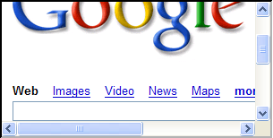
Frames
Embed HTML documents in other documents
<iframe name=“myframe”
src=“http://www.google.com/”>
This text is ignored by most browsers.
</iframe>

Slide 45
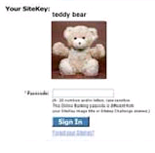
Frame Busting
Goal: prevent web page from loading in a frame
  example: opening login page in a frame will display
  correct passmark image
Frame busting:
if (top != self)
top.location.href = location.href

Slide 46
Correct Frame Busting
Problem: Javascript OnUnload event
Correct frame busting:
<BODY onUnload="javascript: cause_an_abort;)">
if (top != self)
top.location.href = location.href
else { … code of page here …}

Slide 47
THE END

