Slide 1
Intrusion Detection/Prevention Systems

Slide 2
Definitions
Intrusion
  A set of actions aimed to compromise the security goals, namely
    Integrity, confidentiality, or availability, of a computing and networking resource
Intrusion detection
  The process of identifying and responding to intrusion activities
Intrusion prevention
  Extension of ID with exercises of access control to protect computers from exploitation

Slide 3
Elements of Intrusion Detection
Primary assumptions:
  System activities are observable
  Normal and intrusive activities have distinct evidence
Components of intrusion detection systems:
  From an algorithmic perspective:
    Features - capture intrusion evidences
    Models - piece evidences together
  From a system architecture perspective:
    Various components: audit data processor, knowledge base, decision engine, alarm generation and responses

Slide 4

Components of Intrusion Detection System
Audit Records
system activities are observable
Audit Data Preprocessor
Activity Data
Detection
Models
normal and intrusive activities have distinct evidence
Detection Engine
Alarms
Action/Report
Decision
Table
Decision Engine

Slide 5
Intrusion Detection Approaches
Modeling
  Features: evidences extracted from audit data
  Analysis approach: piecing the evidences together
    Misuse detection (a.k.a. signature-based)
    Anomaly detection (a.k.a. statistical-based)
Deployment: Network-based or Host-based
Notes:
Need “both” on all these.

Slide 6
Misuse Detection
pattern matching
Intrusion Patterns
intrusion
activities
Example: if (src_ip == dst_ip) then “land attack”
Can’t detect new attacks

Slide 7
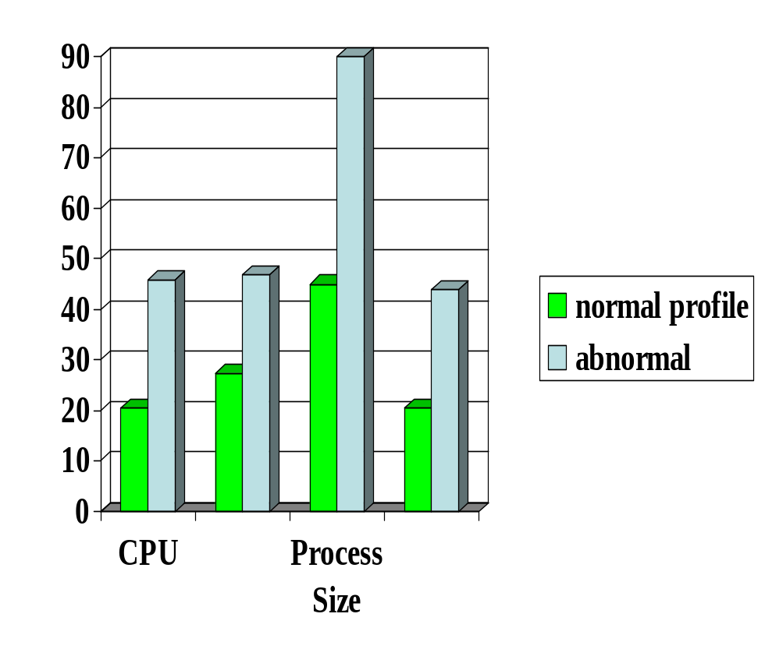

Anomaly Detection
probable intrusion
activity measures
Any problem ?
Relatively high false positive rate - anomalies can just be new normal activities.

Slide 8
Monitoring Networks and Hosts
Network Packets
tcpdump
BSM
Operating System Events
Notes:
Eg, Solaris OS Basic Security Module (BSM)

Slide 9
Key Performance Metrics
Algorithm
  Alarm: A; Intrusion: I
  Detection (true alarm) rate: P(A|I)
    False negative rate P(¬A|I)
  False alarm rate: P(A|¬I)
    True negative rate P(¬A|¬I)
Architecture
  Scalable
  Resilient to attacks

Slide 10
Host-Based IDSs
Using OS auditing mechanisms
  E.G., BSM on Solaris: logs all direct or indirect events generated by a user
  strace for system calls made by a program
Monitoring user activities
  E.G., Analyze shell commands
Monitoring executions of system programs
  E.G., Analyze system calls made by sendmail
Notes:
BSM: Basic Security Module

Slide 11
Network IDSs
Deploying sensors at strategic locations
  E.G., Packet sniffing via tcpdump at routers
Inspecting network traffic
  Watch for violations of protocols and unusual connection patterns
Monitoring user activities
  Look into the data portions of the packets for malicious command sequences
May be easily defeated by encryption
  Data portions and some header information can be encrypted
  The decryption engine still there.
Other problems …
Notes:
Problems: mainly accuracy

Slide 12
Architecture of Network IDS
Policy script
Alerts/notifications
Policy Script Interpreter
Event control
Event stream
Event Engine
tcpdump filters
Filtered packet stream
libpcap
Packet stream
Network

Slide 13
Firewall/IPS Versus Network IDS
Firewall
  Active filtering
  Fail-close
Network IDS
  Passive monitoring
  Fail-open
IDS
FW
Notes:
Protection is not free/cheap. For example, an intrusion detection system (IDS) needs to analyze each packet. This requires a lot of computing power, usually a dedicated high-end workstation. If the IDS is real-time then its response time must be short.
When there is insufficient resources, some protection mechanisms will simply not let data in (fail-close). For example, a firewall, which filters each packet, will simply drop packets when it is overloaded. The dropped packet will not be able to reach beyond the firewall into the internal network. The user experience may not be a happy one because of data loss. However, other protection mechanisms will check/analyze as much as they can but will effectively let all data (fail-open) when there is insufficient resources. For example, an IDS, which simply copies a packet and analyzes it (while the packet continues to reach its target), may only be able to check a packet after a lengthy delay when it is overloaded, letting the packet to complete its potentially malicious actions.
When assessing the protection mechanisms, we will develop models and evaluate under what conditions they will fail-close or fail-open.

Slide 14
Requirements of Network IDS
High-speed, large volume monitoring
  No packet filter drops
Real-time notification
Mechanism separate from policy
Extensible
Broad detection coverage
Economy in resource usage
Resilience to stress
Resilience to attacks upon the IDS itself!

Slide 15
Case Study: Snort IDS

Slide 16
Problems with Current IDSs
Knowledge and signature-based:
  “We have the largest knowledge/signature base”
  Ineffective against new attacks
Individual attack-based:
  “Intrusion A detected; Intrusion B detected …”
  No long-term proactive detection/prediction
Statistical accuracy-based:
  “x% detection rate and y% false alarm rate”
    Are the most damaging intrusions detected?
Statically configured.

Slide 17
Next Generation IDSs
Adaptive
  Detect new intrusions
Scenario-based
  Correlate (multiple sources of) audit data and attack information
Cost-sensitive
  Model cost factors related to intrusion detection
  Dynamically configure IDS components for best protection/cost performance

Slide 18
Adaptive IDSs
ID
Modeling Engine
IDS
anomaly data
anomaly
detection
semiautomatic
ID models
(misuse detection)
ID models
ID models
IDS
IDS

Slide 19
Semi-automatic Generation of ID Models
models
features
Learning
patterns
connection/ session records
Data mining
packets/ events (ASCII)
raw audit data

