Slide 1
Intrusion Detection Systems

Slide 2
What is intrusion detection?
Intrusion detection is the process of detecting & defeating attempts to gain unauthorized access to a network or to create network degradation.
Basic procedure of countering network attacks
  Detecting & stopping the intrusion
    Understand how network attacks occur.
    Stop the attacks:
      Make sure that general patterns of malicious activity are detected
      Ensure that specific events that don’t fall into common categories of attacks are dealt with swiftly
  Tracking the intruder to the source
    Usually spoofed IPs are used!
  Persecute the intruder
    A significant law enforcement effort!

Slide 3
Types of Network Attacks?
By different attackers:
By different attack goals:
  DoS attacks: to disrupt the service(s)
    e.g., TCP SYNC attack
  Network access attacks: to gain access to resources
    Data access e.g., eavesdropping, privilege escalation
    System access e.g., password guessing/cracking,
      Trojan horse attacks, …
 | a. Trusted (internal) users | b. Untrusted (external) users
1. Inexperienced hackers | a1 Inexperienced trusted | b1 inexperienced untrusted
2. Experienced hackers | a2 experienced trusted | b2 experienced untrusted

Slide 4
Network Attacks
Network attacks are usually preceded by reconnaissance attacks.
  Automated tools are available to collect information, and to find vulnerabilities
  May be carried out manually
  Usually involves a series of steps

Slide 5
Examples of Network Attacks
DoS Attacks
  Resource exhaustion attacks
    Available resources (CPU, bandwidth, etc.) are consumed by the attack, causing disruption of services to legitimate users.
  Cessation (or disruption) attacks at OS or a protocol
    Vulnerabilities in the OS or a protocol are exploited by the attacker, causing cessation of normal OS operations.
Network Access Attacks

Slide 6
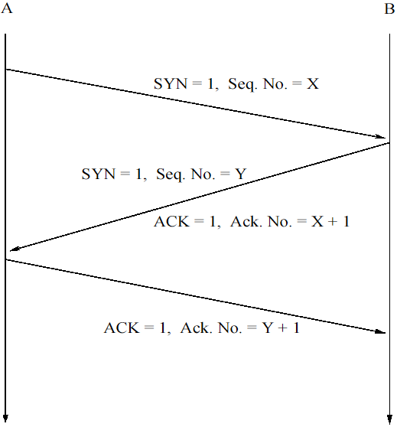
DoS via Syn Flood
A: the initiator;
B: the destination
The three-way TCP handshake:
  A: SYN to initiate
  B: SYN+ACK to respond
  A: ACK gets agreement

Slide 7
Examples of Network Attacks
A1. Resource exhaustion DoS attacks
  Simple DoS attacks
    e.g., TCP SYN Floods:
    Solution? Most network-based IDSs can detect SYN floods by looking for patterns of activity giving away SYN flooding.
  Distributed DoS attacks (DDoS)
    Coordinated large-scale attacks at the victim machines, by a large number of attacking machines
    e.g., The February 7-11, 2000 attacks:
      A combination of 4 DDoS attacks (Trinoo, TFN, TFN2K, and Stacheldraht)

Slide 8
Distributed DoS attacks
Trinoo
  A network of master/slave programs that coordinate with each other to launch a UDP DoS flood against a victim machine
  4 steps to set up a Trinoo network attack:
    Using a compromised account, compile a list of machines that can be compromised.
    Run scripts to compromise the machines in the list, and convert them to Trinoo masters or daemons. (A Trinoo master controls several daemons; the masters are controlled by the compromised host in Step 1).
    Launch the DDoS attack!
    Each daemon launch a UDP DoS attack against the targeted victim, by sending UDP packets to random destination ports.

Slide 9
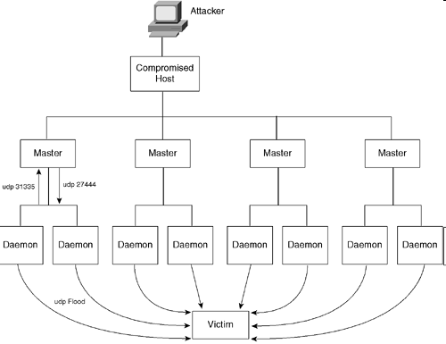
Trinoo network attack

Slide 10
Distributed DoS attacks
TFN (Tribal Flood Network) and TFN2K
  A network of master/slave (clients/daemons) programs that coordinate with each other to launch an attack against a victim machine
  Variety of attacks: SYN flood, ICMP flood, smurf attacks c.f.,
Stacheldraht
  Enhancements over Trinoo and TFN, with encry. traffic
Trinoo | TFN
UDP flood | SYN flood ICMP flood Smurf

Slide 11
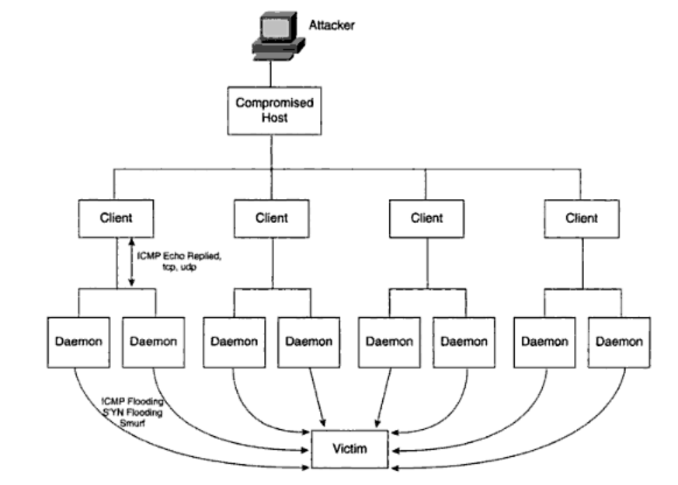
TFN Attack

Slide 12
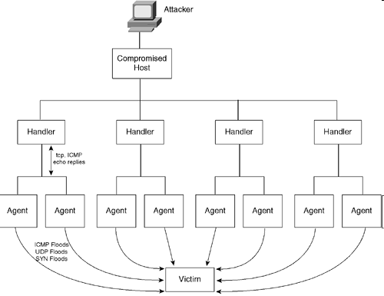
Botnet attack

Slide 13
Distributed DoS attacks
How can IDS prevent DDoS attacks?
  DDoS attacks are not easy to prevent.
  May be detected by using known IDS signatures
    e.g.,
    Cisco IDS signatures 6505 and 6506 are used to detect Trinoo networks
    Cisco IDS signatures 6503 and 6504 are for Stacheldraht networks
    …
    6505 looks for UDP packets containing potential commands from a Trinoo client to a server, and 6506 looks for UDP packets containing potential command replies from a Trinoo server to a client.

Slide 14
Examples of Network Attacks
A2. Cessation-of-operations attacks at OS
  These attacks try to exploit a bug or oversight in the code of an OS, and may cause the OS to stop functioning normally.
  Ping of death attack
    Exploits the maximum length of an IP packet (65,535 bytes)
    When a vulnerable machine receives a packet larger than the maximum, its buffer may overflow, causing the OS to hang or crash.
    Usually carried out by sending an ICMP packet encapsulated in an IP packet.
    Solution?
  Land.c attack

Slide 15
Examples of Network Attacks
A2. Cessation-of-operations attacks at OS
  Land.c attack
    A DoS attack in which an attacker sends a host a TCP SYN packet with the source and destination IP address set to the host’s IP address.
    The source and the destination port number are the same as well.
    The OS eventually becomes trapped in an endless loop of sending and acknowledging SYN packets.
    Solution?
    The IDS may look for the impossible IP packets (with the same source and destination addresses).
    A passive IDS (in sniffing only mode) cannot thwart such an attack (even after having detected it).
    An active IDS (such as the PIX IDS and the Router IDS) may drop the malicious packets once identified.

Slide 16
Systems vulnerable to Land Attack
Below is a list of vulnerable operating systems (discovered by testing on various machines): Source: http://www.answers.com/topic/land-attack
  AIX 3.0
  AmigaOS AmiTCP 4.2 (Kickstart 3.0)
  BeOS Preview release 2 PowerMac
  BSDi 2.0 and 2.1
  Digital VMS
  FreeBSD 2.2.5-RELEASE and 3.0 (Fixed after required updates)
  HP External JetDirect Print Servers
  IBM AS/400 OS7400 3.7
  Irix 5.2 and 5.3
  Mac OS MacTCP, 7.6.1 OpenTransport 1.1.2 and 8.0
  NetApp NFS server 4.1d and 4.3
  NetBSD 1.1 to 1.3 (Fixed after required updates)
  NeXTSTEP 3.0 and 3.1
  Novell 4.11
  OpenVMS 7.1 with UCX 4.1-7
  QNX 4.24
  Rhapsody Developer Release
  SCO OpenServer 5.0.2 SMP, 5.0.4
  SCO Unixware 2.1.1 and 2.1.2
  SunOS 4.1.3 and 4.1.4
  Windows 95, NT and XP SP2

Slide 17
Examples of Network Attacks
B. Network Access Attacks
  Buffer overflows
    Buffer overflows in OS occur when a routine writes an amount of data into a fixed-size buffer that is too small for the amount of data.
    Usually launched to exploit a vulnerability in the OS codes.
    Account for almost 50% of all vulnerabilities
    Common in systems developed by C, which may manipulate data without bound checking.
    A buffer overflow attack is orchestrated by sending to an OS data that is too large for the relevant buffer handling the data to store, causing the next memory area to be overwritten (which may contains pointer to a memory area desired by the attacker). (Figure 14-7)
    Solution?
  Privilege Escalations

Slide 18
Examples of Network Attacks
B. Network Access Attacks
  Privilege Escalations
    A situation in which an attacker using various means to gain more access to the system resources than was intended for him/her.
    Examples: Unicode exploits, Getadmin exploit

Slide 19
The Process of Intrusion Detection
Two approaches for detecting intrusions:
  Statistical anomaly-based IDS
    Relies on preset ‘threshold’
    Drawback: many attacks do not lend themselves to easily being detected based on thresholds
  Pattern matching or signature-based IDS
    Drawback: The IDS do not have signatures for new attacks.
  Combination of both (e.g., Cisco IDS)
Network-based IDS vs Host-based IDS
  Network-based IDS should be implemented first.

Slide 20
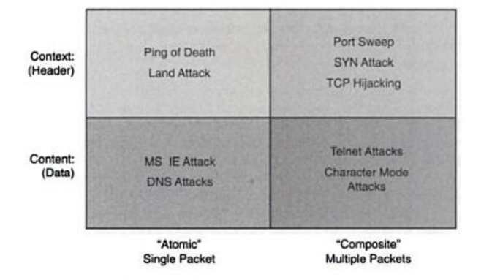
Classification of signatures
  Context based vs content-based signature analysis
  Atomic signature analysis requires only one complete packet.
  Composite signature analysis

Slide 21
Cisco Secure Intrusion Detection
A complete suite of products by Cisco
Offers intrusion detection and response mechanisms
Based on context- and content-based, and atomic and composite signatures
Two primary components:
  The IDS sensors sniff on the network and monitor traffic.
  The management console is used to manage the sensors and provide a GUI for visually observing alarms being generated on the network.

Slide 22
Basic principles of placing sensors and management consoles
Place the sensor in a ‘useful’ location to monitor the traffic that needs to be checked.
Do not exceed the sensor’s bandwidth capabilities.
The console should be placed in a secure location.
Secure the communication between the sensor and the console (when necessary).
Use multiple sensors to monitor various segments of the network. → load distribution
Have a sensor report alarms to multiple consoles.
→ for increased security

Slide 23
Types of Sensors
Passive sensors
  Passively monitors the network traffic
  Pros: does not impose any performance penalties on the network
  Cons?
  Examples: Cisco appliance sensors (Fig. 15-3), the Catalyst IDS module (IDSM)
Sensors with in-line processing capabilities
  Perform in-line processing of the packets contained in the traffic
  Drawback: may degrade the performance of the devices that deploy this form of IDS
  Pros?
  Examples: Cisco routers, PIX with IDS turned on

Slide 24
Notes
When the traffic is encrypted, the sensor cannot alarm on the data that is in encrypted format.
Solution?
  Place the sensor in a location on the network where the traffic has already been decrypted.
  For end-to-end encryption channels (such as SSL), host-based IDS may be needed.

Slide 25
What sensor device to use? (p.448)
Using a router or a PIX as a sensor
  Limitations:
  Limited number of signatures (59 in the router, and 57 in the PIX)
  Cannot shun an attacker
  “Shunning is a term that refers to the Sensor's ability to use a network device to deny entry to a specific network host or an entire network. To implement shunning, the sensor dynamically reconfigures and reloads a network device's access control lists.” (http://www.cisco.com/univercd/cc/td/doc/product/iaabu/csids/csids7/unix_cfg/overview.htm)
  Limited types of response: drop and reset
  Lower throughput
Using IDSM as a sensor
  Especially in a network with high-volume traffic

Slide 26
Snort
NIDS: A network intrusion detection system (NIDS) is an intrusion detection system that tries to detect malicious activity such as denial of service attacks, port scans or even attempts to crack into computers by monitoring network traffic.
Snort: an open source network intrusion prevention and detection system. It uses a rule-based language combining signature, protocol and anomaly inspection methods
Snort: the most widely deployed intrusion detection and prevention technology and it has become the de facto standard technology worldwide in the industry.

Slide 27
Snort
A packet sniffer: capture and display packets from the network with different levels of detail on the console
Packet logger: log data in text file
Honeypot monitor: deceiving hostile parties
NIDS: network intrusion detection system

Slide 28
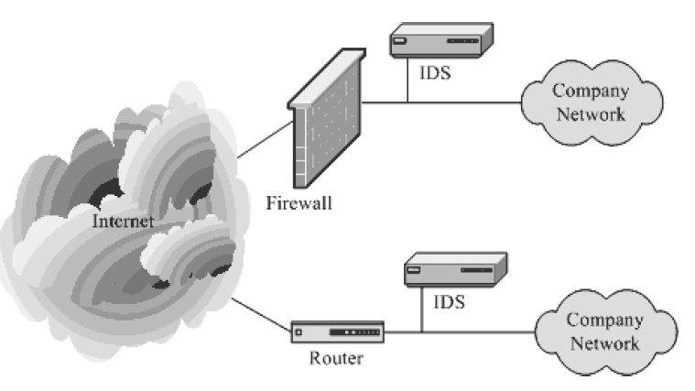
Typical locations for snort

Slide 29
Requirement of snort
lightweight NIDS
small, flexible
highly capable system

Slide 30
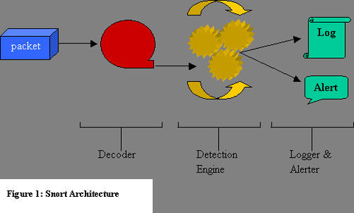
Snort architecture
From: Nalneesh Gaur, Snort: Planning IDS for your enterprise, http://www.linuxjournal.com/article/4668, 2001.

Slide 31
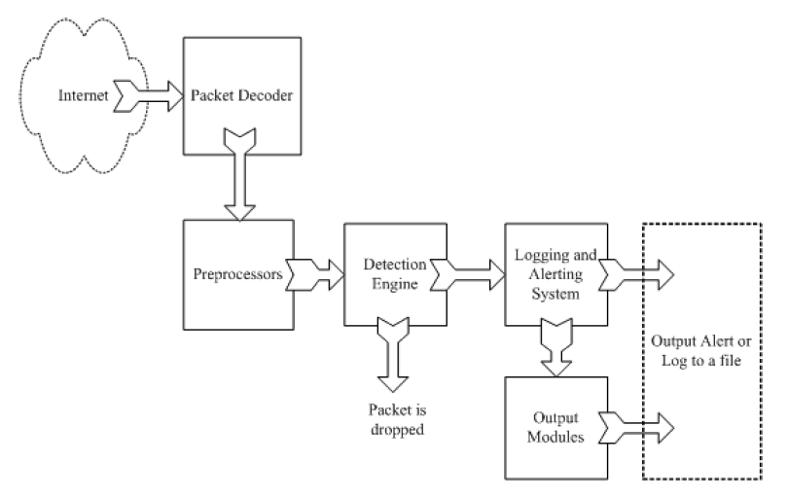
Snort components
From: Rafeeq Ur Rehman, Intrusion Detection Systems with Snort: Advanced IDS Techniques with Snort, Apache, MySQL, PHP, and ACID.

Slide 32
Logical components of snort
Packet Decoder: takes packets from different types of network interfaces (Ethernet, SLIP,PPP…), prepare packets for processing
Preprocessor: (1) prepare data for detection engine; (2) detect anomalies in packet headers; (3) packet defragmentation;(4) decode HTTP URI; (5) reassemble TCP streams.
Detection Engine: the most important part, applies rules to packets
Logging and Alerting System
Output Modules: process alerts and logs and generate final output.

Slide 33
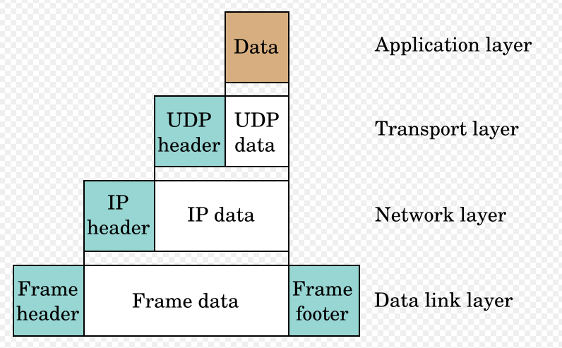
TCP/IP layer
Physical layer
Snort work on network (IP) layer, transport (TCP/UDP) layer protocol, and application layer

Slide 34
Detection Engine
※Things need to be done for detection engine:
The IP header of the packet
The transport layer header. TCP, UDP, ICMP etc.
The application layer level header. Header of DNS, FTP, SNMP, SMTP
Packet payload
※ How to do these?
Apply rules to the packets using a Boyer-Moore string matching algorithm
※ Requirement
Time critical
Fast

Slide 35
Detection engine
Number of rules
Traffic load on the network
Speed of network and machine
Efficiency of detection algorithm

Slide 36
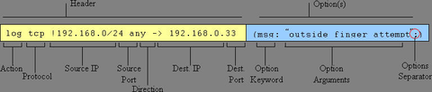
Rules
In a single line
Rules are created by known intrusion signatures.
Usually place in snort.conf configuration file.
rule header
rule options

Slide 37

Rule examples
destination ip address
Apply to all ip packets
Source ip address
Destination port
Source port #
Rule options
Alert will be generated if criteria met
Rule header

Slide 38
Snort Rules: Example
Rule Header
  alert tcp $External_NET any -> $Home_Net21
Rule Options
  (msg: “ftp Exploit”; flow_to_server, established; content: “|31c031db 41c9b046 cd80 31c031db|”; reference: bugtraq,1387; classtype:attempted-admin; sid 344; rev4;)

Slide 39
Snort Rules
Rule Header
  Alert / log / pass / dynamic / activate
  tcp: Protocol being used. UDP / IP / ICMP
  $External_NET: This is the source IP, default is any.
  any: This is the source port set to “any”
  ->: Direction of conversation.
  $Home_Net: This is a variable that Snort will replace with
  21: Port to be monitored.
The header concerns all tcp packages coming from any port from the outside to port 21 on the inside.

Slide 40
Snort Rules
Rule Options
  ( ): Rule option is placed in parentheses.
  msg: “ftp Exploit”;
  flow_to_server, established;
  content: “|31c031db 41c9b046 cd80 31c031db|”; Snort will look whether the package contains this string, the dangerous payload.
  reference: bugtraq,1387; Snorts allow links to third-party warnings.
  classtype:attempted-admin; Class Types allow users to quickly scan for attack types
  sid 344; Snort rule unique identifier. Can be checked against www.snort.org/snort-db.
  rev4; All rules are part of a revision process to limit false positives and detect new attacks.

Slide 41
Snort Rules
Activation: Alert and then turn on another dynamic rule.
Dynamic: Log the traffic when called by the above activation rule.
Pass: Ignore the traffic.
Log: Log the traffic, but do not alert.

Slide 42
Snort Rules
TCP: TCP protocol, for example SMTP, HTTP, FTP
UDP: For example DNS traffic
ICMP: For example ping, traceroute.
IP: For example IPSec, IGMP

Slide 43
Detection engine order to scan the rules
Snort does not evaluate the rules in the order that they appear in the Snort rules file. In default, the order is:
Alert rules
Pass rules
Log rules

Slide 44
Using Snort
Install with libcap / wincap.
Move config / rule files to correct directory and alter them.
Use Snort from the commandline.
Snort can be used to sniff or to decode.

Slide 45
Using Snort
Sniffer Mode
Run-time switches:
  -v verbose
  -d dump package payloads
  -x dump entire package in hex
  -a display arp packages //does not work on your version.
  -e display link layer data
snort -dvae

Slide 46
Using Snort
Packet Logger Mode
Tell snort to output packages to a log file.
Command line options:
  -l dump packages into log directory
  -b log packages in binary (tcpdump) format
Example: snort –b –l /temp/snort

Slide 47
Using Snort
Binary log files are in tcpdump format
Can be read by snort with the –r switch
Readback can be used to dump, log, or perform detection

Slide 48
Using Snort
Full Text Logging
Packets are logged in plain ascii format
One file created per protocol port pair
A port scan creates too many files.

Slide 49
Using Snort
NIDS Mode
Load snort with a set of rules, configure packet analysis plug-ins, and let it monitor hostile network activity

Slide 50
Using Snort
Use –c switch to specify configuration file.
  Snort –c snort.conf
If no config file is specified, snort looks in the /etc directory.

Slide 51
Using Snort
NIDS mode:
Specify an alternative logging directory with –l
Specify an alternate alert mode
  -AL fast, full, none, console
  -M <wrkstn> Send SMB (popup) alerts

Slide 52
Challenges with snort
Misuse detection – avoid known intrusions
Rules database is larger and larger
It continues to grow
snort version 2.3.2, there are 2,600 rules
80% of them are signatures
Snort spends 80% work time to do string match
Anomaly detection – identify new attacks
Probability of detection is low

Slide 53
The Future!
Snort 1.5-2.0
  New plugin architecture
  Write detection modules and add them to rule set
  Hooks for preprocessors
    ip defrag, TCP stream reassembly, statistics, etc
  Hooks for backend/output
    database, SNMP, tunnels, etc.

Slide 54
FIN
Get Snort from:
<www.clark.net/~roesch>
Writing Snort rules:
<www.clark.net/~roesch/snort_rules.html>

