Slide 1
Smoke and Mirrors defenses

Slide 2
IDS: Intrusion Detection System
Also called Network Intrusion Detection (NID)
  This a large category of software and hardware appliances
  Monitor activity to identify malicious or suspicious network events.
    alerts the admin to a possible attack
If it a NIPS (network Intrusion Prevention system), then it will initiate a defensive response.
  such as terminating the connection
    by configuring the firewall to block it.

Slide 3
Types of IDSs
Signature-Based
  Similar to a Anti-Virus program.
  Have the same problems as AV software. The signatures need to updated, before new types of attacks and be detected.
Heuristic Based
  Looks for behavior that is “out of the ordinary”.
  Normally classifies by good/benign, suspicious, or unknown.

Slide 4
Smoke and Mirrors defenses
Honeynet and honeypot projects
  To detect malicious behavior, NIDS require signatures of known attacks and often fail to detect compromises that were unknown at the time it was deployed. On the other hand, honeypots can detect vulnerabilities that are not yet understood.
  Hide computers in the middle of many (possible thousands) "fake" computers
  Because a honeypot has no production value, any attempt to contact it is suspicious. Consequently, forensic analysis of data collected from honeypots is less likely to lead to false positives than data collected by NIDS. ¹
Notes:
1. http://www.honeyd.org/background.php

Slide 5
Smoke and Mirrors defenses (2)
Physical honeypot
  A real machine on the network with it’s own IP address.
  Useful, because it is a full O/S
Virtual honeypot
  Simulated from another machine
    Allows dozens (even hundreds) to be created and run off one computer
    Virtual machines doesn’t have to be the same O/S.

Slide 6
Virtual honeypot
The host O/S can now monitor the virtual machines and log everything.
  Host O/S must be hardened against attacks itself, otherwise…
2 kinds:
  A high-interaction simulates all aspects of an operating system.
  A low-interaction simulates only some parts, for example the network stack.

Slide 7
Virtual honeypot projects
Honeynet project (http://www.honeynet.org)
  Setup a honeynet gateway, in front your computers, then setup possibly 65,000 virtual computers run off possible a single computer.
  The goal of PhaseIII is to develop a bootable CDROM that boots into a Honeynet gateway, or Honeywall. Once booted, all you have to do is place your target systems behind this gateway

Slide 8
Honeyd
Simplier setup then honeynet
Uses an application, setup on a machine, no firewall or gateway is necessary
  Allows scripts to be added, so more services can be emulated form the single system
  Also can emulate routers and network equipment as well.
  More info can be found at http://www.honeyd.org

Slide 9
Value of Honeypots
A Honeypot's primary purpose is to collect information.
  But how do we derive value from that information?
Deception:
  How can Honeynets be used to deceive threats, how can this be of value, and for whom would this be valuable for?
    This research is being done by the following folks:
      Amit Lakhani at the Royal Holloway, University of London.
      Nirbhay Gupta at Edith Cowan University, Australia.

Slide 10
Value of Honeypots (2)
Profiling Threats:
  how can this be of value, and for whom would this be valuable for?
Insider Threats:
  How can they be used for early indications and intelligence gathering of advanced insider threats?
Intelligence Gathering:
  They can be used for intelligence gathering, but how can this be of value, and for whom would this be valuable for?

Slide 11
Value of Honeypots (3)
Legal Issues:
  What are the legal issues of honeypot technologies, and how do they apply to different organizations.
Cyber-Warfare:
  How can they be used by the military within Cyber-warfare and how can this be of value?
Law Enforcement:
  How can law enforcement use this to track down and prosecute criminal activity?

Slide 12
Value of Honeypots (4)
Tools and Tactics:
  How can this be used to identify and learn about new tools, trends or tactics?
    This research is being lead by the following people:
      Elaine Ng at the University of Copenhagen.
Early Warning and Prediction:
  How can it be used for early warning and prediction, how can this be of valuable, and for whom would this be valuable for?

Slide 13
Concept of Honeypots
First popularized in “The Cuckoo’s Egg” by Cliff Stoll
Redefined by the Honeynet Project
  “A security resource who’s value lies in being probed, attacked or compromised”
  Has no production value; anything going to/from a honeypot is likely a probe, attack or compromise
  Used for monitoring, detecting and analyzing attacks

Slide 14
Advantages
Fidelity – Information of high value
Reduced false positives
Reduced false negatives
Simple concept
Not resource intensive
Return on Investment

Slide 15
Disadvantages
Labor/skill intensive
Limited field of view
Does not directly protect vulnerable systems
Risk (more on this later…)

Slide 16
Low-Interaction
Emulates services and operating systems.
Easy to deploy, minimal risk
Captures limited information
Examples include Specter, KFSensor, and Honeyd.

Slide 17
Emulation of Services
QUIT* )
echo -e "221 Goodbye.\r"
exit 0;;
SYST* )
echo -e "215 UNIX Type: L8\r"
;;
HELP* )
echo -e "214-The following commands are recognized (* =>'s unimplemented).\r"
echo -e " USER PORT STOR MSAM* RNTO NLST MKD CDUP\r"
echo -e " PASS PASV APPE MRSQ* ABOR SITE XMKD XCUP\r"
echo -e " ACCT* TYPE MLFL* MRCP* DELE SYST RMD STOU\r"
echo -e " SMNT* STRU MAIL* ALLO CWD STAT XRMD SIZE\r"
echo -e " REIN* MODE MSND* REST XCWD HELP PWD MDTM\r"
echo -e " QUIT RETR MSOM* RNFR LIST NOOP XPWD\r"
echo -e "214 Direct comments to ftp@$domain.\r"
;;
USER* )

Slide 18
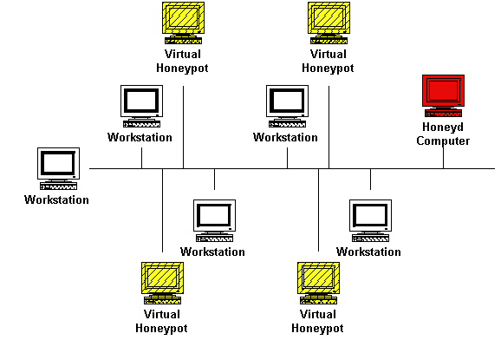
Honeyd

Slide 19
High-interaction
Provide real operating systems and services, no emulation.
Complex to deploy, greater risk.
Capture extensive information.
Examples include ManTrap and Honeynets.

Slide 20
The Role Of Honeypots In The Enterprise
Augments Firewalls and IDS
Research
Incident Response / Forensics
Deception / Deterrence

Slide 21
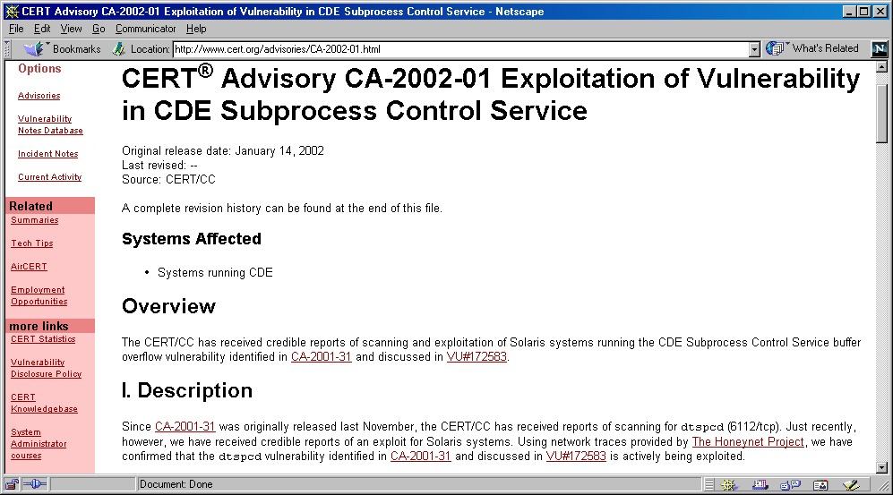
Utility – Identifying new exploits

Slide 22
Honeynets

Slide 23
Honeynet Requirements
Data Control
Data Capture
http://www.honeynet.org/alliance/requirements.html

Slide 24
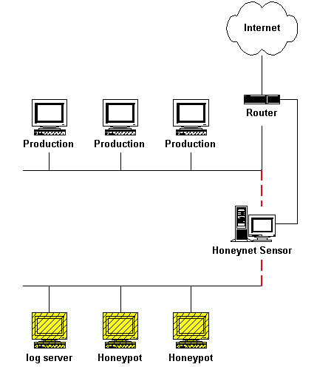
Gen II
Honeynet

Slide 25
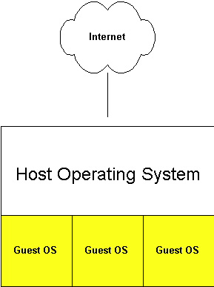
Virtual Honeynets
http://www.honeynet.org/papers/virtual/

Slide 26
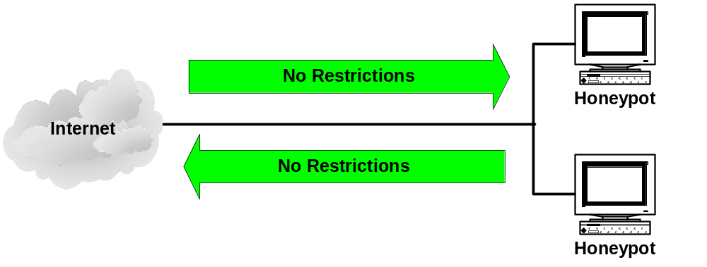
No Data Control
Notes:
Problem
Here we have a Honeynet without any data control. I guess you could say this represents the standard system on a network, but if these systems get compromised, we do not have a means to mitigate the potential damage they may cause on the Internet.
All network traffic is allowed to flow into and out off the Honeynet. If a honeypot is compromised, the attacker can use this system as a launching point to attack other systems on the Internet.
It is essential to control the data that leaves a compromised Honeynet to ensure we are good net citizens.

Slide 27
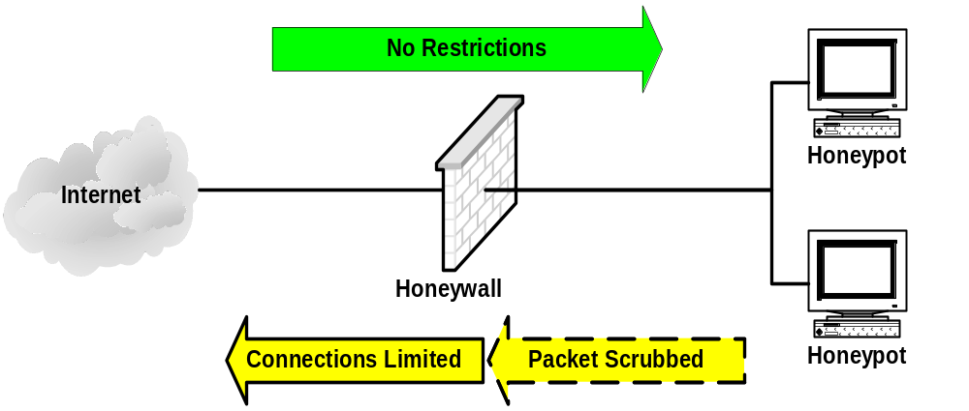
Data Control

Slide 28
Snort fast logging
01/08-10:06:09.729583 [**] [111:10:1] (spp_stream4) STEALTH ACTIVITY
(XMAS scan) detection [**] {TCP} 10.10.10.3:46271 -> 10.10.10.10:1

Slide 29
Snort full logging
[**] [111:10:1] (spp_stream4) STEALTH ACTIVITY (XMAS scan) detection [**]
01/08-10:06:09.729583 10.10.10.3:46271 -> 10.10.10.10:1
TCP TTL:52 TOS:0x0 ID:29436 IpLen:20 DgmLen:60
**U*P**F Seq: 0x452BBA60 Ack: 0x0 Win: 0x400 TcpLen: 40 UrgPtr: 0x0
TCP Options (4) => WS: 10 NOP MSS: 265 TS: 1061109567 0

Slide 30
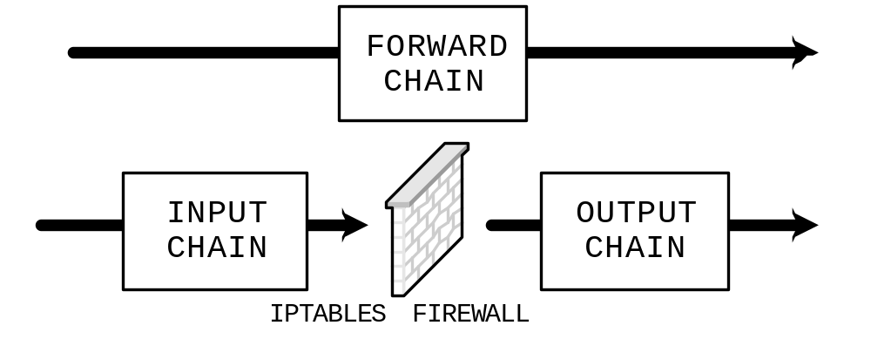
IPTABLES Packet Handling

Slide 31
rc.firewall (data control)
### Set the connection outbound limits for different protocols.
SCALE="day"
TCPRATE="15"
UDPRATE="20"
ICMPRATE="50"
OTHERRATE="15"
iptables -A FORWARD -p tcp -i $LAN_IFACE -m state --state NEW
-m limit --limit ${TCPRATE}/${SCALE} --limit-burst
${TCPRATE} -s ${host} -j tcpHandler
iptables -A FORWARD -p tcp -i $LAN_IFACE -m state --state NEW
-m limit --limit 1/${SCALE} --limit-burst 1 -s ${host}
-j LOG --log-prefix "Drop TCP after ${TCPRATE} attempts“
iptables -A FORWARD -p tcp -i $LAN_IFACE -m state --state NEW
-s ${host} -j DROP
Notes:
Due to the amount of time we have, I will focus on the connection limiting portion of the script, which directly affects data control. As you can see, the first thing we have to do is set the SCALE and the different protocol limits. These limits are dependent on the amount of risk you are willing to take. Remember, the more we let out the more we learn. Ideally, there are enough connections to retrieve toolkits and start probes, but not enough to start attacks.
Next, we have the real magic behind the connection limiting. There are a set of three rules ( like the ones listed in the bottom of the slide) for each protocol. These are the rules that are responsible for the connection limiting and logging once the limit is reached.
As you can see, these rules are added to the FORWARD chain (chain responsible for forwarding traffic through the firewall). The look for tcp traffic coming into the LAN interface, and our statefull firewall is looking for NEW connections. If we have a NEW connection, the limit is checked. If it is not reached, the packet is sent to the tcpHandler. Here, the packet is accepted or sent to the QUEUE (the packet scrubber). If the limit is reached, the packet goes to the next rule where it is logged and dropped.
The –limit-burst portion requires a bit of explanation. Think of a leaky bucket capable of holding a certain number of new connection packets. Our rate tells us how many packets the bucket leaks per ${SCALE}. The –limit-burst tells us how many packets the bucket can hold in the first place. For example, lets say we set our TCPRATE to 25 and SCALE to day. Our honeypot will be able to establish 25 new tcp connections as fast as it possibly can. Once the bucket is full, it only leaks 25 new connections per our ${SCALE}:day: ~1 packet an hour.

Slide 32
iptables connection logging
Jan 8 09:52:43 honeywall user.warn klogd: INBOUND ICMP: IN=br0
OUT=br0 PHYSIN=eth0 PHYSOUT=eth1 SRC=10.10.10.3 DST=10.10.10.10 LEN=84
TOS=0x00 PREC=0x00 TTL=64

Slide 33
iptables connection limits
Jan 9 10:02:27 honeywall user.warn klogd: Drop TCP after 9 attemptsIN=br0
OUT=br0 PHYSIN=eth1 PHYSOUT=eth0 SRC=10.10.10.10 DST=10.10.10.2 LEN=60
TOS=0x00 PREC=0x00 TTL=64 ID=32932 DF PROTO=TCP SPT=32830 DPT=9999
WINDOW=5840 RES=0x00 SYN URGP=0

Slide 34
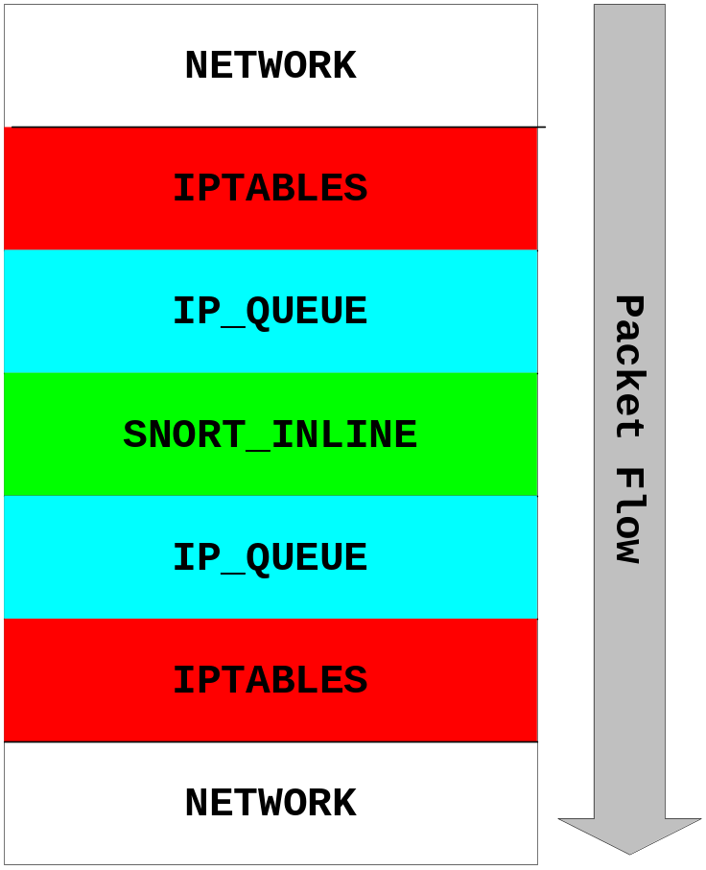
snort_inline
iptables -A FORWARD -i $LAN_IFACE -m state
--state RELATED,ESTABLISHED -j QUEUE
Notes:
Next we have our packet scrubber: snort_inline. Snort_inline is basically Snort. The only difference is that it accepts packets from iptables, via the use of a kernel module named ip_queue, and tells iptables to drop or accept the specific packet. Additionally, snort_inline is capable of replacing portions of the packet payload as the packet traverses the firewall. The decisions are based on the snort rule set with the help of a few new rule types.
Let’s start by looking at the firewall rule that sends the packet to snort_inline. As you can see, it is similar to the rules we saw on the previous slide with the exception of the target: QUEUE. This target tells iptables to pass the packet to a user space application via the use of the ip_queue kernel module. The ip_queue kernel module copies the packet from kernel space to user space and hands it to an application that has registered with the module to receive these packets (only one module can receive packets at any given time). In our case the application is snort_inline. The difference between a packet from ip_queue and one from a sniffer is the absence of a pcap header (contains such things as captured length and time) and the absence of a link layer.
Following the packet through the firewall we see it arrive at the inbound network interface. From here, iptables decides it needs to go to ip_queue when the packet meets the criteria set in the firewall rule that contains the QUEUE target. Iptables hands the packet to ip_queue which then creates a copy and copies it from kernel space to user space. Ip_queue then gives the packet to snort_inline, where a pcap header is added and it is sent via the snort process (to include plugins). If none of the rules match, snort_inline tells ip_queue to accept this packet. Ip_queue then tells iptables to accept the packet and it leaves the oubound interface on its way to its destination. If one of the rules hit, the packet is handled according to the rule types I will explain on the next slide.
One thing to note. If you take a look at the rc.firewall script, you will notice that not all traffic is sent via the QUEUE. The main reason for this is due to the expensive copy from kernel space to user space. If all traffic traversed snort_inline, throughput would suffer. Also, we are only interested in dropping malicious traffic originating from our Honeynet; therefore, we only send traffic from our Honeynet through snort_inline.

Slide 35
snort_inline
reject tcp $HONEYNET any <>
$EXTERNAL_NET 80 (msg: "REJECT";)
drop tcp $HONEYNET any <>
$EXTERNAL_NET 80 (msg: "DROP TCP";)
sdrop tcp $HONEYNET any <>
$EXTERNAL_NET 80 (msg: "SDROP";)
alert tcp $HONEYNET any <>
$EXTERNAL_NET 80 (msg: "Modifying HTTP GET";
content:"GET"; replace:“BET";)
Notes:
Next we have the rule types. In addition to the existing snort rule types, such as log and alert, we have added three new rule types and a keyword. The new rules work as follows:
Reject: drops the matching packet and sends a reset of icmp host unreach depending on the protocol. *** This does not work in bridge mode at this time.
Drop: drops the matching packet and alerts like a normal snort alert rule.
Sdrop: drops the matching packet and does not log. Think of it as a silent drop.
Finally, we have the replace keyword. In conjunction with the content keyword, we can search the packet for a specific word
Thanks to Lance, we have a script that will convert all of your alert rules to drop rules. This script, named convert.sh, comes with the snort_inline distribution that can be downloaded from snort-inline.sf.net The Honeynet Project also officers a statically compiled version of snort_inline with a rule set and configuration file which will make it a lot easier to deploy.

Slide 36
snort_inline logging
03/23-21:21:05.915340 [**] [1:0:0] Dropping Telnet connection [**]
[Priority: 0] {TCP} 10.10.10.10:39528 -> 192.168.1.20:23
03/23-21:21:24.054533 [**] [1:0:0] Modifying HTTP GET command [**]
[Priority: 0] {TCP} 10.10.10.10:38533 -> 192.168.1.20:80

Slide 37
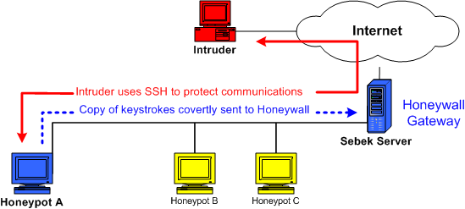
Sebek* Keystroke Logging
* Sebek is developed by Ed Balas, Indiana University

Slide 38
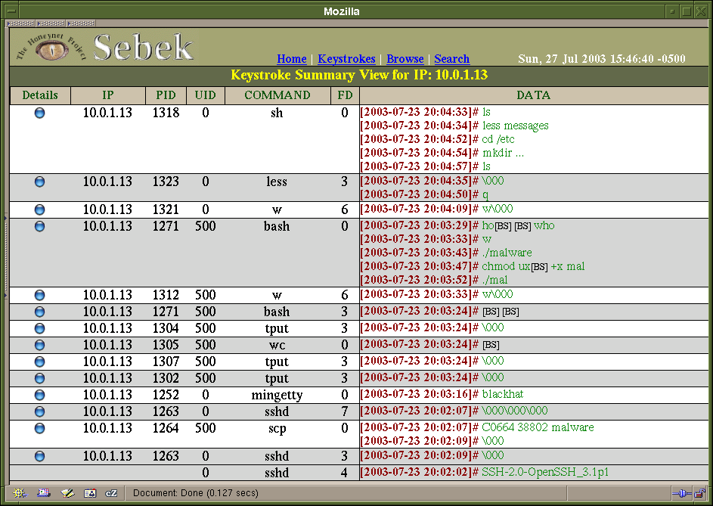
Looking at Keystrokes

Slide 39
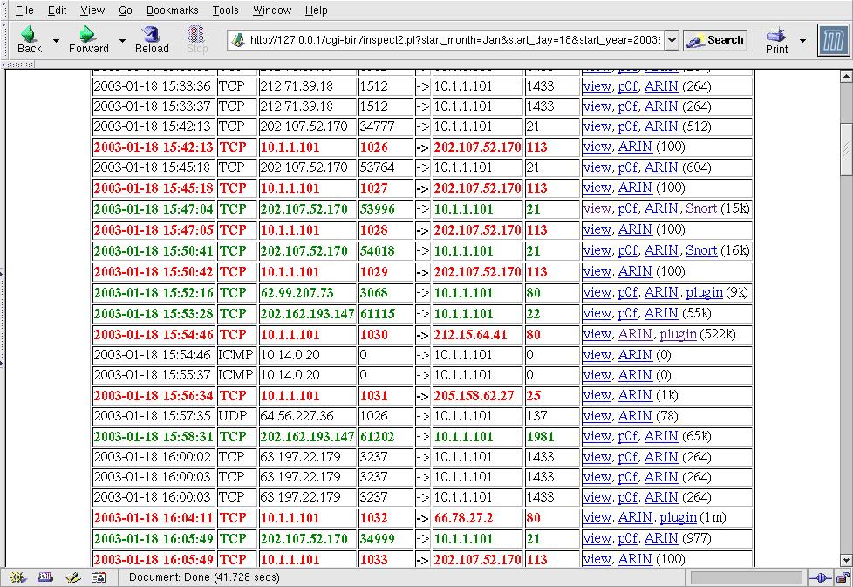
Attacks logged

Slide 40
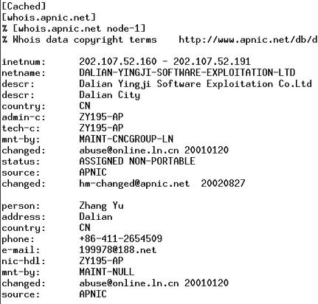
And our attacker is…?

Slide 41
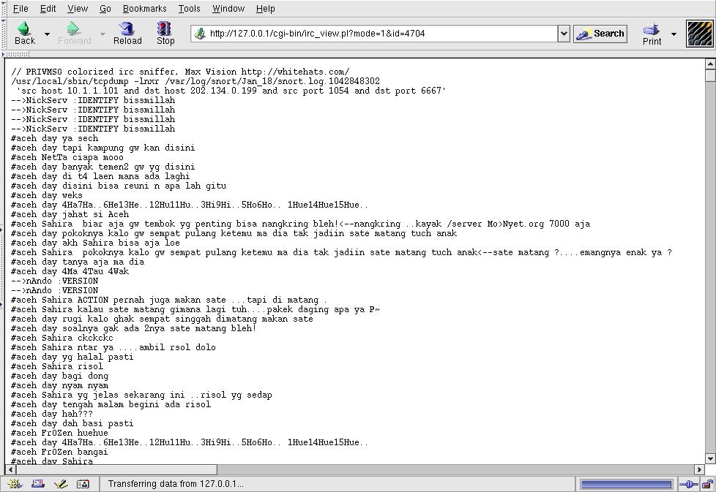
IRC traffic plugin output

Slide 42
Legal Issues
Entrapment
Liability
Privacy

Slide 43
Entrapment
Applies only to law enforcement
Useful only as defence in criminal prosecution
Still, most legal authorities consider honeypots non-entrapment

Slide 44
Liability
An organization may be liable if their honeypot is used to attack or damage third parties
  Example: T.J. Hooper v. Northern Barge Corp. (No weather radios)
  Civil issue, not criminal
  Decided at state level, not federal
This is why the Honeynet Project focuses so much attention on Data Control.

Slide 45
Privacy
No single US federal statute concerning privacy
Electronic Communications Privacy Act (amends Title III of the Omnibus Crime Control and Safe Streets Act of 1968)
  Title I: Wiretap Act (18 USC § 2510-22)
  Title II: Stored Communications Act
  (18 USC § 2701-11)
  Title III: Pen/Trap Act (18 USC § 3121-27)

Slide 46
The Honeywall

Slide 47
Honeywall Bootable CD-ROM
Standard ISO distribution
  GenII Data Capture/Data Control features
  Sebek
  Simple User Interface
  Auto-configure from floppy
Customization features
  “Template” customization (file system)
  Run-time boot customization

Slide 48
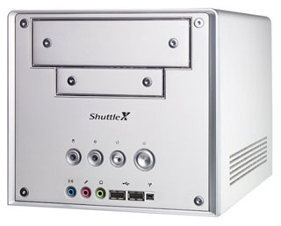
Standardized Hardware

Slide 49
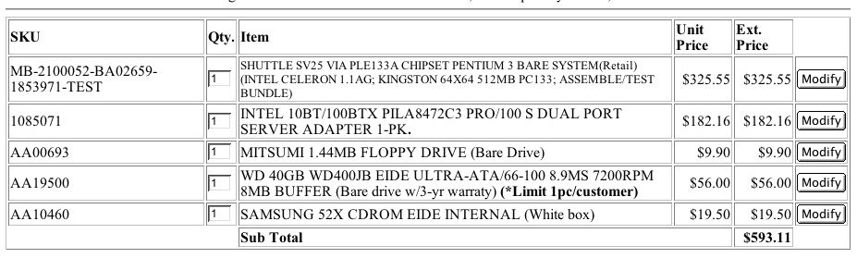
Standardized Hardware

Slide 50
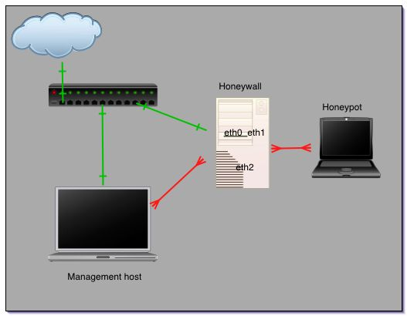
Example honeynet 1
Honeywall w/1 honeypot & direct management connection

Slide 51
Direct Connections
Advantages
  Can’t sniff traffic
  Fewer cables
  Can put in-line in
  emergency w/o
  disruption (FAST!)
Disadvantages
  One honeypot/honeywall/management host
  Can’t directly manage from central location
  Requires mgmt host be in proximity
  Doesn’t scale

Slide 52
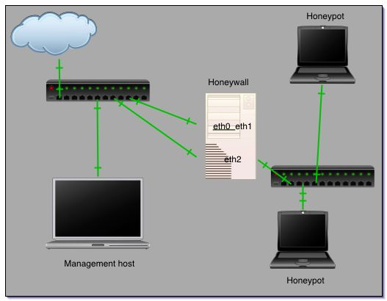
Example honeynet 2
Honeywall w/2 honeypots & shared management connection

Slide 53
Shared Connections
Advantages
  Remotely accessible
  Easily expand number logging to central host
  Can logically monitor many systems using VLANs
Disadvantages
  Can sniff traffic
  Attacker can
  more easily
  locate honeywall
  Requires encryption
  and/or VLAN

Slide 54
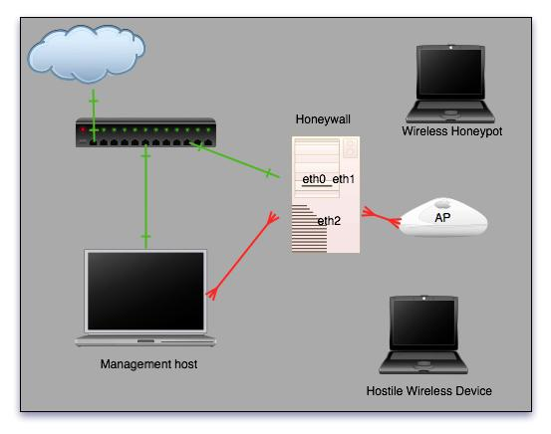
Example honeynet 3
Honeywall in managed wireless network

Slide 55
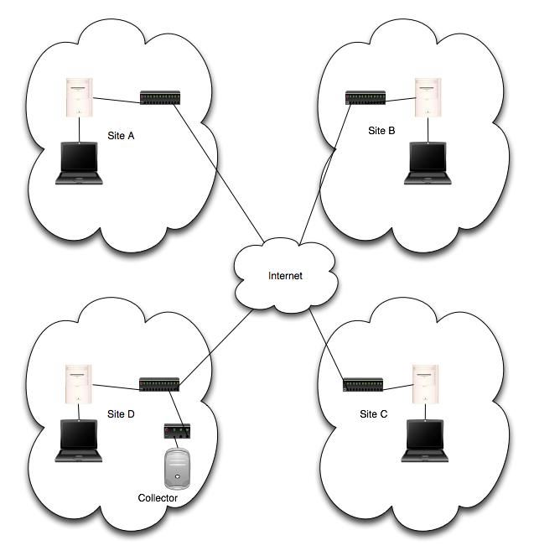
Future
Distributed sensor networks
  Configuration/
  reconfiguration
  Central Logging & Alerting
  OPSEC (open platform security)
  Honeypot management & analysis (forensics take time!)

Slide 56
References
Easttom, “Computer Security Fundamentals”, Prentice Hall
Bueno, Pedro. “Defending Dynamic Web Sites: A Simple Case Study About the Use of Correlated Log Analysis in Forensics”. http://isc.sans.org
Comer, Douglas. “Internetworking with TCP/IP”. Volume 1
Moore, David et al. “Inferring Internet Denial-of-Service Activity”. http://www.usenix.org/publications/library/proceedings/sec01/moore/moore.pdf
Paxson, Vern. “An Analysis of Using Reflectors for Distributed Denial-of-Service Attacks”. http://www.icir.org/vern/papers/reflectors.CCR.01.pdf
http://www.honeynet.org
http://www.honeyd.org

Slide 57
Q
A
&

