Slide 1

Network Security

Slide 2
The course profile
On the principles of network security
For the graduated students
With introduction of hot topics
About the total mark
  30% regular grade plus 70 final exam grade
  One technical report is required, topics can vary according to your own interests, but should be network security related.
  The technical reports have to be submitted before the final exam.

Slide 3
Three basic rules
You have to arrive at this room on the schedule
  7:30pm on Tuesday, 7:20pm is the better
  4:20pm on Tuesday,8:20am is the better
You may interrupt me during my speaking, but please raise your hand before doing it
You may be absent from the class, but you have to inform me before the class and give me the fine reason

Slide 4
Penalty for the violation
Late for the class more than 10 times, your regular grade will 25% lower
Absent from the class without any fine reason exceeding 3 times, your regular grade will be ZERO
Interrupt me without any manners, I will ignore your question, maybe your regular grade will be lower.

Slide 5
Books & references
Network security essentials applications and standards (3rd edition or 4th edition), by Willam Stallings, 2009
“Principles of Computer Security” Wm.A.Conklin, by McGraw-Hill, 2005
the Cooperative Association for Internet Data Analysis (CAIDA). http://www.caida.org/
Network security papers & thesis

Slide 6
Network Security
Chapter 1
Introduction
Notes:
Lecture slides by Lawrie Brown for “Cryptography and Network Security”, 4/e, by William Stallings, Chapter 1 “Introduction”.

Slide 7
Chapter 1 – Introduction
The art of war teaches us to rely not on the likelihood of the enemy's not coming, but on our own readiness to receive him; not on the chance of his not attacking, but rather on the fact that we have made our position unassailable.
—The Art of War, Sun Tzu
Notes:
This quote from the start of Ch0 sets the scene for why we want to study these issues.

Slide 8
Background
Information Security requirements have changed in recent times
traditionally provided by physical and administrative mechanisms
computer use requires automated tools to protect files and other stored information
use of networks and communications links requires measures to protect data during transmission
Notes:
The requirements of information security within an organization have undergone two major changes in the last several decades. Before the widespread use of data processing equipment,the security of information felt to be valuable to an organization was provided primarily by physical (eg. rugged filing cabinets with locks) and administrative mechanisms (eg. Personnel screening procedures during hiring process).
Growing computer use implies a need for automated tools for protecting files and other information stored on it. This is especially the case for a shared system, such as a time-sharing system, and even more so for systems that can be accessed over a public telephone network, data network, or the Internet.
The second major change that affected security is the introduction of distributed systems and the use of networks and communications facilities for carrying data between terminal user and computer and between computer and computer. Network security measures are needed to protect data during their transmission.

Slide 9
Definitions
Computer Security - generic name for the collection of tools designed to protect data and to thwart hackers
Network Security - measures to protect data during their transmission
Internet Security - measures to protect data during their transmission over a collection of interconnected networks
Notes:
Here are some key definitions, note boundaries between them are blurred.

Slide 10

Aim of Course
our focus is on Internet Security, will discuss some topics on other forms of network security
which consists of measures to deter, prevent, detect, and correct security violations that involve the transmission & storage of information
Notes:
Detail the focus of this book/course, which is on Internet Security - being measures to deter, prevent, detect, and correct security violations that involve the transmission & storage of information.

Slide 11
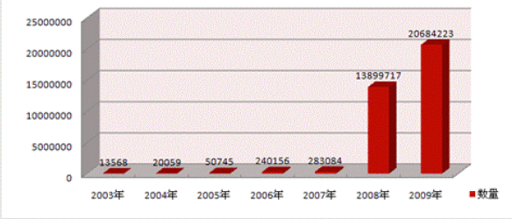
Virus, worms, trojans detected
Notes:
Rapid increasing of the malicious code on the Internet. Bad thing for users, ISP, network managements, but, maybe good thing for network security researchers, developers, and business.

Slide 12
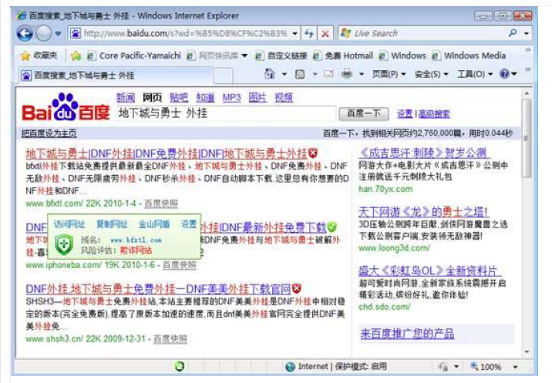
Web fishing
for the case of Baidu.com in 2009, 11 malicious sites out of 20 may exist in the searching results
The rank of these malicious sites are within the top n ( normally on the first result page)

Slide 13
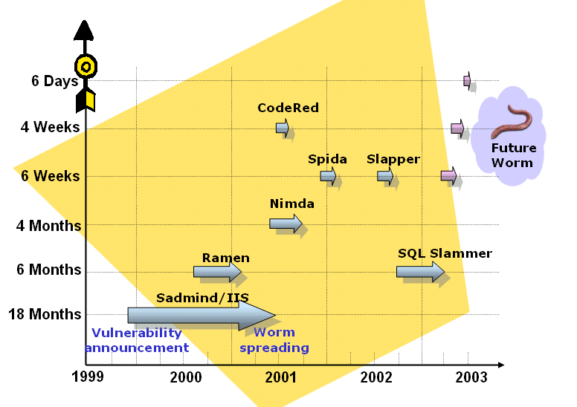
System vulnerability announcement & worm exploitation
Notes:
Discuss observed security trends (Stallings section 1.1 & Figure 1.2 above), noting growth in sophistication of attacks contrasting with decrease in skill & knowledge needed to mount an attack.

Slide 14
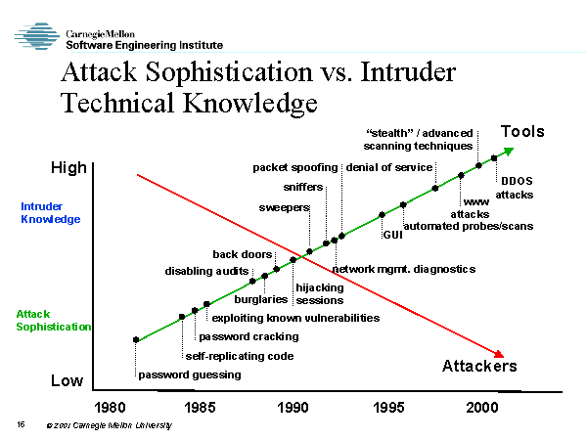
Notes:
These two fig. show us 3 things
The problems of protecting the system & network security is becoming more and more sophisticated, even a 11 year old boy may launch a very dangerous internet attacks
How can we define each of the attacks systematically, to make it clear that each characterized attach is unique.
How can we define the security requirements for users systematically, to make the protection has its own ways, its own strategies scientifically

Slide 15

OSI Security Architecture
ITU-T X.800 “Security Architecture for OSI”
defines a systematic way of defining and providing security requirements
for us it provides a useful, if abstract, overview of concepts we will study
Notes:
To assess effectively the security needs of an organization and to evaluate and choose various security products and policies, the manager responsible for security needs some systematic way of defining the requirements for security and characterizing the approaches to satisfying those requirements. This is difficult enough in a centralized data processing environment; with the use of local and wide area networks,the problems are compounded. ITU-T Recommendation X.800, Security Architecture for OSI, defines such a systematic approach. The OSI security architecture is useful to managers as a way of organizing the task of providing security.

Slide 16
Security ‘components’
Also known as security goals, objectives, etc.
Confidentiality
Data integrity
Origin integrity (aka. Authenticity)
Non-repudiability
Availability

Slide 17
Aspects of Security
consider 3 aspects of information security:
  security attack
    Any action that compromises the security of information owned by an organization
  security mechanism
    A process (or a device incorporating such a process) that is designed to detect, prevent,or recover from a security attack
  security service
    A processing or communication service that enhances the security of the data processing systems and the information transfers of an organization. The services are intended to counter security attacks, and they make use of one or more security mechanisms to provide the service.
Notes:
The OSI security architecture focuses on security attacks,mechanisms,and services. These can be defined briefly as follows:
• Security attack: Any action that compromises the security of information owned by an organization.
• Security mechanism: A process (or a device incorporating such a process) that is designed to detect, prevent,or recover from a security attack.
• Security service: A processing or communication service that enhances the security of the data processing systems and the information transfers of an organization.The services are intended to counter security attacks, and they make use of one or more security mechanisms to provide the service.

Slide 18
Security Attack
any action that compromises the security of information owned by an organization
information security is about how to prevent attacks, or failing that, to detect attacks on information-based systems
often threat & attack used to mean same thing
have a wide range of attacks
can focus of generic types of attacks
  passive
  active
Notes:
Expand on definition and use of “security attack”, as detailed above.
See Stallings Table 1.1 for definitions of threat and attack.

Slide 19

Passive Attacks
Notes:
Have “passive attacks” which attempt to learn or make use of information from the system but does not affect system resources.
By eavesdropping on, or monitoring of, transmissions to:
+ obtain message contents (as shown above in Stallings Figure 1.3a), or
+ monitor traffic flows
Are difficult to detect because they do not involve any alteration of the data.

Slide 20

Active Attacks
Notes:
Also have “active attacks” which attempt to alter system resources or affect their operation.
By modification of data stream to:
+ masquerade of one entity as some other
+ replay previous messages (as shown above in Stallings Figure 1.4b)
+ modify messages in transit
+ denial of service
Active attacks present the opposite characteristics of passive attacks. Whereas passive attacks are difficult to detect, measures are available to prevent their success. On the other hand, it is quite difficult to prevent active attacks absolutely, because of the wide variety of potential physical,software,and network vulnerabilities. Instead, the goal is to detect active attacks and to recover from any disruption or delays caused by them.

Slide 21
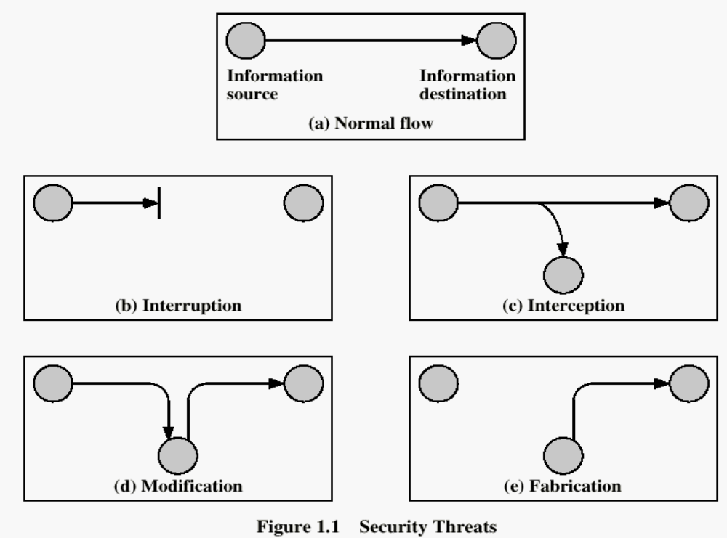
Security Attacks

Slide 22
Security Service
  enhance security of data processing systems and information transfers of an organization
  intended to counter security attacks
  using one or more security mechanisms
  often replicates functions normally associated with physical documents
    which, for example, have signatures, dates; need protection from disclosure, tampering, or destruction; be notarized or witnessed; be recorded or licensed
Notes:
Consider the role of a security service, and what may be required.
Note both similarities and differences with traditional paper documents, which for example:
have signatures & dates;
need protection from disclosure, tampering, or destruction;
may be notarized or witnessed;
may be recorded or licensed

Slide 23
Security Services
X.800:
  “a service provided by a protocol layer of communicating open systems, which ensures adequate security of the systems or of data transfers”
RFC 2828:
  “a processing or communication service provided by a system to give a specific kind of protection to system resources”
Notes:
Also have a couple of definition of “security services” from relevant standards. X.800 defines a security service as a service provided by a protocol layer of communicating open systems, which ensures adequate security of the systems or of data transfers. Perhaps a clearer definition is found in RFC 2828, which provides the following definition: a processing or communication service that is provided by a system to give a specific kind of protection to system resources; security services implement security policies and are implemented by security mechanisms.

Slide 24
Security Services (X.800)
Authentication - assurance that the communicating entity is the one claimed
  Peer entity, data origin
Access Control - prevention of the unauthorized use of a resource
Confidentiality –protection of data from unauthorized disclosure
  Connection confi.
  Connectionless confi.
  Selective-field confi.
  Traffic-flow confi.
Notes:
This list includes the various "classic" security services which are traditionally discussed.
Note there is a degree of ambiguity as to the meaning of these terms, and overlap in their use.
See Stallings Table 1.2 for details of the 5 Security Service categories and the 14 specific services given in X.800.

Slide 25
Security Services (X.800)
Data Integrity - assurance that data received is as sent by an authorized entity, no modification, insertion, deletion, or replay.
  Connection integrity with recovery
  Connection integrity without recovery
  Selective-field connection integrity
  Connectionless integrity
  Selective-field connectionless integrity
Notes:
Which is stronger? Having more requirements? Hard to achieve?

Slide 26
Security Mechanisms (X.800)
Non-Repudiation - protection against denial by one of the parties in a communication
  Non for origin, non for destination
Availability- the property of a system or a system resource being accessible and usable on the demand by an authorized system entity, according to performance specifications for the system

Slide 27
Security Mechanism
feature designed to detect, prevent, or recover from a security attack
no single mechanism that will support all services required
however one particular element underlies many of the security mechanisms in use:
  cryptographic techniques
hence our focus on this topic
Notes:
Now introduce “Security Mechanism” which are the specific means of implementing one or more security services.
Note these mechanisms span a wide range of technical components, but one aspect seen in many is the use of cryptographic techniques.

Slide 28
Security Mechanisms (X.800)
specific security mechanisms:
  encipherment, digital signatures, access controls, data integrity, authentication exchange, traffic padding, routing control, notarization
pervasive security mechanisms:
  trusted functionality, security labels, event detection, security audit trails, security recovery
Notes:
Some examples of mechanisms from X.800. Note that the “specific security mechanisms” are protocol layer specific, whilst the “pervasive security mechanisms” are not. We will meet some of these mechanisms in much greater detail later.
See Stallings Table 1.3 for details of these mechanisms in X.800, and Table 1.4 for the relationship between services and mechanisms.

Slide 29
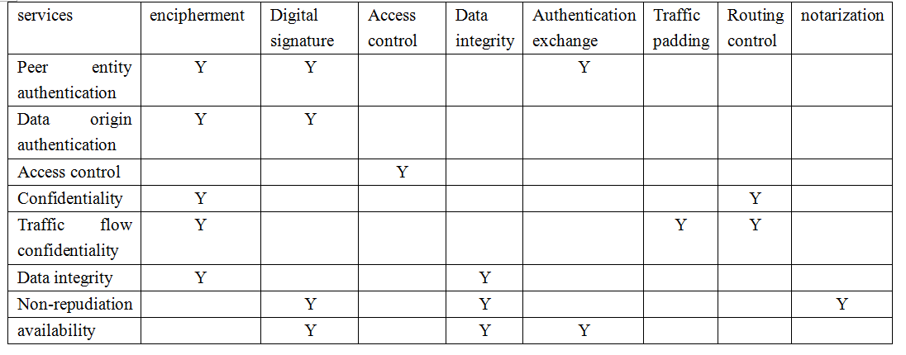
Relations between SS & SM
See table 1.4

Slide 30

Model for Network Security
Notes:
In considering the place of encryption, its useful to use the following two models from Stallings section 1.6.
The first, illustrated in Figure 1.5, models information flowing over an insecure communications channel, in the presence of possible opponents. Hence an appropriate security transform (encryption algorithm) can be used, with suitable keys, possibly negotiated using the presence of a trusted third party.

Slide 31
Model for Network Security
using this model requires us to:
  design a suitable algorithm for the security transformation
  generate the secret information (keys) used by the algorithm
  develop methods to distribute and share the secret information
  specify a protocol enabling the principals to use the transformation and secret information for a security service
Notes:
This general model shows that there are four basic tasks in designing a particular security service, as listed.

Slide 32

Model for Network Access Security
Notes:
The second, illustrated in Figure 1.6, model is concerned with controlled access to information or resources on a computer system, in the presence of possible opponents. Here appropriate controls are needed on the access and within the system, to provide suitable security. Some cryptographic techniques are useful here also.

Slide 33
Model for Network Access Security
using this model requires us to:
  select appropriate gatekeeper functions to identify users
  implement security controls to ensure only authorised users access designated information or resources
trusted computer systems may be useful to help implement this model
Notes:
Detail here the tasks needed to use this model.
Note that trusted computer systems (discussed in Ch 20 can be useful here).

Slide 34
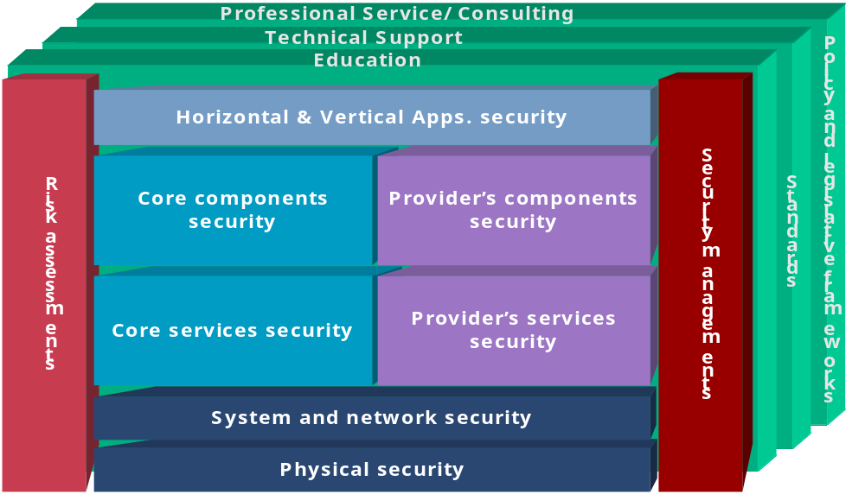
The security framework for information systems

Slide 35
Summary
have considered:
  definitions for:
    computer, network, internet security
X.800 standard
security attacks, services, mechanisms
models for network (access) security
Notes:
Chapter 1 summary.

