Slide 1

Network Security

Slide 2
The review
have considered:
  definitions for:
    computer, network, internet security
X.800 standard
security attacks, services, mechanisms
models for network (access) security

Slide 3
InfoSec Evolution
Compsec
Defence/Monitor
Evidence/Identify
Netsec
Cryptography
Infosec
Credible Computation

Slide 4
Computer system security
Steady and Reliability
Integrity and Availability
Security and Confidentiality
Fault tolerance and Trusty
Monitor and Accountability
Security Controllable

Slide 5
Network security
Interconnected devices security
network management software security
Remote access control
Inter-operation with multi-computer
Security for C/S, B/S, Cluster, Grid, Cloud
Web,VPN,Firewall,IDS/IPS,NetScan
Security for wireless, sensor networks

Slide 6
Contents security
Information processing
  Searching, collection, monitoring, and control
Information security managements
Information security laws
Disaster recovery
  Data recovery
  Service recovery

Slide 7
Key Points: Organization Overview
?
CPU
?
?
Input
Interface
?
Memory
Output
?
Network
?
DISK
?
?
Key Point

Slide 8
Key Points: OS Overview
User
Hacker
Programmer
Sys Designer
?
详见OS安全
?
App-Program
?
API, DLL
Syscall, Command
Operating System
Hardware（Interface）

Slide 9
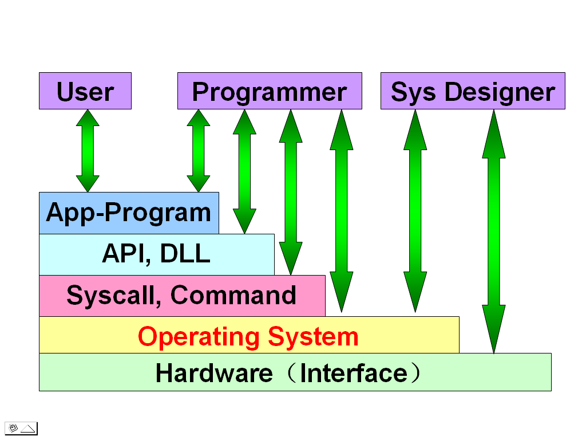
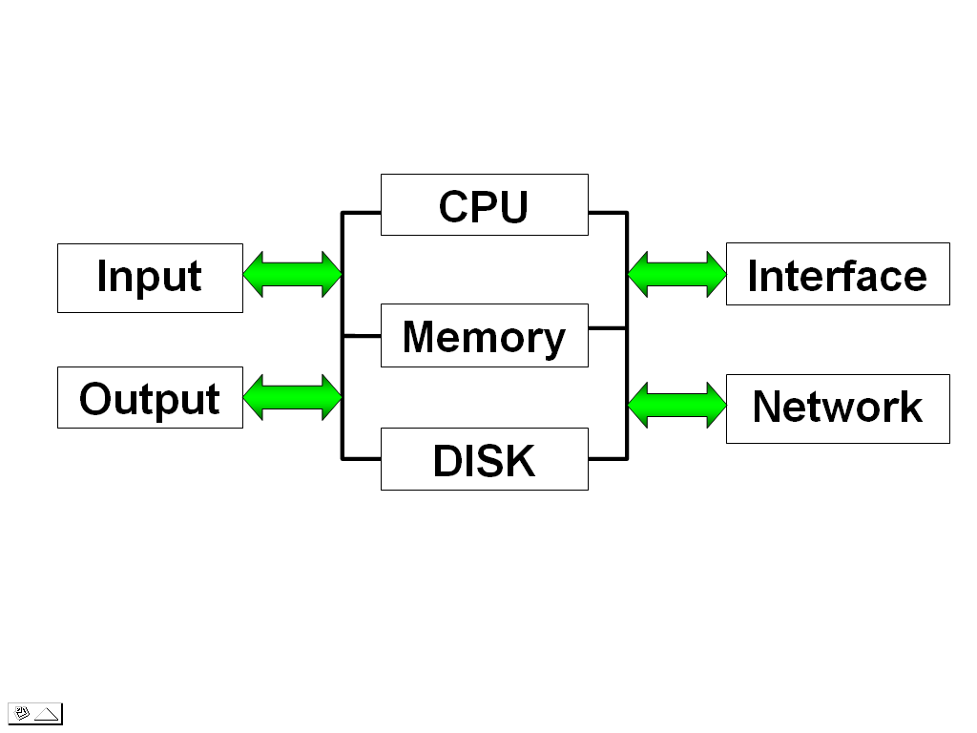
Key Points: Safe Guarantee
Trusted environments
Dependable computing
OS Overview
Dependable storage
Computer
Overview

Slide 10
Relations & combinations of security mechanisms
User identification
Access control
Encryption
Transferring security
Auditing
Recovery

Slide 11
The security framework for information systems
Professional Service/Consulting
Technical Support
Education
User Interface(B/S,C/S…)
Horizontal &Vertical Apps.
ERP，CRM，OA,Web mail.E-Gov…
App
admin
System
admin
Network
admin
App
Security
System
Security
Network
Security
App Middleware
Apache, Sendmail, MySQL…..
Providers’s App Middleware
DB2, SBS, Domino, WebSphere
Oracle, MQ, Weblogic,
Sys Middleware
SSL, IPtable( Firewall) ,
TAR, Squid ( Proxy )...
Providers’s Sys Middleware
Tivoli, Backup,Guard
OS:Windows,Linux,UNIX,Embed OS,Palm…
Hardware(Server,Route,Switch,Mobile)

Slide 12
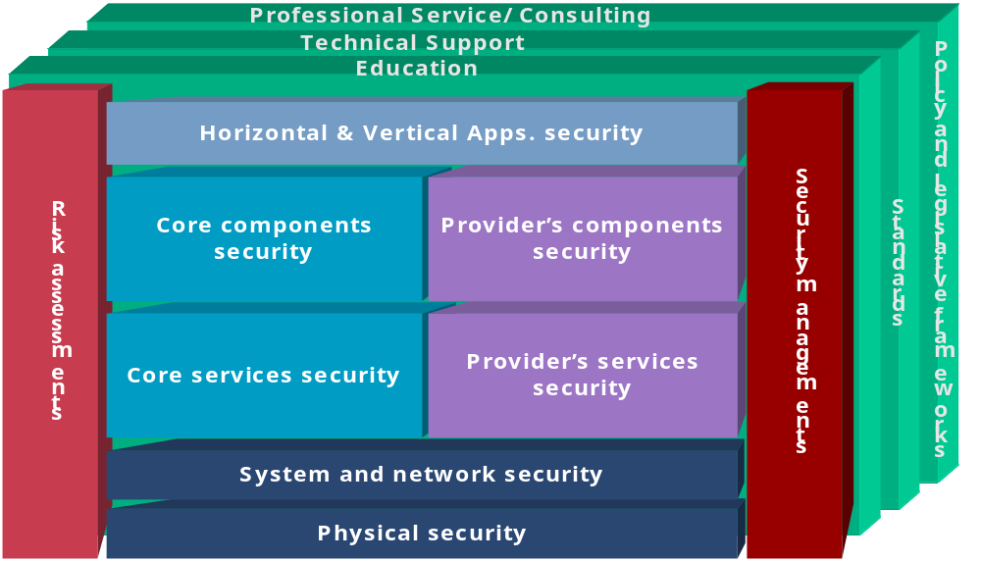
The security framework for information systems

Slide 13
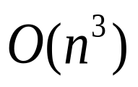
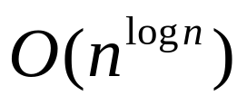
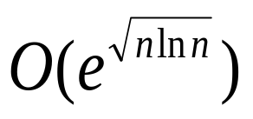
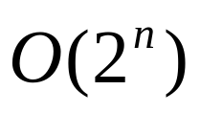
Consume time of Different time complexity
 | 10 | 100 | 10³ | 10⁶
O(n) | 0.00001s | 0.0001s | 0.001s | 1s
 | 0.0001 | 0.01 | 1 | 11.6 d
 | 0.001s | 1s | 16.7 m | 3.2e+4 y
 | 0.00001 s | 0.01 | 16.7 m | 3e+22 y
 | 0.00012 s | 35 m | 4e+22 | 6e+ 1600 y
 | 0.001 s | 4e+16 y | 3e+287 y | 3e+301016

Slide 14
Network Security
Chapter 2
Classical Encryption
Techniques

Slide 15
Symmetric Encryption
or conventional / private-key / single-key
sender and recipient share a common key
all classical encryption algorithms are private-key
was only type prior to invention of public-key in 1970’s
and by far most widely used
Notes:
Symmetric encryption, also referred to as conventional encryption or single-key encryption, was the only type of encryption in use prior to the development of public-key encryption in the 1970s. It remains by far the most widely used of the two types of encryption. All traditional schemes are symmetric / single key / private-key encryption algorithms, with a single key, used for both encryption and decryption. Since both sender and receiver are equivalent, either can encrypt or decrypt messages using that common key.

Slide 16
Some Basic Terminology
plaintext - original message
ciphertext - coded message
cipher - algorithm for transforming plaintext to ciphertext
key - info used in cipher known only to sender/receiver
encipher (encrypt) - converting plaintext to ciphertext
decipher (decrypt) - recovering ciphertext from plaintext
cryptography - study of encryption principles/methods
cryptanalysis (codebreaking) - study of principles/ methods of deciphering ciphertext without knowing key
cryptology - field of both cryptography and cryptanalysis
Notes:
Briefly review some terminology used throughout the course.

Slide 17

Symmetric Cipher Model
Notes:
Detail the five ingredients of the symmetric cipher model, shown in Stallings Figure 2.1:
plaintext - original message
encryption algorithm – performs substitutions/transformations on plaintext
secret key – control exact substitutions/transformations used in encryption algorithm
ciphertext - scrambled message
decryption algorithm – inverse of encryption algorithm

Slide 18
Requirements
two requirements for secure use of symmetric encryption:
  a strong encryption algorithm
  a secret key known only to sender / receiver
mathematically have:
  Y = E_{K}(X)
  X = D_{K}(Y)
assume encryption algorithm is known
implies a secure channel to distribute key
Notes:
We assume that it is impractical to decrypt a message on the basis of the cipher- text plus knowledge of the encryption/decryption algorithm, and do not need to keep the algorithm secret; rather we only need to keep the key secret. This feature of symmetric encryption is what makes it feasible for widespread use. It allows easy distribution of s/w and h/w implementations.
Can take a closer look at the essential elements of a symmetric encryption scheme: mathematically it can be considered a pair of functions with: plaintext X, ciphertext Y, key K, encryption algorithm E_{K}, decryption algorithm D_{K}.

Slide 19
Cryptography
characterize cryptographic system by:
  type of encryption operations used
    substitution / transposition / product
  number of keys used
    single-key or private / two-key or public
  way in which plaintext is processed
    block cipher, in/out is one block of elements
    Stream cipher, in/out is one continuous element
Notes:
Cryptographic systems can be characterized along these three independent dimensions.

Slide 20
Cryptanalysis
objective is to recover key not just message
general approaches:
  cryptanalytic attack
    rely on the nature of the algorithm
    plus general characteristics of the plaintext
    or some sample pairs of plaintext-ciphertext.
  brute-force attack
    try every possible key
Notes:
Typically objective is to recover the key in use rather then simply to recover the plaintext of a single ciphertext.
There are two general approaches:
Cryptanalytic attacks rely on the nature of the algorithm plus perhaps some knowledge of the general characteristics of the plaintext or even some sample plaintext-ciphertext pairs.
Brute-force attacks try every possible key on a piece of ciphertext until an intelligible translation into plaintext is obtained. On average,half of all possible keys must be tried to achieve success.

Slide 21
Cryptanalytic Attacks
ciphertext only
  only know algorithm & ciphertext, is statistical, know or can identify plaintext
known plaintext
  know/suspect plaintext & ciphertext
chosen plaintext
  select plaintext and obtain ciphertext
chosen ciphertext
  select ciphertext and obtain plaintext
chosen text
  select plaintext or ciphertext to en/decrypt
Notes:
Stallings Table 2.1 summarizes the various types of cryptanalytic attacks, based on the amount of information known to the cryptanalyst, from least to most. The most difficult problem is presented when all that is available is the ciphertext only. In some cases, not even the encryption algorithm is known, but in general we can assume that the opponent does know the algorithm used for encryption. Then with increasing information have the other attacks. Generally, an encryption algorithm is designed to withstand a known-plaintext attack.

Slide 22
More Definitions
unconditional security
  no matter how much computer power or time is available, the cipher cannot be broken since the ciphertext provides insufficient information to uniquely determine the corresponding plaintext
computational security
  given limited computing resources (eg time needed for calculations is greater than age of universe), the cipher cannot be broken
Notes:
Two more definitions are worthy of note. An encryption scheme is unconditionally secure if the ciphertext generated by the scheme does not contain enough information to determine uniquely the corresponding plaintext, no matter how much ciphertext is available. An encryption scheme is said to be computationally secure if either the cost of breaking the cipher exceeds the value of the encrypted information, or the time required to break the cipher exceeds the useful lifetime of the information. Unconditional security would be nice, but the only known such cipher is the one-time pad (later).
For all reasonable encryption algorithms, we have to assume computational security where it either takes too long, or is too expensive, to bother breaking the cipher.

Slide 23
Brute Force Search
always possible to simply try every key
most basic attack, proportional to key size
assume either know / recognise plaintext
Key Size (bits) | Number of Alternative Keys | Time required at 1 decryption/µs | Time required at 10⁶ decryptions/µs
32 | 2³² = 4.3 × 10⁹ | 2³¹ µs = 35.8 minutes | 2.15 milliseconds
56 | 2⁵⁶ = 7.2 × 10¹⁶ | 2⁵⁵ µs = 1142 years | 10.01 hours
128 | 2¹²⁸ = 3.4 × 10³⁸ | 2¹²⁷ µs = 5.4 × 10²⁴ years | 5.4 × 10¹⁸ years
168 | 2¹⁶⁸ = 3.7 × 10⁵⁰ | 2¹⁶⁷ µs = 5.9 × 10³⁶ years | 5.9 × 10³⁰ years
26 characters (permutation) | 26! = 4 × 10²⁶ | 2 × 10²⁶ µs = 6.4 × 10¹² years | 6.4 × 10⁶ years
Notes:
A brute-force attack involves trying every possible key until an intelligible translation of the ciphertext into plaintext is obtained. On average, half of all possible keys must be tried to achieve success. Stallings Table 2.2 shows how much time is required to conduct a brute-force attack, for various common key sizes (DES is 56, AES is 128, Triple-DES is 168, plus general mono-alphabetic cipher), where either a single system or a million parallel systems, are used.

Slide 24
Classical Substitution Ciphers
where letters of plaintext are replaced by other letters or by numbers or symbols
or if plaintext is viewed as a sequence of bits, then substitution involves replacing plaintext bit patterns with ciphertext bit patterns
Notes:
In this section and the next, we examine a sampling of what might be called classical encryption techniques. A study of these techniques enables us to illustrate the basic approaches to symmetric encryption used today and the types of cryptanalytic attacks that must be anticipated. The two basic building blocks of all encryption technique are substitution and transposition. We examine these in the next two sections. Finally, we discuss a system that combine both substitution and transposition.

Slide 25
Caesar Cipher
earliest known substitution cipher
by Julius Caesar
first attested use in military affairs
replaces each letter by 3rd letter on
example:
  meet me after the toga party
  PHHW PH DIWHU WKH WRJD SDUWB
Notes:
Substitution ciphers form the first of the fundamental building blocks. The core idea is to replace one basic unit (letter/byte) with another. Whilst the early Greeks described several substitution ciphers, the first attested use in military affairs of one was by Julius Caesar, described by him in Gallic Wars (cf. Kahn pp83-84). Still call any cipher using a simple letter shift a caesar cipher, not just those with shift 3.

Slide 26
Caesar Cipher
can define transformation as:
  a b c d e f g h i j k l m n o p q r s t u v w x y z
  D E F G H I J K L M N O P Q R S T U V W X Y Z A B C
mathematically give each letter a number
  a b c d e f g h i j k l m n o p q r s t u v w x y z
  0 1 2 3 4 5 6 7 8 9 10 11 12 13 14 15 16 17 18 19 20 21 22 23 24 25
then have Caesar cipher as:
  c = E(p) = (p + k) mod (26)
  p = D(c) = (c – k) mod (26)
Notes:
This mathematical description uses modulo (clock) arithmetic. Here, when you reach Z you go back to A and start again. Mod 26 implies that when you reach 26, you use 0 instead (ie the letter after Z, or 25 + 1 goes to A or 0).
Example: howdy (7,14,22,3,24) encrypted using key f (ie a shift of 5) is MTBID

Slide 27
Cryptanalysis of Caesar Cipher
only have 26 possible ciphers
  A maps to A,B,..Z
could simply try each in turn
a brute force search
given ciphertext, just try all shifts of letters
do need to recognize when have plaintext
eg. break ciphertext "GCUA VQ DTGCM"
Notes:
With a caesar cipher, there are only 26 possible keys, of which only 25 are of any use, since mapping A to A etc doesn't really obscure the message! Note this basic rule of cryptanalysis "check to ensure the cipher operator hasn't goofed and sent a plaintext message by mistake"!
Can try each of the keys (shifts) in turn, until can recognise the original message. See Stallings Fig 2.3 for example of search.
Note: as mentioned before, do need to be able to recognise when have an original message (ie is it English or whatever). Usually easy for humans, hard for computers. Though if using say compressed data could be much harder.
Example "GCUA VQ DTGCM" when broken gives "easy to break", with a shift of 2 (key C).

Slide 28
Monoalphabetic Cipher
rather than just shifting the alphabet
could shuffle (jumble) the letters arbitrarily
each plaintext letter maps to a different random ciphertext letter
hence key is 26 letters long
  Plain: abcdefghijklmnopqrstuvwxyz
  Cipher: DKVQFIBJWPESCXHTMYAUOLRGZN
  Plaintext: ifwewishtoreplaceletters
  Ciphertext: WIRFRWAJUHYFTSDVFSFUUFYA
Notes:
With only 25 possible keys, the Caesar cipher is far from secure. A dramatic increase in the key space can be achieved by allowing an arbitrary substitution, where the translation alphabet can be any permutation of the 26 alphabetic characters.
See example translation alphabet, and an encrypted message using it.

Slide 29
Monoalphabetic Cipher Security
now have a total of 26! = 4 x 1026 keys
with so many keys, might think is secure
but would be !!!WRONG!!!
problem is language characteristics
Notes:
Note that even given the very large number of keys, being 10 orders of magnitude greater than the key space for DES, the monoalphabetic substitution cipher is not secure, because it does not sufficiently obscure the underlying language characteristics.

Slide 30
Language Redundancy and Cryptanalysis
human languages are redundant
eg "th lrd s m shphrd shll nt wnt"
letters are not equally commonly used
in English E is by far the most common letter
  followed by T,R,N,I,O,A,S
other letters like Z,J,K,Q,X are fairly rare
have tables of single, double & triple letter frequencies for various languages
Notes:
As the example shows, we don't actually need all the letters in order to understand written English text. Here vowels were removed, but they're not the only redundancy. cf written Hebrew has no vowels for same reason. Are usually familiar with "party conversations", can hear one person speaking out of hubbub of many, again because of redundancy in aural language also. This redundancy is also the reason we can compress text files, the computer can derive a more compact encoding without losing any information. Basic idea is to count the relative frequencies of letters, and note the resulting pattern.

Slide 31

English Letter Frequencies
Notes:
Note that all human languages have varying letter frequencies, though the number of letters and their frequencies varies. Stallings Figure 2.5 shows English letter frequencies. Seberry & Pieprzyk, "Cryptography - An Introduction to Computer Security", Prentice-Hall 1989, Appendix A has letter frequency graphs for 20 languages (most European & Japanese & Malay).

Slide 32
Use in Cryptanalysis
key concept - monoalphabetic substitution ciphers do not change relative letter frequencies
discovered by Arabian scientists in 9th century
calculate letter frequencies for ciphertext
compare counts/plots against known values
if caesar cipher look for common peaks/troughs
  peaks at: A-E-I triple, NO pair, RST triple
  troughs at: JK, X-Z
for monoalphabetic must identify each letter
  tables of common double/triple letters help
Notes:
The simplicity and strength of the monoalphabetic substitution cipher meant it dominated cryptographic use for the first millenium AD. It was broken by Arabic scientists. The earliest known description is in Abu al-Kindi's "A Manuscript on Deciphering Cryptographic Messages", published in the 9th century but only rediscovered in 1987 in Istanbul, but other later works also attest to their knowledge of the field. Monoalphabetic ciphers are easy to break because they reflect the frequency data of the original alphabet. The cryptanalyst looks for a mapping between the observed pattern in the ciphertext, and the known source language letter frequencies. If English, look for peaks at: A-E-I triple, NO pair, RST triple, and troughs at: JK, X-Z.

Slide 33
Example Cryptanalysis
given ciphertext:
  UZQSOVUOHXMOPVGPOZPEVSGZWSZOPFPESXUDBMETSXAIZ
  VUEPHZHMDZSHZOWSFPAPPDTSVPQUZWYMXUZUHSX
  EPYEPOPDZSZUFPOMBZWPFUPZHMDJUDTMOHMQ
count relative letter frequencies (see text)
guess P & Z are e and t
guess ZW is th and hence ZWP is the
proceeding with trial and error finally get:
  it was disclosed yesterday that several informal but
  direct contacts have been made with political
  representatives of the viet cong in moscow
Notes:
Illustrate the process with this example from the text in Stallings section 2.2.

Slide 34
Playfair Cipher
not even the large number of keys in a monoalphabetic cipher provides security
one approach to improving security was to encrypt multiple letters
the Playfair Cipher is an example
invented by Charles Wheatstone in 1854, but named after his friend Baron Playfair
Notes:
Consider ways to reduce the "spikyness" of natural language text, since if just map one letter always to another, the frequency distribution is just shuffled. One approach is to encrypt more than one letter at once. The Playfair cipher is an example of doing this.

Slide 35
Playfair Key Matrix
a 5X5 matrix of letters based on a keyword
fill in letters of keyword (sans duplicates)
fill rest of matrix with other letters
eg. using the keyword MONARCHY
M | O | N | A | R
C | H | Y | B | D
E | F | G | I/J | K
L | P | Q | S | T
U | V | W | X | Z
Notes:
The best-known multiple-letter encryption cipher is the Playfair, which treats digrams in the plaintext as single units and translates these units into ciphertext digrams. The Playfair algorithm is based on the use of a 5x5 matrix of letters constructed using a keyword. The rules for filling in this 5x5 matrix are: L to R, top to bottom, first with keyword after duplicate letters have been removed, and then with the remain letters, with I/J used as a single letter. This example comes from Dorothy Sayer's book "Have His Carcase", in which Lord Peter Wimsey solves it, and describes the use of a probably word attack.

Slide 36
Encrypting and Decrypting
plaintext is encrypted two letters at a time
  if a pair is a repeated letter, insert filler like 'X’
  if both letters fall in the same row, replace each with letter to right (wrapping back to start from end)
  if both letters fall in the same column, replace each with the letter below it (again wrapping to top from bottom)
  otherwise each letter is replaced by the letter in the same row and in the column of the other letter of the pair
Notes:
Plaintext is encrypted two letters at a time,according to the rules as shown. Note how you wrap from right side back to left, or from bottom back to top.
if a pair is a repeated letter, insert a filler like 'X', eg. "balloon" encrypts as "ba lx lo on"
if both letters fall in the same row, replace each with letter to right (wrapping back to start from end), eg. “ar" encrypts as "RM"
if both letters fall in the same column, replace each with the letter below it (again wrapping to top from bottom), eg. “mu" encrypts to "CM"
otherwise each letter is replaced by the one in its row in the column of the other letter of the pair, eg. “hs" encrypts to "BP", and “ea" to "IM" or "JM" (as desired)
Decrypting of course works exactly in reverse. Can see this by working the example pairs shown, backwards.

Slide 37
Security of Playfair Cipher
security much improved over monoalphabetic
since have 26 x 26 = 676 digrams
would need a 676 entry frequency table to analyse (verses 26 for a monoalphabetic)
and correspondingly more ciphertext
was widely used for many years
  eg. by US & British military in WW1
it can be broken, given a few hundred letters
since still has much of plaintext structure
Notes:
The Playfair cipher is a great advance over simple monoalphabetic ciphers, since there are 26*26=676 digrams (vs 26 letters), so that identification of individual digrams is more difficult. Also,the relative frequencies of individual letters exhibit a much greater range than that of digrams, making frequency analysis much more difficult. The Playfair cipher was for a long time considered unbreakable. It was used as the standard field system by the British Army in World War I and still enjoyed considerable use by the U.S.Army and other Allied forces during World War II. Despite this level of confidence in its security,the Playfair cipher is relatively easy to break because it still leaves much of the structure of the plaintext language intact

Slide 38
Polyalphabetic Ciphers
polyalphabetic substitution ciphers
improve security using multiple cipher alphabets
make cryptanalysis harder with more alphabets to guess and flatter frequency distribution
use a key to select which alphabet is used for each letter of the message
use each alphabet in turn
repeat from start after end of key is reached
Notes:
One approach to reducing the "spikyness" of natural language text is used the Playfair cipher which encrypts more than one letter at once. We now consider the other alternative, using multiple cipher alphabets in turn. This gives the attacker more work, since many alphabets need to be guessed, and because the frequency distribution is more complex, since the same plaintext letter could be replaced by several ciphertext letters, depending on which alphabet is used. The general name for this approach is a polyalphabetic substitution cipher. All these techniques have the following features in common:
A set of related monoalphabetic substitution rules is used.
2. A key determines which particular rule is chosen for a given transformation.

Slide 39
Vigenère Cipher
simplest polyalphabetic substitution cipher
effectively multiple caesar ciphers
key is multiple letters long K = k₁ k₂ ... k_{d}
i^{th} letter specifies i^{th} alphabet to use
use each alphabet in turn
repeat from start after d letters in message
decryption simply works in reverse
Notes:
The best known, and one of the simplest, such algorithms is referred to as the Vigenère cipher, where the set of related monoalphabetic substitution rules consists of the 26 Caesar ciphers, with shifts of 0 through 25. Each cipher is denoted by a key letter, which is the ciphertext letter that substitutes for the plaintext letter ‘a’, and which are each used in turn, as shown next.

Slide 40
Example of Vigenère Cipher
write the plaintext out
write the keyword repeated above it
use each key letter as a caesar cipher key
encrypt the corresponding plaintext letter
eg using keyword deceptive
  key: deceptivedeceptivedeceptive
  plaintext: wearediscoveredsaveyourself
  ciphertext:ZICVTWQNGRZGVTWAVZHCQYGLMGJ
Notes:
Discuss this simple example from text Stallings section 2.2.

Slide 41
Aids
simple aids can assist with en/decryption
a Saint-Cyr Slide is a simple manual aid
  a slide with repeated alphabet
  line up plaintext 'A' with key letter, eg 'C'
  then read off any mapping for key letter
can bend round into a cipher disk
or expand into a Vigenère Tableau
Notes:
Implementing polyalphabetic ciphers by hand can be very tedious. Various aids were devised to assist the process.
The "Saint-Cyr Slide" was popularised and named by Jean Kerckhoffs, who published a famous early text "La Cryptographie Militaire" (Miltary Cryptography) in 1883. He named the slide after the French National Military Academy where the methods were taught. He also noted that any slide can be expanded into a tableau, or bent round into a cipher disk.
The Vigenère Tableau (given in the text as Stallings Table 2.3) is a complete set of forward shifted alphabet mappings.

Slide 42
Security of Vigenère Ciphers
have multiple ciphertext letters for each plaintext letter
hence letter frequencies are obscured
but not totally lost
start with letter frequencies
  see if look monoalphabetic or not
if not, then need to determine number of alphabets, since then can attach each
Notes:
The Vigenère & related polyalphabetic ciphers still do not completely obscure the underlying language characteristics.
The key to breaking them was to identify the number of translation alphabets, and then attack each separately.

Slide 43
Kasiski Method
method developed by Babbage / Kasiski
repetitions in ciphertext give clues to period
so find same plaintext an exact period apart
which results in the same ciphertext
of course, could also be random fluke
eg repeated “VTW” in previous example
suggests size of 3 or 9
then attack each monoalphabetic cipher individually using same techniques as before
Notes:
For some centuries the Vigenère cipher was le chiffre indéchiffrable (the unbreakable cipher). As a result of a challenge, it was broken by Charles Babbage (the inventor of the computer) in 1854 but kept secret (possibly because of the Crimean War - not the first time governments have kept advances to themselves!). The method was independently reinvented by a Prussian, Friedrich Kasiski, who published the attack now named after him in 1863. However lack of major advances meant that various polyalphabetic substitution ciphers were used into the 20C. One very famous incident was the breaking of the Zimmermann telegram in WW1 which resulted in the USA entering the war.
In general the approach is to find a number of duplicated sequences, collect all their distances apart, look for common factors, remembering that some will be random flukes and need to be discarded. Now have a series of monoalphabetic ciphers, each with original language letter frequency characteristics. Can attack these in turn to break the cipher.

Slide 44
Autokey Cipher
ideally want a key as long as the message
Vigenère proposed the autokey cipher
with keyword is prefixed to message as key
knowing keyword can recover the first few letters
use these in turn on the rest of the message
but still have frequency characteristics to attack
eg. given key deceptive
  key: deceptivewearediscoveredsav
  plaintext: wearediscoveredsaveyourself
  ciphertext:ZICVTWQNGKZEIIGASXSTSLVVWLA
Notes:
Taking the polyalphabetic idea to the extreme, want as many different translation alphabets as letters in the message being sent. One way of doing this with a smallish key, is to use the Autokey cipher.
The example uses the keyword "DECEPTIVE" prefixed to as much of the message "WEAREDISCOVEREDSAV" as is needed. When deciphering, recover the first 9 letters using the keyword "DECEPTIVE". Then instead of repeating the keyword, start using the recovered letters from the message "WEAREDISC". As recover more letters, have more of key to recover later letters.
Problem is that the same language characteristics are used by the key as the message. ie. a key of 'E' will be used more often than a 'T' etc hence an 'E' encrypted with a key of 'E' occurs with probability (0.1275)2 = 0.01663, about twice as often as a 'T' encrypted with a key of 'T' have to use a larger frequency table, but it exists given sufficient ciphertext this can be broken.

Slide 45
One-Time Pad
if a truly random key as long as the message is used, the cipher will be secure
called a One-Time pad
is unbreakable since ciphertext bears no statistical relationship to the plaintext
since for any plaintext & any ciphertext there exists a key mapping one to other
can only use the key once though
problems in generation & safe distribution of key
Notes:
The One-Time Pad is an evolution of the Vernham cipher, which was invented by Gilbert Vernham in 1918, and used a long tape of random letters to encrypt the message. An Army Signal Corp officer, Joseph Mauborgne, proposed an improvement using a random key that was truly as long as the message, with no repetitions, which thus totally obscures the original message. It produces random output that bears no statistical relationship to the plaintext. Because the ciphertext contains no information whatsoever about the plaintext, there is simply no way to break the code, since any plaintext can be mapped to any ciphertext given some key.
The one-time pad offers complete security but, in practice, has two fundamental difficulties:
There is the practical problem of making large quantities of random keys.
2. And the problem of key distribution and protection, where for every message to be sent, a key of equal length is needed by both sender and receiver.
Because of these difficulties, the one-time pad is of limited utility, and is useful primarily for low-bandwidth channels requiring very high security.

Slide 46
Transposition Ciphers
now consider classical transposition or permutation ciphers
these hide the message by rearranging the letter order
without altering the actual letters used
can recognise these since have the same frequency distribution as the original text
Notes:
All the techniques examined so far involve the substitution of a ciphertext symbol for a plaintext symbol. A very different kind of mapping is achieved by performing some sort of permutation on the plaintext letters. This technique is referred to as a transposition cipher, and form the second basic building block of ciphers. The core idea is to rearrange the order of basic units (letters/bytes/bits) without altering their actual values.

Slide 47
Rail Fence cipher
write message letters out diagonally over a number of rows
then read off cipher row by row
eg. write message out as:
  m e m a t r h t g p r y
  e t e f e t e o a a t
giving ciphertext
  MEMATRHTGPRYETEFETEOAAT
Notes:
The simplest such cipher is the rail fence technique, in which the plaintext is written down as a sequence of diagonals and then read off as a sequence of rows.
The example message is: "meet me after the toga party" with a rail fence of depth 2.
This sort of thing would be trivial to cryptanalyze.

Slide 48
Row Transposition Ciphers
a more complex transposition
write letters of message out in rows over a specified number of columns
then reorder the columns according to some key before reading off the rows
  Key: 3 4 2 1 5 6 7
  Plaintext: a t t a c k p
  o s t p o n e
  d u n t i l t
  w o a m x y z
  Ciphertext: TTNAAPTMTSUOAODWCOIXKNLYPETZ
Notes:
A more complex transposition cipher is to write the message in a rectangle, row by row, and read the message off shuffling the order of the columns in each row.
A pure transposition cipher is easily recognized because it has the same letter frequencies as the original plaintext. For the type of columnar transposition just shown, cryptanalysis is fairly straightforward and involves laying out the ciphertext in a matrix and playing around with column positions. Digram and trigram frequency tables can be useful.

Slide 49
Product Ciphers
ciphers using substitutions or transpositions are not secure because of language characteristics
hence consider using several ciphers in succession to make harder, but:
  two substitutions make a more complex substitution
  two transpositions make more complex transposition
  but a substitution followed by a transposition makes a new much harder cipher
this is bridge from classical to modern ciphers
Notes:
Have seen that ciphers based on just substitutions or transpositions are not secure, and can be attacked because they do not sufficient obscure the underlying language structure
So consider using several ciphers in succession to make harder.
A substitution followed by a transposition is known as a Product Cipher, and makes a new much more secure cipher, and forms the bridge to modern ciphers.

Slide 50
Rotor Machines
before modern ciphers, rotor machines were most common complex ciphers in use
widely used in WW2
  German Enigma, Allied Hagelin, Japanese Purple
implemented a very complex, varying substitution cipher
used a series of cylinders, each giving one substitution, which rotated and changed after each letter was encrypted
with 3 cylinders have 26³=17576 alphabets
Notes:
The next major advance in ciphers required use of mechanical cipher machines which enabled to use of complex varying substitutions.
A rotor machine consists of a set of independently rotating cylinders through which electrical pulses can flow. Each cylinder has 26 input pins and 26 output pins, with internal wiring that connects each input pin to a unique output pin. If we associate each input and output pin with a letter of the alphabet, then a single cylinder defines a monoalphabetic substitution. After each input key is depressed, the cylinder rotates one position, so that the internal connections are shifted accordingly. The power of the rotor machine is in the use of multiple cylinders, in which the output pins of one cylinder are connected to the input pins of the next, and with the cylinders rotating like an “odometer”, leading to a very large number of substitution alphabets being used, eg with 3 cylinders have 26³=17576 alphabets used.
They were extensively used in world war 2, and the history of their use and analysis is one of the great stories from WW2.

Slide 51

Hagelin Rotor Machine
Notes:
This photo of an Allied Hagelin machine was taken by Lawrie Brown at Eurocrypt'93 in Norway. Note pen for scale, and the rotating cipher wheels near the front.

Slide 52
Steganography
an alternative to encryption
hides existence of message
  using only a subset of letters/words in a longer message marked in some way
  using invisible ink
  hiding in LSB in graphic image or sound file (water mark)
has drawbacks
  high overhead to hide relatively few info bits
Notes:
Steganography is an alternative to encryption which hides the very existence of a message by some means. There are a large range of techniques for doing this.
Steganography has a number of drawbacks when compared to encryption. It requires a lot of overhead to hide a relatively few bits of information.
Also, once the system is discovered, it becomes virtually worthless, although a message can be first encrypted and then hidden using steganography.

Slide 53
Summary
have considered:
  classical cipher techniques and terminology
  monoalphabetic substitution ciphers
  cryptanalysis using letter frequencies
  Playfair cipher
  polyalphabetic ciphers
  transposition ciphers
  product ciphers and rotor machines
  stenography
Notes:
Chapter 2 summary.

Slide 54
Cryptography and Network Security
Chapter 3
Notes:
Lecture slides by Lawrie Brown for “Cryptography and Network Security”, 4/e, by William Stallings, Chapter 3 – “Block Ciphers and the Data Encryption Standard”.

Slide 55
Chapter 3 – Block Ciphers and the Data Encryption Standard
All the afternoon Mungo had been working on Stern's code, principally with the aid of the latest messages which he had copied down at the Nevin Square drop. Stern was very confident. He must be well aware London Central knew about that drop. It was obvious that they didn't care how often Mungo read their messages, so confident were they in the impenetrability of the code.
—Talking to Strange Men, Ruth Rendell
Notes:
Intro quote.

Slide 56
Modern Block Ciphers
now look at modern block ciphers
one of the most widely used types of cryptographic algorithms
provide secrecy /authentication services
focus on DES (Data Encryption Standard)
to illustrate block cipher design principles
Notes:
Modern block ciphers are widely used to provide encryption of quantities of information, and/or a cryptographic checksum to ensure the contents have not been altered. We continue to use block ciphers because they are comparatively fast, and because we know a fair amount about how to design them. Will use the widely known DES algorithm to illustrate some key block cipher design principles.

Slide 57
Block vs Stream Ciphers
block ciphers process messages in blocks, each of which is then en/decrypted
like a substitution on very big characters
  64-bits or more
stream ciphers process messages a bit or byte at a time when en/decrypting
many current ciphers are block ciphers
broader range of applications
Notes:
Block ciphers work a on block / word at a time, which is some number of bits. All of these bits have to be available before the block can be processed. Stream ciphers work on a bit or byte of the message at a time, hence process it as a “stream”. Block ciphers are currently better analysed, and seem to have a broader range of applications, hence focus on them.

Slide 58
Block Cipher Principles
most symmetric block ciphers are based on a Feistel Cipher Structure
needed since must be able to decrypt ciphertext to recover messages efficiently
block ciphers look like an extremely large substitution
would need table of 2⁶⁴ entries for a 64-bit block
instead create from smaller building blocks
using idea of a product cipher
Notes:
Most symmetric block encryption algorithms in current use are based on a structure referred to as a Feistel block cipher. A block cipher operates on a plaintext block of n bits to produce a ciphertext block of n bits. An arbitrary reversible substitution cipher for a large block size is not practical, however, from an implementation and performance point of view. In general, for an n-bit general substitution block cipher, the size of the key is n x 2^{n}. For a 64-bit block, which is a desirable length to thwart statistical attacks, the key size is 64 x 2⁶⁴ = 2⁷⁰ = 10²¹ bits. In considering these difficulties, Feistel points out that what is needed is an approximation to the ideal block cipher system for large n, built up out of components that are easily realizable.

Slide 59

Ideal Block Cipher
Notes:
Feistel refers to an n-bit general substitution as an ideal block cipher, because it allows for the maximum number of possible encryption mappings from the plaintext to ciphertext block. A 4-bit input produces one of 16 possible input states, which is mapped by the substitution cipher into a unique one of 16 possible output states, each of which is represented by 4 ciphertext bits. The encryption and decryption mappings can be defined by a tabulation, as shown in Stallings Figure 3.1. It illustrates a tiny 4-bit substitution to show that each possible input can be arbitrarily mapped to any output - which is why its complexity grows so rapidly.

Slide 60
Claude Shannon and Substitution-Permutation Ciphers
Claude Shannon introduced idea of substitution-permutation (S-P) networks in 1949 paper
form basis of modern block ciphers
S-P nets are based on the two primitive cryptographic operations seen before:
  substitution (S-box)
  permutation (P-box)
provide confusion & diffusion of message & key
Notes:
Claude Shannon’s 1949 paper has the key ideas that led to the development of modern block ciphers. Critically, it was the technique of layering groups of S-boxes separated by a larger P-box to form the S-P network, a complex form of a product cipher. He also introduced the ideas of confusion and diffusion, notionally provided by S-boxes and P-boxes (in conjunction with S-boxes).

Slide 61
Confusion and Diffusion
cipher needs to completely obscure statistical properties of original message
a one-time pad does this
more practically Shannon suggested combining S & P elements to obtain:
diffusion – dissipates statistical structure of plaintext over bulk of ciphertext
confusion – makes relationship between ciphertext and key as complex as possible
Notes:
The terms diffusion and confusion were introduced by Claude Shannon to capture the two basic building blocks for any cryptographic system. Every block cipher involves a transformation of a block of plaintext into a block of ciphertext, where the transformation depends on the key. The mechanism of diffusion seeks to make the statistical relationship between the plaintext and ciphertext as complex as possible in order to thwart attempts to deduce the key. Confusion seeks to make the relationship between the statistics of the ciphertext and the value of the encryption key as complex as possible, again to thwart attempts to discover the key.
So successful are diffusion and confusion in capturing the essence of the desired attributes of a block cipher that they have become the cornerstone of modern block cipher design.

Slide 62
Feistel Cipher Structure
Horst Feistel devised the feistel cipher
  based on concept of invertible product cipher
partitions input block into two halves
  process through multiple rounds which
  perform a substitution on left data half
  based on round function of right half & subkey
  then have permutation swapping halves
implements Shannon’s S-P net concept
Notes:
Horst Feistel, working at IBM Thomas J Watson Research Labs devised a suitable invertible cipher structure in early 70's.
One of Feistel's main contributions was the invention of a suitable structure which adapted Shannon's S-P network in an easily inverted structure. It partitions input block into two halves which are processed through multiple rounds which perform a substitution on left data half, based on round function of right half & subkey, and then have permutation swapping halves. Essentially the same h/w or s/w is used for both encryption and decryption, with just a slight change in how the keys are used. One layer of S-boxes and the following P-box are used to form the round function.

Slide 63
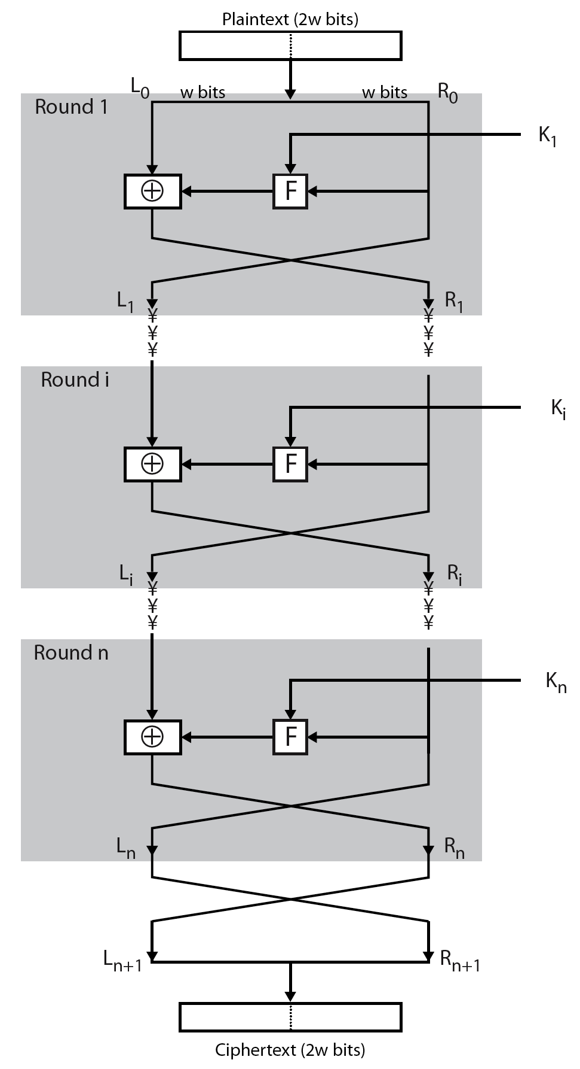
Feistel Cipher Structure
Notes:
Stallings Figure 3.2 illustrates the classical feistel cipher structure, with data split in 2 halves, processed through a number of rounds which perform a substitution on left half using output of round function on right half & key, and a permutation which swaps halves, as listed previously.

Slide 64
Feistel Cipher Design Elements
block size
key size
number of rounds
subkey generation algorithm
round function
fast software en/decryption
ease of analysis
Notes:
The exact realization of a Feistel network depends on the choice of the following parameters and design features:
block size - increasing size improves security, but slows cipher
key size - increasing size improves security, makes exhaustive key searching harder, but may slow cipher
number of rounds - increasing number improves security, but slows cipher
subkey generation algorithm - greater complexity can make analysis harder, but slows cipher
round function - greater complexity can make analysis harder, but slows cipher
fast software en/decryption - more recent concern for practical use
ease of analysis - for easier validation & testing of strength

Slide 65
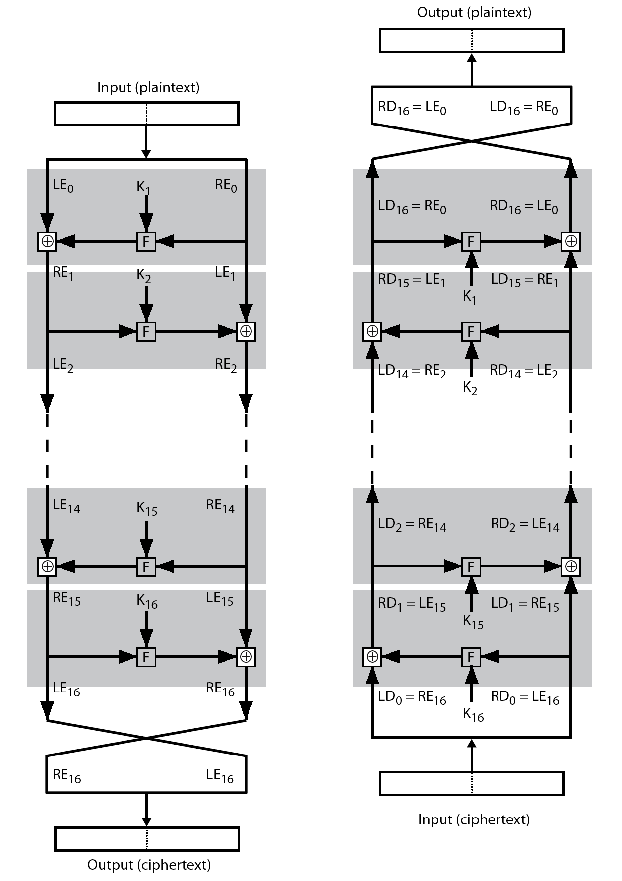
Feistel Cipher Decryption
Notes:
The process of decryption with a Feistel cipher, as shown in Stallings Figure 3.3, is essentially the same as the encryption process. The rule is as follows: Use the ciphertext as input to the algorithm, but use the subkeys Ki in reverse order. That is, use Kn in the first round, Kn–1 in the second round, and so on until K1 is used in the last round. This is a nice feature because it means we need not implement two different algorithms, one for encryption and one for decryption.

Slide 66
Data Encryption Standard (DES)
most widely used block cipher in world
adopted in 1977 by NBS (now NIST)
  as FIPS PUB 46
encrypts 64-bit data using 56-bit key
has widespread use
has been considerable controversy over its security
Notes:
The most widely used private key block cipher, is the Data Encryption Standard (DES). It was adopted in 1977 by the National Bureau of Standards as Federal Information Processing Standard 46 (FIPS PUB 46). DES encrypts data in 64-bit blocks using a 56-bit key. The DES enjoys widespread use. It has also been the subject of much controversy its security.

Slide 67
DES History
IBM developed Lucifer cipher
  by team led by Feistel in late 60’s
  used 64-bit data blocks with 128-bit key
then redeveloped as a commercial cipher with input from NSA and others
in 1973 NBS issued request for proposals for a national cipher standard
IBM submitted their revised Lucifer which was eventually accepted as the DES
Notes:
In the late 1960s, IBM set up a research project in computer cryptography led by Horst Feistel. The project concluded in 1971 with the development of the LUCIFER algorithm. LUCIFER is a Feistel block cipher that operates on blocks of 64 bits, using a key size of 128 bits.
Because of the promising results produced by the LUCIFER project, IBM embarked on an effort, headed by Walter Tuchman and Carl Meyer, to develop a marketable commercial encryption product that ideally could be implemented on a single chip. It involved not only IBM researchers but also outside consultants and technical advice from NSA. The outcome of this effort was a refined version of LUCIFER that was more resistant to cryptanalysis but that had a reduced key size of 56 bits, to fit on a single chip.
In 1973, the National Bureau of Standards (NBS) issued a request for proposals for a national cipher standard. IBM submitted the modified LUCIFER. It was by far the best algorithm proposed and was adopted in 1977 as the Data Encryption Standard.

Slide 68
DES Design Controversy
although DES standard is public
was considerable controversy over design
  in choice of 56-bit key (vs Lucifer 128-bit)
  and because design criteria were classified
subsequent events and public analysis show in fact design was appropriate
use of DES has flourished
  especially in financial applications
  still standardised for legacy application use
Notes:
Before its adoption as a standard, the proposed DES was subjected to intense & continuing criticism over the size of its key & the classified design criteria.
Recent analysis has shown despite this controversy, that DES is well designed. DES is theoretically broken using Differential or Linear Cryptanalysis but in practise is unlikely to be a problem yet. Also rapid advances in computing speed though have rendered the 56 bit key susceptible to exhaustive key search, as predicted by Diffie & Hellman.
DES has flourished and is widely used, especially in financial applications. It is still standardized for legacy systems, with either AES or triple DES for new applications.

Slide 69
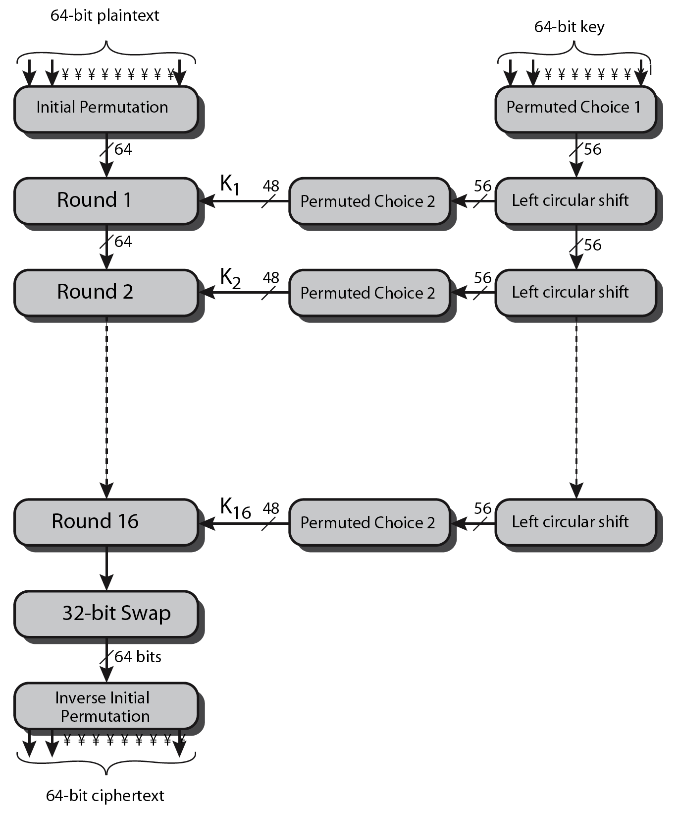
DES Encryption Overview
Notes:
The overall scheme for DES encryption is illustrated in Stallings Figure3.4, which takes as input 64-bits of data and of key.
The left side shows the basic process for enciphering a 64-bit data block which consists of:
- an initial permutation (IP) which shuffles the 64-bit input block
- 16 rounds of a complex key dependent round function involving substitutions & permutations
- a final permutation, being the inverse of IP
The right side shows the handling of the 56-bit key and consists of:
- an initial permutation of the key (PC1) which selects 56-bits out of the 64-bits input, in two 28-bit halves
- 16 stages to generate the 48-bit subkeys using a left circular shift and a permutation of the two 28-bit halves

Slide 70
Initial Permutation IP
first step of the data computation
IP reorders the input data bits
even bits to LH half, odd bits to RH half
quite regular in structure (easy in h/w)
example:
IP(675a6967 5e5a6b5a) = (ffb2194d 004df6fb)
Notes:
The initial permutation and its inverse are defined by tables, as shown in Stallings Tables 3.2a and 3.2b, respectively. The tables are to be interpreted as follows. The input to a table consists of 64 bits numbered left to right from 1 to 64. The 64 entries in the permutation table contain a permutation of the numbers from 1 to 64. Each entry in the permutation table indicates the position of a numbered input bit in the output, which also consists of 64 bits.
Note that the bit numbering for DES reflects IBM mainframe practice, and is the opposite of what we now mostly use - so be careful! Numbers from Bit 1 (leftmost, most significant) to bit 32/48/64 etc (rightmost, least significant).
Note that examples are specified using hexadecimal.
Here a 64-bit plaintext value of “675a6967 5e5a6b5a” (written in left & right halves) after permuting with IP becomes “ffb2194d 004df6fb”.

Slide 71
DES Round Structure
uses two 32-bit L & R halves
as for any Feistel cipher can describe as:
  L_{i} = R_{i–1}
  R_{i} = L_{i–1} ⊕ F(R_{i–1}, K_{i})
F takes 32-bit R half and 48-bit subkey:
  expands R to 48-bits using perm E
  adds to subkey using XOR
  passes through 8 S-boxes to get 32-bit result
  finally permutes using 32-bit perm P
Notes:
Detail here the internal structure of the DES round function F, which takes R half & subkey, and processes them through E, add subkey, S & P.
This follows the classic structure for a feistel cipher.
Note that the s-boxes provide the “confusion” of data and key values, whilst the permutation P then spreads this as widely as possible, so each S-box output affects as many S-box inputs in the next round as possible, giving “diffusion”.

Slide 72

DES Round Structure
Notes:
Stallings Figure 3.6 illustrates the internal structure of the DES round function F. The R input is first expanded to 48 bits by using expansion table E that defines a permutation plus an expansion that involves duplication of 16 of the R bits (Stallings Table 3.2c). The resulting 48 bits are XORed with Ki. This 48-bit result passes through a substitution function comprising 8 S-boxes which each map 6 input bits to 4 output bits, producing a 32-bit output, which is then permuted by permutation P as defined by Stallings Table 3.2d.

Slide 73
Substitution Boxes S
have eight S-boxes which map 6 to 4 bits
each S-box is actually 4 little 4 bit boxes
  outer bits 1 & 6 (row bits) select one row of 4
  inner bits 2-5 (col bits) are substituted
  result is 8 lots of 4 bits, or 32 bits
row selection depends on both data & key
  feature known as autoclaving (autokeying)
example:
  S(18 09 12 3d 11 17 38 39) = 5fd25e03
Notes:
The substitution consists of a set of eight S-boxes, each of which accepts 6 bits as input and produces 4 bits as output. These transformations are defined in Stallings Table 3.3, which is interpreted as follows: The first and last bits of the input to box Si form a 2-bit binary number to select one of four substitutions defined by the four rows in the table for Si. The middle four bits select one of the sixteen columns. The decimal value in the cell selected by the row and column is then converted to its 4-bit representation to produce the output. For example, in S1, for input 011001, the row is 01 (row 1) and the column is 1100 (column 12). The value in row 1, column 12 is 9, so the output is 1001.
The example lists 8 6-bit values (ie 18 in hex is 011000 in binary, 09 hex is 001001 binary, 12 hex is 010010 binary, 3d hex is 111101 binary etc), each of which is replaced following the process detailed above using the appropriate S-box. ie
S1(011000) lookup row 00 col 1100 in S1 to get 5
S2(001001) lookup row 01 col 0100 in S2 to get 15 = f in hex
S3(010010) lookup row 00 col 1001 in S3 to get 13 = d in hex
S4(111101) lookup row 11 col 1110 in S4 to get 2 etc

Slide 74
DES Key Schedule
forms subkeys used in each round
  initial permutation of the key (PC1) which selects 56-bits in two 28-bit halves
  16 stages consisting of:
    rotating each half separately either 1 or 2 places depending on the key rotation schedule K
    selecting 24-bits from each half & permuting them by PC2 for use in round function F
note practical use issues in h/w vs s/w
Notes:
The DES Key Schedule generates the subkeys needed for each data encryption round. The 64-bit key input is first processed by Permuted Choice One (Stallings Table 3.4b). The resulting 56-bit key is then treated as two 28-bit quantities C & D. In each round, these are separately processed throgh a circular left shift (rotation) of 1 or 2bits as shown in Stallings Table 3.4d. These shifted values serve as input to the next round of the key schedule. They also serve as input to Permuted Choice Two (Stallings Table 3.4c), which produces a 48-bit output that serves as input to the round function F.
The 56 bit key size comes from security considerations as we know now. It was big enough so that an exhaustive key search was about as hard as the best direct attack (a form of differential cryptanalysis called a T-attack, known by the IBM & NSA researchers), but no bigger. The extra 8 bits were then used as parity (error detecting) bits, which makes sense given the original design use for hardware communications links. However we hit an incompatibility with simple s/w implementations since the top bit in each byte is 0 (since ASCII only uses 7 bits), but the DES key schedule throws away the bottom bit! A good implementation needs to be cleverer!

Slide 75
DES Decryption
decrypt must unwind steps of data computation
with Feistel design, do encryption steps again using subkeys in reverse order (SK16 … SK1)
  IP undoes final FP step of encryption
  1st round with SK16 undoes 16th encrypt round
  ….
  16th round with SK1 undoes 1st encrypt round
  then final FP undoes initial encryption IP
  thus recovering original data value
Notes:
As with any Feistel cipher, DES decryption uses the same algorithm as encryption except that the subkeys are used in reverse order SK16 .. SK1.
If you trace through the DES overview diagram can see how each decryption step top to bottom with reversed subkeys, undoes the equivalent encryption step moving from bottom to top.

Slide 76
Avalanche Effect
key desirable property of encryption alg
where a change of one input or key bit results in changing approx half output bits
making attempts to “home-in” by guessing keys impossible
DES exhibits strong avalanche
Notes:
A desirable property of any encryption algorithm is that a small change in either the plaintext or the key should produce a significant change in the ciphertext. In particular, a change in one bit of the plaintext or one bit of the key should produce a change in many bits of the ciphertext. If the change were small, this might provide a way to reduce the size of the plaintext or key space to be searched. DES exhibits a strong avalanche effect, as may be seen in Stallings Table 3.5.

Slide 77
Strength of DES – Key Size
56-bit keys have 2⁵⁶ = 7.2 x 10¹⁶ values
brute force search looks hard
recent advances have shown is possible
  in 1997 on Internet in a few months
  in 1998 on dedicated h/w (EFF) in a few days
  in 1999 above combined in 22hrs!
still must be able to recognize plaintext
must now consider alternatives to DES
Notes:
Since its adoption as a federal standard, there have been lingering concerns about the level of security provided by DES in two areas: key size and the nature of the algorithm.
With a key length of 56 bits, there are 2^56 possible keys, which is approximately 7.2*10^16 keys. Thus a brute-force attack appeared impractical.
However DES was finally and definitively proved insecure in July 1998, when the Electronic Frontier Foundation (EFF) announced that it had broken a DES encryption using a special-purpose "DES cracker" machine that was built for less than $250,000. The attack took less than three days. The EFF has published a detailed description of the machine, enabling others to build their own cracker [EFF98].
There have been other demonstrated breaks of the DES using both large networks of computers & dedicated h/w, including:
- 1997 on a large network of computers in a few months
- 1998 on dedicated h/w (EFF) in a few days
- 1999 above combined in 22hrs!
It is important to note that there is more to a key-search attack than simply running through all possible keys. Unless known plaintext is provided, the analyst must be able to recognize plaintext as plaintext.
Clearly must now consider alternatives to DES, the most important of which are AES and triple DES.

Slide 78
Strength of DES – Analytic Attacks
now have several analytic attacks on DES
these utilise some deep structure of the cipher
  by gathering information about encryptions
  can eventually recover some/all of the sub-key bits
  if necessary then exhaustively search for the rest
generally these are statistical attacks
include
  differential cryptanalysis
  linear cryptanalysis
  related key attacks
Notes:
Another concern is the possibility that cryptanalysis is possible by exploiting the characteristics of the DES algorithm. The focus of concern has been on the eight substitution tables, or S-boxes, that are used in each iteration. These techniques utilise some deep structure of the cipher by gathering information about encryptions so that eventually you can recover some/all of the sub-key bits, and then exhaustively search for the rest if necessary. Generally these are statistical attacks which depend on the amount of information gathered for their likelihood of success. Attacks of this form include differential cryptanalysis. linear cryptanalysis, and related key attacks.

Slide 79
Strength of DES – Timing Attacks
attacks actual implementation of cipher
use knowledge of consequences of implementation to derive information about some/all subkey bits
specifically use fact that calculations can take varying times depending on the value of the inputs to it
particularly problematic on smartcards
Notes:
We will discuss timing attacks in more detail later, as they relate to public-key algorithms. However,the issue may also be relevant for symmetric ciphers. A timing attack is one in which information about the key or the plaintext is obtained by observing how long it takes a given implementation to perform decryptions on various ciphertexts. A timing attack exploits the fact that an encryption or decryption algorithm often takes slightly different amounts of time on different inputs. The AES analysis process has highlighted this attack approach, and showed that it is a concern particularly with smartcard implementations, though DES appears to be fairly resistant to a successful timing attack.

Slide 80
Differential Cryptanalysis
one of the most significant recent (public) advances in cryptanalysis
known by NSA in 70's cf DES design
Murphy, Biham & Shamir published in 90’s
powerful method to analyse block ciphers
used to analyse most current block ciphers with varying degrees of success
DES reasonably resistant to it, cf Lucifer
Notes:
Biham & Shamir show Differential Cryptanalysis can be successfully used to cryptanalyse the DES with an effort on the order of 2⁴⁷ encryptions, requiring 2⁴⁷ chosen plaintexts. They also demonstrated this form of attack on a variety of encryption algorithms and hash functions.
Differential cryptanalysis was known to the IBM DES design team as early as 1974 (as a T attack), and influenced the design of the S-boxes and the permutation P to improve its resistance to it. Compare DES’s security with the cryptanalysis of an eight-round LUCIFER algorithm which requires only 256 chosen plaintexts, verses an attack on an eight-round version of DES requires 2¹⁴ chosen plaintexts.

Slide 81
Differential Cryptanalysis
a statistical attack against Feistel ciphers
uses cipher structure not previously used
design of S-P networks has output of function f influenced by both input & key
hence cannot trace values back through cipher without knowing value of the key
differential cryptanalysis compares two related pairs of encryptions
Notes:
The differential cryptanalysis attack is complex. The rationale behind differential cryptanalysis is to observe the behavior of pairs of text blocks evolving along each round of the cipher, instead of observing the evolution of a single text block. Each round of DES maps the right-hand input into the left-hand output and sets the right-hand output to be a function of the left-hand input and the subkey for this round, which means you cannot trace values back through cipher without knowing the value of the key. Differential Cryptanalysis compares two related pairs of encryptions, which can leak information about the key, given a sufficiently large number of suitable pairs.

Slide 82

Differential Cryptanalysis Compares Pairs of Encryptions
with a known difference in the input
searching for a known difference in output
when same subkeys are used
Notes:
This attack is known as Differential Cryptanalysis because the analysis compares differences between two related encryptions, and looks for a known difference in leading to a known difference out with some (pretty small but still significant) probability. If a number of such differences are determined, it is feasible to determine the subkey used in the function f.
Shown here is the equation from Stallings section 3.4 which shows how this removes the influence of the key, hence enabling the analysis.

Slide 83
Differential Cryptanalysis
have some input difference giving some output difference with probability p
if find instances of some higher probability input / output difference pairs occurring
can infer subkey that was used in round
then must iterate process over many rounds (with decreasing probabilities)
Notes:
The overall strategy of differential cryptanalysis is based on these considerations for a single round. The procedure is to begin with two plaintext messages m and m’ with a given difference and trace through a probable pattern of differences after each round to yield a probable difference for the ciphertext. You submit m and m’ for encryption to determine the actual difference under the unknown key and compare the result to the probable difference. If there is a match, then suspect that all the probable patterns at all the intermediate rounds are correct. With that assumption, can make some deductions about the key bits. This procedure must be repeated many times to determine all the key bits.

Slide 84
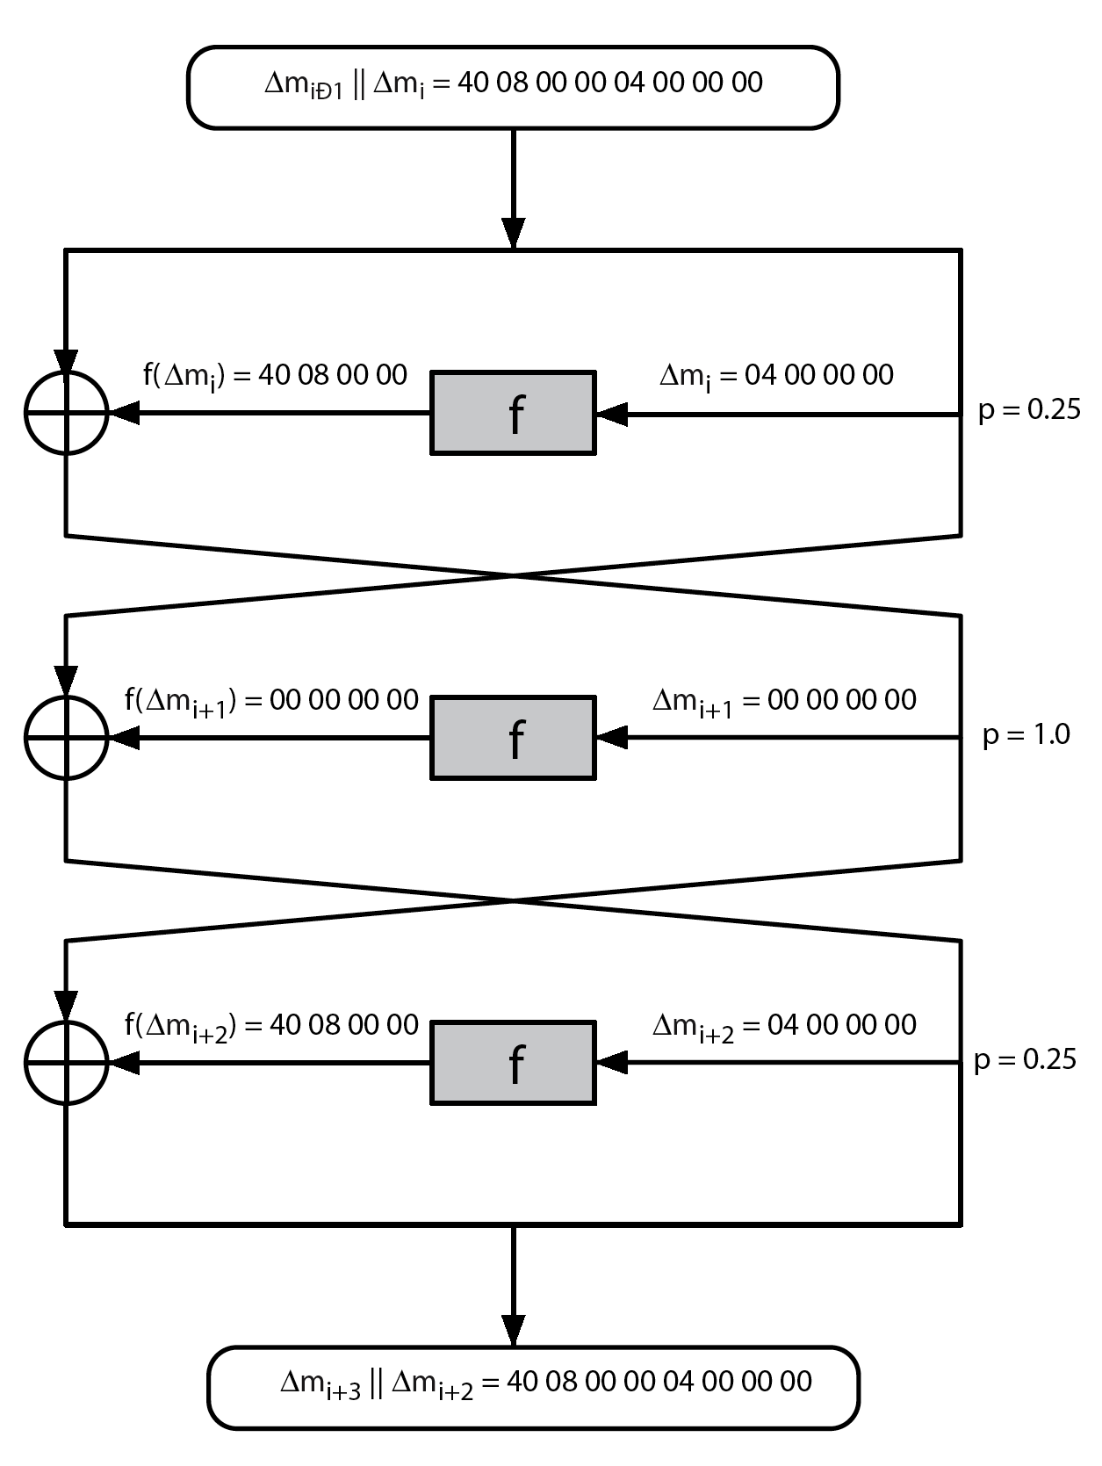
Differential Cryptanalysis
Notes:
Stallings Figure 3.7 illustrates the propagation of differences through three rounds of DES. The probabilities shown on the right refer to the probability that a given set of intermediate differences will appear as a function of the input differences. Overall, after three rounds the probability that the output difference is as shown is equal to 0.25*1*0.25=0.0625. Since the output difference is the same as the input, this 3 round pattern can be iterated over a larger number of rounds, with probabilities
multiplying to be successively smaller.

Slide 85
Differential Cryptanalysis
perform attack by repeatedly encrypting plaintext pairs with known input XOR until obtain desired output XOR
when found
  if intermediate rounds match required XOR have a right pair
  if not then have a wrong pair, relative ratio is S/N for attack
can then deduce keys values for the rounds
  right pairs suggest same key bits
  wrong pairs give random values
for large numbers of rounds, probability is so low that more pairs are required than exist with 64-bit inputs
Biham and Shamir have shown how a 13-round iterated characteristic can break the full 16-round DES
Notes:
Differential Cryptanalysis works by performing the attack by repeatedly encrypting plaintext pairs with known input XOR until obtain desired output XOR. See [BIHA93] for detailed descriptions. Attack on full DES requires an effort on the order of 2⁴⁷ encryptions, requiring 2⁴⁷ chosen plaintexts to be encrypted, with a considerable amount of analysis – in practise exhaustive search is still easier, even though up to 2⁵⁵ encryptions are required for this.

Slide 86
Linear Cryptanalysis
another recent development
also a statistical method
must be iterated over rounds, with decreasing probabilities
developed by Matsui et al in early 90's
based on finding linear approximations
can attack DES with 2⁴³ known plaintexts, easier but still in practise infeasible
Notes:
A more recent development is linear cryptanalysis. This attack is based on finding linear approximations to describe the transformations performed in DES. This method can find a DES key given 2^43 known plaintexts, as compared to 2^47 chosen plaintexts for differential cryptanalysis. Although this is a minor improvement, because it may be easier to acquire known plaintext rather than chosen plaintext, it still leaves linear cryptanalysis infeasible as an attack on DES. Again, this attack uses structure not seen before. So far, little work has been done by other groups to validate the linear cryptanalytic approach.

Slide 87
Linear Cryptanalysis
find linear approximations with prob p != ½
  P[i₁,i₂,...,i_{a}] ⊕ C[j₁,j₂,...,j_{b}] = K[k₁,k₂,...,k_{c}]
  where i_{a},j_{b},k_{c} are bit locations in P,C,K
gives linear equation for key bits
get one key bit using max likelihood alg
using a large number of trial encryptions
effectiveness given by: |p–¹/₂|
Notes:
The objective of linear cryptanalysis is to find an effective linear equation relating some plaintext, ciphertext and key bits that holds with probability p<>0.5 as shown. Once a proposed relation is determined, the procedure is to compute the results of the left-hand side of the equation for a large number of plaintext-ciphertext pairs, in order to determine whether the sum of the key bits is 0 or 1, thus giving 1 bit of info about them. This is repeated for other equations and many pairs to derive some of the key bit values. Because we are dealing with linear equations, the problem can be approached one round of the cipher at a time, with the results combined. See [MATS93] for details.

Slide 88
DES Design Criteria
as reported by Coppersmith in [COPP94]
7 criteria for S-boxes provide for
  non-linearity
  resistance to differential cryptanalysis
  good confusion
3 criteria for permutation P provide for
  increased diffusion
Notes:
Although much progress has been made in designing block ciphers that are cryptographically strong, the basic principles have not changed all that much since the work of Feistel and the DES design team in the early 1970s. Some of the criteria used in the design of DES were reported in [COPP94], and focused on the design of the S-boxes and on the P function that distributes the output of the S boxes, as summarized above. See text for further details.

Slide 89
Block Cipher Design
basic principles still like Feistel’s in 1970’s
number of rounds
  more is better, exhaustive search best attack
function f:
  provides “confusion”, is nonlinear, avalanche
  have issues of how S-boxes are selected
key schedule
  complex subkey creation, key avalanche
Notes:
The cryptographic strength of a Feistel cipher derives from three aspects of the design: the number of rounds, the function F, and the key schedule algorithm. Briefly discuss these.
The greater the number of rounds, the more difficult it is to perform cryptanalysis, even for a relatively weak F. In general, the criterion should be that the number of rounds is chosen so that known cryptanalytic efforts require greater effort than a simple brute-force key search attack. This criterion is attractive because it makes it easy to judge the strength of an algorithm and to compare different algorithms.
The function F provides the element of confusion in a Feistel cipher, want it to be difficult to “unscramble” the substitution performed by F. One obvious criterion is that F be nonlinear. The more nonlinear F, the more difficult any type of cryptanalysis will be. We would like it to have good avalanche properties, or even the strict avalanche criterion (SAC). Another criterion is the bit independence criterion (BIC). One of the most intense areas of research in the field of symmetric block ciphers is that of S-box design. Would like any change to the input vector to an S-box to result in random-looking changes to the output. The relationship should be nonlinear and difficult to approximate with linear functions.
A final area of block cipher design, and one that has received less attention than S-box design, is the key schedule algorithm. With any Feistel block cipher, the key schedule is used to generate a subkey for each round. Would like to select subkeys to maximize the difficulty of deducing individual subkeys and the difficulty of working back to the main key. The key schedule should guarantee key/ciphertext Strict Avalanche Criterion and Bit Independence Criterion.

Slide 90
DES
DES 56 bits Key to encrypt 64 bit plaintext，get 64 bit ciphertext
Three stages:
  1. X₀=IP（X）=L₀R₀
  L₀ consist first 32 bits of X_{0,} similar of R₀。
  2. function F 16 rounds:L_{i}R_{i}(1<=i<=16）
  L_{i}=R_{i-1}, R_{i}=L_{i-1} ⊕ F(R_{i-1}, K_{i})
  K_{i} is 48 bits subkey。K₁，K₂，…，K_{16 are the function of} K（56bits）
  3.R₁₆L₁₆ use IP⁻¹ get ciphertext Y。
  Y=IP⁻¹（R₁₆L₁₆）

Slide 91
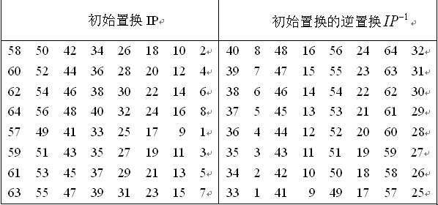
IP and IP⁻¹
      要加密的输入块的64位，首先要经过初始置换IP的作用。即置换了的输入要把原输入的第58位作为它的第1位，原输入的第50位作为它的第2位，……，原输入的第7位作为它的最后一位。逆初始置换，是以预输出作为它的输入 ,参见表

Slide 92
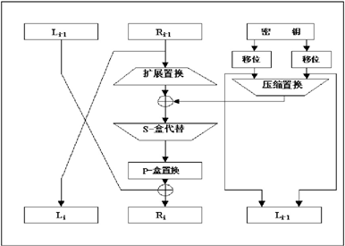
Function F
计算函数F的运算见图所示，它是DES密码的关键部件，它包含四种密码功能：扩展函数、模2加运算、S盒运算和置换函数P运算。
？

Slide 93
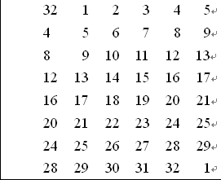
      ① Extension E
扩展函数E的功能，就是将一个32位的输入块，扩展为48位的输出块。这48位的输出块分成8个6位的块，它是按照下表依次选择它的输入中的位取得的

Slide 94
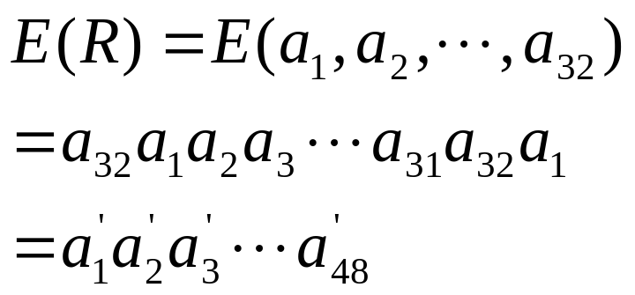
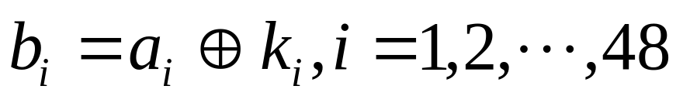
      ② Mod 2 cal.
模2加功能是将E(R)的各位与密钥K各位逐位模2加，得到输出，具体如下：

Slide 95
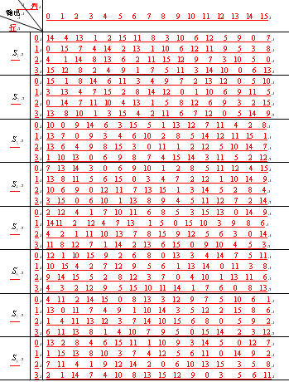

      ③ S box
密码函数F中，共有8个S盒，称为8个不同的选择函数，分别用 表示，见下表 。每个S盒，都是将6位作为输入，得到一个4位块作为输出。
怎么由输入得到输出的？

Slide 96
      ④ Pertumation P
置换函数P把S盒输出的32位数据打乱重排，得到32位的加密函数结果。置换函数P与S盒互相配合提高了DES的安全性。这种函数由下表给出。
16 7 20 21 29 12 28 17 1 15 23 26 5 18 31 10 2 8 24 14 32 27 3 9 19 13 30 6 22 11 4 25

Slide 97












      具体加密过程是：
      输入的明文64位数据，首先经过初始置换IP后把其左半1至32位记为 ，右半33至64位记为 ，即成了置换了的输入，然后把 与密钥发生器产生的密钥 进行运算，其结果记为 ，再与进行模2加得 ，把 记为 放在左边，
      把 记为 放在右边，从而完成第一次迭代运算；在此基础上，重 复上述迭代过程，一直迭代至第16次，所得的第16次迭代结果左右不交换，即 记为 放在左边， 记为 放在右边，成为预输出，最后经过初始置换的逆置换 运算后即得密文。

Slide 98
DES安全性分析
DES的核心是S盒，除此之外的计算是属线性的。S盒作为该密码体制的非线性组件对安全性至关重要。
S盒的设计准则：
1. S盒不是它输入变量的线性函数
2.改变S盒的一个输入位至少要引起两位的输出改变
3. 对任何一个S盒，如果固定一个输入比特，其它输入变化时，输出数字中0和1的总数近于相等。

Slide 99
DES安全性分析
公众仍然不知道S盒的构造中是否还使用了进一步的设计准则（有陷门？）。
密钥长度是否足够？
迭代的长度？（8、16、32？）

Slide 100
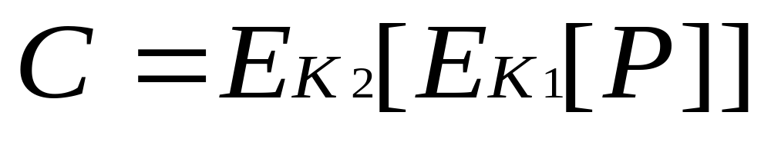
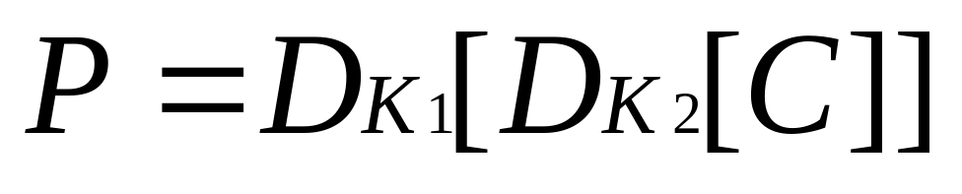
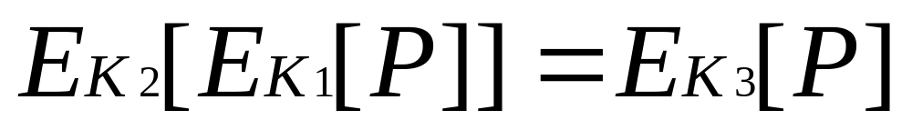
Triple DES
double DES
加密
解密
问题：下式成立吗？

Slide 101
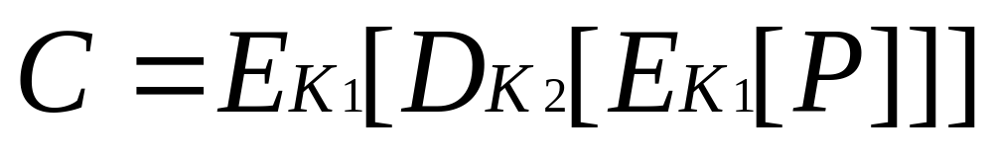
triple DES
two keys triple DES
目前，没有针对三重DES的攻击方法，它是一种较受欢迎的DES替代方案。

Slide 102
Summary
have considered:
  block vs stream ciphers
  Feistel cipher design & structure
  DES
    details
    strength
  Differential & Linear Cryptanalysis
  block cipher design principles
Notes:
Chapter 3 summary.

