Slide 1

Network Security

Slide 2
E-commerce Systems
Electronic Payment Systems

Slide 3
E-payment systems
To transfer money over the Internet
Methods of traditional payment
  Check, credit card, or cash
Methods of electronic payment
  Electronic cash, software wallets, smart cards, and credit/debit cards
  Scrip is digital cash minted by third-party organizations

Slide 4
Requirements for e-payments
Atomicity
  Money is not lost or created during a transfer
Good atomicity
  Money and good are exchanged atomically
Non-repudiation
  No party can deny its role in the transaction
  Digital signatures

Slide 5
Desirable Properties of Digital Money
Universally accepted
Transferable electronically
Divisible
Non-forgeable, non-stealable
Private (no one except parties know the amount)
Anonymous (no one can identify the payer)
Work off-line (no on-line verification needed)
No known system satisfies all.

Slide 6
Types of E-payments
E-cash
Electronic wallets
Smart card
Credit card

Slide 7
Electronic Cash
Primary advantage is with purchase of items less than $10
  Credit card transaction fees make small purchases unprofitable
  Micropayments
    Payments for items costing less than $1

Slide 8
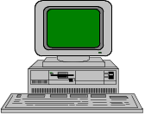
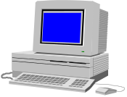
E-cash Concept
Merchant
1. Consumer buys e-cash from Bank
2. Bank sends e-cash bits to consumer (after
charging that amount plus fee)
3. Consumer sends e-cash to merchant
4. Merchant checks with Bank that e-cash
is valid (check for forgery or fraud)
5. Bank verifies that e-cash is valid
6. Parties complete transaction: e.g., merchant
present e-cash to issuing back for deposit
once goods or services are delivered
Consumer still has (invalid) e-cash
5
4
Bank
3
2
1
Consumer

Slide 9
Electronic Cash Issues
E-cash must allow spending only once
Must be anonymous, just like regular currency
  Safeguards must be in place to prevent counterfeiting
  Must be independent and freely transferable regardless of nationality or storage mechanism
Divisibility and Convenience
Complex transaction (checking with Bank)
  Atomicity problem

Slide 10
Two storage methods
On-line
  Individual does not have possession personally of electronic cash
  Trusted third party, e.g. online bank, holds customers’ cash accounts
Off-line
  Customer holds cash on smart card or software wallet
  Fraud and double spending require tamper-proof encryption

Slide 11
Advantages and Disadvantages of Electronic Cash
Advantages
  More efficient, eventually meaning lower prices
  Lower transaction costs
  Anybody can use it, unlike credit cards, and does not require special authorization
Disadvantages
  Tax trail non-existent, like regular cash
  Money laundering
  Susceptible to forgery

Slide 12
Electronic Cash Security
Complex cryptographic algorithms prevent double spending
  Anonymity is preserved unless double spending is attempted
Serial numbers can allow tracing to prevent money laundering
  Does not prevent double spending, since the merchant or consumer could be at fault

Slide 13
Blind Signatures
Goal
  to have the bank sign documents without knowing what they are signing.
Why?
  Anonymity with Authentication

Slide 14
How to sign with blind fold?
How?
  Basic: Sign anything
1. You encrypt the message
2. Send it to the bank
3. The bank signs the message and returns it
4. You decrypt the signed message
5. You spend it

Slide 15
Cut and Choose
Problems
  The bank honors anything I write down
Solution: the Cut-and-choose algorithm
1. Prepare n copies of the messages and n different keys, and send them to the bank
2. The bank requests the keys for and opens n - 1 of them, and verifies them. It then signs the remaining one.
3. The bank sends back the signed message, which can then be decrypted and spent

Slide 16
Anonymous digital cash?
Protocol #1
Protocol #2
Protocol #3
Protocol #4

Slide 17
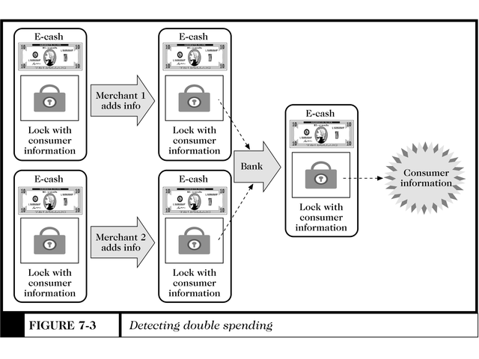
Detecting Double Spending

Slide 18
Past and Present E-cash Systems
E-cash not popular in U.S., but successful in Europe and Japan
  Reasons for lack of U.S. success not clear
    Manner of implementation too complicated
    Lack of standards and interoperable software that will run easily on a variety of hardware and software systems

Slide 19
Past and Present E-cash Systems
Checkfree
  Allows payment with online electronic checks
Clickshare
  Designed for magazine and newspaper publishers
  Miscast as a micropayment only system; only one of its features
  Purchases are billed to a user’s ISP, who in turn bill the customer

Slide 20
Past and Present E-cash Systems
CyberCash
  Combines features from cash and checks
  Offers credit card, micropayment, and check payment services
  Connects merchants directly with credit card processors to provide authorizations for transactions in real time
    No delays in processing prevent insufficient e-cash to pay for the transaction
CyberCoins
  Stored in CyberCash wallet, a software storage mechanism located on customer’s computer
  Used to make purchases between .25c and $10
  PayNow -- payments made directly from checking accounts

Slide 21
Past and Present E-cash Systems
DigiCash
  Trailblazer in e-cash
  Allowed customers to purchase goods and services using anonymous electronic cash
  Recently entered Chapter 11 reorganization
Coin.Net
  Electronic tokens stored on a customer’s computer is used to make purchases
  Works by installing special plug-in to a customer’s web browser
  Merchants do not need special software to accept eCoins.
  eCoin server prevents double-spending and traces transactions, but consumer is anonymous to merchant

Slide 22
Aggregation
Used when individual transactions are too small for credit card (e.g. $2.00)
Consumer and Merchant sign up with Aggregator
Consumer makes purchase. Merchant notifies Aggregator.
Aggregator keeps Consumer’s account. When amount owed is large enough (or every month), charges to Consumer’s credit card
Aggregator sends money (less fees) to Merchant
QPASS, CyberCash, GlobeID

Slide 23
Past and Present E-cash Systems
MilliCent
  Developed by Digital, now part of Compaq
  Electronic scrip system
  Participating merchant creates and sells own scrip to broker at a discount
    Consumers register with broker and buy bulk generic scrip, usually with credit card
    Customers buy by converting broker scrip to vendor-specific scrip, i.e. scrip that a particular merchant will accept
  Customers can purchase items of very low value
  Brokers required for two reasons:
    Small payments require aggregation to insure profitability
    System is easier to use -- customer need only deal with one broker for all their scrip needs

Slide 24
Electronic Wallets
Stores credit card, electronic cash, owner identification and address
  Makes shopping easier and more efficient
    Eliminates need to repeatedly enter identifying information into forms to purchase
    Works in many different stores to speed checkout
  Amazon.com one of the first online merchants to eliminate repeat form-filling for purchases

Slide 25
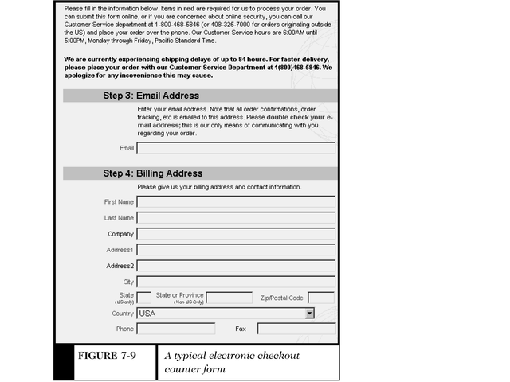
An Electronic Checkout Counter Form

Slide 26
Electronic Wallets
Agile Wallet
  Developed by CyberCash
  Allows customers to enter credit card and identifying information once, stored on a central server
  Information pops up in supported merchants’ payment pages, allowing one-click payment
  Does not support smart cards or CyberCash, but company expects to soon
eWallet
  Developed by Launchpad Technologies
  Free wallet software that stores credit card and personal information on users’ computer, not on a central server; info is dragged into payment form from eWallet
  Information is encrypted and password protected
  Works with Netscape and Internet Explorer

Slide 27
Electronic Wallets
Microsoft Wallet
  Comes pre-installed in Internet Explorer 4.0, but not in Netscape
  All information is encrypted and password protected
  Microsoft Wallet Merchant directory shows merchants setup to accept Microsoft Wallet

Slide 28
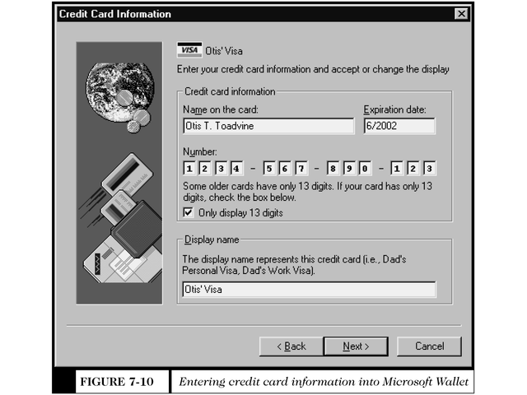
Entering Information Into Microsoft Wallet

Slide 29
W3C Proposed Standard for Electronic Wallets
World Wide Web Consortium (W3C) is attempting to create an extensible and interoperable method of embedding micropayment information on a web page
  Extensible systems allow improvement of the system without eliminating previous work
Merchants must accept several payment options to insure the widest possible Internet audience
  Merchants must embed in their Web page payment information specific to each payment system
  This redundancy spurred W3C to develop common standards for Web page markup for all payment systems
  Must move quickly to prevent current methods from becoming entrenched

Slide 30
W3C Electronic Commerce Interest Group (ECIG) Draft Standard Architecture
Client (consumer’s web browser) initiates micropayment activity
  Client browser includes Per Fee Link Handler module and one or more electronic wallets
  New HTML tags will carry micropayment information

Slide 31
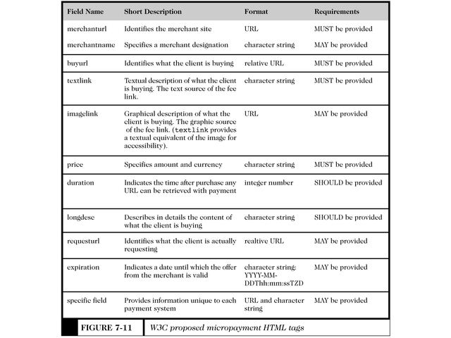
W3C Proposed Micropayment HTML Tags

Slide 32
The ECML Standard
Electronic Commerce Modeling Language (ECML) proposed standards for electronic wallets
  Companies forming the consortium are America Online, IBM, Microsoft, Visa, and MasterCard
  Ultimate goal is for all commerce sites to accept ECML
  Unclear how this standard will incorporate privacy standards W3C set forth
  Electronic Commerce Modeling Language (ECML)
  Wallet/Merchant Standards Initiative, July 1999
  (Next four slides)

Slide 33
Current state of the market - online data exchanges
Providing payment and order information to merchants while shopping online is typically a manual consumer process
27% of online buyers abandon orders before check-out due to the hassle of filling out forms ¹
There is no standard way for identifying the specific data attributes that consumers must provide to merchants during an online transaction
  This significantly complicates/limits the ability for digital wallets to automatically exchange information with a merchant web site
“76% of merchants surveyed indicated they are willing to participate in a multi site wallet enterprise,” indicating that “multi site wallets offer reduced acquisition costs that far outweigh the risk to merchants of losing an existing customer” ¹
1 Jupiter Communications

Slide 34
ECML - Wallet/Merchant Standard
Creating a standard approach for the exchange of information will enhance the ability for digital wallets to be used at all merchant sites and therefore facilitate the growth of e-commerce
ECML is a universal, open standard for digital wallets and online merchants that facilitates the seamless exchange of payment and order information to support online purchase transactions
  Uniform field names only to start; will evolve over time
The ECML Alliance today:
  America Online, American Express, Brodia (formerly Transactor Networks), Compaq, CyberCash, Discover, Financial Services Technology Consortium (FSTC), IBM, MasterCard, Microsoft, Novell, SETCo, Sun Microsystems, Trintech, and Visa
ECML is designed to be security protocol independent, support global implementations, and support any payment instrument
ECML does not change the “look and feel” of a merchant’s site

Slide 35
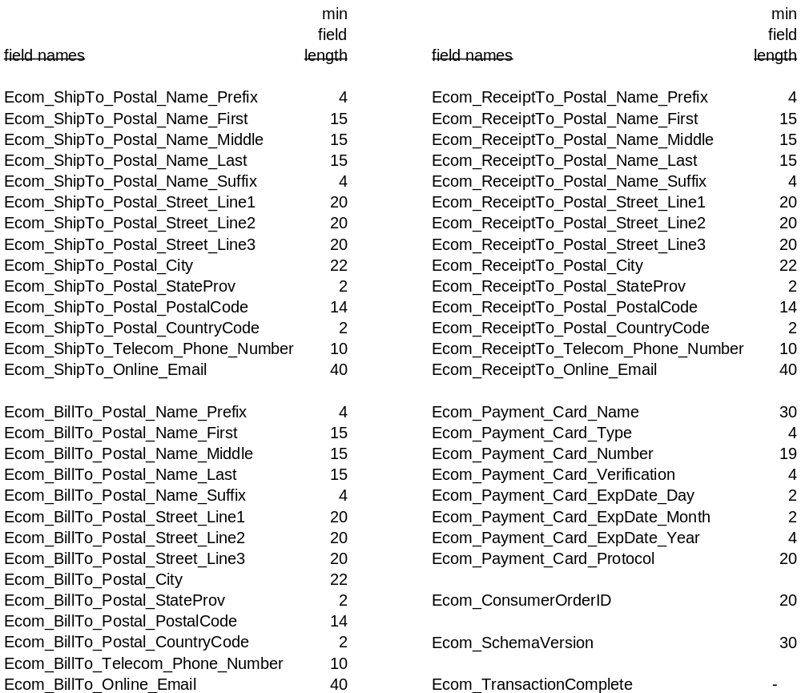
Summary of current ECML specification

Slide 36
ECML implementation and Alliance participation
The ECML Alliance seeks widespread support for and adoption of the ECML standard
ECML is publicly available today and can be easily implemented by online merchants, e-commerce technology vendors, and other interested parties
  www.ecml.org - the official web site of ECML
ECML has been enthusiastically endorsed by several e-commerce industry segments, including the following leading online merchants:
  beyond.com
  Dell Computer
  fashionmall.com
  healthshop.com
  Nordstrom.com
  Omaha Steaks
  Reel.com
  1-800-Batteries
To support the current version of ECML, a merchant will need to make a one-time change to incorporate the uniform field names into the check-out pages of its web site, and make changes to CGI/ASP scripts
Organizations interested in participating in the ECML Alliance should contact coordinator@ecml.org with their indication of interest

Slide 37
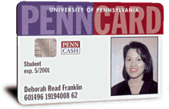
Smart Cards
Magnetic stripe
  140 bytes, cost $0.20-0.75
Memory cards
  1-4 KB memory, no processor, cost $1.00-2.50
Optical memory cards
  4 megabytes read-only (CD-like), cost $7.00-12.00
Microprocessor cards
  Embedded microprocessor
    (OLD) 8-bit processor, 16 KB ROM, 512 bytes RAM
    Equivalent power to IBM XT PC, cost $7.00-15.00
    32-bit processors now available
Notes:
52

Slide 38
Smart Cards
Plastic card containing an embedded microchip
Available for over 10 years
So far not successful in U.S., but popular in Europe, Australia, and Japan
Unsuccessful in U.S. partly because few card readers available
Smart cards gradually reappearing in U.S.; success depends on:
  Critical mass of smart cards that support applications
  Compatibility between smart cards, card-reader devices, and applications

Slide 39
Smart Card Applications
Ticketless travel
  Seoul bus system: 4M cards, 1B transactions since 1996
  Planned the SF Bay Area system
Authentication, ID
Medical records
Ecash
Store loyalty programs
Personal profiles
Government
  Licenses
Mall parking
. . .
Notes:
52

Slide 40
Advantages and Disadvantages of Smart Cards
Advantages:
  Atomic, debt-free transactions
  Feasible for very small transactions (information commerce)
  (Potentially) anonymous
  Security of physical storage
  (Potentially) currency-neutral
Disadvantages:
  Low maximum transaction limit (not suitable for B2B or most B2C)
  High Infrastructure costs (not suitable for C2C)
  Single physical point of failure (the card)
  Not (yet) widely used

Slide 41

Mondex Smart Card
Holds and dispenses electronic cash (Smart-card based, stored-value card)
Developed by MasterCard International
Requires specific card reader, called Mondex terminal, for merchant or customer to use card over Internet
Supports micropayments as small as 3c and works both online and off-line at stores or over the telephone
Secret chip-to-chip transfer protocol
Value is not in strings alone; must be on Mondex card
Loaded through ATM
  ATM does not know transfer protocol; connects with secure device at bank

Slide 42
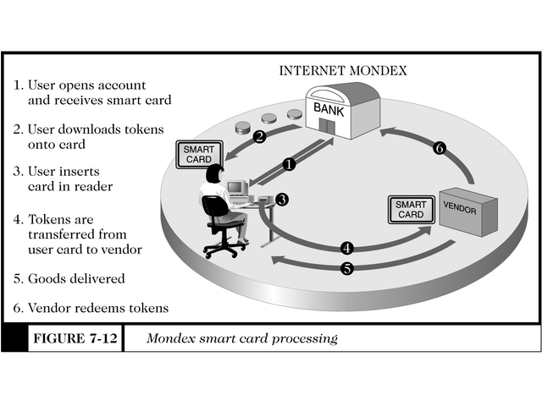
Mondex Smart Card Processing

Slide 43
Mondex transaction
Here's what happens "behind the scenes" during a Mondex transaction between a consumer and merchant. Placing the card in a Mondex terminal starts the transaction process:
  Information from the customer's chip is validated by the merchant's chip. Similarly, the merchant's card is validated by the customer's card.
  The merchant's card requests payment and transmits a "digital signature" with the request. Both cards check the authenticity of each other's message. The customer's card checks the digital signature and, if satisfied, sends acknowledgement, again with a digital signature.
  Only after the purchase amount has been deducted from the customer's card is the value added to the merchant's card. The digital signature from this card is checked by the customer's card and if confirmed, the transaction is complete.

Slide 44
Mondex Smart Card
Disadvantages
  Card carries real cash in electronic form, creating the possibility of theft
  No deferred payment as with credit cards -cash is dispensed immediately
Security
  Active and dormant security software
    Security methods constantly changing
    ITSEC E6 level (military)
  VTP (Value Transfer Protocol)
    Globally unique card numbers
    Globally unique transaction numbers
    Challenge-response user identification
    Digital signatures
  MULTOS operating system
    firewalls on the chip

Slide 45
Credit Cards
Credit card
  Used for the majority of Internet purchases
  Has a preset spending limit
  Currently most convenient method
  Most expensive e-payment mechanism
    MasterCard: $0.29 + 2% of transaction value
  Disadvantages
    Does not work for small amount (too expensive)
    Does not work for large amount (too expensive)
Charge card
  No spending limit
  Entire amount charged due at end of billing period

Slide 46
Payment Acceptance and Processing
Merchants must set up merchant accounts to accept payment cards
Law prohibits charging payment card until merchandise is shipped
Payment card transaction requires:
  Merchant to authenticate payment card
  Merchant must check with card issuer to ensure funds are available and to put hold on funds needed to make current charge
  Settlement occurs in a few days when funds travel through banking system into merchant’s account

Slide 47
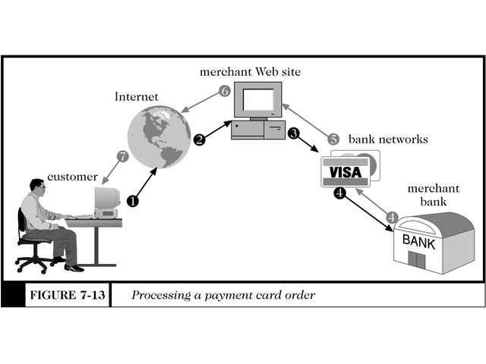
Processing a Payment Card Order

Slide 48
Open and Closed Loop Systems
Closed loop systems
  Banks and other financial institutions serve as brokers between card users and merchants -- no other institution is involved
  American Express and Discover are examples
Open loop systems
  Transaction is processed by third party
  Visa and MasterCard are examples

Slide 49
Setting Up Merchant Account
Merchant bank
  Also called acquiring bank
  Does business with merchants that want to accept payment cards
  Merchant receives account where they deposit card sales totals
  Value of sales slips is credited to merchant’s account

Slide 50
Processing Payment Cards Online
Can be done automatically by software packaged with electronic commerce software
Can contract with third party to handle payment card processing
  Can also pick, pack, and ship products to the customer
  Allows merchant to focus on web presence and supply availability

Slide 51
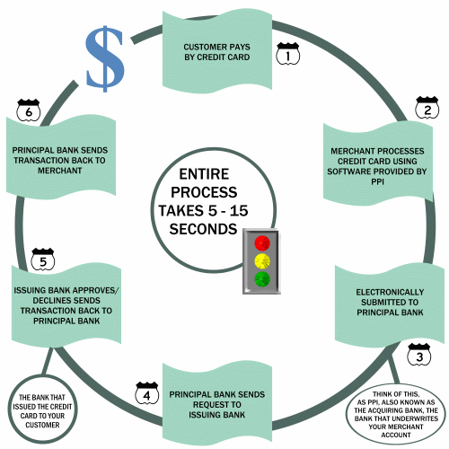
Credit Card Processing
SOURCE: PAYMENT
PROCESSING INC.

Slide 52
Payment Processing Services
Internetsecure
  Provides secure credit card payment services
  Supports payments with Visa and MasterCard
  Provides risk management and fraud detection, and ensures all proper security for credit card transactions is maintained
  Ensures all transactions are properly credited to merchant’s account

Slide 53
Payment Processing Services
Tellan
  Provides PCAuthorize for smaller commerce sites and WebAuthorize for larger enterprise-class merchant sites
  Both systems capture credit card information from the merchant’s form and connect directly to the bank network using dial-up or private, leased lines
  Bank network receives credit information, performs credit authorization, and deposits the money in the merchant’s bank account
  The merchant’s web site receives confirmation or rejection of the transaction, which is communicated to the customer

Slide 54
Payment Processing Services
IC Verify
  Provides electronic transaction processing for merchants for all major credit and debit cards
  Also allows check guarantees and verification transactions
  A CyberCash company
Authorize.Net
  Online, real time service that links merchants with issuing banks by simply inserting a small block of HTML code into their transaction page

Slide 55
Secure Electronic Transaction (SET) Protocol
Jointly designed by MasterCard and Visa with backing of Microsoft, Netscape, IBM, GTE, SAIC, and others
Designed to provide security for card payments as they travel on the Internet
  Contrasted with Secure Socket Layers (SSL) protocol, SET validates consumers and merchants in addition to providing secure transmission
SET specification
  Uses public key cryptography and digital certificates for validating both consumers and merchants
  Provides privacy, data integrity, user and merchant authentication, and consumer nonrepudiation

Slide 56
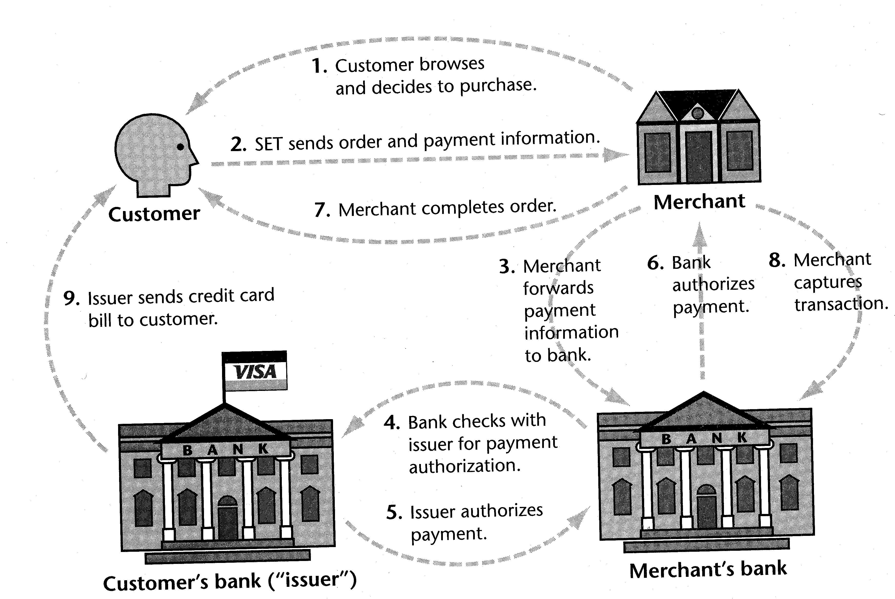
The SET protocol
The SET protocol coordinates the activities of the customer,
merchant, merchant’s bank, and card issuer. [Source: Stein]

Slide 57
SET Payment Transactions
SET-protected payments work like this:
  Consumer makes purchase by sending encrypted financial information along with digital certificate
  Merchant’s website transfers the information to a payment card processing center while a Certification Authority certifies digital certificate belongs to sender
  Payment card-processing center routes transaction to credit card issuer for approval
  Merchant receives approval and credit card is charged
  Merchant ships merchandise and adds transaction amount for deposit into merchant’s account

Slide 58
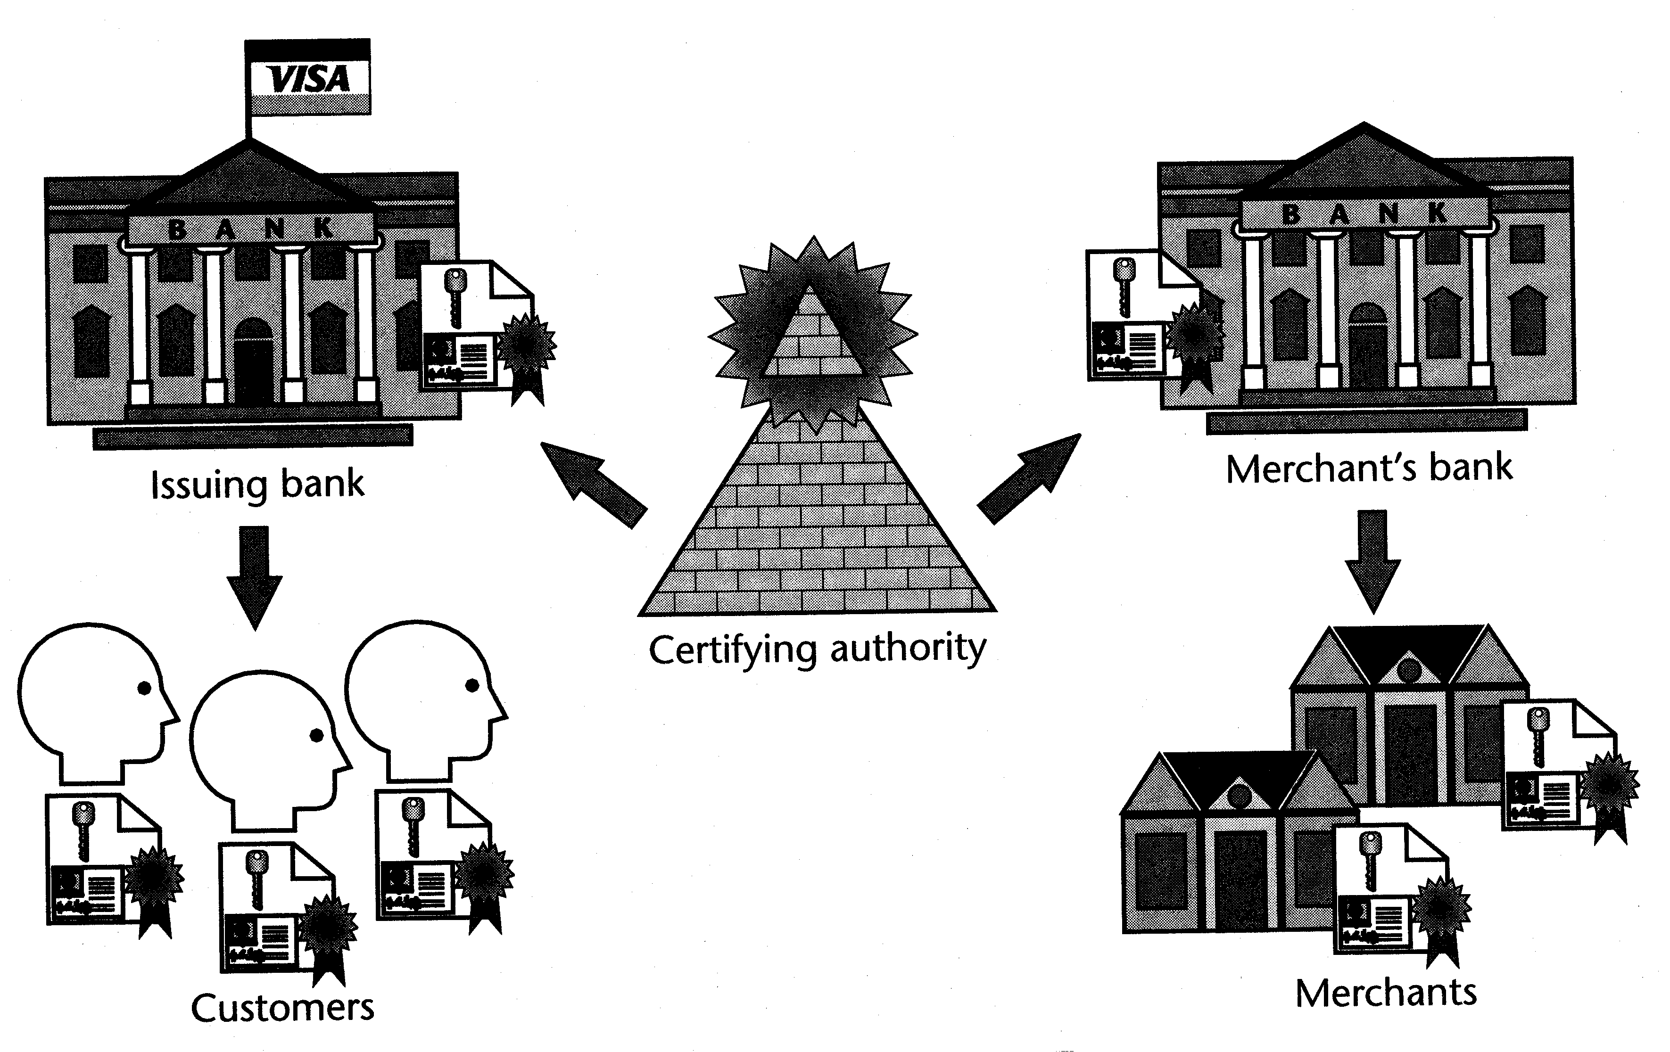
SET uses a hierarchy of trust
All parties hold certificates signed directly or
indirectly by a certifying authority. [Source: Stein]

Slide 59
SET Protocol
Extremely secure
  Fraud reduced since all parties are authenticated
  Requires all parties to have certificates
So far has received lukewarm reception
80 percent of SET activities are in Europe and Asian countries
Problems with SET
  Not easy to implement
  Not as inexpensive as expected
  Expensive to integrated with legacy applications
  Not tried and tested, and often not needed
  Scalability is still in question

Slide 60
Q&A

