Slide 1
MySQL Joins

Slide 2
MySQL Joins Overview
MySQL Join is used to join the records from two tables using join clause.
The Join Clause return you the set of records from both table on the basis of common column.

Slide 3
MySQL Join Types
MySQL Inner Join
MySQL Equi Join
MySQL Natural Join
MySQL Cross Join
MySQL Outer Join
  Left Outer Join
  Right Outer Join
Self Join

Slide 4
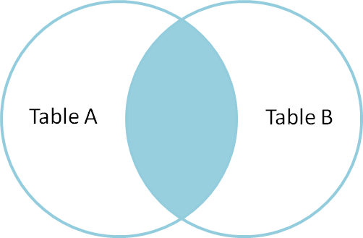
MySQL Inner Join
Inner join produces only the set of records that match in both Table A and Table B.

Slide 5
MySQL Inner Join
(Contd:)
The INNER JOIN keyword returns rows when there is at least one match in both tables.
If there are rows in "Persons" that do not have matches in "Orders", those rows will NOT be listed.
Example:
SELECT Persons.LastName, Persons.FirstName, Orders.OrderNo
FROM Persons INNER JOIN Orders
ON Persons.P_Id = Orders.P_Id
ORDER BY Persons.LastName

Slide 6
MySQL Outer Join
MySQL Outer Join return you the set of all matching records from both table.
The Outer Join does not requires each records to be matched in both the tables.
MySQL Outer Join is categorized into two groups.
  MySQL Left Outer Join
  MySQL Right Outer Join

Slide 7
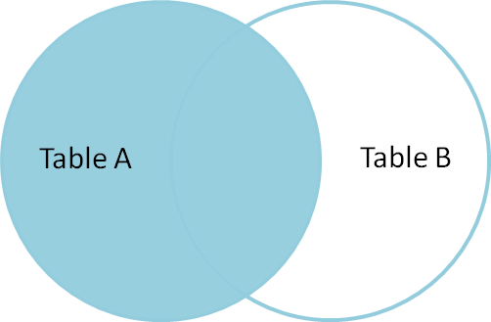
MySQL Left Outer Join
Left outer join produces a complete set of records from Table A, with the matching records (where available) in Table B. If there is no match, the right side will contain null.

Slide 8
MySQL Left Outer Join
(Contd:)
The left join is used in case of need to return all rows from the left table, even if the right table doesn't have any match.
Example:
SELECT Persons.LastName, Persons.FirstName, Orders.OrderNo
FROM Persons LEFT JOIN Orders
ON Persons.P_Id=Orders.P_Id
ORDER BY Persons.LastName

Slide 9
MySQL Right Outer Join
The right join is used in case of need to return all rows from the right table, even if the left table doesn't have any match.
Example:
SELECT Persons.LastName,Persons.FirstName, Orders.OrderNo
FROM Persons RIGHT JOIN Orders
ON Persons.P_Id = Orders.P_Id
ORDER BY Persons.LastName

Slide 10
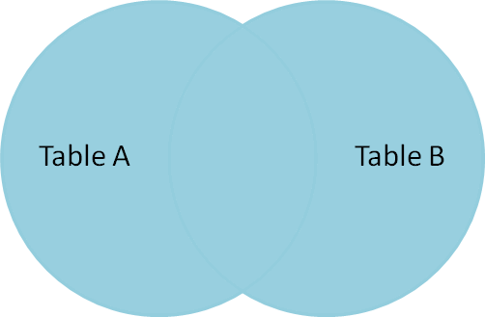
MySQL Cross Join
Cross Join is also called Cartesian Product Join.
The Cross Join in SQL return you a result table in which each row from the first table is combined with each rows from the second table.

Slide 11
MySQL Cross Join
(Contd:)
In other words, you can say it is the cross multiplication of number of rows in each table.
Example:
SELECT * FROM persons cross join orders;

Slide 12
MySQL Equi Join
Equi Join is a classified type of Inner Join in Mysql.
Equi Join is used to combine records from two table based on the common column exists in both table.
The Equi Join returns you only those records which are available in both table on the basis of common primary field name.
Example:
SELECT persons.firstname,orders.orderNo
FROM persons, orders
WHERE persons.p_id = orders.p_id;

Slide 13
MySQL Natural Join
MySQL Natural Join is a specialization of equi-joins.
The join compares all columns in both tables that have the same column-name in both tables that have column name in the joined table.
Example:
SELECT persons.firstname, orders.orderNo
FROM persons NATURAL JOIN orders;

Slide 14
MySQL Self Join
These join allow you to retrieve related records from the same table.
The most common case where you'd use a self-join is when you have a table that references itself.
Example:
SELECT m.name as "Manager", p.name as "Employee“
FROM employee m, employee p
WHERE m.emp_id = p.manager_id;

