Slide 1
SQL Select

Slide 2
SQL Select
The SELECT statement is used to pull information from a table.
SELECT retrieves rows, columns, and derived values from one or more tables.
The general format is:
  Syntax:
  SELECT column(s)
  FROM table(s)
  [JOIN join(s)]
  [WHERE search_condition(s)]
  [GROUPBY grouping_column(s)]
  [HAVING search_condition(s)]
  [ORDERBY sort_column(s)];

Slide 3
Selecting All Data
The simplest form of SELECT retrieves everything from a table
mysql> select * from pet;
+----------+--------+---------+------+------------+------------+
| name | owner | species | sex | birth | death |
+----------+--------+---------+------+------------+------------+
| Fluffy | Harold | cat | f | 1999-02-04 | NULL |
| Claws | Gwen | cat | f | 1994-03-17 | NULL |
| Buffy | Harold | dog | f | 1989-05-13 | NULL |
| Fang | Benny | dog | m | 1999-08-27 | NULL |
| Bowser | Diane | dog | m | 1998-08-31 | 1995-07-29 |
| Chirpy | Gwen | bird | f | 1998-09-11 | NULL |
| Whistler | Gwen | bird | | 1997-12-09 | NULL |
| Slim | Benny | snake | m | 1996-04-29 | NULL |
+----------+--------+---------+------+------------+------------+
8 rows in set (0.00 sec)

Slide 4
Selecting Particular Rows
You can select only particular rows from your table.
For example, if you want to verify the change that you made to Bowser's birth date, select Bowser's record like this:
mysql> SELECT * FROM students WHERE name = “Ali";
+--------+-------+------+------------+
| name | owner | sex | birth |
+--------+-------+------+------------+
| Ali | Ahmed | m | 1998-08-31 |
+--------+-------+------+------------+
1 row in set (0.00 sec)

Slide 5
Selecting Particular Rows
To find all students born after 1998
  SELECT * FROM students WHERE birth >= "1998-1-1";
To find all employees where department IT And gender male.
  SELECT * FROM employees WHERE dept_id=7 AND gender = “male";
To find all employees having department id 2 or 7, use a logical OR
  SELECT * FROM employees WHERE dept_id=2
  OR dept_id=7;

Slide 6
Selecting Particular Columns
If you don’t want to see entire rows from your table, just name the columns in which you are interested, separated by commas.
mysql> select name, cnic_no from employees;
  +----------+-----------------+
  | name | cnic_no |
  +----------+-----------------+
  | Ahmed | 41306-4076076-6 |
  | Ali | 31306-4076870-7 |
  | Faisal | 41306-6034500-4 |
  | Sadaf | 47606-6476000-7 |
  | Yousuf | 69876-4076000-2 |
  | Muhammad | 46577-4076000-5 |
  | Sehar | 42234-5676000-4 |
  | Sobia | 57306-4076000-6 |
  +----------+-----------------+
  8 rows in set (0.01 sec)

Slide 7
AS
The AS statement can be used to create a column alias (an alternative name/identifier) that you specify to control how column headings are displayed in a result.
Syntax:
SELECT column1 AS alias1,
column2 AS alias2,
...
columnN ASaliasN
FROMtable;

Slide 8
AS Example
To rename column alias
SELECT nemes AS ‘Employee Name’,birth AS ‘Birth Date’ FROM employees;
+---------------+------------+
| Employee Name | Birth Date |
+---------------+------------+
| Ahmed | 1991-08-27 |
| Yusuf | 1990-02-04 |
| Sehar | 1990-09-11 |
| Sobia | 1988-08-31 |
| Muhammad | 1988-12-09 |
| Faisal | 1987-04-29 |
| Ali | 1985-03-17 |
| Sadaf | 1983-05-13 |
+---------------+------------+
8 rows in set (0.02 sec)

Slide 9
DISTINCT
Results of queries oftentimes contain duplicate values for a particular column.
The DISTINCT keyword eliminates duplicate rows from a result.
Syntax:
SELECT DISTINCT column(s)
FROM table(s);

Slide 10
DISTINCT Example
SELECT DISTINCT dept_id
FROM employees;

Slide 11
Where
The WHERE clause can be used to filter unwanted rows in a result (ie, yield a subset of all rows in the result with a specified condition).
Syntax:
SELECT column(s)
FROM table
WHERE test_column operatorvalue;

Slide 12
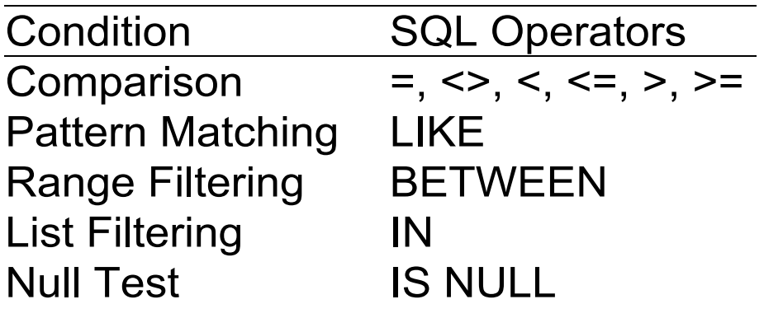
Types of Conditions

Slide 13
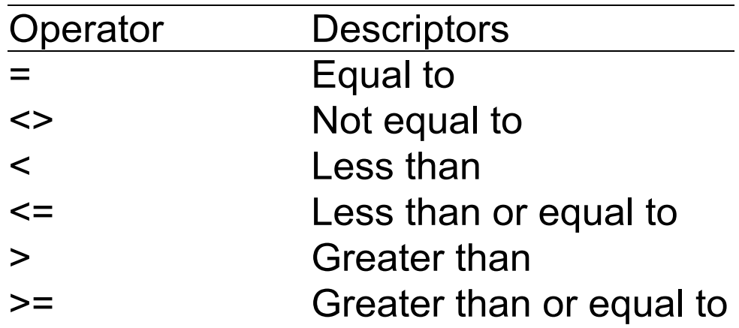
Comparison Operators

Slide 14
Notes on WHERE
Occasionally, you may need to specify multiple conditions in a single WHERE clause.
You can use the AND, OR or NOT operators to combine two or more conditions into a compound condition.
AND, OR, and NOT operators are known as Boolean operators; they are designed to work with “truth” values: true, false, and unknown.

Slide 15
LIKE
You can use the LIKE operator to retrieve partial information for a character string (not numbers or date/times) rather than an exact value.
LIKE uses a pattern that values are matched against.

Slide 16
Pattern Matching
MySQL provides:
  Standard SQL pattern matching.
  SQL Pattern matching:
  To perform pattern matching, use the LIKE or NOT LIKE comparison operators
  By default, patterns are case insensitive.
Special Characters:
  _ Used to match any single character.
  % Used to match an arbitrary number of characters.

Slide 17
Pattern Matching Example
To find names beginning with ‘b’:
mysql> SELECT name FROM students WHERE name LIKE "b%";
  +--------+
  | name |
  +--------+
  | Bushra |
  | Benazir|
  +--------+

Slide 18
Pattern Matching Example
To find names ending with ‘dia’
mysql> SELECT name FROM students WHERE name LIKE "%dia";
  +--------+
  | name |
  +--------+
  | Fadia |
  | Sadia |
  +--------+

Slide 19
Pattern Matching Example
To find names containing a ‘a’:
mysql> SELECT name FROM students WHERE name LIKE "%a%";
  +--------+
  | name |
  +--------+
  | Ali |
  | Ahmed |
  | Saher |
  | Sadia |
  | Sadia |
  +--------+

Slide 20
Pattern Matching Example
To find names containing exactly five characters, use the _ pattern character:
mysql> SELECT * FROM pet WHERE name LIKE "_____";
  +--------+
  | name |
  +--------+
  | Ahmed |
  | Saher |
  | Sadia |
  | Sadia |
  +--------+

Slide 21
Regular Expression Matching
The other type of pattern matching provided by MySQL uses extended regular expressions.
When you test for a match for this type of pattern, use the REGEXP and NOT REGEXP operators (or RLIKE and NOT RLIKE, which are synonyms).

Slide 22
Regular Expression Example
To find names beginning with b, use ^ to match the beginning of the name:
mysql> SELECT name FROM employees WHERE name REGEXP "^b";
  +--------+
  | name |
  +--------+
  | Bushra |
  | Benazir|
  +--------+

Slide 23
Regular Expression Example
To find names ending with ‘dia’, use ‘$’ to match the end of the name:
mysql> SELECT name FROM students WHERE name REGEXP "dia$";
  +--------+
  | name |
  +--------+
  | Fadia |
  | Sadia |
  +--------+

Slide 24
Working with NULLs
NULL means missing value or unknown value.
To test for NULL, you cannot use the arithmetic comparison operators, such as =, < or <>.
Rather, you must use the IS NULL and IS NOT NULL operators instead.
mysql> select name from employees where phone IS NOT NULL;
  +--------+
  | name |
  +--------+
  | Ahmed |
  +--------+
  1 row in set (0.01 sec)

Slide 25
BETWEEN
Use the BETWEEN clause to determine whether a given value falls within a specified range.
BETWEEN works with character strings, numbers, and date/times.
The range contains a low and high value, separated by AND (inclusive).
You can negate a BETWEEN condition with NOT BETWEEN.
Syntax:
SELECT columns
FROM table
WHERE test_column BETWEEN
low_value AND high value;

Slide 26
BETWEEN Example
SELECT name
FROM employees
WHERE salary BETWEEN 30000 AND 50000

