Slide 1
Accessing MySQL from PHP

Slide 2
Outline
  Connecting to MySQL
  Executing Queries
  Example: Adding a Record
  Retrieving Query Results
  Escaping Special Characters
  Counting Returned or Affected Records
  Using Prepared Statements

Slide 3
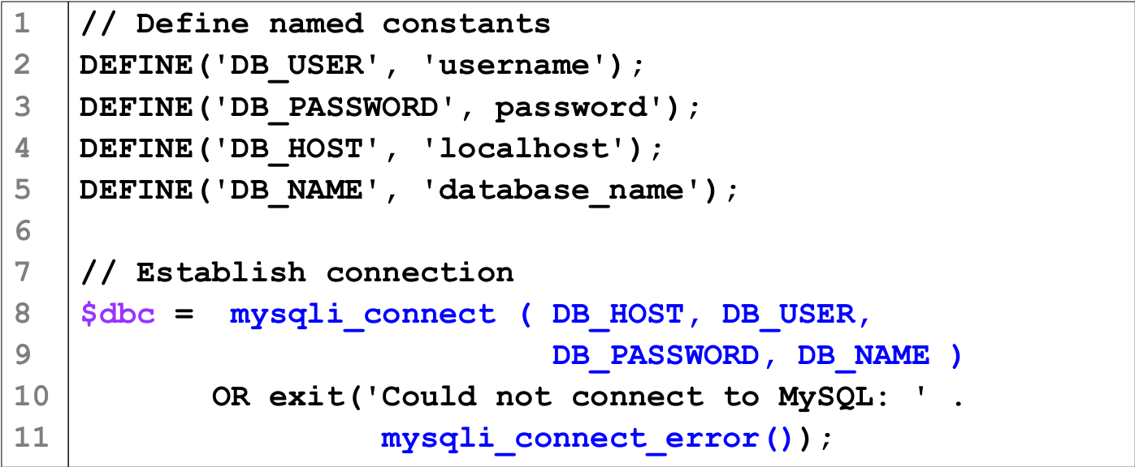
Connecting to MySQL

Slide 4
Line 8: mysqli_connect() connects to a MySQL server running at DB_HOST and selects the database DB_NAME Upon success, $dbc holds a reference to the database which is needed by subsequent mysqli_* function calls.
Line 10: "expr1 OR expr2 " means "If expr1 is true, don’t evaluate expr2 ).
  This kind of evaluation is called short circuit evaluation.
  So at line 10, exit() will only be called if mysqli_connect() fails.
Line 11: mysqli_connect_error() returns a string containing a detailed error message about the failed connection.

Slide 5
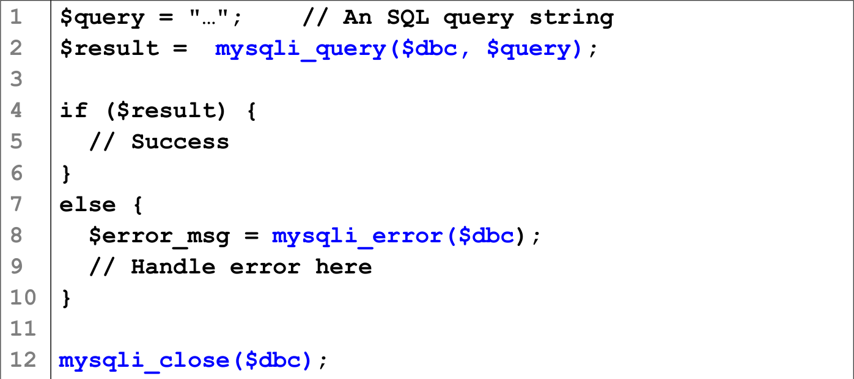
Executing Queries

Slide 6
Line 2: mysqli_query() sends a query to a server. It returns TRUE (or a result object for SELECT, SHOW, DESCRIBE, and EXPLAIN commands) on success or FALSE on failure.
Line 8: mysqli_error() returns a string containing a detailed error message about the failed query operation.
Line 12: mysqli_close() closes the database connection.

Slide 7
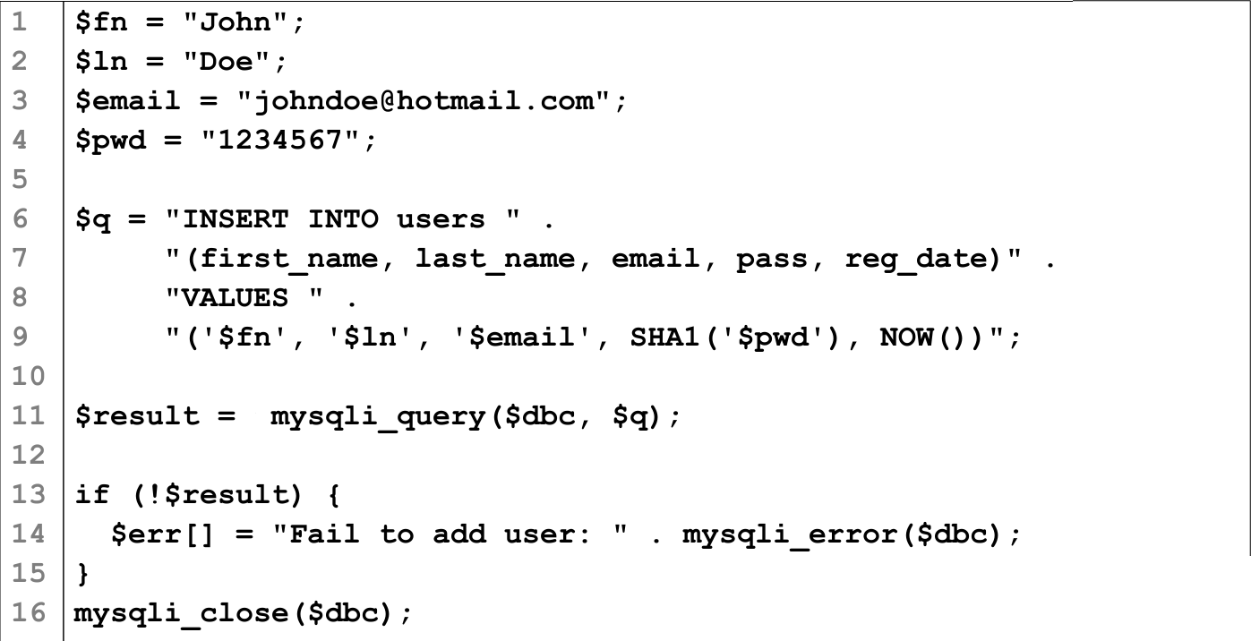
Example: Adding a Record

Slide 8
Line 1-4: In practice these values are usually obtained from a HTML form.
Line 9: SHA1() is an MySQL function that performs a one-way encryption on its parameter and returns a 40-character long encrypted string.
  It is safer to store a password as encrypted string than as plain text.
  To compare passwords, you will need to compare the encrypted version.
Line 9: NOW() is a function that returns the current date and time of the MySQL server (not the Web server).

Slide 9
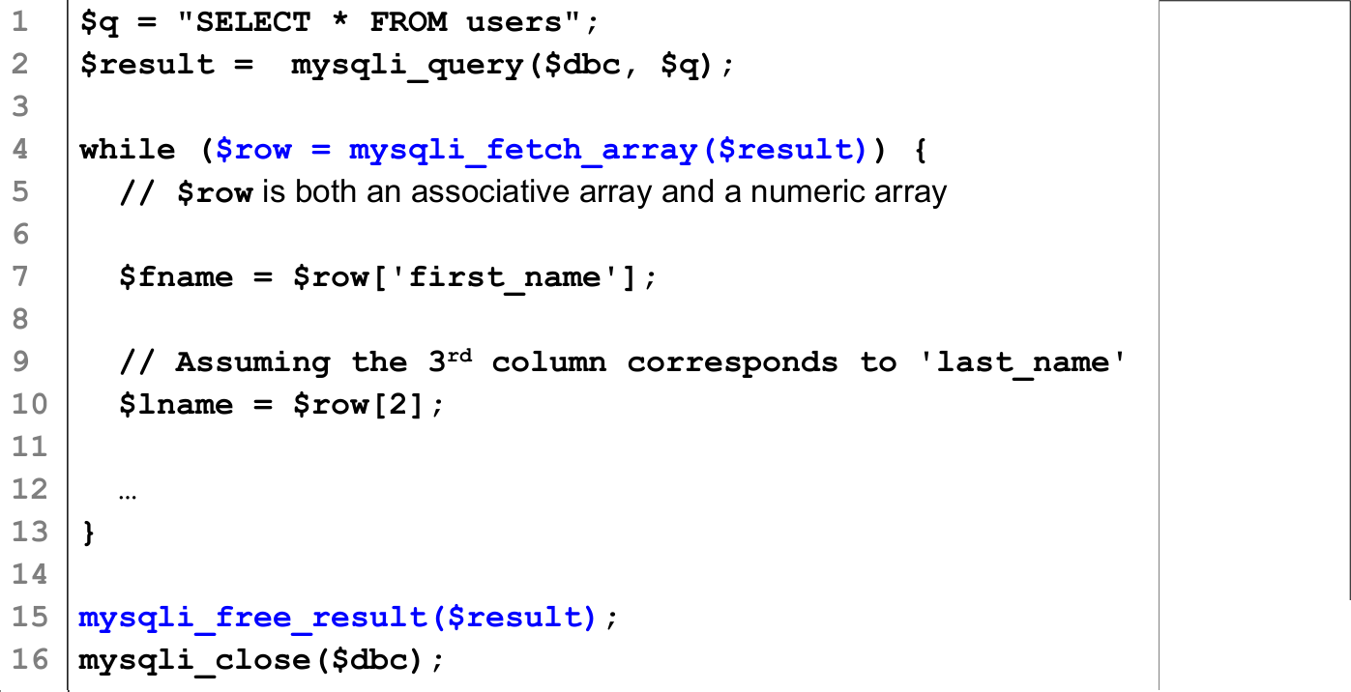
Retrieving Query Results

Slide 10
Line 2: A "SELECT" query returns a result set that contains multiple rows. For such command, mysqli_query() returns a reference to the result set.
We can only retrieve one row of results at a time.
Line 4: mysqli_fetch_array($result) returns the current row as an array (which can be processed as an associative or a numeric array). The function returns NULL when no more row is available.
Line 15: mysqli_free_result($result) frees the resource used by $result.

Slide 11
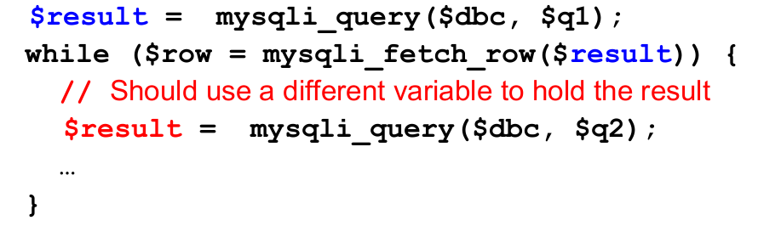
Related functions:
  mysqli_fetch_row() – returns the result set as a numeric array.
  mysqli_fetch_assoc()– returns the result set as an associative array.
  mysqli_fetch_object() – returns the result set as an object
Use different variables to hold the results of different queries.

Slide 12
Escaping Special Characters
Before using an input string in an SQL query, you should make sure all the special characters in the string are properly escaped.
mysqli_real_escape_string($dbc, $data)
  returns a string containing all the characters in $data but with all the special characters in $data properly escaped.

Slide 13
Counting Returned or Affected Records
mysqli_num_rows($result)
returns the total number of rows in a result set returned by a SELECT query.
  You can use this function to help you figure out if a SELECT command retrieves any row before starting to fetch anything from the result set.
mysqli_affected_rows($dbc)
returns the total number of rows affected by an INSERT, UPDATE, or DELETE query.
  You can use this function to check if your command achieve its objective. e.g., is a DELETE command deleting exactly one row?

Slide 14
Using Prepared Statements
With a prepared query, the SQL syntax is sent to MySQL first for "compilation". Then the specific values are sent separately.
Advantage of prepared statements are
  Greater security
  Potentially better performance

Slide 15
Using Prepared Statements
Without prepared statement:
As prepared statement:
  $q = "SELECT first_name, last_name FROM users " .
  "WHERE last_name=? ";
  $stmt = mysqli_prepare($dbc, $q);
  mysqli_stmt_bind_param($stmt, 's', $lname );
  mysqli_stmt_execute($stmt);
  $q = "SELECT first_name, last_name FROM users " ."WHERE last_name=$lname ";
  $result = mysqli_query($q);

Slide 16
Using Prepared Statements
$q = "SELECT first_name, last_name FROM users " ."WHERE last_name=? ";
? serves as a placeholder in the query.
$stmt = mysqli_prepare($dbc, $q);
Requests the server to compile the query
mysqli_stmt_bind_param($stmt, 's', $lname );
Substitute the value of $lname into the location of the placeholder. 's' indicates the value is a string. ('d' for decimal, 'i' for integer, 'b' for binary data.)
mysqli_stmt_execute($stmt);
Execute the query

Slide 17
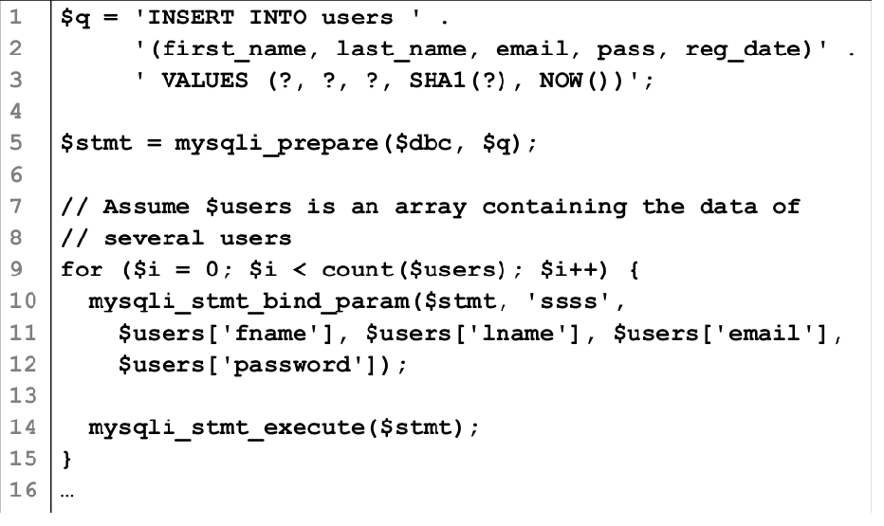
Example: Using Prepared Statements

Slide 18
References and Resources
PHP Manual for MySQL Improved Extension
http://www.php.net/manual/en/book.mysqli.php

