Slide 1

IMPACT OF WEATHER & COVID ON ACCIDENTS
GROUP 9

Slide 2
Objective
To understand the effects of weather on traffic in general, and how those effects were affected due to Covid. Also, what the impact of lockdown has been on the weather, and if there are any significant changes in the weather events because of Covid.
Some questions about the data include
What type of events have caused the most accidents?
What effects did the Coronavirus have on traffic and accidents (whether they went down, increased due to stress, etc.)?
What impact did the Coronavirus have on the environment, and if so, in what form is it manifesting?

Slide 3
Data sources
Accidents Data Source: The accidents data consists of traffic accident events in the US from 2019 to June 2020. It consists of attributes like start time, end time, the type of accident, the severity of the accident and some information about the location such a city, state, county, zip code, etc.
Weather Data Source : Similar to the accidents data, the weather data contains information about weather events in the USA from 2019 to June 2020 about the type, severity, the timestamp and location information, not unlike the Accidents data.
COVID-19 Data Source: In this dataset we have the COVID-19 case details of each county in the US from Jan 2020 to till date. This dataset has details about number of cases, cumulative case per thousand and million, health index, economic support index, how many hospitalized, how many deaths, restricted on gathering, schools closed and many.

Slide 4
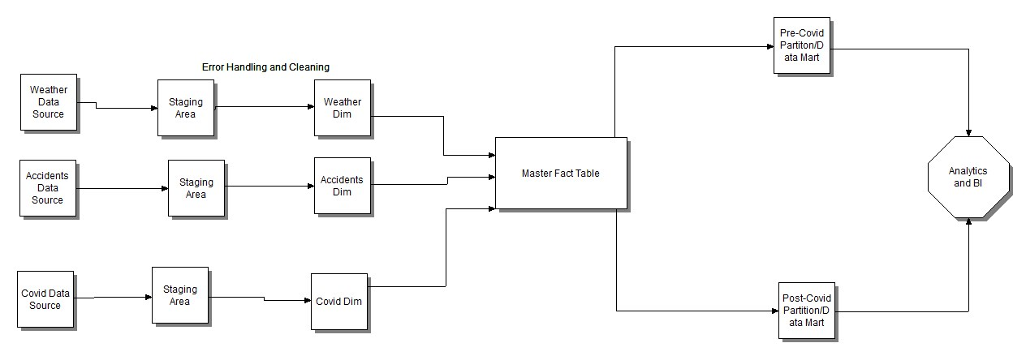
High level Design

Slide 5
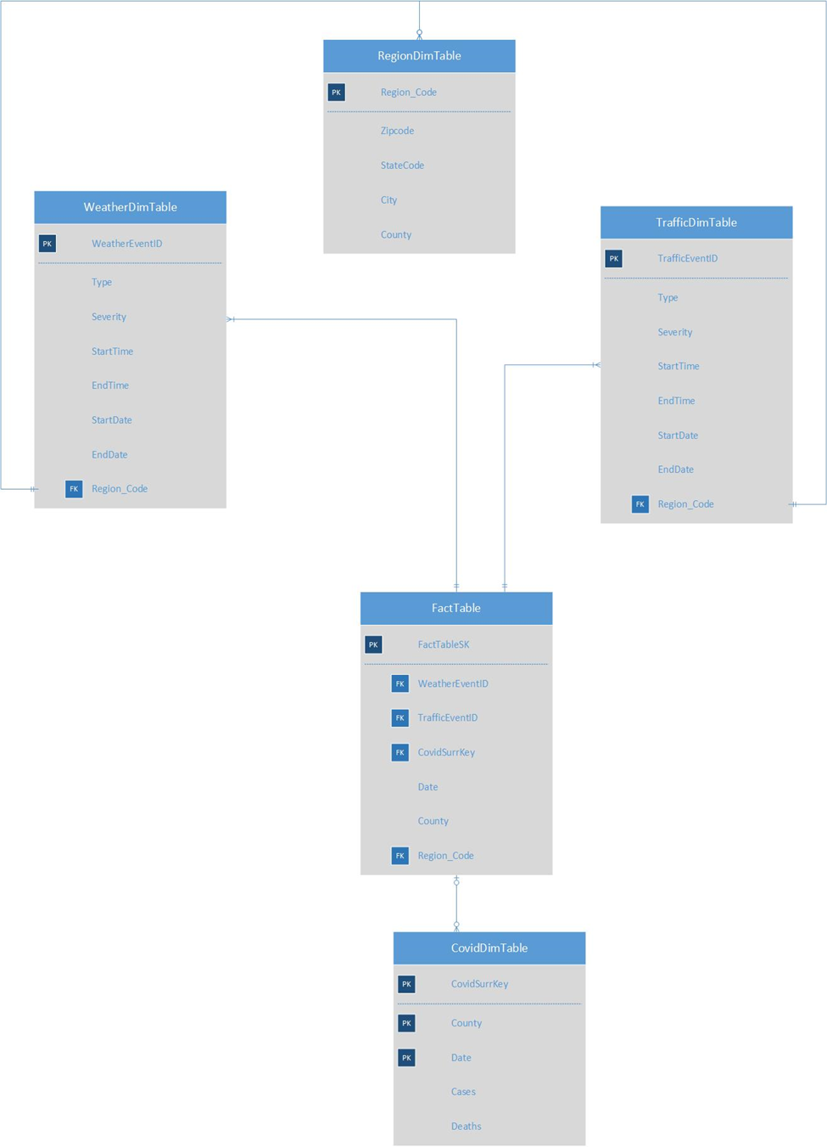
Dimensional m0del

Slide 6
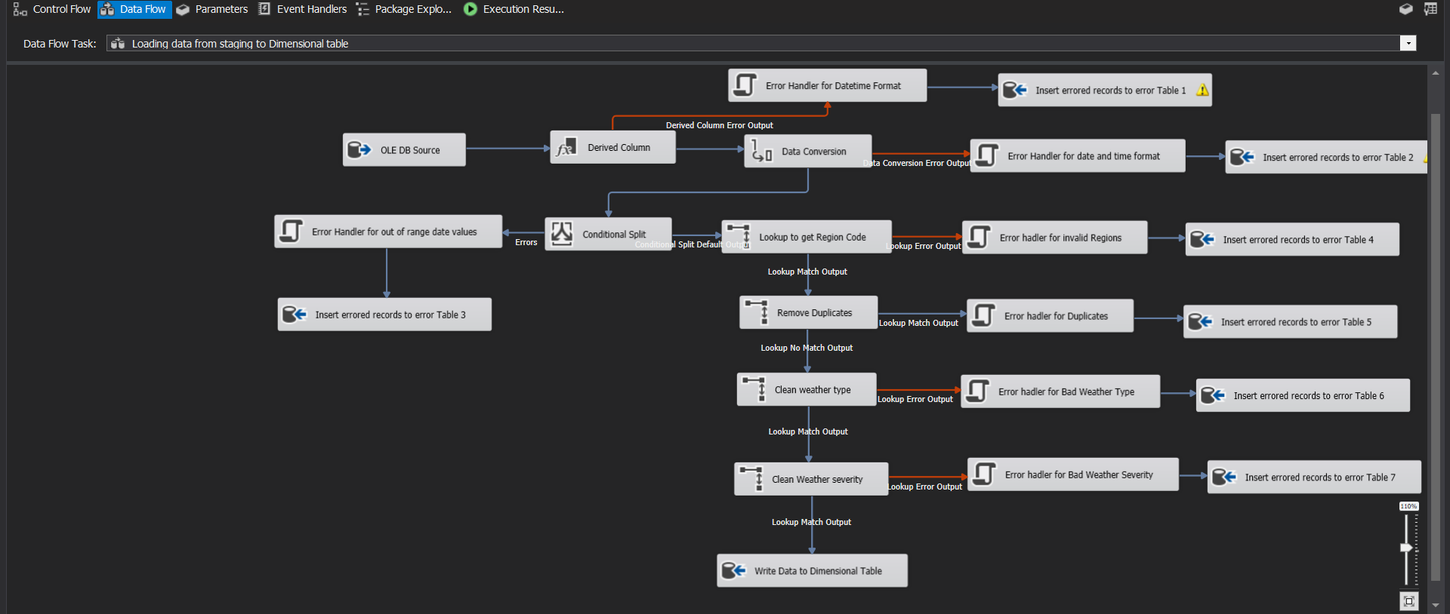
ERROR HANDLING(Accidents/Weather)

Slide 7
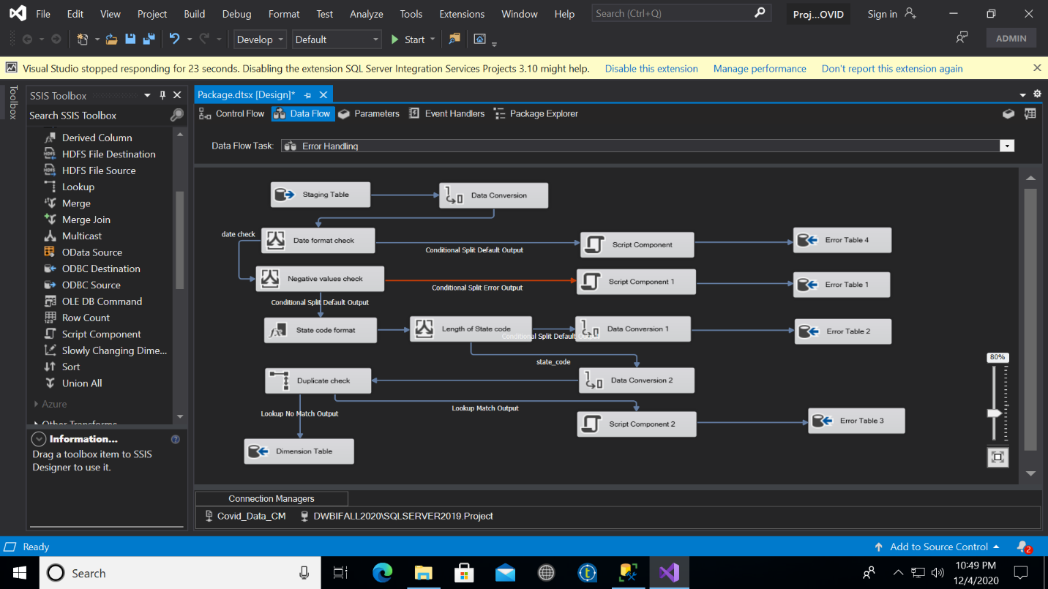
Error Handling(covid)

Slide 8
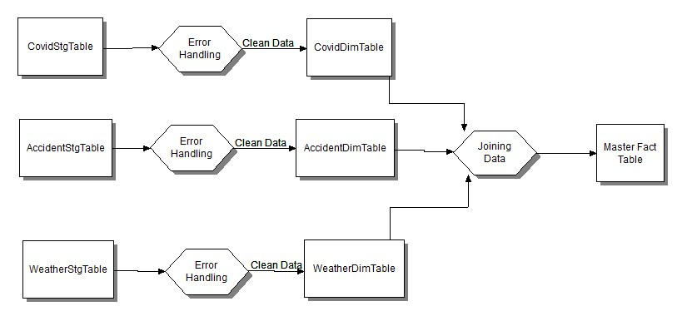
POPULATING FACT TABLE(INTIAL LOAD)

Slide 9
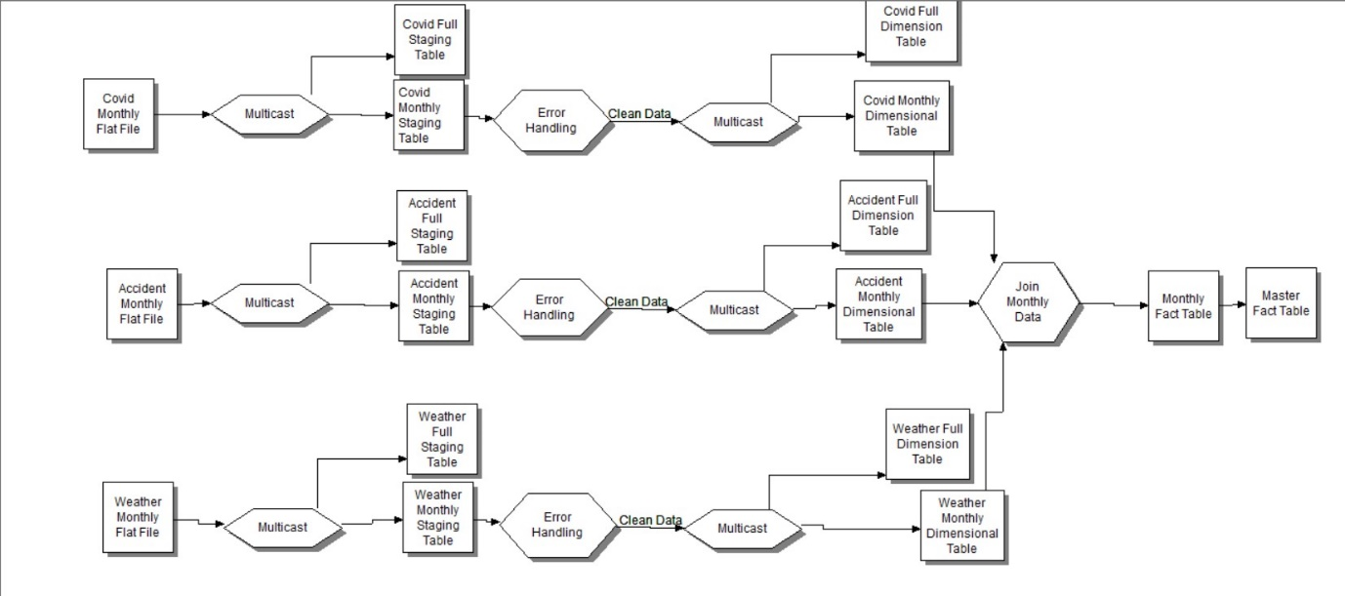
POPULATING FACT TABLE(MONTHLY LOADS)

Slide 10
DATA MARTS
Pre Covid Mart
With this mart, we can create further views by joining the RegionDim Table and performing aggregations by geographic regions, all of which were done further in Tableau.
Post Covid Mart
With the post Covid data, we can join the dimensional table, Weather and Accident, and use the Region tables to derive data and answer more specific questions.
Users have freedom to manipulate the data through joins with the dimensional tables to answer any questions they have.

Slide 11
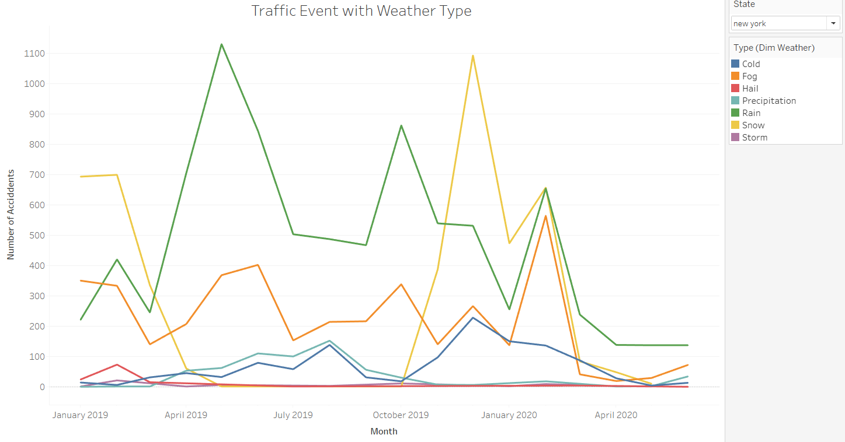
Relationship between traffic incidents and weather events

Slide 12
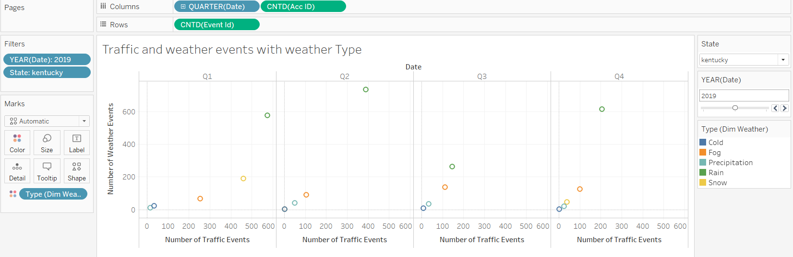
Relationship between traffic incidents and weather events

Slide 13
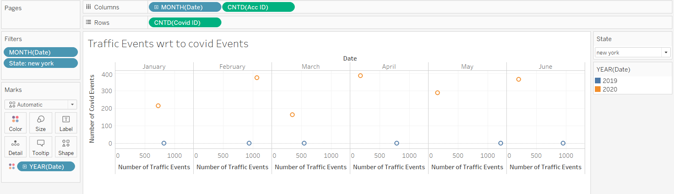
Relationship between traffic incidents and coviD-19 cases

