Slide 1



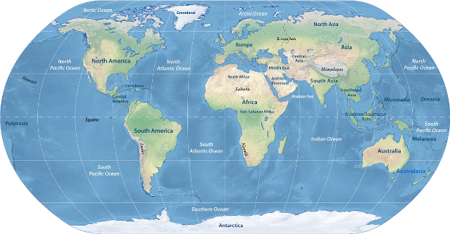
Tata Strategic Revenue and Demand Analysis for Global Expansion
This presentation analyzes Tata's global revenue and demand trends, aiming to identify opportunities for strategic expansion and growth.
Presented By: Raja Babu Kumar

Slide 2

Objective
This analysis provides comprehensive insights into revenue trends, top-performing countries, and customer behavior to inform strategic decision-making for Tata's global operations.
Revenue Trends
Top Performing Countries
Customer Analysis
Identify key revenue patterns and fluctuations.
Understand the contribution of different countries to overall revenue.
Gain insights into customer behavior and identify key customer segments.

Slide 3

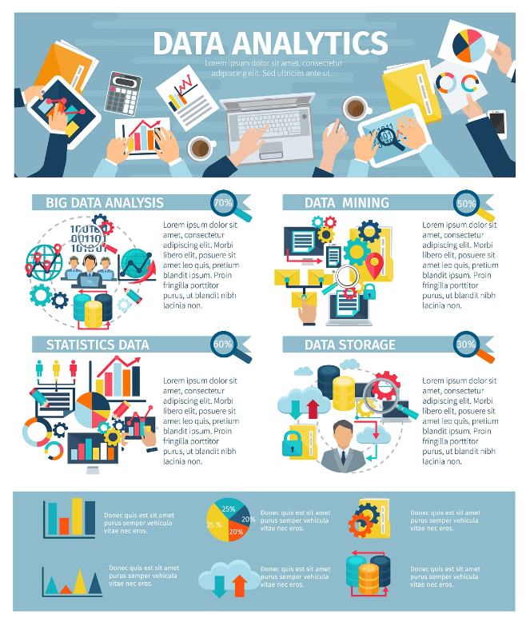
Scope
The analysis focuses on data from 2011, excluding the United Kingdom, and includes monthly revenue trends, top revenue-generating countries and customers, and product demand by region.
1
Monthly Revenue Trends
Analyze revenue fluctuations throughout the year 2011.
2
Top Revenue-Generating Countries
Identify the top countries contributing to overall revenue.
3
Top Customers
Highlight the most valuable customers based on revenue generated.
4
Product Demand by Region
Understand the regional variations in product demand.

Slide 4

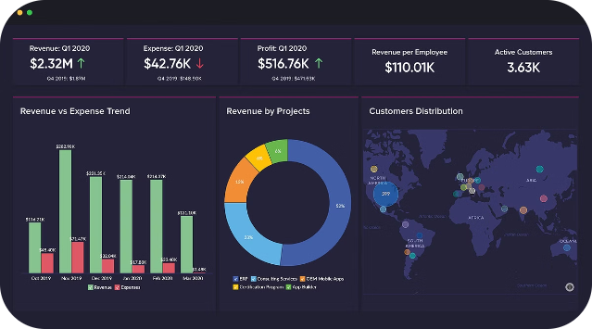
Overview of Data
The dataset contains information on various aspects of Tata's operations, providing valuable insights into revenue, customer behavior, and product demand.
InvoiceNo
InvoiceDate
CustomerID
Country
Revenue
Product

Slide 5
Dataset Description
The dataset consists of six key columns: InvoiceNo, InvoiceDate, CustomerID, Country, Revenue, and Product, providing comprehensive information about transactions and customer interactions.
InvoiceNo
InvoiceDate
CustomerID
Country
Unique identifier for each invoice.
Date of the invoice.
Unique identifier for each customer.
Country of the customer.

Slide 6

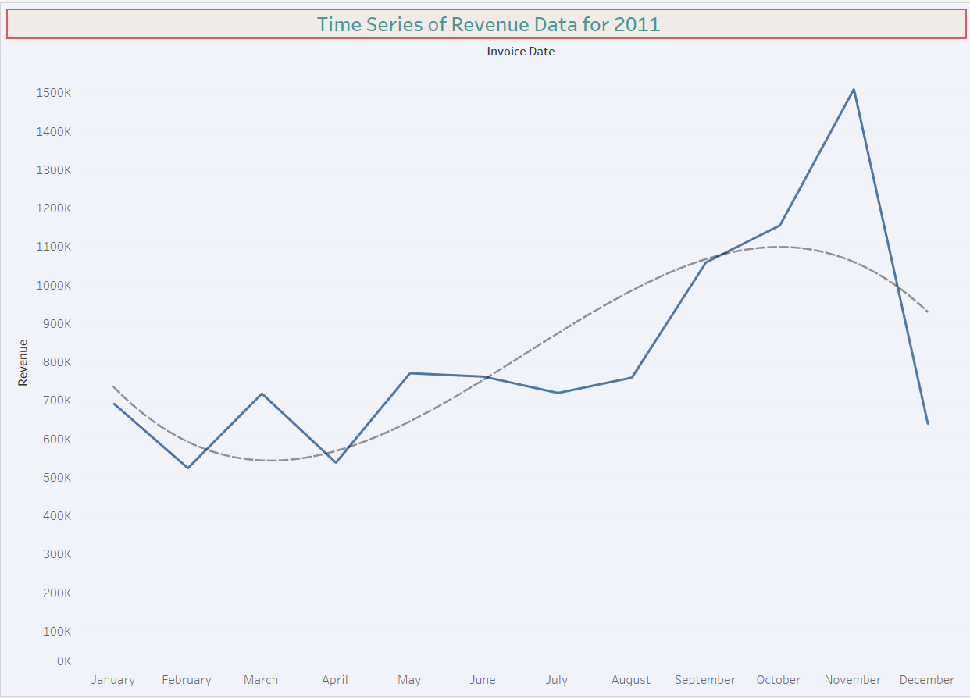
Monthly Revenue Trends
Analysis of monthly revenue trends reveals seasonal fluctuations and highlights key growth periods throughout the year.
1
Peak Season: November
Identify months with highest revenue to understand customer buying behavior and seasonal demand.
2
Low Season: February
Analyze months with lower revenue to understand potential factors affecting sales.
3
Growth Trends
Identify periods of significant revenue growth and understand contributing factors.

Slide 7

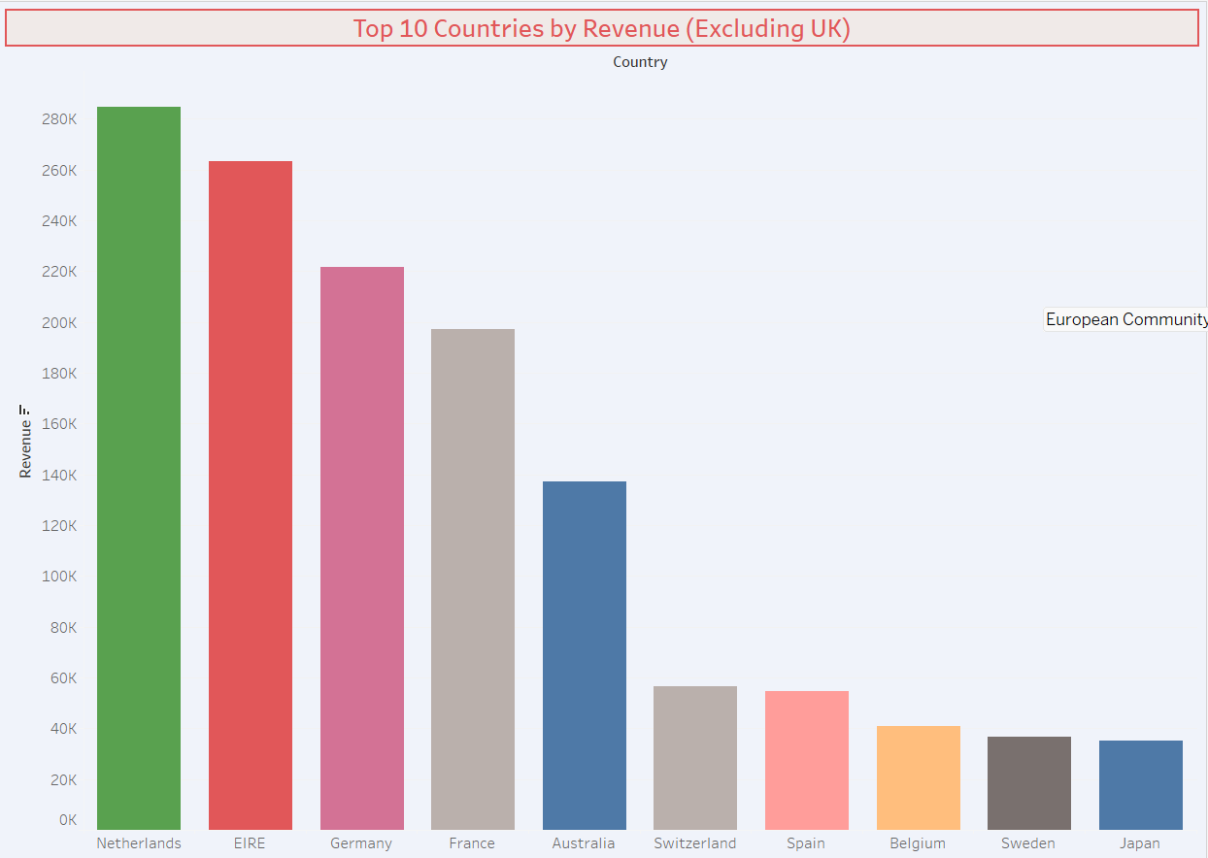



Top 10 Revenue-Generating Countries
The analysis identifies the top countries contributing to overall revenue, highlighting key markets for Tata's global expansion strategy.
Top 10 Countries
1. Netherlands 2. EIRE 3. Germany 4. France 5. Australia
6. Switzerland 7. Spain 8.Belgium 9. Sweden 10.Japan
Top 3 Country
1. Netherlands
2. EIRE
3. Germany
Targeted Marketing
Rest of the Countries to Boost our Products.

Slide 8

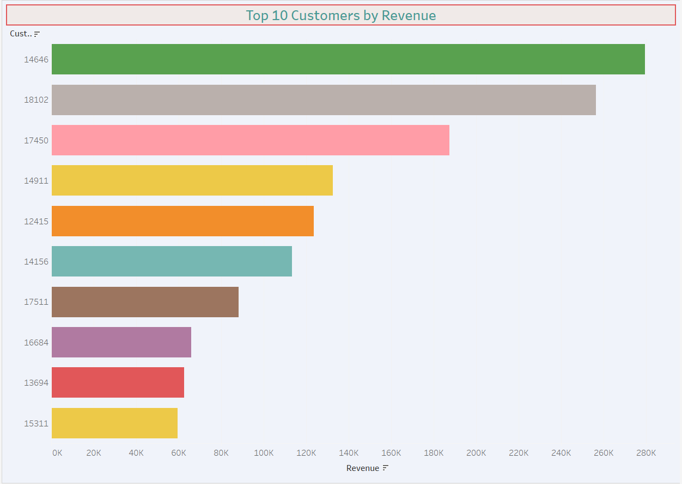



Top Customers
Identifying and understanding top customers is crucial for building strong relationships and maximizing customer lifetime value.
High-Value Customers
Customer ID 14646
Top 10 Customers
1. ID: 14646 2. ID: 18102 3. ID: 17450 4. ID: 14911 5. ID: 12415
6. ID: 14156 7. ID: 17511 8. ID: 17450 9. ID: 13694 10. ID: 15311
Personalized Marketing
Develop personalized marketing campaigns to target all the rest of customers.

Slide 9
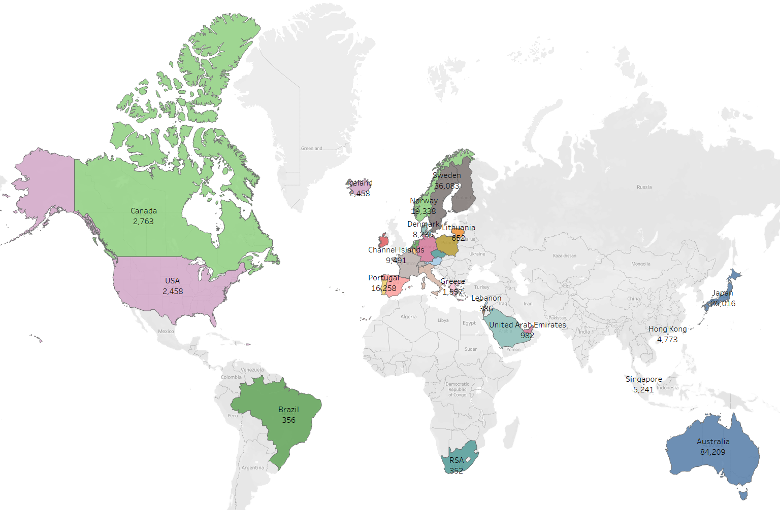
Product Demand by Region
Understanding regional variations in product demand is crucial for tailoring product offerings and marketing strategies to specific markets.

Slide 10
Strategic Recommendations
1
Seasonal Strategy
Tailor marketing and stock strategies according to seasonal trends.
2
International Expansion
Focus on high-revenue countries and regions with high product demand for expansion.
3
Customer Retention
Develop loyalty programs for top customers to ensure continued revenue generation.

Slide 11



