Slide 1
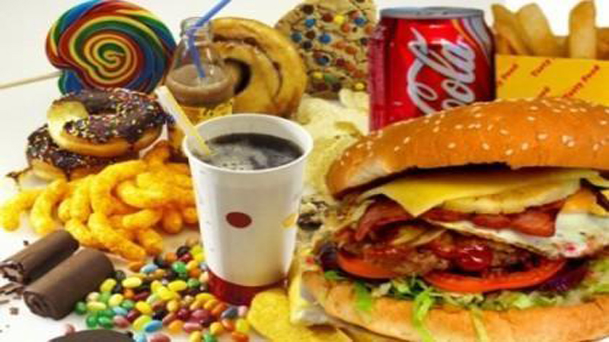
JUNK FOOD

Slide 2
"Junk food" is a term used to describe food that is high in calories from sugar and/or fat, and possibly sodium, making it hyperpalatable, but with little dietary fiber, protein, vitamins, minerals, or other important forms of nutritional value. It is also known as HFSS food (high in fat, salt and sugar).

Slide 3
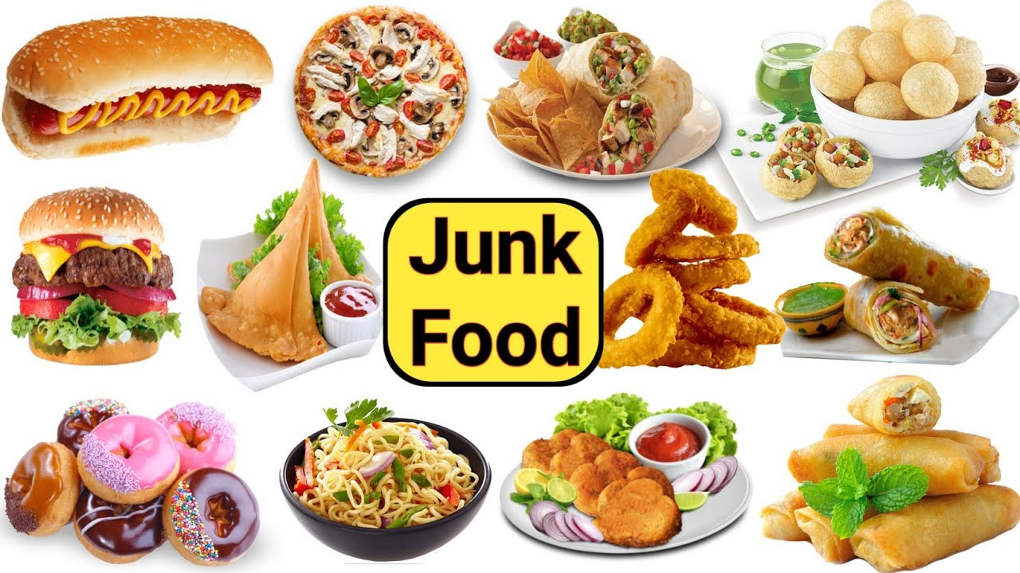

Slide 4
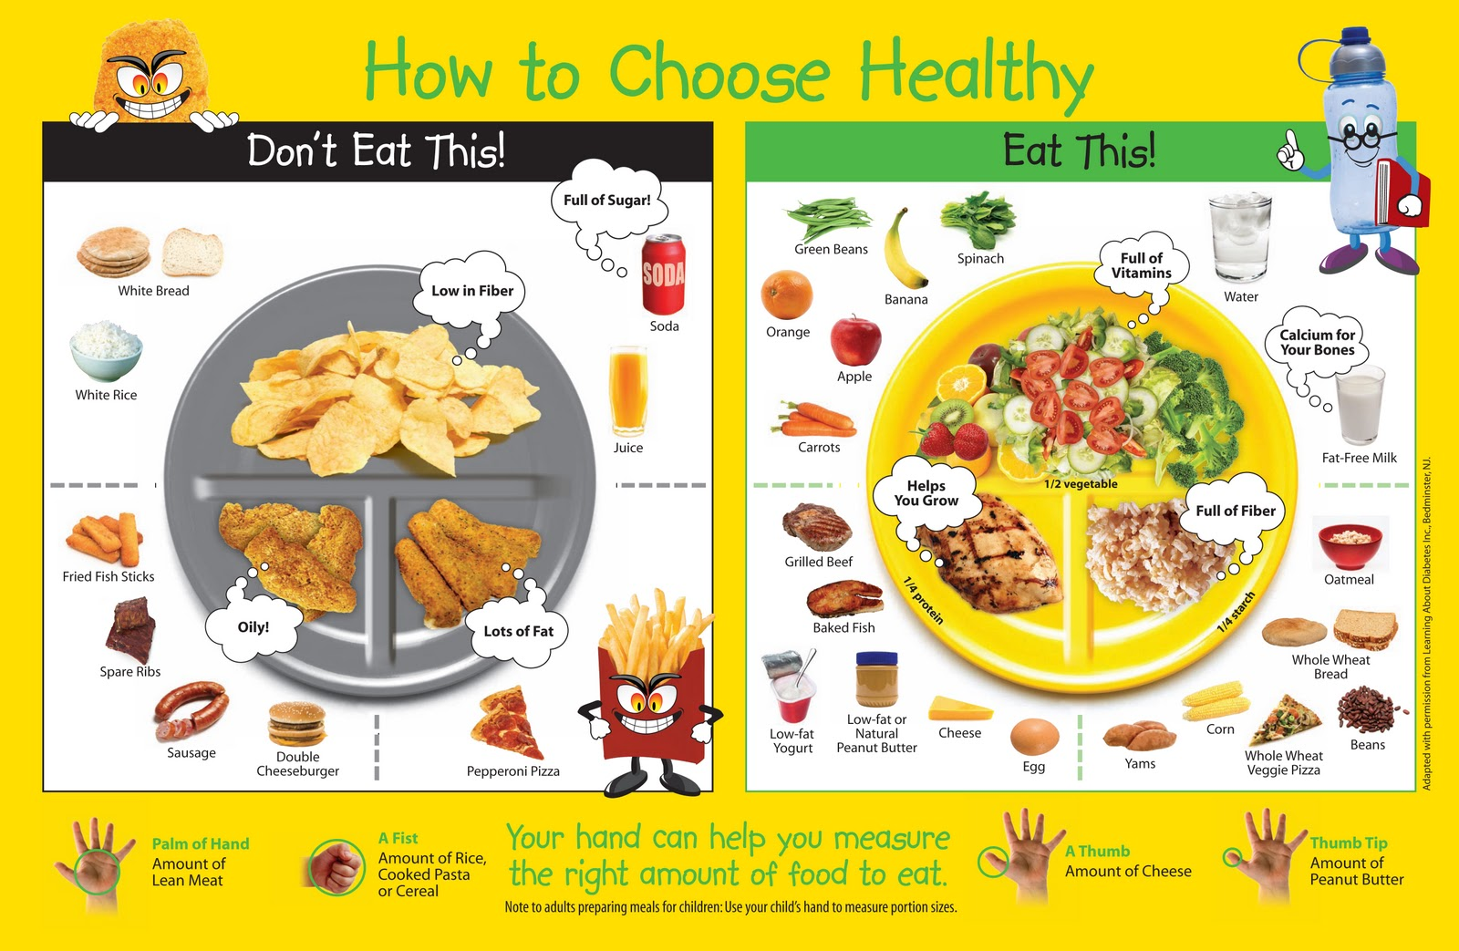

Slide 5
Junk food' is food that contains high levels of fats, salt or sugar, and lacks nutrients such as Fast Food and Overeating · It's low in fiber. · It's high in palatability (that is, it tastes good). · It offers a high number of calories in a small volume.
fibre, vitamins and minerals.

Slide 6
unk foods are high in starch, sugar, saturated fat, trans fat and salt, but low in fruit, vegetables, fibre and wholegrains. This means most junk foods don't ...

Slide 7
What is junk food
Some common examples of junk foods include sodas and snack foods, such as potato chips, crackers and candy. Popular fast-food items, like hamburgers and French ...

Slide 8
Junk food definition, facts $ side effects: lesson for kids
12 Jan 2023 — Junk food is any food with little to no nutritional value. A simple way to think of junk food is 'empty calories'. Junk foods have calories but ...

Slide 9
The impacts of junk food on health
Long-term, junk foods can lead to tooth decay and poor bowel habits. Junk foods can also lead to obesity and associated diseases such as heart ...

Slide 10
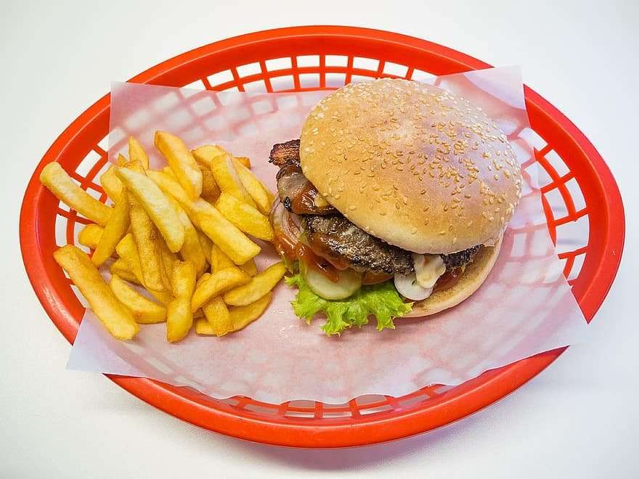

Slide 11


Slide 12
THANK YOU

