Slide 1
Autonomous Log Intelligence & Self-Healing System Using Local LLMs + Knowledge Graphs
Raja Sekhar Amirapu

Slide 2
Problem Statement-The Observability Crisis: Data Overload and Privacy Deadlocks
  Modern infrastructure generates massive, "noisy," and unstructured log data that overwhelms traditional tools. Relying on human engineers to manually search ("grep") through this data for Root Cause Analysis (RCA) is slow, prone to error, and leads to prolonged downtime and alert fatigue.
  While AI offers a solution to the data volume problem, current "Cloud AIOps" models require sending sensitive log data to third-party vendors. This creates unacceptable privacy risks, regulatory compliance failures (e.g., GDPR, HIPAA), and high costs.

Slide 3
Solution Overview
Here is the summary of the updated solution:
The Solution: Graph-Augmented Private AI
We propose a self-contained intelligence engine that runs entirely on-premise or within your secure VPC, ensuring zero data leakage while transforming how incidents are resolved.
Hybrid Intelligence: The system combines Local LLMs (to understand the semantics of log text) with a Dynamic Knowledge Graph (to understand the structure and dependencies of your infrastructure).
Contextual Reasoning (GraphRAG): Instead of viewing errors in isolation, the AI uses the graph to trace causality. It links "noisy" logs to specific root causes—such as upstream service failures, database dependencies, or recent code commits—providing deterministic rather than probabilistic analysis.
Autonomous Remediation: Armed with deep contextual awareness, the system can safely trigger self-healing actions, reducing Mean Time to Resolution (MTTR) from hours of manual searching to seconds of automated fixing.

Slide 4
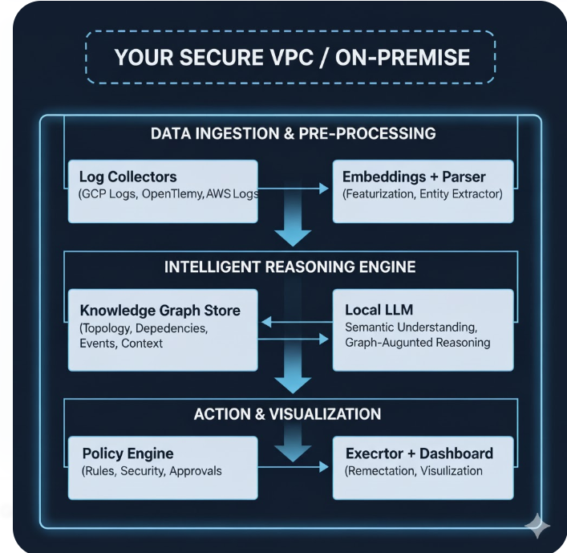
Architecture Diagram

Slide 5
Data Ingestion & Pre-Processing
Log Collectors (GCP Logs, OpenTelemetry, AWS Logs): The system accepts logs from diverse, multi-cloud sources and standardized collection platforms like OpenTelemetry, unifying heterogeneous data streams.
Embeddings + Parser: Raw logs are passed through parsers to extract key entities and are converted into numerical embeddings. This process extracts features, structures the data, and prepares it for semantic analysis by the AI.

Slide 6
Intelligent Reasoning Engine (The Core AI)
This is the "brain" where data is analyzed for root cause and context.
Local LLM (Large Language Model): The model runs locally (in your VPC), providing semantic understanding—it comprehends the intent and meaning of log messages like a human.
Knowledge Graph Store: This acts as the long-term memory and structural map of the infrastructure, storing Topology, Dependencies, Events, and Context.
Graph-Augmented Reasoning (GraphRAG): The Local LLM queries the Knowledge Graph to ground its conclusions in reality. This allows the system to move beyond simple pattern matching to deterministic causality—for instance, tracing a high-latency log message back to a specific upstream service dependency stored in the Graph.

Slide 7
Action & Visualization
This stage ensures incidents are resolved autonomously and safely, while providing visibility to operators.
Policy Engine: Acts as a critical guardrail. Based on the confidence and severity determined by the LLM/KG, the Policy Engine applies predefined Rules, Security checks, and Approvals before any automated action is taken.
Executor + Dashboard: The final component responsible for Remediation (triggering self-healing scripts like restarts or rollbacks) and providing Visualization of the incident, analysis, and actions taken to the human team.

Slide 8
Stage 1: Visibility
This capability revolutionizes log analysis by applying AI to the entire data lifecycle.
Unified Foundation: Logs are centralized from all multi-cloud and application sources (e.g., GCP, AWS, OpenTelemetry) to establish a comprehensive data stream.
Intelligent Summarization: Local LLMs process massive volumes of log data to generate concise, natural language executive summaries of incidents, drastically reducing cognitive load and accelerating engineer handoffs.
Robust Metadata Extraction: LLMs replace fragile RegEx parsing to reliably extract key entities (Service IDs, Request Statuses, etc.) from unstructured text. This structured metadata is critical for accurate correlation and serves as the essential input for the Knowledge Graph.

Slide 9
Stage 2: Intelligence
This capability is the analytical core of the system, designed to enable deterministic Root Cause Analysis (RCA):
AIOps Correlation: Advanced ML and LLMs are used to group disparate log, metric, and trace events semantically and temporally, defining a single, unified incident structure.
Knowledge Graph Mapping: The correlated events and system entities are mapped into a dynamic Knowledge Graph (nodes and causal edges), linking transient failures to the static infrastructure topology.
Accelerated RCA: The system executes graph traversal algorithms to instantly trace the failure chain back to the most upstream structural or behavioral change (Patient Zero), providing a highly confident root cause statement for autonomous self-healing.

Slide 10
Knowledge Graphs for Bug Origin Identification
The Knowledge Graph (KG) acts as the system's structural memory to enable deterministic Root Cause Analysis (RCA).
Mapping: The KG models the infrastructure using Nodes (Services, Deployments, Error Types, Config Changes) and Edges that define their causal and topological dependencies.
Querying: The system utilizes Graph Traversal queries to follow the cause-effect chains backward from the symptom.
RCA: This process instantly identifies the Bug Origin—the specific deployment or configuration change that represents the "freshest change" immediately preceding the failure—thereby enabling highly precise, automated self-healing

Slide 11
Stage 3: Assistance
The system utilizes a Human-in-the-Loop (HITL) model to ensure safety and expert control over remediation.
AI Diagnosis & Suggestion: The Local LLM leverages the Knowledge Graph's (KG) deterministic RCA and validated Historical Fixes to generate a highly precise, low-blast-radius remediation plan (an executable script or command).
Human Oversight: The Policy Engine routes the proposed fix to a Dashboard based on its risk profile.
Controlled Execution: Operators are given the ability to review the full context of the AI's suggestion, modify the proposed script if necessary, and manually approve the execution, ensuring that high-stakes actions are always confirmed by expert human judgment.

Slide 12
Stage 4: Autonomy
Policy Engine: Acts as the guardrail, assessing the risk of the LLM's suggested fix and dictating whether the action is immediately executed, denied, or routed for Human-in-the-Loop (HITL) review.
Rollback Focus: The primary self-healing action is a surgical Rollback to a known-good state, targeting the exact Bug Origin identified by the Knowledge Graph to minimize the blast radius.
Validation: The process is closed-loop; the system performs post-remediation checks to confirm the fix resolved the incident, feeding success or failure data back into the system for continuous learning and policy refinement.

Slide 13
The Shift to Predictive Operations
Predictive Ops uses the historical data and structural context accumulated in the KG to identify weak signals and emerging threats, enabling the system to act proactively.
Weak Signal Detection: The Local LLM continuously analyzes the rate of change in log patterns (e.g., increasing frequency of warning messages, subtle latency spikes) that would be ignored by traditional threshold alerting.

Slide 14
Dependency Load Forecasting:
The Knowledge Graph models service dependencies and current resource utilization. The system forecasts load propagation—if Service A is trending toward capacity limits, the KG predicts which downstream Service B will be the first to fail.

Slide 15
Proactive Remediation
Instead of waiting for the failure, the system triggers pre-emptive, low-risk actions:
Example: Predicting resource exhaustion on a container and triggering an auto-scaling event 30 minutes before the projected failure time.
Action: Triggering a controlled resource increase or diverting traffic away from a potentially unstable service.

Slide 16
Full Prototype Integration: The Closed-Loop System
Component | Role in the Loop | Outcome
LLM + KG | Intelligent Reasoning: Generates predictions, performs RCA, and creates the validated remediation plan. | Accurate Diagnosis/Prediction
Policy Engine | Risk Control: Assesses the risk of the proposed fix/prevention, enforces security policies, and routes the action (Auto-Execute vs. HITL). | Safe Governance
Dashboard | HITL Interface: Provides the single pane of glass for human oversight, displaying prediction/RCA context and allowing operators to review and modify the generated fix. | Controlled Execution
Executor + Validation | Final Action: Executes the approved fix (rollback/proactive scale-up) and immediately validates the system's return to health, feeding the result back to the KG. | Verified Self-Healing

Slide 17
Software and Deployment
Full Source Code: All proprietary code for the LLM inference engine, KG modeler, and policy engine (containerized for secure deployment).
Container Images: Ready-to-deploy Docker/Kubernetes container images for all architectural components (LLM, KG, Policy Engine).
Deployment Scripts: Complete IaC (Infrastructure as Code) templates (e.g., Terraform/Helm charts) for deployment into the customer’s secure VPC/On-Premise environment.

Slide 18
Functionality and Testing
Live Dashboard: A fully functional UI demonstrating:
Real-time event streams and anomaly detection.
Prediction alerts with root cause likelihood.
The Human-in-the-Loop review queue (Review/Modify/Execute functionality).

Slide 19
Functionality and Testing Continued
End-to-End Simulation: A comprehensive test suite proving the system can successfully complete the entire loop.
Simulated Failure → RCA → Prediction/Remediation → Suggestion → Execution → Validation
Performance Metrics: Report detailing the Mean Time To Resolution (MTTR) improvement achieved during testing and the latency of the LLM/KG reasoning engine.

Slide 20
Documentation and Training
Architecture Document: Finalized design specification for all components, including data flow, KG schema, and LLM architecture.
Operator Runbook: Detailed guide for operating, managing, and troubleshooting the platform.
Policy Template Library: A set of default, customizable policies for immediate deployment (e.g., "HITL for all production rollbacks").

Slide 21
Conclusion
Zero Privacy Risk: Achieve Full Data Sovereignty (On-Prem/VPC) by leveraging Local LLMs and Knowledge Graphs—no log data leaves your secure perimeter.
Decisive Intelligence: Eliminate manual toil by moving from keyword search to Contextual Reasoning. The LLM + KG provides deterministic, causality-driven RCA in seconds.
Unmatched Efficiency & Safety: Drastically reduce MTTR via targeted self-healing (Rollbacks), while the Human-in-the-Loop model ensures expert control over high-risk actions.
The Future is Predictive: The integrated prototype enables Predictive Operations, allowing teams to proactively prevent failures before customer impact.

