Slide 1
Agentic AI: The Next Evolution
From Automation to Autonomous Decision-Making
AI agents don’t just respond — they plan, act, and learn. This presentation explores how enterprises are deploying autonomous AI systems to handle complex, multi-step workflows with minimal human intervention.
“The question is not whether AI will replace humans, but which humans will use AI to replace others.” — Harvard Business Review, 2024

Slide 2
Executive Summary
What is Changing
AI is evolving from reactive systems (answering questions) to proactive agents (completing goals). Traditional AI waits for a prompt; Agentic AI breaks down a goal, creates a plan, calls tools, and executes — all autonomously.
Business Impact
40-60% reduction in repetitive task cycle time | 24/7 operations without staffing costs | 3x faster root-cause analysis in IT/ops
Market Signal
“By 2028, 15% of day-to-day work decisions will be made autonomously through agentic AI.” — Gartner, 2024

Slide 3
What is Agentic AI?
Definition
Agentic AI refers to AI systems that autonomously pursue goals by breaking them into sub-tasks, using external tools (APIs, databases, browsers), reasoning over intermediate results, and adapting plans when they encounter obstacles.
Key Characteristics
Goal-directed: Given “Book cheapest flight to NYC”, it searches, compares, and books — not just searches.
Tool-using: Can call APIs, run code, query databases, and send emails.
Self-correcting: If a step fails, it retries, reroutes, or escalates.
Simple Example
User: “Research the top 3 competitors and send me a summary by 5 PM.” An agentic AI browses the web, extracts data, compiles the report, and emails it — without further instructions.

Slide 4
Traditional vs Agentic AI
Traditional AI: Reactive
Waits for input, returns a single response, then stops. Example: ChatGPT answering “What is the capital of France?” — one question, one answer, no follow-through.
Agentic AI: Proactive
Pursues a goal across many steps. Example: “Onboard a new client” — it creates the account, assigns a CSM, schedules kickoff, sends welcome email, and logs everything in CRM.
Key Differences at a Glance
Single-step (Traditional) vs Multi-step with tool use (Agentic)
Low autonomy, human drives each step (Traditional) vs High autonomy, human sets goal only (Agentic)
No memory between sessions (Traditional) vs Persistent memory enables learning over time (Agentic)

Slide 5
Analogy: Digital Employee
Think of an Agentic AI as a skilled new employee who has been given a job description, a desk, and a toolbox. They don’t need hand-holding for every task.
LLM = Brain
Reasons, understands language, makes decisions. Like a smart analyst who reads reports and draws conclusions.
Tools = Hands
Web browsers, APIs, code interpreters, email clients. The agent can search Google, pull a report from Salesforce, or trigger a Jira ticket.
Memory = Experience
Remembers past interactions, client preferences, and prior decisions — like an employee who recalls what worked last quarter.
Planner = Manager
Breaks big goals into steps, sequences tasks, delegates to sub-agents — like a project manager orchestrating a team.

Slide 6
Core Components
Reasoning Engine (LLM)
The core intelligence that interprets goals, evaluates options, and generates next actions. Examples: GPT-4, Claude, Gemini.
Planner / Orchestrator
Decomposes a goal into sub-tasks and sequences them. “To close this support ticket, first retrieve account data, then diagnose, then respond.”
Tools / APIs
External capabilities: web search, database queries, code execution, CRM updates, email. Each tool extends what the agent can do in the real world.
Memory (Short + Long Term)
Short-term: current session context. Long-term: vector database storing past interactions, policies, and domain knowledge for retrieval.
Feedback Loop
After each action, the agent observes the result and updates its plan. If an API call fails, it retries with different parameters or escalates to a human.

Slide 7
Architecture
1. Goal — One instruction starts everything. E.g., “Resolve all P1 incidents.”
2. Plan — Goal is broken into ordered steps before any action is taken.
3. Execute — Each step runs using the right tool: API, shell command, or database query.
4. Observe → Adjust → Repeat — After each step, results are checked. Failures trigger a retry or human escalation.

Slide 8
Types of Agents
Reactive Agents
Respond to immediate inputs without memory or planning. Example: a chatbot that answers FAQs. Fast, predictable, but limited in scope.
Planning Agents
Use reasoning to form multi-step plans before acting. Example: an agent that plans a data migration by sequencing backup → test → migrate → validate.
Multi-Agent Systems
Multiple specialized agents collaborate. Example: an Orchestrator delegates to a Research Agent, a Code Agent, and a QA Agent — like a software development team.
Fully Autonomous Agents
Operate with minimal human oversight over extended time. Example: an AI that monitors infrastructure 24/7, self-heals issues, and only escalates anomalies above a threshold.

Slide 9
Use Cases
BFSI: Fraud Detection & AML
An agent monitors transactions in real-time, cross-references sanctions lists, flags anomalies, and auto-files Suspicious Activity Reports — cutting analyst workload by 70%.
E-Commerce: Dynamic Pricing
Tracks competitor pricing, inventory levels, and demand signals every 15 minutes, then autonomously adjusts prices to maximize margin — no human approval needed per change.
IT Operations: Incident Resolution
Detects alerts, correlates logs, executes runbooks, and resolves 60% of L1 incidents autonomously. Mean time to resolve drops from 45 minutes to under 4 minutes.
Analytics: BI & Insight Agents
A business user says “Why did revenue drop in Q3?”. The agent queries the data warehouse, builds visualizations, identifies root causes, and delivers a narrative report in minutes.

Slide 10
Example Use Case
Scenario: Enterprise Customer Support Agent
A customer emails: “My invoice from last month is wrong. Can you fix it and resend?”
Step 1: Understand
Agent parses the email, identifies intent (billing dispute), and extracts customer ID from the email signature.
Step 2: Retrieve & Diagnose
Queries CRM for account history, pulls last invoice from the billing system, and compares line items against contract terms to identify the discrepancy.
Step 3: Act & Close
Corrects the invoice in the billing system, generates a PDF, emails it to the customer with an explanation, and logs the resolution in CRM — all without human involvement.
Result: Resolution time drops from 48 hours to under 3 minutes. CSAT scores improve by 35%.

Slide 11
Benefits
Reduced Cycle Time
Multi-step processes that took days (onboarding, compliance checks, report generation) are completed in minutes. JPMorgan’s COIN agent reviews 12,000 commercial loan agreements in seconds vs. 360,000 lawyer-hours annually.
24/7 Operations
Agents don’t sleep, take breaks, or go on vacation. IT incident resolution, customer support, and data monitoring run around the clock without staffing overhead.
Better, Faster Decisions
Agents process more data signals simultaneously than any human team. A pricing agent tracks 500 SKUs across 10 competitors in real time — impossible for a human analyst.
Continuous Learning
Every interaction is logged and can be used to fine-tune future behavior. Agents improve over time, adapting to edge cases and new business rules without re-engineering.

Slide 12
Challenges
Hallucinations & Reliability
LLMs can confidently generate incorrect outputs. In agentic settings, one wrong reasoning step cascades into wrong actions. Mitigation: retrieval-augmented generation (RAG), structured output validation, and human checkpoints on critical decisions.
Governance & Auditability
Regulators demand explainability. When an agent denies a loan or flags fraud, you need a complete audit trail of every decision, tool call, and data source used. This requires logging at every step.
Trust & Compliance
Agents that take actions (send emails, update records, execute transactions) require strict permission boundaries. “Prompt injection” attacks — where malicious input hijacks agent behavior — are an emerging threat vector.
“The biggest risk isn’t that AI does something malicious — it’s that it does something plausible but wrong at scale.” — AI Safety researcher, 2024

Slide 13
Governance Model
Human-in-the-Loop (HITL)
Not all decisions should be fully autonomous. Define “confidence thresholds”: actions above 95% confidence execute automatically; below that, an alert is sent to a human approver. Example: refunds under $500 auto-approved, over $500 require manager sign-off.
Audit Trails & Explainability
Every agent action must be logged: what data was accessed, what tools were called, what decision was made, and why. Use structured event logs compatible with your SIEM or compliance platform (e.g., Splunk, Datadog).
Role-Based Access Control (RBAC)
Agents operate under the principle of least privilege. A customer support agent can read CRM data but cannot write to the finance system. Scope permissions to the minimum required for each agent’s function.
Governance Framework Example
AWS, Azure, and Google Cloud all offer AI governance toolkits with model cards, usage policies, and monitoring dashboards — adopt these as your baseline, then layer business-specific rules on top.

Slide 14
Implementation Strategy
Phase 1: Assistive AI (Months 0-6)
AI augments humans without taking autonomous action. Example: Copilot drafts emails, agents surface relevant KB articles, dashboards auto-populate. Human reviews every output before it goes live. Low risk, fast ROI.
Phase 2: Semi-Agentic (Months 6-18)
Agents handle defined workflows end-to-end for low-risk tasks. Example: auto-close resolved tickets, auto-approve routine purchase orders under a threshold. Humans approve exceptions only.
Phase 3: Fully Agentic (Month 18+)
Agents run entire business processes with minimal oversight. Multi-agent pipelines handle end-to-end: customer onboarding, fraud investigation, campaign management. Governance and audit infrastructure must be mature before this phase.
Key success factor: start with a high-volume, well-defined process (e.g., IT incident triage) rather than a complex, judgment-heavy one.

Slide 15
Build vs Buy
Build (Custom Development)
Full control over data privacy, model choice, and integration. Best for highly regulated industries (BFSI, healthcare) or proprietary workflows. Requires ML engineering talent and 6-18 months to production. Frameworks: LangChain, LlamaIndex, AutoGen.
Buy (SaaS / Platform)
Faster time-to-value (weeks, not months). Examples: Salesforce Agentforce for CRM workflows, ServiceNow AI Agents for ITSM, Microsoft Copilot Studio for business automation. Trade-off: less customization, vendor lock-in risk.
Recommendation: Hybrid Approach
Buy for commodity workflows (support, HR, IT). Build for competitive differentiators (proprietary pricing models, unique risk algorithms). Use open-source foundations (LLaMA, Mistral) to reduce licensing costs at scale.
“Don’t build what you can buy; don’t buy what defines your competitive edge.”

Slide 16
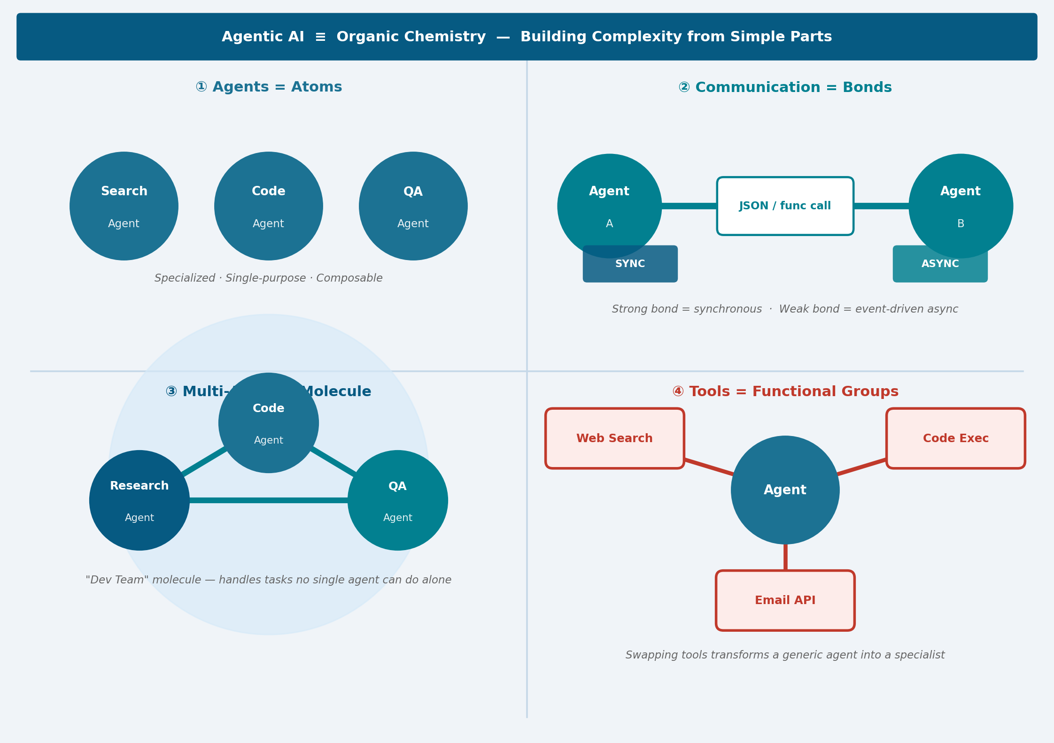
Organic Chemistry Analogy
Agents = Atoms — Simple, specialized, composable units with one job each.
Communication = Bonds — Agents connect via structured JSON messaging (sync or async).
Multi-Agent = Molecule — Research + Code + QA agents combine into a capable “Dev Team.”
Tools = Functional Groups — Attach search, code, or email tools to define what an agent can do.

Slide 17
Key Takeaways
AI That Acts, Not Just Answers
The shift from “AI as a chatbot” to “AI as a worker” is the defining enterprise trend of 2025-2030. Agentic AI closes the loop between insight and action — it doesn’t just tell you what to do, it does it.
Enterprise Transformation is Underway
Leading companies in BFSI, retail, and tech are already deploying agentic pipelines in production. Those who wait for “the technology to mature” will face a 2-3 year competitive gap that is very hard to close.
Early Adoption Advantage
First-movers gain compounding advantages: more interaction data → better-trained agents → faster operations → lower costs. The ROI on an agent improves every month it runs.
Start Small, Scale Fast
Pick one high-volume, well-defined process. Prove ROI in 90 days. Then scale to adjacent workflows. You don’t need a multi-year transformation program — you need a focused pilot.

Slide 18
Closing
AI is Moving from Tool to Workforce
We are entering an era where AI agents will sit alongside human employees in org charts — not replacing them, but augmenting their capacity to do more, faster, with greater consistency.
The Question is No Longer “If”
It’s “how fast” and “how responsibly.” Every enterprise has processes that are repetitive, data-rich, and rule-governed — these are ideal agent candidates available today.
Your Next Step
1. Identify one candidate process (high volume, structured, measurable). 2. Run a 30-day proof-of-concept with a focused agent. 3. Measure cycle time, cost, and quality vs. baseline. 4. Present findings to leadership and secure Phase 2 budget.
“The future belongs to organizations that treat AI not as a feature, but as a fundamental operating capability.”

