Slide 1
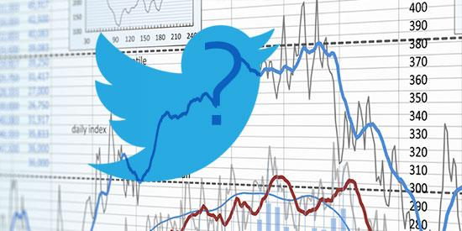

Slide 2
Elon’s Tweets vs. TSLA Stock Price (Sentiment Analysis)
By: Parth, Sneha, & Raja

Slide 3
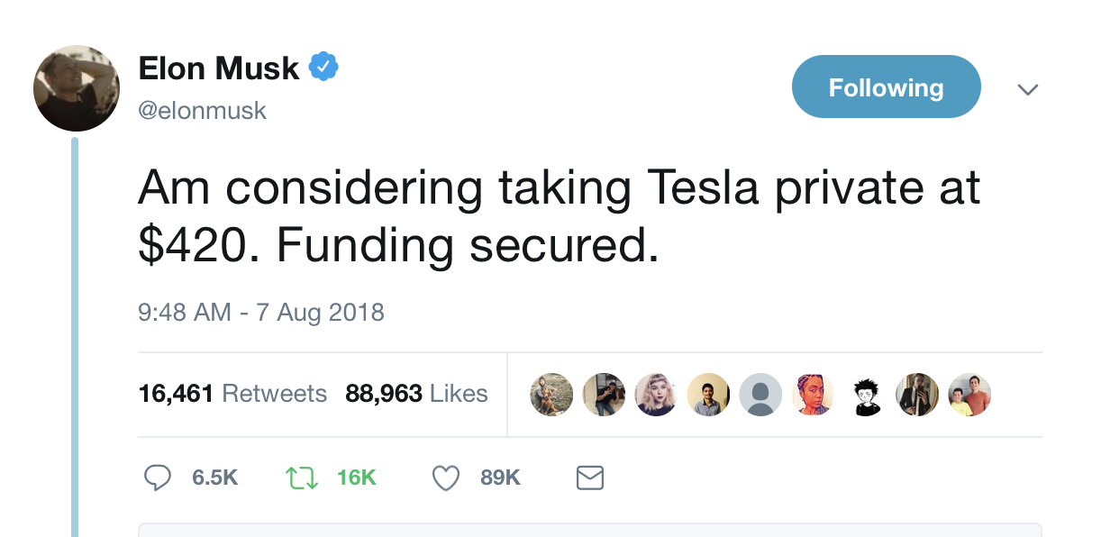
Our Project
Sentiment Analysis of Elon’s Tweets of Tesla’s stock movement
Twitter API + IEX Stock Data API
Pulled stock data via IEX wrapper
VADER Sentiment Analysis
Correlating stock price & sentiment
Data put in two dataframes
Python, Pandas, Matplotlib, & Jupyter Notebook

Slide 4
Project Limitations
Restriction use of API keys
Could only pull 200 tweets at a time
Date/Time format mismatch between dataframes, which was not enough to match the stock data and tweets
Multiple tweets on a single day to analyze the compound score
VADER is not 100% accurate

Slide 5
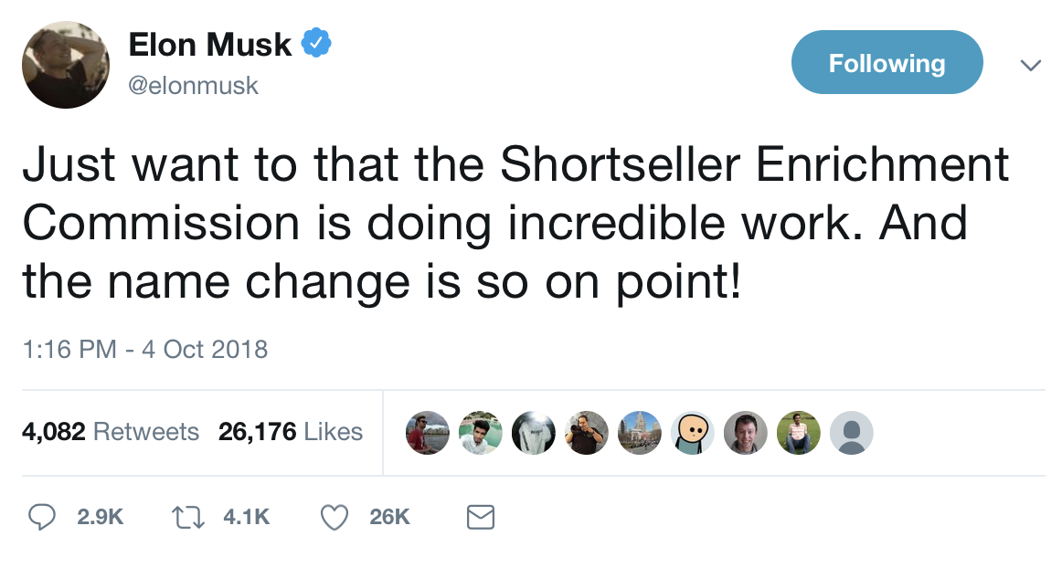
Why Elon?
Current event
Elon’s tweet have got out of hand
SEC recently opened an investigation for his tweets
We love Tesla

Slide 6
APIs Used

Slide 7
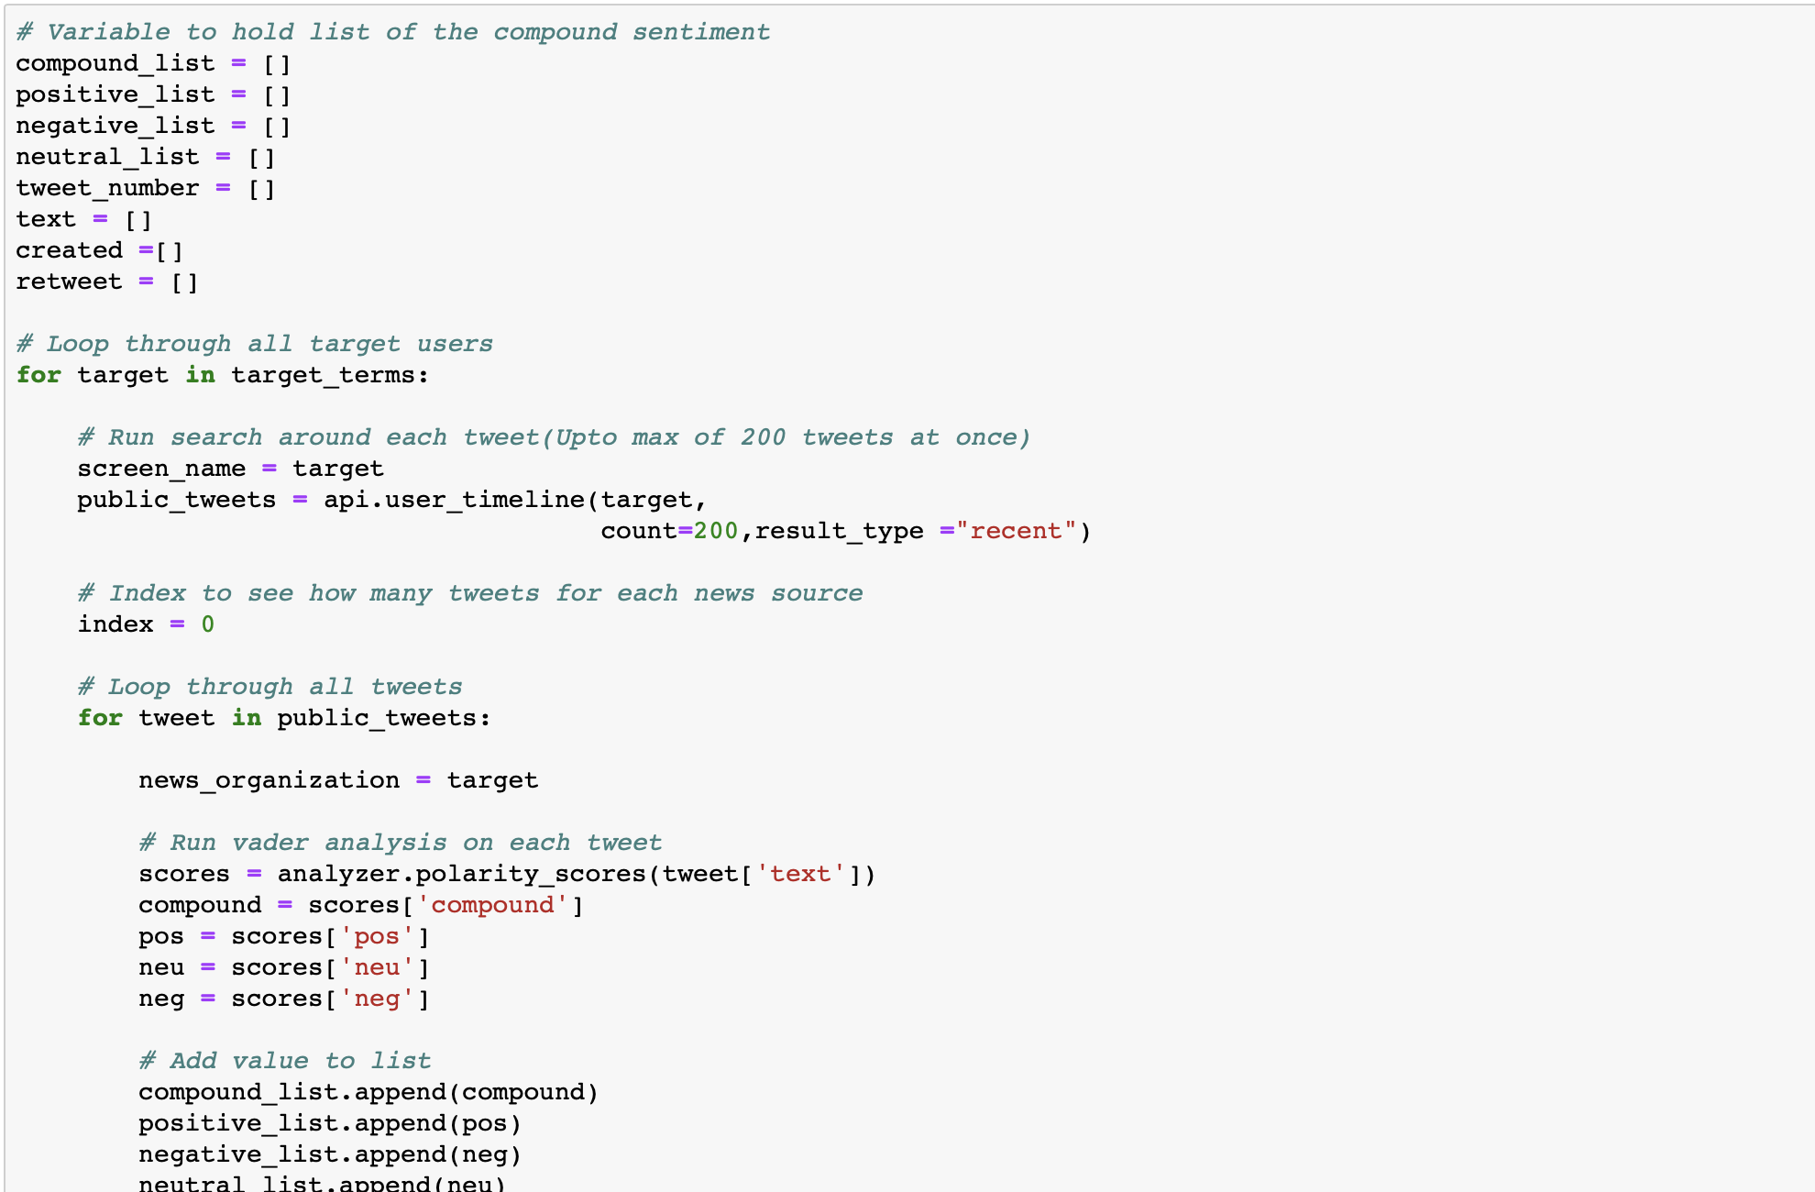
Twitter API (public_tweets = api.user_timeline)

Slide 8
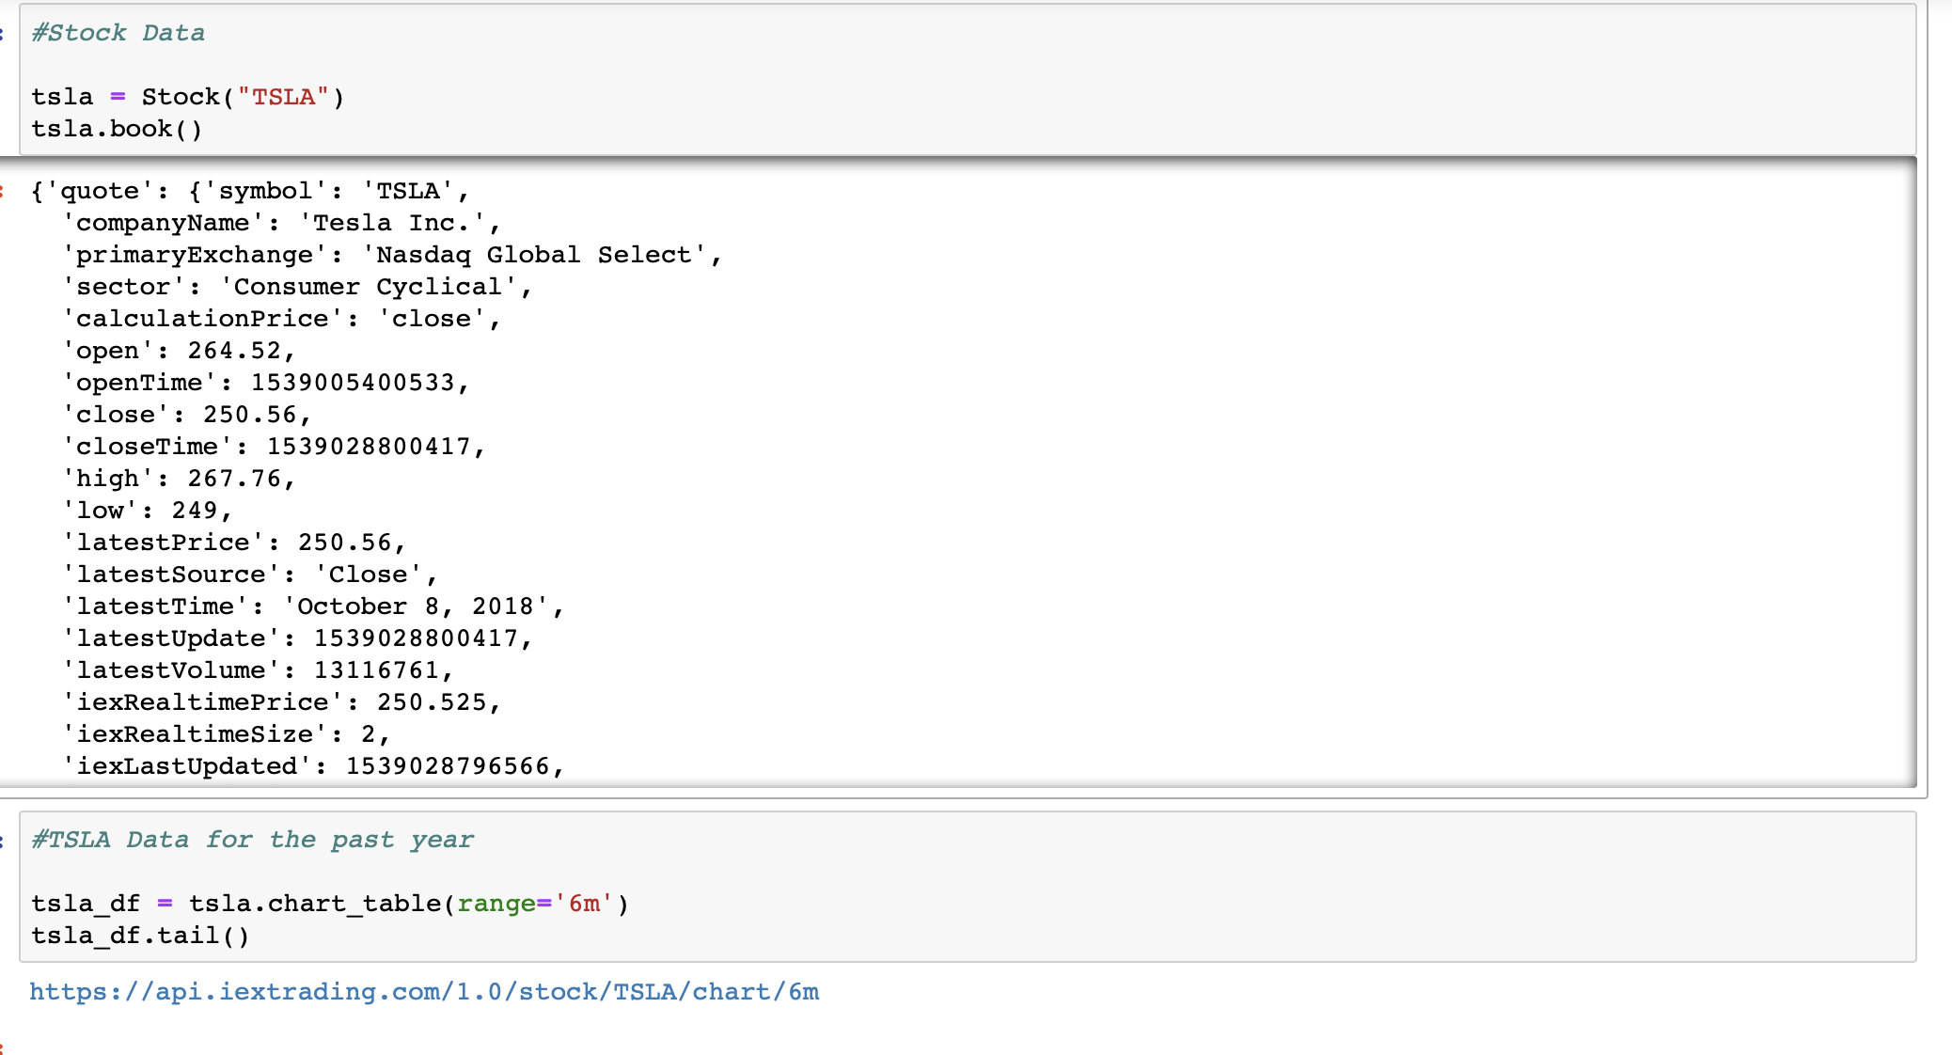
IEX Stock Market API

Slide 9
DataFrames Used for Analysis

Slide 10
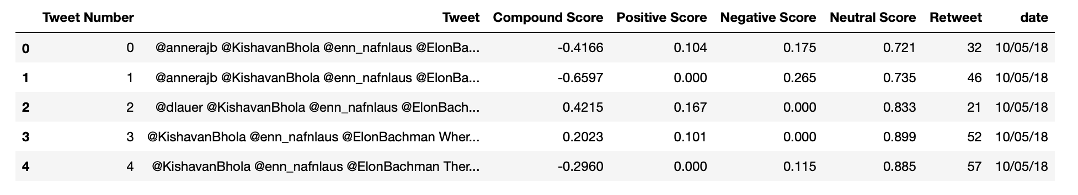
tweets_table DataFrame
Tweet Number
Tweets
Compound Score
Positive Score
Negative Score
Neutral Score
Retweet
Date

Slide 11
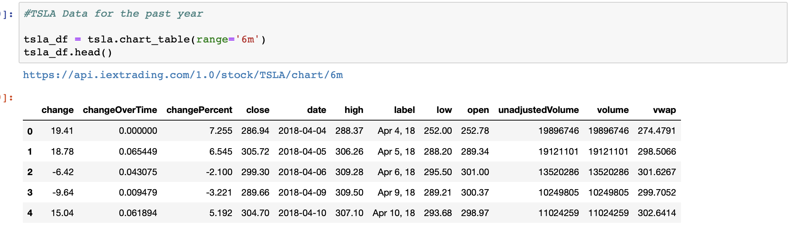
sorted_tsla DataFrame
Change
Change over time
Change Percent
Close
Date
High
Label
Low

Slide 12
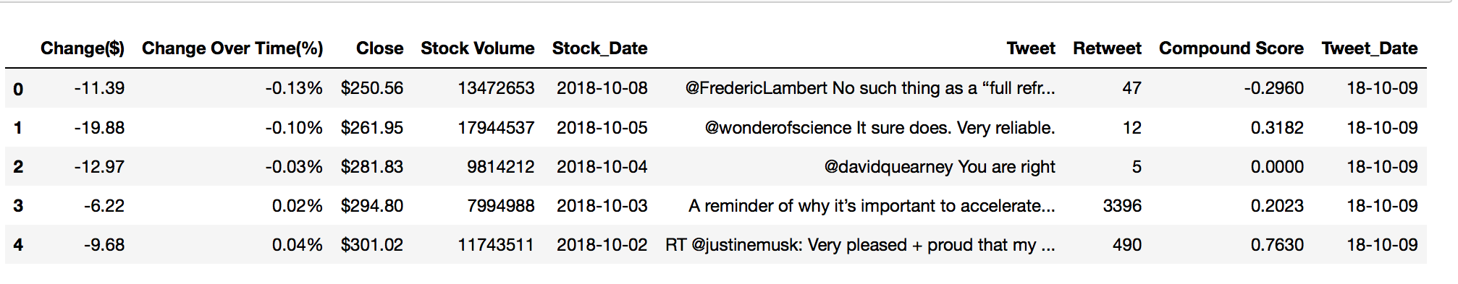
final_df DataFrame
Change($)
Change over time(%)
Close
Stock Volume
Stock_Date

Slide 13
Visualization

Slide 14
Does Elon’s tweets impact stock price?

Slide 15
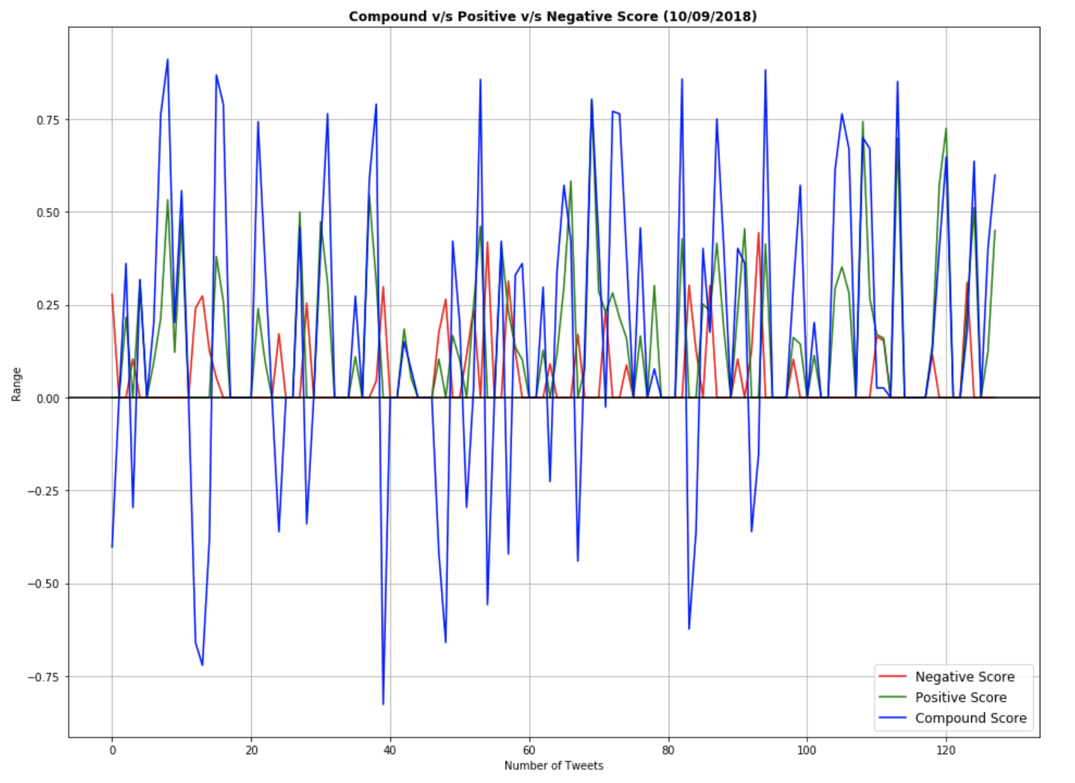
Compound vs Positive vs Negative Score

Slide 16
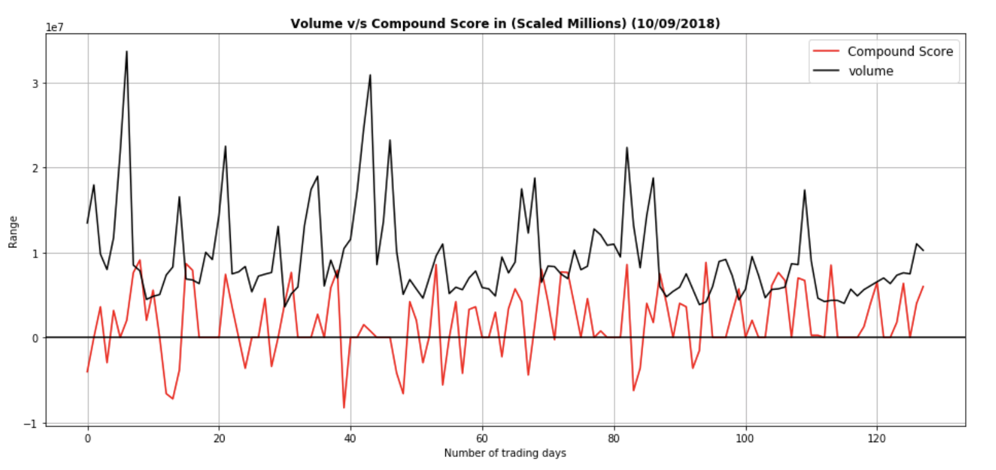
Volume vs Compound Score in (scaled millions)

Slide 17
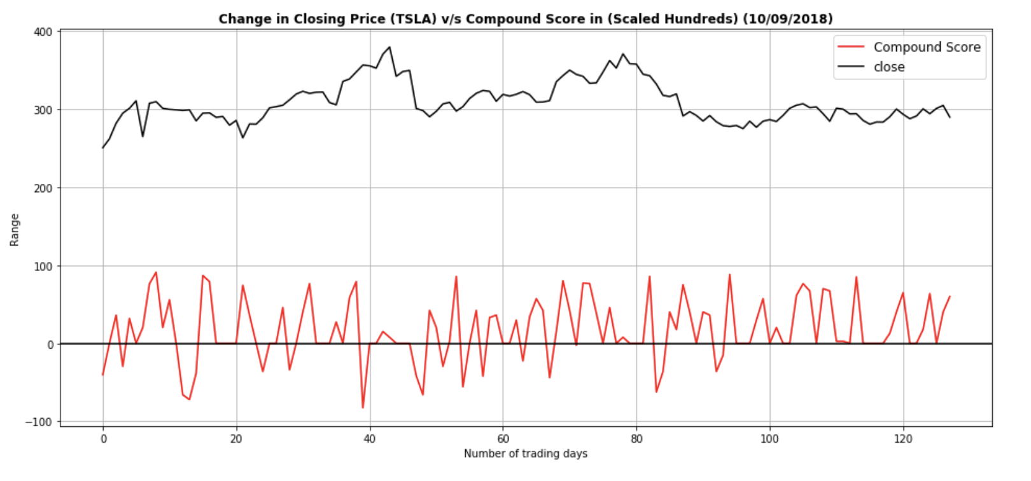
Change in Closing Price (TSLA) vs Compound Score (scaled in Hundreds)

Slide 18
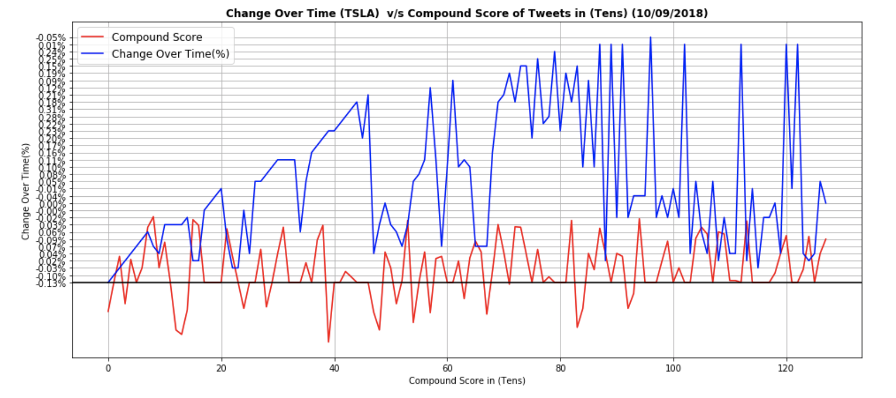
Change Over Time (TSLA) vs Compound Score of Tweets in (Tens)

Slide 19
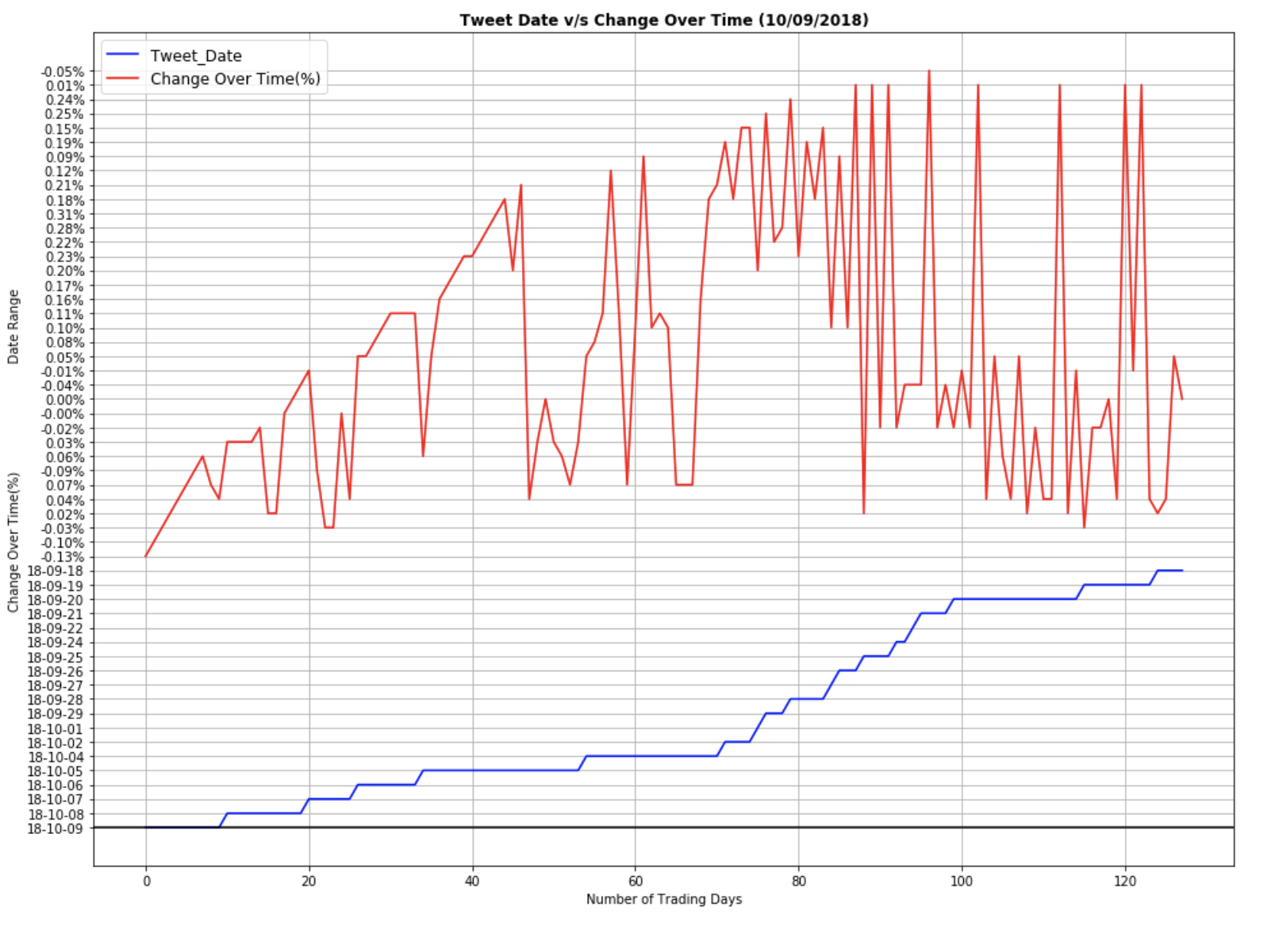
Tweet Date vs Change Over Time

Slide 20
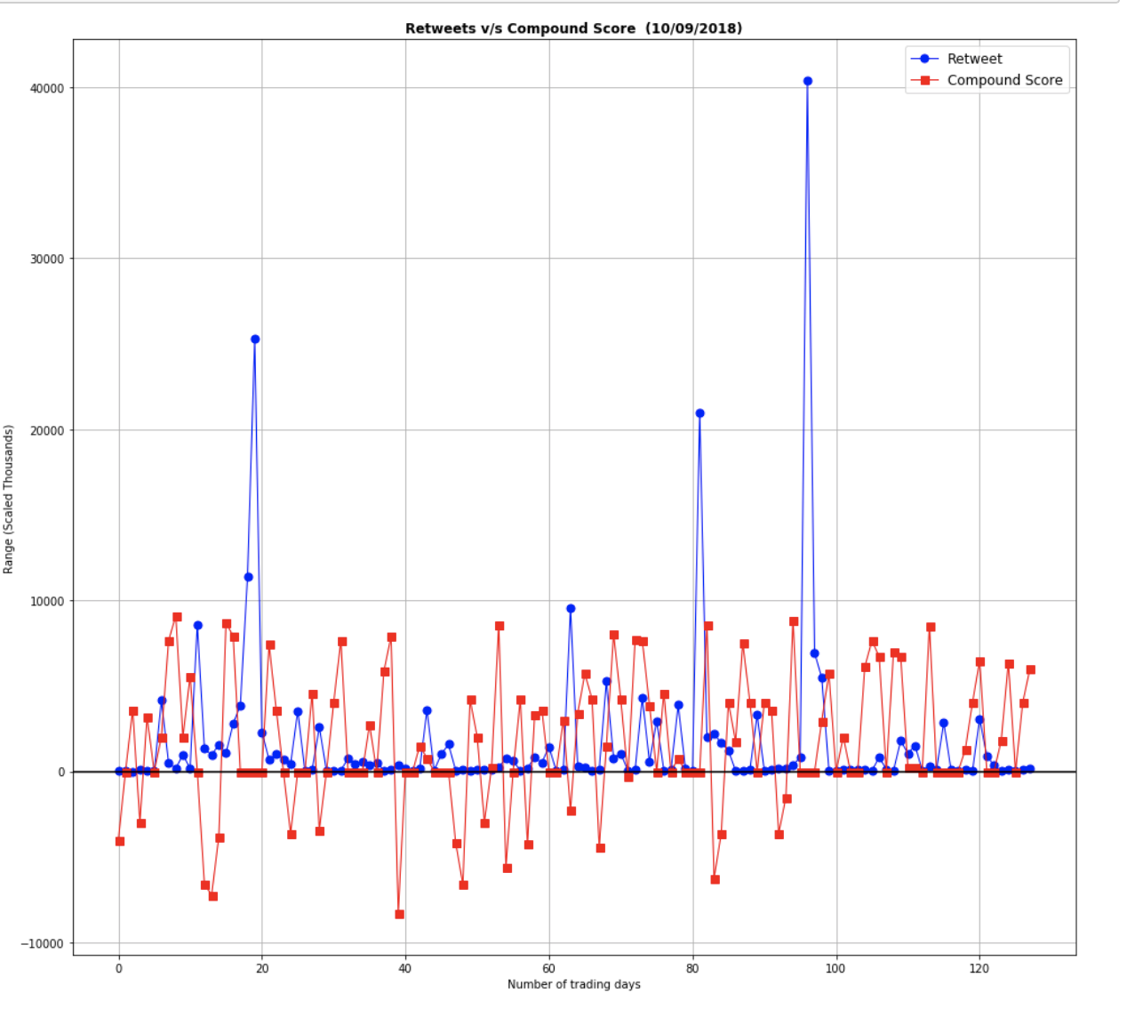
Retweets vs Compound Score

Slide 21
Conclusion

Slide 22
We conclude that, the social media sentiment score along with some other tools and advanced machine learning implementation can predict the movement of stocks based on the behavior/reactions of sentiments analyzed over social media platforms.
Also Elon tweets do have a correlation as stated above in the visualisations, so yes we would not be biased just looking at the news or tweets but understanding the data and visualizing we agree.
Down Below some real data…….

Slide 23
Real World Proof

Slide 24
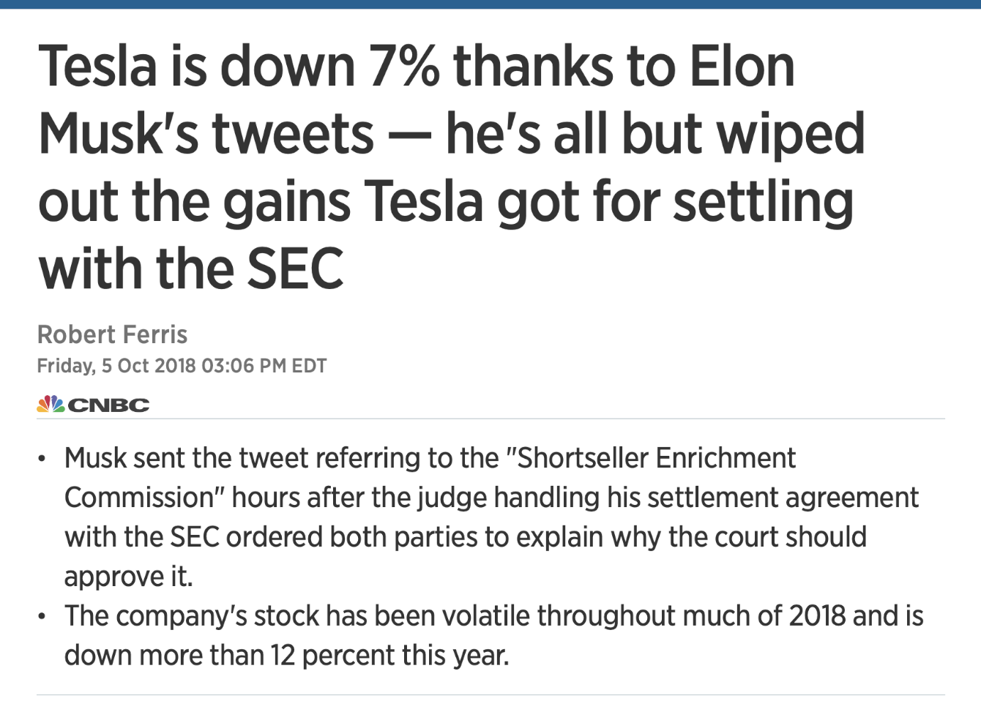
Source: https://apple.news/A0nnCvDxwQ8CYfY2Ae1yQnA

Slide 25
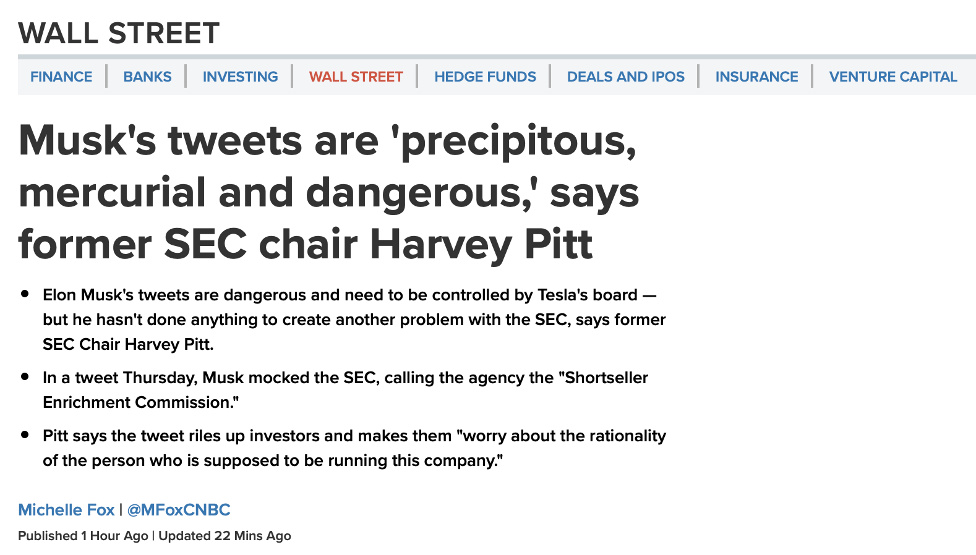
Source: https://www.cnbc.com/2018/10/05/musks-tweets-are-dangerous-says-former-sec-chair-harvey-pitt.html

Slide 26
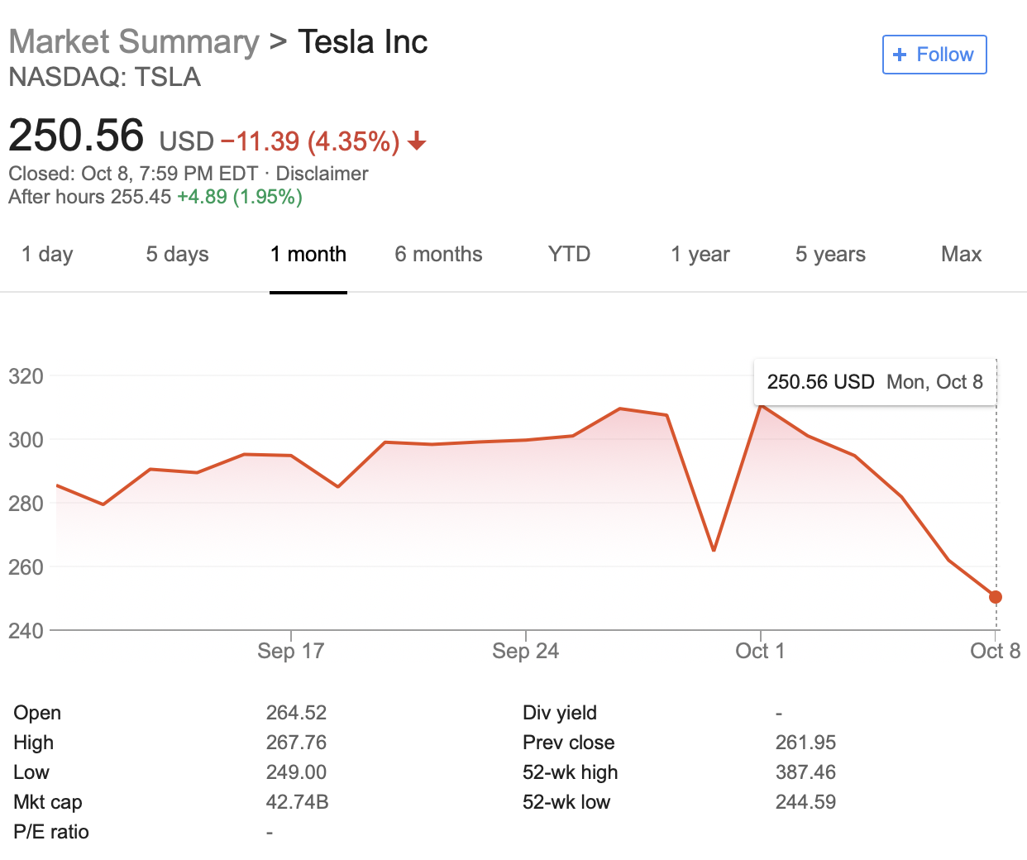

Slide 27
Q&A

