Slide 1
Ajax & jQuery
Internet Engineering
Spring 2015
Bahador Bakhshi
CE & IT Department, Amirkabir University of Technology

Slide 2
Questions
Q5) How to update a portion of web page?
Check new mails?
Q5.1) Is it possible?
Q5.2) Should we wait for server response?
Q5.3) What does server return back?

Slide 3
Homework
Homework 3

Slide 4
Outline
Ajax
Introduction
Implementation
More details
Examples
jQuery
Selection
Action
Ajax
Examples

Slide 5
Outline
Ajax
Introduction
Implementation
More details
Examples
jQuery
Selection
Action
Ajax
Examples

Slide 6
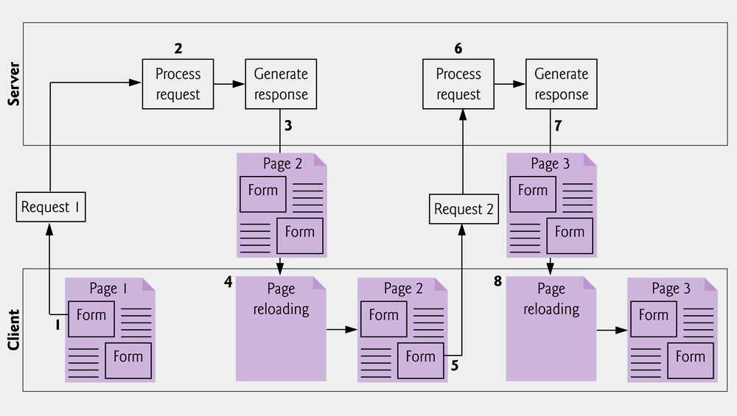
Introduction
Traditional web applications

Slide 7
Introduction (cont’d)
Traditional web application is synchronous
User (request) & Server (response) are synchronized
User is filling forms → Server in idle mode
Server is processing → User is waiting
Whole page must be reload to update a section of page
Check new mail in webmail → refresh the page!
Long response time & More BW overhead
Typically user is involved in page dynamics!
No automatic update!
Notes:
Three characteristics of traditional web pages that we don’t like!!!

Slide 8
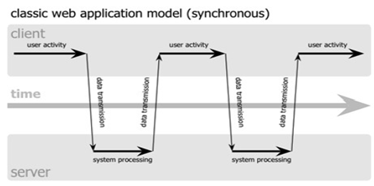
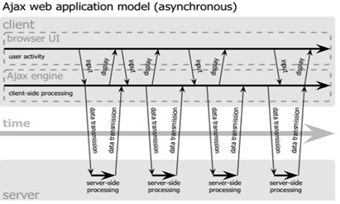
Synchronous vs. Asynchronous
Synchronous whole page update that interrupts user operation
(Automated) Asynchronous update of a portion of page without interrupting user
E.g. updating list of emails while reading/composing other emails

Slide 9
Asynchronous Implementation
How to implement the asynchronous method?
What are required to implement it?
1) Send request to server from inside a web page
Links or forms do not work
Browser sends request but it reloads whole page!
2) Process server’s responses
Typically the response is not HTML, it is data
3) Update part of page using the processed data
We already know it, access DOM using JavaScript

Slide 10
Asynchronous Implementation: Ajax
Ajax: Asynchronous JavaScript And XML
Concept is new
Be able to send asynch. request from web pages
To build Internet applications with much more appealing user interfaces
But the technology is not new!
A mix of well-known programming techniques
Is based on JavaScript & HTTP requests
Get data by HTTP (which contains XML)
Update page without reloading by JavaScript

Slide 11
Ajax
Ajax: Asynchronous
User has not to wait for response from server
We can send request, continue other jobs, and process the response when is ready
Server requests are not necessarily synchronized with user actions
Ajax application may already have asked of the server, and received, the data required by the user
Periodic tasks (e.g., Automated “check new emails”)
Ajax can be synchronous!!!
However, typically is asynchronous

Slide 12
Ajax (cont’d)
Ajax: JavaScript
Ajax is implemented by JavaScript
JavaScript functions using a special object
Generate HTTP request to server
Get response from server
Process the response & update the page
Using DOM
JavaScript can be replaced by other client-side scripting languages!

Slide 13
Ajax (cont’d)
Ajax: XML
Initial idea/design: Ajax is used to update page using data formatted as XML
Response from server in XML format
XML is not the mandatory response format
Server can send back any file format
Text, HTML, Image, …
JavaScript must be aware of the data type

Slide 14
Ajax Operation
An event occurs in web page, e.g.,
User clicks on a button, fills a form, …
Automated/Periodic task just started
JavaScript event handler creates & sends an HTTP request to the server
The server responds with a small amount of data, rather than a complete web page
JavaScript uses this data to modify the page
This is faster because less data is transmitted and because the browser has less work to do

Slide 15
Ajax Applications
Everywhere we need dynamic content from server in a portion of a web page
Google Suggest
Web mails (Gmail)
Google Docs
RSS Readers
Rich Internet Application (RIA)
…

Slide 16
Outline
Ajax
Introduction
Implementation
More details
Examples
jQuery
Selection
Action
Ajax
Examples

Slide 17
XMLHttpRequest
Ajax is implemented by the XMLHttpRequest object
Allows JavaScript to formulate HTTP requests and submit them to the server
Provides a mechanism to get response and some facilities to process it
Requests can synch. or asynch. and any type of document can be requested

Slide 18
XMLHttpRequest: Methods
open('method','URL','isAsync')
method: specifies the HTTP method
E.g., GET, POST, …
URL: target URL, where the request is handled
isAsyc:
'true': asynchronous operation
'false': synchronous operation
send(content)
Sends the request, optionally with POST data

Slide 19
XMLHttpRequest: Operation Mode
XMLHttpRequest supports both synchronous and synchronous operation modes
isAsyn: true / false?
In synchronous mode
The send() method is blocking
Does not return until the request is sent and a response is received
In asynchronous mode
The send() method is not blocking
Just sends the request and returns

Slide 20
XMLHttpRequest: Methods
setRequestHeader('x','y')
Sets a parameter and value pair x=y and assigns it to the header to be sent with the request
abort()
Stops the current request
getAllResponseHeaders()
Returns all headers as a string
getResponseHeader(x)
Returns the value of header x as a string

Slide 21
XMLHttpRequest: Properties
status
HTTP status code returned by server
statusText
HTTP reason phrase returned by server
responseText
Data returned by the server in text string form
xmlhttp = new XMLHttpRequest();
…
var doc = xmlhttp.responseText;

Slide 22
XMLHttpRequest: Properties
responseXML returns the response as XML
Can be treated and parsed using the DOM
Content-Type of response is important
Content-Type=“text/xml”
var xmlDoc = xmlhttp.responseXML.documentElement;
var value = xmlDoc.getElementsByTagName
("tagname")[0].childNodes[0].nodeValue;

Slide 23
XMLHttpRequest: Properties
readyState
Integer reporting the status of the request:
0 = The request is not initialized, before open
1 = The request has been set up, before send
2 = The request has been sent, send called
3 = The request is in process, request is sent
4 = The request is complete, response is ready
Onreadystatechange
The event handler will be called when the object’s readyState property changes

Slide 24
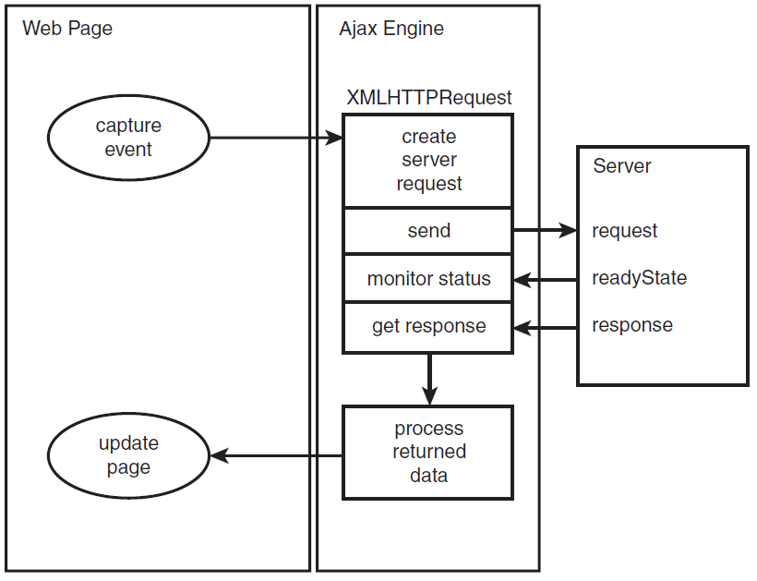
Overall Operation View

Slide 25
Synchronous Mode Code Skeleton
function synchronousAjax(){
xmlhttp = new XMLHttpRequest();
xmlhttp.open("GET","URL",false);
xmlhttp.send(null);
if(xmlhttp.status == 200){
var response = xmlhttp.responseText;
...
}
else{
window.alert("Error: "+ xmlhttp.statusText);
}
}

Slide 26
Asynchronous Mode Code Skeleton
function asynchronousAjax(){
var xmlhttp=new XMLHttpRequest();
xmlhttp.onreadystatechange = process;
xmlhttp.open("GET","URL",true);
xmlhttp.send(null);
}
function process(){
if(this.readyState == 4){
if(this.status == 200){
var response = this.responseText;
...
}
else{
window.alert("Error: "+ this.statusText);
}
}
}

Slide 27
Example 1: Load Static File
<div id="test">
<h2>Click to let Ajax change this text</h2>
</div>
<button type="button" onclick="loadTextDocSynch('test1.txt')"> Click Me(test1.txt)</button>
<button type="button" onclick="loadTextDocAsynch('test2.txt')"> Click Me(test2.txt)</button>
<button type="button" onclick="LoadXMLDocAsynch('test3.xml')"> Click Me(test3.xml) </button>

Slide 28
Example 1: Load Static File
function loadTextDocSynch(url){
xmlhttp=new XMLHttpRequest();
xmlhttp.open("GET",url,false);
xmlhttp.send(null);
if(xmlhttp.status == 200){
document.getElementById('test'). innerHTML=xmlhttp.responseText;
}
else{
window.alert("Error "+ xmlhttp.statusText);
}
}

Slide 29
Example 1: Load Static File
function loadTextDocAsynch(url){
var xmlhttp=new XMLHttpRequest();
xmlhttp.onreadystatechange = process;
_{xmlhttp.open("GET",url,true);}
_{xmlhttp.send(null);}
}
_{function process(){}
_{if(this.readyState == 4){}
_{if(this.status == 200){}
document.getElementById('test').
_{innerHTML=this.responseText;}
}
else{window.alert("Error "+ xmlhttp.statusText); }
}
}

Slide 30
Example 1: Load Static File
function LoadXMLDocAsynch(url){
var xmlhttp=new XMLHttpRequest();
xmlhttp.onreadystatechange = processXML;
xmlhttp.open("GET",url,true);
xmlhttp.send(null);
}
function getNodeValue(doc, name){
return (doc.getElementsByTagName(name))[0].childNodes[0].nodeValue;
}
function processXML(){
if(this.readyState == 4){
if(this.status == 200){
var xmlDoc = this.responseXML.documentElement;
var res = "Name: "+ getNodeValue(xmlDoc, "name") +"<br />";
res += "Model: "+ getNodeValue(xmlDoc, "model") +"<br />";
res += "OS: "+ getNodeValue(xmlDoc, "OS") + " - "+ getNodeValue(xmlDoc, "version");
document.getElementById("test").innerHTML = res;
}
else{ window.alert("Error "+ xmlhttp.statusText); }
}
}

Slide 31
Outline
Ajax
Introduction
Implementation
More details
Examples
jQuery
Selection
Action
Ajax
Examples

Slide 32
More Details: Sending Data
Since Ajax uses HTTP requests, it can send data
Query part of the URL
Body of POST
The content is passed as the argument to send
Encoding is important in both GET and POST
E.g. some characters are not legal in URL: URL encoding
The escape method does these replacements
xmlhttp.setRequestHeader('Content-Type', 'application/x-www-form-urlencoded');
xmlhttp.send("var1=" + escape(value1) + "&var2=" + escape(value2));

Slide 33
More Details: Other HTTP Methods
In addition to GET and POST, other HTTP methods can also be used
For example to analyze HTTP headers
Send a “HEAD” request
xmlhttp.open("HEAD","URL",true);
In the response, analyze the HTTP headers
getAllResponseHeaders()
getResponseHeader(x)

Slide 34
More Details: Concurrency
We create a request object, and append our request information to it
When the server responds, its result is also in the request object
Question: What happens if, before we get a response, we use the request object to send off another request?
Answer: We have overwritten the request object, so the response to the original request is lost
Solution: We will need to create and use more than one request object

Slide 35
More Details: Avoid HTTP Caching
We send a request using GET, and it works
We want to get a new value, send the same request again
Nothing happens! Why not?
Answer: The browser/cache server has cached our URL; it sees that we use it again without change, and gives us the cached response
Wrong solution: Turn off browser caching
Correct solution:
Change the URL in some unimportant way; a commonly used trick: adding of a parameter with a random and meaningless value to the request data
url = url + "?dummy=" + (new Date()).getTime();
url = url + "?dummy=" + (new Math()).random();
The server is free to ignore this parameter
Control caching
setRequestHeader("Cache-Control", "no-cache");

Slide 36
More Details: Security
URL in open() can be a relative path or a complete URL
For security reason, browsers only allow to request URL in the same domain of the page
To access other sites, server side proxy is needed
Method open() may also take an additional 4th and 5th parameters
userid and password
The two parameters are used to bypass HTTP authentication

Slide 37
Ajax Server Side
The Ajax requests need to be handled
Ajax server?!
There is no such thing as an Ajax server
Ajax pages can be served by any web server
It is possible to build simple Ajax applications with no server-side scripting at all
Request a static server resource
Ajax applications may make calls to various other server-side resources such as web services
Requesting an ASP or PHP file is the most common way to access database information

Slide 38
Outline
Ajax
Introduction
Implementation
Remarks
Examples
jQuery
Selection
Action
Ajax
Examples

Slide 39
Example 2: Live Suggestion: Client
function showHint(str){
if(str.length==0){
document.getElementById("txtHint").innerHTML=""; return;
}
xmlhttp=new XMLHttpRequest();
xmlhttp.onreadystatechange=function(){
if (xmlhttp.readyState ==4 && xmlhttp.status==200)
document.getElementById("txtHint").innerHTML = xmlhttp.responseText;
}
xmlhttp.open("POST","gethint.php",true);
xmlhttp.setRequestHeader('Content-Type', 'application/x-www-form-urlencoded');
xmlhttp.send("query="+escape(str));
}
============================================================
<form>
First name:
<input type="text" onkeyup="showHint(this.value)" size="20" />
</form>
<p>Suggestions: <span id="txtHint"></span></p>

Slide 40
Example 2: Live Suggestion: Server
<?php
$a[]="Ahmad";
...
$a[]="Sajjad";
$q=$_POST["query"];
if (strlen($q) > 0){
$hint="";
for($i=0; $i < count($a); $i++){
if (strtolower($q)==strtolower(substr($a[$i],0,strlen($q)))){
if($hint==""){ $hint=$a[$i];}
else{ $hint=$hint." , ".$a[$i];}
}
}
}
if ($hint == ""){ $response="no suggestion"; }
else { $response=$hint; }
echo $response;
?>

Slide 41
Example 3: Run Remote JavaScript
Two text files
msg1.js
window.alert("Hi, I am a window.alert Message");
msg2.js
var newp = document.createElement("p");
newp.innerHTML="I am a HTML message";
b = document.getElementsByTagName("body")[0];
b.appendChild(newp);

Slide 42
Example 3: Run Remote JavaScript
<html> <head>
<script type="text/javascript">
function runJsAsynch(url){
var xmlhttp=new XMLHttpRequest();
xmlhttp.onreadystatechange = process;
xmlhttp.open("GET",url,true);
xmlhttp.send(null);
}
function process(){
if(this.readyState == 4){
if(this.status == 200) eval(this.responseText);
else window.alert("Error "+ xmlhttp.statusText);
}
}
</script>

Slide 43
Example 3: Run Remote JavaScript
<body>
<button type="button" onclick="runJsAsynch('msg1.js')">Alert Message</button>
<button type="button" onclick="runJsAsynch('msg2.js')">HTML Message</button>
</body>
</html>

Slide 44
Example 4: XSLT Transform
<body>
Select Course:
<select name="course">
<option value="IE">Internet Engineering</option>
<option value="NM">Network Management</option>
<option value="C">C Programming</option>
</select>
<input type="button" onclick="displayResult()" value="Result" />
<div id="resutl" style="border-style:solid; width:50%;"><span id="dummy"/></div>
</body>
Notes:
XSLT address is not hard-coded in HTML, we can select & apply any XSLT

Slide 45
Example 4: XSLT Transform
function loadXMLDoc(dname){
xhttp = new XMLHttpRequest();
xhttp.open("GET",dname,false);
xhttp.send("");
return xhttp.responseXML;
}
function displayResult(){ name=document.getElementsByName("course")[0].value;
xml=loadXMLDoc(name+".xml");
xsl=loadXMLDoc("course.xslt");
xsltProcessor=new XSLTProcessor();
xsltProcessor.importStylesheet(xsl);
resultDocument = xsltProcessor.transformToFragment(xml,document);
resultdiv=document.getElementById("resutl"); resultdiv.replaceChild(resultDocument,
resultdiv.children[0]);
}

Slide 46
Outline
Ajax
Introduction
Implementation
Remarks
Examples
jQuery
Selection
Action
Ajax
Examples

Slide 47
Introduction
jQuery is a JavaScript Library that simplifies JavaScript programming (Write Less, Do More)
HTML element selections
HTML element manipulation
CSS manipulation
Event handling
JavaScript effects and animations
HTML DOM traversal and modification
Ajax

Slide 48
How to Use jQuery
Download the library from jQuery.com
A text file: jquery.js
Include the library in the HTML
<head>
<script type="text/javascript" src="jquery.js"></script>
</head>

Slide 49
Outline
Ajax
Introduction
Implementation
Remarks
Examples
jQuery
Selection
Action
Ajax
Examples

Slide 50
jQuery Syntax
The jQuery syntax is made of selecting HTML elements and performing some action on the element(s)
Basic syntax is: $(selector).action()
A dollar sign to define jQuery
A (selector) to "query (or find)" HTML elements
A jQuery action() to be performed on the element(s)
Examples:
$("p").hide() - hides all paragraphs
$("p.test").hide() - hides all paragraphs with class="test"

Slide 51
jQuery Selectors
$(this): the current selected element
jQuery Element Selectors
Similar to CSS selectors to select HTML elements
$("p") → all <p> elements
$("p.intro") → all <p> elements with class="intro"
$("p#demo") → the <p> elements with id="demo"
jQuery Attribute Selectors
Similar to XPath expressions to select elements with given attributes
$("[href]") → all elements with an href attribute
$("[href='#']") → all elements with an href value equal to "#"
$("[href!='#']")→ all elements with an href attribute NOT equal to "#"

Slide 52
jQuery Selectors
Selector | Example
* | $("*")
#id , .class, element | $("#lastname"), $(".intro"), $("p"), $(".intro.demo")
:first, :last, :even, :odd | $("p:first"), $("p:last"), $("tr:even“)
[attribute], [attribute=value], [attribute!=value] | $("[href]"), $("[href='default.htm']"), $("[href!='default.htm']")
:input, :text, :password, :radio, :checkbox, :file | $(":input"), $(":text"), $(":password")

Slide 53
Outline
Ajax
Introduction
Implementation
Remarks
Examples
jQuery
Selection
Action
Ajax
Examples

Slide 54
jQuery HTML Manipulation
$(selector).html()
Returns HTML content of the selected item(s)
$(selector).html(content)
Changes HTML content of the selected item(s)
$(selector).append(content)
Appends content to the inside of matching HTML elements
$(selector).prepend(content)
Prepends content to the inside of matching HTML elements
$(selector).after(content/HTML code)
Inserts content/HTML code after all matching elements
$(HTML code)
Generate on the fly DOM elements
$(HTML code).appendTo(selector)
Appends the new element as a child to all selected nodes

Slide 55
jQuery HTML Manipulation
Method | Description
html() | Sets or returns the content of selected elements
val() | Returns value of input
addClass() | Adds one or more classes to selected elements
hasClass() | Checks if any of the selected elements have a specified class
attr() | Sets or returns an attribute and value of selected elements
after() | Inserts content after selected elements
append() | Inserts content at the end of (but still inside) selected elements
before() | Inserts content before selected elements
prepend() | Inserts content at the beginning of (but still inside) selected elements
empty() | Removes all child elements and content from selected elements
remove() | Removes selected elements
removeAttr() | Removes an attribute from selected elements
removeClass() | Removes one or more classes (for CSS) from selected elements

Slide 56
jQuery CSS Manipulation
$(selector).css()
The css() method has three different syntaxes, to perform different tasks
css(name)
Return CSS property value
css(name,value)
Set CSS property and value
css({property1: value1; property2: value2;…})
Set multiple CSS properties and values

Slide 57
jQuery Events
$(selector).event(a function name)
$(selector).event(function() {..some code... } )
Event Method | Description
$(document).ready(function) | Binds a function to the ready event of a document
$(selector).click(function) | Triggers, or binds a function to the click event of selected elements
$(selector).dblclick(function) | Triggers, or binds a function to the double click event of selected elements
$(selector).focus(function) | Triggers, or binds a function to the focus event of selected elements
$(selector).mouseover(function) | Triggers, or binds a function to the mouseover event of selected elements

Slide 58
jQuery Effects
jQuery has a few built in effects
Fading, hiding, …
$(selector).effect(delay, callback)
Delay: optional, millisecond
Callback: optional, runs after effect completes
Popular effects
hide(), show(), fadein(), fadeout(), slideUp(), slideDown(), slideToggle(), animate(), ...

Slide 59
jQuery Effects
Function | Description
$(selector).hide() | Hide selected elements
$(selector).show() | Show selected elements
$(selector).toggle() | Toggle (between hide and show) selected elements
$(selector).slideDown() | Slide-down (show) selected elements
$(selector).slideUp() | Slide-up (hide) selected elements
$(selector).slideToggle() | Toggle slide-up and slide-down of selected elements
$(selector).fadeIn() | Fade in selected elements
$(selector).fadeOut() | Fade out selected elements
$(selector).fadeTo() | Fade out selected elements to a given opacity

Slide 60
jQuery & DOM
$(selector).parent()
The parent of the selected element
$(selector).children(filter)
Array of the direct children of selected element that matched to the filter
$(selector).find(filter)
Array of the descendant s of selected element that matched to the filter
$(selector).each(function(){..})
Loops over the array of selected elements and runs the custom function

Slide 61
Outline
Ajax
Introduction
Implementation
Remarks
Examples
jQuery
Selection
Action
Ajax
Examples

Slide 62
jQuery Ajax
$(selector).load(URL, data, callback)
Selector is the HTML element(s) to change
URL is the address data to load
To send data to the server, we need the data parameter
To trigger a function after completion, we use the callback parameter
Status and events: ajaxComplete(), ajaxStart(), …
$.ajax({name:value, name:value, ... })
sync: ture/false, type: POST/GET, url: URL, success(), error(), …

Slide 63
Ajax example
$(document).ready(function(){
$("#txt").ajaxStart(function(){
$("#wait").css("backgorund-color","red");
});
$("#txt").ajaxComplete(function(){
$("#wait").css("backgorund-color","green");
});
$("button").click(function(){
$("#txt").load("test.htm");
});
});
===========================================================
$("button").click(function(){ $.ajax({url:"demo_ajax_load.txt",success:function(result){
$("div").html(result);
}});
});

Slide 64
Outline
Ajax
Introduction
Implementation
Remarks
Examples
jQuery
Selection
Action
Ajax
Examples

Slide 65
Example
Course homepage using jQuery
Sliding elements
Automatic row highlighting
Automatic new items counter

Slide 66
Outline
Ajax
Introduction
Implementation
Remarks
Examples
jQuery
Selection
Action
Ajax
Examples

Slide 67
Answers
Q5) Should we reload whole page to update a part of it?
No! High performance (bandwidth, time) overhead
Q5.1) If not, how?
Using Ajax get data from server
Update HTML though DOM
Q5.2) Should we wait for server response?
Ajax supports both synchronous and asynchronous modes
Q5.3) What does server return back?
Anything, by default text and XML is supported

Slide 68
Homework
Homework 3

Slide 69
References
Reading Assignment: Chapter 10 of “Programming the World Wide Web”
Ryan Asleson, Nathaniel T. Schutta, “Foundations of Ajax”
Phil Ballard, “Sams Teach Yourself Ajax in 10 Minutes”
Bear Bibeault and Yehuda Katz, “jQuery in Action” (Farsi translation is also available)
w3schools.com/ajax/default.asp
w3schools.com/jquery/default.asp

