Slide 1

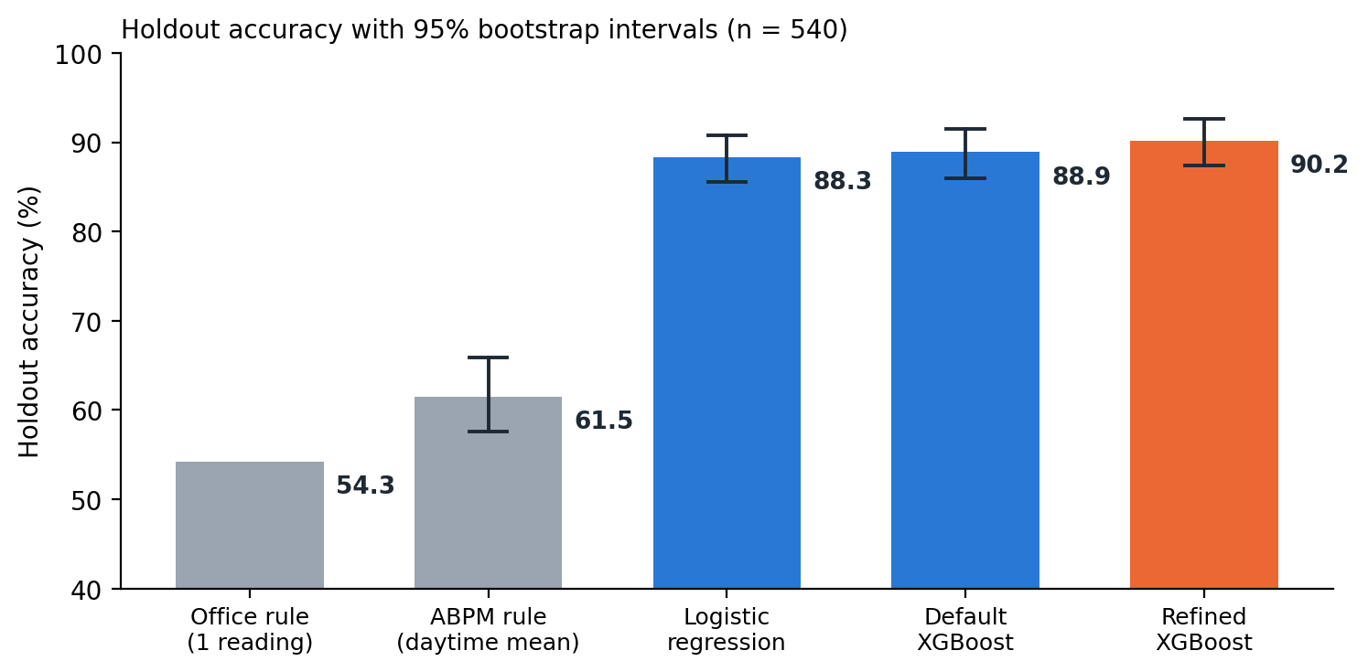
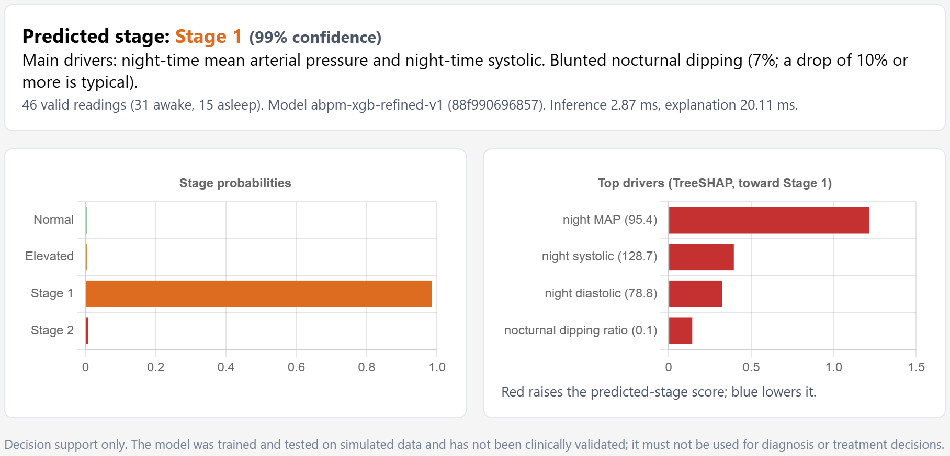
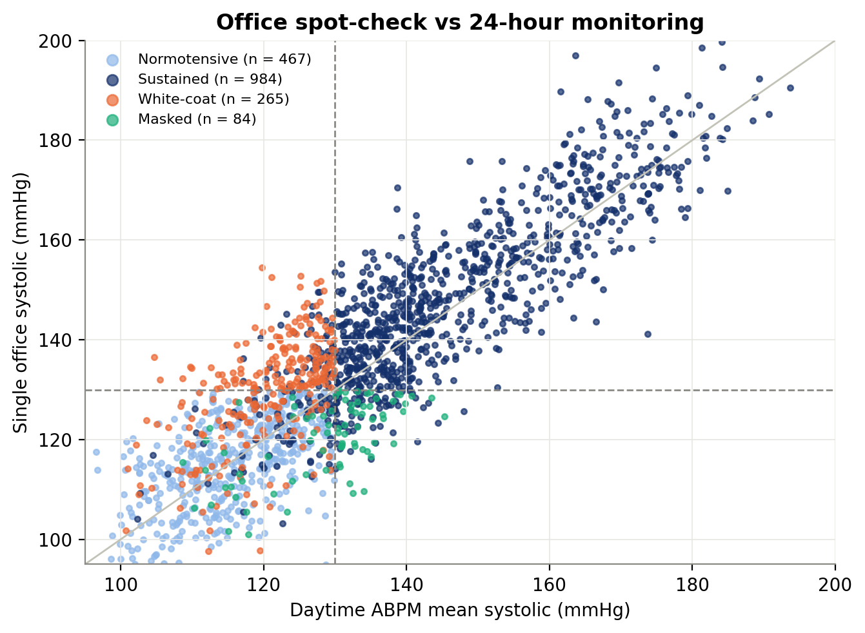
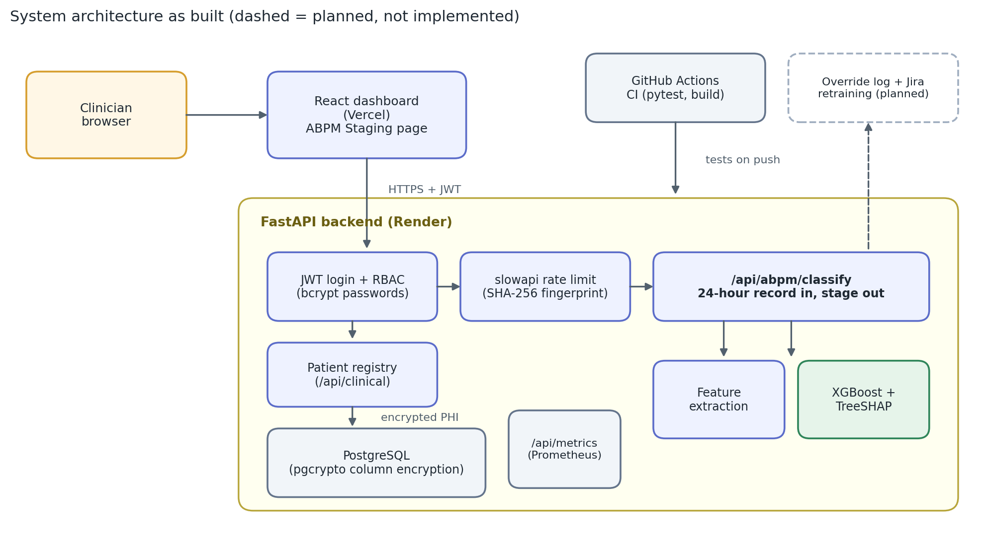
Telehealth Hypertension Analytics
Explained, audited blood pressure staging from 24-hour monitoring
Raja Chakraborty, M.S. in Data Science | rajachakraborti@gmail.com
Faculty advisor: Jonathan Pollyn | DSC-590 Data Science Capstone | Grand Canyon University
1 Project Description
3 Functional Requirements, Specifications and Standards
5 Relevant Data Summaries
What it is. A decision-support tool that reads a patient's full 24-hour blood pressure record, suggests a hypertension stage, shows which measurements drove the result, and flags uncertain cases for a clinician.
Who it helps. Clinicians who review ambulatory monitoring (ABPM), where a wearable cuff takes about 48 readings across a day and night.
Requirement | Specification as built | Standard or evidence
Stage a patient from a 24-hour record | One API call takes about 48 readings and returns Normal, Elevated, Stage 1 or Stage 2 | 2017 ACC/AHA staging (Whelton et al., 2018)
Explain every result | Top four contributing measurements plus a plain-English summary | TreeSHAP attributions (Lundberg et al., 2020)
Give trustworthy confidence | Calibrated probabilities (error 0.014); results under 65% flagged for review | Reporting guided by TRIPOD+AI (Collins et al., 2024)
Respond within 200 ms | Measured 22 ms for prediction plus explanation | Project service-level objective
Protect patient data | Hashed passwords, role-based access tokens, rate limiting, encrypted patient columns | HIPAA Security Rule safeguards (U.S. Department of Health and Human Services, 2013)
Be reproducible and tested | Fixed random seeds, 44 automated tests, tagged release | Documented in a model card (Mitchell et al., 2019)
90.2%
97%
of 540 unseen patients staged correctly
of Stage 2 patients caught (131 of 135)
0
22 ms
1
2
3
patients staged more than one step from the true stage
to predict and explain one patient
Record in
Stage + explain
Clinician decides
48 readings from one 24-hour cuff recording
Normal, Elevated, Stage 1 or Stage 2, with reasons
Low-confidence cases are flagged for review
What was built. A machine learning model, a secured web service (API), a dashboard page and 44 automated tests, released together as one tagged version on GitHub.
Data. Real patient records are protected, so every result here uses 1,800 simulated patients.
4 Design Process
Accuracy on patients the model never saw. Rules on one office reading or the daytime average are right 54% and 61% of the time. The gain over simpler machine learning is small and within the margin of error; the model's edge is better-calibrated confidence and explanations.
2 Project Justification
Six stages, reshaped by two reviews: professor feedback on holdout leakage, then a self-audit.
High blood pressure is a leading modifiable risk factor for cardiovascular disease, yet it is usually diagnosed from a few office readings (Whelton et al., 2018).
A single reading can mislead in both directions: white-coat hypertension looks high only in the clinic, and masked hypertension looks normal in the clinic but is high outside it.
1
Define requirements
Clinical need, staging rules and security needs set first
2
Simulate and prepare data
1,800 patients, 48 readings each, with noise, artifacts and gaps
3
Select the model fairly
Choices by cross-validation on training data only; 540 patients held back for one final test
25.5%
54%
48
4
Build the service
Secured API and dashboard page; model, model card and tests released together
one office reading disagrees with true status
office-rule staging accuracy
readings per patient to review by hand
5
Audit the whole project
Claims checked against the code; security and evaluation gaps found and fixed
The dashboard's ABPM Staging page, captured from the running app: the predicted stage with its confidence, stage probabilities, and the four measurements that drove the result. Night-time pressure carries the most weight, a pattern built into the simulated data.
6
Report honestly
Limits and open issues published with the results
Where it errs. Most mistakes fall within 5 mmHg of a stage boundary, where the stage is a judgment call. Accuracy is lowest under age 45 (86%, 93 patients), so it needs a larger test.
6 Limits and Next Steps
Simulated data only. Not clinically validated and not for patient care.
Next: test on real multi-site records, predict real outcomes, and show prediction sets with coverage guarantees near stage boundaries (Angelopoulos & Bates, 2023).
Planned, not built: clinician override logging and retraining.
Each dot is a simulated patient. Orange: high in clinic but not hypertensive (white-coat). Green: normal in clinic but hypertensive (masked).
System as built. The dashed box (clinician override logging and retraining) is planned, not implemented.
References
Angelopoulos, A. N., & Bates, S. (2023). Conformal prediction: A gentle introduction. Foundations and Trends in Machine Learning, 16(4), 494–591. https://doi.org/10.1561/2200000101
Collins, G. S., Moons, K. G. M., Dhiman, P., Riley, R. D., Beam, A. L., Van Calster, B., ... Logullo, P. (2024). TRIPOD+AI statement: Updated guidance for reporting clinical prediction models that use regression or machine learning methods. BMJ, 385, Article e078378. https://doi.org/10.1136/bmj-2023-078378
Lundberg, S. M., Erion, G., Chen, H., DeGrave, A., Prutkin, J. M., Nair, B., Katz, R., Himmelfarb, J., Bansal, N., & Lee, S.-I. (2020). From local explanations to global understanding with explainable AI for trees. Nature Machine Intelligence, 2(1), 56–67. https://doi.org/10.1038/s42256-019-0138-9
Mitchell, M., Wu, S., Zaldivar, A., Barnes, P., Vasserman, L., Hutchinson, B., Spitzer, E., Raji, I. D., & Gebru, T. (2019). Model cards for model reporting. In Proceedings of the Conference on Fairness, Accountability, and Transparency (pp. 220–229). ACM. https://doi.org/10.1145/3287560.3287596
U.S. Department of Health and Human Services. (2013). Modifications to the HIPAA Privacy, Security, Enforcement, and Breach Notification Rules under the Health Information Technology for Economic and Clinical Health Act and the Genetic Information Nondiscrimination Act; other modifications to the HIPAA rules. Federal Register, 78(17), 5566–5702.
Whelton, P. K., Carey, R. M., Aronow, W. S., Casey, D. E., Collins, K. J., Himmelfarb, C. D., ... Wright, J. T. (2018). 2017 ACC/AHA/AAPA/ABC/ACPM/AGS/APhA/ASH/ASPC/NMA/PCNA guideline for the prevention, detection, evaluation, and management of high blood pressure in adults. Journal of the American College of Cardiology, 71(19), e127–e248. https://doi.org/10.1016/j.jacc.2017.11.006
Code, notebook and tests: github.com/rajachakraborti/telehealth-hypertension-analytics | release tag topic7-submission (commit 73adefd) | rajachakraborti@gmail.com
Grand Canyon University, College of Engineering and Technology | Technology Capstone Showcase | Results use simulated data and are not clinically validated.

