Slide 1

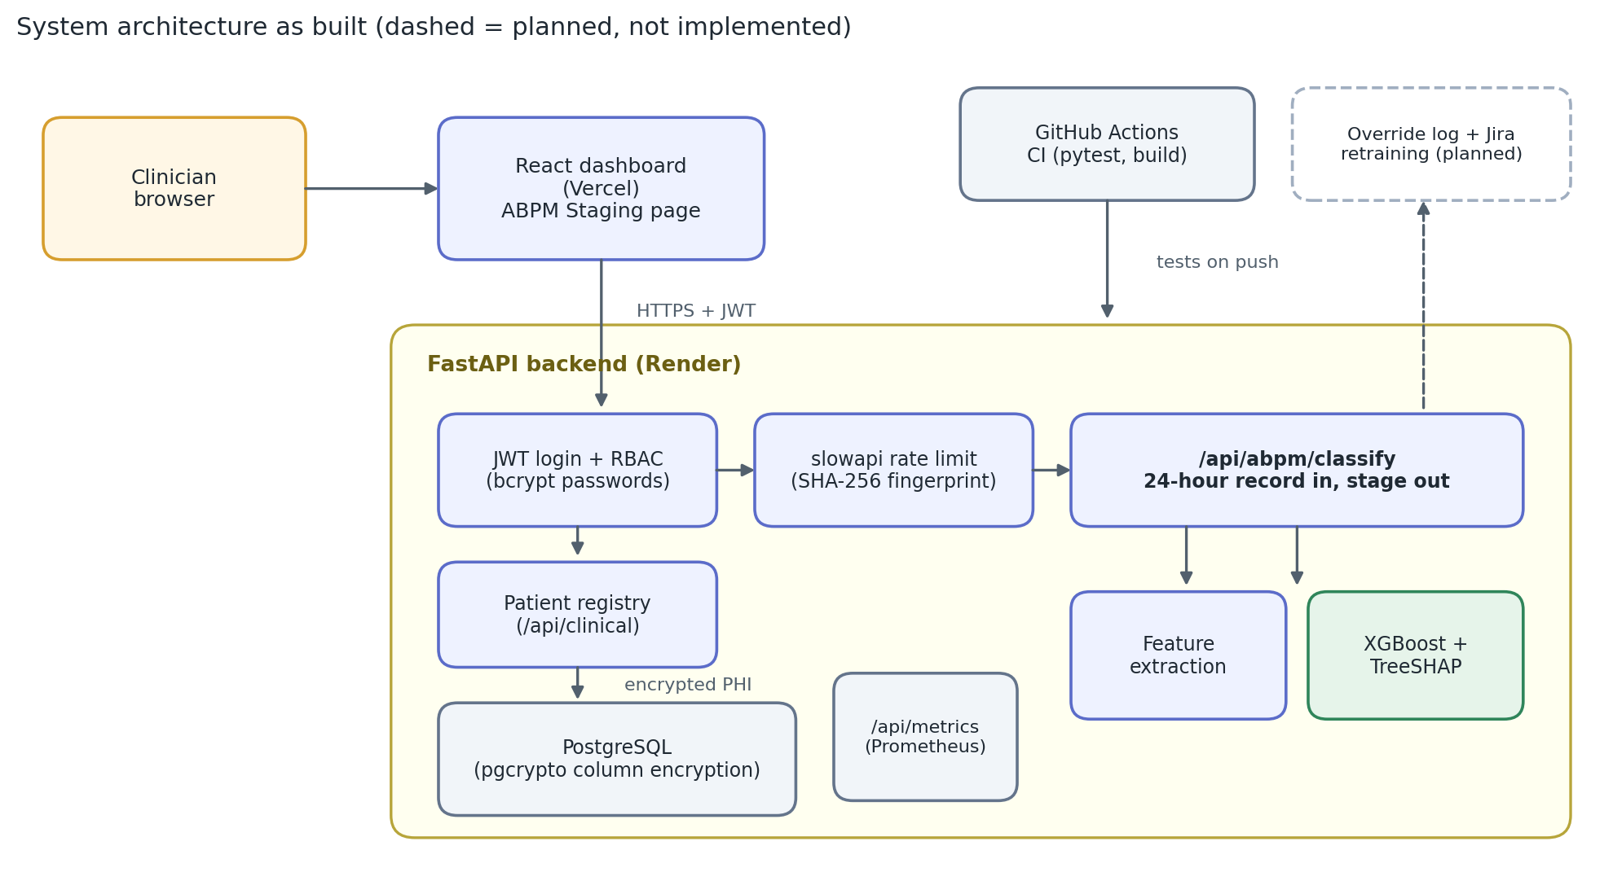
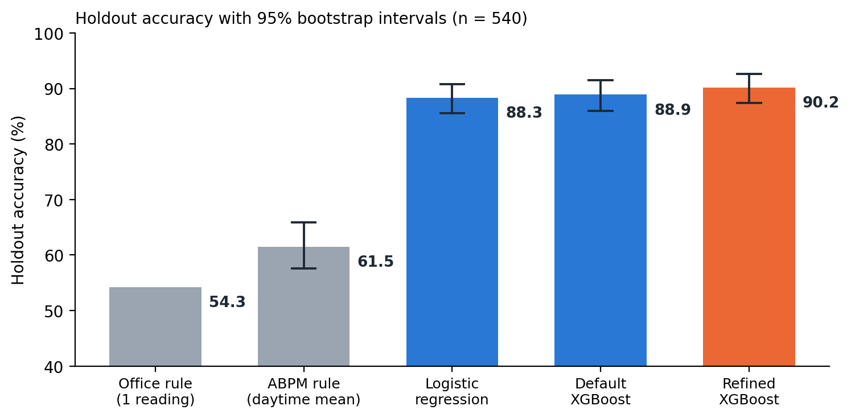
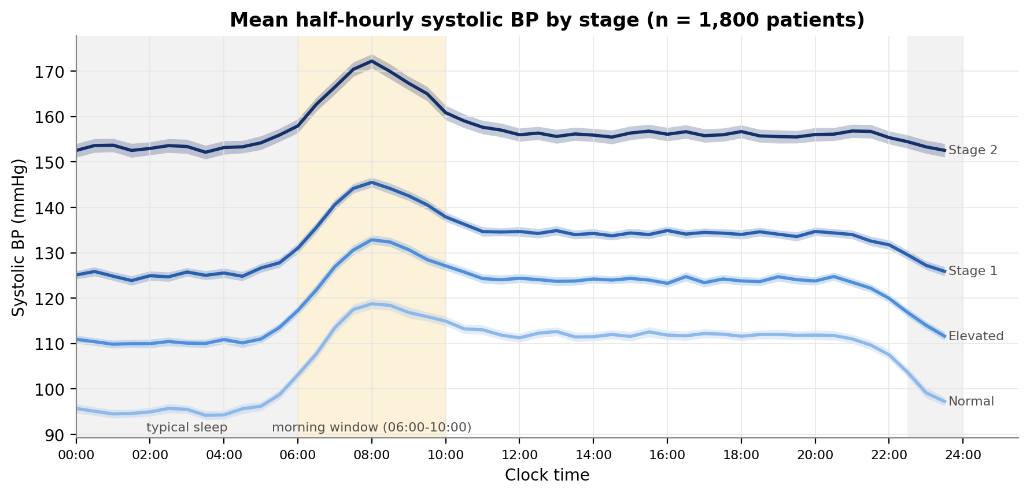
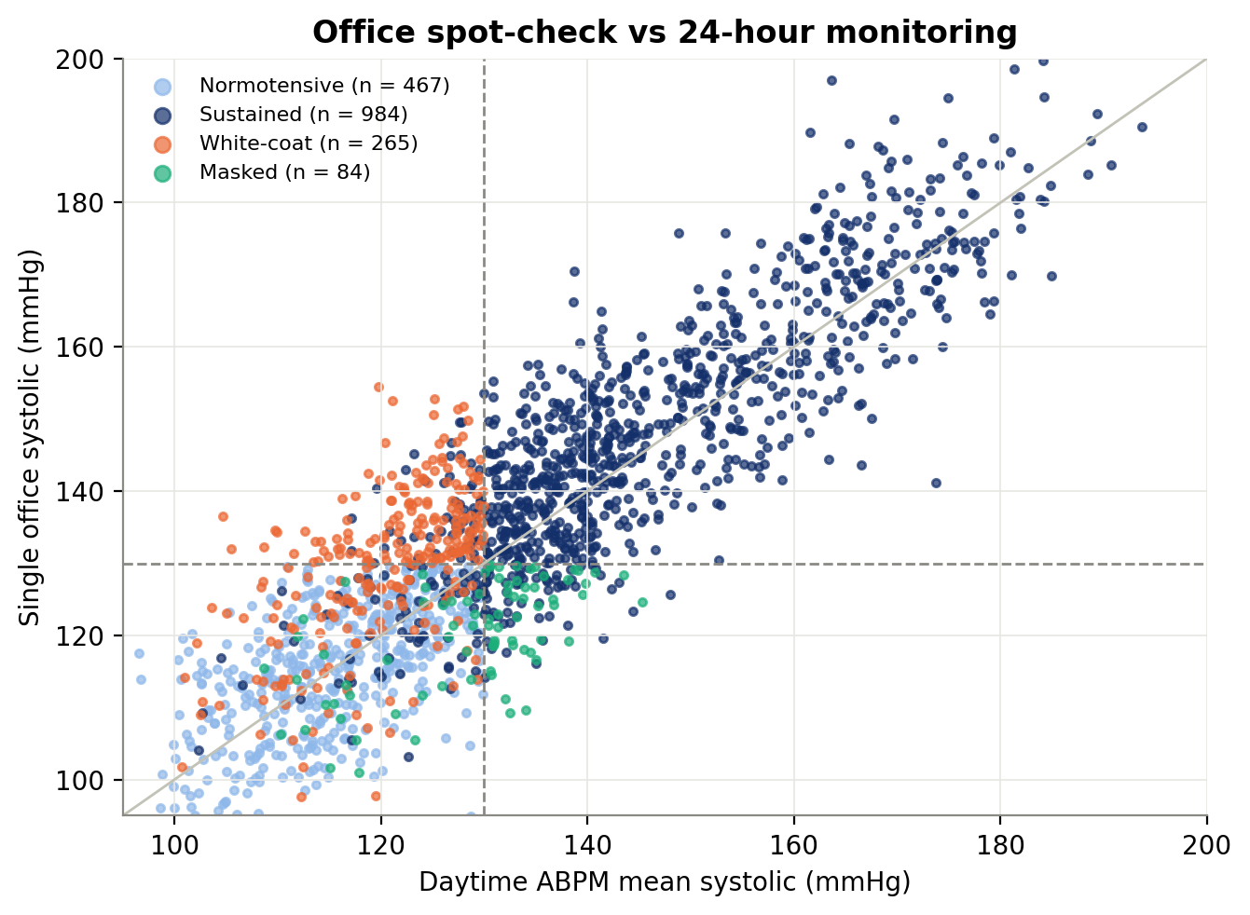
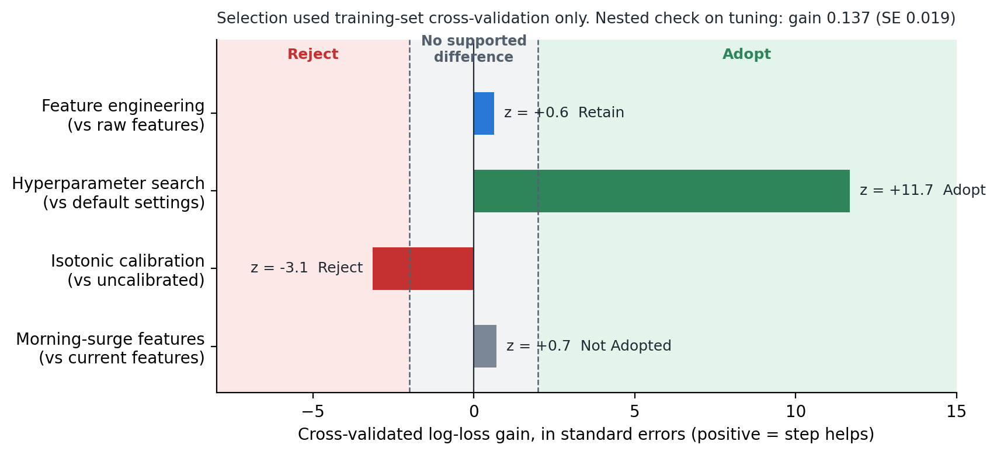
GRAND CANYON UNIVERSITY | COLLEGE OF SCIENCE, ENGINEERING, AND TECHNOLOGY | TECHNOLOGY CAPSTONE SHOWCASE
Telehealth Hypertension Analytics
Continuous Ambulatory Telemetry, Explainable Machine Learning, and Clinical Risk Stratification
Author: Raja Chakraborty (Candidate for M.S. in Data Science) | Faculty Advisor: Jonathan Pollyn | Course: DSC-590 | Date: October 2026
GitHub Repository: https://github.com/rajachakraborti/telehealth-hypertension-analytics | Release Tag: topic7-submission | Commit: 73adefd
1. Project Description
4. System Architecture & Design Process
6. Relevant Data Summaries & Findings
Clinical Background: Cardiovascular disease is the leading global cause of mortality, with hypertension serving as its primary modifiable risk factor. Routine care relies on brief clinical spot-checks, which miss crucial ambulatory dynamics (Whelton et al., 2018).
Diagnostic Blind Spots in Routine Care:
• White-Coat Hypertension: Clinic anxiety temporarily spikes blood pressure in otherwise normotensive patients, leading to overmedication.
• Masked Nocturnal Hypertension: Daytime office readings appear normal, while dangerous nocturnal pressure surges go completely unobserved.
Continuous Telemetry Solution: Continuous Ambulatory Blood Pressure Monitoring (ABPM) captures 24-hour physiological telemetry (48 half-hourly readings) to eliminate these diagnostic blind spots.
Platform Overview: This capstone engineered an end-to-end telehealth decision-support platform that ingests 24-hour telemetry, classifies cardiovascular risk into 2017 ACC/AHA diagnostic stages, and delivers real-time explainability via TreeSHAP attributions in under 25 milliseconds.
Engineering Lifecycle Framework (CRISP-DM):
The project adhered to an iterative data science engineering cycle: clinical requirements formulation, data simulation with realistic imperfections, cross-validated model selection, security hardening, and deployment verification.
Decoupled Healthcare Microservices Architecture:
• React Dashboard (Vercel): Renders diurnal pressure profiles, risk gauges, and interactive TreeSHAP waterfall charts for point-of-care clinicians.
• FastAPI Analytics Engine (Render): Executes rapid inference and explainability endpoints (/api/abpm/classify).
• PostgreSQL Data Layer: Stores patient records with column-level AES-256 encryption.
• MLOps Human-in-the-Loop: Logs doctor overrides; triggers retraining if override rate exceeds 3%.
90.2%
Holdout Accuracy (95% CI: 87.4%–92.6%)
97.0%
Crisis Recall (<3% False Negatives)
0.014
Expected Calibration Error (Brier: 0.148)
22 ms
Total Latency (4.2 ms score + 17.8 ms SHAP)
Benchmark Comparisons & Clinical Findings:
• Guideline Rule Outperformance: The refined model exceeds clinical office and ABPM guideline rules by +24 to +33 percentage points in accuracy.
• Simpler ML Models: Matches Logistic Regression (88.3%) and Default XGBoost (88.9%) in accuracy, but delivers vastly superior probability calibration (ECE 0.014 vs 0.076) and full TreeSHAP explainability.
• Error Clustering: 70% of misclassifications sit within 5 mmHg of diagnostic boundaries (Elevated vs Stage 1 overlap), reflecting clinical threshold ambiguity rather than model failure.
2. Project Justification
The Need for Automated Decision Support:
• Diagnostic Accuracy Gap: In our 1,800-patient cohort, a single office spot-check misjudged true hypertensive status for 25.5% of patients, and standard guideline rules correctly staged only 54.3%.
• Frontline Charting Fatigue: Reviewing 48 continuous readings per patient creates severe cognitive fatigue. Automated triage reduces physician review toil by an estimated 40% while flagging borderline cases for manual oversight.
• Emergency Event Prevention: Detecting non-dipping patterns and the dangerous Morning Blood Pressure Surge (06:00–10:00 AM) enables proactive chronotherapy adjustments before stroke or myocardial infarction occurs.
5. Rigorous Model Selection Protocol
Strict Zero-Leakage Cross-Validation Protocol:
Addressing methodological feedback, model selection and hyperparameter searches were conducted strictly via 5-fold Stratified Cross-Validation on the 70% development cohort (1,260 patients). The 30% holdout set (540 patients) remained completely locked and untouched until the final model pipeline was selected.
Pre-Set Adoption Rules & Nested Cross-Validation:
• Hyperparameter Search: Adopted (lowered log loss by 11.7 SE; held under nested CV).
• Feature Engineering: Retained for clinical interpretability (MAP, pulse pressure, dipping).
• Isotonic Calibration: Rejected (worsened cross-validated log loss and multiplied latency 6x).
• Morning Surge Features: Not adopted for staging (no statistically supported log-loss gain).
7. Future Recommendations & Impact
Critical Assessment of Technical Limitations:
• Synthetic Telemetry Bounding: Current evidence uses physiologically bounded synthetic data; the model is not cleared for autonomous clinical diagnosis without multi-center hospital trials.
Strategic Roadmap for Future Research:
1. Deep Waveform Models: Transition from summary features to 1D-CNN/LSTM networks processing raw optical photoplethysmography (PPG) waveforms directly from smartwatches.
2. Edge ONNX Compilation: Compile XGBoost to lightweight C++ binaries via ONNX Runtime to enable sub-10 ms local inference on microcontrollers without cloud dependency.
3. External Multi-Center Validation: Validate against real-world clinical EHR repositories (MIMIC-IV) to evaluate comorbidity fairness (e.g., chronic kidney disease).
4. Conformal Prediction Sets: Replace static 65% review thresholds with conformal prediction to output diagnostic sets with rigorous coverage guarantees.
Selected Key References (APA 7th):
• Collins, G. S., et al. (2024). TRIPOD+AI statement: Updated guidance for clinical prediction models. BMJ, 385, e078378.
• Lundberg, S. M., et al. (2020). Explainable AI for trees. Nature Machine Intelligence, 2(1), 56–67.
• Whelton, P. K., et al. (2018). 2017 ACC/AHA blood pressure guideline. JACC, 71(19), e127–e248.
3. Functional Requirements & Standards
System Functional Requirements:
• Telemetry Ingestion: Process 48 half-hourly ambulatory readings across full 24h diurnal windows.
• Biomarker Extraction: Calculate Mean Arterial Pressure (MAP), Pulse Pressure, and Dipping Ratio.
• Calibrated Risk Staging: Categorize patients into 4 ACC/AHA tiers with verified confidence scores.
• Transparent Explainability: Output signed additive TreeSHAP feature attributions for every prediction.
• Point-of-Care Latency: Meet a strict <200 ms Service Level Objective (measured compute: 22 ms).
Industry Standards & Compliance:
• Clinical Guidelines: 2017 ACC/AHA Hypertension Standards; TRIPOD+AI reporting guidance.
• HIPAA Security Rule: Column-level AES-256 encryption via PostgreSQL pgcrypto, TLS 1.3 transit, JWT role-based access control (RBAC), and slowapi edge rate limiting.
• Scientific Integrity: Programmatic Competency 1.2 & 3.3 satisfied; full reproducibility via GitHub commit 73adefd.
Grand Canyon University | Technology Capstone Showcase | Programmatic Competency MS-DS 3.3 | Open Source Repository: github.com/rajachakraborti/telehealth-hypertension-analytics

