Slide 1
Telehealth Hypertension Analytics
From 24-hour blood pressure records to an explained, audited staging model
Raja Chakraborty | DSC-590 Data Science Capstone, Completion Phase
Grand Canyon University | Instructor: Jonathan Pollyn | October 2026
github.com/rajachakraborti/telehealth-hypertension-analytics | tag topic7-submission | commit 73adefd
Notes:
This is the completion-phase summary of my capstone: a decision-support system that stages hypertension from a patient's 24-hour blood pressure record. In the next nine minutes: the problem, what I built, how I chose the model, the results, what a technical audit of the whole project found, and what I would do next. Everything here traces to the repository at tag topic7-submission.

Slide 2
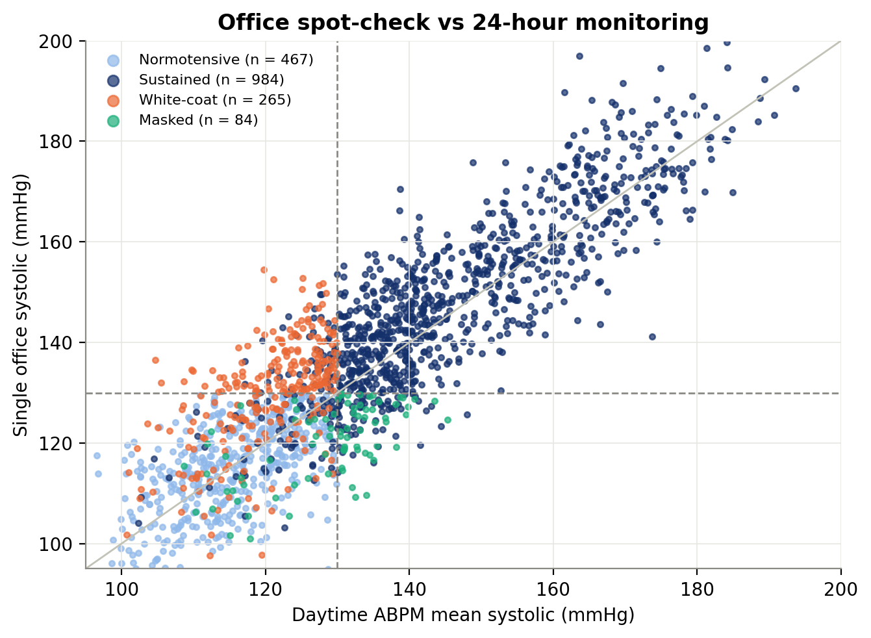
A single office reading misjudges about one patient in four
In the simulated cohort, one clinic reading disagrees with the patient's true hypertensive status 25.5% of the time
• Office spot-check: stages 54.3% of patients correctly
• White-coat 14.7% and masked 4.7%: opposite errors from the same single reading
• 24-hour monitoring (ABPM) fixes this but produces 48 readings per patient to review
• Goal: stage each patient from the full record, show which measurements drove the result, and flag low-confidence cases
Telehealth Hypertension Analytics | DSC-590 | R. Chakraborty | release tag topic7-submission
2
Notes:
Hypertension is diagnosed from spot-checks in the clinic, but blood pressure moves through the day. White-coat patients read high only in clinic; masked patients read normal in clinic and high outside it. In my simulated cohort, 25.5% of patients are misjudged by one office reading, and a rule applied to that single reading stages only 54.3% correctly. Ambulatory monitoring records 48 readings over 24 hours and fixes this, but nobody has time to read 48 numbers per patient. The goal: automate the staging and show why.

Slide 3
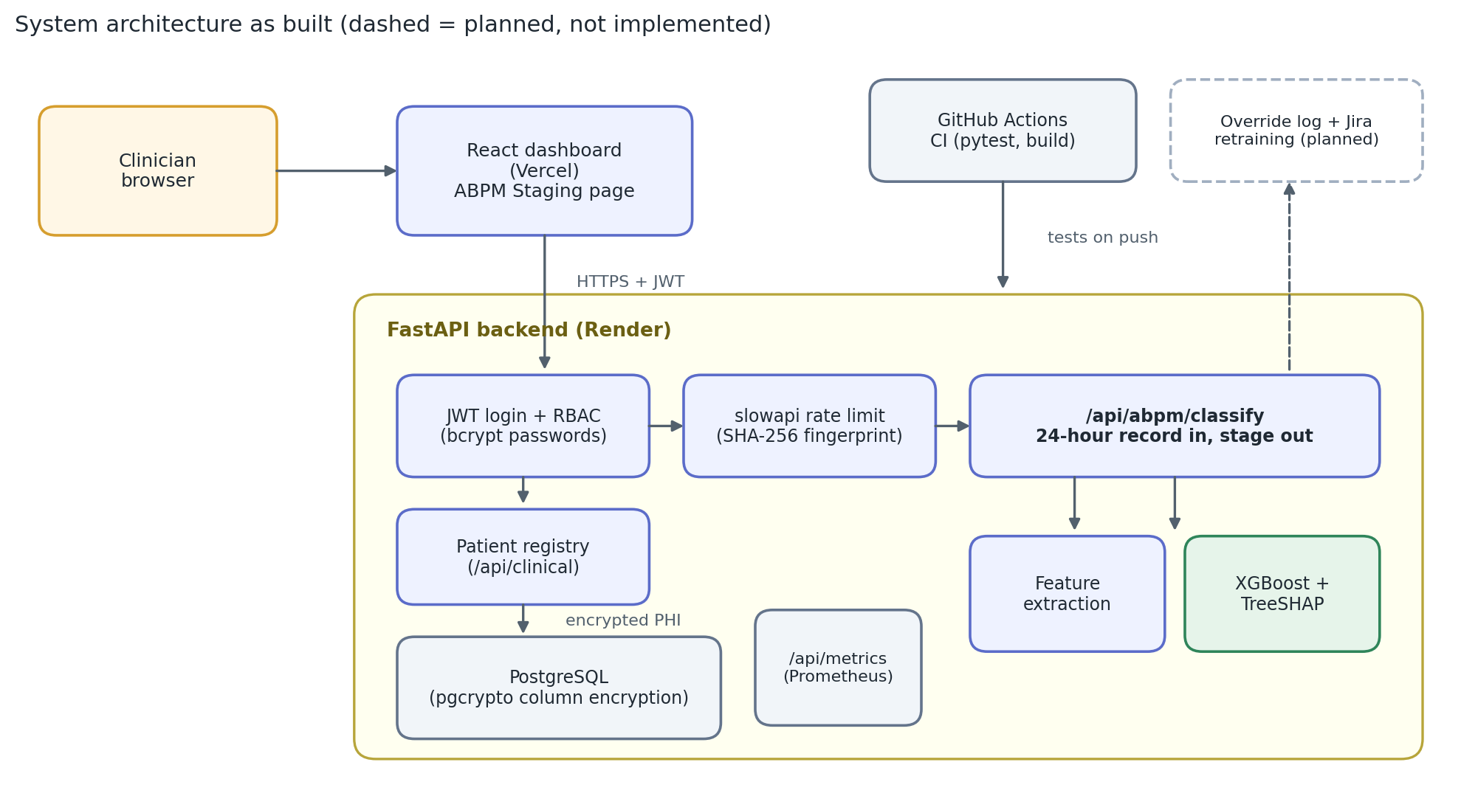
A staging API and dashboard page serve the refined model
Architecture as built; the Jira retraining loop from the earlier design is not implemented and is shown dashed
• One request = one patient-day: 48 readings in, stage + explanation out
• Explained: exact TreeSHAP drivers, signed
• Safe by default: flags confidence under 65% for manual review
• Secured: bcrypt passwords, JWT roles, rate limit, encrypted PHI columns
Telehealth Hypertension Analytics | DSC-590 | R. Chakraborty | release tag topic7-submission
3
Notes:
This is the system as built, not as originally designed. A clinician signs in through the React dashboard on Vercel; the FastAPI backend on Render checks the JWT role, rate-limits, and serves one endpoint that takes a 24-hour record and returns the stage, probabilities, the top explaining measurements and a manual-review flag. Patient identifiers are stored with column-level encryption in PostgreSQL. The audit corrected two things I had claimed earlier: login previously accepted any password, and the override-to-Jira retraining loop was never built, so it is dashed here.

Slide 4
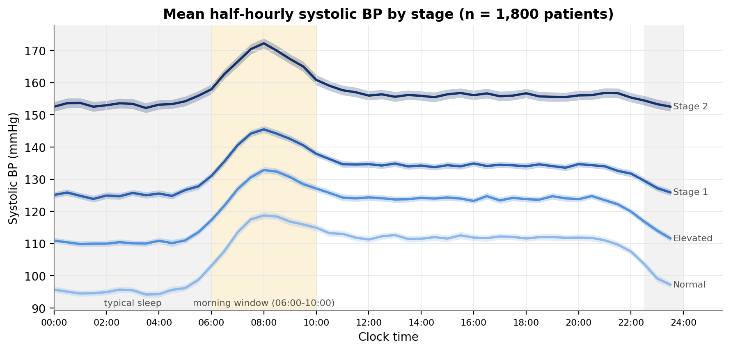
Each patient is a 24-hour record reduced to 11 clinical features
Simulated because real patient records are protected; dipping and surge patterns are built into the simulator
• 1,800 patients x 48 readings: noise, 3% artifacts, 8% missing
• 11 features: day/night pressure, MAP, pulse pressure, dipping ratio, age, BMI, heart rate
• XGBoost, tuned on 1,260 patients; 540 held out and untouched until the end
• Caveat: labels and features come from the same simulator, so scores are an upper bound
Mean systolic profile by stage. The night-time dip and the 06:00 to 10:00 surge are assumptions built into the simulator, so seeing them confirms the pipeline works; it is not a clinical finding.
Telehealth Hypertension Analytics | DSC-590 | R. Chakraborty | release tag topic7-submission
4
Notes:
The cohort is simulated: 1,800 patients, 450 per stage, each with 48 half-hourly readings with measurement noise, 3% cuff artifacts and 8% missing readings. From each record I compute day and night averages, mean arterial pressure, pulse pressure and the nocturnal dipping ratio, the way a clinician reads an ambulatory report. One caution I carry through the whole deck: the simulator builds in the dipping and morning-surge differences, so finding them confirms the pipeline works; it is not a clinical discovery.

Slide 5
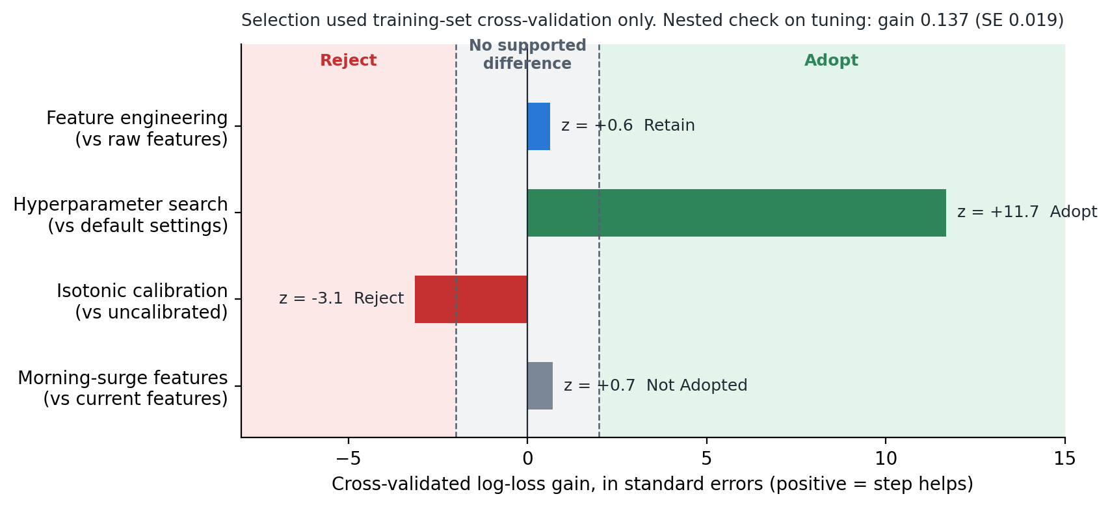
Cross-validation chose the model; the holdout chose nothing
Rules were fixed first: adopt at 2 standard errors of log-loss gain, reject at minus 2
• Tuning: adopted; holds up under nested CV
• Features: kept for interpretability, no accuracy gain
• Isotonic calibration: rejected, worse log loss and 5 to 6x slower
• Surge features: no supported gain
Corrected claims: feature engineering did not raise accuracy, and calibration did not "worsen" Brier score and ECE in cross-validation; its clear cost is log loss and latency.
Telehealth Hypertension Analytics | DSC-590 | R. Chakraborty | release tag topic7-submission
5
Notes:
My professor pointed out that I had used holdout results to keep or drop refinements. I rebuilt the selection. Rules first: adopt a step only if it lowers cross-validated log loss by at least two standard errors, reject it if it raises it by that much. Result: hyperparameter search is strongly supported (z about 12, and it survives nested cross-validation). Feature engineering shows no reliable accuracy gain, so I keep it as the clinically defined design, not as an improvement. Isotonic calibration is rejected because it makes log loss worse (z -3.1), and the morning-surge features add nothing. Two of my earlier explanations were wrong, and the report now says so.

Slide 6
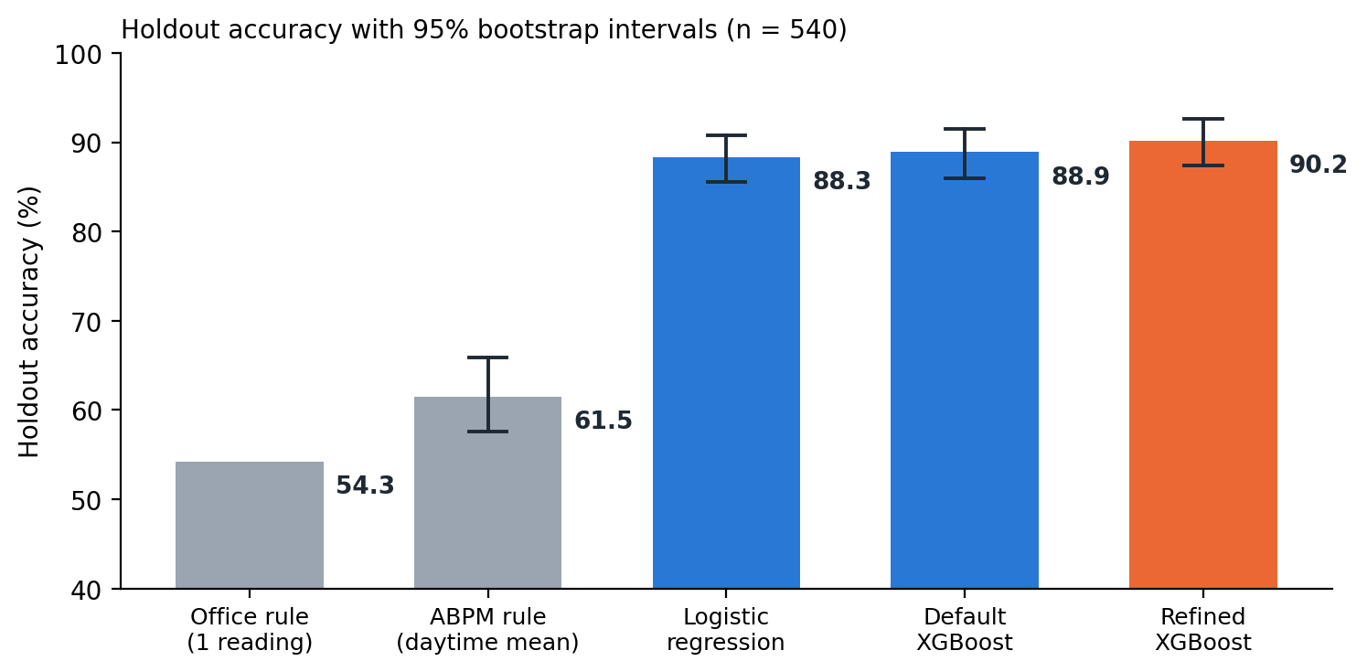
90.2% accuracy and 97% Stage 2 recall, with the uncertainty shown
Clear win over guideline rules; the gain over simpler machine learning is within noise
0.970
0.985
Stage 2 recall
Stage 2 precision
0.984
0.014
macro ROC-AUC
calibration error (ECE)
22 ms
+24 to +33
prediction + explanation
points vs ABPM rule (95% CI)
Versus logistic regression the accuracy gain is -0.2 to +3.7 points (95% CI), and versus default XGBoost -0.6 to +3.1: both include zero.
Telehealth Hypertension Analytics | DSC-590 | R. Chakraborty | release tag topic7-submission
6
Notes:
On 540 held-out patients the refined model reaches 90.2% accuracy; Stage 2 recall is 0.970 at precision 0.985, macro AUC 0.984, and calibration error 0.014. Inference plus explanation takes about 22 milliseconds. The honest reading of the intervals: the gain over guideline rules is large (24 to 33 points), but the gain over logistic regression (-0.2 to +3.7) and default XGBoost (-0.6 to +3.1) includes zero. What the extra work buys is better-calibrated probabilities and an explanation, not a large accuracy jump.

Slide 7
The audit found real gaps between the claims and the code
Eight of the eleven findings, most serious first; the first six are fixed (full list in the report)
Finding | Severity | Status
Login accepted any password for a known username | Critical | Fixed, tested
Registration stored plaintext and allowed self-assigned admin role | Critical | Fixed, tested
Served model was per-reading and leaky, not the reported model | High | Fixed: new endpoint, parity test
Holdout set influenced refinement decisions | High | Fixed: CV selection + nested check
Suite broken (1 import error, 1 failing test); no tests for new logic | Medium | Fixed: all tests pass
Jira override retraining and a dashboard SHAP view were claimed, not built | Medium | Claim removed; SHAP page built
Database encryption key has a built-in default | Medium | Open: needs re-encryption
Demo accounts ship with known passwords; CORS open to all origins | Low | Mitigated: hashed, env overrides
Telehealth Hypertension Analytics | DSC-590 | R. Chakraborty | release tag topic7-submission
7
Notes:
I audited the whole project: the notebook, the backend, the frontend and the tests. The most serious findings were in security: login accepted any password for an existing username, and registration stored plaintext passwords and let a caller choose the administrator role. Both are fixed and tested. The model the API served was a different, leakier per-reading model than the one in my report, so I built an endpoint that serves the evaluated model and proved it reproduces the notebook. The earlier selection process used the holdout, now fixed. Two items remain open and are stated plainly: the database encryption key falls back to a default and needs a re-encryption migration, and the committed demo accounts need rotated passwords on any shared deployment.

Slide 8
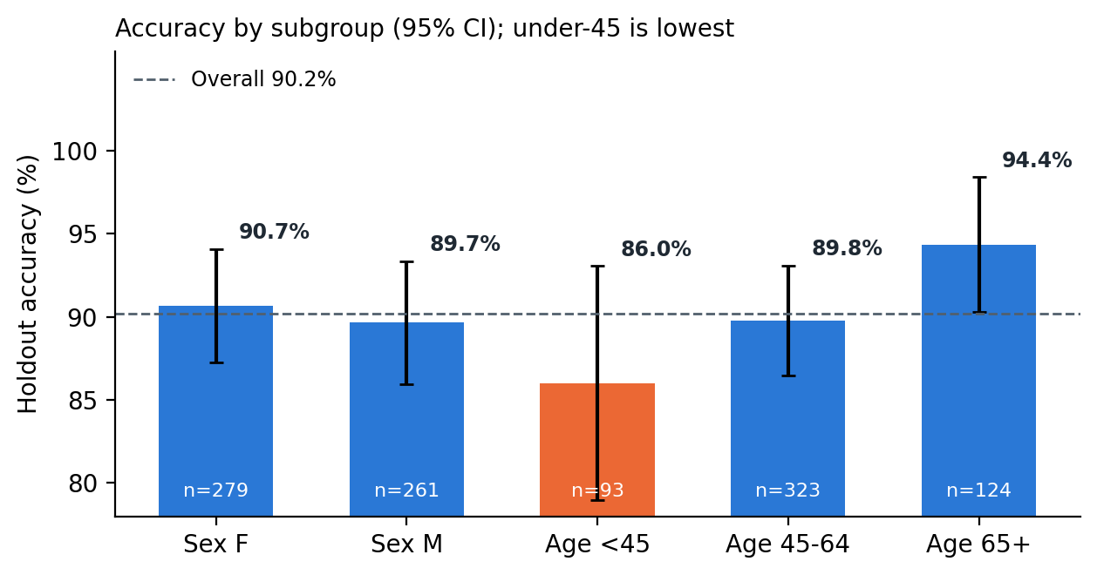
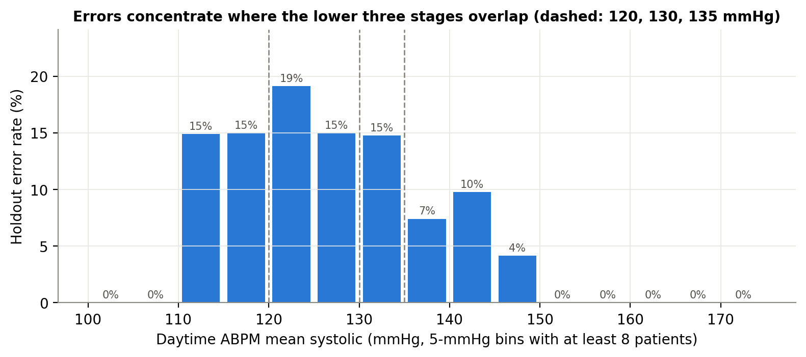
Where it fails: near stage cut-points, and for younger patients
70% of errors fall within 5 mmHg of a stage boundary; accuracy is lowest under age 45
• Boundary errors: a 5 mmHg measurement wobble can flip a stage; the review flag and, later, prediction sets target these cases
• Not validated clinically: simulated data, same-generator labels; the API returns a disclaimer with every result
Telehealth Hypertension Analytics | DSC-590 | R. Chakraborty | release tag topic7-submission
8
Notes:
Errors are not random. 70% of the mistakes sit within five millimetres of mercury of a stage boundary, where a patient's true stage is genuinely ambiguous. Accuracy is 86.0% for patients under 45 against 94.4% for those 65 and over; with 93 young patients that interval is wide, so this is a flag to investigate, not a conclusion. The biggest limitation is the data: the labels come from the same simulator as the features, so the headline accuracy is an upper bound and says nothing yet about clinical validity.

Slide 9
Next: prove it on real data, then predict outcomes
Each recommendation answers a specific finding; the last two follow current practice in clinical machine learning
1 Validate externally
All evidence is synthetic. Test on real multi-site ABPM data and report to TRIPOD+AI (Collins et al., 2024).
2 Predict outcomes, not stage
Stage labels come from the same thresholds the model learns, so it mostly re-learns a rule.
3 Add conformal prediction sets
The 65% review cut-off is unvalidated; sets with a coverage guarantee suit boundary cases (Angelopoulos & Bates, 2023).
4 Close the loop
Log overrides, monitor drift, retrain on a schedule, ship a model card per release (Mitchell et al., 2019).
5 Audit fairness at scale
Under-45 accuracy is 86% on 93 patients; confirm or refute on a larger real sample.
Telehealth Hypertension Analytics | DSC-590 | R. Chakraborty | release tag topic7-submission
9
Notes:
My recommendations follow from the audit rather than from a wish list. First, nothing here is clinically validated, so the priority is an external test on real ambulatory data, reported to the TRIPOD+AI standard. Second, because the stage labels are produced by the same guideline thresholds the model learns, the more valuable target is a real outcome, such as confirmed hypertension or cardiovascular events. Third, my 65 percent review threshold is a policy choice, not a validated one; conformal prediction gives sets with a coverage guarantee, which suits boundary cases. Fourth, close the loop I had only drawn: log clinician overrides, monitor drift, and publish a model card per release. Fifth, check performance by age and sex on a larger sample. Deep sequence models only make sense once real raw waveform data exists.

