Slide 1

Customer Churn Analysis
Saad Hasan Khan
(Systems and Computer Engineering)
Carleton ID: 101057121

Slide 2
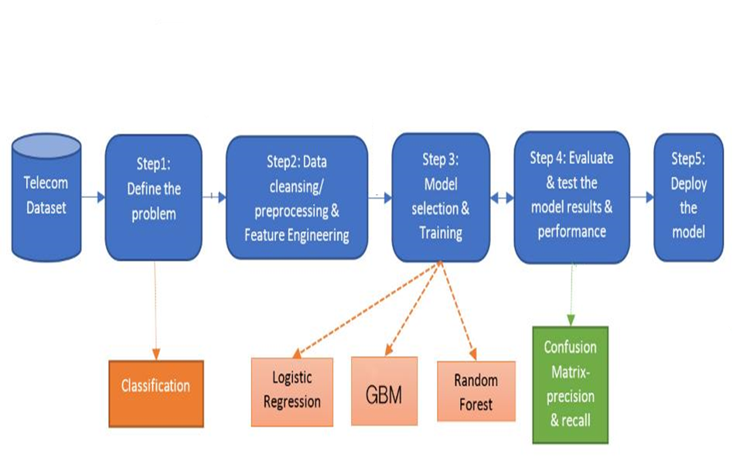
.

Slide 3
Problem statement
In Canada lots of telecom service providers are keep trying to make more profit by increasing numbers of customers. Giant companies include Rogers communication, BCE Inc., Tellus Corporation and others. By applying different data mining techniques on this IBM dataset will be helpful to understand the churn prediction in Canadian Telecom industry for the large datasets as real datasets are confidential.
As the problem is to predict the telco customer churn. There are many classification algorithms could be implemented to classify whether the customer leave or not. Famous methods which includes Logistic Regression, Random forest, gbm and Artificial Neural Network.
Furthermore, Unsupervised learning using k-means to cluster the customers based on the importance

Slide 4
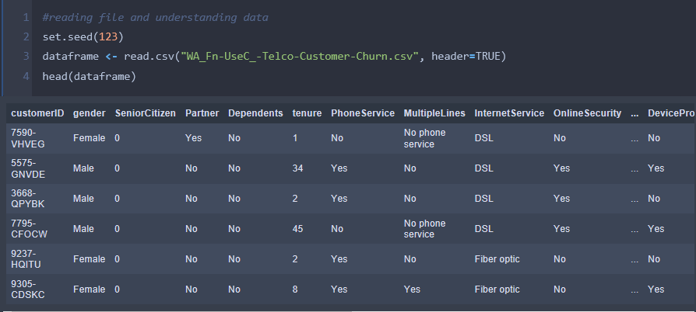
Data exploration

Slide 5
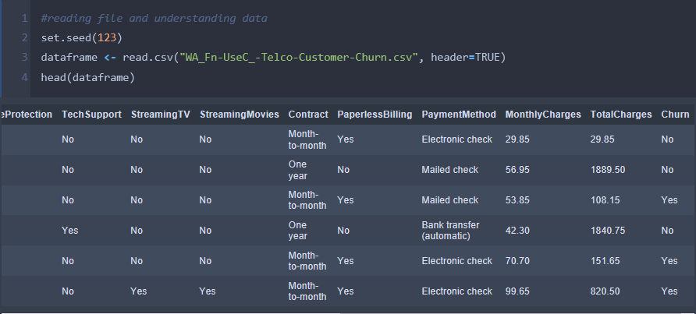
Data exploration(cont.)

Slide 6
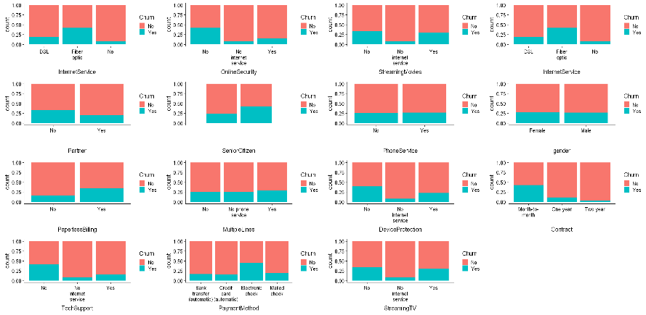

Slide 7
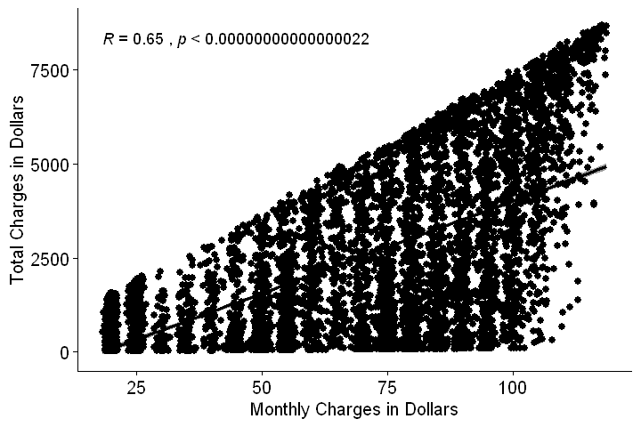
Corelation between continous features

Slide 8
Data cleaning/pre-processing
Omitted the missing values
Replaced text using correlation between features w.r.t situation
Replaced Customer duration with the help of Monthly Charges and Total Charges
Conversion of all dependent categorical variables into numeric form and gave a specific number for each category in the variable
Removed unimportant features like Customer ID, Senior Citizen

Slide 9
Data partitioning
Training Set is 80 percent for training the algorithm
Test Set is 20 percent for checking the strength of algorithm includes Accuracy, Precision, Recall and Specificity using decision matrix

Slide 10
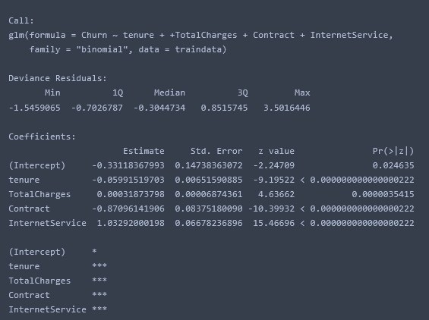
Methodology: logistic regression
In this project, we are using logistic Regression as our evaluation method for the dataset.
𝑃 Churn = 𝑒^v / 1+𝑒^v
Where, Churn = 1 for leaving the service provider & 0 for not leaving service provider

Slide 11
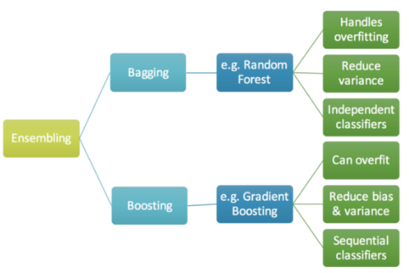
Methodology: Gradient boost machine
It produces a prediction model in the form of an ensemble of weak prediction models, typically decision trees.

Slide 12
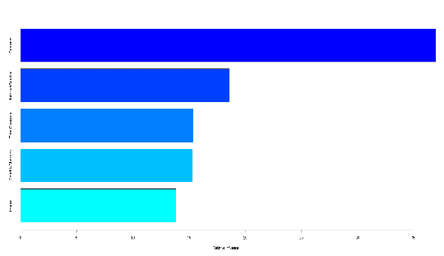
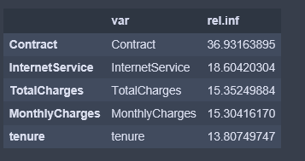
Gradient boost machine(cont.)
Features Selection

Slide 13
Random Forests
Random Forests are similar to a famous Ensemble technique called Bagging but
have a different tweak in it.
In Random Forests
the idea is to correlate the several trees which are generated by the different bootstrapped
samples from training Data.
And then we simply reduce the Variance in the Trees by averaging them.
Averaging the Trees helps us to reduce the variance and also improve the
Performance of Decision Trees on Test Set and eventually avoid Overfitting.

Slide 14
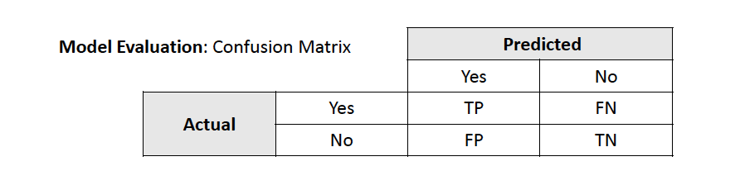
Model Evaluation: Confusion Matrix gbm
PREDICTED
YES | NO
915 | 99
187 | 190
ACTUAL
YES
NO

Slide 15
TABLE
 | Logistic Regression | Gradient Boost Machine | Neural Network | Random Forest
Accuracy | 0.77 | 0.80 | 0.79 | 0.78
Precision | 0.62 | 0.65 | 0.40 | 0.72
Recall | 0.44 | 0.50 | 0.70 | 0.33
Specificity | 0.90 | 0.90 | 0.80 | 0.95

Slide 16
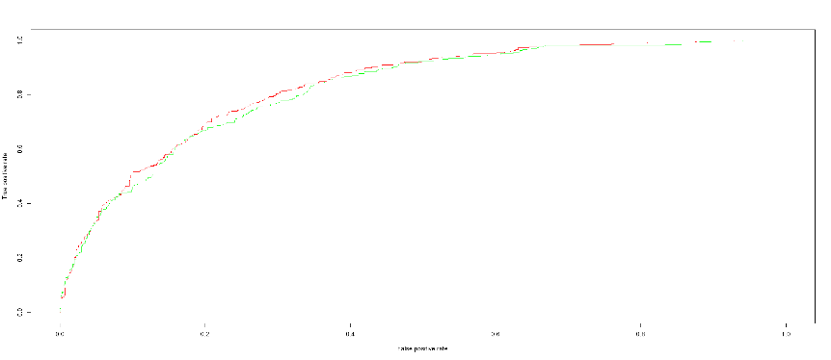
Roc curves for logistics regression and gradient boost machine

Slide 17
Remaining work in the project
Implementation of Artificial Neural Networks; Forward feed using R Library “Neuralnet,” “nnet” and “MASS”
Clustering of Customer using K-Means algorithm between 2 continuous variables, Monthly Charges and tenure using Library “cluster”

Slide 18
Thank you

