Slide 1
Digital Portfolio
STUDENT NAME: Raja.R
REGISTER NO AND NMID: 24131060500121047
DEPARTMENT: Bachelor of Computer Application
COLLEGE: Shree Raghvendra Arts and Science college

Slide 2
PROJECT TITLE
Agile Vs WaterFall: Choosing
The Right Methodology

Slide 3
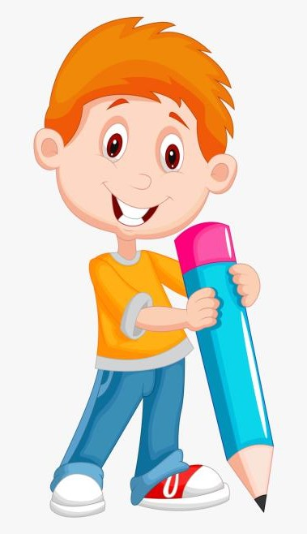

AGENDA
Problem Statement
Project Overview
End Users
Tools and Technologies
Portfolio design and Layout
Features and Functionality
Results
Conclusion
3/21/2024 Annual Review

Slide 4
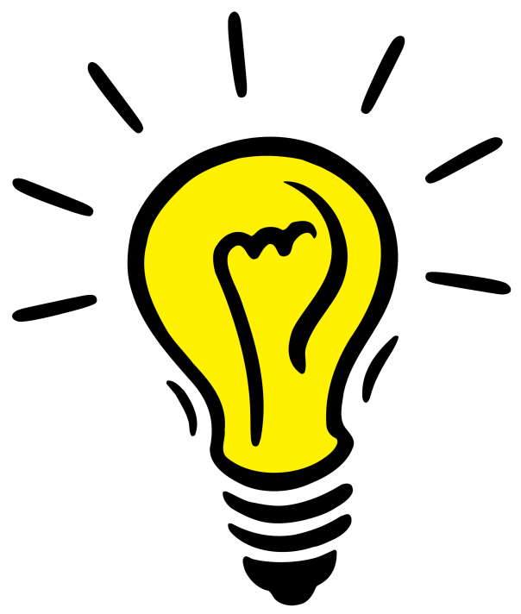
PROBLEM STATEMENT
Organizations face challenges in selecting the right development methodology
Project failures due to poor methodology alignment
Need for flexibility vs structured planning

Slide 5
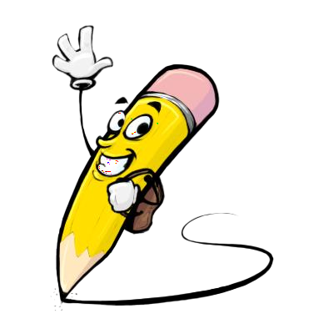
PROJECT OVERVIEW
Agile: Iterative, flexible, and adaptive approach to software development
Waterfall: Linear, structured, and sequential model
Each method has strengths and weaknesses depending on project type

Slide 6

WHO ARE THE END USERS?
Software development teams
Project managers
IT companies and startups
Clients and stake
holders involved in product development

Slide 7

TOOLS AND TECHNIQUES
Agile Tools: Jira, Trello, Scrum boards, Kanban boards
Waterfall Tools: Microsoft Project, Gantt charts
Collaboration tools: Slack, Confluence
Version control: Git, GitHub

Slide 8
POTFOLIO DESIGN AND LAYOUT
Clean, professional theme with a dual-color scheme (e.g., Blue for Waterfall, Green for Agile)
Use comparison charts and infographics
Flow diagrams for both methodologies
Icons for planning, sprints, delivery stages
8

Slide 9
FEATURES AND FUNCTIONALITY
Agile: Flexibility, continuous feedback, incremental delivery
Waterfall: Clear structure, well-defined stages, predictable timelines
Key differences in cost, time, and adaptability
Real-world use cases for each methodology

Slide 10
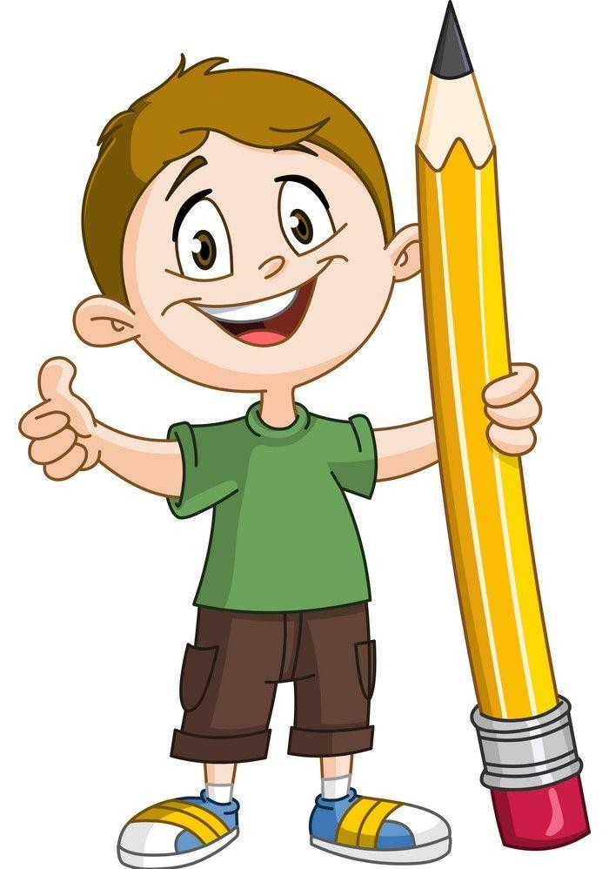
RESULTS
Agile improves adaptability and client satisfaction
Waterfall provides clarity and predictability for fixed-scope projects
Choosing the right method depends on project complexity and requirements
3/21/2024 Annual Review
10

Slide 11
CONCLUSION
No single “best” methodology—depends on project needs
Agile for dynamic projects, Waterfall for stable and well-defined projects
Hybrid models (Agile-Waterfall mix) are becoming popular
11

