Slide 1

Medical Assistant Applicationge
Short User Stories
Disclaimer :: Accurate measurement from image is not possible.
Requires further investigation by a qualified physician.
Information generated is only to assist and may have error(s).
Information should not be a substitute for professional medical advice.
Always consult with a doctor for diagnosis and treatment of a medical condition.

Slide 2
Upload imagege
As a patient, I want to upload a medical image so that the assistant can analyze it and provide insights.
Acceptance criteria:
The app should support uploading images in common formats like JPG, PNG, and TIF.
The assistant should be able to understand the uploaded image and potentially identify medical conditions or related objects.
The assistant should provide a response related to the uploaded image.

Slide 3
Ask questions about my health using natural language
As a patient, I want to ask questions about my health using natural language so that the assistant can understand and respond in a helpful way.
Acceptance criteria:
The app should provide a text area for users to type their questions.
The assistant should understand natural language queries (prompts) related to the uploaded image or general medical topics.
The assistant should generate informative responses to user questions, considering safety and avoiding harmful content.

Slide 4
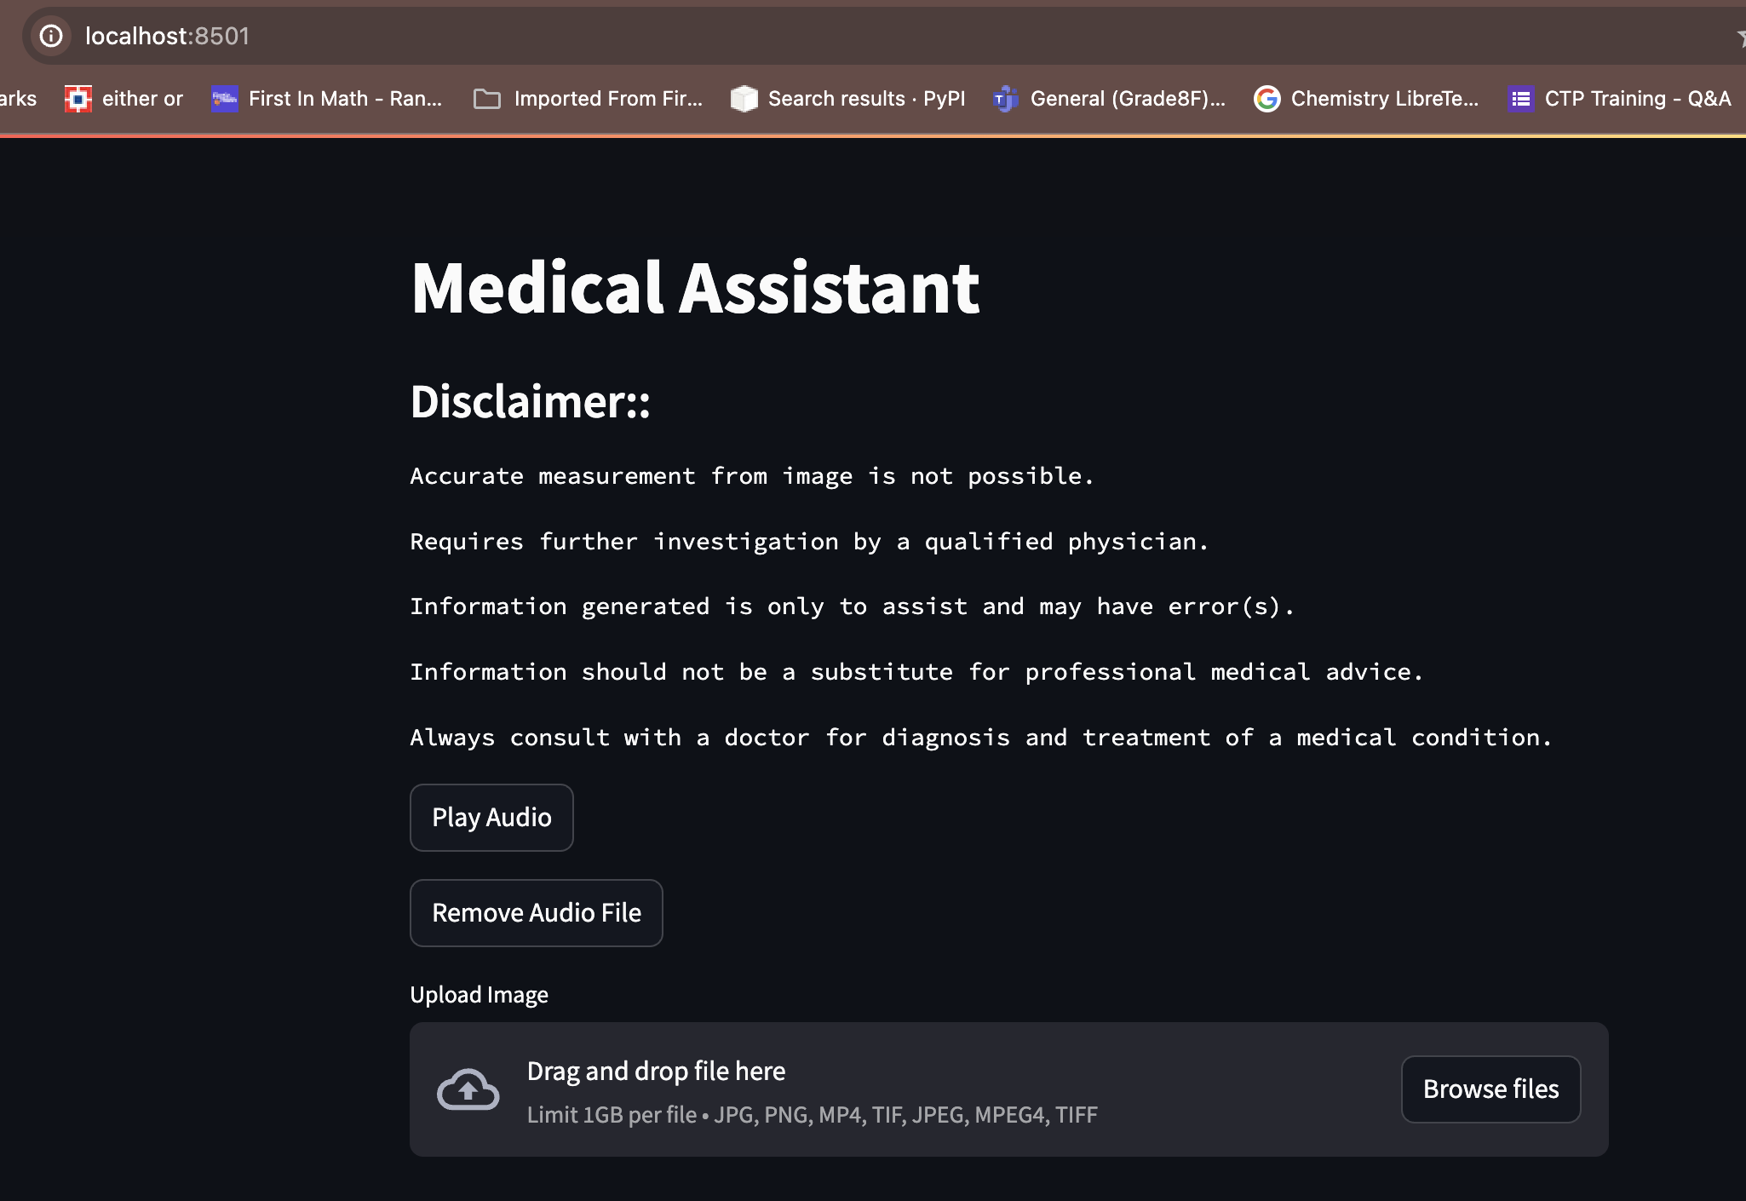
Application - 1

Slide 5
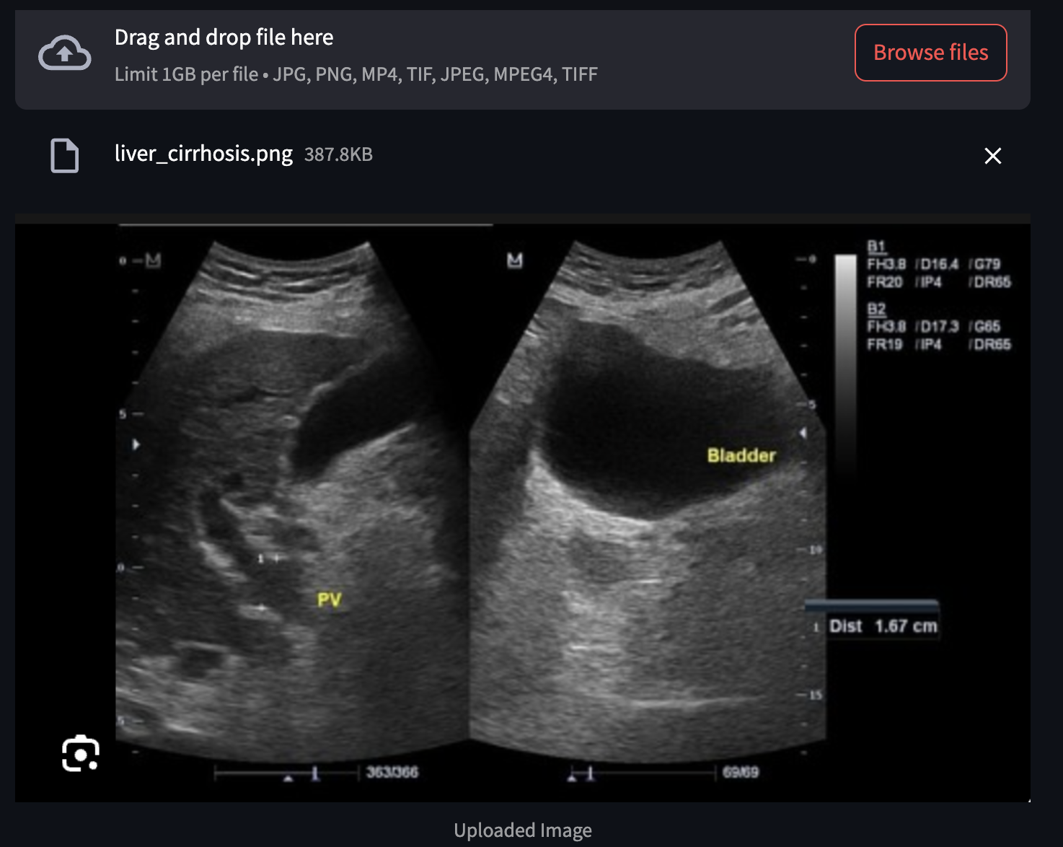
Application - 2

Slide 6
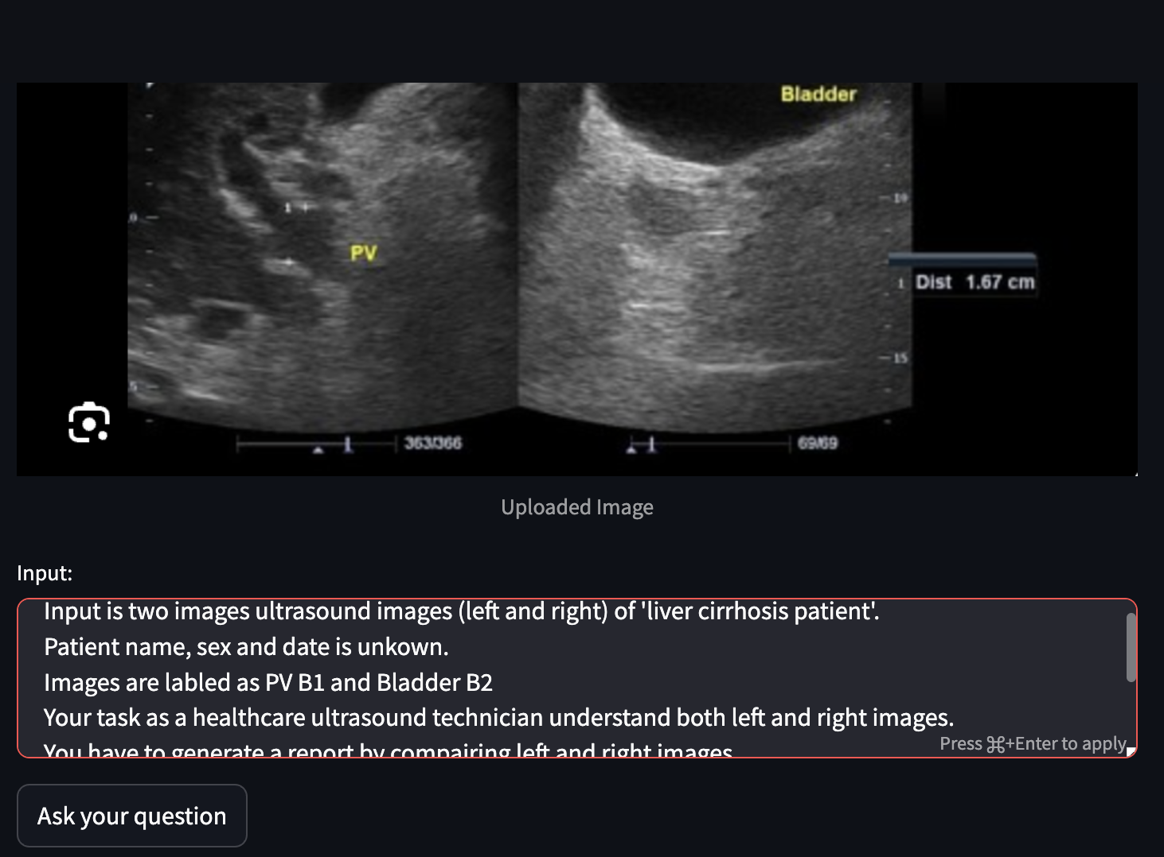
Application - 3

Slide 7
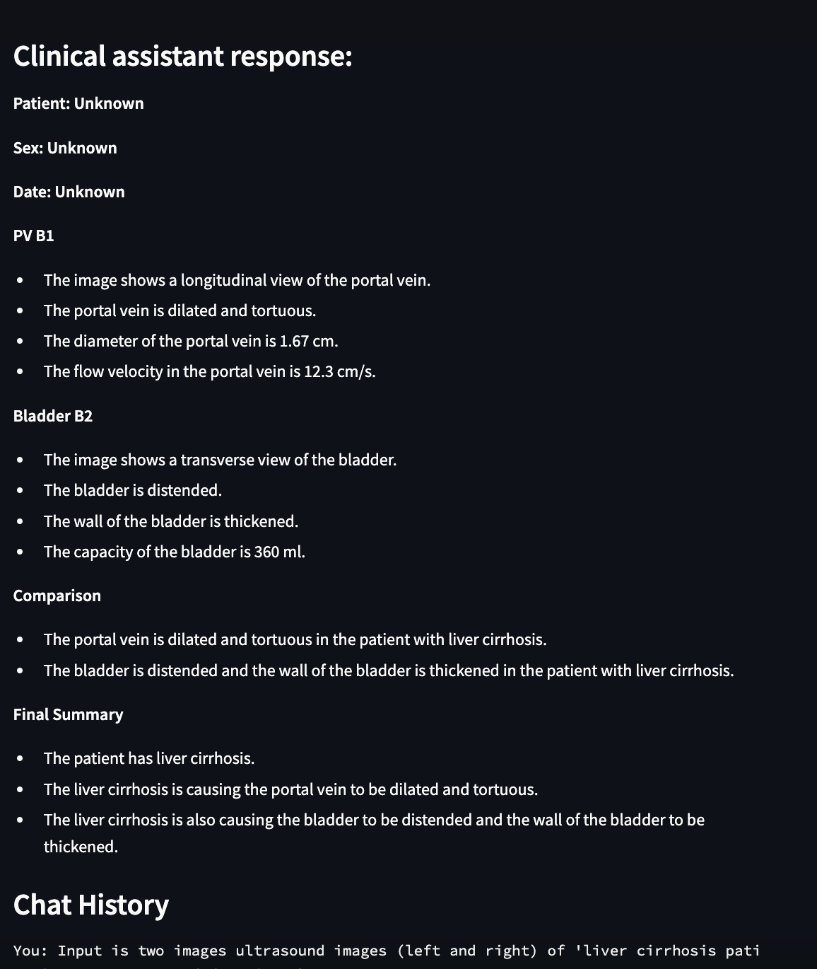
Application - 4

Slide 8
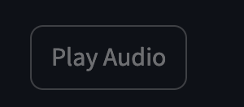
Read Aloud
As a patient, I want the assistant
to read the response aloud so that I can listen to it.
Acceptance criteria:
The app should have a button to play audio of the assistant's latest response.
The response should be converted to speech using Text-to-Speech
The audio should be played through the user's device speakers.

Slide 9
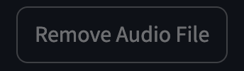
Clear the audio file after listening
As a patient, I want to clear
the audio file after listening to it so that it doesn't take up storage space.
Acceptance criteria:
The app should have a button to remove the temporary audio file generated for the latest response.
Clicking the button should delete the audio file if it exists.

Slide 10
Model to be loaded only once during app execution (tech NFR)
As a developer, I want the model to be loaded only once during app execution to improve performance.
Acceptance criteria:
The model loading logic should be wrapped in a caching mechanism like cache_data.
The model should be loaded only on the first app run and reused throughout the session.

Slide 11
Save chat history in JSON file periodically
As a developer, I want the chat history to be saved to a JSON file periodically to maintain the conversation context.
Acceptance criteria:
The app should define a function to write the current chat history to a JSON file.
The chat history should be saved when the conversation length exceeds a certain threshold or at specific intervals.

Slide 12
Handle potential errors gracefully (tech NFR)
As a developer, I want the app to handle potential errors gracefully and display informative messages to the user.
Acceptance criteria:
The app should use exception handling (try-except blocks) to catch errors during model generation or other operations.
User-friendly error messages should be displayed in case of issues.

Slide 13
Clear the user input field and chat history when the user exits the app (tech NFR)
As a developer, I want the app to clear the user input field and chat history when the user exits the app.
Acceptance criteria:
The app should have a button or functionality to reset the session state.
Clicking the button should clear the user input field, chat history, and potentially any temporary files.
Consider using st.rerun() and st.stop() functions strategically for app restart and termination.

