Slide 1
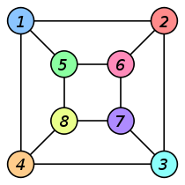
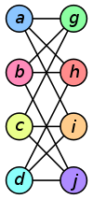
Introduction to Graph Mining
Sangameshwar Patil
Systems Research Lab
TRDDC, TCS, Pune

Slide 2
Outline
Motivation
  Graphs as a modeling tool
  Graph mining
Graph Theory: basic terminology
Important problems in graph mining
FSG: Frequent Subgraph Mining Algorithm

Slide 3
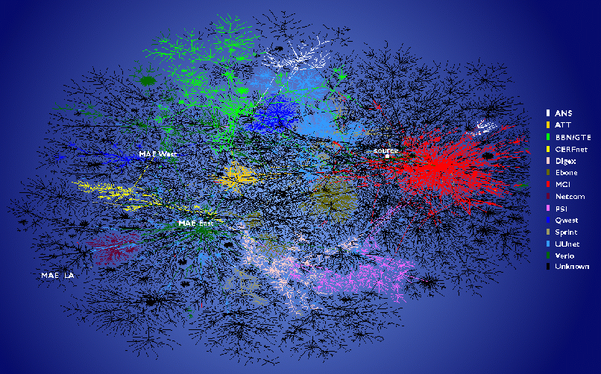
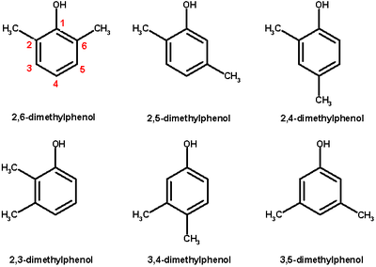
Motivation
Graphs are very useful for modeling variety of entities and their inter-relationships
  Internet / computer networks
    Vertices: computers/routers
    Edges: communication links
  WWW
    Vertices: webpages
    Edges: hyperlinks
  Chemical molecules
    Vertices: atoms
    Edges: chem. Bonds
  Social networks (Facebook, Orkut, LinkedIn)
    Vertices: persons
    Edges: friendship
  Citation/co-authorship network
  Disease transmission
  Transport network (airline/rail/shipping)
  Many more…

Slide 4
Motivation: Graph Mining
What are the distinguishing characteristics of these graphs?
When can we say two graphs are similar?
Are there any patterns in these graphs?
How can you tell an abnormal social network from a normal one?
How do these graph evolve over time?
Can we generate synthetic, but realistic graphs?
  Model evolution of Internet?
…

Slide 5
Terminology-I
A graph G(V,E) is made of two sets
  V: set of vertices
  E: set of edges
Assume undirected, labeled graphs
  L_{v}: set of vertex labels
  L_{E}: set of edge labels
Labels need not be unique
  e.g. element names in a molecule

Slide 6
Terminology-II
A graph is said to be connected if there is path between every pair of vertices
A graph G_{s} (V_{s}, E_{s}) is a subgraph of another graph G(V, E) iff
  V_{s} is subset of V and E_{s} is subset of E
Two graphs G₁(V₁, E₁) and G₂(V₂, E₂) are isomorphic if they are topologically identical
  There is a mapping from V₁ to V₂ such that each edge in E₁ is mapped to a single edge in E₂ and vice-versa

Slide 7
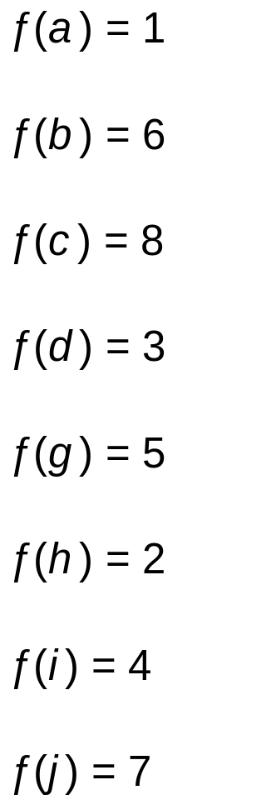
Example of Graph Isomorphism

Slide 8
Terminology-III:
Subgraph isomorphism problem
Given two graphs G₁(V₁, E₁) and G₂(V₂, E₂): find an isomorphism between G₂ and a subgraph of G₁
  There is a mapping from V₁ to V₂ such that each edge in E₁ is mapped to a single edge in E₂ and vice-versa
NP-complete problem
  Reduction from max-clique or hamiltonian cycle problem

Slide 9
Need for graph isomorphism
Chemoinformatics
  drug discovery (~ 10⁶⁰ molecules ?)
Electronic Design Automation (EDA)
  designing and producing electronic systems ranging from PCBs to integrated circuits
Image Processing
Data Centers / Large IT Systems

Slide 10
Other applications of graph patterns
Program control flow analysis
  Detection of malware/virus
Network intrusion detection
Anomaly detection
Classifying chemical compounds
Graph compression
Mining XML structures
…

Slide 11
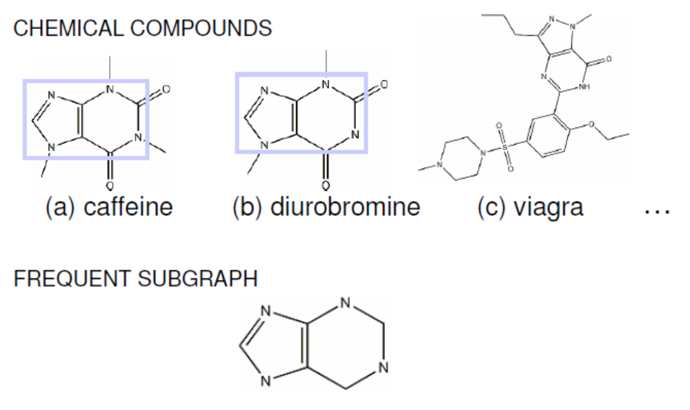
Example*: Frequent subgraphs
*From K. Borgwardt and X. Yan (KDD’08)

Slide 12
Questions ?

Slide 13
An Efficient Algorithm for Discovering Frequent Sub-graphs
IEEE ToKDE 2004 paper
by
Kumarochi & Karypis

Slide 14
Outline
Motivation / applications
Problem definition
Recap of Apriori algorithm
FSG: Frequent Subgraph Mining Algorithm
  Candidate generation
  Frequency counting
  Canonical labeling

Slide 15
Need for graph isomorphism
Chemoinformatics
  drug discovery (~ 10⁶⁰ molecules ?)
Electronic Design Automation (EDA)
  designing and producing electronic systems ranging from PCBs to integrated circuits
Image Processing
Data Centers / Large IT Systems?

Slide 16
Outline
Motivation / applications
Problem definition
  Complexity class GI
Recap of Apriori algorithm
FSG: Frequent Subgraph Mining Algorithm
  Candidate generation
  Frequency counting
  Canonical labeling

Slide 17
Problem Definition
Given
  D : a set of undirected, labeled graphs
  σ : support threshold ; 0 < σ <= 1
Find all connected, undirected graphs that are sub-graphs in at-least σ . | D | of input graphs

Slide 18
Complexity
Sub-graph isomorphism
  Known to be NP-complete
Graph Isomorphism (GI)
  Ambiguity about exact location of GI in conventional complexity classes
    Known to be in NP
    But is not known to be in P or NP-C
    (factoring is another such problem)
  A class in its own
    Complexity class GI
    GI-hard
    GI-complete

Slide 19
Outline
Motivation / applications
Problem definition
Recap of Apriori algorithm
FSG: Frequent Subgraph Mining Algorithm
  Candidate generation
  Frequency counting
  Canonical labeling

Slide 20
Apriori-algorithm: Frequent Itemsets
C_{k}: Candidate itemset of size k
L_{k}: frequent itemset of size k
Frequent: count >= min_support
Find frequent set L_{k−1}.
Join Step
  C_{k} is generated by joining L_{k−1} with itself
Prune Step
  Any (k−1)-itemset that is not frequent cannot be a subset of a frequent k -itemset, hence should be removed.

Slide 21
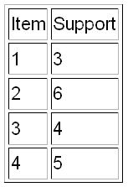
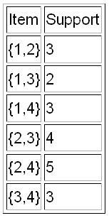
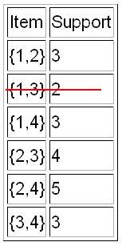
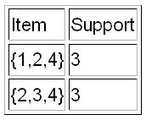
Apriori: Example
Set of transactions : { {1,2,3,4}, {2,3,4}, {2,3}, {1,2,4}, {1,2,3,4}, {2,4} }
min_support: 3
L₁
C₂
L₂
L₃
{1,2,3} and {1,3,4} were pruned as {1,3} is not frequent.
{1,2,3,4} not generated since {1,2,3} is not frequent. Hence algo terminates.

Slide 22
Outline
Motivation / applications
Problem definition
Recap of Apriori algorithm
FSG: Frequent Subgraph Mining Algorithm
  Candidate generation
  Frequency counting
  Canonical labeling

Slide 23
FSG: Frequent Subgraph Discovery Algo.
ToKDE 2004
  Updated version of ICDM 2001 paper by same authors
Follows level-by-level structure of Apriori
Key elements for FSG’s computational scalability
  Improved candidate generation scheme
  Use of TID-list approach for frequency counting
  Efficient canonical labeling algorithm

Slide 24
FSG: Basic Flow of the Algo.
Enumerate all single and double-edge subgraphs
Repeat
  Generate all candidate subgraphs of size (k+1) from size-k subgraphs
  Count frequency of each candidate
  Prune subgraphs which don’t satisfy support constraint
  Until (no frequent subgraphs at (k+1) )

Slide 25
Outline
Motivation / applications
Problem definition
Recap of Apriori algorithm
FSG: Frequent Subgraph Mining Algorithm
  Candidate generation
  Frequency counting
  Canonical labeling

Slide 26
FSG: Candidate Generation - I
Join two frequent size-k subgraphs to get (k+1) candidate
  Common connected subgraph of (k-1) necessary
Problem
  K different size (k-1) subgraphs for a given size-k graph
  If we consider all possible subgraphs, we will end up
    Generating same candidates multiple times
    Generating candidates that are not downward closed
    Significant slowdown
  Apriori algo. doesn’t suffer this problem due to lexicographic ordering of itemset

Slide 27
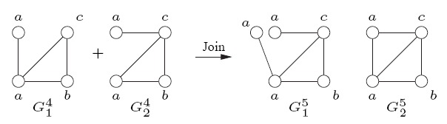
FSG: Candidate Generation - II
Joining two size-k subgraphs may produce multiple distinct size-k
  CASE 1: Difference can be a vertex with same label

Slide 28
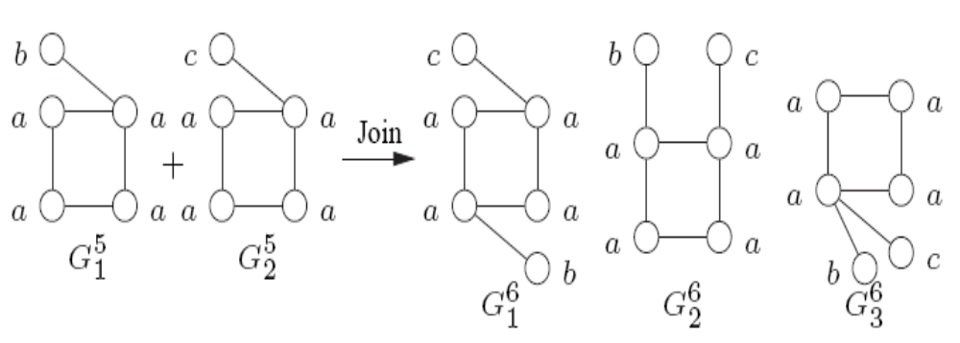
FSG: Candidate Generation - III
CASE 2: Primary subgraph itself may have multiple automorphisms
CASE 3: In addition to joining two different k-graphs, FSG also needs to perform self-join

Slide 29
FSG: Candidate Generation Scheme
For each frequent size-k subgraph F_{i} , define
primary subgraphs: P(F_{i}) = {H_{i,1} , H_{i,2}}
H_{i,1} , H_{i,2} : two (k-1) subgraphs of F_{i} with smallest and second smallest canonical label
FSG will join two frequent subgraphs F_{i} and F_{j} iff
P(F_{i}) ∩ P(F_{j}) ≠ Φ
This approach correctly generates all valid candidates and leads to significant performance improvement over the ICDM 2001 paper

Slide 30
Outline
Motivation / applications
Problem definition
Recap of Apriori algorithm
FSG: Frequent Subgraph Mining Algorithm
  Candidate generation
  Frequency counting
  Canonical labeling

Slide 31
FSG: Frequency Counting
Naïve way
  Subgraph isomorphism check for each candidate against each graph transaction in database
  Computationally expensive and prohibitive for large datasets
FSG uses transaction identifier (TID) lists
  For each frequent subgraph, keep a list of TID that support it
To compute frequency of G_{k+1}
  Intersection of TID list of its subgraphs
  If size of intersection < min_support,
    prune G_{k+1}
  Else
    Subgraph isomorphism check only for graphs in the intersection
Advantages
  FSG is able to prune candidates without subgraph isomorphism
  For large datasets, only those graphs which may potentially contain the candidate are checked

Slide 32
Outline
Motivation / applications
Problem definition
Recap of Apriori algorithm
FSG: Frequent Subgraph Mining Algorithm
  Candidate generation
  Frequency counting
  Canonical labeling

Slide 33
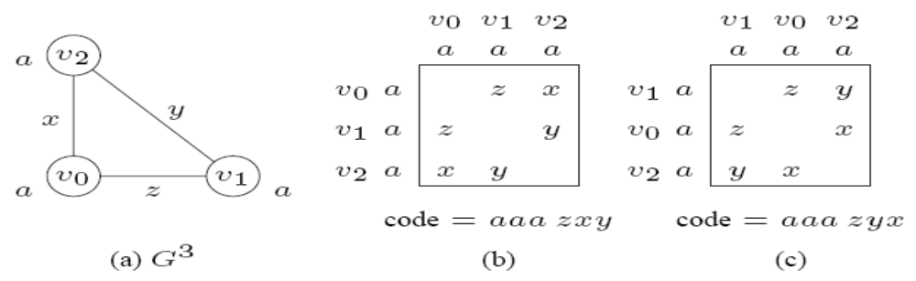
Canonical label of graph
Lexicographically largest (or smallest) string obtained by concatenating upper triangular entries of adj. matrix (after symmetric permutation)
Uniquely identifies a graph and its isomorphs
  Two isomorphic graphs will get same canonical label

Slide 34
Use of canonical label
FSG uses canonical labeling to
  Eliminate duplicate candidates
  Check if a particular pattern satisfies the downward closure property
Existing schemes don’t consider edge-labels
  Hence unusable for FSG as-is
Naïve approach for finding out canonical label is O( |v| !)
  Impractical even for moderate size graphs

Slide 35
FSG: canonical labeling
Vertex invariants
  Inherent properties of vertices that don’t change across isomorphic mappings
  E.g. degree or label of a vertex
Use vertex invariants to partition vertices of a graph into equivalent classes
If vertex invariants cause m partitions of V containing p1, p2, …, pm vertices respectively, then number of different permutations for canonical labeling
π (p_{i} !) ; i = 1, 2, …, m
which can be significantly smaller than |V| ! permutations

Slide 36
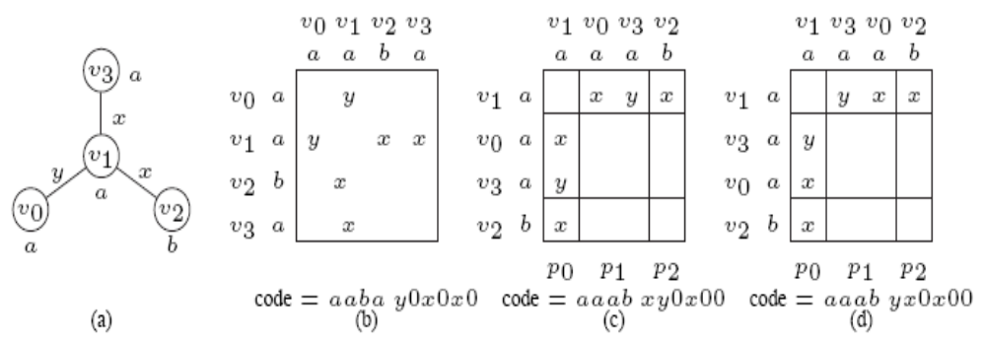
FSG canonical label: vertex invariant - I
Partition based on vertex degrees and labels
Example: number of permutations reqd = 1 ! x 2! x 1! = 2
Instead of 4! = 24

Slide 37
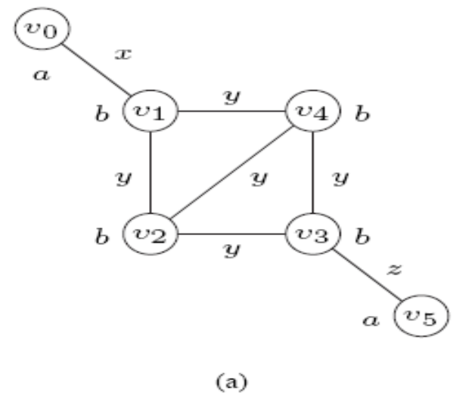
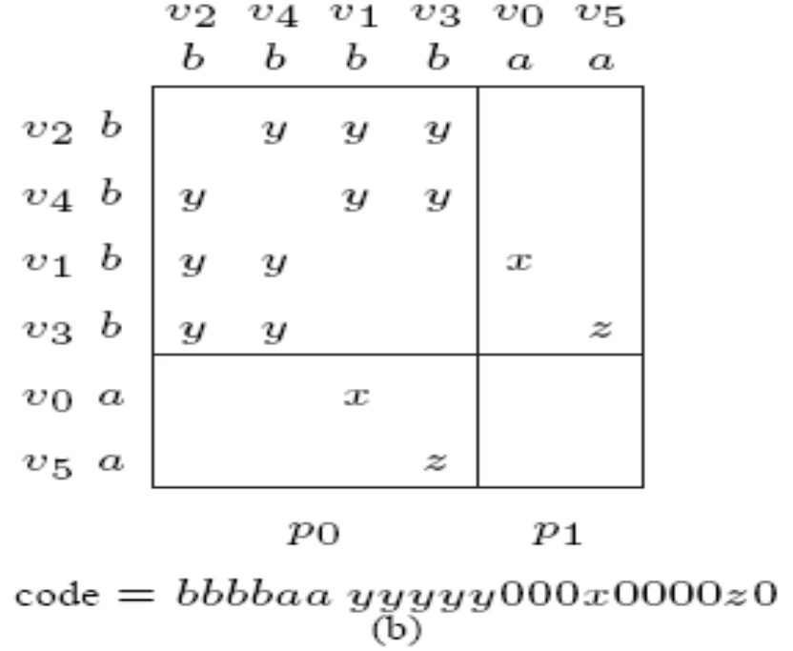
FSG canonical label: vertex invariant - II
Partition based on neighbour lists
Describe each adjacent vertex by a tuple
< l_{e}, d_{v}, l_{v} >
  l_{e} = edge label
  d_{v} = degree
  l_{v} = label

Slide 38
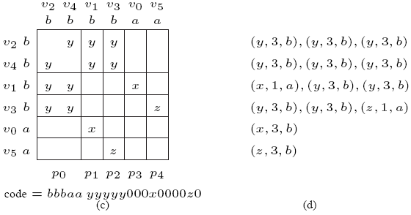
FSG canonical label: vertex invariant - II
Two vertices in same partition iff their nbr. lists are same
Example: only 2! Permutations instead of 4! x 2!

Slide 39
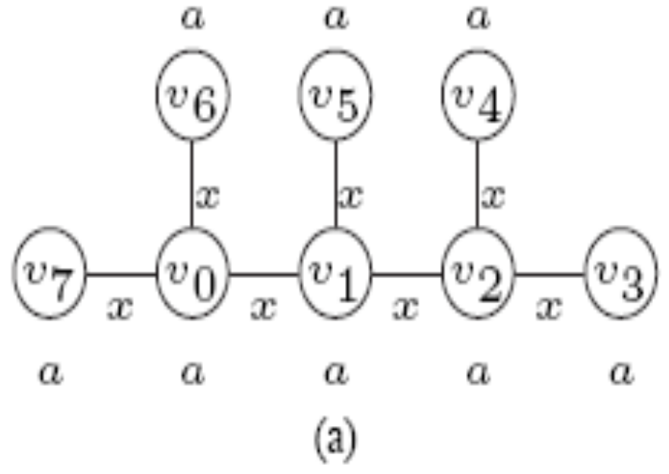
FSG canonical label: vertex invariant - III
Iterative partitioning
Different way of building nbr. list
Use pair <pv, le> to denote adjacent vertex
  pv = partition number of adj. vertex c
  le = edge label

Slide 40
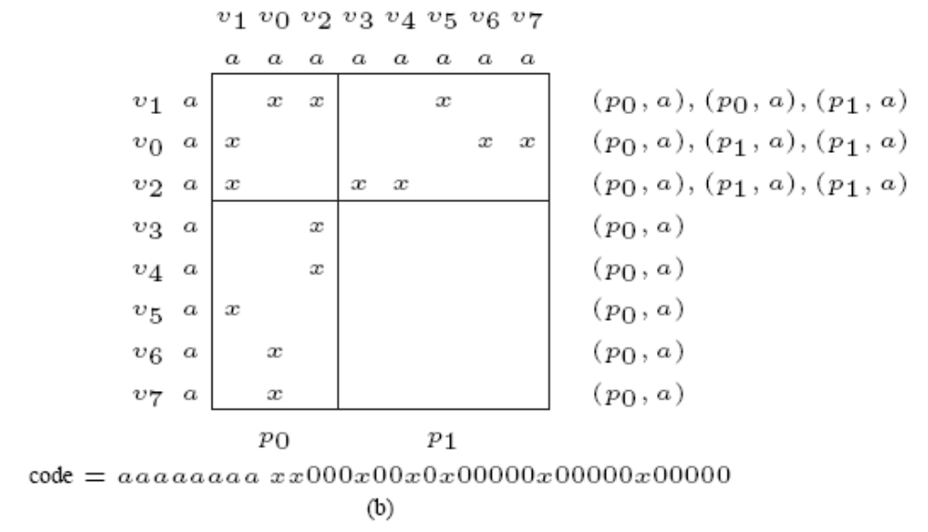
FSG canonical label: vertex invariant - III
Iter 1: degree based partitioning

Slide 41
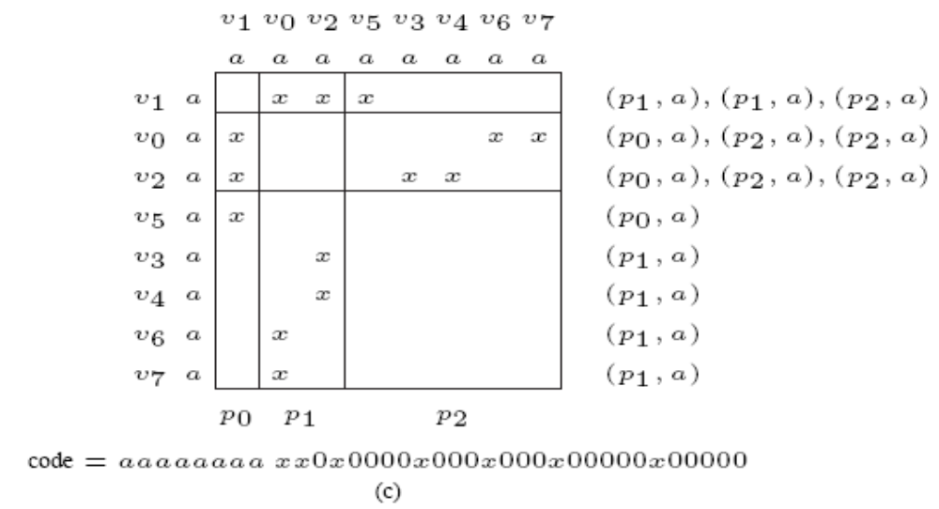
FSG canonical label: vertex invariant - III
Nbr. List of v1 is different from v0, v2. Hence new partition introduced.
Renumber partitions and update nbr. lists. Now v5 is different.

Slide 42
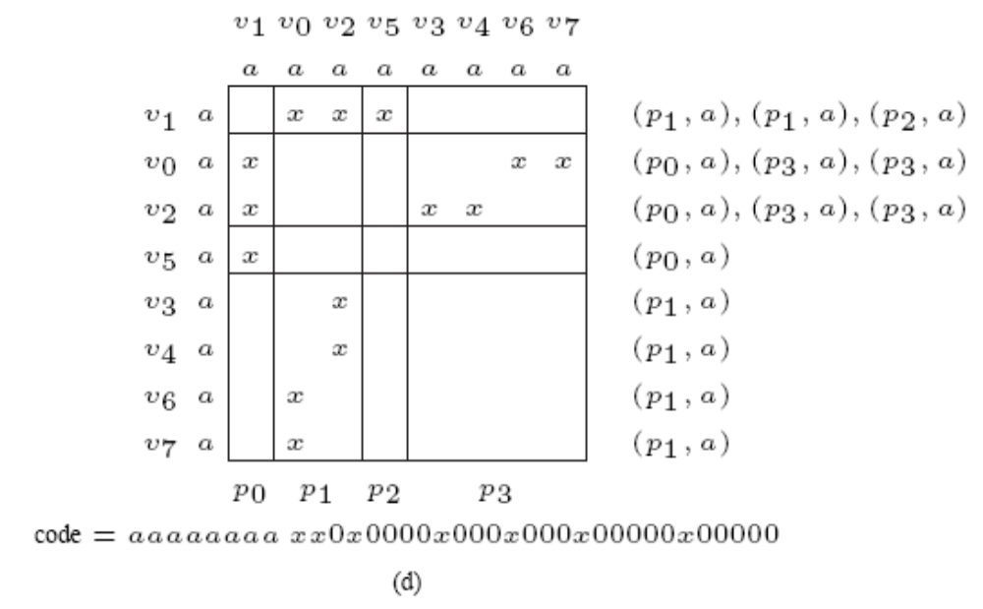
FSG canonical label: vertex invariant - III

Slide 43
Next steps
What are possible applications that you can think of?
  Chemistry
  Biology
We have only looked at “frequent subgraphs”
  What are other measures for similarity between two graphs?
  What graph properties do you think would be useful?
  Can we do better if we impose restrictions on subgraph?
    Frequent sub-trees
    Frequent sequences
    Frequent approximate sequences
Properties of massive graphs (e.g. Internet)
  Power law (zipf distribution)
  How do they evolve?
  Small-world phenomenon (6 hops of separation, kevin beacon number)

Slide 44
Questions ?
Thanks

