Slide 1
GRAPH MINING a general overview of some mining techniques
presented by
Rafal Ladysz

Slide 2
PREAMBLE: from temporal to spatial (data)
clustering of time series data was presented (September) in aspect of problems with clustering subsequences
this presentation focuses on spatial data (graphs, networks)
and techniques useful for mining them
in a sense, it is “complementary” to that dealing with temporal data
  this can lead to mining spatio-temporal data – more comprehensive and realistic scenario
  data collected already (CS 710/IT 864 project)...

Slide 3
first: graphs and networks
let assume in this presentation (for the sake of simplicity) that
(connected) GRAPHS = NETWORKS
suggested AGENDA to follow:
first: formal definition of GRAPH will be given
followed by preview of kinds of NETWORKS
and brief history behind that classification
finally, examples of mining structured data:
  association rules
  clustering

Slide 4
graphs
we usually encounter data in relational format, like ER databases or XML documents
graphs are example of so called structured data
they are used in biology, chemistry, social networks, communication etc.
can capture relations between objects far beyond flattened representations
here is analogy:
  relational data graph-based data
  OBJECT VERTEX
  RELATION EDGE

Slide 5
graph - definitions
graph (G.) definition: set of nodes joined by a set of lines (undirected graphs) or arrows (directed graphs)
  planar: can be drawn with no 2 edges crossing.
  non-planar: if it is not planar; further subdivision follows:
    bipartite: if it is non-planar and the vertex set can be partitioned into S and T so that every edge has one end in S and the other in T
    complete: if it is non-planar and each node is connected to every other node
illustration:
  connected: is possible to get from any node to any other by following a sequence of adjacent nodes
  acyclic: if no cycles exist, where cycle occurs when there is a path that starts at a particular node and returns to that same node; hence special class of Directed Acyclic Graphs - DAG

Slide 6
graph – definitions cont.
components: vertices V (nodes) and edges E
  vertices: represent objects of interest connected with edges
  edges: represented by arcs connecting vertices; can be
    directed and represented by an arrow or
    undirected represented by a line – hence directed and undirected graphs; we can further define
    weighted: represented as lines with a numeric value assigned, indicating the cost to traverse the edge; used in graph-related algorithms (e.g. MST)

Slide 7
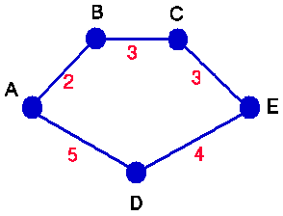
graph – definitions cont.
degree is the number of edges wrt a node
  undirected G: the degree is the number of edges incident to the node; that is all edges of the node
  directed G:
    indegree - the number of edges coming into the node
    outdegree - the number of edges going out of the node
paths: occurs when nodes are adjacent and can be reached through one another; many kinds, but important for this presentation is
  shortest path: between two nodes where the sum of the weights of all the edges on the path is minimized
  example: the path ABCE costs 8
  and path ADE costs 9,
  hence ABCE would be the shortest path

Slide 8
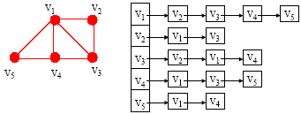
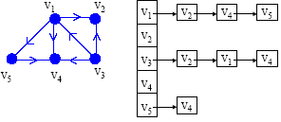
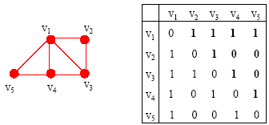
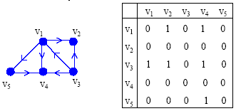
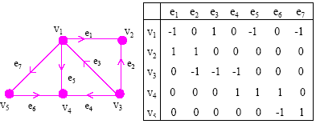
graph representation
adjacency list
adjacency matrix
incidence matrix

Slide 9
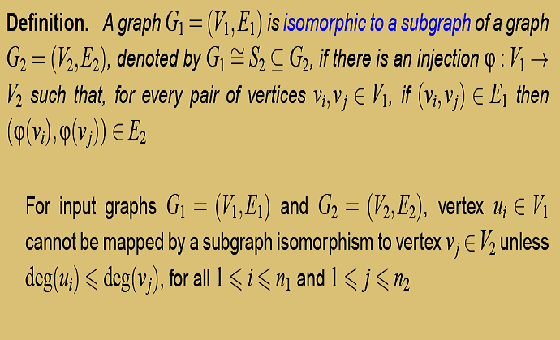
graph isomorphism

Slide 10
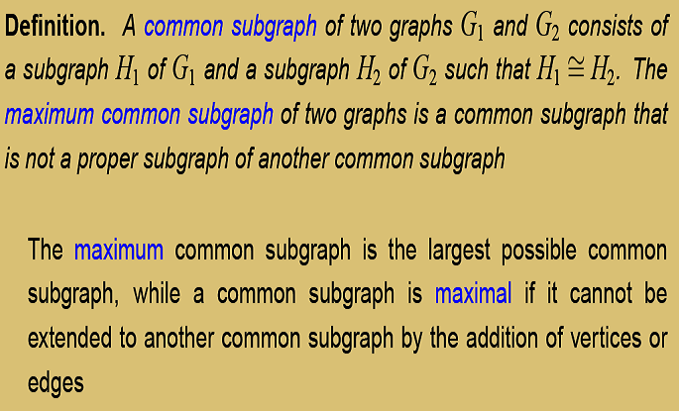
subgraph isomorphism

Slide 11
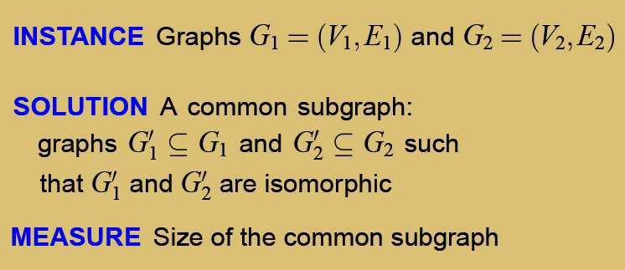
maximum common subgraph

Slide 12
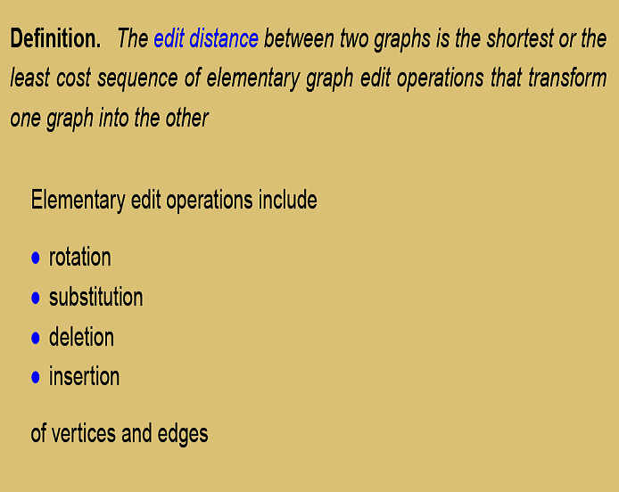
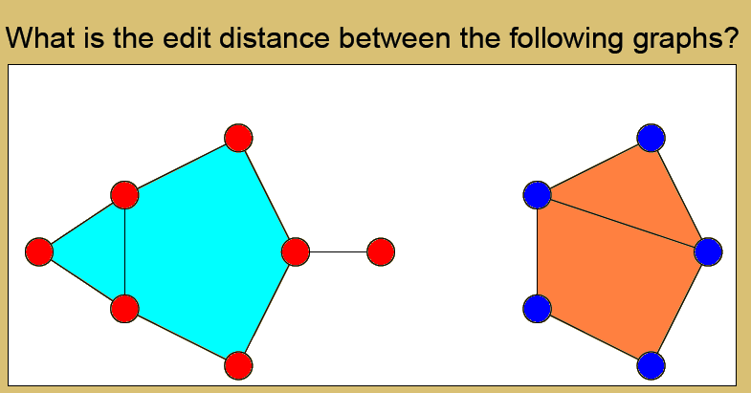
elementary edit operations

Slide 13
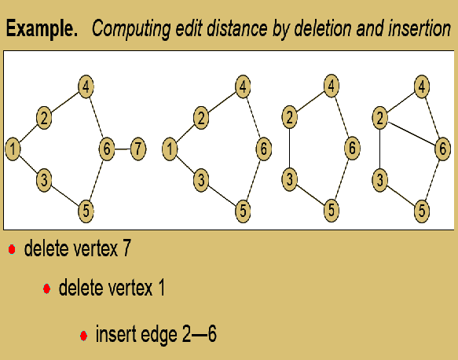
example

Slide 14
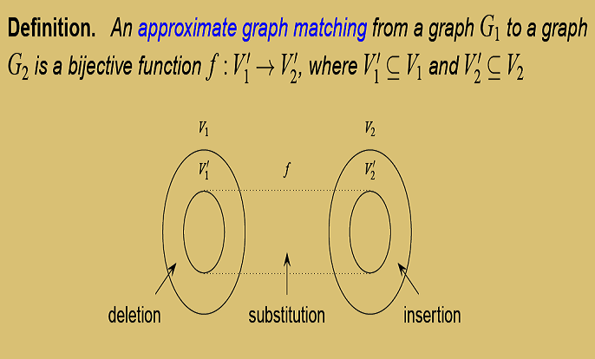
graph matching definition

Slide 15
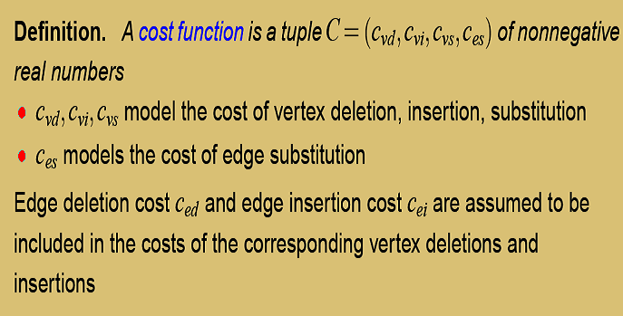
cost function

Slide 16
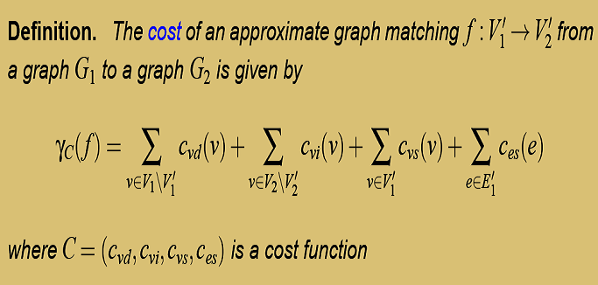
cost function cont.

Slide 17
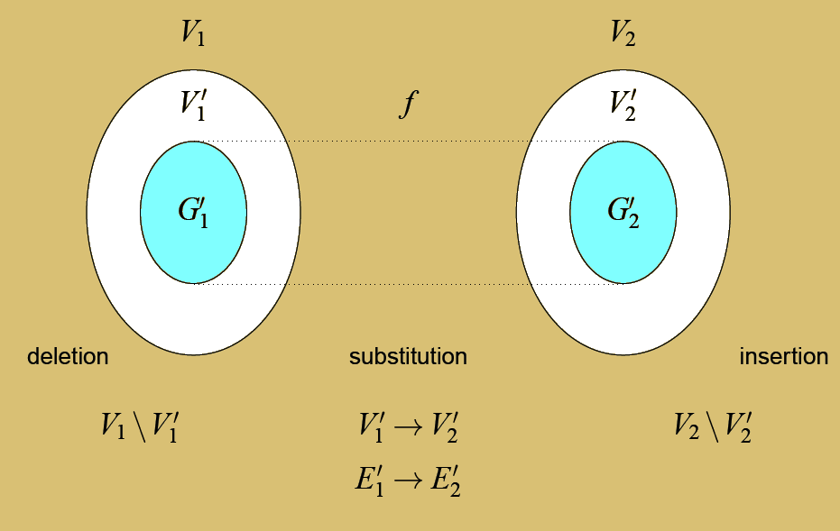
graph matching definition revisited

Slide 18
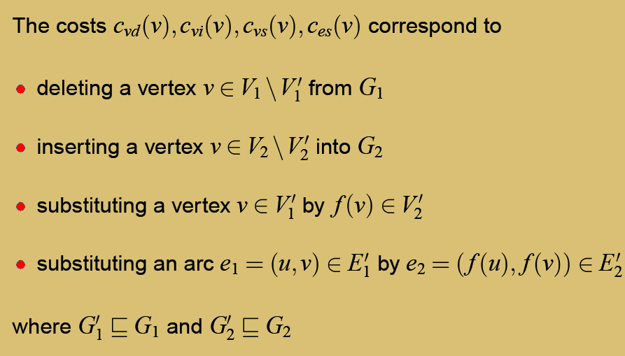
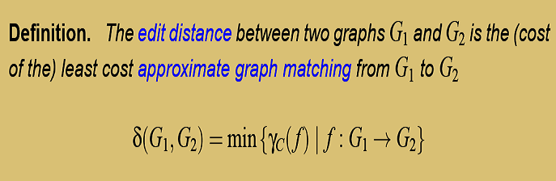
costs description and distance definition

Slide 19
networks and link analysis
examples of NETWORKS:
  Internet
  neural network
  social network (e.g. friends, criminals, scientists)
  computer network
all elements of the “graph theory” outlined can be now applied to intuitively clear term of networks
mining such structures (graphs, networks) are recently called LINK ANALYSIS

Slide 20
networks - overview
first spectacular appearance of SW networks due to Milgram’s experiment: “six degrees of separation”
Erdos, Renyi lattice model: Erdos number
  starting with not connected n vertices
  equal probability p of making independently any connection between each pair of vertices
  p determines if the connectivity is dense or sparse
  for n → ∞ (large) and p ~ 1/N: each vertex expected to have a “small” number of neighbors
  shortage: little clustering (independent edging)
  hence: limited use as a social networks model

Slide 21
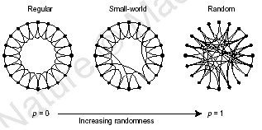
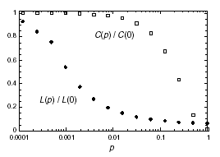
networks - overview
Watts, Strogatz: concept of a network somewhere between regular and random
n vertices, k edges per node; some edges cut
rewiring probability (proportion) p
p is uniform: not very realistic!
average path length L(p):
  measure of separation (globally)
clustering coefficient C(p):
  measure of cliquishness (locally)
many vertices, sparse connections

Slide 22
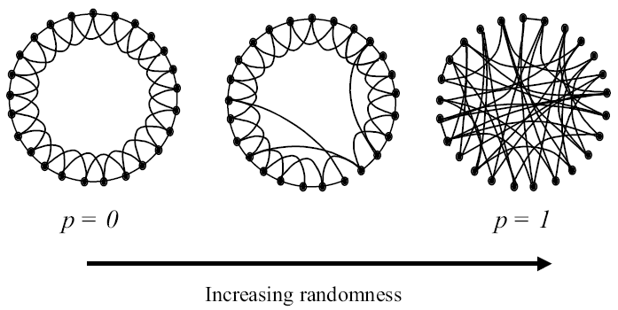
rewiring networks: from order to randomness
REGULAR SMALL WORLD RANDOM

Slide 23
small world characteristics
Average Path Length (L): the average distance between any two entities, i.e. the average length of the shortest path connecting each pair of entities (edges are unweighted and undirected)
Clustering Coefficient (C): a measure of how clustered, or locally structured, a graph is; put another way, C is an average of how interconnected each entity's neighbors are

Slide 24
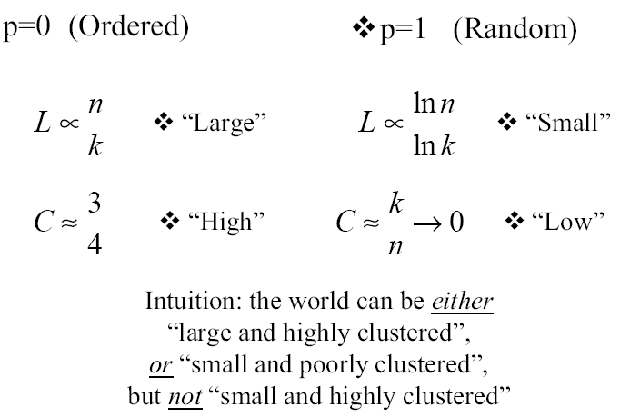
rewiring networks cont.

Slide 25
network characteristics: they influence
clustering coefficient
path length
ring graph
(lattice)
Small World
random network

Slide 26
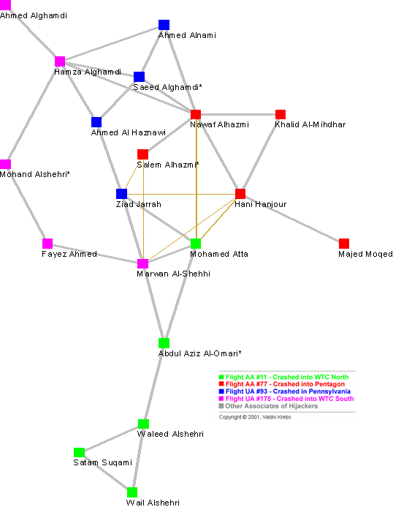
case study: 9/11
 | C | L
contacts | 0.41 | 4.75
contacts & shortcuts | 0.42 | 2.79
comments about shortcuts:
they reduced L, and made a clique
(clusters) of some members
question: how such a structure
contributes to the network’s
resilience?

Slide 27
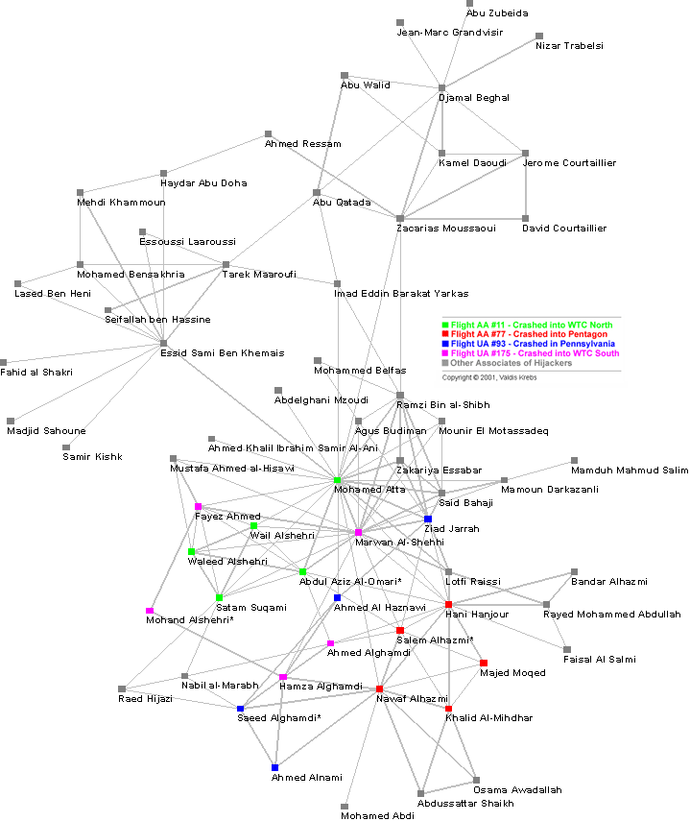
other associates included

Slide 28
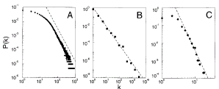
networks - overview
Barabasi, Albert: self-organization of complex networks and two principal assumptions:
  growth (neglected in the project)
  preferential attachment (followed in the project)
power low: P(k) ∼ k^{-γ} implies scale-free (SF) characteristics of real social networks like Internet, citations etc. (e.g. γ_{actor} ≅ 2.3)
linear behavior in
log-log plots

Slide 29
networks - overview
Kleinberg's model: variant of SW model (WS)
  regular lattice; build the connection in biased way (rather than uniformly or at random)
  connections closer together (Euclidean metric) are more likely to happen (p ∼ k^{-d}, d = 2, 3, ...)
  probability of having a connection between two sites decays with the square of their distance
this may explain Milgram’s experiment:
  in social SW networks (knowledge of geography exists) using only local information one can be very effective at finding short paths in social contacts network
  this does not account for long range connections, though

Slide 30
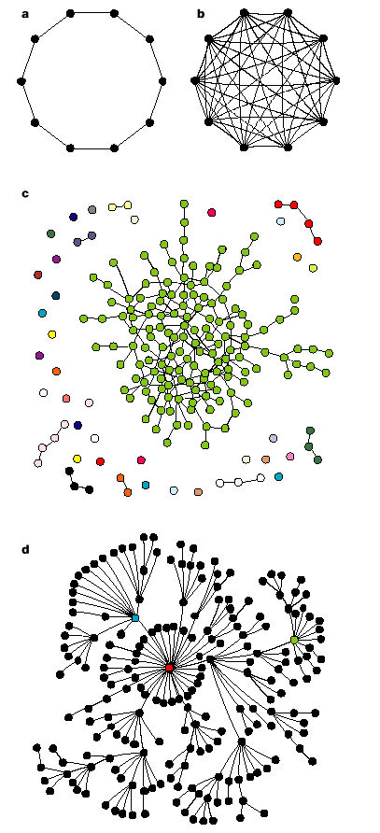
networks: four types altogether
ring (regular):
a lattice
fully connected
random network
power law (scale-free) network

Slide 31
frequent subgraph discovery
stems from searching for FREQUENT ITEMS
in ASSOCIATION RULES discovery
basic concepts:
  given set of transactions each consisting of a list of items (“market basket analysis”)
  objective: finding all rules correlating “purchased” items
    e.g. 80% of those who bought new ink printer simultaneously bought spare inks

Slide 32
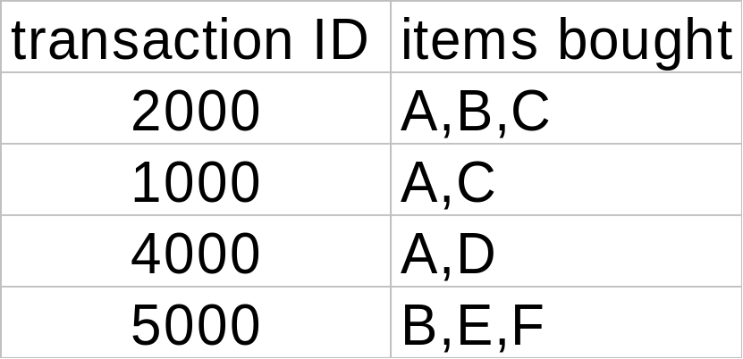
rule measure: support and confidence
buys both
buys diaper
find all the rules X ⇒ Y with minimum confidence and support
  support s: probability that a transaction contains {X & Y}
  confidence c: conditional probability that a transaction having {X} also contains Y
buys beer
let min. support 50%
and min. confidence 50%
  A ⇒ C (50%, 66.6%)
  C ⇒ A (50%, 100%)

Slide 33
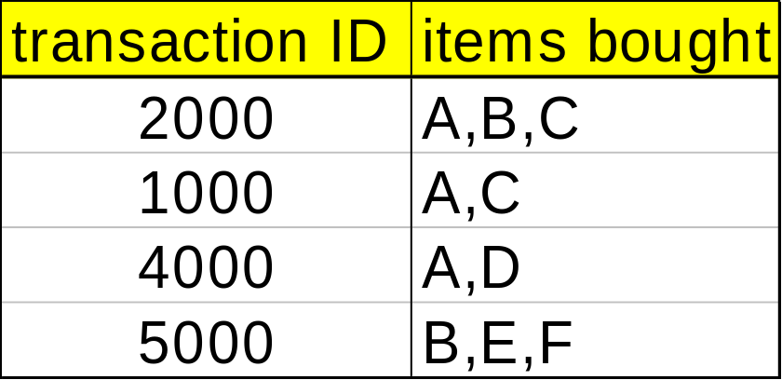
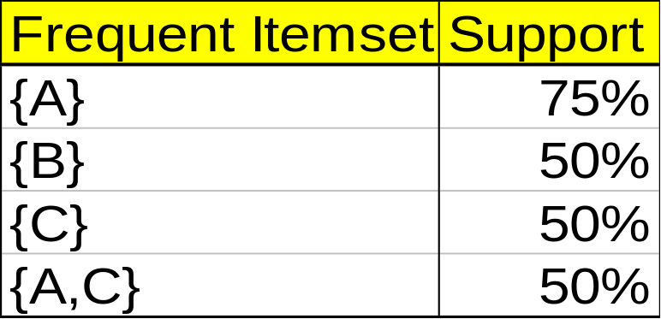
mining association rules - example
min. support 50%
min. confidence 50%
for rule A ⇒ C:
  support = support({A & C}) = 50%
  confidence = support({A & C})/support({A}) = 66.6%
the Apriori principle says that
  any subset of a frequent itemset must be frequent

Slide 34
mining frequent itemsets: the key step
find the frequent itemsets: the sets of items that have minimum support
  a subset of a frequent itemset must also be a frequent itemset
    i.e., if {AB} is a frequent itemset, both {A} and {B} should be a frequent itemset
  iteratively find frequent itemsets with cardinality from 1 to k (k-itemset)
use the frequent itemsets to generate association rules.

Slide 35
problem decomposition
two phases:
generate all itemsets whose support is above a threshold; call them large (or hot) itemsets. (any other itemset is small.)
how? generate all combinations? (exponential – HARD!)
for a given large itemset
Y = I₁ I₂ … I_{k} k >= 2
generate (at most k rules) X ⇒ I_{j} X = Y - {I_{j}}
confidence = c ≤ support(Y)/support (X)
so, have a threshold c and decide which ones you keep. (EASY...)

Slide 36
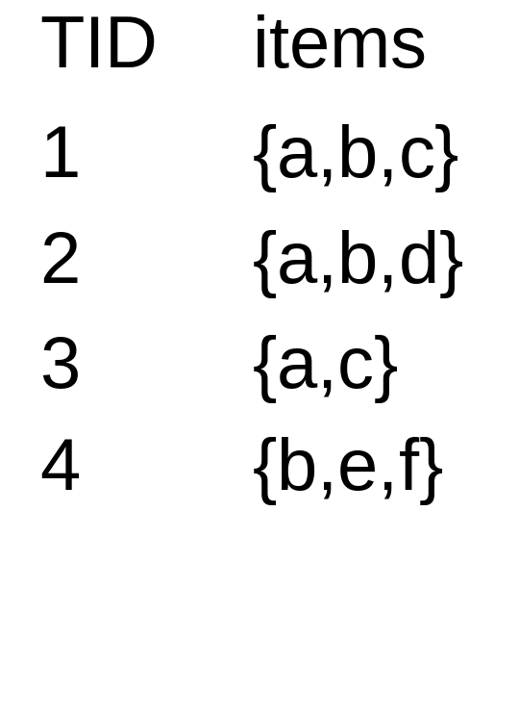
examples
assume s = 50 % and c = 80 %
minimum support: 50 % ⇒ itemsets {a,b} and {a,c}
rules: a ⇒ b with support 50 % and confidence 66.6 %
a ⇒ c with support 50 % and confidence 66.6 %
c ⇒ a with support 50% and confidence 100 %
b ⇒ a with support 50% and confidence 100%

Slide 37
Apriori algorithm
Join Step: C_{k} is generated by joining L_{k-1}with itself
Prune Step: Any (k-1)-itemset that is not frequent cannot be a subset of a frequent k-itemset
pseudo-code:
    C_{k}: Candidate itemset of size k
    L_{k} : frequent itemset of size k
    L₁ = {frequent items};
    for (k = 1; L_{k} !=∅; k++) do begin
    C_{k+1} = candidates generated from L_{k};
    for each transaction t in database do
      increment the count of all candidates in C_{k+1} that are contained in t
    L_{k+1} = candidates in C_{k+1} with min_support
    end
    return ∪_{k} L_{k};

Slide 38








Apriori algorithm: example
Database D
L₁
C₁
Scan D
C₂
C₂
L₂
Scan D
C₃
Scan D
L₃

Slide 39
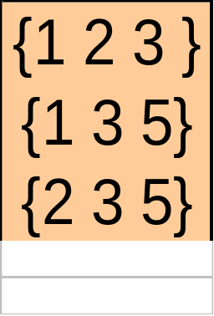
candidate generation: example
C2 L2
C₃
L2 ⊗L2
since {1,5} and {1,2} do not have enough support

Slide 40
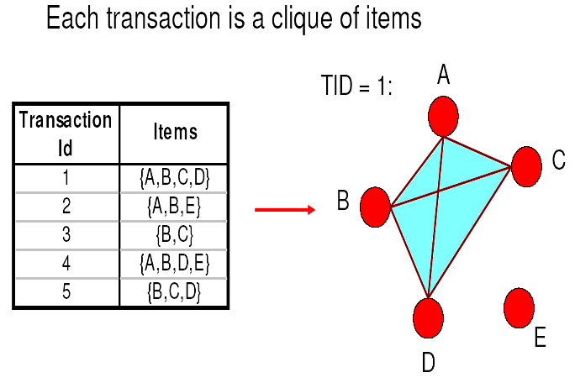
back to graphs: transactions

Slide 41
apriori-like algorithm for graphs
find frequent 1-subgraphs (subg.)
repeat
  candidate generation
    use frequent (k-1)-subg. to generate candidate k-sub.
  candidate pruning
    prune candidate subgraphs with infrequent (k-1)-subg.
  support counting
    count the support s for each remaining candidate
  eliminate infrequent candidate k-subg.

Slide 42
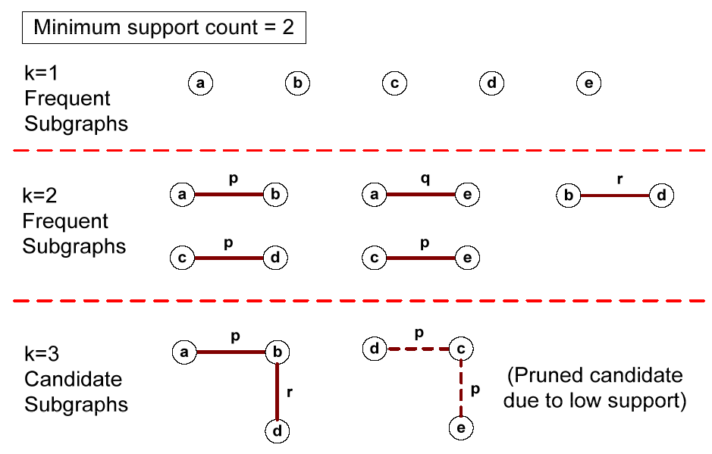
a simple example
remark: merging 2 frequent k-itemset produces 1 candidate (k+1)-itemset now
becomes merging two frequent k-subgraphs may result in more than 1 candidate
(k+1)-subgraph

Slide 43
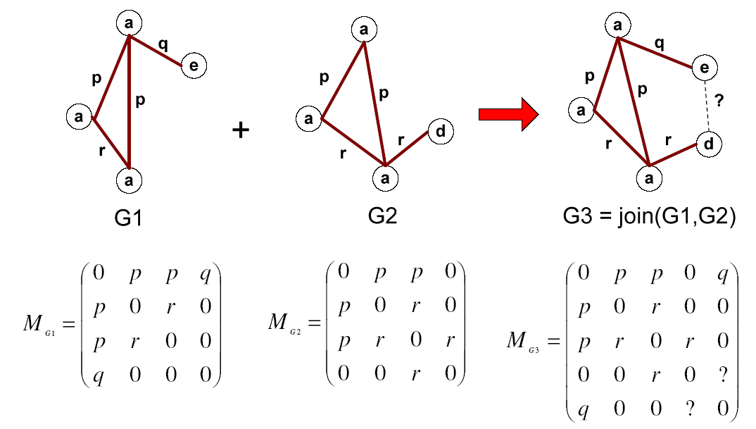
multiplicity of candidates

Slide 44
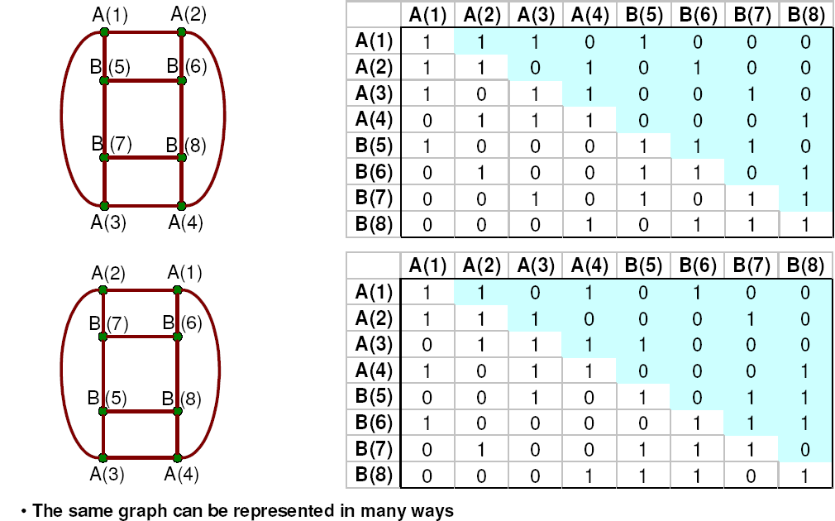
graph representation: adjacency matrix
REMARK: two graphs are isomorphic if they are topologically equivalent

Slide 45
going more formally:
Apriori algorithm and graph isomorphism
testing for graph isomorphism is needed for:
  candidate generation step to determine whether a candidate has been generated
  candidate pruning step to check if (k-1)-subgraphs are frequent
  candidate counting to check whether a candidate is contained within another graph

Slide 46
FSG algorithm: finding frequent subgraphs
proposed by Kuramochi and Karypis
key features:
  uses sparse graph representation (space, time): QUESTION: adjacency list or matrix?
  increases size of freq. subg. by adding 1 edge at a time: that allows for effective candidate generating
  uses canonical labeling, uses graph isomorphism
objectives:
  finding patterns in these graphs
  finding groups of similar graphs
  building predictive models for the graphs
applications in biology

Slide 47
FSG: big picture
problem setting: similar to finding frequent itemsets for association rule discovery
input: database of graph transactions
  undirected simple graph (no loops, no multiples edges)
  each graph transaction has labeled edges/vertices.
  transactions may not be connected
minimum support threshold: s
output
  frequent subgraphs that satisfy the support constraint
  each frequent subgraph is connected

Slide 48
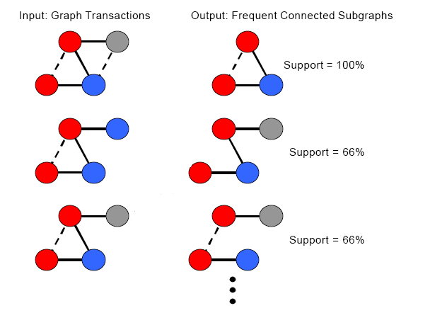
finding frequent subgraphs
remark: it’s not clear about how they computed s

Slide 49
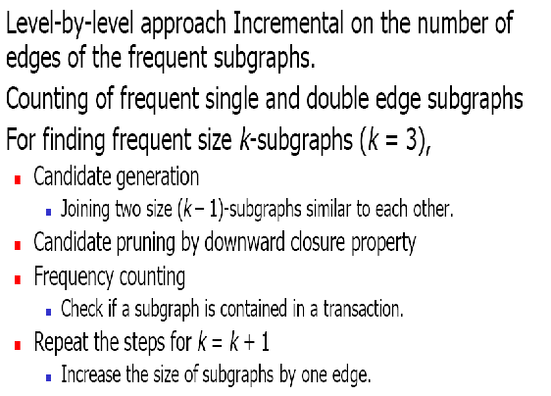
frequent subgraphs discovery: FSG

Slide 50
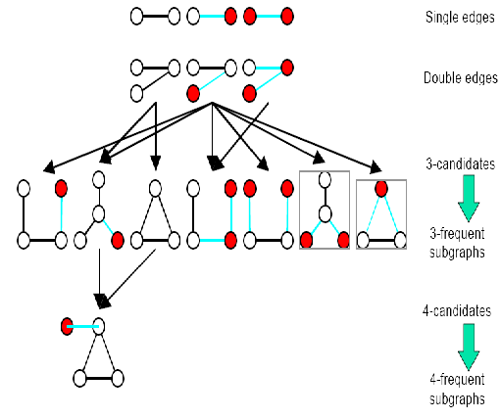
FSG: the algorithm
comment: in graphs some “trivial” operations become very complex/expensive!

Slide 51
trivial operations with graphs…
candidate generation:
  to determine two candidates for joining, we need to perform subgraph isomorphism for redundancy check
candidate pruning:
  to check downward closure property, we need subgraph isomorphism again
frequency counting
  subgraph isomorphism once again needed for checking containment of a frequent subgraphs
computational efficiency issue
  how to reduce the number of graph/subgraph isomorphism operations?

Slide 52
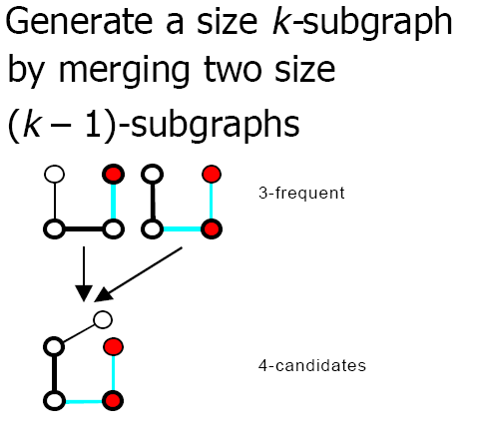
FSG approach to candidate generation

Slide 53
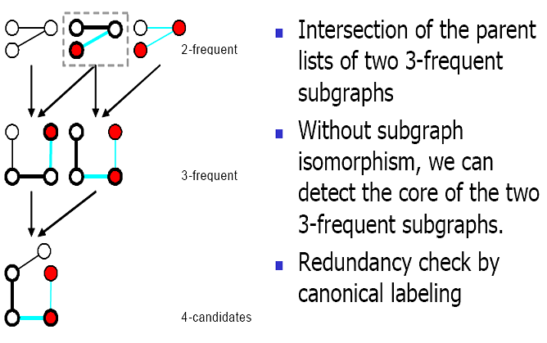
candidate generation cont.

Slide 54
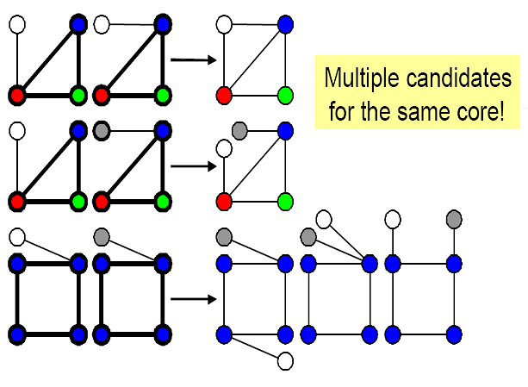
candidate generation: core detection

Slide 55
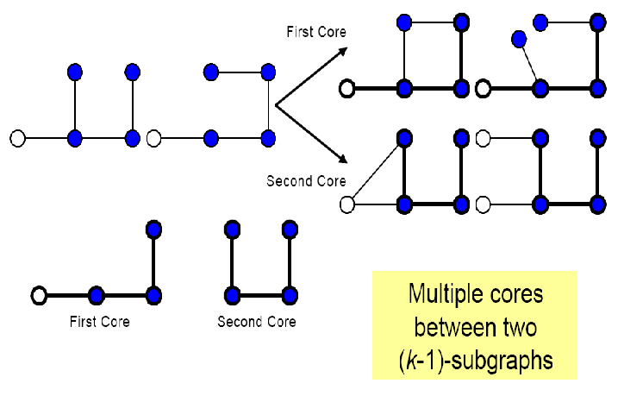
core detection cont.

Slide 56
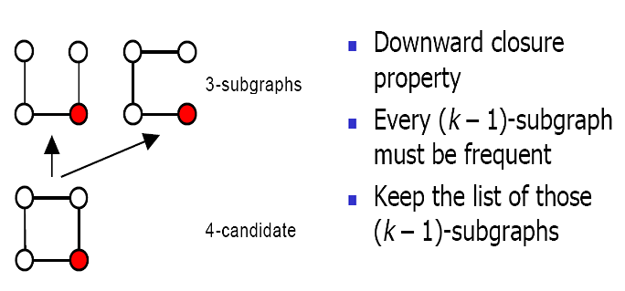
FSG approach to candidate pruning

Slide 57
candidate pruning algorithmically
pruning of size k-candidates
for all the (k – 1)-subgraphs of a size k- candidate,
check if downward closure property holds
(canonical labeling is used to speed up computation)
build the parent list of (k – 1)-frequent subgraphs
for the k-candidate
(used later in the candidate generation, if this candidate survives the frequency counting check)

Slide 58
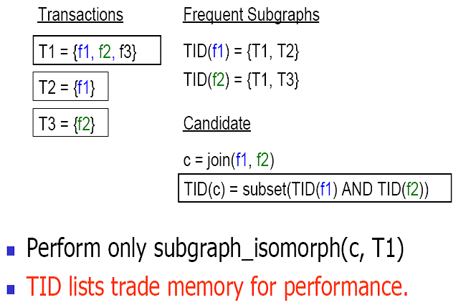
FSG approach to frequency counting

Slide 59
frequency counting algorithmically
frequency counting
keep track of the TID lists
if a size k-candidate is contained in a transaction, all the size (k – 1)-parents must be contained in the same transaction
perform subgraph isomorphism only on the intersection of the TID lists of the parent frequent subgraphs of size k – 1
remarks:
  significantly reduces the number of subgraph
  isomorphism checks; trade-off between running time and memory

Slide 60
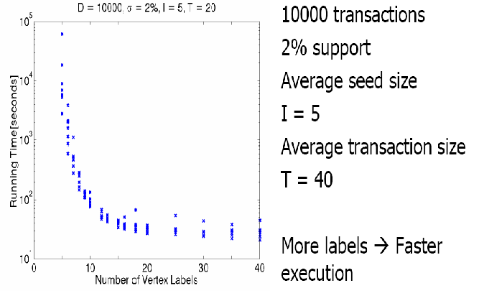
FSG: example of experimental results

Slide 61
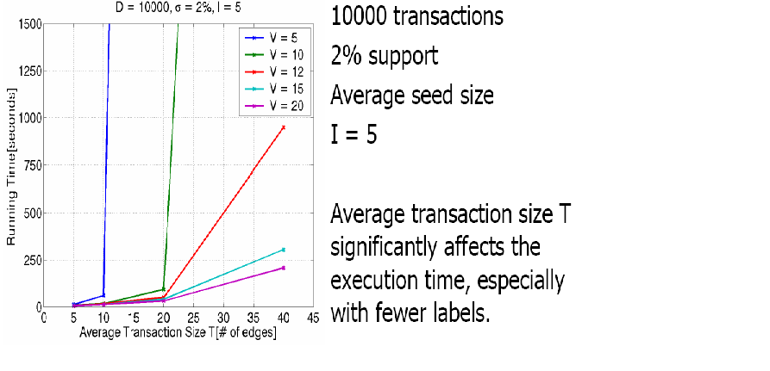
experimental results: scalability

Slide 62
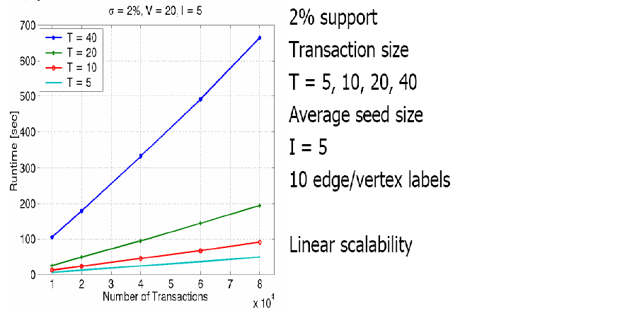
scalability cont.

Slide 63
back to SMALL WORLD and CLUSTERING
Yutaka Matsuo gives an example of approaching the small world model from clustering point of view
the algorithm is called Small World Clustering (SWC)

Slide 64
SWC: optimization problem
given:
  graph G = (V,E) where V, E are sets of vertices and edges, respectively
  k is a positive integer
Small World Clustering (SWC) is defined as finding a graph G` such that
k edges are removed from G so that
f = aL_{G`} + bC_{G`} is minimized
  where a, b are constants,
  and L_{G`}, C_{G} are L and C for G`
objective: detecting clusters based on SW structure

Slide 65
SWC: extended path concept
what we know already about SW networks:
  highly clustered (C >> C_{rand})
  with short path length (L ≥ L_{rand})
introducing extended path length between nodes i, j of graph G:
d(i, j) if (i, j) are connected
d`(i, j) =
n = |V| otherwise
problem to find optimal connection among all pairs of nodes: NP-complete (intractable!)

Slide 66
SWC: algorithm
to make it feasible, approximate algorithm for SWC is designed as follows:
  prune an edge which maximize f iteratively until k edges are pruned
  add an edge which maximize f
    if an edge to be added is the same as the most previously pruned one, terminate
  prune an edge which maximize f; go to 2

Slide 67
SWC: application example
word co-occurrence; works as follows:
  select up to n frequent words as nodes
  compute Jaccard J coefficient for each pair of words
  if J > J_{threshold} add an edge (i.e. a word)
next slides:
  a word co-occurrence graph with a single linkage clustering: C = 0.201, L = 12.1
  clusters obtained by SWC; C = 0.689, L = 18.3

Slide 68
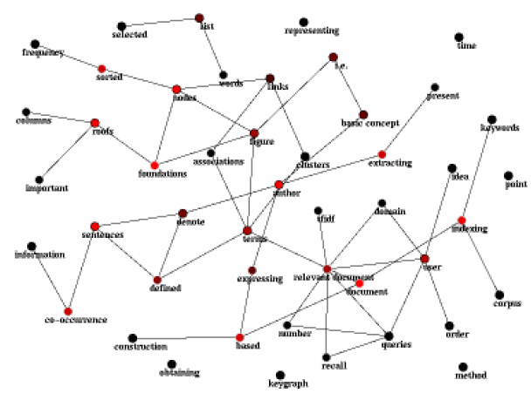

Slide 69
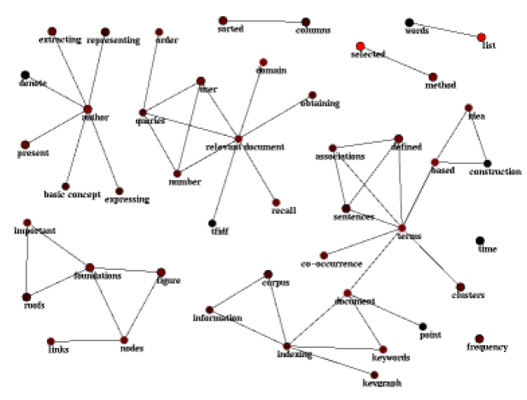

Slide 70
REFERENCES
Wu, A.Y. et al.: Mining Scale-free Networks using Geodesic Clustering
Kuramochi, M. et al.: Frequent Subgraph Discovery
presentations of Dr. D. Barbara (INFS 797, spring 2004 and INFS 755, fall 2002)
Wats, Duncan: "Collective dynamics of 'small world' networks“
Lise Getoor: "Link Mining: A New Data Mining Challenge"
"Clustering using Small World Structure“
Yutaka Matsuo: “Clustering Small World Structure”
Jennifer Jie Xy and Hsinchun Chen: "Using Shortest Path Algorithms to Identify Criminal Associations“
Valdis E. Krebs: "Mapping Networks of Terrorist Cells"
and more...

