Slide 1
Open-source chips, from RTL to GDSII: a hands-on workshop
PREPARED FOR OPEN SOURCE INDIA
150 minutes: watch one chip take shape, run the flow yourself, and learn what verification caught
Raja Gopal
github.com/rajaghv-dev/open-ai-silicon
Notes:
PLAN: block 0–10 min (Why open-source silicon); about 2 min on this slide.
Source: git config user.name = Raja Gopal; repository URL from README.md. Prepared for Open Source India; not issued by the conference. Say plainly: the repository is private at the moment of writing (see the status slide in block G).

Slide 2
Today in 150 minutes: eight blocks
0–10
Why open-source silicon
10–40
The open-source EDA flow
40–60
Lab block 1
LAB
60–85
Tour of the designs
85–105
Lab block 2
LAB
105–125
What verification caught
125–140
Road to silicon
140–150
Recap and questions
Notes:
PLAN: block 0–10 min (Why open-source silicon); about 2.5 min on this slide.
Agenda. Block ranges are the owner's plan for the 150-minute session. docs/LABS.md has its own facilitator outline (labs of 15 minutes each, a break at 70-80); this deck follows the owner's block plan instead, so use LABS.md only for the lab worksheets.

Slide 3
Open silicon lets anyone follow a chip from text to layout
1
2
3
Open tools
An open PDK
Open designs
Yosys, OpenROAD, Magic, KLayout, Netgen
SkyWater sky130, 130 nm
12 examples, simplest first
Simulated and hardened in a container. Not fabricated.
Notes:
PLAN: block 0–10 min (Why open-source silicon); about 2 min on this slide.
Sources: README.md and CLAUDE.md (RTL to GDSII on SkyWater sky130A with LibreLane 3.0.2 and OpenROAD); docs/SPEC.md section 1 (goal: examples small enough for free compute). Talking points: the tools, the process data (PDK) and the designs are all public, so every step can be repeated and inspected.

Slide 4
You will leave having run the flow yourself
Watch one chip take shape
1
Run six flow stages yourself
2
Learn what verification caught
3
Notes:
PLAN: block 0–10 min (Why open-source silicon); about 2 min on this slide.
Sources: docs/LABS.md (six labs, one flow stage each, 3 to 65 seconds each, measured on uart under 2 CPUs / 8 GB) and docs/SPEC.md 5.8. Outcomes are the owner's block plan: see the flow, run it, tour the designs, learn what verification caught.

Slide 5
Every design is sized for a free-tier machine
2
8 GB
1.62 GB
8.0 min
CPUs
memory cap
largest peak
slowest build
Colab
Codespaces
GitHub Actions
A 2-CPU, 8 GB container stands in for the free tiers.
Measured on an Apple-silicon VM; cloud machines will be slower.
Notes:
PLAN: block 0–10 min (Why open-source silicon); about 2 min on this slide.
Sources: docs/SPEC.md 5.4 (tight profile = 2 CPUs, 8 GB) and 5.1 (tiers); output/<design>/resources.json container_peak_mem_gb and wall_s_total for the 11 designs rebuilt under the tight profile; output/baseline_tight.md (Apple-silicon Colima VM, container capped to 2 CPUs / 8 GB; wall times are a lower bound for cloud x86). Colab, Codespaces: not verified.

Slide 6
The open-source EDA flow
Watch one chip, cnn_lite, take shape: tools, steps, and the open PDK
Minutes 10–40 of 150
Notes:
PLAN: block 10–40 min (The open-source EDA flow); about 0.5 min on this slide.
Block B: 30 minutes. Stage images, tools and step times are from build/results/_flow_stages/cnn_lite (stages.json, tools.json); the design is cnn_lite because it fills its die.

Slide 7
The whole flow, from RTL to GDSII
RTL
netlist
floor-
plan
placed
clock
tree
routed
checked
GDSII
Every step is open source.
LibreLane runs it. The sky130 open PDK makes it possible.
Notes:
PLAN: block 10–40 min (The open-source EDA flow); about 2 min on this slide.
Sources: README.md and CLAUDE.md (flow = LibreLane 3.0.2 + OpenROAD); build/results/_flow_stages/cnn_lite/tools.json (76 steps). No detail on this slide on purpose; each stage has its own slide next.

Slide 8
First, check that the RTL does what we mean
IN
Verilog RTL and a testbench.
OUT
A pass or fail verdict.
RTL
(Verilog)
testbench
PASS /
FAIL
TOOL
Verilator lints, Icarus Verilog simulates.
TIME
Lint: 0.8 s
Notes:
PLAN: block 10–40 min (The open-source EDA flow); about 2 min on this slide.
Sources: build/results/_flow_stages/cnn_lite/stages.json (tool, step_wall_s, description per image) and tools.json (phase times; total 411.2 s over 77 steps, 2 CPUs / 8 GB, Apple-silicon VM); docs/SPEC.md section 4. Lint is step 01 (Verilator) of the flow; simulation is run separately with iverilog (make simulate-*).

Slide 9
Synthesis turns RTL into library cells
IN
RTL and the cell library.
assign y = a & b;
OUT
A netlist of sky130 standard cells.
sky130_fd_sc_hd__and2_1
(a standard cell)
TOOL
Yosys, with ABC.
TIME
Synthesis step: 6.7 s
Notes:
PLAN: block 10–40 min (The open-source EDA flow); about 2 min on this slide.
Sources: build/results/_flow_stages/cnn_lite/stages.json (tool, step_wall_s, description per image) and tools.json (phase times; total 411.2 s over 77 steps, 2 CPUs / 8 GB, Apple-silicon VM); docs/SPEC.md section 4. Steps 05-09 (yosys). sky130_fd_sc_hd__and2_1 is a cell of the sky130_fd_sc_hd standard-cell library. Lab 1 runs this stage on uart: 674 cells.

Slide 10

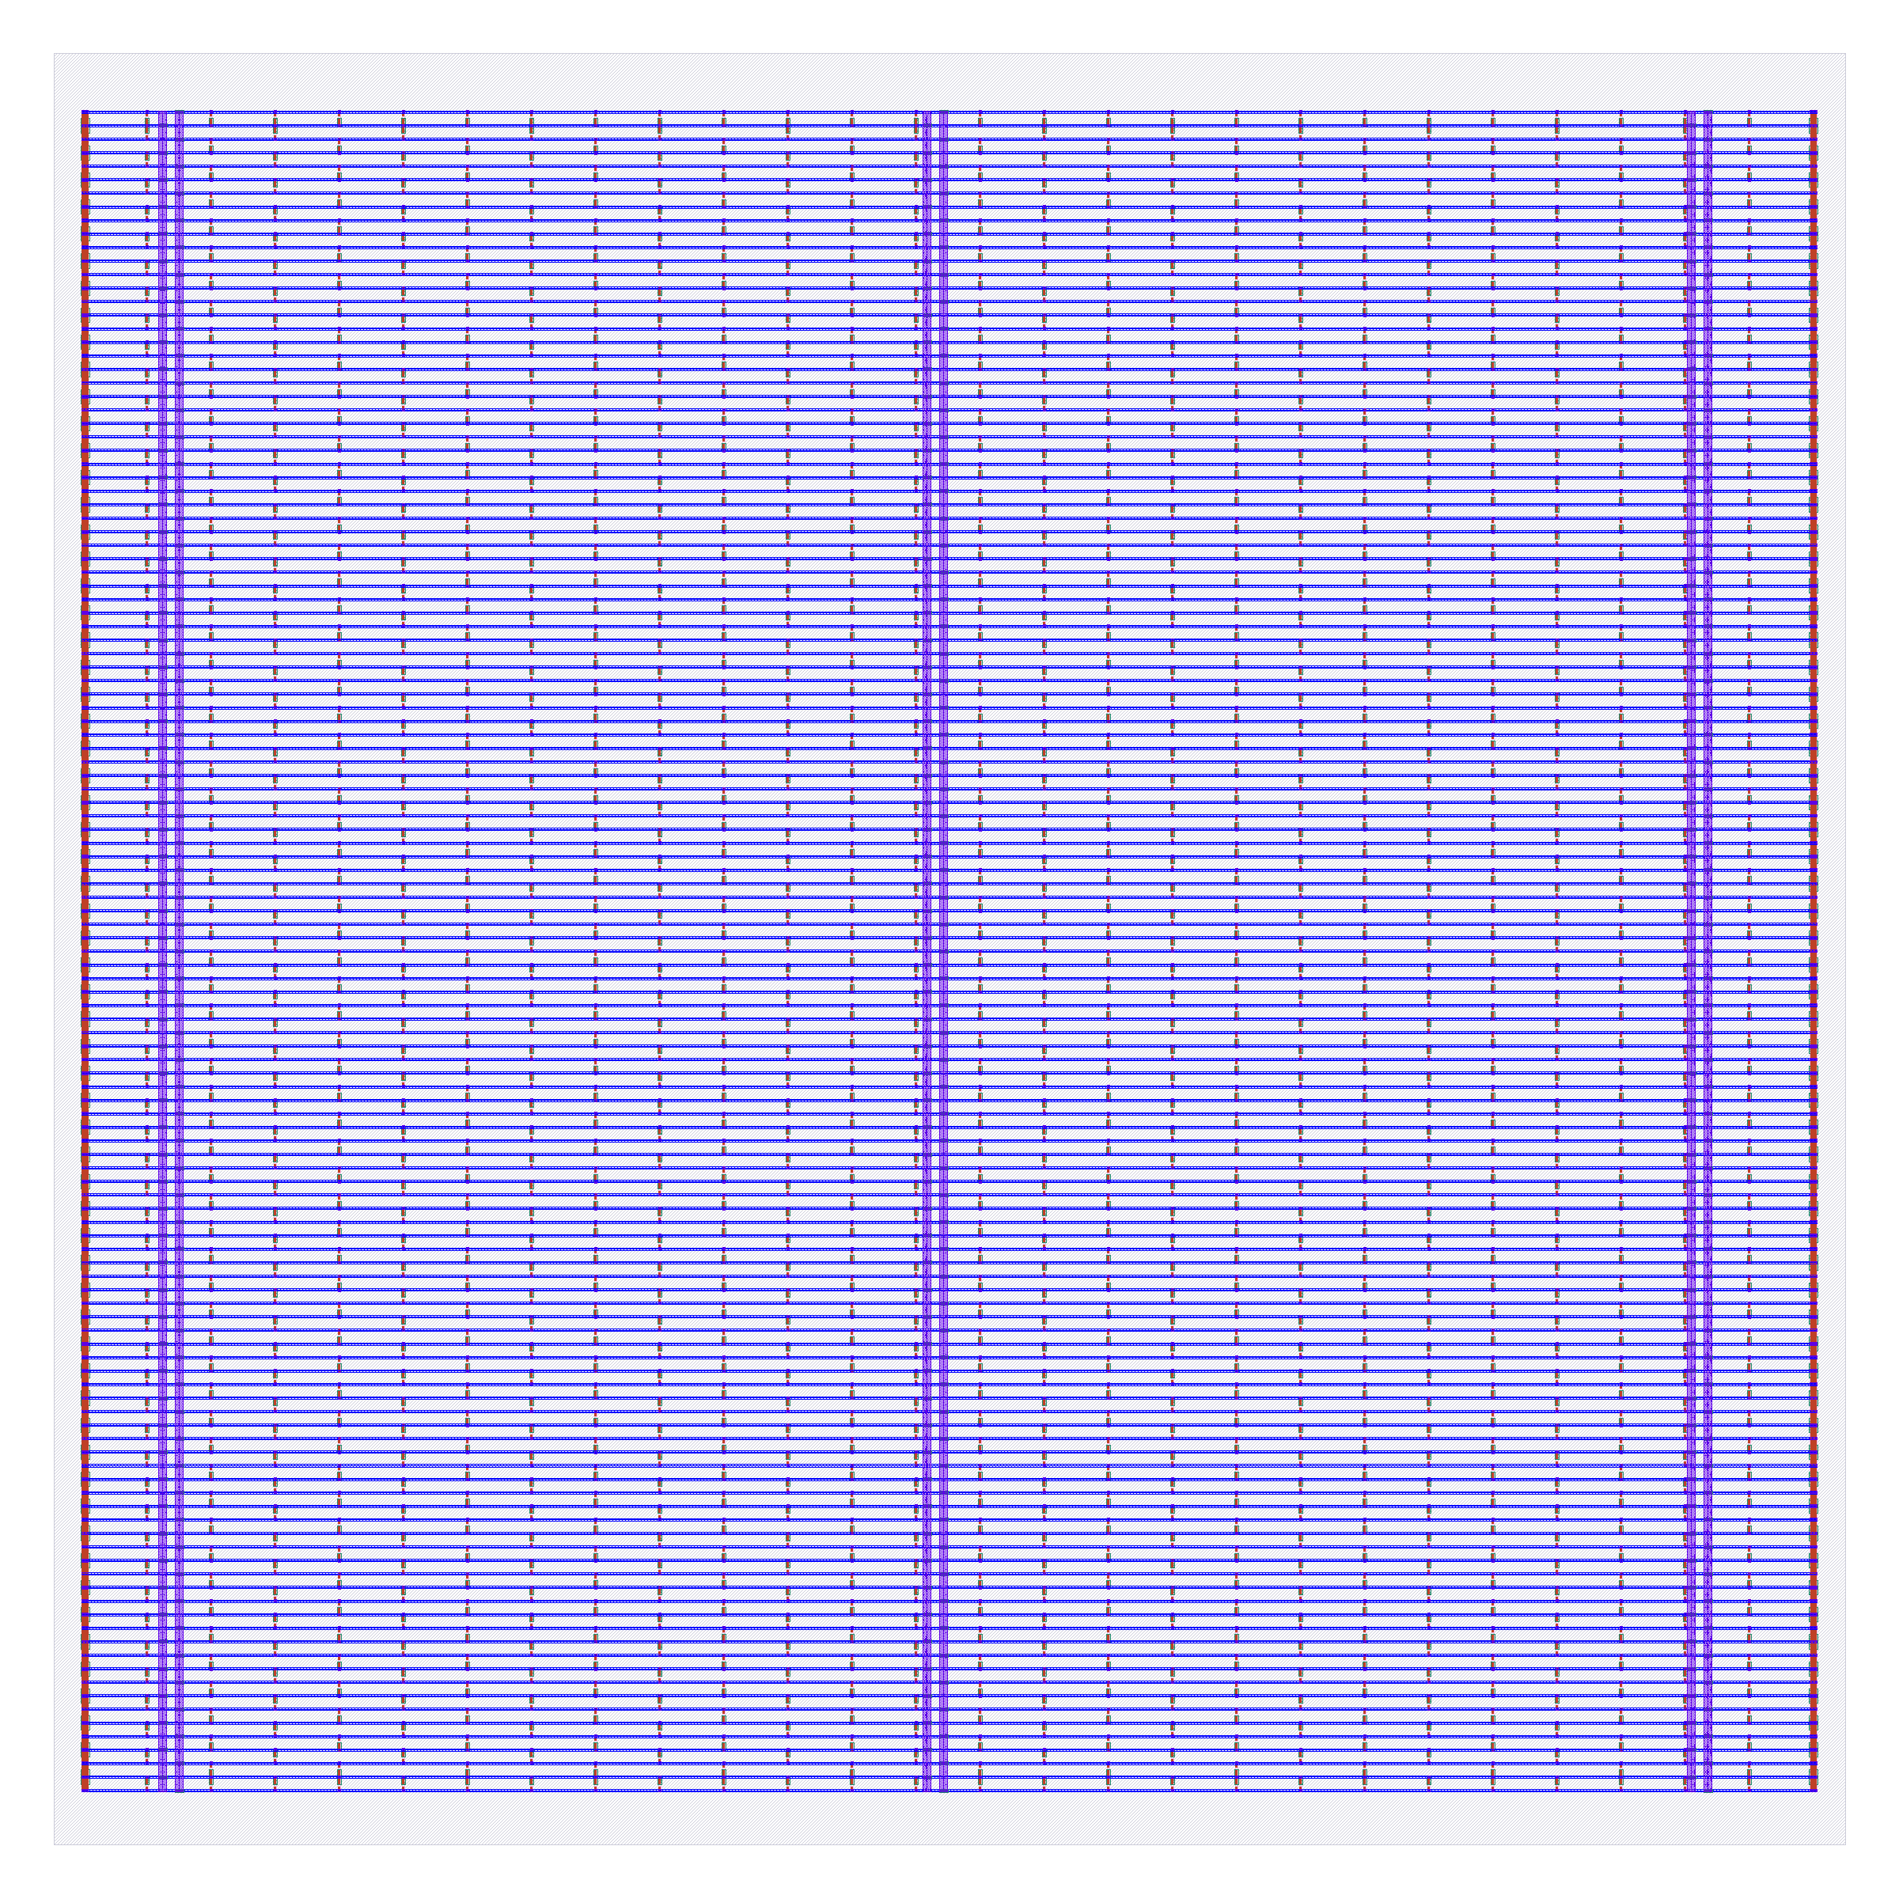
Floorplanning draws the die and its power grid
IN
The netlist.
OUT
A die, rows for cells, pins, a power grid.
TOOL
OpenROAD.
TIME
Floorplan 0.6 s, power 0.6 s
Left: rows and pins. Right: power grid. Cell outlines (LEF), not full mask geometry.
Notes:
PLAN: block 10–40 min (The open-source EDA flow); about 2 min on this slide.
Sources: build/results/_flow_stages/cnn_lite/stages.json (tool, step_wall_s, description per image) and tools.json (phase times; total 411.2 s over 77 steps, 2 CPUs / 8 GB, Apple-silicon VM); docs/SPEC.md section 4. Image 01_floorplan.png: Die and core are defined; the placement rows (grey) are drawn from the DEF ROW lines and the IO pins (orange) from the first DEF that has them. Cells and power grid do not exist yet. Step directory: 13-openroad-floorplan (+ pins from 26-odb-customioplacement). Image 02_pdn.png: Tap cells are inserted and the power grid (met1 rails, met4/met5 stripes) is added. Step directory: 21-openroad-generatepdn.

Slide 11
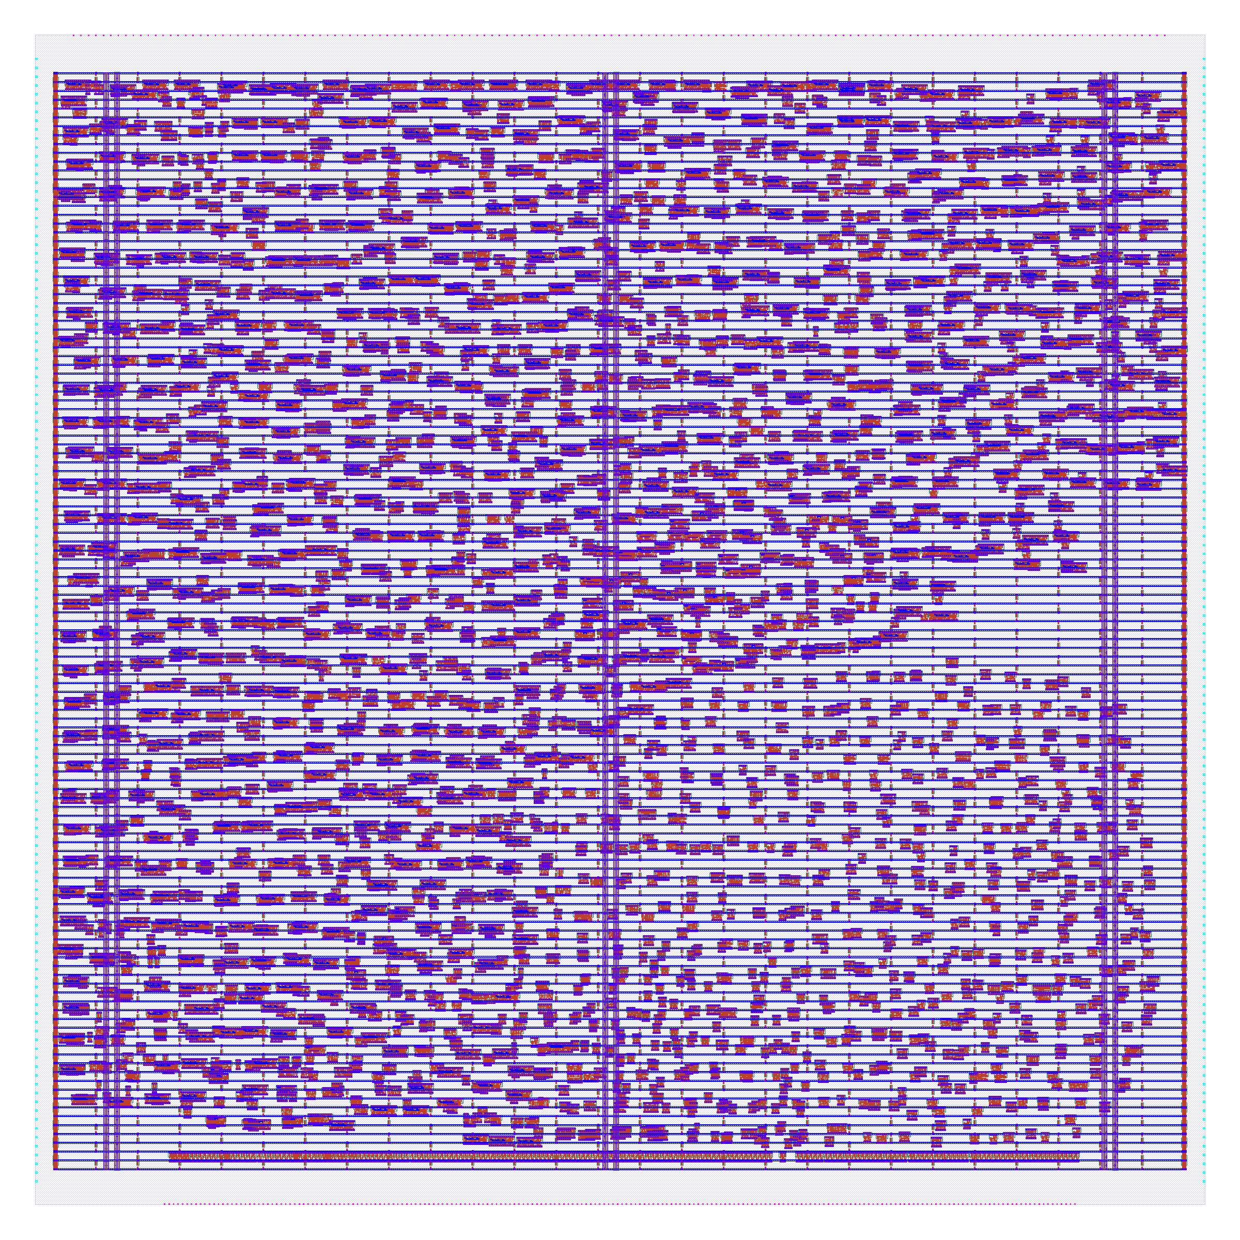
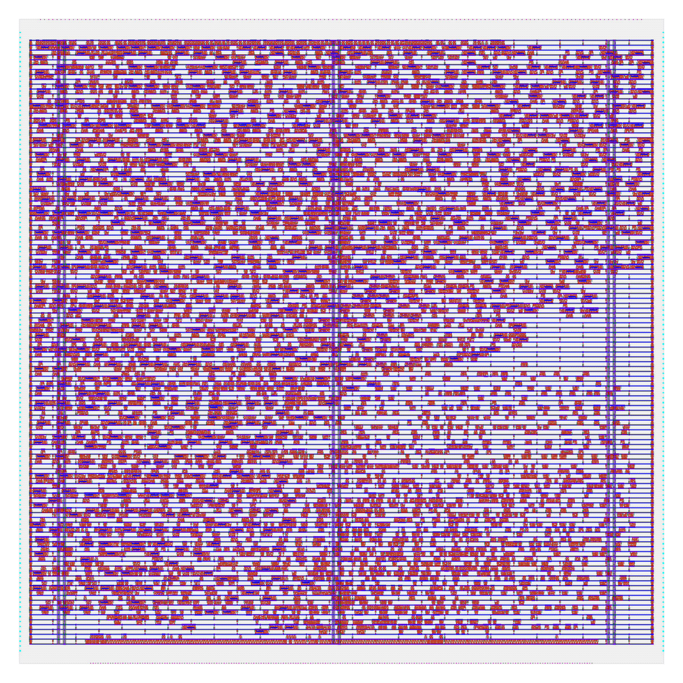
Placement gives every cell a position
IN
The floorplanned netlist.
OUT
Every cell on a legal site.
TOOL
OpenROAD: global, then detailed.
TIME
Global 2.0 s, detailed 0.8 s
Left: rough. Right: legal. Cell outlines (LEF), not full mask geometry.
Notes:
PLAN: block 10–40 min (The open-source EDA flow); about 2 min on this slide.
Sources: build/results/_flow_stages/cnn_lite/stages.json (tool, step_wall_s, description per image) and tools.json (phase times; total 411.2 s over 77 steps, 2 CPUs / 8 GB, Apple-silicon VM); docs/SPEC.md section 4. Image 03a_global_placement.png: Cells get rough positions; they overlap and are not yet on legal sites. Step directory: 28-openroad-globalplacement. Image 03_placement.png: Cells are snapped onto legal sites with no overlaps; still no signal wires. Step directory: 34-openroad-detailedplacement.

Slide 12
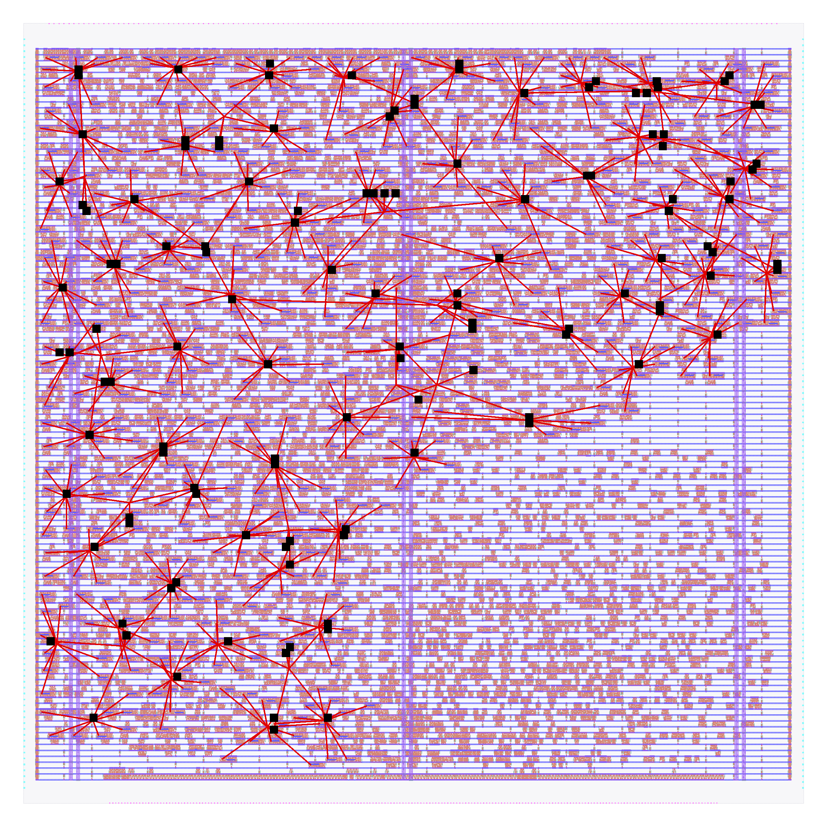
The clock tree reaches every flip-flop
IN
The placed design.
OUT
A buffered clock network.
TOOL
OpenROAD (TritonCTS).
TIME
7.0 s
Clock nets are straight lines between pins, not routed wires; layout dimmed.
Notes:
PLAN: block 10–40 min (The open-source EDA flow); about 2 min on this slide.
Sources: build/results/_flow_stages/cnn_lite/stages.json (tool, step_wall_s, description per image) and tools.json (phase times; total 411.2 s over 77 steps, 2 CPUs / 8 GB, Apple-silicon VM); docs/SPEC.md section 4. Image 04_cts.png: Same placement, dimmed; the 127 clock buffers/loads inserted by CTS are black squares and the 84 clock nets (connectivity drawn as straight red lines from DEF, not real routing) show the tree. Step directory: 35-openroad-cts.

Slide 13
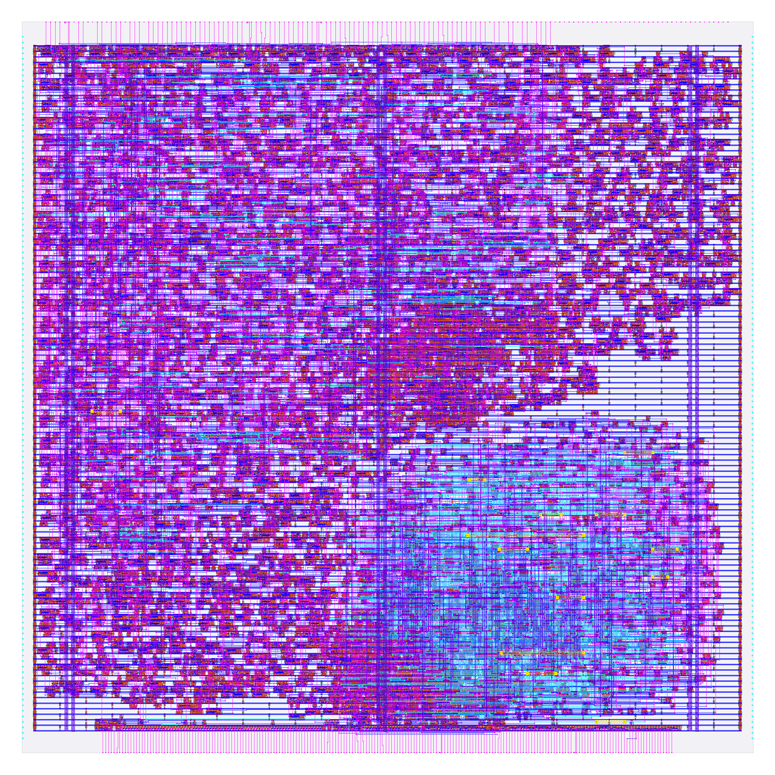
Routing draws the wires, and takes the longest
IN
Placed cells and the clock tree.
OUT
Every connection on metal layers.
TOOL
OpenROAD: global, then detailed.
TIME
250 s for detailed routing
Real routed wires; the cells are drawn as outlines (LEF).
Notes:
PLAN: block 10–40 min (The open-source EDA flow); about 2 min on this slide.
Sources: build/results/_flow_stages/cnn_lite/stages.json (tool, step_wall_s, description per image) and tools.json (phase times; total 411.2 s over 77 steps, 2 CPUs / 8 GB, Apple-silicon VM); docs/SPEC.md section 4. Image 05_routing.png: All signal wires are routed on met1-met5 and the pins are connected. Step directory: 45-openroad-detailedrouting.

Slide 14
Timing is checked at every corner
IN
The routed design.
slow corner
+11.62 ns
100 °C, 1.60 V
OUT
Setup and hold slack per corner.
typical
+16.41 ns
25 °C, 1.80 V
TOOL
OpenSTA, inside OpenROAD.
fast corner
+17.70 ns
OpenROAD in signoff: 13.6 s
−40 °C, 1.95 V
TIME
Notes:
PLAN: block 10–40 min (The open-source EDA flow); about 2 min on this slide.
Sources: build/results/_flow_stages/cnn_lite/stages.json (tool, step_wall_s, description per image) and tools.json (phase times; total 411.2 s over 77 steps, 2 CPUs / 8 GB, Apple-silicon VM); docs/SPEC.md section 4. Values: output/cnn_lite/metrics.json, worst of min/nom/max extraction for each process corner (timing__setup__ws__corner:*_ss_100C_1v60, *_tt_025C_1v80, *_ff_n40C_1v95).

Slide 15
Verification asks: is the layout legal and correct?
IN
The finished layout.
Magic DRC
design rules
KLayout DRC
design rules
OUT
Reports with zero errors.
Netgen LVS
layout = netlist
TOOL
Magic and KLayout (DRC), Netgen (LVS).
KLayout XOR
two outputs agree
TIME
Magic 47.4 s, KLayout 30.8 s, Netgen 1.4 s
Notes:
PLAN: block 10–40 min (The open-source EDA flow); about 2 min on this slide.
Sources: build/results/_flow_stages/cnn_lite/stages.json (tool, step_wall_s, description per image) and tools.json (phase times; total 411.2 s over 77 steps, 2 CPUs / 8 GB, Apple-silicon VM); docs/SPEC.md section 4. Times are the signoff phase per tool from tools.json (they include stream-out and XOR). Antenna checks run in OpenROAD.

Slide 16
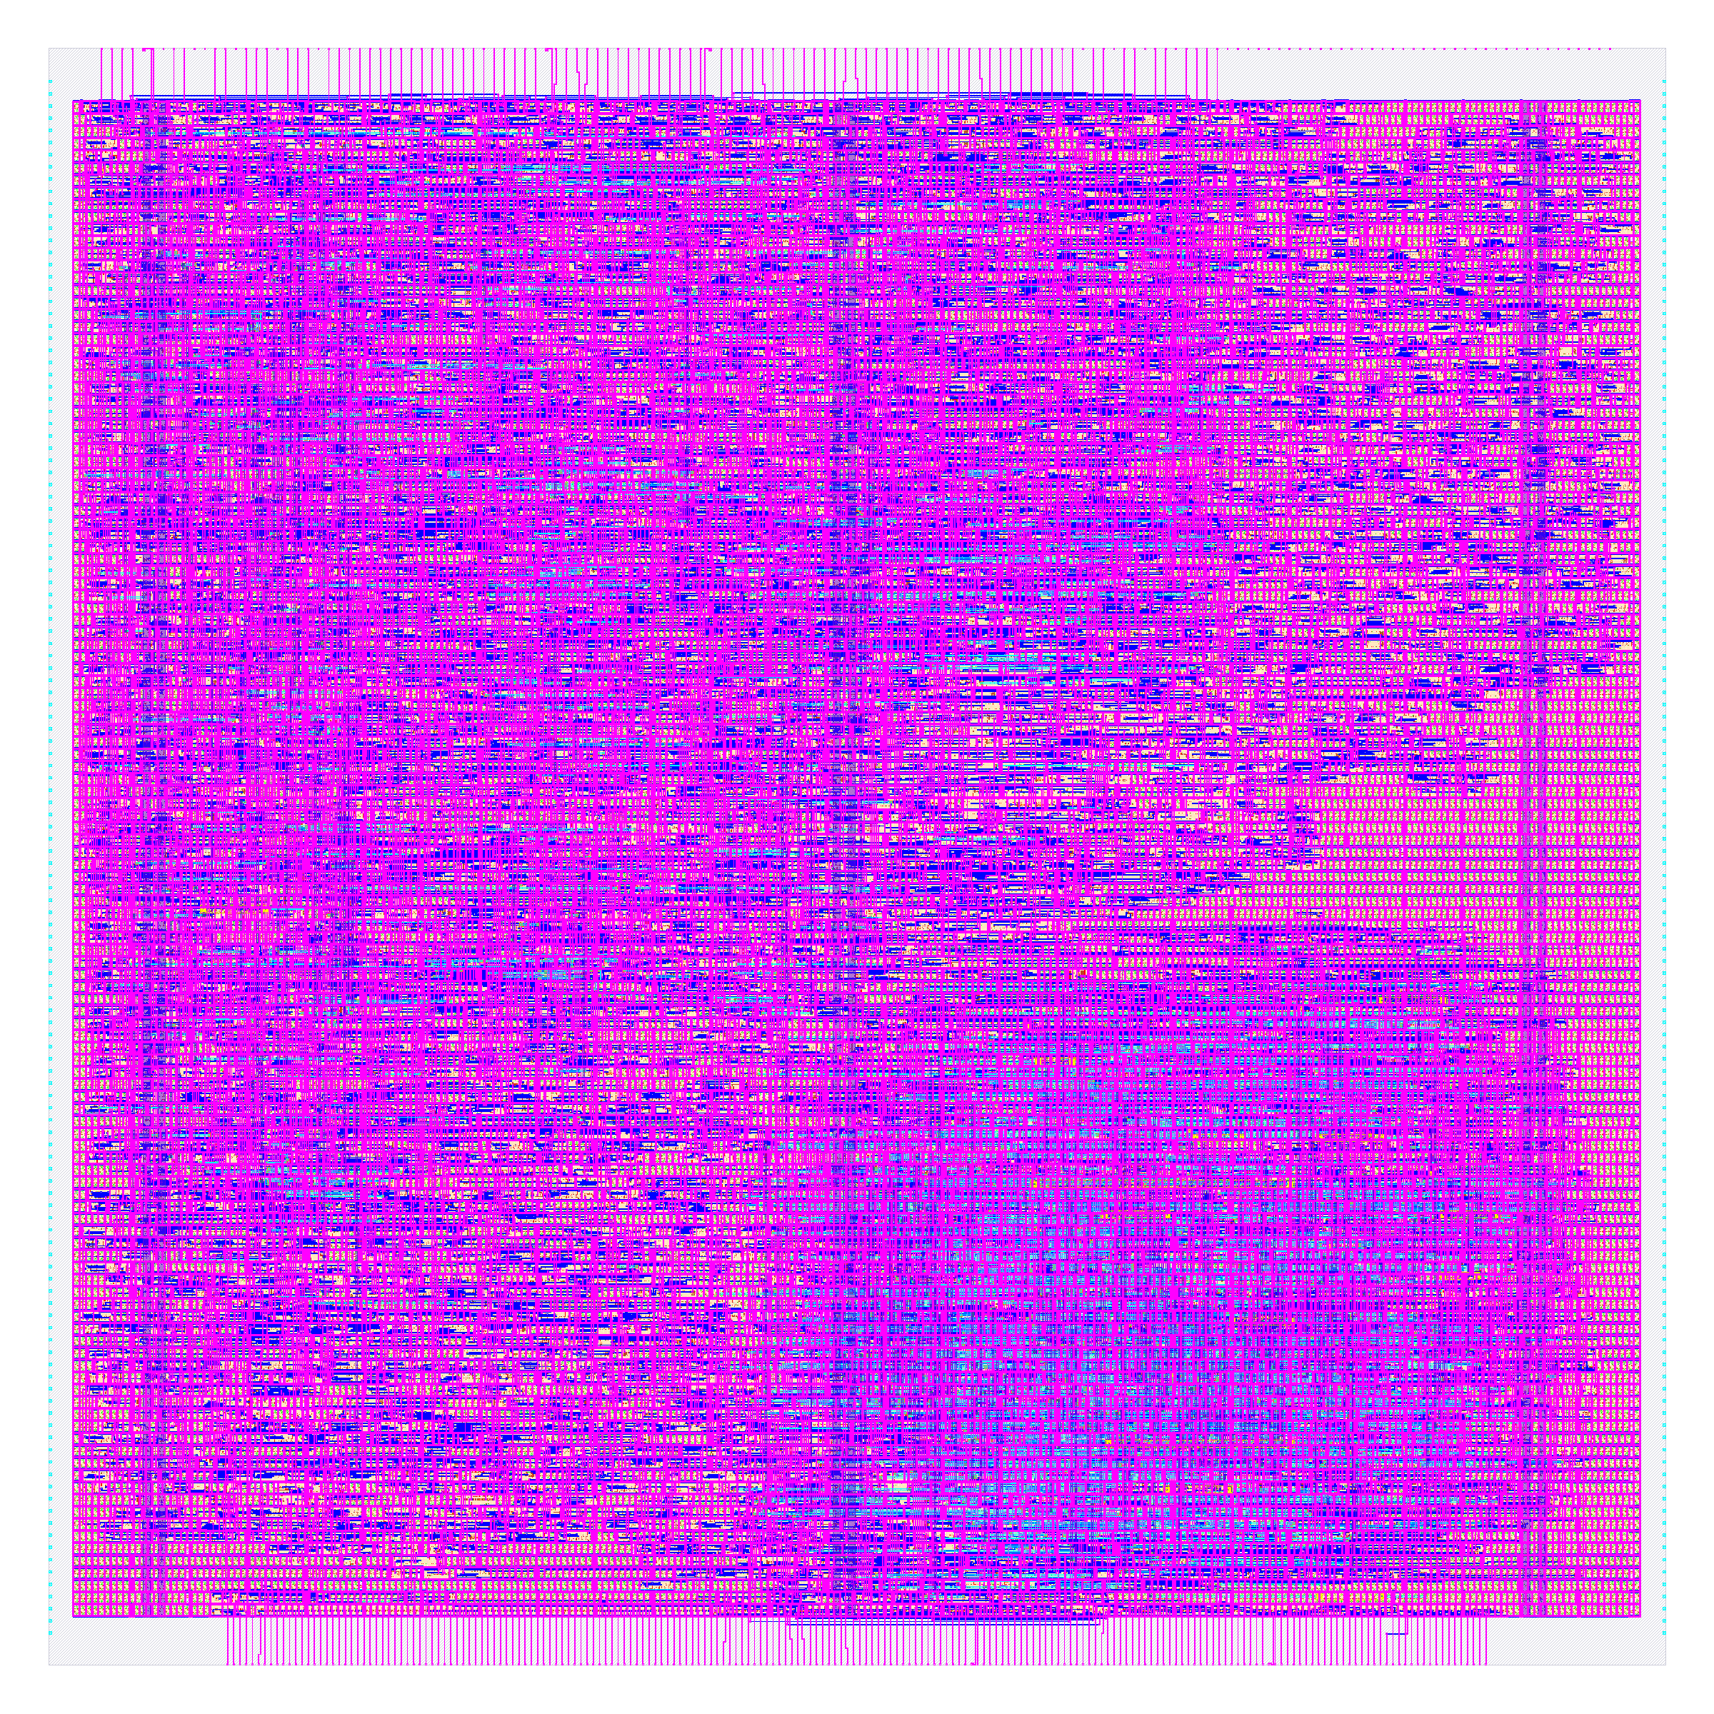
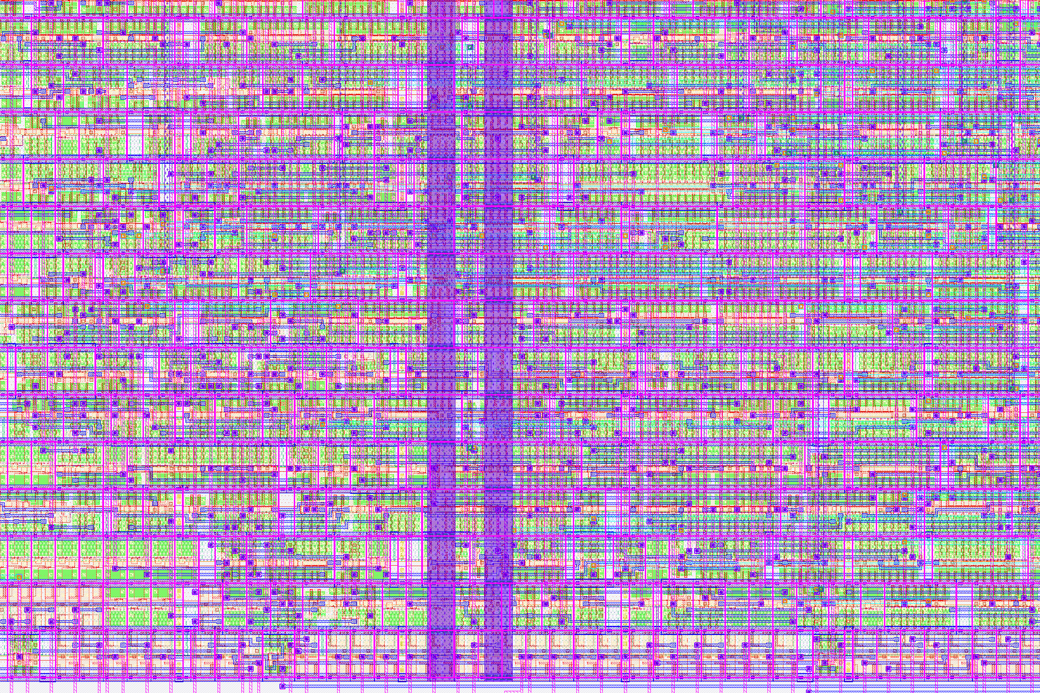
Last, the layout is written out as GDSII
IN
The routed, checked design.
OUT
A GDSII file for the foundry.
TOOL
Magic and KLayout write the stream.
TIME
Stream-out: 3.3 s
The real thing: every layer, transistors included. Right: a 60 × 40 µm zoom.
Notes:
PLAN: block 10–40 min (The open-source EDA flow); about 2 min on this slide.
Sources: build/results/_flow_stages/cnn_lite/stages.json (tool, step_wall_s, description per image) and tools.json (phase times; total 411.2 s over 77 steps, 2 CPUs / 8 GB, Apple-silicon VM); docs/SPEC.md section 4. Image 06_final.png: The finished GDSII with every layer including transistors (diffusion, poly), not only cell abstracts. Step directory: final (final/gds, from 57-magic-streamout / 58-klayout-streamout). Image 07_zoom_cells.png: Zoom on a 60 x 40 um window at (150, 10) um chosen as the densest logic region: cells, local interconnect and metal tracks. Step directory: final (final/gds).

Slide 17
LibreLane runs all of it, step by step
Runs Yosys, OpenROAD, Magic, KLayout and Netgen in order.
77
Records metrics for every run.
steps in one run
One config.json per design.
Notes:
PLAN: block 10–40 min (The open-source EDA flow); about 2 min on this slide.
Sources: build/results/_flow_stages/cnn_lite/tools.json (total_steps 77); CLAUDE.md (LibreLane 3.0.2); docs/SPEC.md 4.1 and 5.4 (resources.json records peak memory and wall time per step).

Slide 18
The sky130 open PDK is what makes it possible
130 nm
open
5
process node
standard cells
metal layers
Published by SkyWater, so anyone can design for it.
Notes:
PLAN: block 10–40 min (The open-source EDA flow); about 2 min on this slide.
Sources: README.md and CLAUDE.md (SkyWater sky130A 130 nm); docs/SPEC.md 4.2 (PDK pins). '5 metal layers' as given in the task brief for sky130 (met1 to met5); sky130_fd_sc_hd is the standard-cell library used by the flow.

Slide 19
Routing takes 68% of the build time
6.9 min in total (cnn_lite, 2 CPUs, 8 GB)
routing
signoff
CTS
279 s
95 s
15 s
Notes:
PLAN: block 10–40 min (The open-source EDA flow); about 2.5 min on this slide.
Sources: build/results/_flow_stages/cnn_lite/tools.json phases (lint 0.83 s; synthesis 7.18 s; floorplan 5.02 s; placement 9.08 s; CTS 14.97 s; routing 279.09 s; signoff 95.07 s); sum_of_step_wall_s 411.2. Phase boundaries by step number as defined in tools.json (routing includes fill insertion; signoff = RCX, STA, IR drop, stream-out, XOR, DRC, LVS). 2 CPUs / 8 GB on an Apple-silicon VM;

Slide 20
Five automatic checks must all come back clean
0
0
0
0
0
Magic DRC
KLayout DRC
LVS
Antenna
XOR
Errors found, summed over 12 designs.
Timing too: 11 of 12 designs meet setup and hold (not cnn_fp16).
Notes:
PLAN: block 10–40 min (The open-source EDA flow); about 2.5 min on this slide.
Sources: output/<design>/metrics.json keys magic__drc_error__count, klayout__drc_error__count, design__lvs_error__count, antenna__violating__nets, design__xor_difference__count, summed over the 12 designs with metrics (spm_ref, counter_wb, uart, ring_osc, pwm_dac, sigma_delta, aes128, bnn_mnist, fcnn_mnist, user_proj_example, cnn_lite, cnn_fp16). Timing: timing__setup_vio__count and timing__hold_vio__count > 0 for 1 design(s) (cnn_fp16). Max-slew violations are non-zero in 9 of 12 designs; counts per design in the appendix. Setup the next block with: these checks passed on counter_wb and ring_osc too, while they were hollow (block F).

Slide 21
Lab block 1
Setup, then labs 1 to 3. The labs use uart (small, so each stage takes seconds); numbers differ from the cnn_lite pictures.
Minutes 40–60 of 150
Notes:
PLAN: block 40–60 min (Lab block 1); about 0.5 min on this slide.
Block C: 20 minutes. Setup about 2 minutes (128 s measured), labs 3, 6 and 9 s each; the rest is predicting, looking and discussing. The labs run on uart, not cnn_lite, so every stage takes seconds.

Slide 22
One setup, then six small labs
RUN
make lab-setup
about 2 minutes, once
Lab 1
Lab 2
Lab 3
Lab 4
Lab 5
Lab 6
synth
floorplan
place
clock
route
signoff
3 s
6 s
9 s
12 s
32 s
65 s
Each lab starts from its own checkpoint.
Run on this Mac's Linux VM (2 CPUs, 8 GB). Codespaces and Colab: not verified.
Notes:
PLAN: block 40–60 min (Lab block 1); about 3 min on this slide.
Sources: docs/LABS.md (worksheet, reference values, commands) and docs/SPEC.md 5.8; commands are defined in mk/L1.mk (lab-setup, lab, lab-check, lab-list, lab-reset, lab-knob, lab-pack, lab-unpack). Reference values are for uart, measured on the Mac VM (arm64, 2 CPUs, 8 GB, profile tight); x86 machines, a real Codespace and Colab are NOT tested (LABS.md expects 1.5 to 2 times longer). make lab-setup: reference run plus checkpoints, 128 s measured on uart. Labs 1 to 6 measured 3, 6, 9, 12, 32 and 65 s (wall, including container start). Each lab starts from its own checkpoint, so a failed lab never blocks the next. make lab-list shows the labs and your status.

Slide 23
While setup runs, it executes all 76 steps once
The reference run of uart, step by step
Reference run
Checkpoints
Your results
all 76 steps
saved before each lab
build/labs/uart/mine
Notes:
PLAN: block 40–60 min (Lab block 1); about 2.5 min on this slide.
Sources: output/uart/resources.json (76 steps, wall_s per step, grouped by step number: lint, synth 1-9; floorplan 10-27; placement 28-34; clock tree 35-38; routing 39-53; signoff 54-76); docs/LABS.md (setup 128 s measured on the Mac VM). Use the time to talk through the stages.

Slide 24
Lab 1: how many cells does Verilog become?
PREDICT
3 small Verilog files become 50, 700 or 5,000 cells?
674
RUN
make lab N=1
make lab-check N=1
Cells, cell area, unmapped cells.
cells after synthesis (uart)
LOOK AT
REFERENCE
674 cells, 6,147 µm², 0 unmapped, 0 latches.
Labs use uart (2,026 cells, whole flow about 2 min): numbers differ from cnn_lite.
Run on this Mac's Linux VM (2 CPUs, 8 GB). Codespaces and Colab: not verified.
Notes:
PLAN: block 40–60 min (Lab block 1); about 4.5 min on this slide.
Sources: docs/LABS.md (worksheet, reference values, commands) and docs/SPEC.md 5.8; commands are defined in mk/L1.mk (lab-setup, lab, lab-check, lab-list, lab-reset, lab-knob, lab-pack, lab-unpack). Reference values are for uart, measured on the Mac VM (arm64, 2 CPUs, 8 GB, profile tight); x86 machines, a real Codespace and Colab are NOT tested (LABS.md expects 1.5 to 2 times longer). Labs run on uart, the flow section shows cnn_lite: reference numbers differ (e.g. lab 4: 32 clock buffers on uart; cnn_lite's clock tree has 127 buffers/loads in stages.json). Predict: 50, 700 or 5,000 cells? Why (ask the room): Why is the cell area (6,147 um^2) much smaller than the die area seen in lab 2? If it fails: Log is build/labs/uart/mine/lab1/lab.log; usually run make lab-setup again.

Slide 25
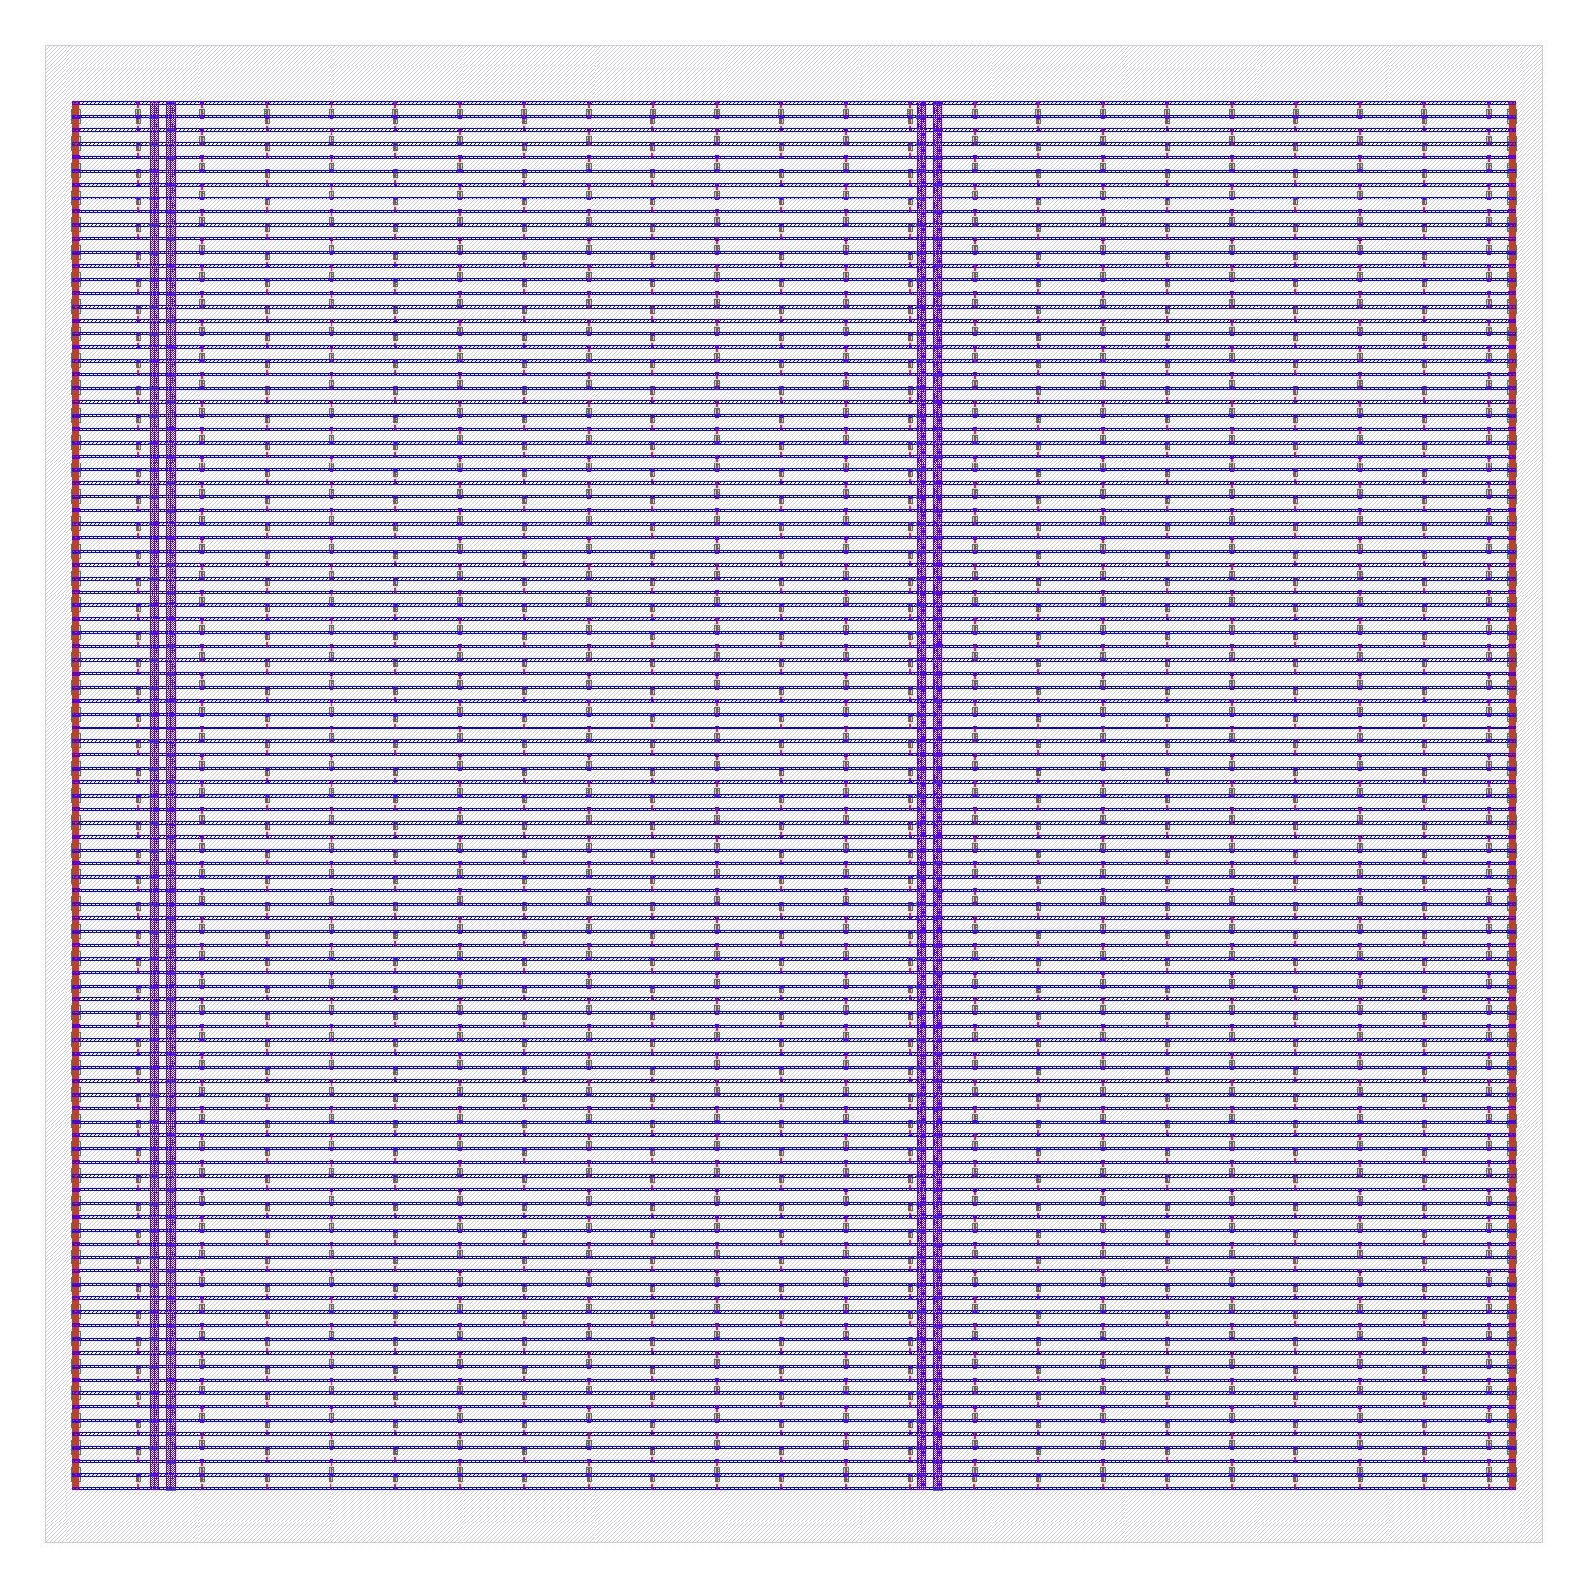
Lab 2: a die with rows and a power grid
PREDICT
The die is 300 × 300 µm. What fraction will cells fill?
RUN
make lab N=2
make lab-check N=2
LOOK AT
Die, core, rows, power-grid violations.
REFERENCE
102 rows, 0 violations, utilization 0.095.
Labs use uart (2,026 cells, whole flow about 2 min): numbers differ from cnn_lite.
Run on this Mac's Linux VM (2 CPUs, 8 GB). Codespaces and Colab: not verified.
Notes:
PLAN: block 40–60 min (Lab block 1); about 4.5 min on this slide.
Sources: docs/LABS.md (worksheet, reference values, commands) and docs/SPEC.md 5.8; commands are defined in mk/L1.mk (lab-setup, lab, lab-check, lab-list, lab-reset, lab-knob, lab-pack, lab-unpack). Reference values are for uart, measured on the Mac VM (arm64, 2 CPUs, 8 GB, profile tight); x86 machines, a real Codespace and Colab are NOT tested (LABS.md expects 1.5 to 2 times longer). Labs run on uart, the flow section shows cnn_lite: reference numbers differ (e.g. lab 4: 32 clock buffers on uart; cnn_lite's clock tree has 127 buffers/loads in stages.json). Predict: what fraction of the 300 x 300 um die will the cells fill? Why (ask the room): Why does the power grid exist before any signal wire? If it fails: Run make lab-check N=2; if the checkpoint is missing run make lab-setup or make lab-unpack.

Slide 26
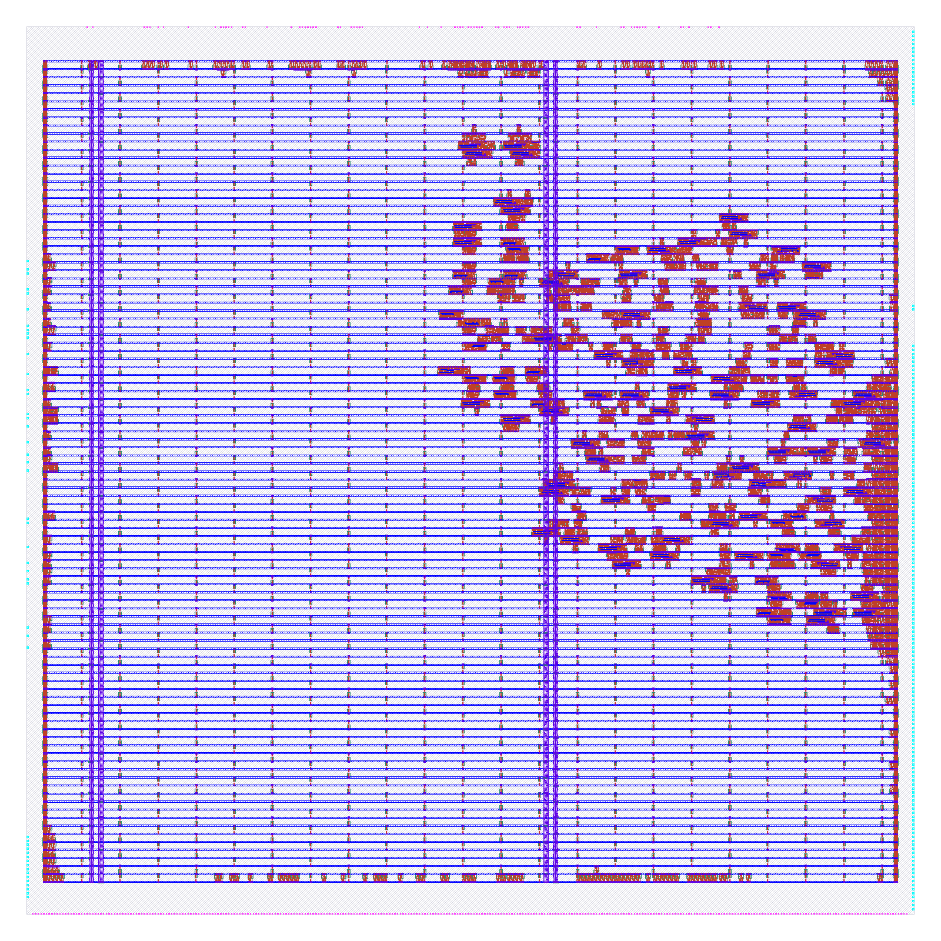
Lab 3: do cells spread out or cluster?
PREDICT
Will cells spread over the die, or cluster?
RUN
make lab N=3
make lab-check N=3
LOOK AT
Cells placed, wirelength, setup slack.
REFERENCE
1,912 cells, 15,404 µm wire, +17.908 ns.
Labs use uart (2,026 cells, whole flow about 2 min): numbers differ from cnn_lite.
Run on this Mac's Linux VM (2 CPUs, 8 GB). Codespaces and Colab: not verified.
Notes:
PLAN: block 40–60 min (Lab block 1); about 4.5 min on this slide.
Sources: docs/LABS.md (worksheet, reference values, commands) and docs/SPEC.md 5.8; commands are defined in mk/L1.mk (lab-setup, lab, lab-check, lab-list, lab-reset, lab-knob, lab-pack, lab-unpack). Reference values are for uart, measured on the Mac VM (arm64, 2 CPUs, 8 GB, profile tight); x86 machines, a real Codespace and Colab are NOT tested (LABS.md expects 1.5 to 2 times longer). Labs run on uart, the flow section shows cnn_lite: reference numbers differ (e.g. lab 4: 32 clock buffers on uart; cnn_lite's clock tree has 127 buffers/loads in stages.json). Predict: spread or cluster? Why (ask the room): The cells cluster on the right. What pulled them there? (Hint: where are the IO pins?) If it fails: Placement failure means the die is too full; see knob util.

Slide 27
Tour of the designs
Small to large: two light slides each
Minutes 60–85 of 150
Notes:
PLAN: block 60–85 min (Tour of the designs); about 0.5 min on this slide.
Block D: 25 minutes, about one minute per slide. Standard cells = design__instance__count__stdcell (includes tap cells, not fill).

Slide 28
spm_ref multiplies two numbers one bit at a time
An 8-bit multiplicand times a serial multiplier; the product streams out one bit per clock.
x bit
(serial)
8 AND gates +
carry-save adders
product bit
(serial)
Checked: 67,286 multiplications, 0 errors.
Was broken: the original did not multiply (3 × 3 gave 3).
Notes:
PLAN: block 60–85 min (Tour of the designs); about 1 min on this slide.
Sources: designs/spm_ref/src/spm.v header; tests/testbenches/spm_tb.v (run: 'spm_tb: 67286 multiplications, 1094197 bit/status checks, 0 errors'); build/v4/gl_all.log (spm_ref gate-level PASS); docs/SPEC.md 6.2 (original did not multiply); output/spm_ref/metrics.json and resources.json. Detail: Self-checking testbench compares every product bit with a x b computed in the testbench: 67,286 multiplications, 1,094,197 checks, 0 errors (iverilog); gate-level simulation of the synthesized netlist also passes (build/v4/gl_all.log). Original RTL did not multiply; rewritten with the same ports.

Slide 29
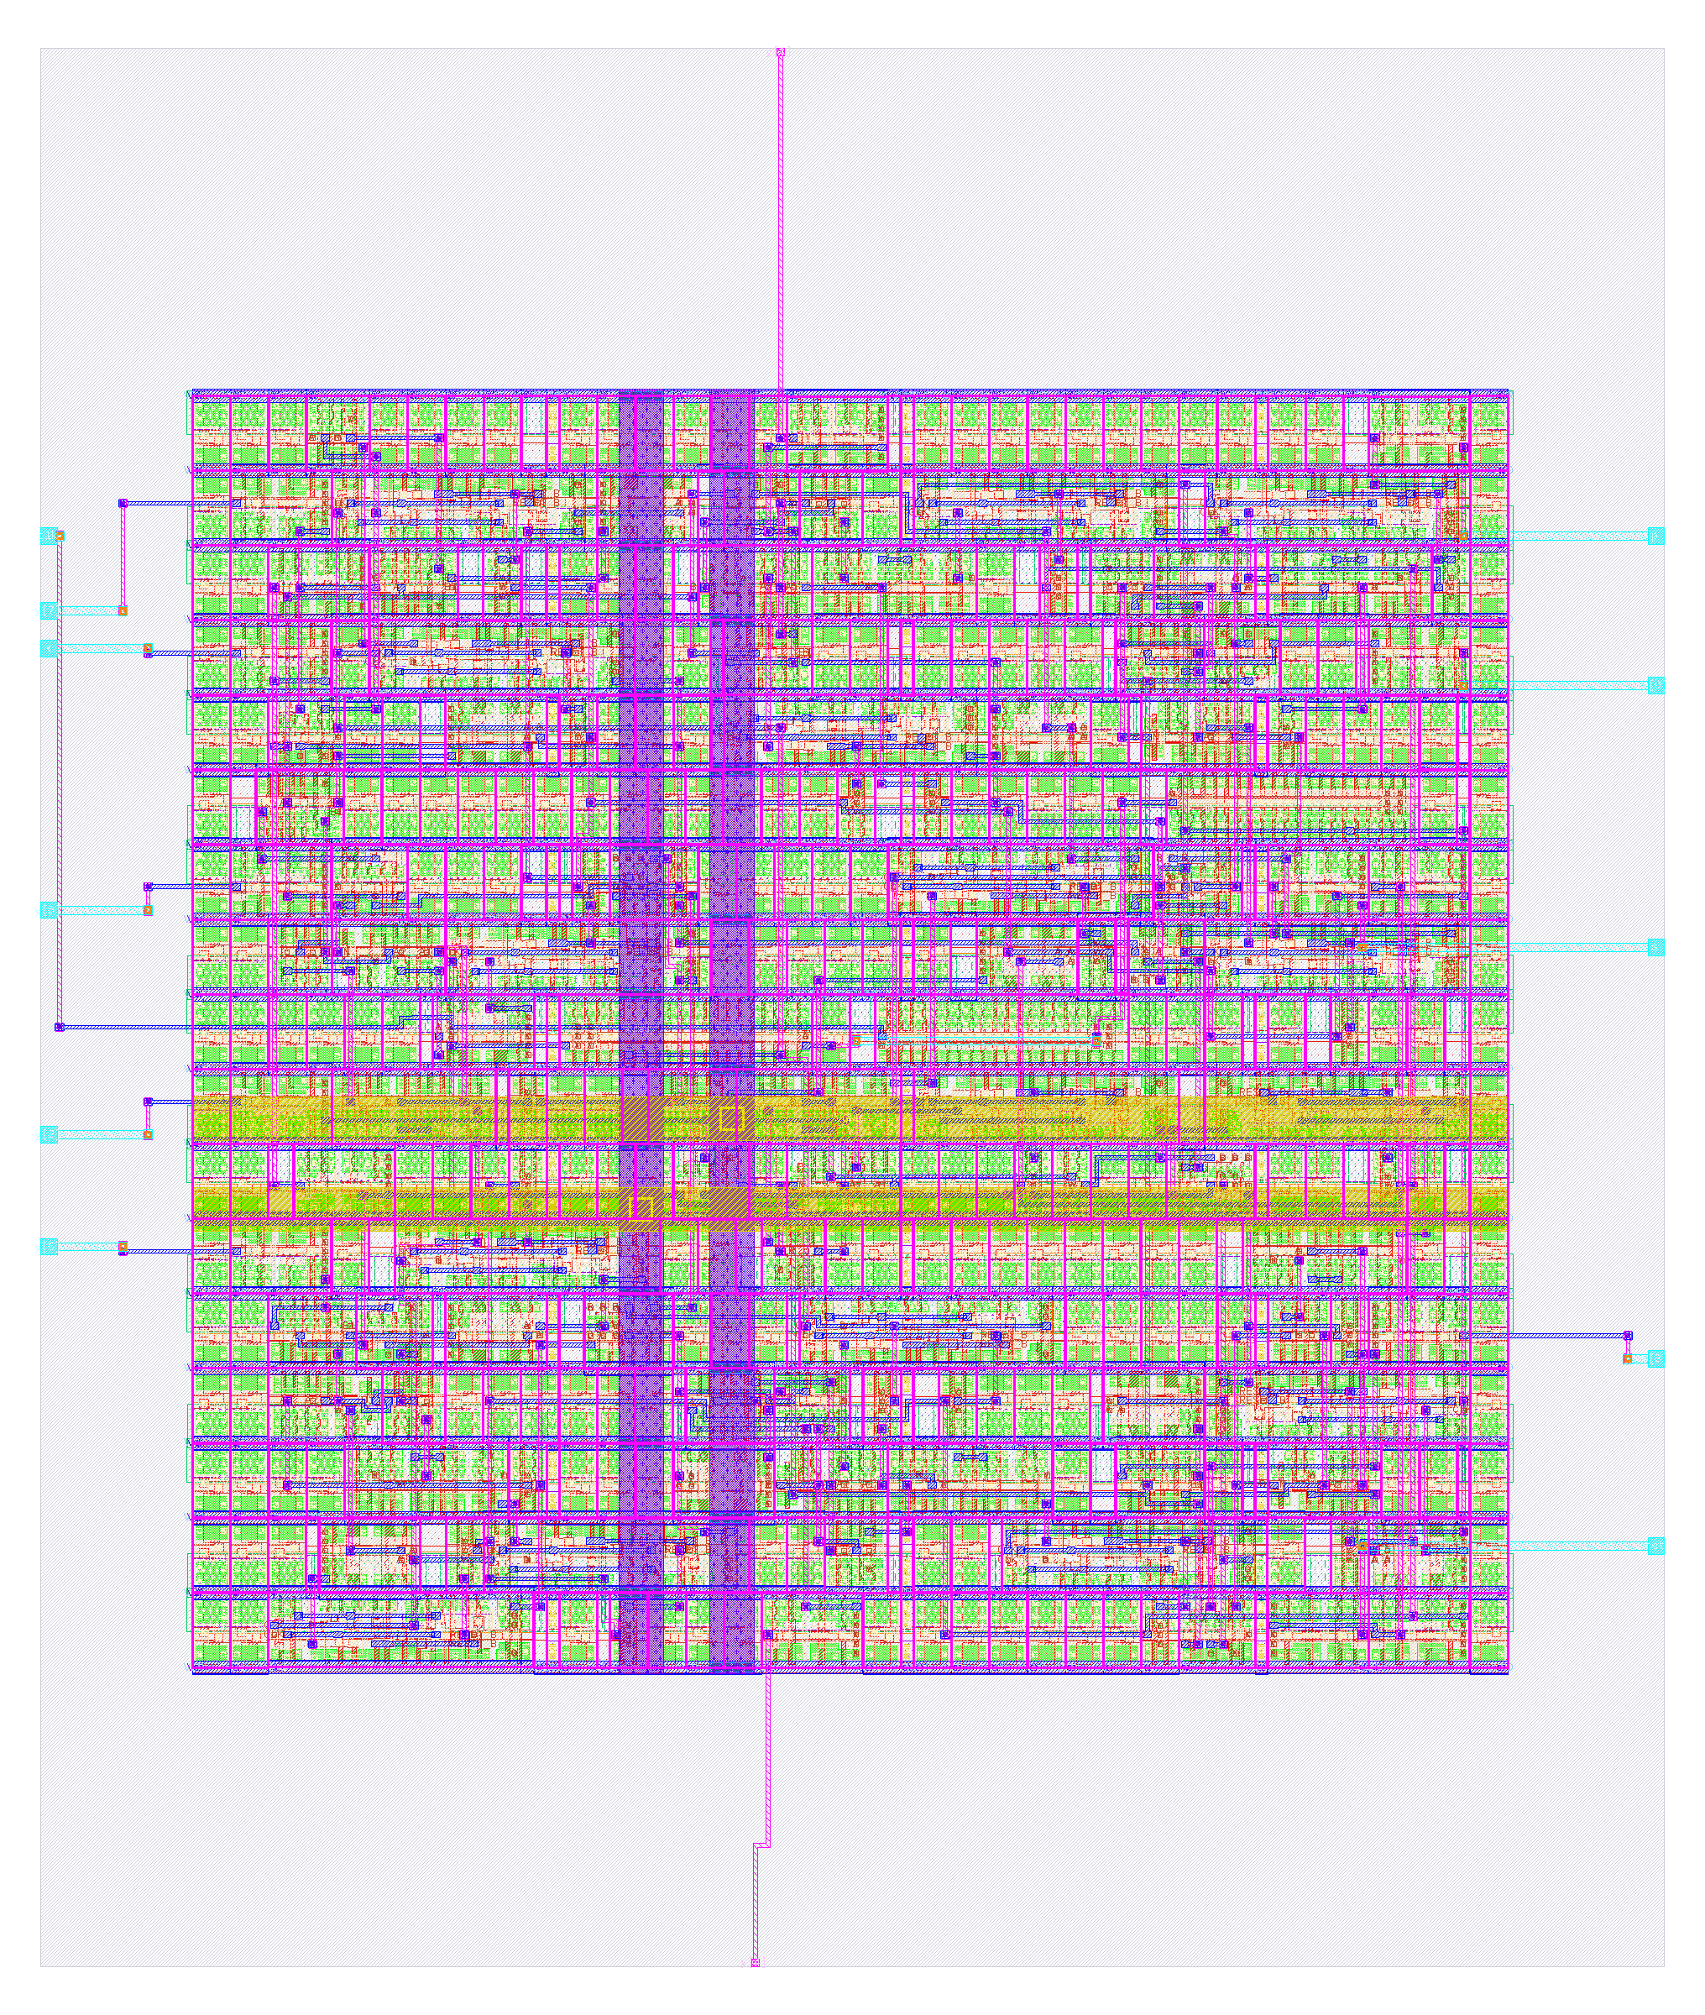
Here is spm_ref as a finished layout
140
standard cells
59.1 × 69.8 µm
die size
42 s
build time, 2 CPUs / 8 GB
+0.10 ns
worst slack (hold)
2 CPUs / 8 GB, Apple-silicon VM; not fabricated.
Notes:
PLAN: block 60–85 min (Tour of the designs); about 1 min on this slide.
Sources: designs/spm_ref/src/spm.v header; tests/testbenches/spm_tb.v (run: 'spm_tb: 67286 multiplications, 1094197 bit/status checks, 0 errors'); build/v4/gl_all.log (spm_ref gate-level PASS); docs/SPEC.md 6.2 (original did not multiply); output/spm_ref/metrics.json and resources.json.

Slide 30
counter_wb is a counter you can read over a bus
A 32-bit counter behind a Wishbone slave; the logic-analyzer output mirrors the count.
Wishbone
bus
32-bit counter
+ control
la_data_out
[31:0]
Checked: RTL tests and gate-level simulation.
Was hollow: 1 of about 67 flip-flops survived. Fixed.
Notes:
PLAN: block 60–85 min (Tour of the designs); about 1 min on this slide.
Sources: rtl/examples/counter_wb/counter_wb.v header (all registers in one always block); build/audit/AUDIT.md (1 of ~67 flip-flops, 34 'multiple conflicting drivers'); build/v4/gl_all.log (counter_wb gate-level PASS); output/counter_wb/metrics.json (design__instance__count__class:sequential_cell = 67, synthesis__check_error__count = 0) and resources.json. Detail: RTL testbench passes five checks (initial value, write/read, reset, free-running count, logic-analyzer mirror); gate-level simulation of the synthesized netlist passes (build/v4/gl_all.log). The original assigned its registers in two always blocks, so synthesis kept 1 of about 67 flip-flops (build/audit/AUDIT.md); now all in one block (RTL header), 67 sequential cells in output/counter_wb.

Slide 31
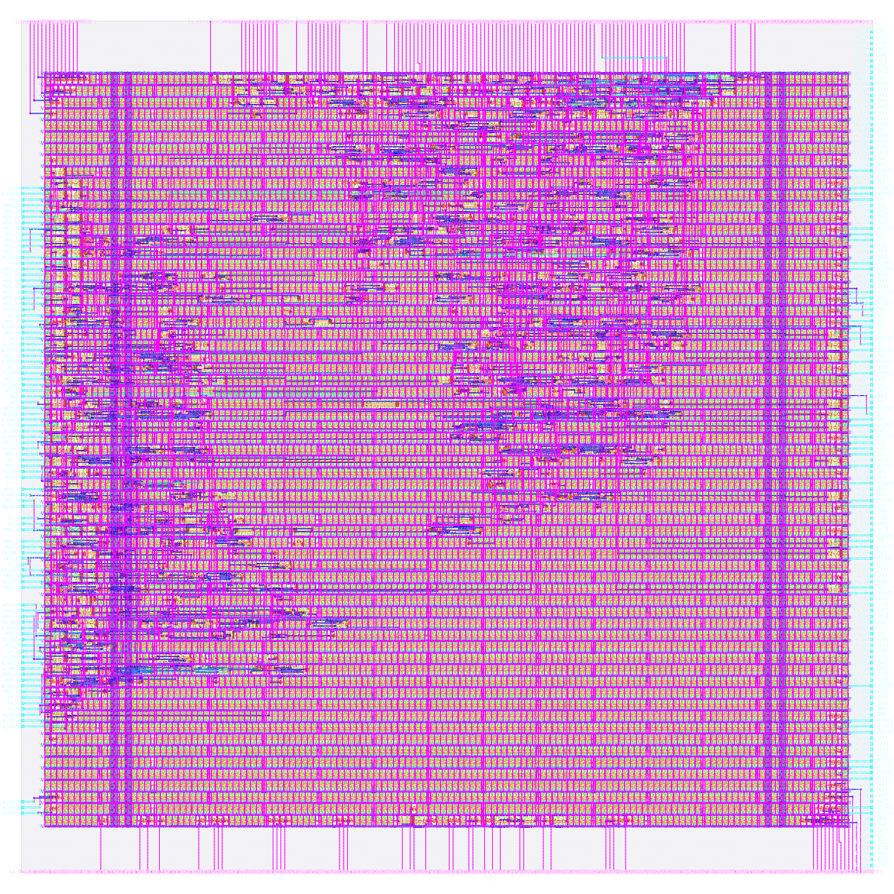
Here is counter_wb as a finished layout
1,214
standard cells
200 × 200 µm
die size
70 s
build time, 2 CPUs / 8 GB
+0.11 ns
worst slack (hold)
2 CPUs / 8 GB, Apple-silicon VM; not fabricated.
Notes:
PLAN: block 60–85 min (Tour of the designs); about 1 min on this slide.
Sources: rtl/examples/counter_wb/counter_wb.v header (all registers in one always block); build/audit/AUDIT.md (1 of ~67 flip-flops, 34 'multiple conflicting drivers'); build/v4/gl_all.log (counter_wb gate-level PASS); output/counter_wb/metrics.json (design__instance__count__class:sequential_cell = 67, synthesis__check_error__count = 0) and resources.json.

Slide 32
uart sends and receives bytes over two wires
A full-duplex 8N1 UART behind a Wishbone slave; the baud divider is a parameter.
Wishbone
registers
uart_tx and
uart_rx
io_out[0] TX
io_in[1] RX
Checked: loopback of 34 bytes through the Wishbone UART.
Lab design: you run its flow in the labs.
Notes:
PLAN: block 60–85 min (Tour of the designs); about 1 min on this slide.
Sources: rtl/examples/uart/uart_wb.v, uart_tx.v, uart_rx.v headers; tests/testbenches/uart_tb.v (compiles only uart_tx.v + uart_rx.v); build/v4/gl_all.log (uart: '32 Wishbone loopback bytes incl. 00/FF', PASS); mk/Q1.mk; output/uart/metrics.json and resources.json. Detail: The committed uart_tb exercises uart_tx and uart_rx only (loopback, CLKS_PER_BIT = 5). The gate-level runs use 34 Wishbone loopback bytes (uart_wb_tb) and pass on the synthesized and the routed netlist (build/v4/gl_all.log, gl_final.log).

Slide 33
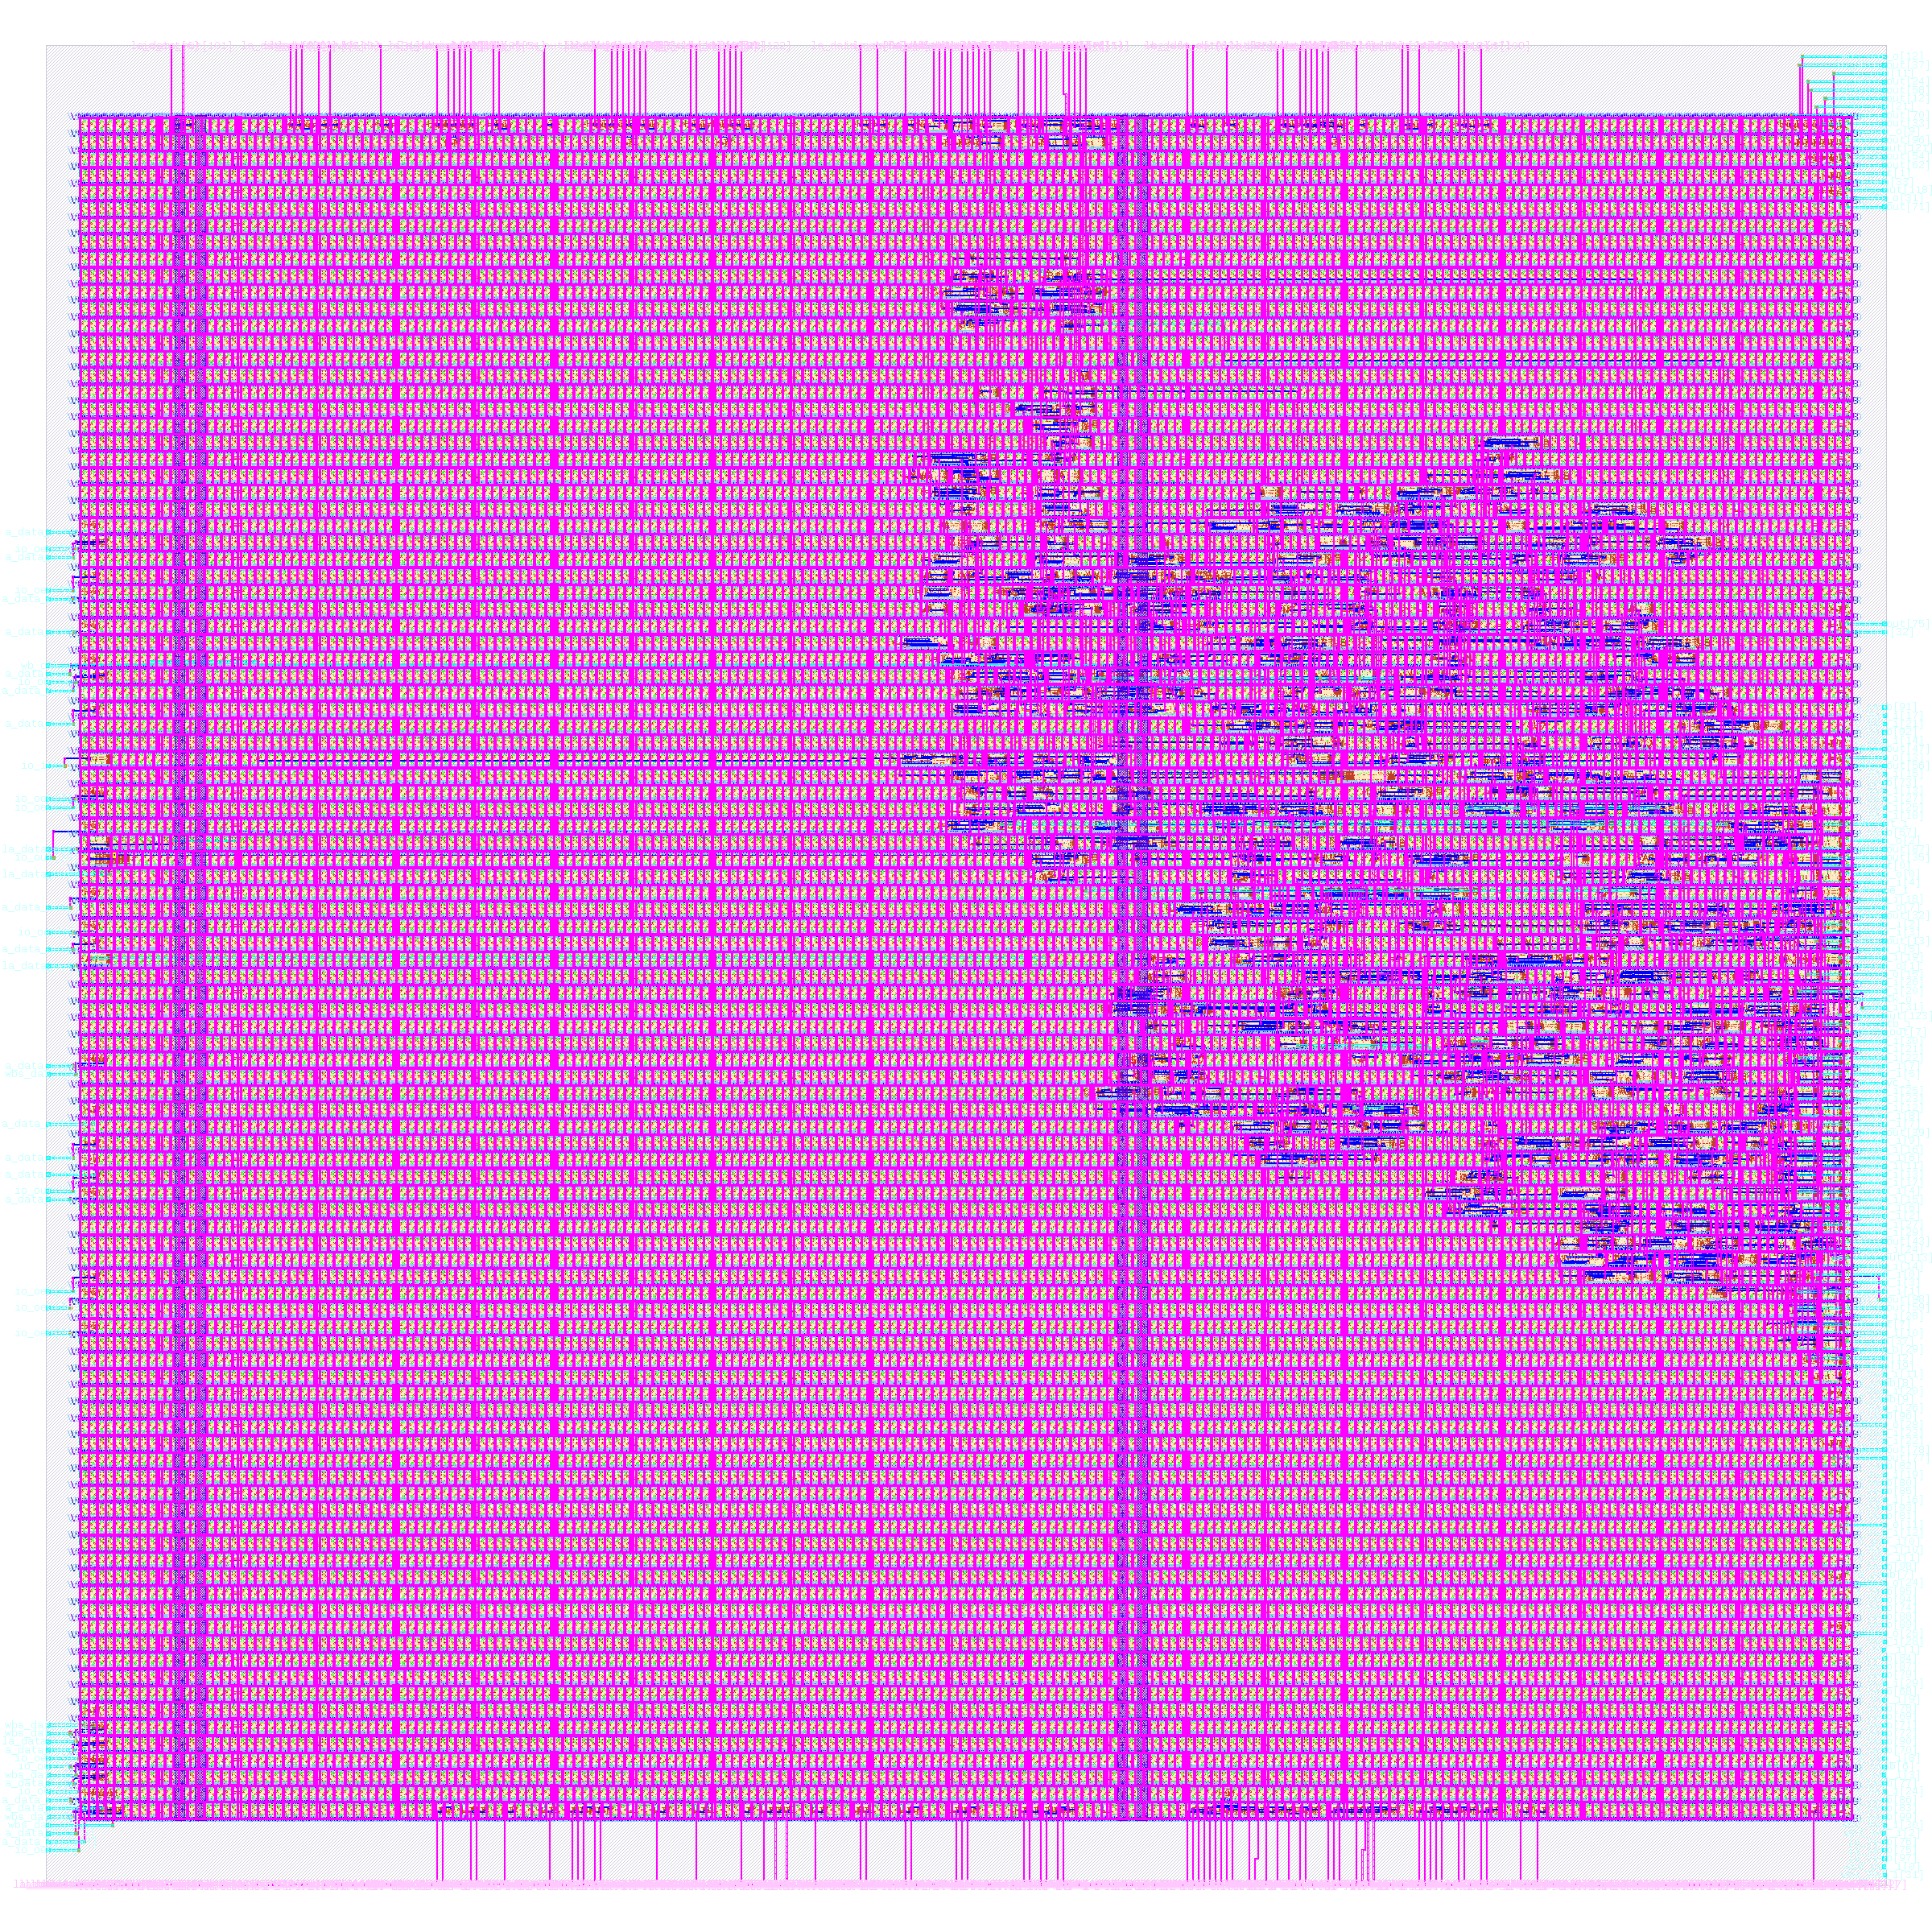
Here is uart as a finished layout
2,026
standard cells
300 × 300 µm
die size
112 s
build time, 2 CPUs / 8 GB
+0.11 ns
worst slack (hold)
2 CPUs / 8 GB, Apple-silicon VM; not fabricated.
Notes:
PLAN: block 60–85 min (Tour of the designs); about 1 min on this slide.
Sources: rtl/examples/uart/uart_wb.v, uart_tx.v, uart_rx.v headers; tests/testbenches/uart_tb.v (compiles only uart_tx.v + uart_rx.v); build/v4/gl_all.log (uart: '32 Wishbone loopback bytes incl. 00/FF', PASS); mk/Q1.mk; output/uart/metrics.json and resources.json.

Slide 34
ring_osc counts the beats of a ring of inverters
A ring of 31 inverting stages; a divider and counter tally its edges. Enable register at +0x08.
31-stage
ring
divider +
synchroniser
toggle count
(Wishbone)
Checked: RTL tests and a gate-level test on the real cell ring.
Was hollow: synthesis deleted the whole ring. Fixed.
Notes:
PLAN: block 60–85 min (Tour of the designs); about 1 min on this slide.
Sources: rtl/examples/ring_osc/ring_osc_wb.v header (structure, why explicit cells, 'one counted edge = 64 ring cycles'); build/audit/AUDIT.md (ring absent from the netlist); build/v4/gl_all.log (ring_osc: 'committed tb on the real cell ring', PASS); output/ring_osc/metrics.json and resources.json. Detail: The original ring (a combinational loop of not primitives) was folded away by Yosys; the RTL test used a divider instead of the ring (build/audit/AUDIT.md). Now the ring is built from explicit sky130 nand2_1 / inv_1 cells (RTL header) and the gate-level test runs on the real cell ring and passes (build/v4/gl_all.log). Oscillation frequency in silicon remains unmeasured.

Slide 35
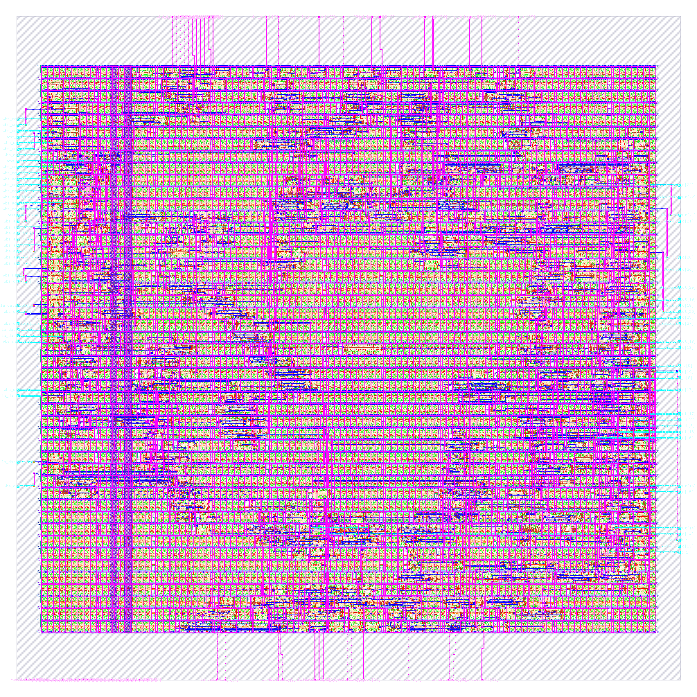
Here is ring_osc as a finished layout
830
standard cells
150 × 150 µm
die size
57 s
build time, 2 CPUs / 8 GB
+0.11 ns
worst slack (hold)
2 CPUs / 8 GB, Apple-silicon VM; not fabricated.
Notes:
PLAN: block 60–85 min (Tour of the designs); about 1 min on this slide.
Sources: rtl/examples/ring_osc/ring_osc_wb.v header (structure, why explicit cells, 'one counted edge = 64 ring cycles'); build/audit/AUDIT.md (ring absent from the netlist); build/v4/gl_all.log (ring_osc: 'committed tb on the real cell ring', PASS); output/ring_osc/metrics.json and resources.json.

Slide 36
pwm_dac turns a number into a duty cycle
An 8-bit counter is compared with a duty register; a filter turns the pulses into a voltage.
duty register
(Wishbone)
counter <
duty ?
pwm_out
Checked: 0%, 50% and 255/256 duty tests pass.
Notes:
PLAN: block 60–85 min (Tour of the designs); about 1 min on this slide.
Sources: rtl/examples/pwm_dac/pwm_dac_wb.v header; tests/testbenches/pwm_dac_tb.v; build/v4/gl_all.log (pwm_dac PASS); output/pwm_dac/metrics.json and resources.json. Detail: Testbench passes: duty 0 always low, duty 255 gives 255/256 high, duty 128 gives exactly 50%, duty register reads back (iverilog). Gate-level simulation passes.

Slide 37
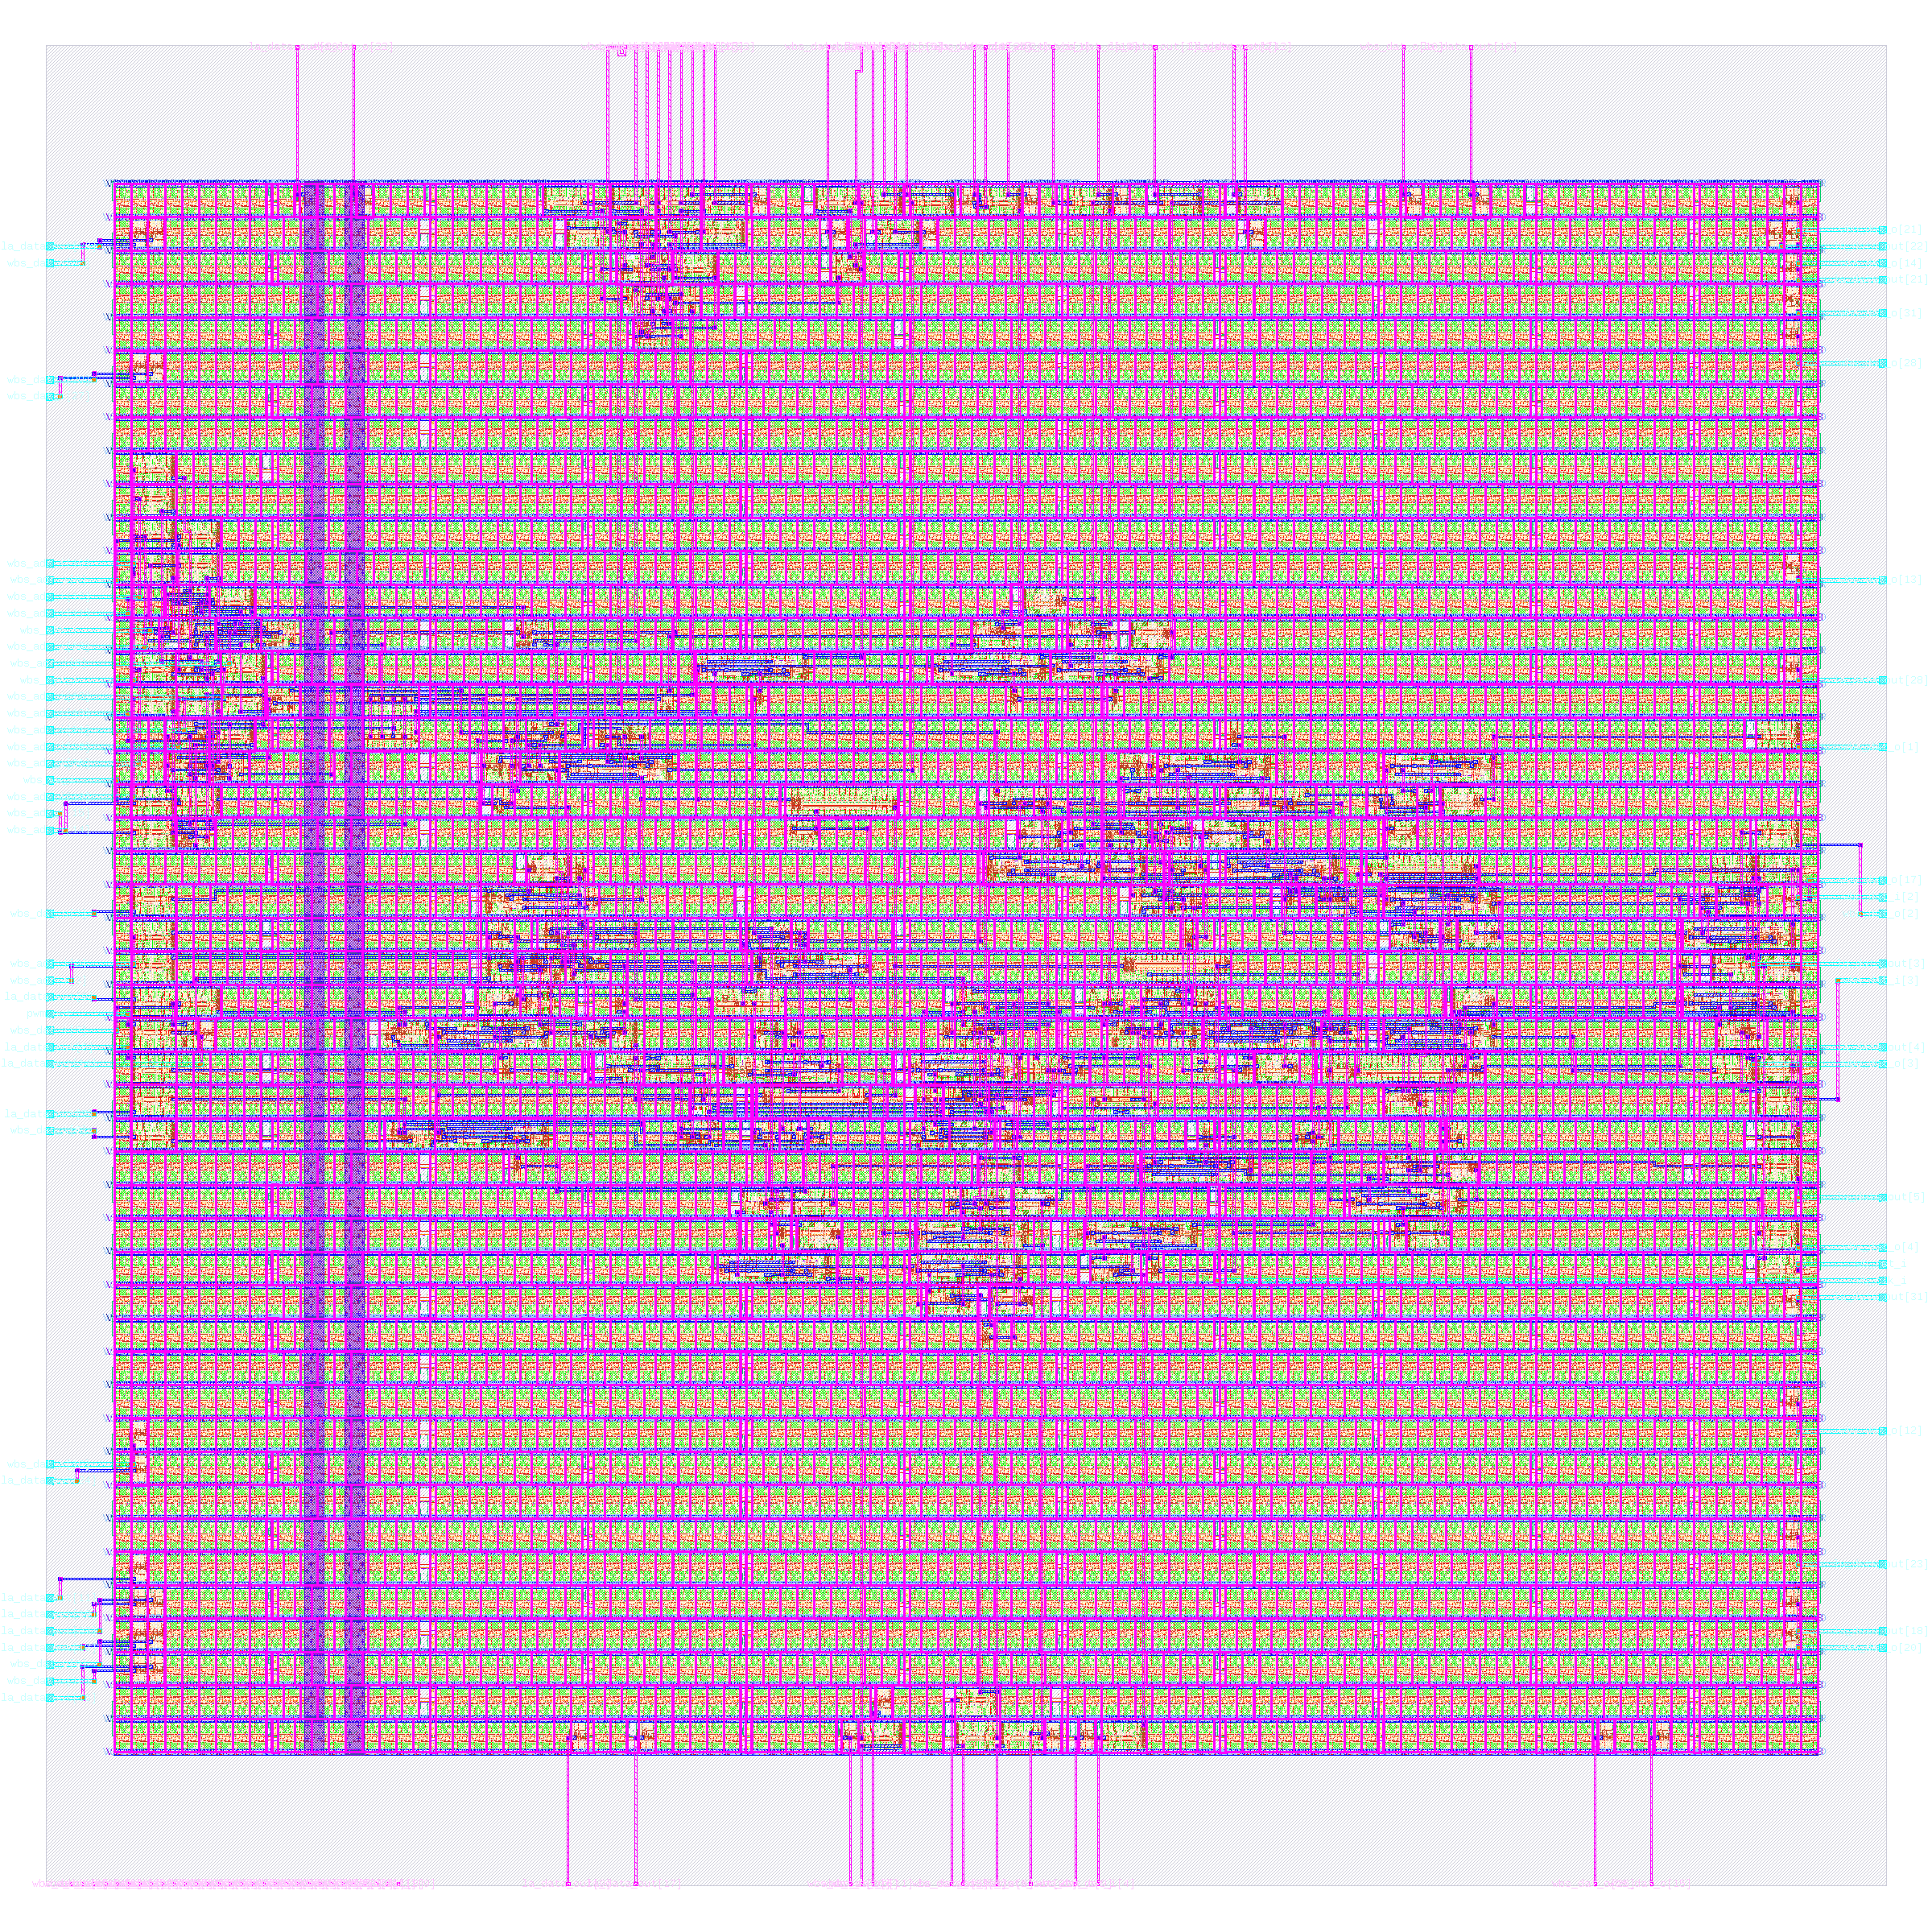
Here is pwm_dac as a finished layout
524
standard cells
150 × 150 µm
die size
51 s
build time, 2 CPUs / 8 GB
+0.12 ns
worst slack (hold)
2 CPUs / 8 GB, Apple-silicon VM; not fabricated.
Notes:
PLAN: block 60–85 min (Tour of the designs); about 1 min on this slide.
Sources: rtl/examples/pwm_dac/pwm_dac_wb.v header; tests/testbenches/pwm_dac_tb.v; build/v4/gl_all.log (pwm_dac PASS); output/pwm_dac/metrics.json and resources.json.

Slide 38
sigma_delta turns a number into a bit stream
A 16-bit accumulator whose carry is a 1-bit stream; the density of ones tracks the input.
input
16 bit
accumulator
carry = out
1-bit stream +
256-cycle count
Checked: density tests pass at 0, half and full scale.
Notes:
PLAN: block 60–85 min (Tour of the designs); about 1 min on this slide.
Sources: rtl/examples/sigma_delta/sigma_delta_wb.v header; tests/testbenches/sigma_delta_tb.v; build/v4/gl_all.log (sigma_delta PASS); output/sigma_delta/metrics.json and resources.json. Detail: Testbench passes: input 0 gives all zeros, 0xFFFF all ones, 0x8000 about 50%, density register near 128, input register reads back (iverilog). Gate-level simulation passes.

Slide 39
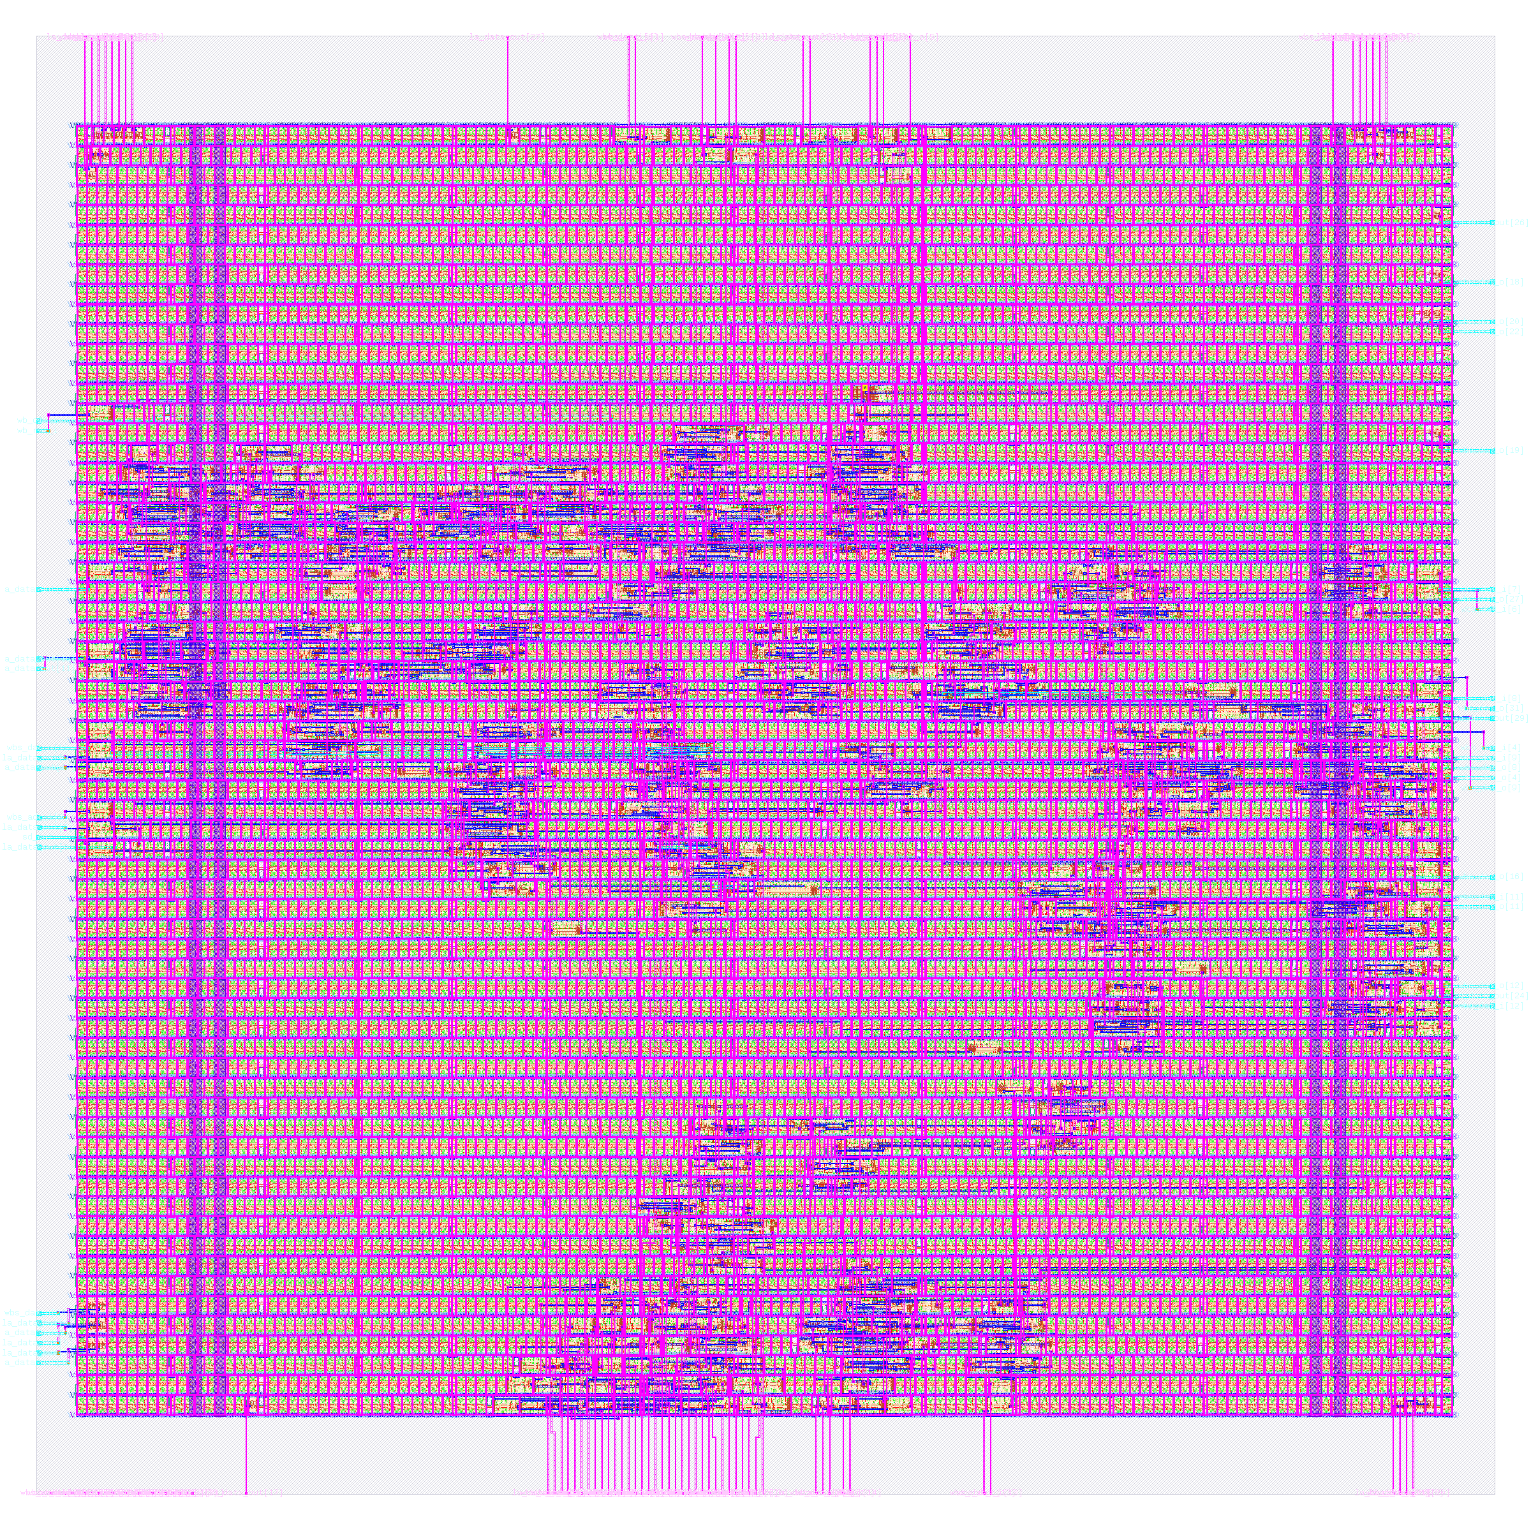
Here is sigma_delta as a finished layout
1,026
standard cells
200 × 200 µm
die size
74 s
build time, 2 CPUs / 8 GB
+0.11 ns
worst slack (hold)
2 CPUs / 8 GB, Apple-silicon VM; not fabricated.
Notes:
PLAN: block 60–85 min (Tour of the designs); about 1 min on this slide.
Sources: rtl/examples/sigma_delta/sigma_delta_wb.v header; tests/testbenches/sigma_delta_tb.v; build/v4/gl_all.log (sigma_delta PASS); output/sigma_delta/metrics.json and resources.json.

Slide 40
aes128 encrypts a block in 51 clock cycles
A compact AES-128 core: four shared S-boxes and an on-the-fly round key.
state ⊕ key
4 S-boxes +
MixColumns
128-bit
state
Checked: FIPS-197 vectors and 2,000 random blocks.
Was broken: the original gave wrong ciphertext; 32,432 cells.
Notes:
PLAN: block 60–85 min (Tour of the designs); about 1 min on this slide.
Sources: rtl/examples/aes128/aes128_core.v header; tests/testbenches/aes128_tb.v (run: KAT 0/1/2 PASS, random 1000 core + 1000 wb, 'aes128 testbench: PASS (0 errors)'); build/v4/gl_all.log (aes128 PASS); docs/SPEC.md section 3 and 6.2/6.3 (51 cycles; excluding tap cells 7,288); output/baseline_tight.md (original: 32,432 cells, -6.20 ns); output/aes128/metrics.json and resources.json (new build). Detail: Passes FIPS-197 Appendix B and C.1 and the all-zero vector, plus 1,000 random vectors through the core and 1,000 through Wishbone: 0 mismatches (iverilog); gate-level simulation passes (build/v4/gl_all.log). Original build: 32,432 cells, 800 x 800 um, setup -6.20 ns, wrong ciphertext for both NIST vectors.

Slide 41
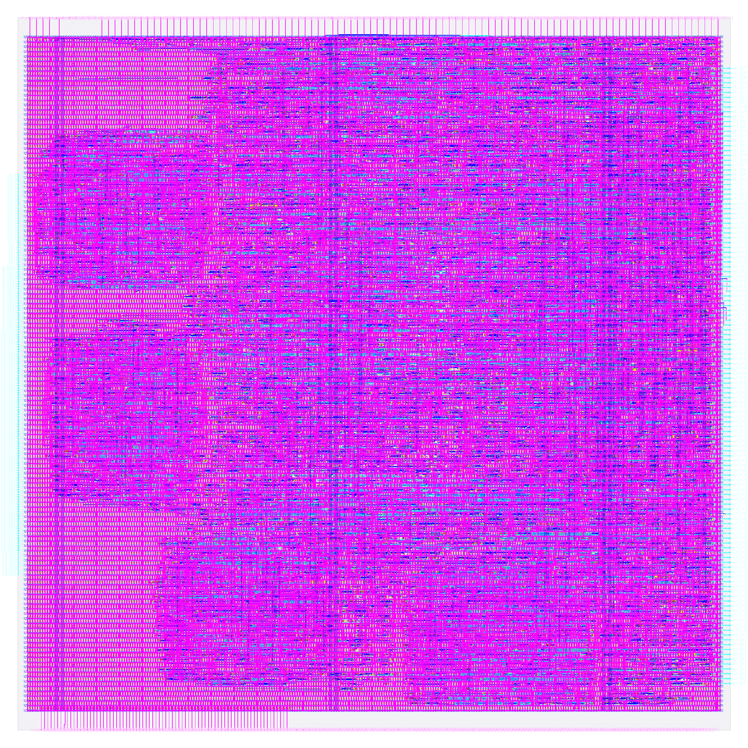
Here is aes128 as a finished layout
9,403
standard cells
400 × 400 µm
die size
7.5 min
build time, 2 CPUs / 8 GB
+0.06 ns
worst slack (hold)
2 CPUs / 8 GB, Apple-silicon VM; not fabricated.
Notes:
PLAN: block 60–85 min (Tour of the designs); about 1 min on this slide.
Sources: rtl/examples/aes128/aes128_core.v header; tests/testbenches/aes128_tb.v (run: KAT 0/1/2 PASS, random 1000 core + 1000 wb, 'aes128 testbench: PASS (0 errors)'); build/v4/gl_all.log (aes128 PASS); docs/SPEC.md section 3 and 6.2/6.3 (51 cycles; excluding tap cells 7,288); output/baseline_tight.md (original: 32,432 cells, -6.20 ns); output/aes128/metrics.json and resources.json (new build).

Slide 42
bnn_mnist recognises digits with 1-bit arithmetic
A 196 → 32 → 10 binarized network: XNOR and count, then a 4-bit score per digit.
196 pixel
bits
32 hidden
XNOR + count
10 scores
class
(argmax)
Checked: all 10,000 test images match; 90.10% accurate.
Was untrained: random weights; 34,707 cells.
Notes:
PLAN: block 60–85 min (Tour of the designs); about 1 min on this slide.
Sources: rtl/bnn_mnist/bnn_top.v header; build/sim/full.log ('RTL accuracy: 9010/10000 = 90.10%', 'total checks: 130302, errors: 0'); models/bnn_mnist/weights.json; docs/SPEC.md 7.2, 7.4 and section 3; build/v4/gl_all.log (bnn_mnist PASS, 200 images); output/baseline_tight.md (original 34,707 cells, -6.62 ns); output/bnn_mnist/metrics.json and resources.json (new build). Detail: RTL equals the integer reference on all 10,000 MNIST test images (130,302 checks, 0 errors). Accuracy 90.10% (9,010 / 10,000). 770 cycles per inference; 7,552 ROM bits. Gate-level simulation of 200 images passes. Before: 784 -> 32 -> 10 with random weights, 34,707 cells, 900 x 900 um, setup -6.62 ns.

Slide 43
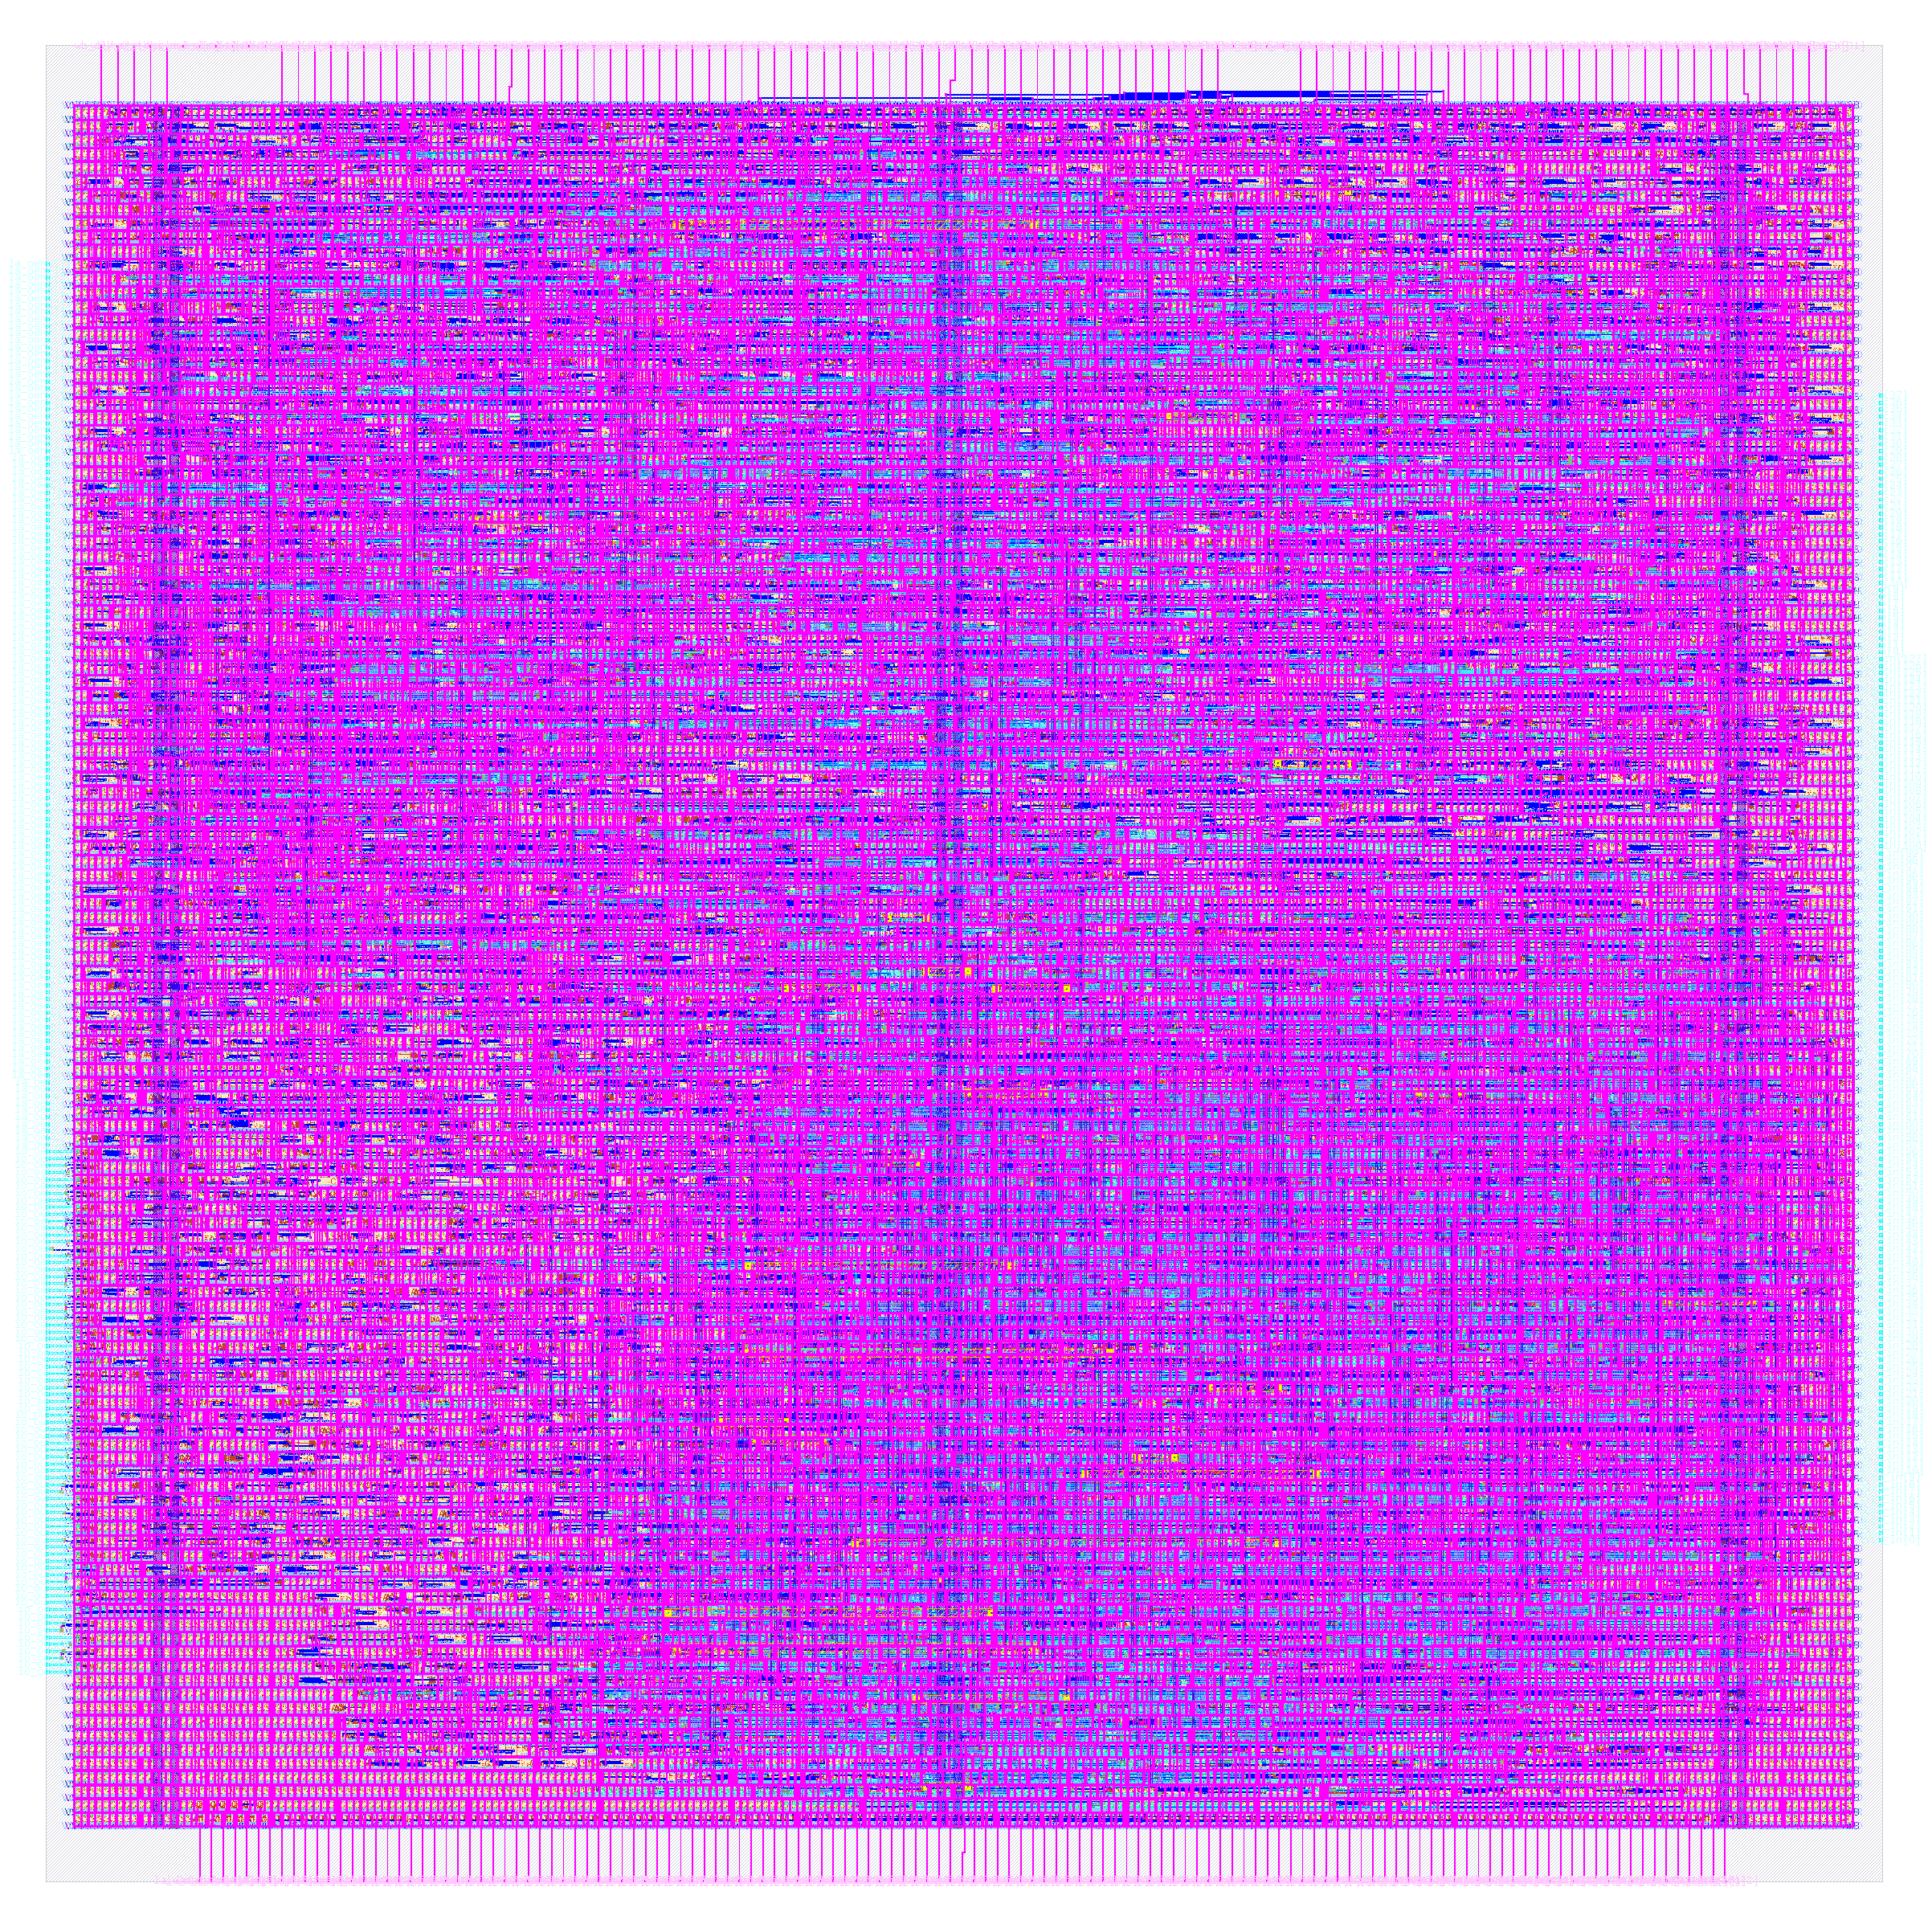
Here is bnn_mnist as a finished layout
7,466
standard cells
360 × 360 µm
die size
7.1 min
build time, 2 CPUs / 8 GB
+0.11 ns
worst slack (hold)
2 CPUs / 8 GB, Apple-silicon VM; not fabricated.
Notes:
PLAN: block 60–85 min (Tour of the designs); about 1 min on this slide.
Sources: rtl/bnn_mnist/bnn_top.v header; build/sim/full.log ('RTL accuracy: 9010/10000 = 90.10%', 'total checks: 130302, errors: 0'); models/bnn_mnist/weights.json; docs/SPEC.md 7.2, 7.4 and section 3; build/v4/gl_all.log (bnn_mnist PASS, 200 images); output/baseline_tight.md (original 34,707 cells, -6.62 ns); output/bnn_mnist/metrics.json and resources.json (new build).

Slide 44
fcnn_mnist recognises digits with one neuron layer
One 196-to-10 fixed-point layer. user_proj_example is the same RTL, routed up to met4 only.
196 gray
pixels
10 neurons
serial MAC
sigmoid
lookup
max finder
(class)
Checked: 1,000 images match the bit-exact model; 91.72% accurate.
Before: 784 inputs, 16-bit, 102,091 cells.
Notes:
PLAN: block 60–85 min (Tour of the designs); about 1 min on this slide.
Sources: rtl/fcnn/user_proj_example.v, models/fcnn_mnist/golden.py header; models/fcnn_mnist/weights.json (float_test_accuracy 0.9208, hw_test_accuracy 0.9172); tests/testbenches/fcnn_mnist_tb.v (re-run, 1000 images: 0 mismatches, 909/1000, 602 cycles); build/v4/gl_all.log and gl_final.log (fcnn_mnist and user_proj_example: 100 images, PASS); docs/SPEC.md 6.2 (original 102,091 and 56,517 cells); designs/user_proj_example/config.json RT_MAX_LAYER met4; output/fcnn_mnist and output/user_proj_example metrics.json + resources.json. Detail: 1,000 MNIST images through Wishbone: 0 mismatches against the bit-exact reference, 909 / 1,000 correct, 602 cycles each. On 10,000 images the model gives 92.08% in floating point and 91.72% hardware-exact. Gate-level simulation of 100 images passes on the synthesized and routed netlists (build/v4). user_proj_example: same RTL, RT_MAX_LAYER met4; see appendix.

Slide 45
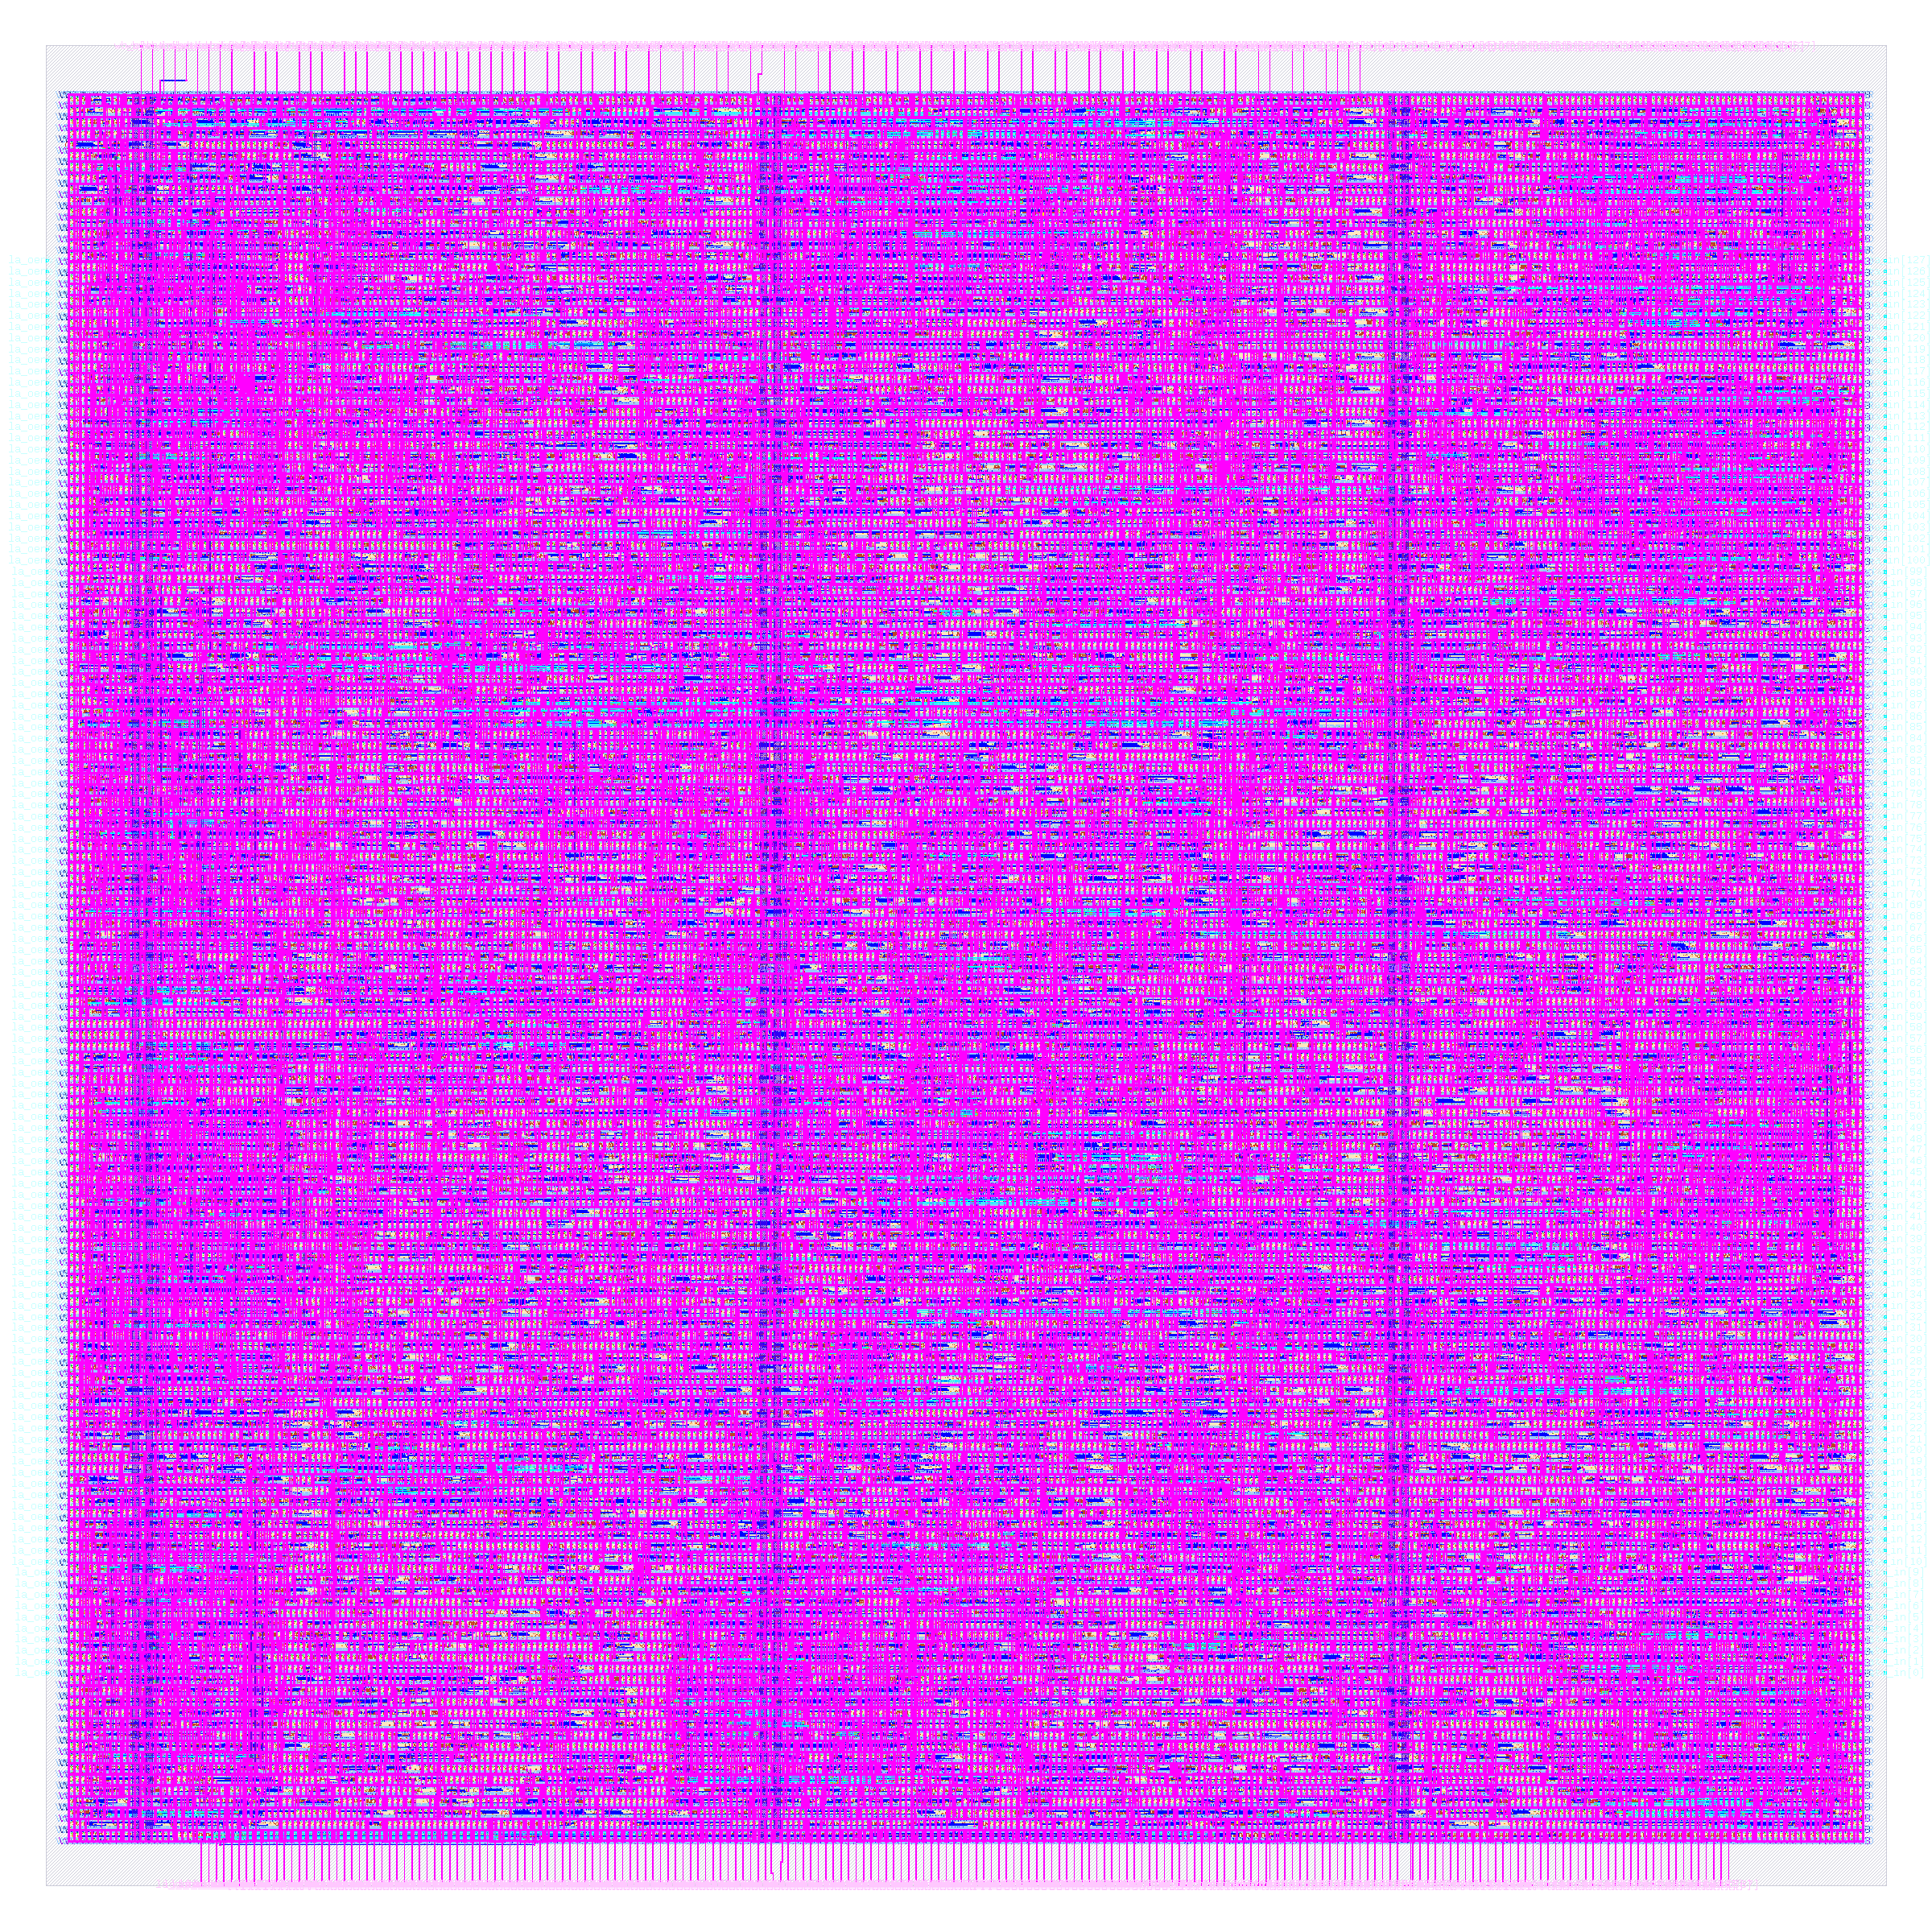
Here is fcnn_mnist as a finished layout
12,212
standard cells
450 × 450 µm
die size
8.0 min
build time, 2 CPUs / 8 GB
+0.08 ns
worst slack (hold)
2 CPUs / 8 GB, Apple-silicon VM; not fabricated.
Notes:
PLAN: block 60–85 min (Tour of the designs); about 1 min on this slide.
Sources: rtl/fcnn/user_proj_example.v, models/fcnn_mnist/golden.py header; models/fcnn_mnist/weights.json (float_test_accuracy 0.9208, hw_test_accuracy 0.9172); tests/testbenches/fcnn_mnist_tb.v (re-run, 1000 images: 0 mismatches, 909/1000, 602 cycles); build/v4/gl_all.log and gl_final.log (fcnn_mnist and user_proj_example: 100 images, PASS); docs/SPEC.md 6.2 (original 102,091 and 56,517 cells); designs/user_proj_example/config.json RT_MAX_LAYER met4; output/fcnn_mnist and output/user_proj_example metrics.json + resources.json.

Slide 46
cnn_lite recognises digits with a tiny convolution
Four 3 × 3 binary filters, a 2 × 2 pool, then a dense layer over 144 features.
14 × 14
bits
conv 3×3
4 filters
2×2 pool
144 bits
dense
144 → 10
Checked: all 10,000 images match; 91.37% accurate.
About 69 times fewer cells than cnn_fp16.
Notes:
PLAN: block 60–85 min (Tour of the designs); about 1 min on this slide.
Sources: rtl/cnn_lite/cnn_lite_top.v header; build/sim/cnn_lite_full.log ('10000 vectors, 0 errors', 150048 checks); docs/SPEC.md 6.5 (91.37%, 94.43% with 8 filters); build/v4/gl_all.log (cnn_lite PASS, 200 images, latency 1587); output/cnn_lite/metrics.json vs output/cnn_fp16/metrics.json (ratio 531505/7700). Detail: RTL equals the reference on all 10,000 images (150,048 checks, 0 errors); accuracy 91.37% (9,137 / 10,000); 8 filters would reach 94.43% at twice the ROM; 1,587 cycles per inference; gate-level simulation of 200 images passes. cnn_fp16 has 531,505 cells; cnn_lite 7,700 (ratio about 69).

Slide 47
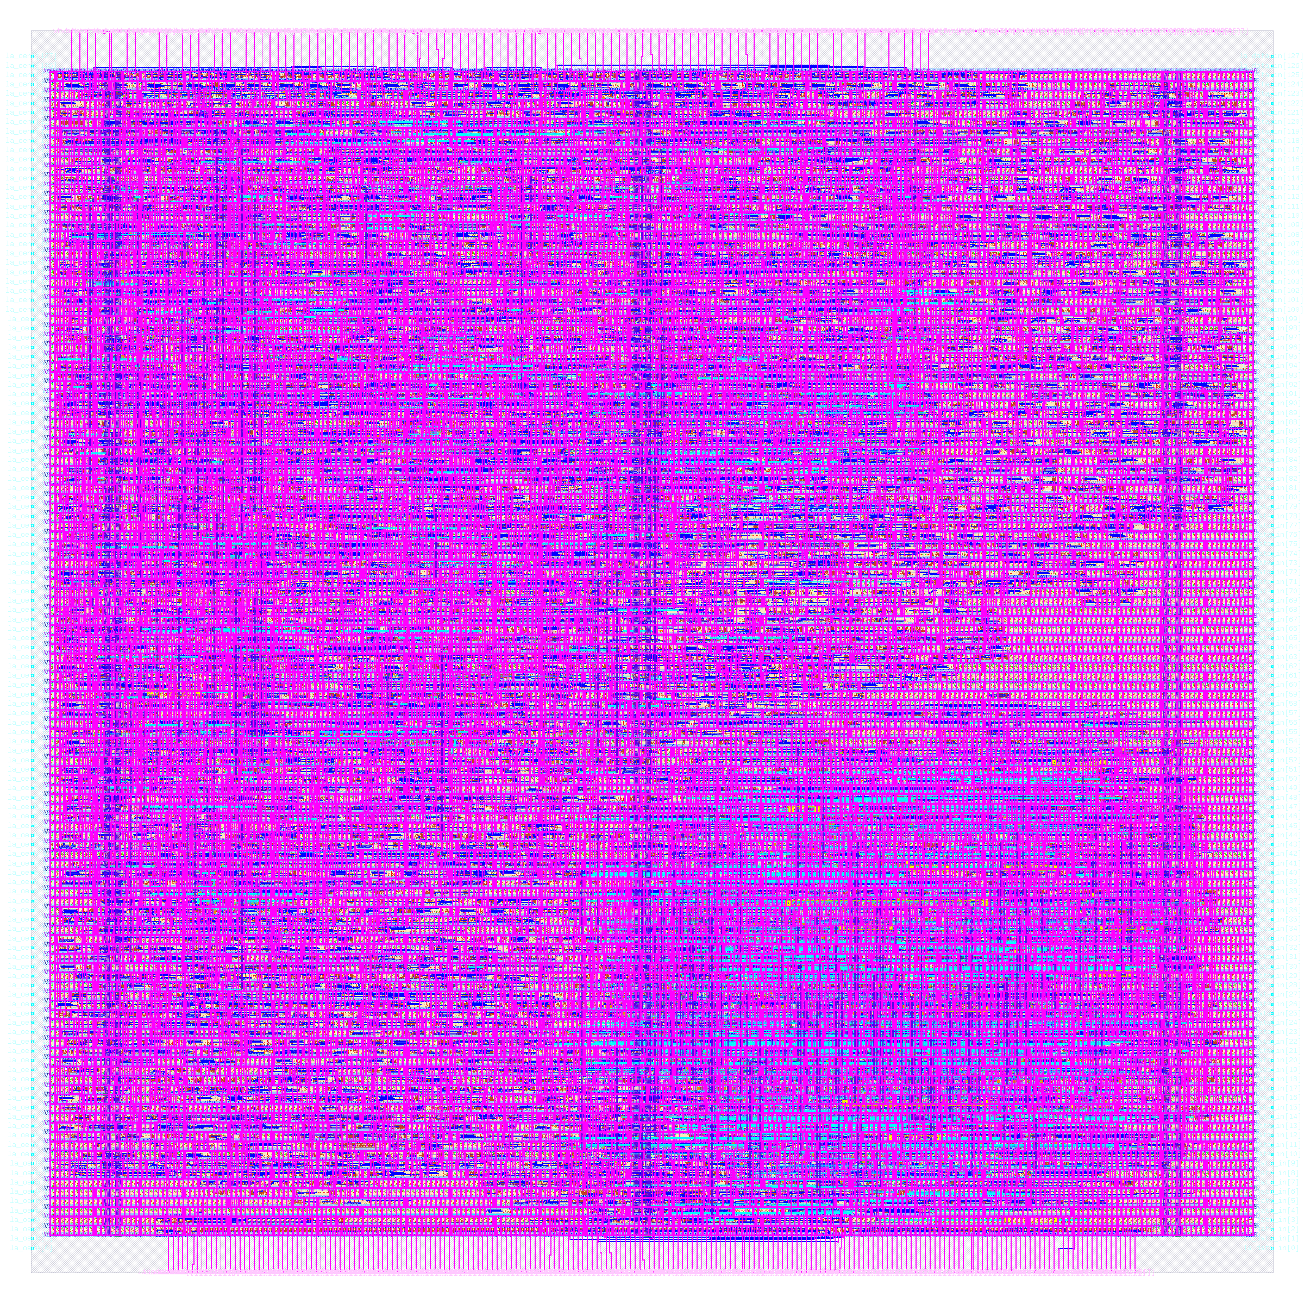
Here is cnn_lite as a finished layout
7,700
standard cells
360 × 360 µm
die size
6.9 min
build time, 2 CPUs / 8 GB
+0.07 ns
worst slack (hold)
2 CPUs / 8 GB, Apple-silicon VM; not fabricated.
Notes:
PLAN: block 60–85 min (Tour of the designs); about 1 min on this slide.
Sources: rtl/cnn_lite/cnn_lite_top.v header; build/sim/cnn_lite_full.log ('10000 vectors, 0 errors', 150048 checks); docs/SPEC.md 6.5 (91.37%, 94.43% with 8 filters); build/v4/gl_all.log (cnn_lite PASS, 200 images, latency 1587); output/cnn_lite/metrics.json vs output/cnn_fp16/metrics.json (ratio 531505/7700).

Slide 48
cnn_fp16 is the large float16 reference we keep
Conv2D, MaxPool and Dense in float16, generated by HLS. Not downsized; workstation only.
image
Conv2D
MaxPool
Dense
float16
Not re-verified here: no self-checking test in the repo.
Fails timing at the slow corner (−5.18 ns).
Notes:
PLAN: block 60–85 min (Tour of the designs); about 1 min on this slide.
Sources: CLAUDE.md and docs/SPEC.md 3 and 6.2 (108 KB HLS Verilog, cannot be regenerated, ~32 GB); output/cnn_fp16/metrics.json (531,505 cells, 2800 x 1760, setup -5.18, hold -0.49, slew 142,619, cap 2,207, 5,843 setup and 8 hold failing paths); docs/RESULTS.md (peak 23 GB, ~3.5 hours). No layout.png exists for it. Detail: 108 KB of HLS-generated Verilog; the HLS tool is not available so it cannot be regenerated. Hardened on a workstation (about 3.5 hours, 23 GB peak memory), 0 DRC, 0 LVS errors; setup -5.18 ns and hold -0.49 ns at the worst corner.

Slide 49
Here is cnn_fp16 as a finished layout
531,505
standard cells
2800 × 1760 µm
IMAGE PLACEHOLDER
die size
pending: build/results/cnn_fp16/layout.png
~3.5 h*
build time (workstation)
−5.18 ns
worst slack (setup)
Workstation only (*docs/RESULTS.md); fails timing at the slow corner. Not fabricated.
Notes:
PLAN: block 60–85 min (Tour of the designs); about 1 min on this slide.
Sources: CLAUDE.md and docs/SPEC.md 3 and 6.2 (108 KB HLS Verilog, cannot be regenerated, ~32 GB); output/cnn_fp16/metrics.json (531,505 cells, 2800 x 1760, setup -5.18, hold -0.49, slew 142,619, cap 2,207, 5,843 setup and 8 hold failing paths); docs/RESULTS.md (peak 23 GB, ~3.5 hours). No layout.png exists for it.

Slide 50
Lab block 2
Labs 4 to 6, then a knob experiment. Still uart: for example 32 clock buffers in lab 4.
Minutes 85–105 of 150
Notes:
PLAN: block 85–105 min (Lab block 2); about 0.5 min on this slide.
Block E: 20 minutes. Labs take 12, 32 and 65 s; the clock-period experiment about 55 s per value.

Slide 51
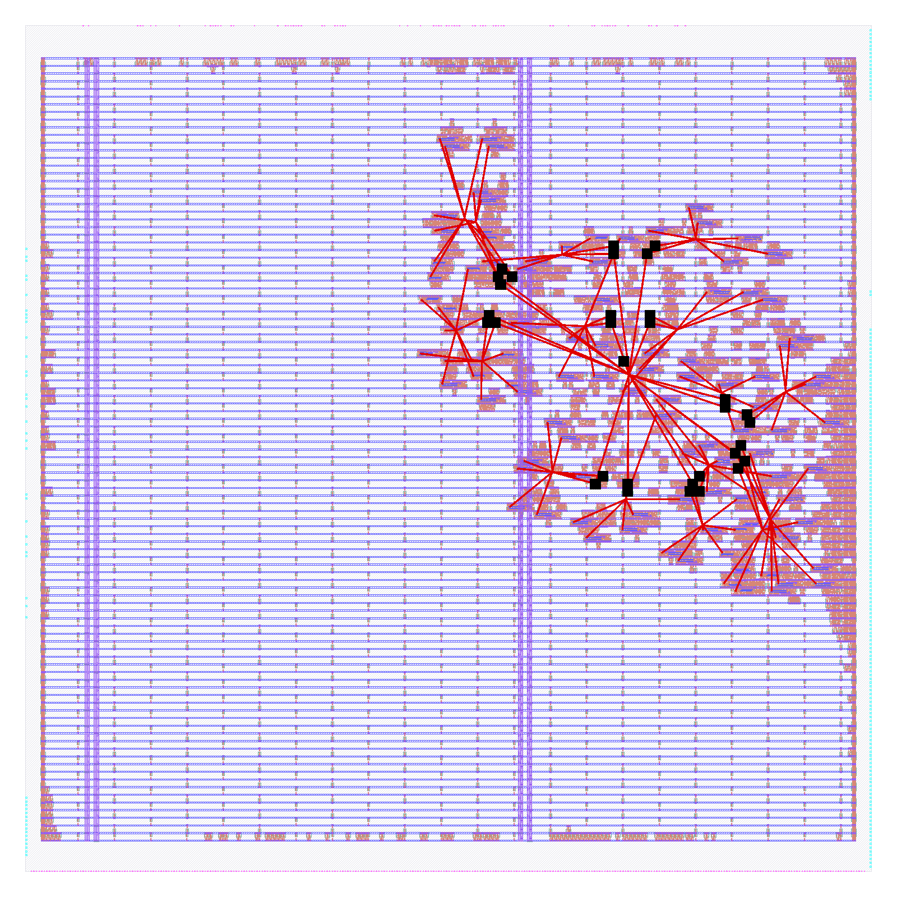
Lab 4: how many buffers does a clock tree need?
PREDICT
How many clock buffers for about 100 flip-flops?
RUN
make lab N=4
make lab-check N=4
LOOK AT
Clock buffers, slack, skew.
REFERENCE
32 buffers, skew 0.259 ns, hold +0.309 ns.
Labs use uart (2,026 cells, whole flow about 2 min): numbers differ from cnn_lite.
Run on this Mac's Linux VM (2 CPUs, 8 GB). Codespaces and Colab: not verified.
Notes:
PLAN: block 85–105 min (Lab block 2); about 4 min on this slide.
Sources: docs/LABS.md (worksheet, reference values, commands) and docs/SPEC.md 5.8; commands are defined in mk/L1.mk (lab-setup, lab, lab-check, lab-list, lab-reset, lab-knob, lab-pack, lab-unpack). Reference values are for uart, measured on the Mac VM (arm64, 2 CPUs, 8 GB, profile tight); x86 machines, a real Codespace and Colab are NOT tested (LABS.md expects 1.5 to 2 times longer). Labs run on uart, the flow section shows cnn_lite: reference numbers differ (e.g. lab 4: 32 clock buffers on uart; cnn_lite's clock tree has 127 buffers/loads in stages.json). Predict: how many clock buffers does a tree for about 100 flip-flops need? Why (ask the room): Why does CTS care about hold slack but placement did not? If it fails: Hold or slew failures show as negative slack; the lab still completes.

Slide 52
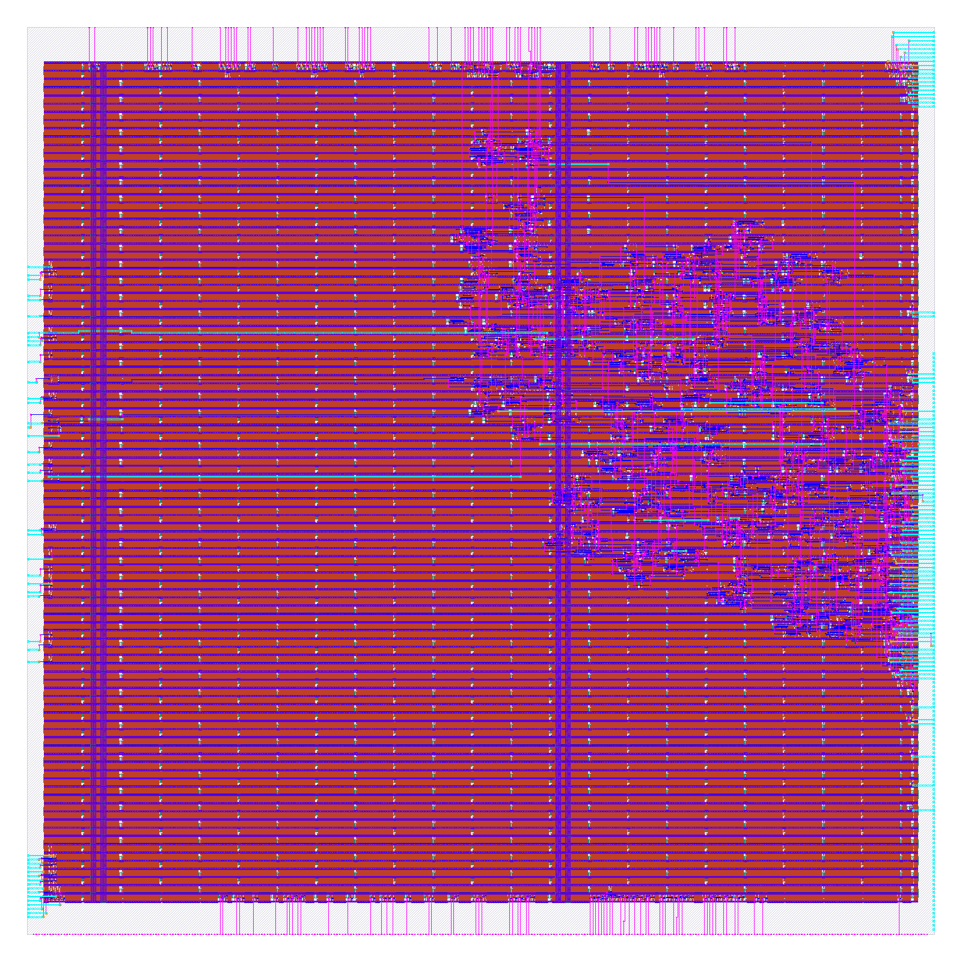
Lab 5: is the routed wire longer than the estimate?
PREDICT
Routed wire versus lab 3's estimate: shorter, equal, longer?
RUN
make lab N=5
make lab-check N=5
LOOK AT
Routed wirelength, violations.
REFERENCE
18,764 µm routed; 0 routing, 0 antenna violations.
Labs use uart (2,026 cells, whole flow about 2 min): numbers differ from cnn_lite.
Run on this Mac's Linux VM (2 CPUs, 8 GB). Codespaces and Colab: not verified.
Notes:
PLAN: block 85–105 min (Lab block 2); about 4 min on this slide.
Sources: docs/LABS.md (worksheet, reference values, commands) and docs/SPEC.md 5.8; commands are defined in mk/L1.mk (lab-setup, lab, lab-check, lab-list, lab-reset, lab-knob, lab-pack, lab-unpack). Reference values are for uart, measured on the Mac VM (arm64, 2 CPUs, 8 GB, profile tight); x86 machines, a real Codespace and Colab are NOT tested (LABS.md expects 1.5 to 2 times longer). Labs run on uart, the flow section shows cnn_lite: reference numbers differ (e.g. lab 4: 32 clock buffers on uart; cnn_lite's clock tree has 127 buffers/loads in stages.json). Predict: routed wire length versus the lab 3 estimate: shorter, equal or longer? Why (ask the room): Why is the final wire longer than the placement estimate? If it fails: The route may be too congested (see knob util); the message names the step. About 30 s: talk while it runs.

Slide 53
Lab 6: which signoff check fails first?
PREDICT
DRC, LVS or XOR: which is likeliest to fail?
RUN
make lab N=6
make lab-check N=6
LOOK AT
DRC, LVS, XOR, three corners.
REFERENCE
All four checks 0; setup +16.5 / +13.2 / +17.7 ns.
Labs use uart (2,026 cells, whole flow about 2 min): numbers differ from cnn_lite.
Run on this Mac's Linux VM (2 CPUs, 8 GB). Codespaces and Colab: not verified.
Notes:
PLAN: block 85–105 min (Lab block 2); about 4 min on this slide.
Sources: docs/LABS.md (worksheet, reference values, commands) and docs/SPEC.md 5.8; commands are defined in mk/L1.mk (lab-setup, lab, lab-check, lab-list, lab-reset, lab-knob, lab-pack, lab-unpack). Reference values are for uart, measured on the Mac VM (arm64, 2 CPUs, 8 GB, profile tight); x86 machines, a real Codespace and Colab are NOT tested (LABS.md expects 1.5 to 2 times longer). Labs run on uart, the flow section shows cnn_lite: reference numbers differ (e.g. lab 4: 32 clock buffers on uart; cnn_lite's clock tree has 127 buffers/loads in stages.json). Predict: which of DRC, LVS, XOR is most likely to fail on a flow-generated design? Why (ask the room): Which corner is worst for setup, and why? If it fails: A DRC or LVS count above 0 is a real finding, not a tooling error; open mine/lab6/runs/lab/final/ reports. About 1 minute: talk while it runs. Reference corners: tt 16.521, ss 13.230, ff 17.667 ns.

Slide 54
Experiment: tighten the clock until slack goes negative
RUN
make lab-knob KNOB=clock VALUE=10
make lab-knob KNOB=clock VALUE=6
about 55 s each
25 ns
10 ns
6 ns
+13.194 ns
+1.086 ns
−0.228 ns
slack
slack
51 failing paths
Clock period (uart): shorter clock, less slack.
Run on this Mac's Linux VM (2 CPUs, 8 GB). Codespaces and Colab: not verified.
Notes:
PLAN: block 85–105 min (Lab block 2); about 4 min on this slide.
Sources: docs/LABS.md (worksheet, reference values, commands) and docs/SPEC.md 5.8; commands are defined in mk/L1.mk (lab-setup, lab, lab-check, lab-list, lab-reset, lab-knob, lab-pack, lab-unpack). Reference values are for uart, measured on the Mac VM (arm64, 2 CPUs, 8 GB, profile tight); x86 machines, a real Codespace and Colab are NOT tested (LABS.md expects 1.5 to 2 times longer). Knob clock on uart: 25 ns: slack +13.194; 10 ns: +1.086; 6 ns: -0.228 ns with 51 failing paths (LABS.md knob table; SPEC 5.8). Each run about 55 s; runs on a copy of the config, designs/*/config.json is not touched. A failing run is a valid result. Ask: what did we ask for that the chip could not give?

Slide 55
More knobs: each change has a measured cost
synth
AREA 0 / AREA 3 / DELAY 0
674 / 968 / 740 cells
density
make lab-knob KNOB=density VALUE=70
routed wire −3.8%
util
VALUE=75, then 92 (spm_ref)
fails: cannot legalize
A failing run is a valid result.
Notes:
PLAN: block 85–105 min (Lab block 2); about 3 min on this slide.
Sources: docs/LABS.md (worksheet, reference values, commands) and docs/SPEC.md 5.8; commands are defined in mk/L1.mk (lab-setup, lab, lab-check, lab-list, lab-reset, lab-knob, lab-pack, lab-unpack). Reference values are for uart, measured on the Mac VM (arm64, 2 CPUs, 8 GB, profile tight); x86 machines, a real Codespace and Colab are NOT tested (LABS.md expects 1.5 to 2 times longer). Knob table in docs/LABS.md: synthesis strategy on uart AREA 0: 674 cells, AREA 3: 968, DELAY 0: 740 (make lab-knob KNOB=synth "VALUE=AREA 3"); placement density 70: routed wirelength 18764 -> 18054 um (-3.8 percent; global-route wirelength went UP 0.9 percent, one design and one change: do not over-claim); utilization on spm_ref: 40 passes, 75 fails in the repair step after global placement (DPL-0036), 92 fails in global placement (GPL-0301). DELAY 1 is refused on purpose (out of memory at 16 GB or less).

Slide 56
What verification caught
The originals' defects, then the hollow-design story and two new checks
Minutes 105–125 of 150
Notes:
PLAN: block 105–125 min (What verification caught); about 0.5 min on this slide.
Block F: 20 minutes. Sources: docs/SPEC.md section 3 and build/audit/AUDIT.md (audit of 2026-10-05).

Slide 57
The originals had real bugs; we fixed them
FOUND
NOW
spm_ref
did not multiply
rewritten, tested
aes128
wrong ciphertext
new core passes NIST
bnn_mnist
random weights
trained, 90.10%
fcnn_mnist
accuracy never tested
91.72% measured
Six small tests
could not fail
now exit non-zero
cnn_fp16
fails slow-corner timing
kept as reference
Notes:
PLAN: block 105–125 min (What verification caught); about 3 min on this slide.
Sources: docs/SPEC.md section 3 and 6.2; the commit message of d2e98d2 (git log); output/baseline_tight.md; output/cnn_fp16/metrics.json (setup -5.18, hold -0.49). 'Six small tests' = spm_ref, counter_wb, uart, ring_osc, pwm_dac, sigma_delta (SPEC section 3). Full table in the appendix.

Slide 58
A clean layout of an empty design
PASSED
RTL simulation
DRC
LVS
Timing
INSIDE
almost nothing: the logic had been removed
Found by an audit on 2026-10-05, in counter_wb and ring_osc.
Notes:
PLAN: block 105–125 min (What verification caught); about 3 min on this slide.
Sources: build/audit/AUDIT.md (Verdict: two of eleven cloud designs are hollow; counter_wb kept 1 flip-flop of ~67, ring_osc lost its 31-inverter ring; 'the flow, metrics, CI gate and RTL simulations all report them as clean'); docs/SPEC.md section 3. This is the best teaching story of the project: every check we ran agreed, and every check was blind to the same thing.

Slide 59
counter_wb kept 1 flip-flop of about 67
Original
1
Fixed
67
flip-flops that survived synthesis
Cause: two always blocks drove the same registers.
Now 1,214 standard cells (was 750).
Notes:
PLAN: block 105–125 min (What verification caught); about 3 min on this slide.
Sources: build/audit/AUDIT.md finding 1 (counter, running, overflow assigned in two always blocks; Yosys 'multiple conflicting drivers' x34; 1 FF kept; 32 bits of wbs_dat_o and 128 la_data_out bits tied to constants; hidden by ERROR_ON_SYNTH_CHECKS=false); rtl/examples/counter_wb/counter_wb.v header ('every register ... is assigned in the ONE always block below'); output/counter_wb/metrics.json (design__instance__count__class:sequential_cell = 67, design__instance__count__stdcell = 1,214, was 750 in output/baseline_tight.md; synthesis__check_error__count = 0).

Slide 60
ring_osc lost its entire ring of inverters
31 inverting
stages
Yosys folds
and deletes
no ring in
the netlist
66 of 77 flip-flops found; the RTL test used a divider.
Fixed: the ring is built from explicit sky130 cells.
Now 830 standard cells (was 709).
Notes:
PLAN: block 105–125 min (What verification caught); about 3 min on this slide.
Sources: build/audit/AUDIT.md finding 2 (the (* keep *) not-primitive ring was dropped; no combinational cycle in the netlist; RTL test replaced the ring with a divider); rtl/examples/ring_osc/ring_osc_wb.v header (Yosys folds pairs of $not cells and deletes the loop; ring now built from explicit sky130_fd_sc_hd__nand2_1 and __inv_1 instances, dont-touch in the config; counted edge = 64 ring cycles); build/v4/gl_all.log (ring_osc gate-level test on the real cell ring PASS); output/ring_osc/metrics.json (new build) vs output/baseline_tight.md (709 cells).

Slide 61
Two new permanent checks guard against hollow designs
make gl-counter
Simulate the synthesized netlist
pattern: gl-<name>, e.g. gl-counter
make check-counter
Surviving registers = RTL registers
pattern: check-<name>, e.g. check-counter
Run on this Mac's Linux VM only.
Notes:
PLAN: block 105–125 min (What verification caught); about 4 min on this slide.
Sources: mk/Q1.mk header (make gl-<name>: synthesis-only LibreLane run on a copy, then the design's self-checking testbench on the sky130 netlist with the sky130_fd_sc_hd functional models; make check-<name>: scripts/flow/check_signoff.py, DRC/LVS/XOR/antenna/slack/synthesis checks and 'surviving flip-flops >= flip-flops the RTL elaborates to'; gl-all and check-all run every design; names: spm counter uart aes128 ring-osc pwm-dac sigma-delta bnn fcnn user-proj cnn-lite). docs/SPEC.md 6.6 and 3. These commands have been run on the Mac VM only.

Slide 62
Both new checks pass for all 11 designs
11 of 11
11 of 11
11 of 11
gate-level, synthesized netlist
gate-level, routed netlist
registers survive
Before the fix
counter_wb: 1 of about 67 flip-flops kept
ring_osc: the whole ring gone from the netlist
Notes:
PLAN: block 105–125 min (What verification caught); about 3 min on this slide.
Sources: build/v4/gl_all.log (gl-all on the synthesized netlist: 11 of 11 PASS; vectors: spm_ref exhaustive 8x8 plus random, 67,286 multiplications; uart_wb 34 Wishbone loopback bytes; aes128 3 known-answer vectors plus 1,000 core and 1,000 Wishbone vectors; bnn_mnist 200 vectors; cnn_lite 200; fcnn_mnist and user_proj_example 100 images each; counter_wb, ring_osc, pwm_dac, sigma_delta their committed testbenches); build/v4/gl_final.log (same testbenches on the post-route netlist: 11 of 11 rc=0), build/v4/check_all.log (make check-all: registers the RTL describes equal the sequential cells that survive: 16, 67, 101, 686, 77, 25, 74, 517, 668, 668, 617 for the designs in table order spm_ref, counter_wb, uart, aes128, ring_osc, pwm_dac, sigma_delta, bnn_mnist, fcnn_mnist, user_proj_example, cnn_lite; 11 of 11 PASS). Written by an independent verifier. Before the fix: counter_wb kept 1 of about 67 flip-flops and ring_osc lost its ring (66 flip-flops found, ring absent), build/audit/AUDIT.md. Commands: make gl-<name>, make check-<name> (mk/Q1.mk).

Slide 63
Road to silicon
Run it yourself afterwards; then Caravel and ChipIgnite, clearly marked as planned
Minutes 125–140 of 150
Notes:
PLAN: block 125–140 min (Road to silicon); about 0.5 min on this slide.
Block G: 15 minutes.

Slide 64
make lunch: one unattended command
RUN
make lunch
bnn_mnist by default
7 min 48 s
14 s
437 s
bnn_mnist, Docker, development Mac
the same, on a re-run
bnn_mnist, Docker-free Ubuntu container
Container: 2 CPUs, 8 GB, arm64. A re-run skips finished stages.
Notes:
PLAN: block 125–140 min (Road to silicon); about 4 min on this slide.
Sources: mk/F3.mk and scripts/flow/lunch.sh (check the environment, install what is missing, simulate, harden reuse-first, check-<name>, gl-<name> NETLIST=final on the routed netlist, collect, pack build/lunch/open-ai-silicon-lunch_<design>.tar.gz); README.md and docs/SETUP.md: bnn_mnist in Docker mode 7 min 48 s end to end on the development Mac, 14 s on a re-run; Docker-free in a fresh ubuntu:22.04 container (2 CPUs, 8 GB, no Docker, arm64): spm_ref 191 s including a 138 s tool install, bnn_mnist 437 s. Uses Docker when a daemon answers, otherwise the Nix-installed tools. Not measured on x86, Colab or a real Codespace.

Slide 65
Running it yourself: where things stand today
GitHub Actions
tests and RTL simulation passed twice; hardening, gate-level and lunch workflows not run there
DONE
Colab notebook
exists; ran as a script in a container, not run on Colab
OPEN
Codespaces
nothing run in a real Codespace
OPEN
Repository
private
OPEN
The labs have run on one Mac's Linux VM only.
Notes:
PLAN: block 125–140 min (Road to silicon); about 4 min on this slide.
Sources: owner statement 2026-10-05 and docs/AGENTS_QUICKREF.md / README.md: the repository is PRIVATE; the Colab notebook notebooks/open_ai_silicon_rtl2gds.ipynb exists and its cells ran as a script in a Docker-free Ubuntu container, but it has NOT been run on Colab; nothing has run in a real Codespace (.devcontainer/devcontainer.json exists); GitHub Actions: the test and RTL-simulation jobs have passed twice on GitHub (gh run list: ci success, two runs); the hardening, gate-level and lunch workflows have not run there. docs/WORKSHOP_HOSTING.md for the routes.

Slide 66
Next, a design could go to silicon through ChipIgnite
PLANNED, NOT DONE
Harden
bnn_mnist
Wrap in
Caravel
Pass
precheck
Submit
(a human)
The wrapper and the precheck are not done yet.
Notes:
PLAN: block 125–140 min (Road to silicon); about 2 min on this slide.
Sources: docs/SPEC.md section 8 (8.2 wrapper rules, die 2920 x 3520 um; 8.4 hardening, macro about 400 x 400 um; 8.5 precheck, 14 checks; 8.6 submission) and section 12 (open decision 3). Repository has no chipignite/ directory (checked 2026-10-05). PLANNED, NOT DONE.

Slide 67
What stands between this and a shuttle
Caravel wrapper and ChipFoundry precheck
not started
OPEN
Gate-level and no-logic-lost checks
in place
DONE
Max-slew violations
remain in 8 designs
OPEN
Fabricated
nothing
OPEN
spm_ref, counter_wb, uart, ring_osc, sigma_delta, aes128, fcnn_mnist, user_proj_example
Notes:
PLAN: block 125–140 min (Road to silicon); about 3 min on this slide.
Sources: docs/SPEC.md section 8 (wrapper, precheck) and 6.1 (target: max-slew and max-cap reported); mk/Q1.mk (gl-<name>, check-<name>); build/v4/gl_all.log, gl_final.log, check_all.log (11 of 11); output/<design>/metrics.json design__max_slew_violation__count > 0 for: spm_ref, counter_wb, uart, ring_osc, sigma_delta, aes128, fcnn_mnist, user_proj_example (plus cnn_fp16, a workstation reference). No chipignite/ directory exists. Nothing fabricated.

Slide 68
A shuttle slot costs money and needs a decision
$14,950
2026-12-07
20
per project
tapeout date
projects needed
Shuttle CI2612. Facts from web research, not re-verified.
Whether to buy a slot is still the owner's decision.
Notes:
PLAN: block 125–140 min (Road to silicon); about 2 min on this slide.
Sources: docs/SPEC.md 8.7 'Shuttle facts' (web research of 2026-10-04, marked unverified): CI2612 commitment 2026-11-04, tapeout 2026-12-07, delivery 2027-05-25; $14,950 per project (100 packaged parts or bare die, an evaluation board); $500 non-refundable deposit; a shuttle needs 20 projects; no standing free shuttle found. docs/SPEC.md 12: whether to buy a slot is an open owner decision.

Slide 69
Three things to take away
A chip flow is small steps you can run and inspect
1
Open tools and an open PDK make every step visible
2
Clean checks are not enough: verify the logic survived
3
Notes:
PLAN: block 140–150 min (Recap and questions); about 3 min on this slide.
Recap: (1) the flow is a sequence of small stages you can run and look at (blocks B, C, E); (2) open tools plus an open PDK make every step inspectable; (3) clean DRC, LVS and timing do not prove the logic survived: count what survives and simulate the netlist (block F).

Slide 70
Twelve designs, one open flow, nothing fabricated yet
12
11
0
0
designs
rebuilt on 2 CPUs / 8 GB
builds pending
chips fabricated
Standard cells = design__instance__count__stdcell:
it counts tap cells, not fill.
Notes:
PLAN: block 140–150 min (Recap and questions); about 2.5 min on this slide.
Sources: designs/ (12 design directories); output/<design>/resources.json present for 11 designs rebuilt under the tight profile; no chip has been fabricated (docs/SPEC.md section 8, 12). Standard cells = design__instance__count__stdcell, which counts tap cells but not fill (docs/SPEC.md 6.2); excluding tap cells bnn_mnist is 5,828 and aes128 7,288. Full tables in the appendix.

Slide 71
Where to go next: run it again, on your own
make lunch
make lab-setup
make lab N=1
make gl-counter
One run, the labs, the gate-level check
github.com/rajaghv-dev/open-ai-silicon
The repository is private for now.
Notes:
PLAN: block 140–150 min (Recap and questions); about 2 min on this slide.
Sources: mk/L1.mk and mk/Q1.mk (commands); docs/LABS.md; repository URL from README.md (private at the moment of writing). Commands shown exist in the repository's make files.

Slide 72
Questions
Raja Gopal · Prepared for Open Source India
github.com/rajaghv-dev/open-ai-silicon
Minutes 140–150 of 150
Notes:
PLAN: block 140–150 min (Recap and questions); about 3 min on this slide.
Questions. Sources: README.md (repository URL); git config user.name.

Slide 73
Appendix
Full tables and command reference
Notes:
PLAN: appendix, not presented.
Appendix: detail removed from the main slides; not presented.

Slide 74
Appendix: build numbers per design
Design | Std cells* | Die (µm) | Setup ns | at | Hold ns | at | Peak mem | Wall
spm_ref | 140 | 59.1 × 69.8 | +1.61 | max_ss | +0.10 | min_ff | 0.64 GB | 42 s
counter_wb | 1,214 | 200 × 200 | +8.05 | max_ss | +0.11 | min_ff | 0.60 GB | 70 s
uart | 2,026 | 300 × 300 | +13.19 | max_ss | +0.11 | min_ff | 0.84 GB | 112 s
ring_osc | 830 | 150 × 150 | +8.44 | max_ss | +0.11 | min_ff | 0.60 GB | 57 s
pwm_dac | 524 | 150 × 150 | +13.87 | max_ss | +0.12 | min_ff | 0.57 GB | 51 s
sigma_delta | 1,026 | 200 × 200 | +10.76 | max_ss | +0.11 | min_ff | 0.63 GB | 74 s
aes128 | 9,403 | 400 × 400 | +8.61 | max_ss | +0.06 | min_ff | 1.62 GB | 7.5 min
bnn_mnist | 7,466 | 360 × 360 | +11.35 | max_ss | +0.11 | min_ff | 1.21 GB | 7.1 min
fcnn_mnist | 12,212 | 450 × 450 | +9.65 | max_ss | +0.08 | max_ff | 1.54 GB | 8.0 min
user_proj_example | 12,361 | 450 × 450 | +9.61 | max_ss | +0.10 | max_ff | 1.57 GB | 7.7 min
cnn_lite | 7,700 | 360 × 360 | +11.62 | max_ss | +0.07 | min_ff | 1.38 GB | 6.9 min
cnn_fp16 | 531,505 | 2800 × 1760 | −5.18 | max_ss | −0.49 | max_ss | 23 GB† | ~3.5 h†
*Std cells: design__instance__count__stdcell (taps in, fill out). †cnn_fp16: docs/RESULTS.md. ss = slow, ff = fast corner.
Notes:
PLAN: appendix, not presented.
Sources: output/<design>/metrics.json (design__instance__count__stdcell, design__die__bbox, timing__setup__ws__corner:* and timing__hold__ws__corner:*: worst over all corners, corner named) and resources.json; same values as scripts/docs_tables.py. Tight profile: 2 CPUs, 8 GB, Apple-silicon VM; cloud x86 will be slower. cnn_fp16 peak/wall: docs/RESULTS.md workstation run.

Slide 75
Appendix: signoff counts per design
Design | Magic DRC | KLayout | LVS | Antenna | XOR | Max-slew | Max-cap
spm_ref | 0 | 0 | 0 | 0 | 0 | 11 | 0
counter_wb | 0 | 0 | 0 | 0 | 0 | 41 | 0
uart | 0 | 0 | 0 | 0 | 0 | 24 | 0
ring_osc | 0 | 0 | 0 | 0 | 0 | 27 | 0
pwm_dac | 0 | 0 | 0 | 0 | 0 | 0 | 0
sigma_delta | 0 | 0 | 0 | 0 | 0 | 18 | 0
aes128 | 0 | 0 | 0 | 0 | 0 | 40 | 0
bnn_mnist | 0 | 0 | 0 | 0 | 0 | 0 | 0
fcnn_mnist | 0 | 0 | 0 | 0 | 0 | 4 | 0
user_proj_example | 0 | 0 | 0 | 0 | 0 | 4 | 0
cnn_lite | 0 | 0 | 0 | 0 | 0 | 0 | 0
cnn_fp16 | 0 | 0 | 0 | 0 | 0 | 142,619 | 2,207
Orange = remaining max-slew / max-cap violations.
Notes:
PLAN: appendix, not presented.
Sources: output/<design>/metrics.json keys magic__drc_error__count, klayout__drc_error__count, design__lvs_error__count, antenna__violating__nets, design__xor_difference__count, design__max_slew_violation__count, design__max_cap_violation__count.

Slide 76
Appendix: how each design was verified (1 of 2)
Design | Verification
spm_ref | Self-checking testbench compares every product bit with a x b computed in the testbench: 67,286 multiplications, 1,094,197 checks, 0 errors (iverilog); gate-level simulation of the synthesized netlist also passes (build/v4/gl_all.log). Original RTL did not multiply; rewritten with the same ports.
counter_wb | RTL testbench passes five checks (initial value, write/read, reset, free-running count, logic-analyzer mirror); gate-level simulation of the synthesized netlist passes (build/v4/gl_all.log). The original assigned its registers in two always blocks, so synthesis kept 1 of about 67 flip-flops (build/audit/AUDIT.md); now all in one block (RTL header), 67 sequential cells in output/counter_wb.
uart | The committed uart_tb exercises uart_tx and uart_rx only (loopback, CLKS_PER_BIT = 5). The gate-level runs use 34 Wishbone loopback bytes (uart_wb_tb) and pass on the synthesized and the routed netlist (build/v4/gl_all.log, gl_final.log).
ring_osc | The original ring (a combinational loop of not primitives) was folded away by Yosys; the RTL test used a divider instead of the ring (build/audit/AUDIT.md). Now the ring is built from explicit sky130 nand2_1 / inv_1 cells (RTL header) and the gate-level test runs on the real cell ring and passes (build/v4/gl_all.log). Oscillation frequency in silicon remains unmeasured.
pwm_dac | Testbench passes: duty 0 always low, duty 255 gives 255/256 high, duty 128 gives exactly 50%, duty register reads back (iverilog). Gate-level simulation passes.
sigma_delta | Testbench passes: input 0 gives all zeros, 0xFFFF all ones, 0x8000 about 50%, density register near 128, input register reads back (iverilog). Gate-level simulation passes.
Notes:
PLAN: appendix, not presented.
Sources: see each design's slide notes; testbench runs of tests/testbenches/*; build/v4/gl_all.log.

Slide 77
Appendix: how each design was verified (2 of 2)
Design | Verification
aes128 | Passes FIPS-197 Appendix B and C.1 and the all-zero vector, plus 1,000 random vectors through the core and 1,000 through Wishbone: 0 mismatches (iverilog); gate-level simulation passes (build/v4/gl_all.log). Original build: 32,432 cells, 800 x 800 um, setup -6.20 ns, wrong ciphertext for both NIST vectors.
bnn_mnist | RTL equals the integer reference on all 10,000 MNIST test images (130,302 checks, 0 errors). Accuracy 90.10% (9,010 / 10,000). 770 cycles per inference; 7,552 ROM bits. Gate-level simulation of 200 images passes. Before: 784 -> 32 -> 10 with random weights, 34,707 cells, 900 x 900 um, setup -6.62 ns.
fcnn_mnist | 1,000 MNIST images through Wishbone: 0 mismatches against the bit-exact reference, 909 / 1,000 correct, 602 cycles each. On 10,000 images the model gives 92.08% in floating point and 91.72% hardware-exact. Gate-level simulation of 100 images passes on the synthesized and routed netlists (build/v4). user_proj_example: same RTL, RT_MAX_LAYER met4; see appendix.
cnn_lite | RTL equals the reference on all 10,000 images (150,048 checks, 0 errors); accuracy 91.37% (9,137 / 10,000); 8 filters would reach 94.43% at twice the ROM; 1,587 cycles per inference; gate-level simulation of 200 images passes. cnn_fp16 has 531,505 cells; cnn_lite 7,700 (ratio about 69).
cnn_fp16 | 108 KB of HLS-generated Verilog; the HLS tool is not available so it cannot be regenerated. Hardened on a workstation (about 3.5 hours, 23 GB peak memory), 0 DRC, 0 LVS errors; setup -5.18 ns and hold -0.49 ns at the worst corner.
Notes:
PLAN: appendix, not presented.
Sources: see each design's slide notes; testbench runs of tests/testbenches/*; build/v4/gl_all.log.

Slide 78
Appendix: what we found in the originals
Design | Found | Now
spm_ref | RTL did not multiply: 3 × 3 gave 3. Its test was failing but exited 0. | Rewritten (carry-save, same ports); test checks 1,094,197 bits, 0 errors.
counter_wb | Hollow: 1 of about 67 flip-flops survived synthesis (34 'multiple conflicting drivers'); RTL simulation, DRC, LVS and timing passed. | All registers in one always block; gate-level test passes.
ring_osc | Hollow: the 31-inverter ring was deleted by synthesis; the RTL test used a divider instead. | Ring built from explicit sky130 cells; gate-level test on the real ring passes.
aes128 | Wrong ciphertext for both NIST vectors; 1,306 failing endpoints at max_ss_100C_1v60, worst setup −6.20 ns. | Column-serial core passes FIPS-197 and 2,000 random blocks.
bnn_mnist | Random weights; pixel register sampled every clock; testbench used the wrong address and passed anyway; 32 failing endpoints at max_ss_100C_1v60, worst setup −6.62 ns. | Trained (90.10%); handshake fixed; RTL matches reference on 10,000 images.
fcnn_mnist | Testbench only checked that the RTL compiles; accuracy in hardware unknown; 102,091 cells. | 196 inputs, 8-bit; 91.72% hardware-exact.
cnn_fp16 | Fails slow-corner setup (−5.18 ns) and hold (−0.49 ns); 142,619 max-slew violations. | Not changed: HLS source unavailable; workstation-only.
Six small tests | Each ended in a plain $finish, so a failed check could not fail the run. | All testbenches now exit non-zero on a failed check or a timeout.
Notes:
PLAN: appendix, not presented.
Sources: docs/SPEC.md section 3 and 6.2; build/audit/AUDIT.md; output/baseline_tight.md; output/*/metrics.json (per-corner: timing__setup_vio__count__corner:max_ss_100C_1v60 = 32 for the original bnn_mnist, 1,306 for the original aes128).

Slide 79
Appendix: fcnn_mnist and user_proj_example
Design | Std cells | Setup / hold (ns) | Wall | Peak | Max-slew | Max-cap
fcnn_mnist | 12,212 | +9.65 / +0.08 | 8.0 min | 1.54 GB | 4 | 0
user_proj_example (met4 only) | 12,361 | +9.61 / +0.10 | 7.7 min | 1.57 GB | 4 | 0
Same RTL; user_proj_example is routed up to met4 only.
Notes:
PLAN: appendix, not presented.
Sources: output/fcnn_mnist and output/user_proj_example metrics.json and resources.json; designs/user_proj_example/config.json RT_MAX_LAYER met4.

Slide 80
Appendix: lab and check commands
Command | What it does
make lunch [DESIGN=bnn_mnist] | one unattended run: check, install, simulate, harden, gl, pack
make view [DESIGN=uart] | walk through the stored results
make lab-setup | once: reference run + checkpoints (~2 min)
make lab N=3 | run lab 3 into your own area
make lab-check N=3 | compare with the reference
make lab-list | labs, expected time, your status
make lab-reset | clear your results
make lab-knob KNOB=clock VALUE=10 | cause-and-effect experiment
make lab-pack / lab-unpack PACK=<file> | fallback pack
make gl-<name> / check-<name> | gate-level sim / surviving registers; <name> is spm, counter, uart, aes128, ring-osc, pwm-dac, sigma-delta, bnn, fcnn, user-proj or cnn-lite
Notes:
PLAN: appendix, not presented.
Sources: docs/LABS.md Commands; mk/L1.mk (lab-setup, lab, lab-check, lab-reset, lab-list, lab-knob, lab-pack, lab-unpack); mk/Q1.mk (gl-<name>, gl-all, check-<name>, check-all). Options DESIGN=uart (default), PROFILE=tight, CPUSET, USE_DOCKER=0 (not tested), LABROOT.

Slide 81
Appendix: the stages of cnn_lite, step by step
Stage | Step | Tool | Step time
floorplan | 13-openroad-floorplan | OpenROAD | 0.63 s
pdn | 21-openroad-generatepdn | OpenROAD | 0.639 s
global_placement | 28-openroad-globalplacement | OpenROAD | 1.965 s
placement | 34-openroad-detailedplacement | OpenROAD | 0.757 s
cts | 35-openroad-cts | OpenROAD | 6.957 s
routing | 45-openroad-detailedrouting | OpenROAD | 250.21 s
final_def | final | OpenROAD, Magic and KLayout (final outputs) | n/a
final | final | OpenROAD, Magic and KLayout (final outputs) | n/a
zoom | final | OpenROAD, Magic and KLayout (final outputs) | n/a
Notes:
PLAN: appendix, not presented.
Sources: build/results/_flow_stages/cnn_lite/stages.json (stage, step_directory, tool, step_wall_s, description). Pre-final images are drawn from DEF + LEF (cell outlines); the clock-tree image draws clock nets as straight lines.

