Slide 1
Justice System and Jail Overflow
(CS 752-Spring 2023)
Raja Gond
190050096
Namrita Varshney
22D0366
Md. Kamran
190050066
Jail Overflow in India

Slide 2
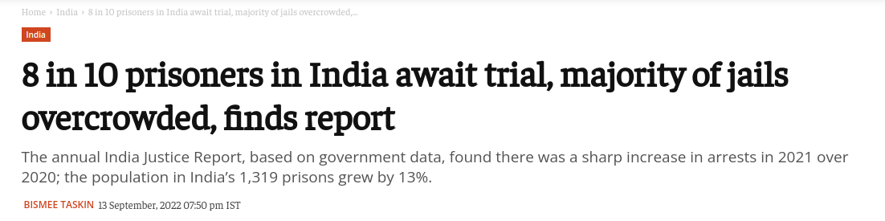
Problem Description
Jail Overflow in India

Slide 3
Problem Description
For developing countries like India, prison overcrowding has serious implications for the administration of justice, as well as for the human rights of prisoners. Despite the well-established justice system, the justice delivery mechanism in India is often slow and plagued by numerous challenges, including an enormous backlog of cases, outdated laws, and a shortage of judges. This has led to a significant prison overcrowding problem in India, with many of its jails operating at more than their sanctioned capacity. A solution is needed to address this issue and prevent its harmful effects on prisoners, prison systems, and society as a whole.
Jail Overflow in India

Slide 4
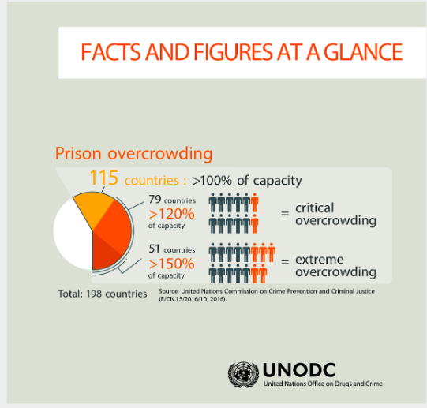
Motivation Why Justice System and Jail Overflow is a relevant and Interesting Topic.
Human Rights
Financial Cost
Social Justice
Public Safety
Jail Overflow in India
Notes:
Financial Cost: Overcrowding in jails can leads to additional costs, such as the need for additional staff and facilities.

Slide 5
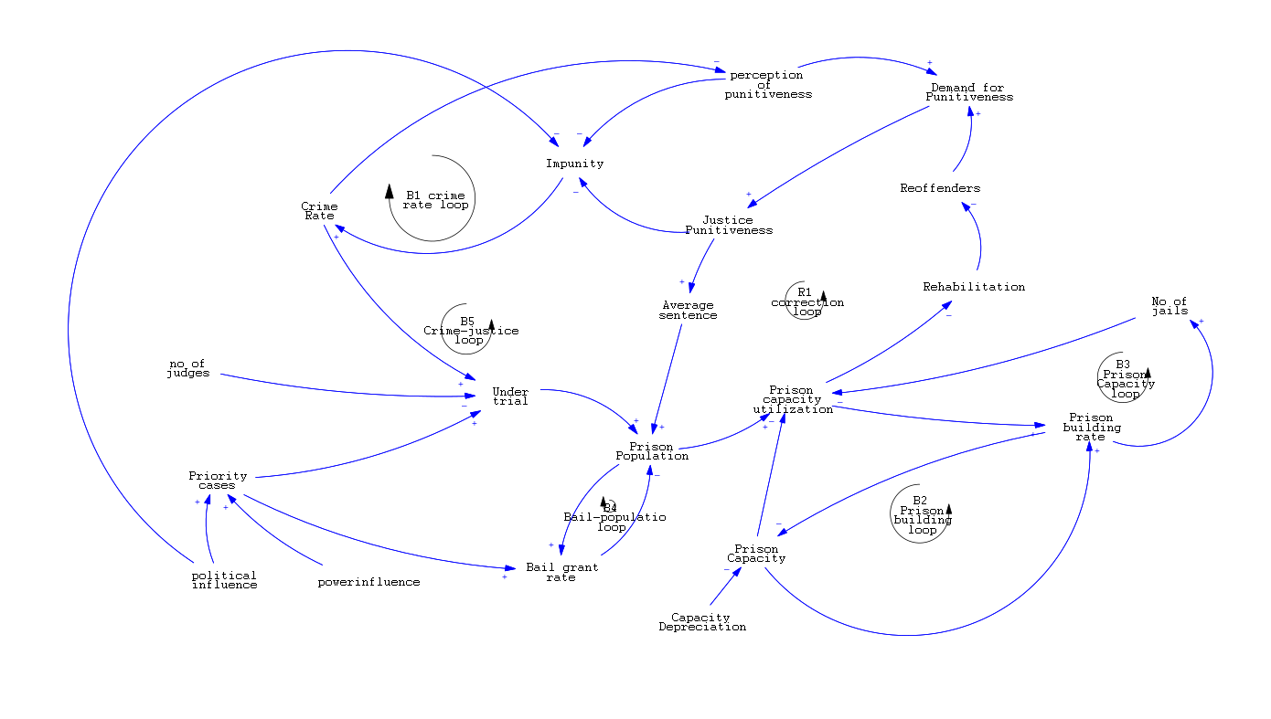
Causal Loop Diagram
Jail Overflow in India

Slide 6
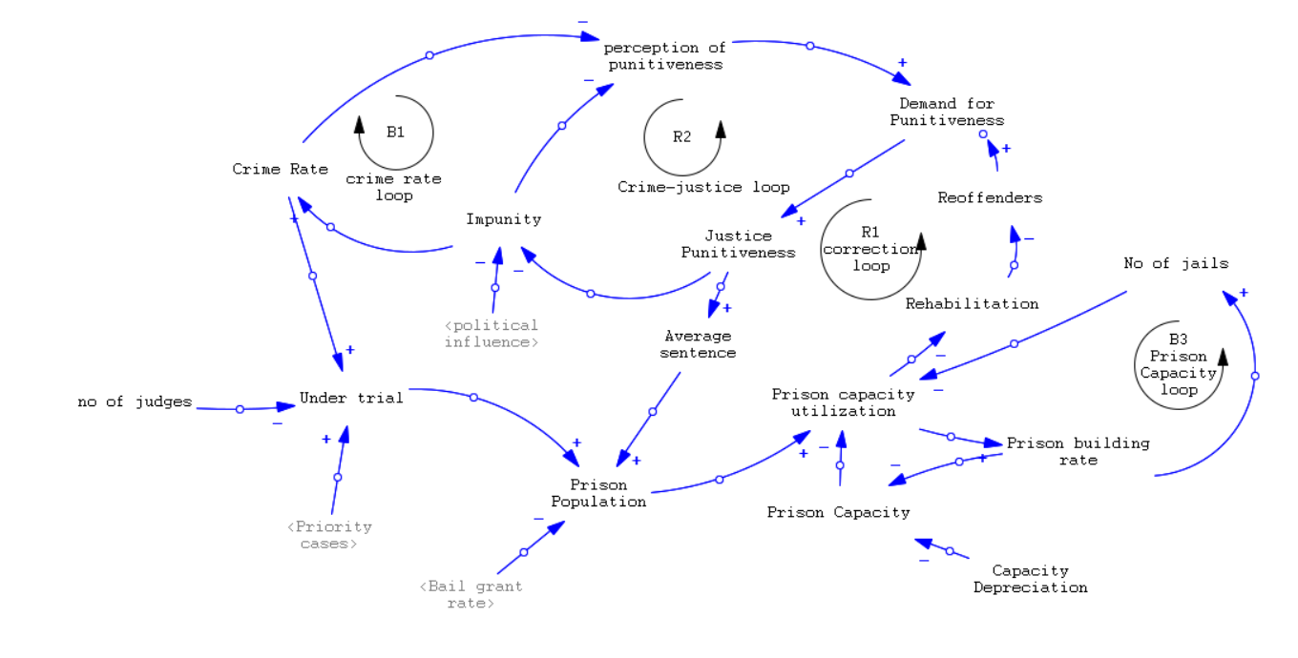
Refined Causal Loop Diagram
Jail Overflow in India

Slide 7
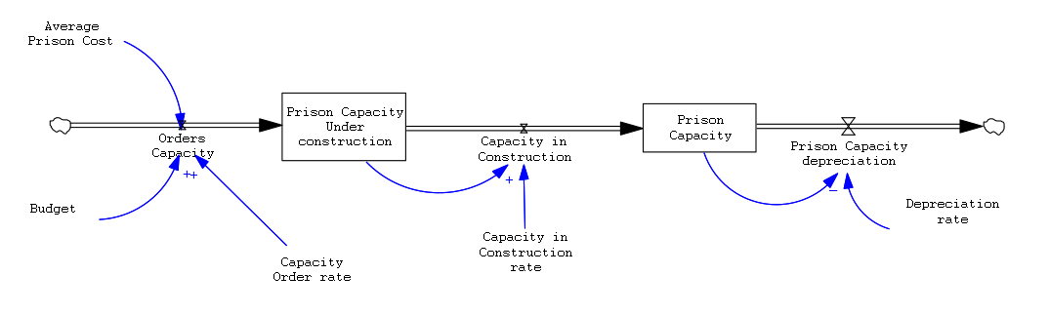
Stock Flow Diagram
View 2
Jail Overflow in India

Slide 8
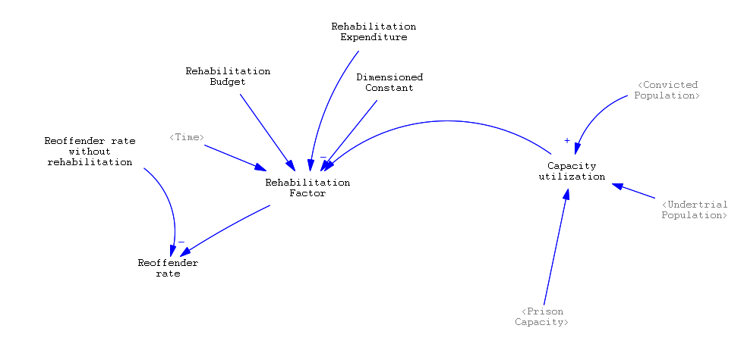
Stock Flow Diagram
View 3
Jail Overflow in India

Slide 9
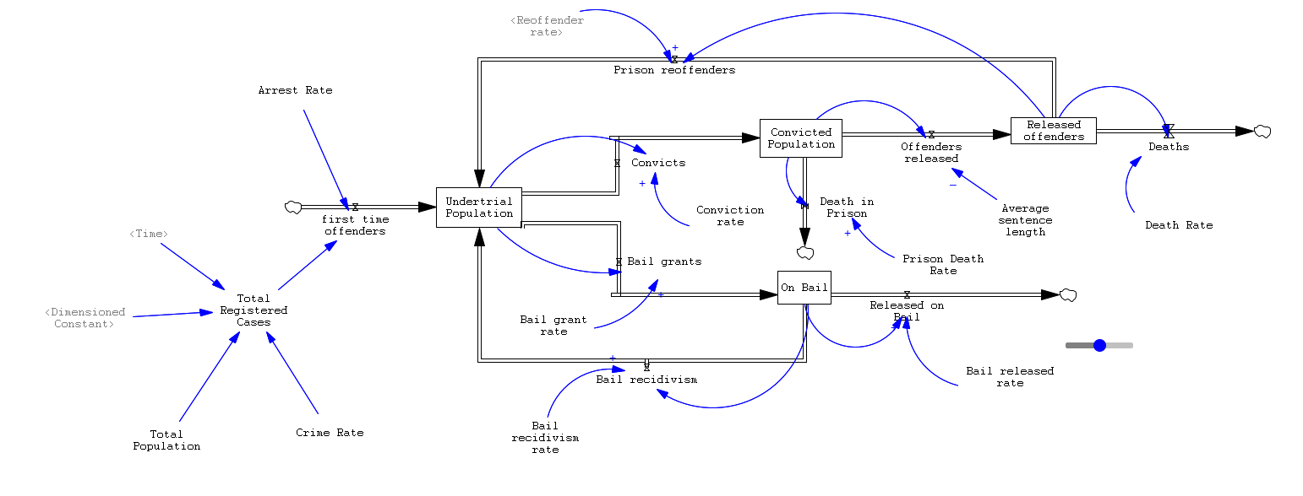
Stock Flow Diagram
View 1
Jail Overflow in India

Slide 10
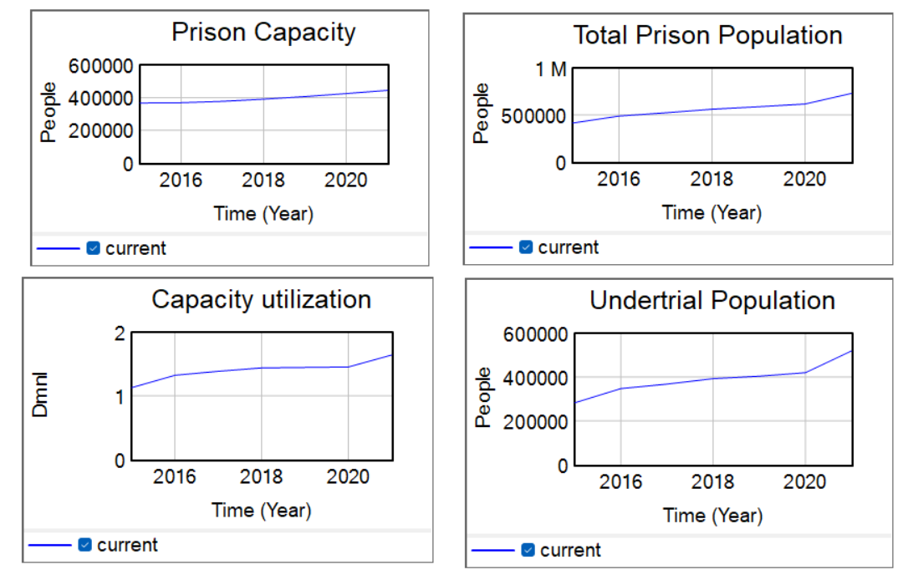
Generated Graph
Notes:
due to delay in police investigation, non-furnishing of bail by economically weak prisoners, non-appearance of witnesses in courts on the dates of hearing.

Slide 11
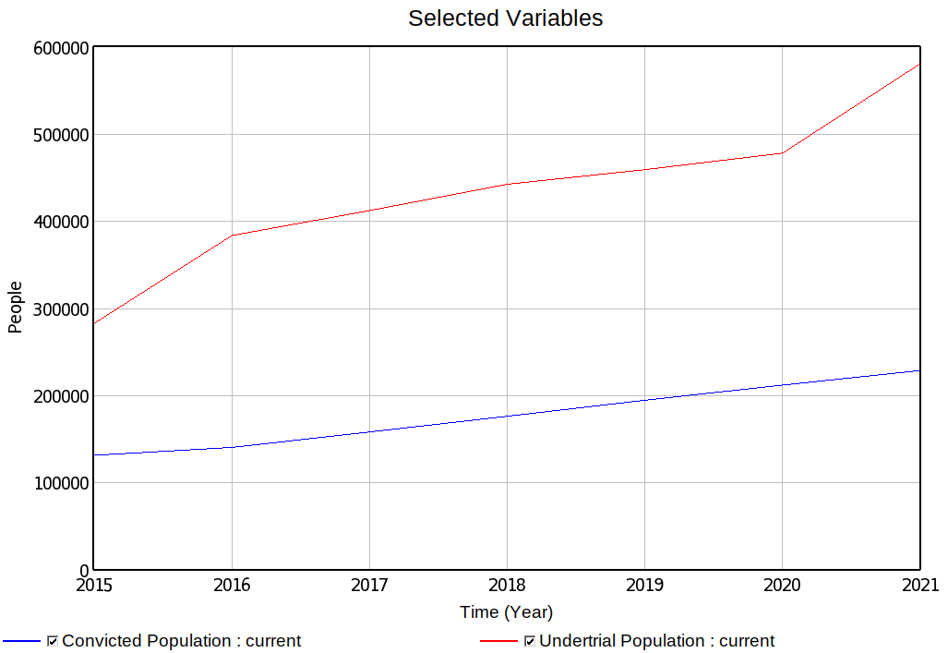
Convicted vs Undertrail Population
According to the Prison Statistics India Report, 70% of Prison population is UnderTrial.
Jail Overflow in India

Slide 12
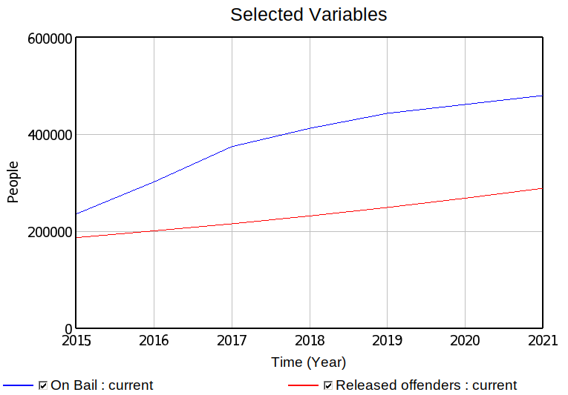
Undertrail Bail granted vs Convicted Release
According to the News Report , 68% of undertrial prisoners were not aware of Section 436A of C.R.P.C.
Jail Overflow in India

Slide 13
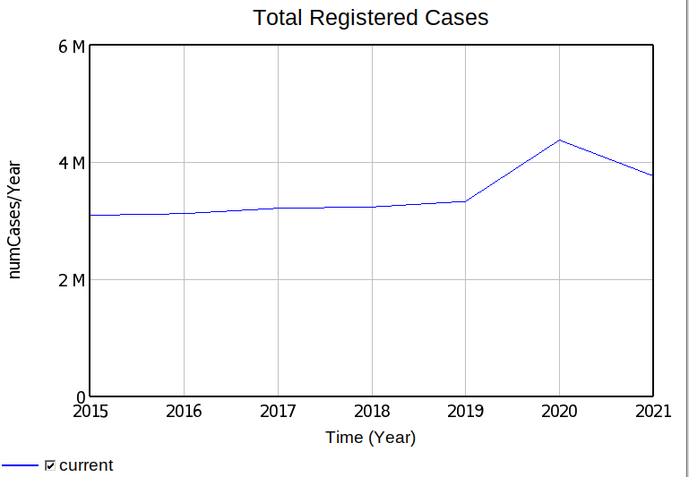

Total Registered Cases and Crime Rate
According to the Prison Statistics India Report and National Crime Records Bureau Report(Crime In India),
Registered Cases are increasing every year by 3%.
Crime rate is increasing by 3.6%.
Formula For Crime Rate is :
Jail Overflow in India

Slide 14
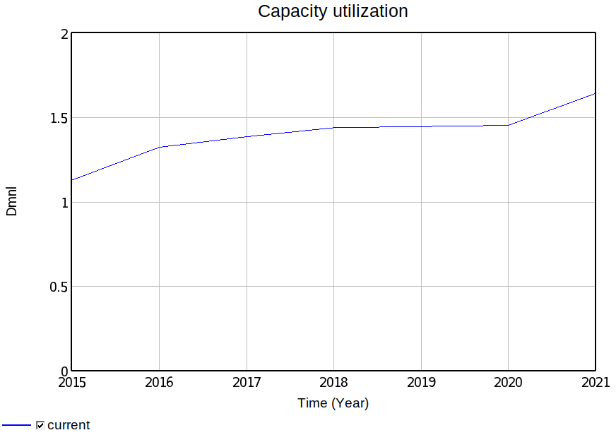
Prison Capacity Utilization
According to the Prison Statistics India Report , Capacity utilization in Prison has been Greater than 100% for many Years.
Capacity utilization is observed approximately 150% for some Years.
Jail Overflow in India

Slide 15
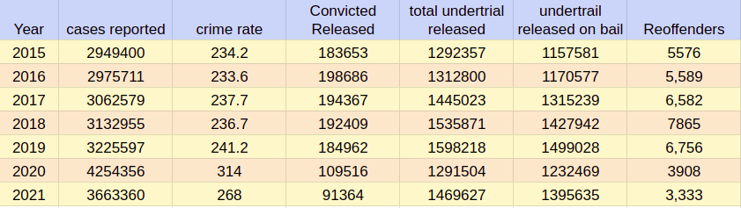
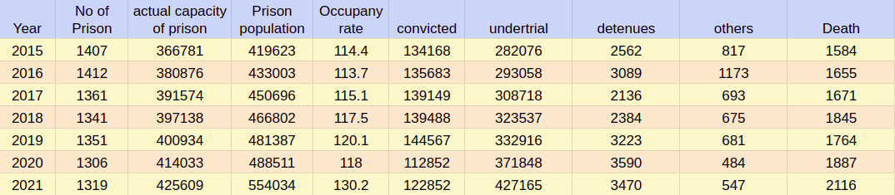
Data Used
Jail Overflow in India

Slide 16
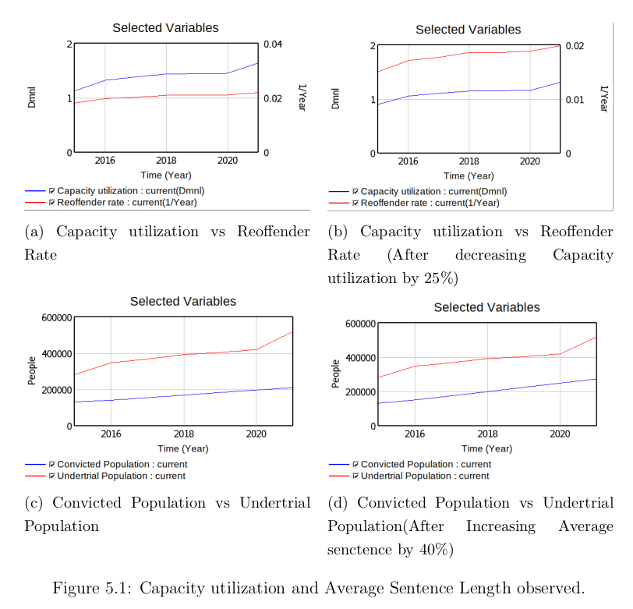
Observations
Jail Overflow in India

Slide 17
Challenges Faced
Resources
Lack of Research Paper Targeting Prison Overcrowding problem with respect to India
Complex Nature of the Problem
Solution depends on sufficiently large number of factors such as government policies, Judiciary and awareness among citizen
Difficulte to compute some variable.
Variable like “Perception of Punitiveness, Justice Punitiveness, demand for Punitiveness, Impunity, Political and power Influence” are very difficult to Compute.
Complexity of Model
Model became very complex to simulate on large factors. Computing all formulae became a road blocker.
Couldn’t load Data in Vensim.
Although, We Collected all the the data from 1998 to 2021 but later we found that we can’t load data in Vensim PLE which was the biggest set back of this project.
Jail Overflow in India

Slide 18
Conclusion
Prison Overflow is a major problem in India and its important to understand dynamics of the criminal justice system and the impact of prison overcrowding on the overall justice system.
Working on this project provides us a valuable framework for understanding and addressing the complex challenges facing our justice system today. By modelling the prison overflow problem using techniques such as Stock Flow Diagram we have learned the complexity of problem and how modelling a real life problem is challenge in itself.
Jail Overflow in India

Slide 19
References
Prison OverCrowding: Finding Successful Policies to Manage Capacity Utilization : System Dynamics Group Geography Department, University of Bergen, Bergen Norway.
Role Of Institutions In Fighting Corruption: Part III Chapter 13 JUSTICE SYSTEM
News : Why are India's Jail so Overcrowded?
Panel Reform International: OverCrowded
Prison Statistics India Report: From 1998 - 2021
National Crime Records Bureau : From 1998 - 2021
Prison Problems In India : An Overview on the Constitutional and Legal Status
OverCrowding in Prison
The Problem of Prisoners:An Analysis
Jail Overflow in India

Slide 20
Thank you for listening!
Questions?
Jail Overflow in India

Slide 21
Backup Slide
Jail Overflow in India

Slide 22
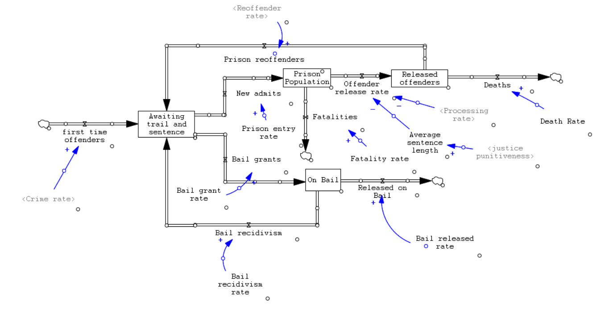
Initial Stock flow Diagram
View 1
Jail Overflow in India

Slide 23
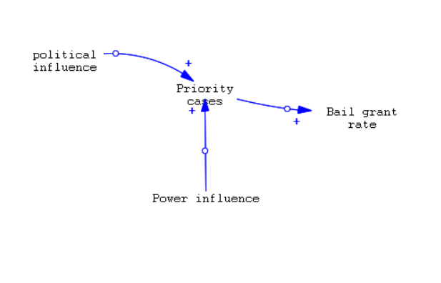
Initial Stock flow Diagram
View 2
Jail Overflow in India

Slide 24
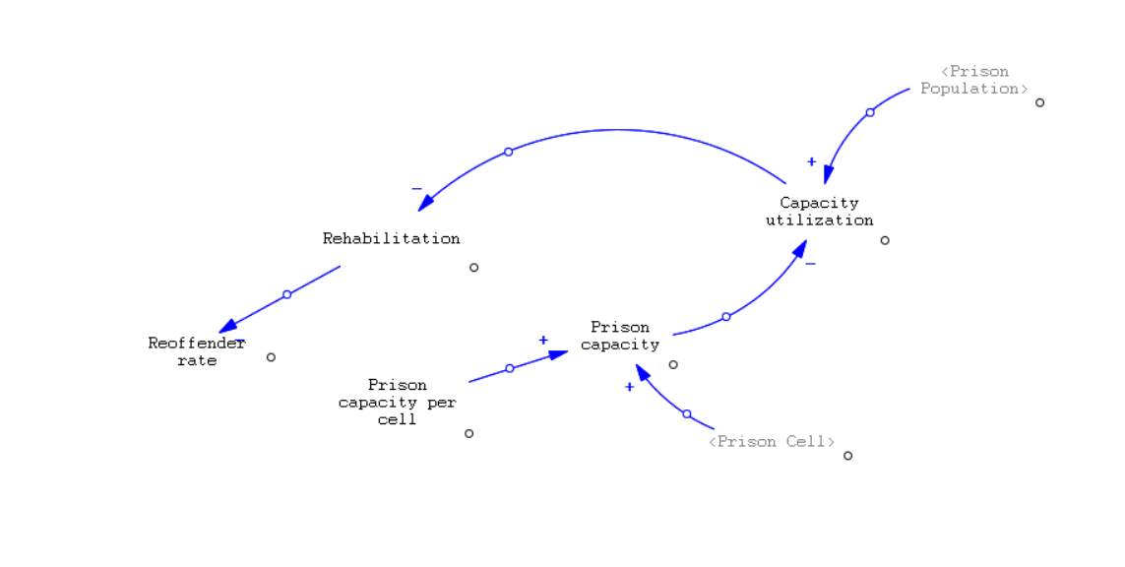
Initial Stock flow Diagram
View 3
Jail Overflow in India

Slide 25
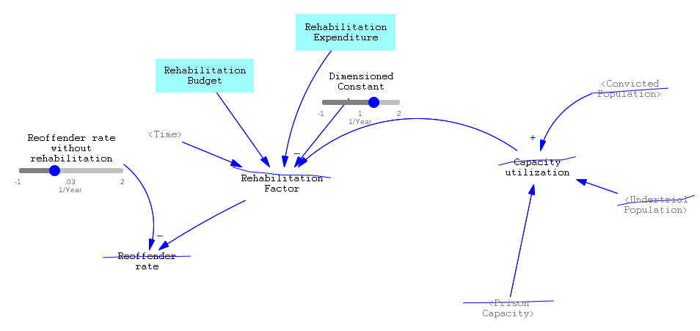
Simulated Stock Flow Diagram
Jail Overflow in India

Slide 26
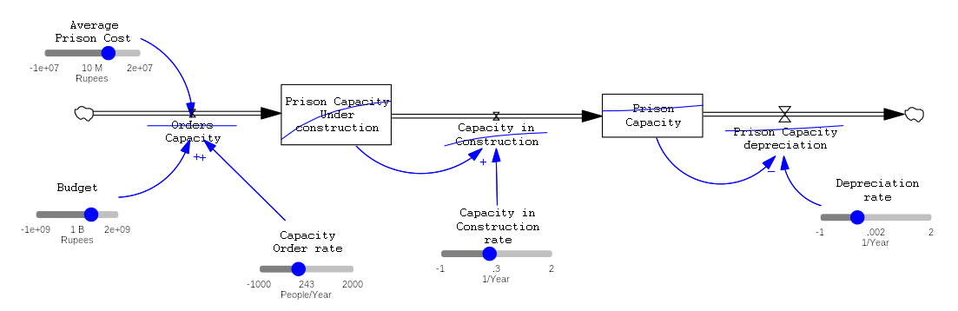
Simulated Stock Flow Diagram
Jail Overflow in India

Slide 27
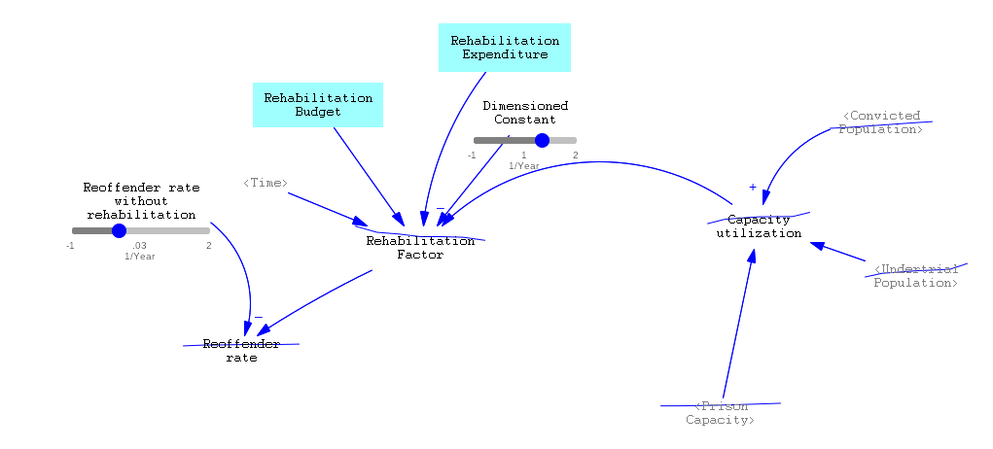
Simulated Stock Flow Diagram
Jail Overflow in India

