Slide 1
EMUCXL:
an emulation and access library for CXL
Raja Gond
under the guidance of
Prof. Purushottam Kulkarni
rajagond@cse.iitb.ac.in
R&D2-Spring 2023
11-05-2023

Slide 2
Outline
Introduction
Background and Motivation
CXL Emulation
Design of Emucxl
Discussion and Challenges
Future Work
Conclusion

Slide 3
Introduction
Low Latency
The emergence of Compute Express Link (CXL) in the interconnects market holds great promise for transforming the architecture of host-device interconnects.
Interconnects: a pathway that allows different components within a computer system to communicate with each other.
CXL Promises
Cache Coherent
High Bandwidth
New class of Open Standard Interconnect

Slide 4
Introduction
Low Latency
Emucxl is a library that enables user applications to perform load and store operations on emulated CXL devices. It is build on the idea presented in the paper titled Direct Access, High-Performance Memory Disaggregation with DirectCXL
CXL Promises
Cache Coherent
High Bandwidth
New class of Open Standard Interconnect

Slide 5
Background and Motivation
Build in-house prototypes of CXL hardware
1
Problem-1: Commercial CXL hardware is not available in the market
at the moment
CXL over Ethernet
Direct Access, High Performance Memory Disaggregation with DirectCXL
Hello Bytes, Bye Blocks
2
software-based emulations of CXL
devices
Pond- Microsoft
Exploiting CXL-Based Memory for Distributed Deep Learning
NUMA Node

Slide 6
Background and Motivation
1
DirectCXL software Runtime for CXL
Problem-2: How user applications can access CXL devices, such as loading or storing data on them.
Direct access of CXL devices
2
Emucxl (Open Source)
Based on DirectCXL software Runtime

Slide 7



CXL-Emulation
+
+
=
YES
This Photo by Unknown Author is licensed under CC BY-SA
Linux
CXL hardware not yet available
Possible but under active development
Emulate CXL devices with Qemu
Also require support from Linux Kernel
Already in active development to support CXL devices.
Load and Store aren’t yet supported
https://www.computeexpresslink.org/
https://www.kernel.org/

Slide 8
CXL-Emulation
CXL Emulation on regular 2-socket (2S) server systems
+-----------------------------------+
| |
| Guest OS / Linux |
| |
+--------vv-----------vv-----------+
| | | |
vv vv
+---------------+ +---------------+
| vNode 0 DRAM | | vNode 1 DRAM |
+---------------+ +---------------+
+---+ +---+ +---+ +----------------+
|cpu| |cpu| |cpu| | |
+---+ +---+ +---+ +----------------+
══════════════════════
║║ ║║
╔════════╗ ╔════════╗
║Host Node 0 ╠═║ Host Node 1║
╚════════╝ ╚════════╝
A paper called Pond by Microsoft emulate the following two characteristics of Compute Express Link (CXL) attached DRAM:
Characteristics
No local CPU which can directly accesses it, i.e., CXL-memory treated as a “computeless/cpuless” node
Latency:~150ns
https://github.com/vtess/Pond

Slide 9
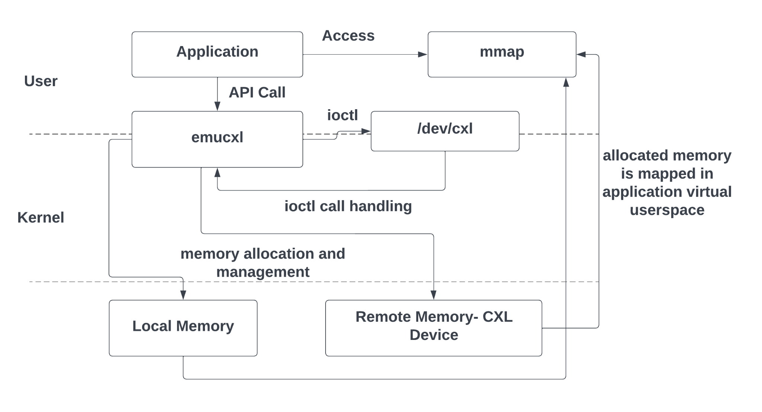
Design of EMUCXL
We are using simplified approach and assume that only one user applications is using the emucxl.
kmalloc_node or vmalloc_node to allocate memory on specific node
remap_pfn_range to memory mapped the allocated memory to user virtual address space.

Slide 10
Design of EMUCXL
Some APIs that was planned for implementation.
void emucxl_init () | Set up the device file and other configurations required for Emucxl operation
void emucxl_exit () | Close the device file
void* emucxl alloc (..., type tp , size t size ) | Used to allocate memory either remotely or locally, depending on the type specified
bool emucxl free (..., void* address) | used to free allocated memory.
void* emucxl migrate (..., void * address , type tp , size t new) | used to transfer memory between local and remote locations, depending on the type specified.
bool emucxl resize (..., void* address , size t curr , size t new) | used to resize memory either in its original location or in the opposite location of the new size, if possible.

Slide 11
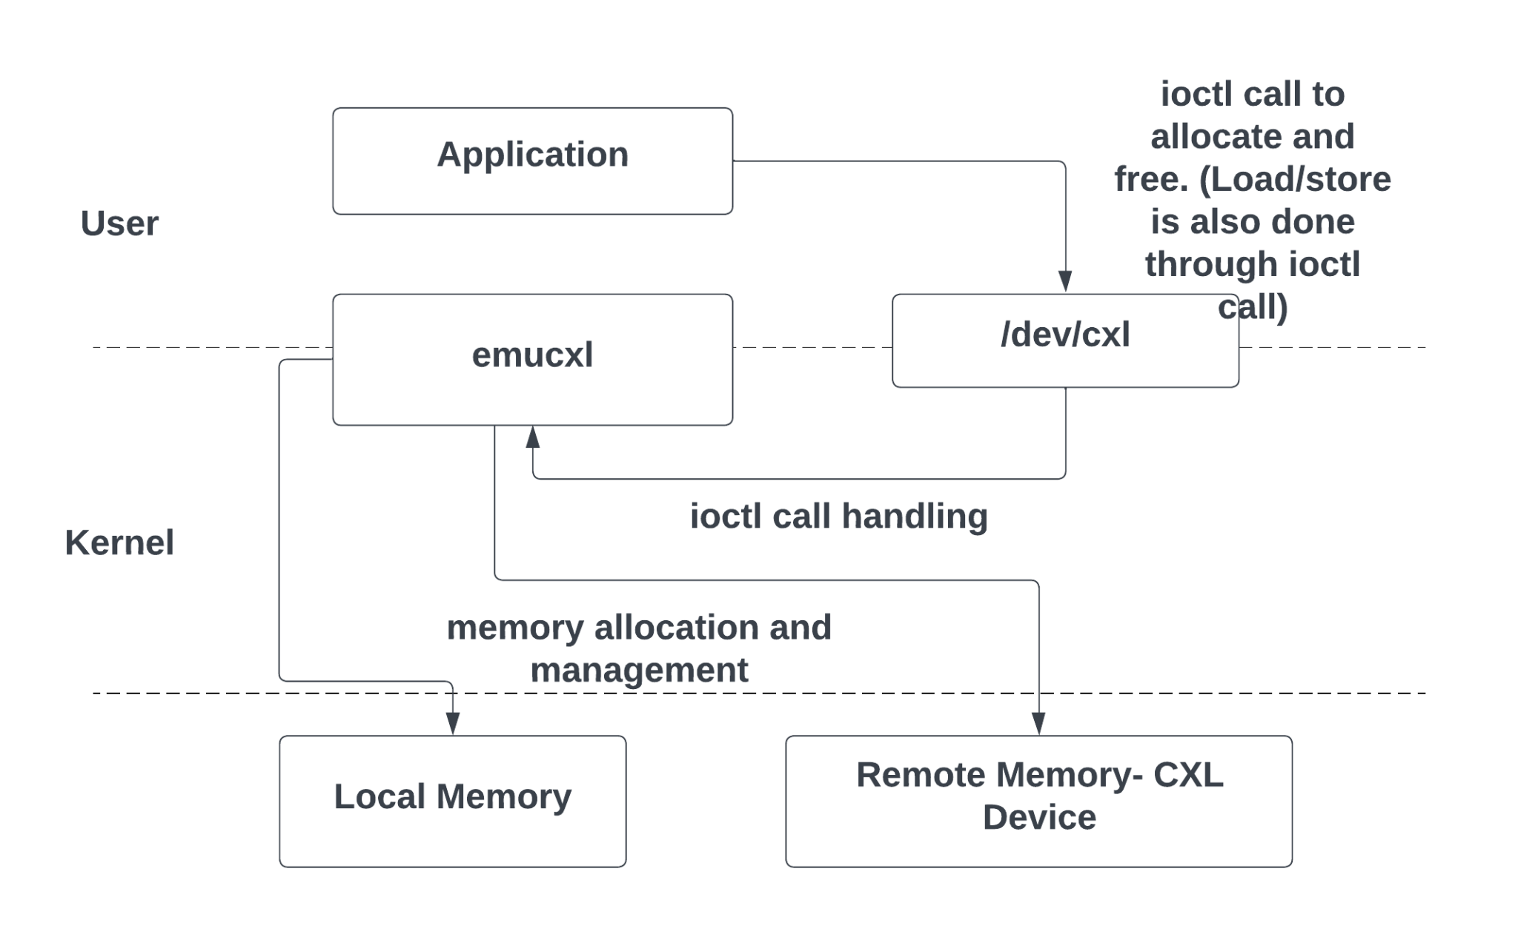
Design of EMUCXL
The current implementation does not support any API calls or memory-mapped access.
Challenges that comes along the way is discussed in next section

Slide 12
Discussion and Challenges
NUMA-aware memory allocation
vmalloc_node ( size , NUMA_NODE ) ;
kmalloc_node ( size , GFP_KERNEL , NUMA_NODE ) ;
// contiguous allocation
kzalloc_node ( size , GFP_KERNEL , NUMA_NODE ) ;
// contiguous allocation and initialise with zero
vzalloc_node ( size , NUMA_NODE ) ; // initialise with zero

Slide 13
Discussion and Challenges
ioctl calls
#define EMUCXL_ALLOCATE_MEMORY _IOWR ( ’ e ‘ , 4 , emucxl_arg_t* )
// ioctl command
copy_from_user and copy_to_user API is used to transfer data.

Slide 14
Discussion and Challenges
Challenge: Managing allocation for a combination of local and remote memory.
Another challenge was allocating memory in kernel space with kmalloc_node and then mapping it to application userspace. Although I tried remap_pfn_range , but it resulted in program crashes. The mmap API is considered as a possible
solution, but no numa-aware allocation is found.
While kmalloc_node was able to allocate memory, vmalloc_node was not working in the EMUCXL setup.

Slide 15
Future Work
API implementation
Memory-mapped address space supports for user application
Support for more than one user application accessing emucxl

Slide 16
Conclusion
The emergence of CXL represents a significant technological advancement that has the potential to transform data centre architectures. CXL specification is gaining wide traction in the industry due to the simplicity of implementing low-latency caching and memory semantics.
EMUCXL provides a simplified interface for user applications to get a feel of reading / writing on emulated cxl devices. The development of EMUCXL is a non-trivial task that required significant research, experimentation, and programming expertise.

Slide 17
Thank you for listening!
Questions?
synerg@cse.iitb.ac.in

Slide 18
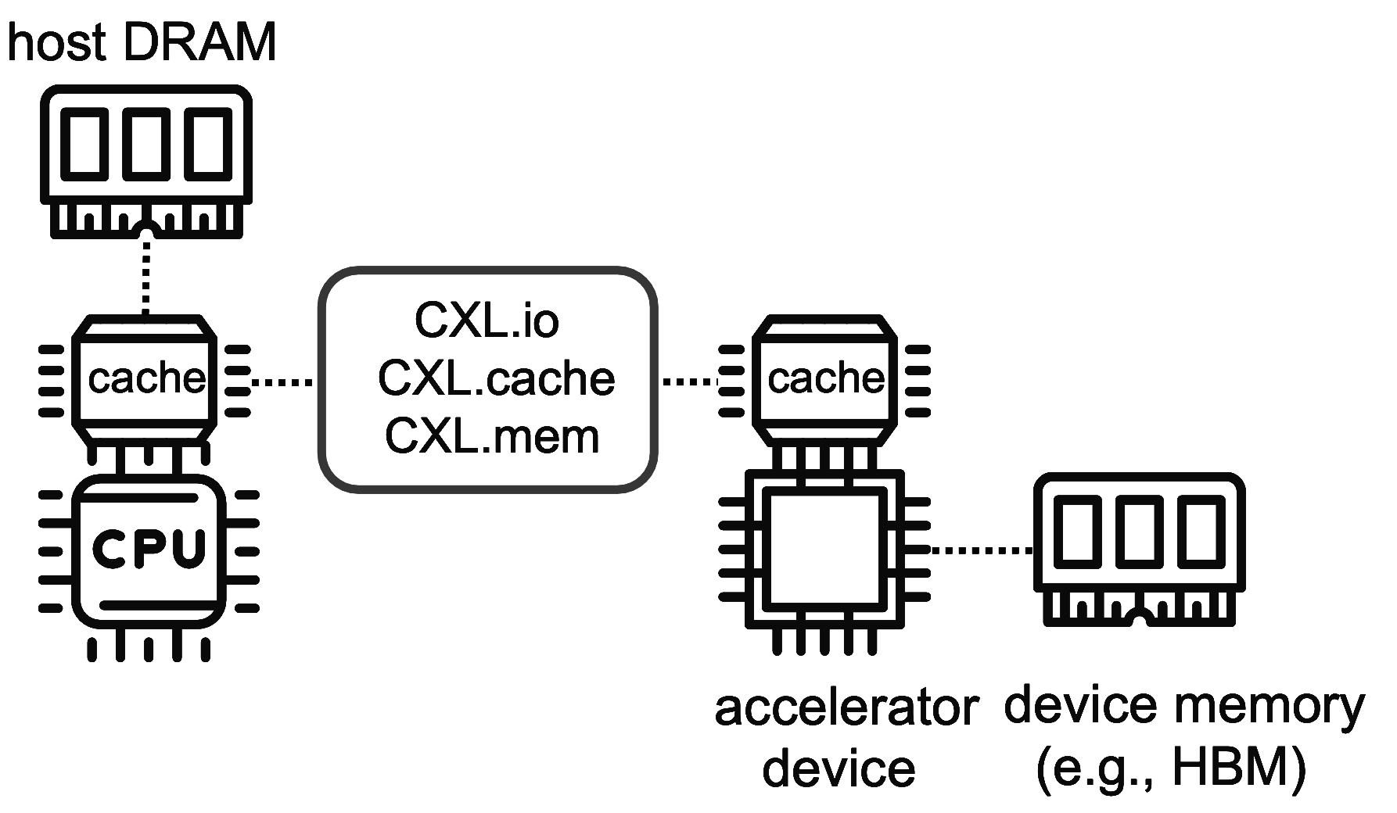
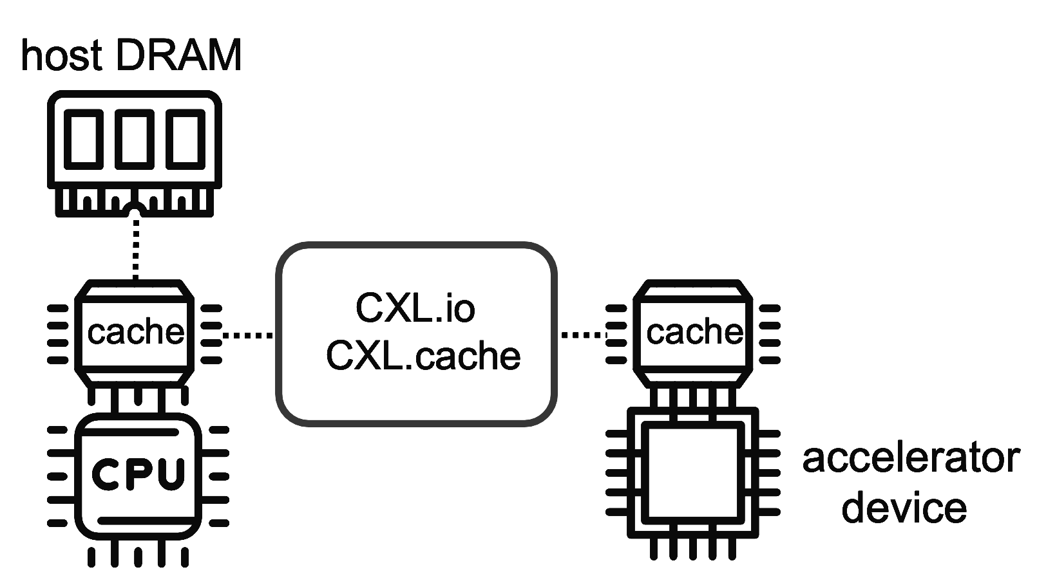
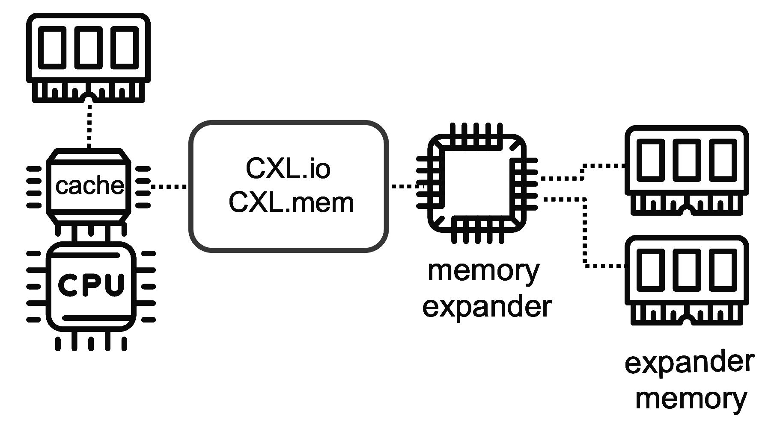
Type of CXL devices
Type 2 device (e.g GPU)
Type 3 device (e.g memory pool)
Type 1 device (e.g NIC)
https://ieeexplore.ieee.org/stamp/stamp.jsp?tp=&arnumber=10015193

