Slide 1
Compute Express Link (CXL)
The Interconnect Revolution
Sameer Ahmad
sameerahmad@cse.iitb.ac.in
Raja Gond
rajagond@cse.iitb.ac.in
Seminar - RnD - Spring 2023
23-03-2023

Slide 2
Outline
Life before CXL
Why CXL?
CXL-101
Use Cases
Conclusion

Slide 3
Life Before CXL
With PCIe (Peripheral Component Interconnect Express) Only
CPU Attached Memory
(OS Managed)
Writeback memory
PCIe DMA
PCIe DMA
CPU
CPU
GPU
FPGA
AI
NIC
NIC
Memory load/store
Uncached memory
Accelerator attached Memory
(Runtime Managed Cache)
PCIe P2P
https://www.computeexpresslink.org/_files/ugd/0c1418_8c010eed2bac49438e2168ec71bbff34.pdf

Slide 4
Life Before CXL
With PCIe (Peripheral Component Interconnect Express) Only
CPU Attached Memory
(OS Managed)
Memory connected to CPU - Cacheable
Memory connected to PCIe device - Uncacheable
Works well for a lot of applications with existing software
Writeback memory
PCIe DMA
PCIe DMA
CPU
CPU
GPU
F
P
G
A
AI
NIC
NIC
Memory load/store
Uncached Memory
Accelerator attached Memory
(Runtime Managed Cache)
PCIe P2P

Slide 5
Life Before CXL
Challenges with this model
CPU Attached Memory
(OS Managed)
Heterogeneous computing and disaggregation - Efficient resource sharing including memory
Memory Bandwidth and capacity extension on PCIe I/O
- Memory tiering and different memory types
Writeback memory
PCIe DMA
PCIe DMA
CPU
CPU
GPU
F
P
G
A
AI
NIC
NIC
Memory load/store
Uncached Memory
Accelerator attached Memory
(Runtime Managed Cache)
PCIe P2P

Slide 6
Why CXL?
Industry mega-trends are driving demand for faster data processing and next-generation data center performance:
Proliferation of Cloud Computing
Growth of Artificial Intelligence and Analytics
Cloudification of the Network and Edge

Slide 7
Why CXL?
Host
CXL Enabled Device
CPU
CPU
Cacheable Host Memory
Device Cache
Host Cache
Device Memory
Host Memory
Host mapped cacheable device memory with DRAM like latency.
Fig: CXL-enabled environments

Slide 8
Why CXL?
CPU Attached Memory
(OS Managed)
Writeback memory
PCIe DMA
Memory load/store
CPU
CPU
GPU
F
P
G
A
AI
NIC
NIC
Memory load/store
Writeback Memory
Accelerator attached Memory
(Runtime Managed Cache)
PCIe DMA
Fig: CXL-enabled environments

Slide 9
Why CXL?
Need a new class of interconnect for heterogeneous computing and disaggregation usages:
Efficient resource sharing
Shared memory pools with efficient access mechanisms
Enhanced movement of operands and results between accelerators and target devices
Significant latency reduction to enable disaggregated memory

Slide 10
Why CXL?
The industry needs open standards that can comprehensively address next-gen interconnect challenges

Slide 11
CXL-101
CXL: A new class of open standard interconnect
Industry Open Standard for High Speed Communications
150+ Member Companies
All CPU, GPU and memory vendors in consortium
CXL has a bright future and will be a game-changer in the industry!!
https://www.computeexpresslink.org/

Slide 12
CXL-101
Host
Internal IO Devices
Processor Interconnect:
Open industry standard
High-bandwidth, low-latency
Coherent interface
Leverages PCI Express®
Targets high-performance computational workloads
Artificial Intelligence
Machine Learning
HPC
Comms
CPU
CPU
CXL Controller
CXL.io
CXL.mem
CXL.cache
PCIe PHY
CXL Link
PCIe PHY
Device
CXL.io
CXL.mem
CXL.cache
CXL Controller
Modules
Modules

Slide 13
CXL-101
CXL is a new class of interconnect for device connectivity and cache coherent interface using PCIe, enabling memory expansion and heterogeneous memory for disaggregated computing platforms.
Disaggregated computing is a computing architecture that separates compute, memory, and storage resources into distinct physical devices connected by a high-speed network.

Slide 14
CXL-101
CXL has an alternate protocol that runs across the standard PCIe 5.0 physical layer, consisting of three protocols;
CXL.io for discovery, configuration, register access, and interrupt.
CXL.cache for device access to processor memory, and
CXL.memory for processor access to device attached memory.
Host
Internal IO Devices
CPU
CPU
CXL Controller
CXL.io
CXL.mem
CXL.cache
PCIe PHY
CXL Link
PCIe PHY
Device
CXL.io
CXL.mem
CXL.cache
CXL Controller
Modules
Modules

Slide 15
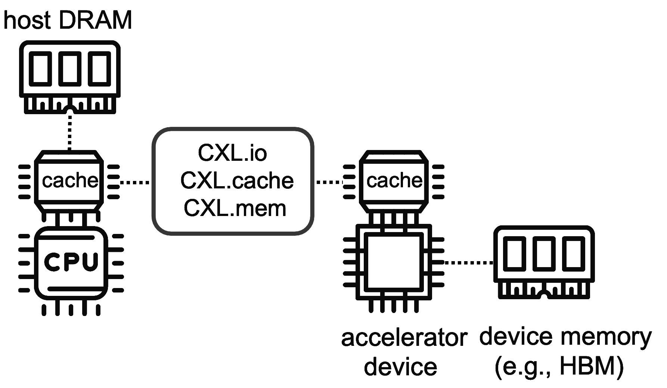
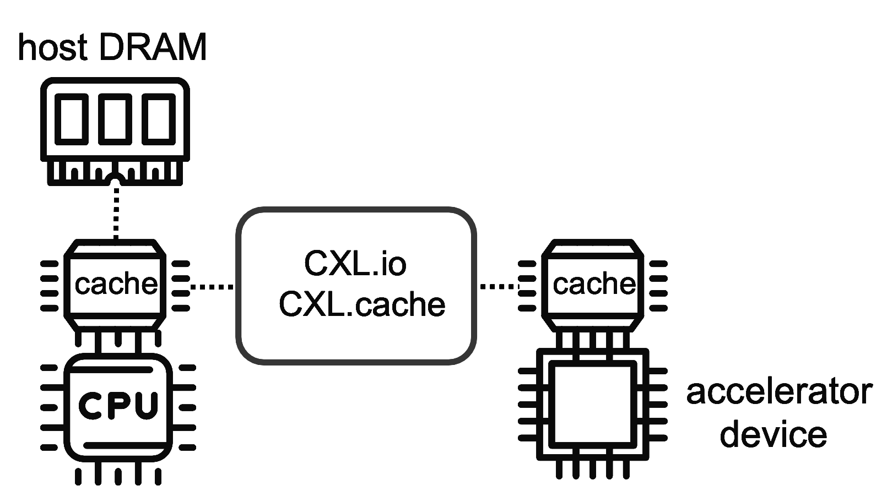
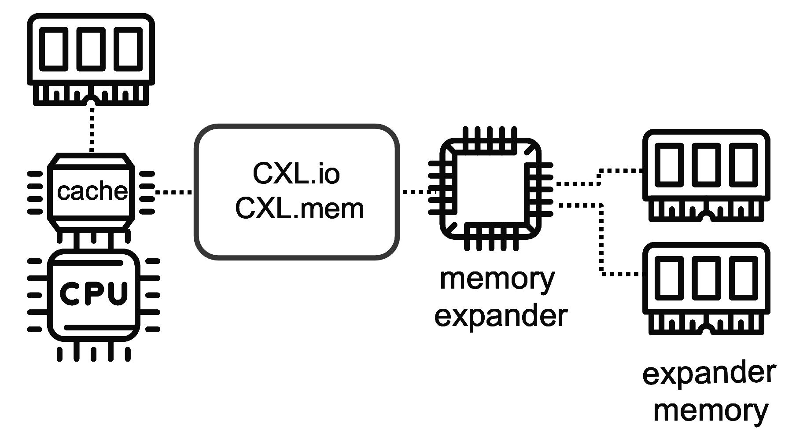
CXL-101
Type of CXL devices
Type 2 device (e.g GPU)
Type 3 device (e.g memory pool)
Type 1 device (e.g NIC)
https://ieeexplore.ieee.org/stamp/stamp.jsp?tp=&arnumber=10015193

Slide 16
CXL-101
CXL is a cache coherent interconnect technology.
All device types of CXL compatible with most existing PCIe devices, including SSDs.
Even though CXL is built upon PCIe, it basically guarantees that all the caches across different computing complexes in the same CXL hierarchy are coherent.
Host
Host Cache
0xAFF
123456
Invalidate
Cache Line
Load 0xAFF
Device
Device Memory
Device Processing
0xAFF
123456
654321

Slide 17

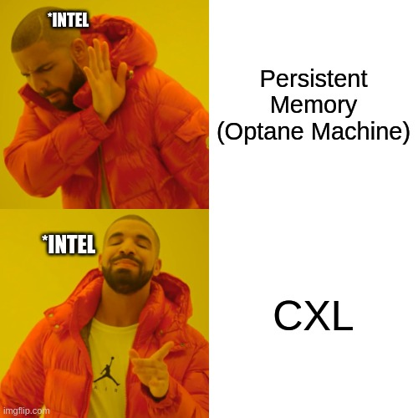
Time for meme :)

Slide 18
Use Cases
TOOLSET
Memory Pooling
Memory Expansion
Memory Sharing
Potential works with CXL

Slide 19



TOOLSET
+
+
=
YES
This Photo by Unknown Author is licensed under CC BY-SA
Linux
CXL hardware not yet available
Possible but under development
Emulate CXL devices with Qemu
Also require support from Linux Kernel
Already in active development to support CXL devices.
Load and Store aren’t yet supported
https://www.computeexpresslink.org/
https://www.kernel.org/

Slide 20
TOOLSET
CXL Emulation on regular 2-socket (2S) server systems
+-----------------------------------+
| |
| Guest OS / Linux |
| |
+--------vv-----------vv-----------+
| | | |
vv vv
+---------------+ +---------------+
| vNode 0 DRAM | | vNode 1 DRAM |
+---------------+ +---------------+
+---+ +---+ +---+ +----------------+
|cpu| |cpu| |cpu| | |
+---+ +---+ +---+ +----------------+
══════════════════════
║║ ║║
╔════════╗ ╔════════╗
║Host Node 0 ╠═║ Host Node 1║
╚════════╝ ╚════════╝
A paper called Pond by Microsoft emulate the following two characteristics of Compute Express Link (CXL) attached DRAM:
Characteristics
No local CPU which can directly accesses it, i.e., CXL-memory treated as a “computeless/cpuless” node
Latency:~150ns
https://github.com/vtess/Pond

Slide 21
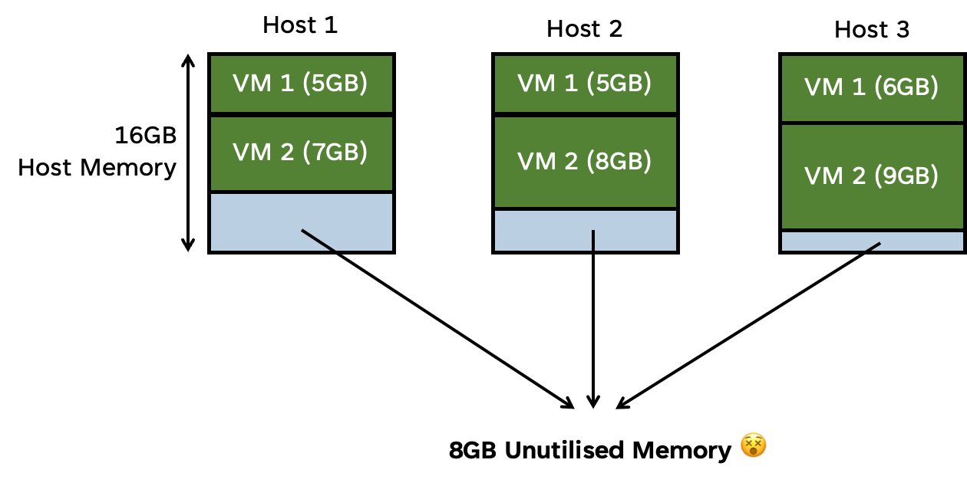
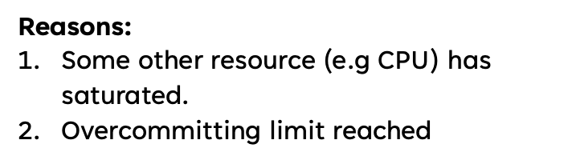
Memory Pooling
Memory is becoming the largest portion of server costs for cloud datacenters
DRAM can account for upto 50% of server costs

Slide 22

Memory Pooling
We cannot just deploy less memory as sometimes full amount is needed
X
Problem: High Capacity for some Workloads. Often Expensive memory is underutilized
CXL Memory pooling will help to reduce total memory while still enabling high use
https://github.com/vtess/Pond

Slide 23
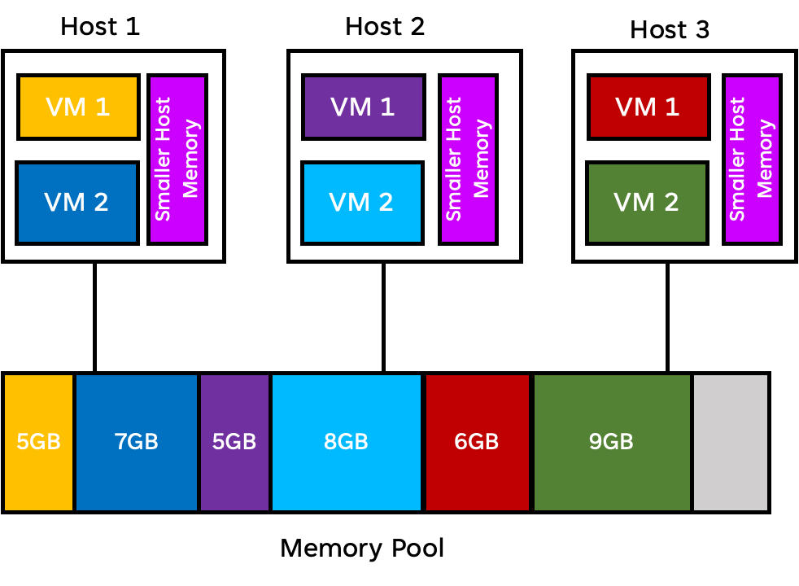
Memory Pooling
Each Host has a small host memory attached to it
Remaining memory requirements of the VMs
CXL Switch(es)
Different policies can define how much, when and how to allocate memory from the pool

Slide 24
CXL Memory Expansion
Improves processor efficiency
Host
CXL Promises
CXL Memory Expander
Increases Capacity
Improves Bandwidth
Memory channels
Memory
Lowers Total Cost of Ownership (TCO)

Slide 25
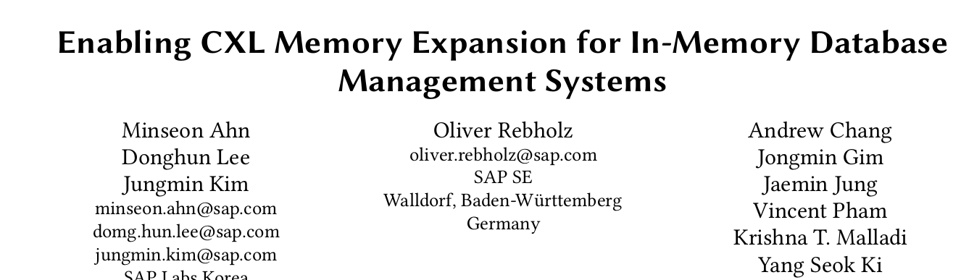
CXL Memory Expansion
Limited memory volume is always a performance bottleneck in an in-memory database management system (IMDBMS) as the data size keeps increasing.
This work proposes a flexible CXL-based memory expansion with potentially lower TCO in an IMDBMS as one of the significant use cases of CXL memory.
https://dl.acm.org/doi/10.1145/3533737.3535090

Slide 26
Coherent Memory Sharing
S1 Copy
S1 Copy
S2 Copy
Device memory can be shared by all hosts to increase data flow efficiency and improve memory utilization
S2 Copy
(2)
Host-1
Host-2
Host-N
CXL
CXL
CXL
CXL Switch(es)
(1)
(2) Host can have a coherent copy of
the shared region or portions of
shared region in host cache
CXL
Device - 1
S1
(1) Shared Memory
S2
https://www.computeexpresslink.org/_files/ugd/0c1418_998df4f459734f319e7a12cc2163b943.pdf

Slide 27
Potential works with CXL
Development of CXL library that can provide an interface to user applications for performing operations on CXL devices.
Creating a standard emulator for different types of CXL devices(Currently there is only Type 3 device emulator available).
Modification of device drivers to provide support for CXL-enabled Accelerator devices.

Slide 28
Conclusion
CXL specification is gaining wide traction in the industry due to the simplicity of implementing low-latency caching and memory semantics on a well-established PCIe infrastructure.
References:
Compute Express Link™ and CXL™ Consortium
https://www.computeexpresslink.org/
Craig Rodgers’ presentation on CXL

Slide 29
Thank you for listening!
Questions?
synerg@cse.iitb.ac.in

