Slide 1




TokenWeave: Accelerating Tensor Parallelism LLM Inference Through Efficient Compute-Communication Overlap
Raja Gond, Nipun Kwatra, and Ram Ramjee
Microsoft Research, India

Slide 2
Compute-Communication Overlap
Idea: Split compute; while one task computes, the other communicates
Micro-split: Matmul already split into tiles; fuse communication with tile
CoCoNET [ASPLOS’22], TPU [ASPLOS’23], TileLink [MLSys’25], Comet [MLSys’25]
Macro-split: Split input batch of tokens into smaller batches and compute of one is overlapped with communication of another
PipeMOE [Infocom’23], Lancet [MLSys’24], Nanoflow [OSDI’25] , DeepSeek TWO-batch
Overlap NOT enabled by default for tensor-parallel inference in vLLM/SGLang
Communication takes significant resources, lengthening compute time
Splitting has significant overheads & requires large batches for gains

Slide 3
TokenWeave: Summary of Contributions
TokenWeave overlaps compute with communication & normalization
New AllReduce-RMSNorm Kernel
Symmetric memory + Multimem/NVLS to reduce comm. resources
Wave-aware macro-split to reduce splitting overhead
Up to 1.28× speedup in latency, 1.19× higher end-to-end throughput
Results on H100 DGX/B200 DGX over a strong vllm_multimem baseline (vLLM enhanced with Symmetric memory & NVLS support)
Code open-sourced at github.com/microsoft/tokenweave

Slide 4
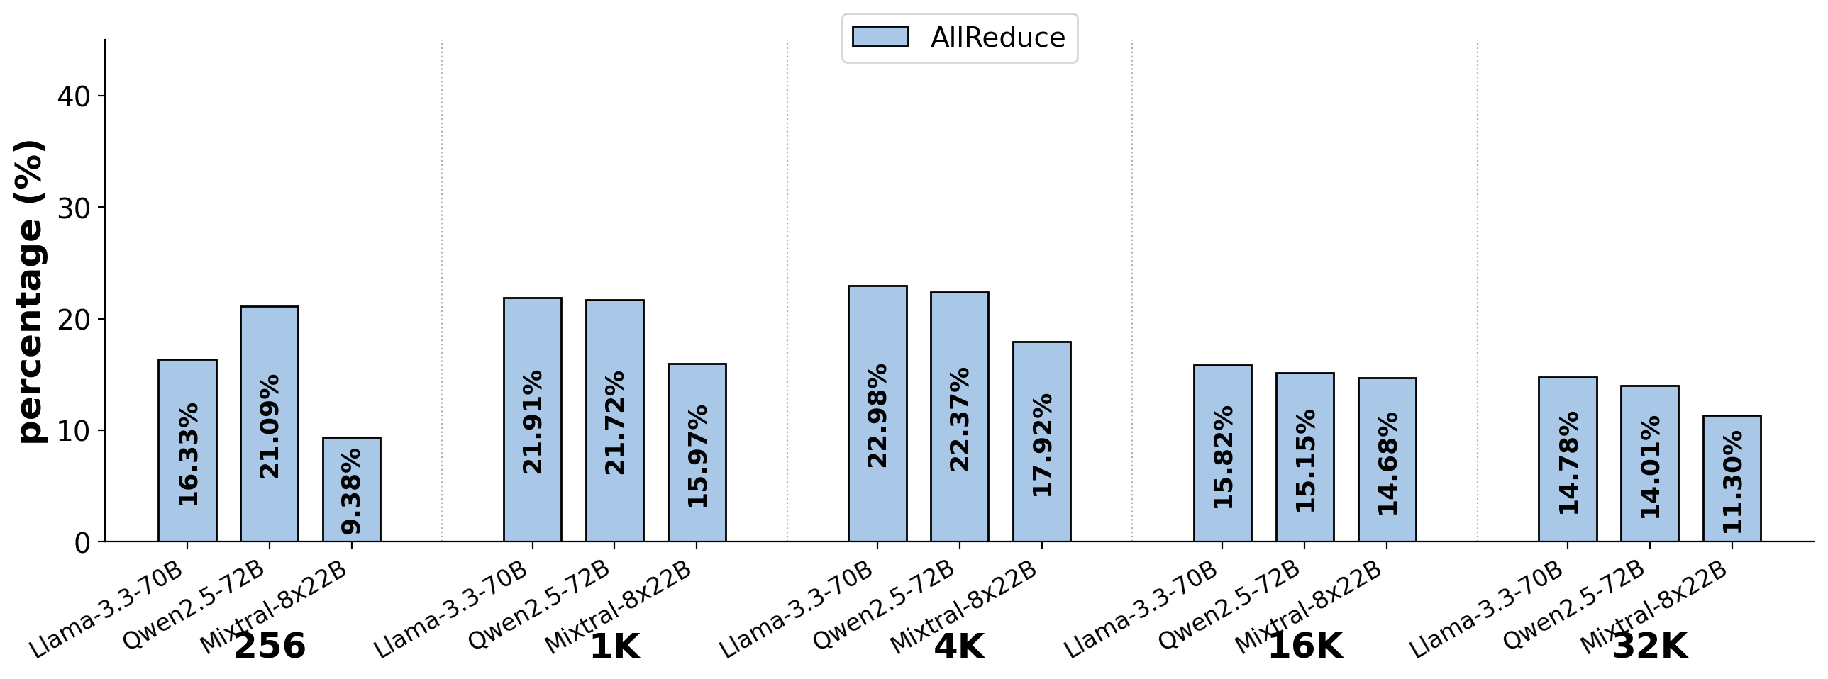
Communication Overhead
9-23% overhead on 8xH100 DGX with high bandwidth NVLINK

Slide 5
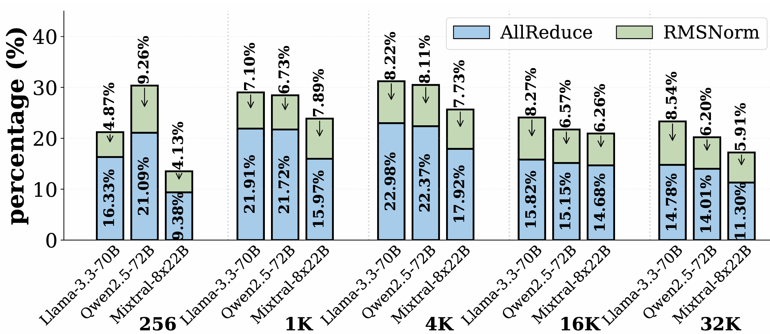
RMSNorm: Significant overhead!
4-9% overhead for RMSNorm on 8xH100 DGX

Slide 6
Why is RMSNorm overhead so high?
Tensor-parallel inference today: AllReduce → RMSNorm
RMSNorm does redundant work on Full Tensor
Why not ReduceScatter → RMSNorm →AllGather?
RMSNorm does 1/G work (G GPUs) and mathematically equivalent
ReduceScatter + AllGather significantly slower than AllReduce!
AllReduce → RMSNorm is more performant than despite redundancy!

Slide 7
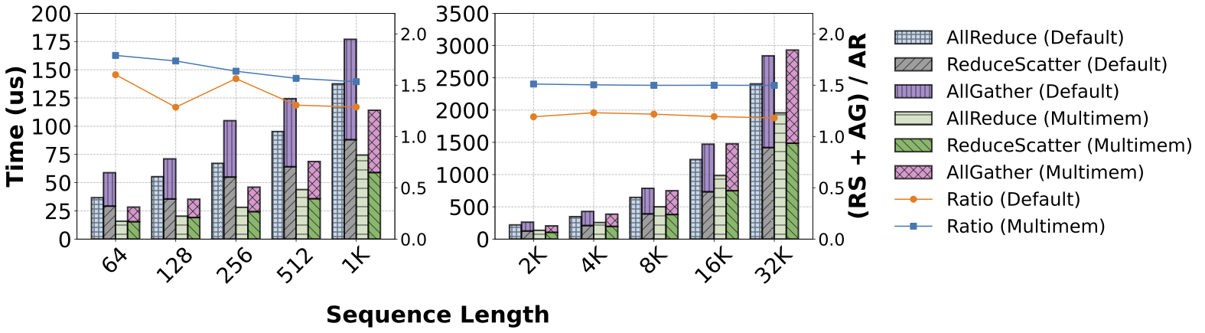
ReduceScatter + AllGather (RS+AG) vs AllReduce (AR)
RS+AG is 1.2–1.7× AR on 8 × H100 due to extra HBM read/writes

Slide 8
1. AllReduce-RMSNorm Kernel
AllReduce → RMSNorm into ReduceScatter → RMSNorm →AllGather
Idea: Leverage Symmetric Memory + MultiMem support in Hopper/Blackwell/…
ReduceScatter using multimem_ld_reduce_add PTX
In-network reduction & store result directly in register
RMSNorm using only register/shared memory (avoid HBM read/write)
AllGather using multimem_st PTX
Read from register (avoid HBM read) and write into remote HBM
Saves 2N/G reads and N/G writes per GPU (N: #tokens, G: #GPUs)
AllReduce-RMSNorm 1.3–1.4× AR+RMSNorm & 4+% end-to-end gains

Slide 9
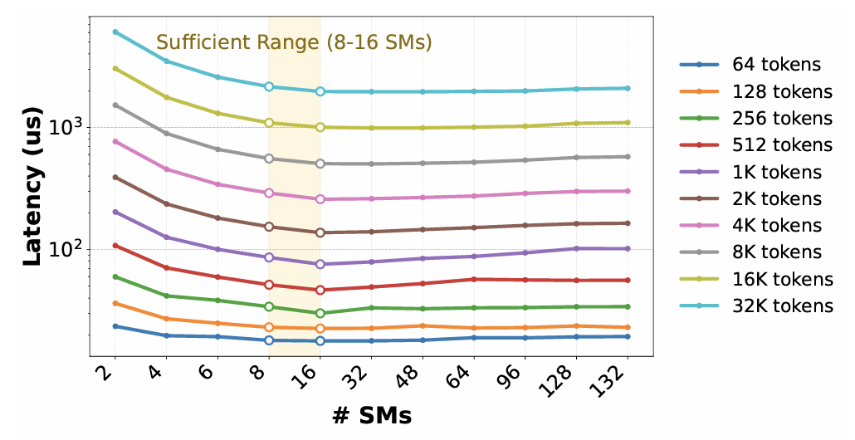
2. Symmetric Memory + Multimem/NVLS benefit: Reduced SM requirements
16 SMs for optimal performance but 2-8 SMs sufficient for overlap scenarios
Only 2-8 SMs sufficient for Communication + Normalization!

Slide 10
3. Wave-aware Splitting
Example: 100 SMs, Matmul with 250 CTAs
Full
Matmul with 250 CTAs
2 Full waves, last wave 50% occ.
Wasted fraction = 0.5 / 3 = 16.6%
Two-way Split
2 Matmuls with 125 CTAs each
1 Full wave, last wave 25% occ.
Wasted fraction = 0.75/2 = 37.5%
Instead: 2-split of 100 CTAs + 150 CTAs; Wasted fraction = 0.5/3=16.6%
Wave-aware split: Ensures no additional quantization overhead over Full

Slide 11

Tensor-Parallelism today
RMSNorm
RMSNorm
AllReduce
AllReduce
Feed-Forward Layer (FFN)
Feed-Forward Layer (FFN)
RMSNorm
RMSNorm
AllReduce
AllReduce
Self Attention Layer (Attn)
Self Attention Layer (Attn)
Batch
Batch

Slide 12
TokenWeave
AllReduce-RMSNorm
Splitting Approach:
Don’t split if less than 1-wave
If more than 1-wave, use wave-aware two-split
Feed-Forward Layer (FFN)
AllReduce-RMSNorm
Self Attention Layer (Attn)
Batch
Staggered Execution
Split-1
Split-2
Compute & communication+normalization overlap
Notes:
In TokenWeave we first split the batch ----

Slide 13
Experimental Setup
Hardware:
Primary: 8×H100 NVIDIA DGX (NVLink4 +NVSHARP)
Also: 4×H100 & 8×B200
Models:
Llama-3.3-70B (dense)
Qwen2.5-72B (dense)
Mixtral-8x22B (MoE)
Workloads:
Real-world: ShareGPT, arXiv traces
Synthetic: fixed (input, output) lengths
Baselines:
vLLM-Default: vLLM v0.8.5 (no overlap)
vLLM-Multimem: vLLM + optimized AllReduce
vLLM-nocomm: communication removed
(theoretical lower bound performance)
TileLink: state-of-the-art tile-level overlap
NanoFlow: prior coarse-grained overlap system
Implementation:
vLLM V1 (v0.8.5), PyTorch 2.6.0, CUDA 12.4, Triton 3.2.0
github.com/microsoft/tokenweave

Slide 14
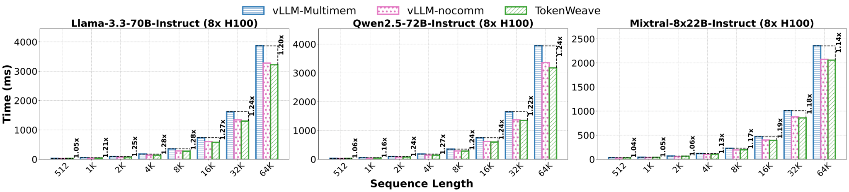
Evaluation: Latency
Overall: TokenWeave achieves up to 1.28× speedup
20+% gains at 1K+ tokens in Dense and 13-19% for 4K+tokens in MoE
At sequence lengths ≥ 4K, TokenWeave outperforms vLLM-nocomm

Slide 15
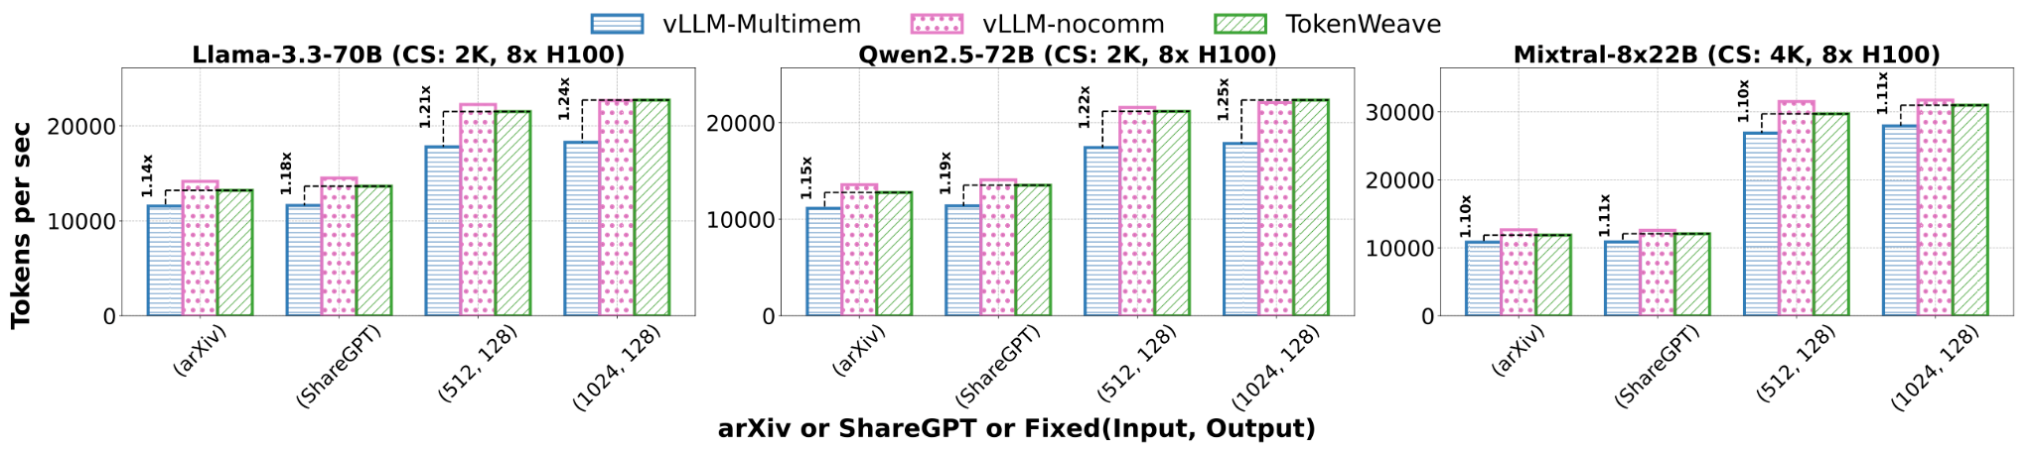
Evaluation: End-to-end Throughput
TokenWeave achieves up to 1.19× speedup on sharegpt & arxiv traces

Slide 16
TokenWeave: Summary
Challenges
Solution
RMSNorm adds 4–9% overhead
Communication uses many SMs, lengthening compute
Splitting overhead overwhelms gains at small batch sizes
New AllReduce–RMSNorm kernel
2–8 SMs for both comm + norm using symmetric memory + NVLS
Wave-aware at most two-way token split
Up to 1.28× speedup in latency, 1.19× higher end-to-end throughput
Code: github.com/microsoft/tokenweave

