Slide 1
Compound AI
Anu Agarwal, Saksham Gera, Ritik Hariani, Dhruv kathpalia
CS598 Systems for Generative AI (Spring 2025)

Slide 2
OMS-DPM: Optimizing the Model Schedule for Diffusion Probabilistic Models
Authors: Enshu Liu, Xuefei Ning, Zinan Lin, Huazhong Yang, Yu Wang (ICML 2023)

Slide 3
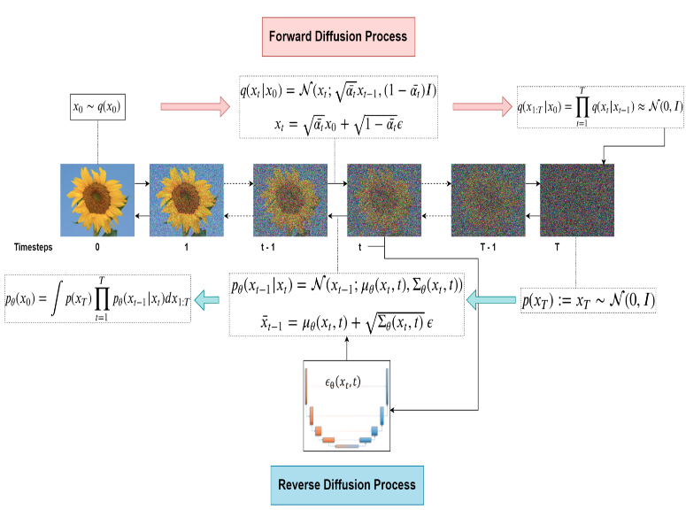
DPM
Fig 1: LearnOpenCV. (2023). “An In-Depth Guide to Denoising Diffusion Probabilistic Models DDPM - Theory to Implementation”

Slide 4
Problem Statement
DPMs Suffer from slow sampling speed.
DPMs solve SDEs/ODEs using time dependent score functions.
Neural networks evaluate the score, requiring discretization of continuous trajectories into thousands of steps.
Sampling can be up to 1000x slower than GANs.

Slide 5
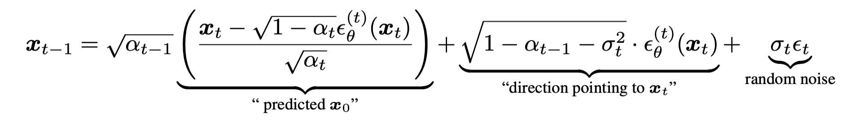
Background & Related Works
Training Free Samplers: Aim to reduce the Number of Function Evaluations (NFE) needed in the denoising process
DDIM: Deterministic non-Markovian sampling process
DPM-SOLVER: High order diffusion ODE solver

Slide 6
Background & Related Works
AutoML: Automates the machine learning pipeline, including tasks like model selection, hyperparameter tuning, and neural architecture design.​
Data Preprocessing
- Data Collection
- Data Visualization
- Data Cleaning
- Data Augmentation
Feature Engineering
- Feature Selection
- Feature Extraction
Model Generation
- Structure Identification
- Hyperparameter optimization
Model Validation
Fig 2: Pipeline diagram for typical AutoML

Slide 7
Background & Related Works
Predictor Based Neural Architecture Search (NAS):
A subfield of AutoML focused on automating the design of NN architectures.
Utilizes performance predictors trained on a subset of architectures to estimate the performance of new architectures efficiently.
Reduces the need for exhaustive training, accelerating the search process.​

Slide 8
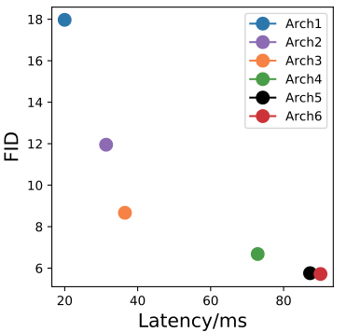
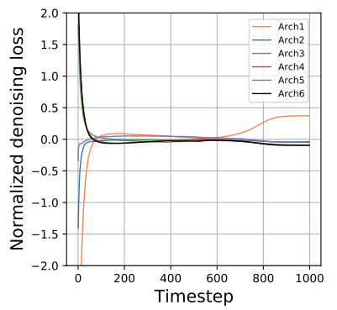
Motivation
Architecture 1 with worst FID score outperforms most models in late denoising steps.
In the later stages of denoising, replacing arch 6 with arch 1, yields lesser overall loss and latency.
Fig 3: Performance of 90 step DPM solver across set of different
size models.
Fig 4: Denoising loss on CIFAR-10 test set.

Slide 9
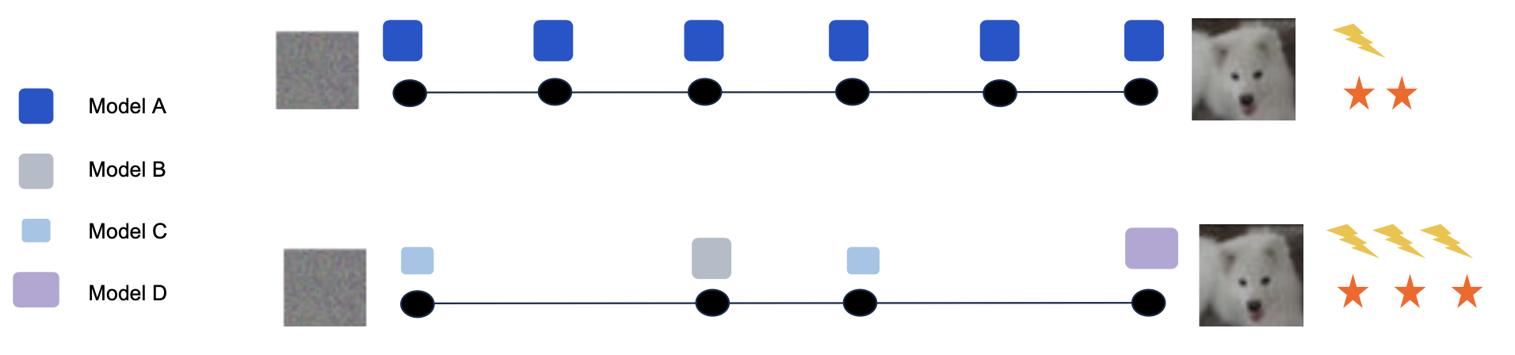
Hypothesis
“ Mixing Different models across steps can benefit the trade off between generation quality and latency ”

Slide 10
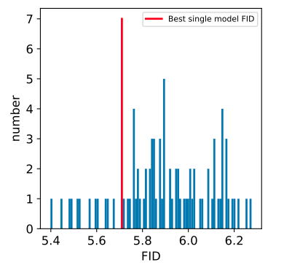
Empirical Proof of Hypothesis
Randomly select models for each of the denoising step to form model schedules.
Certain model schedules can outperform the best single model i.e arch 6. in terms of both quality and latency.
Fig 5: Histogram of FIDs obtained by randomly combining models as the score function estimators for a 90 step DPM solver.

Slide 11


Model Schedule Optimization
Sampling Time: M Steps
Time Budget: C (Hyperparameter)
Upper limit on number of steps: L
Where, refers to the sample quality score (e.g, FID).

Slide 12
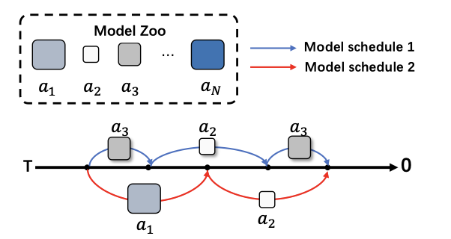
Model Schedule Optimization
Discretize L timesteps (Linear for DDIM and uniform logSNR for DPM solver)
To maintain M ≤ L, add null model a₀ to the zoo.
If a₀ is used at a certain timestep, that timestep is skipped for reverse generation process.

Slide 13
The Challenge
Finding the most optimal model schedule
Loss values are not a good indication of generation quality.
For N models and L step discretization, the search space size becomes (N+1)^{L}
Impractical to get optimal model from large search space with brute force search algorithms.

Slide 14
Let’s Estimate!
It takes about 1 GPU hour to generate 5k samples (256×256 resolution), for evaluating only a single model schedule.
Assuming we have N=5 models in the zoo, and a maximum of L=1000 timesteps, the time taken to exhaustively search the entire search-space of (1+N)^{L} schedules would be
1 x 6¹⁰⁰⁰ GPU hours Impractical!!

Slide 15
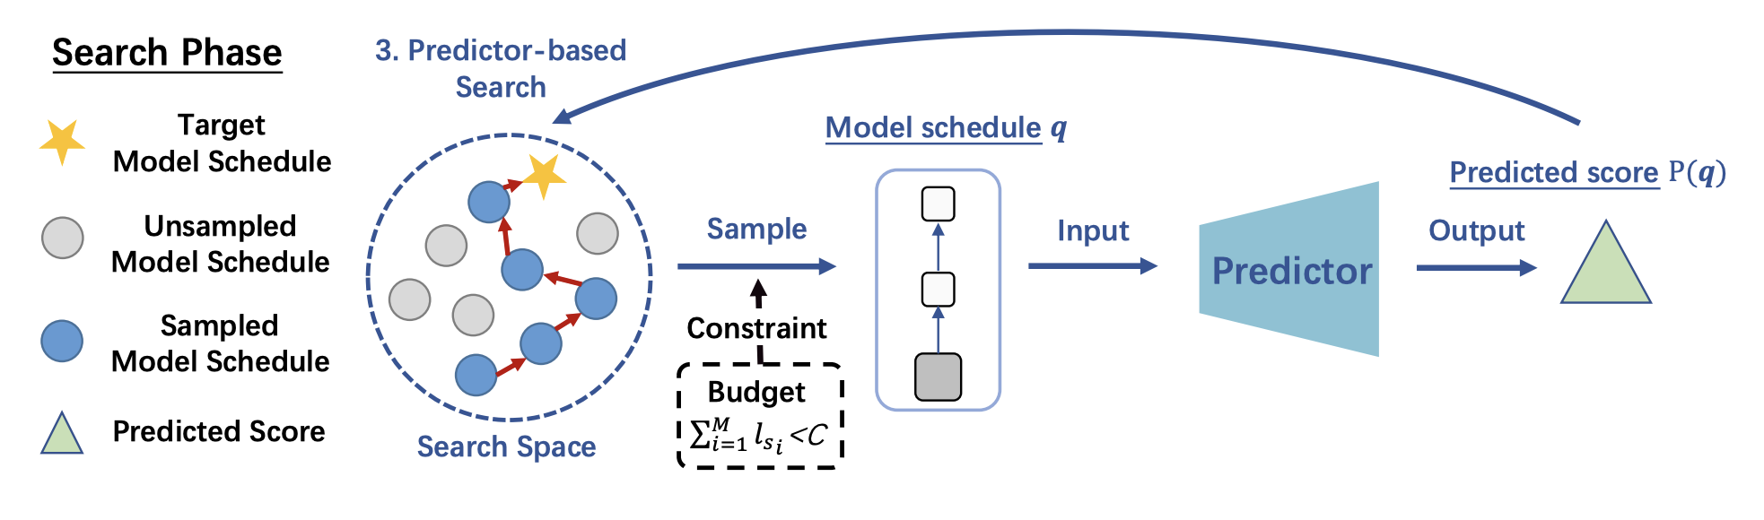
Predictor-based Model Schedule Optimization
Train a separate predictor model which predicts the generation quality (i.e FID score) for a given model schedule, and use it to efficiently navigate the model schedule search space

Slide 16
Overall Workflow
Step 1: Gather training data for the predictor
Step 2: Train a performance predictor using this data
Step 3: Run a predictor-based search to find a suitable DPM schedule

Slide 17
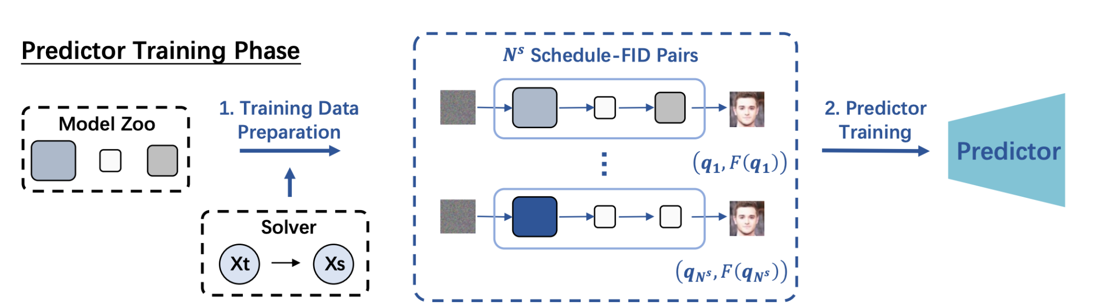
Gathering the Predictor Training Data

Slide 18
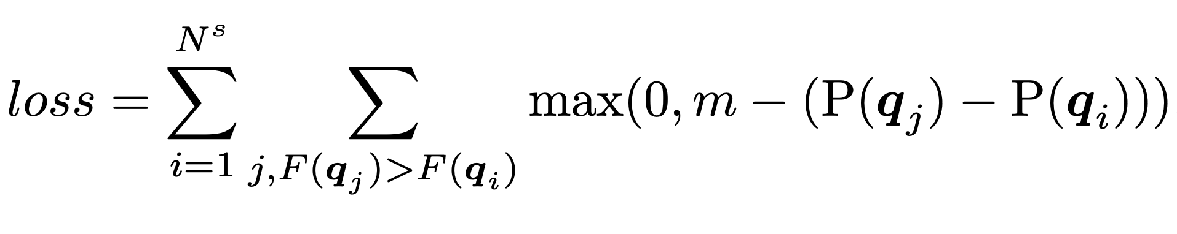
Training the Predictor Model
While comparing any two schedule, it is more important for the predictor to correctly estimate relative FID scores, as compared to their absolute values. The predictor training loss tries to preserve the relative ordering of predicted FID scores: q: model schedule P(q): Predicted generation quality of schedule q m : hinge compare margin

Slide 19
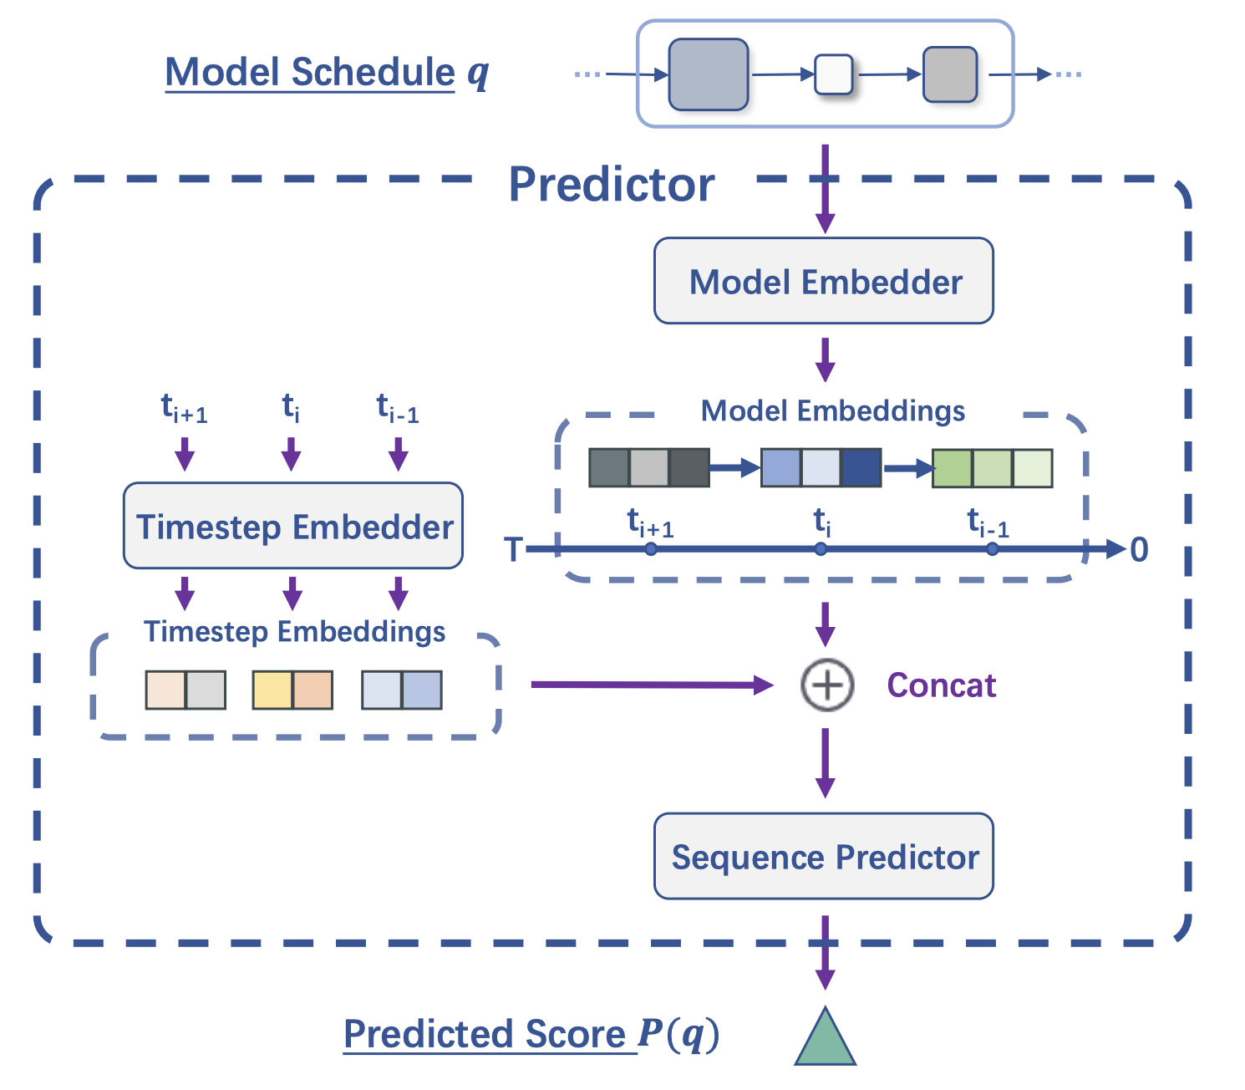
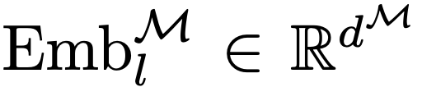
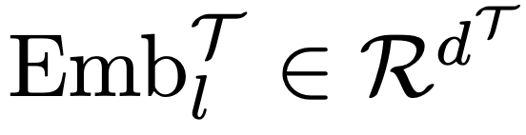
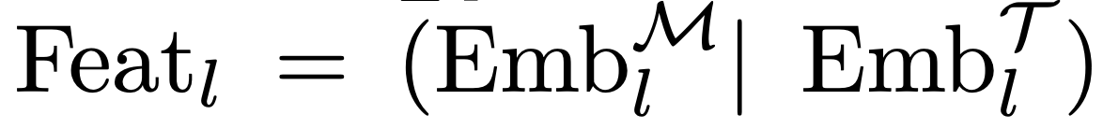
Predictor Design
Model Embedder : A d^{M} dimensional embedding is learned for each model
Timestep Embedder : MLP that generates using sinusoidal embedding vector of timestep t Thus, for each timestep, we have
Sequence predictor : LSTM followed by MLP which gives the final score P(q)

Slide 20
Predictor based Evolutionary Search
The algorithm iteratively modifies the current best model schedules (evaluated by the predictor) in the hope of finding better ones.

Slide 21
Predictor based Evolutionary Search
Select a schedule q_{i} with lowest predicted FID, out of available schedules P
Introduce mutations in q_{i} to generate new variations of q_{i}
Add these newly generated schedule to the set of available schedules P
Repeat steps 1-3 for a fixed number of iterations
The schedule with the lowest predicted FID out of P is the selected schedule.

Slide 22
Experimental Setup
Task : Unconditional Generation
Datasets: CIFAR-10, CelebA, ImageNet-64, LSUN Church
Samplers : DDIM, DPM-Solver
Model Zoo: U-Net Architecture tweaked manually and trained on above datasets specifically for the experiment.
Task: Text-to-image Generation
Dataset : MS-COCO 256x256 validation set (image-caption pairs)
Sampler : DPM-Solver
Model Zoo : Four incremental publicly available checkpoints of stable-diffusion-v1

Slide 23
Experimental Setup
Baselines: (1) Using single model across all timesteps (2) Schedule with best FID under budget C in the training set (3) Randomly generated schedule under budget C
Metrics: Fréchet Inception Distance (FID) - It measures the distance between distribution of real and generated images

Slide 24
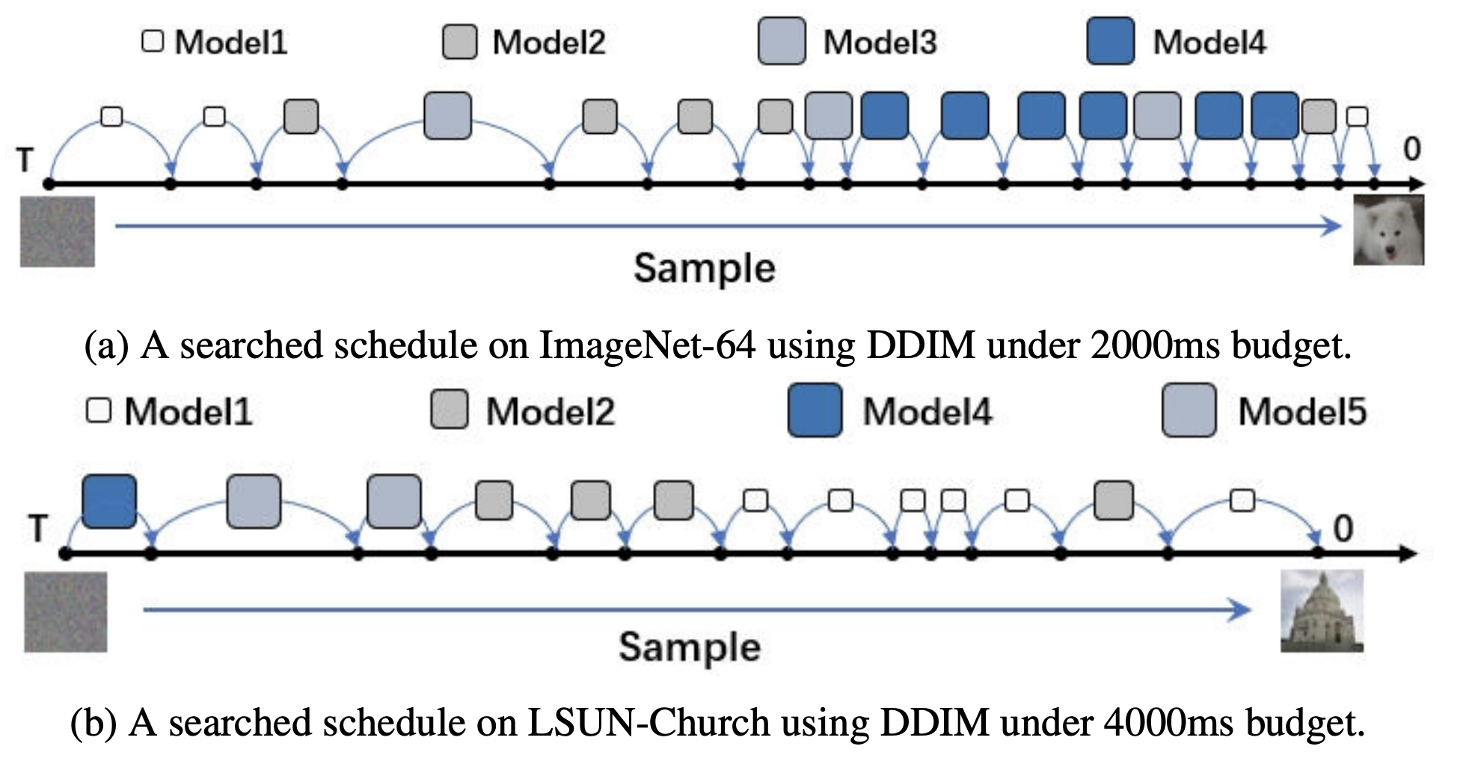
Results

Slide 25
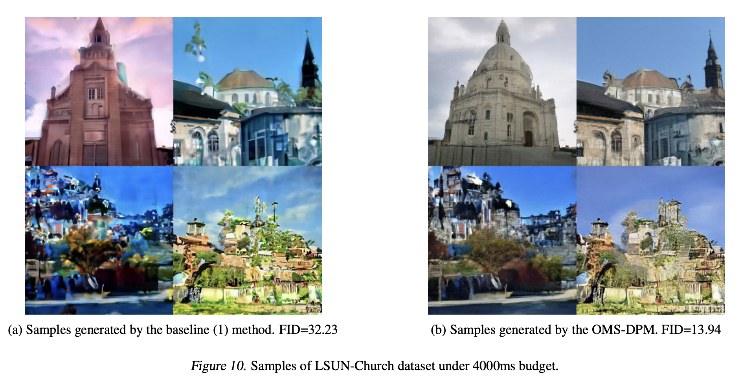
Results

Slide 26
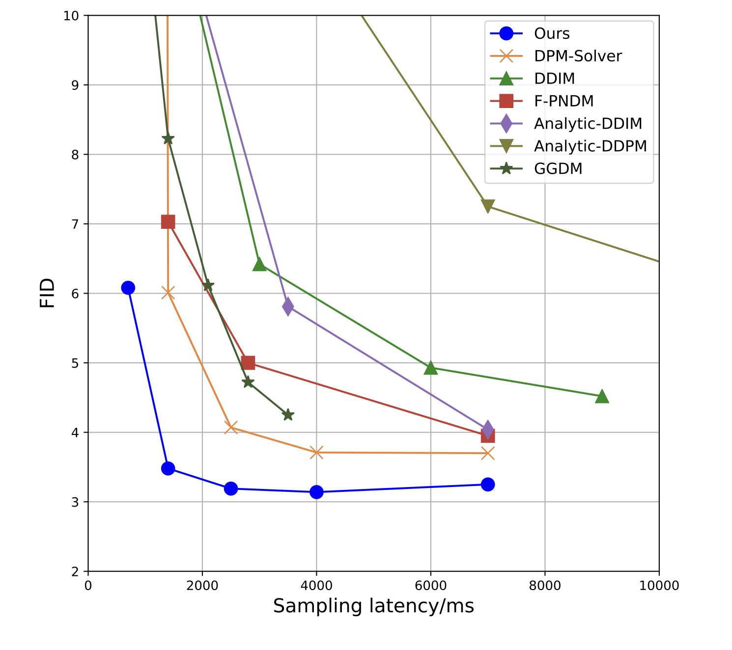
Results
The DPMs with model schedules derived by OMS-DPM achieves a significantly better trade-off than existing DPMs
Generation quality vs latency on CIFAR-10

Slide 27
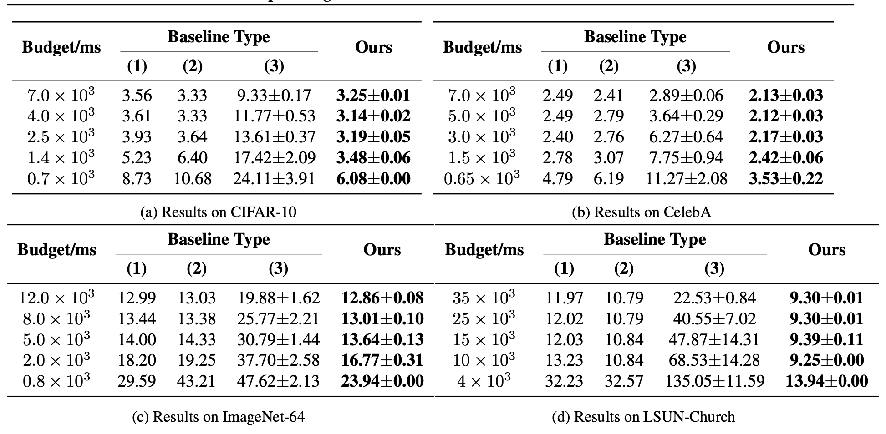
Evaluations
FIDs scores for Unconditional Generation with DPM-Solver

Slide 28
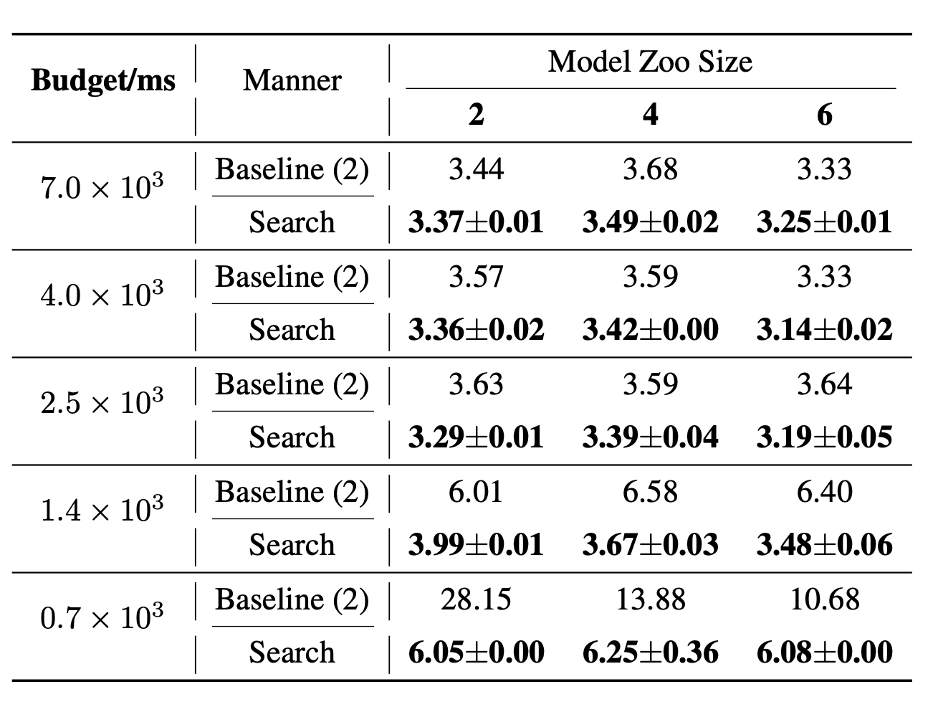
Ablations
Varying Model Zoo Size: Using the largest model zoo with N = 6 achieves the best results

Slide 29
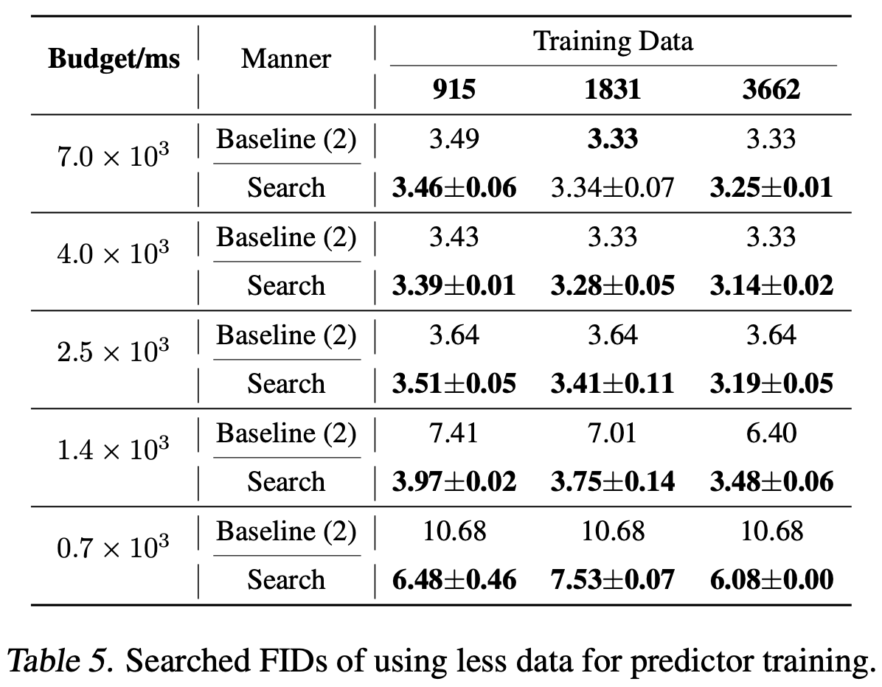
Ablations
Varying predictor Training Data Size:
More training data gives better results
Less training data config still exceeds baseline results

Slide 30
Review
Strengths
Explores a rather overlooked dimension - model schedule for improving DPMs
Leverages different models to achieve lower FID score than a single model
No retraining of models required
Robust to datasets, samplers and time budgets.
Weaknesses
Requires multiple off-the-shelf models trained on the same dataset
Predictor training data-collection is time consuming and expensive
Provides empirical improvements in FID without theoretical guarantees

Slide 31
Future Work
Using different generative models handle different aspects of creation
Combining off-the-shelf models trained on different datasets in a multi-modal setup would be an interesting future direction

Slide 32
Self-Reflection in LLM Agents: Effects on Problem-Solving Performance
By: Matthew Renze (John Hopkins University), Erhan Guven (John Hopkins University)

Slide 33
Motivation
LLMs still make errors despite chain-of-thought (CoT) prompting.
Inspired by human learning: reflection on mistakes leads to better future performance.
Aim: Can LLMs benefit from self-reflection to improve problem-solving?
Valuable for building more robust, autonomous LLM-based agents.

Slide 34
Prior Works
Reflexion (Shinn et al.): Verbal reinforcement improves LLM reasoning.
Self-Refine (Madaan et al.): Iterative self-feedback for answer correction.
Metacognitive Prompting (Wang & Zhao): Improves LLM understanding.
SelfCheck, ReAct, and Toolformer: Related techniques leveraging LLM feedback and tools.

Slide 35
Introduction
Research Question: Does self-reflection improve LLM accuracy on MCQA tasks?
Compared 9 LLMs across 8 self-reflection strategies + 1 baseline.
Domains covered: math, science, law, logic, English, medicine.
Designed a controlled, large-scale experiment for reproducibility and analysis.

Slide 36
Background
LLMs can use CoT prompting to simulate reasoning.
Despite improvements, CoT often contains logical/mathematical errors.
Self-reflection simulates metacognition: analyzing one’s reasoning and revising based on it.
This study decomposes reflection into multiple strategies to evaluate effectiveness.

Slide 37
Agents Compared
Baseline – No reflection
Retry – Try again after failure
Keywords – Labels for error types
Advice – Generic guidance for future improvement
Explanation – Why the original answer was wrong
Instructions – Step-by-step guide to solving the problem
Solution – Full correct solution using CoT
Composite – All above types combined
Unredacted – Composite + correct answer (used as upper-bound)

Slide 38
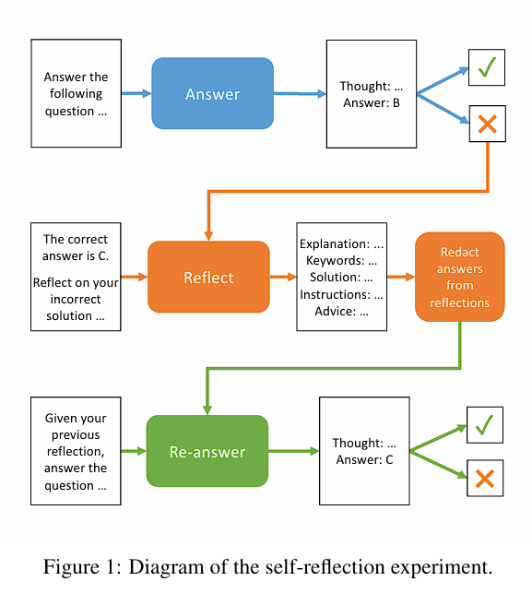
Methodology
Each model first answers all questions (Baseline pass)
Incorrect answers are reflected upon using the correct answer
Each agent generates a specific reflection type, then re-answers
Redactions applied to prevent answer leakage (except Unredacted agent)
Accuracy evaluated before and after reflection using McNemar’s test

Slide 39
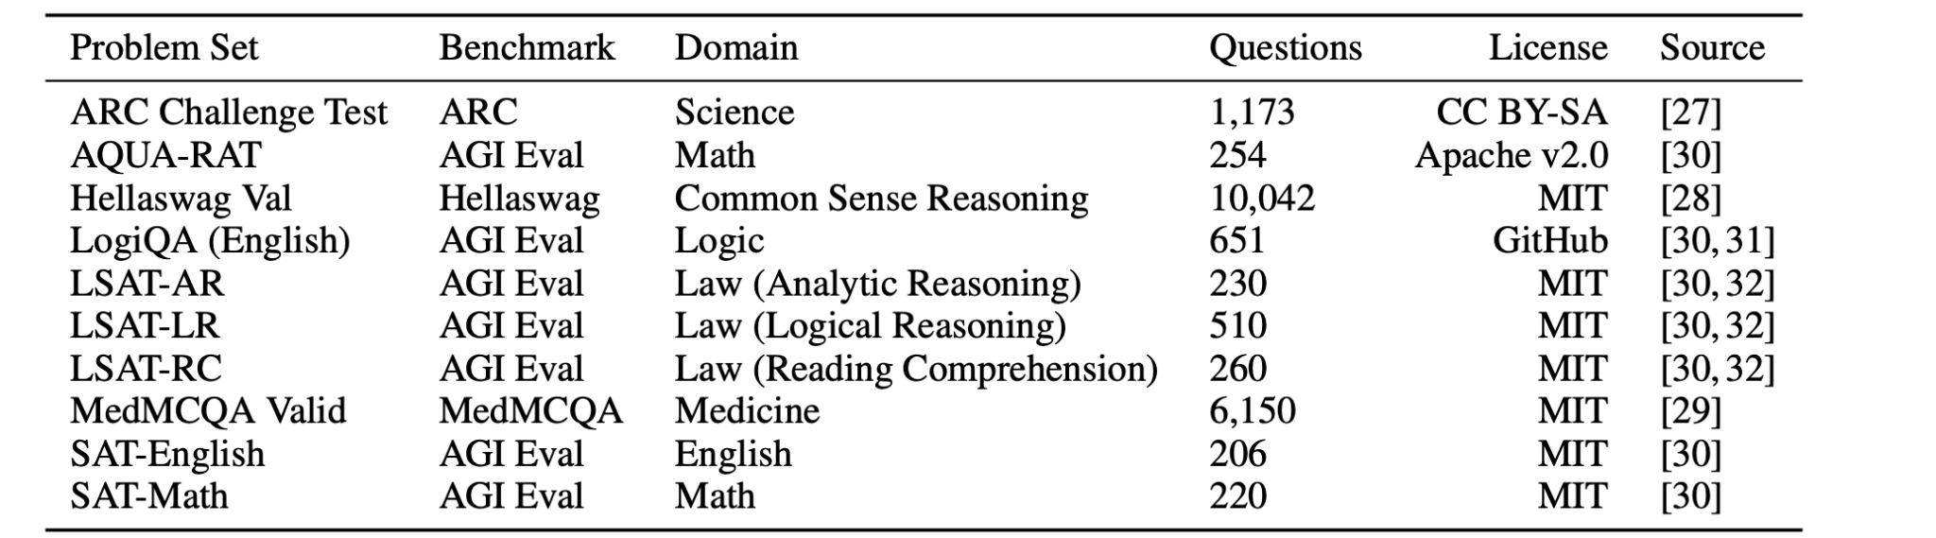
Dataset
Set of multiple-choice question-and-answer (MCQA) problems from benchmarks like ARC, AGIEval, HellaSwag, MedMCQA
Randomly selected 100 questions from each of the 10 datasets.
Table 1.Problem sets used to create the 1000 question multi-domain MCQA exam

Slide 40
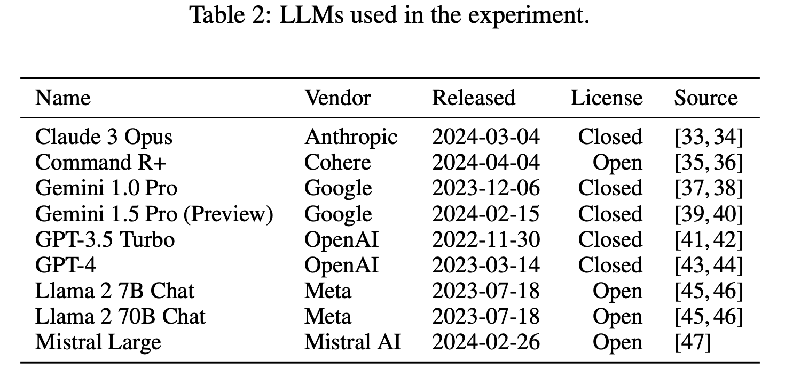
Models Evaluated
Evaluation of Nine Popular LLMs
Models evaluated include GPT-4, Llama 2 70B, Gemini 1.5 Pro, etc.
Strengths and Weaknesses of LLMs
GPT-4, Gemini 1.5 Pro, and Claude Opus: Powerful with a large number of parameters.
Higher cost per token compared to smaller models.
Smaller Models
GPT-3.5 and Llama 2 7B: More cost-efficient

Slide 41
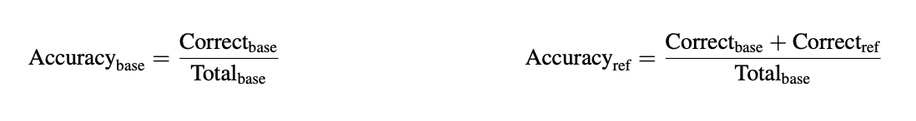
Metrics & Analysis
Primary Metric: Correct-Answer Accuracy
Accuracy = Correct Answers / Total Questions.
Self-reflecting agents only re-answer incorrectly answered questions by the Baseline agent.
Total score for self-reflecting agent = Baseline agent score + Correct re-answer score.
Accuracy Calculations

Slide 42
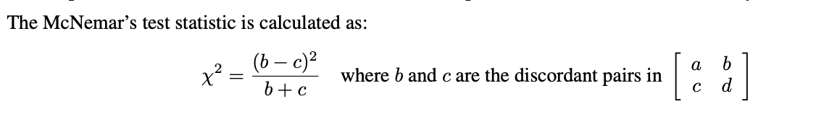
Metrics & Analysis
Statistical Analysis
McNemar Test used to compare Baseline and self-reflecting agent scores.
Test compares binary outcomes (correct/incorrect answers) using a 2x2 contingency table.
Cell a: both agents incorrect; d: both correct. Cell b: incorrect/correct pairs; c: correct/incorrect pairs.

Slide 43
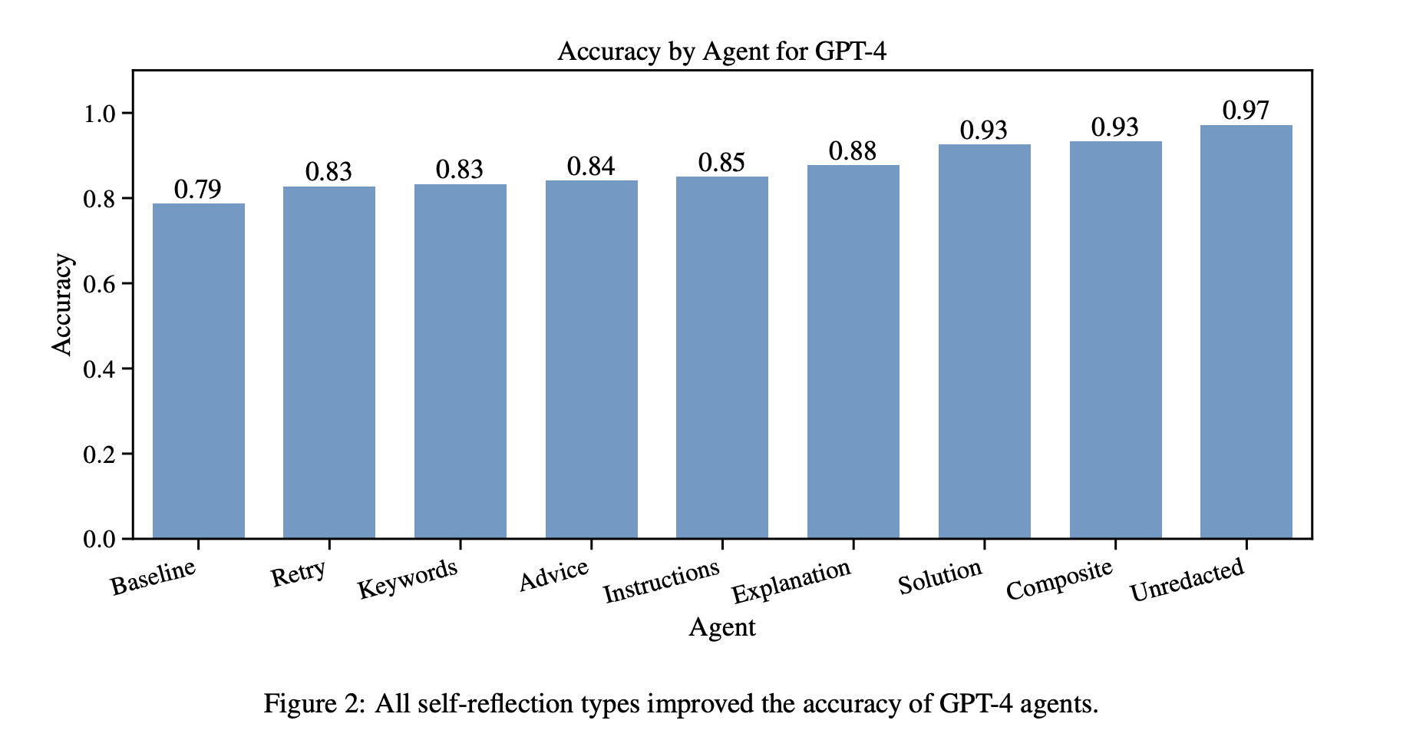
Results: By Agent

Slide 44
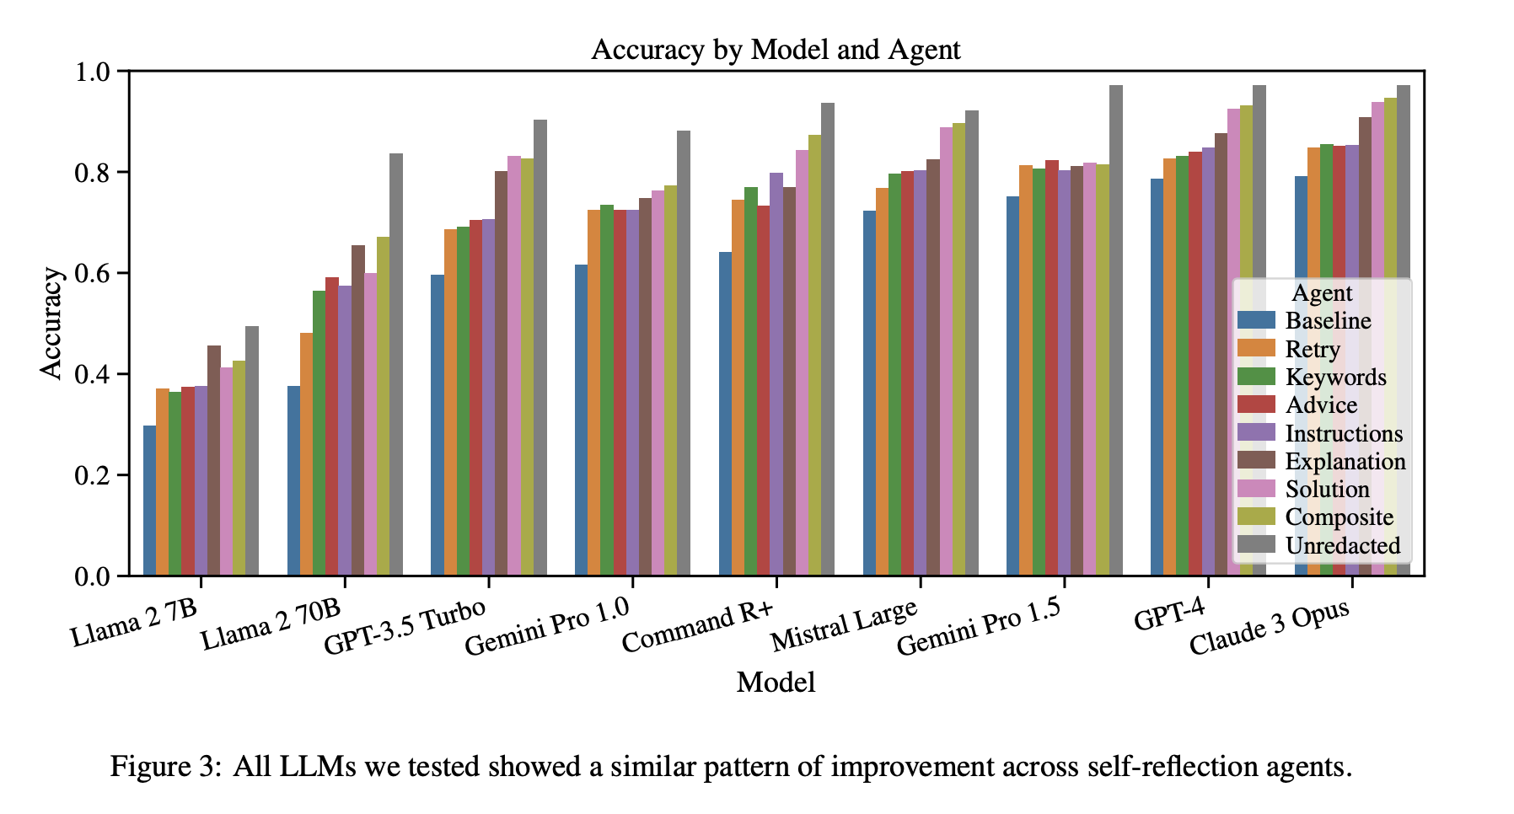
Results: By Model

Slide 45
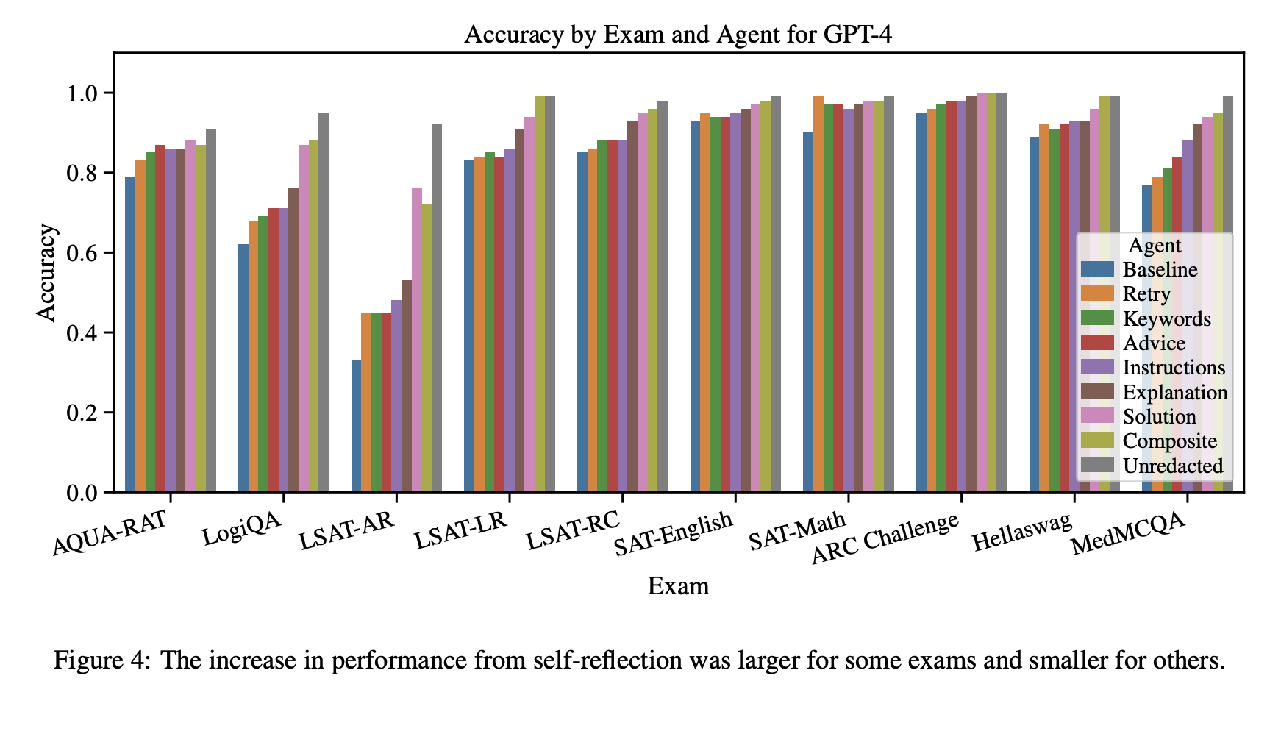
Results: By Exam Domain

Slide 46
Interpretation
All types of self-reflection improve LLM performance.
Self-reflection types with more information (e.g., Instructions, Explanation, Solution) outperform those with less (e.g., Retry, Keywords, Advice).
Retry agents showed significant improvements across all LLMs.
Self-reflection effectively eliminates direct answer leakage, while guiding towards correct answers indirectly.

Slide 47
Implications
Practical implications: Self-reflecting agents can avoid repeating mistakes and reduce unproductive loops.
Theoretical implications: Supports metacognition in LLMs to improve performance based on error feedback.

Slide 48
Limitations
Study limited to single-step tasks; self-reflection harms multi-step reasoning (e.g., -4% accuracy in HotpotQA) due to cognitive overload.
Near-perfect accuracy (~100%) in high-performing models obscures measurable performance improvements.
Larger models (GPT-4o) show 36% higher reflection gains vs. smaller ones (Llama-3 8B).
Iterative reflection increases compute costs by 2–5×, hindering resource-efficient deployment.
LSAT-AR’s outlier performance gains (largest improvement) skewed aggregate results.

Slide 49
Future Work
Test with more complex problems, especially those harder than the LSAT-AR exam.
Implement multi-step problems and provide feedback after each step for error correction.
Explore self-reflection with external tools (e.g., errors from Python compilers, search engines).
Investigate agents with external memory to store and retrieve past reflections. (RAG can be used in real world scenario)
Conduct surveys on self-reflection across diverse LLMs, agent types, and domains.

Slide 50
Vulcan: Automatic Query planning for Live ML Analytics
Authors: Yiwen Zhang, Xumiao Zhang, Ganesh Ananthanarayanan, Anand Iyer, Yuanchao Shu, Victor Bahl, Z. Morley Mao, Mosharaf Chowdhury (NSDI 2024)

Slide 51
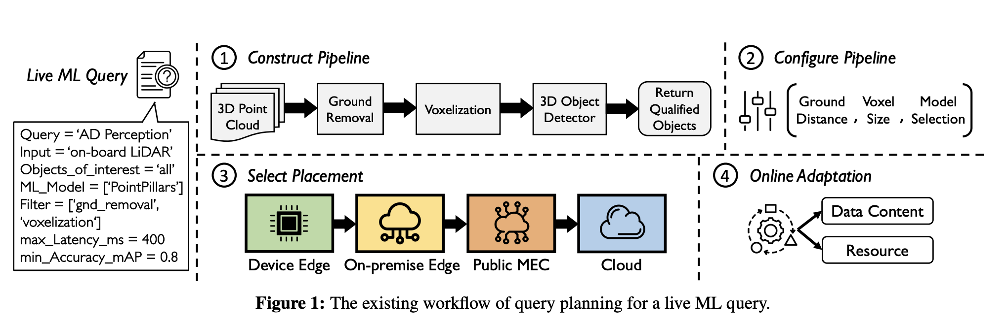
Motivation
Sample Live ML Query : Detect surrounding objects in edge assisted autonomous driving
Fig. The existing workflow of query planning for a live ML query
Notes:
If we want to stick to the user specified performance constraint, there are a lot of decisions to make for each of the above steps, lots of knobs to turn, to reach an optimal configuration that satisfies the constraints

Slide 52
Motivation
Key Challenges faced with current SOTA Live ML Analytics systems are:
Huge search space to find the optimal knob configurations
Constructing pipelines based on performance requirements is challenging
No joint optimization framework for pipeline placement and query configurations

Slide 53
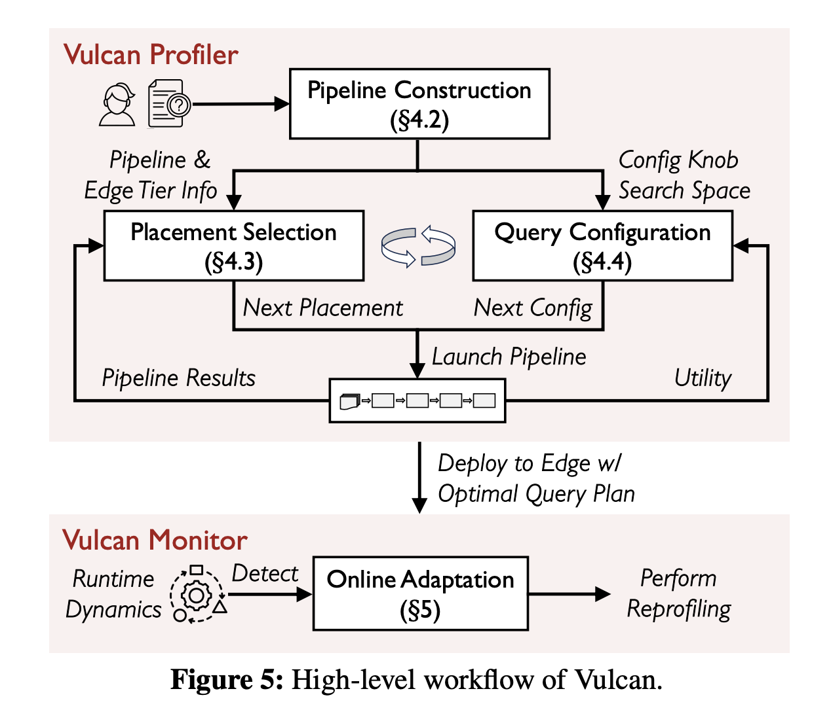
Vulcan : Key Contributions
Vulcan is the first end-to-end system for automatic query planning in live ML analytics which supports:
Utility-based pipeline construction (accuracy/latency aware)
Efficient pipeline placement on ege infrastructure tiers
Query configuration using Bayesian Optimization (BO)
Fast online adaptation to changing runtime dynamics
Fig. High-level workflow of Vulcan

Slide 54
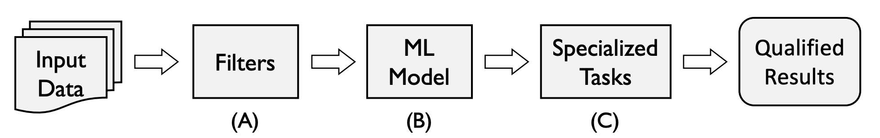
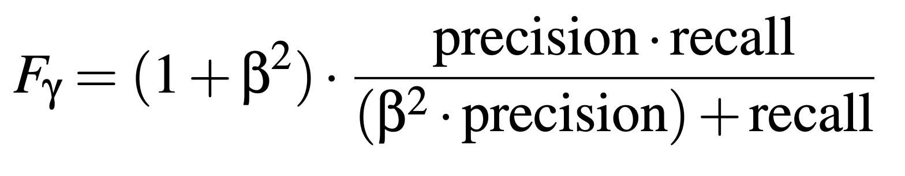
Utility-aware Pipeline Construction
Challenge:
Choosing the best filter order affects both accuracy and latency.
Vulcan’s Solution:
Models filters as information retrieval operators (precision & recall).
Defines F_{γ} metric as
Evaluates only a few key configurations to identify best filter sequence.
Fig. Template used by Vulcan to construct the initial pipeline
Notes:
Problem : Search space for filter ording is exponential.
Reduces search space from exponential → linear in filters.

Slide 55
Efficient Pipeline Placement
Problem:
Operator placement affects network latency, GPU cost.
Full profiling for all configurations × placements is expensive.
Vulcan’s Innovations:
Observes: accuracy ≠ placement-dependent.
Reuses results from a single offline run to estimate cost for all placements.
Reduces search complexity from O(M×N) → O(N) (where M: pipeline choices, N: query config choices)
Achieves up to 174× network savings and better latency.

Slide 56
Query Config Selection via BO
Challenges:
Many configuration knobs (e.g., model type, compression level).
Exhaustive or greedy tuning is slow or gets stuck.
Vulcan’s Approach:
Uses Bayesian Optimization (BO) with Gaussian prior + UCB acquisition.
Jointly tunes configurations with placement to find global optimum.
Achieves 3.5× faster tuning than greedy hill climbing.
Notes:
Stops when utility improves <10% over 5 trials

Slide 57
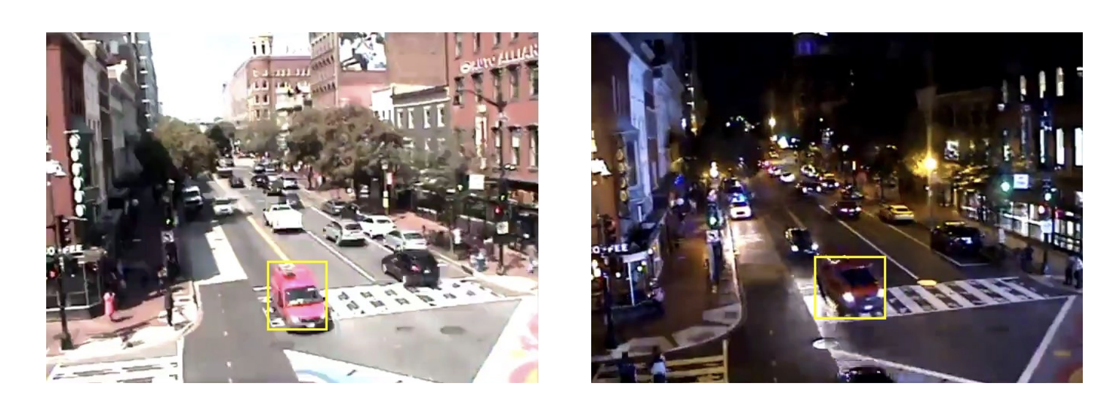
Online Adaptation
Challenge:
Changing network bandwidth, compute loads, or data patterns.
Vulcan’s Solution:
Monitors “utility” (accuracy + latency / resource use).
Detects >10% utility drop → triggers quick reprofiling.
Leverages prior configs (best/worst K) to warm-start BO.
Dynamically updates container configs via API (no downtime).
Adjusts placement as well (e.g., move detector to edge if MEC chokes).
Fig. Scenes taken during different time of the day from a video query detecting red vehicles
Notes:
Result: 2.5× better 99th percentile latency in dynamic settings

Slide 58
Review
Strengths
Jointly optimizes filter ordering, placement, and configuration
Fast, intelligent profiling via BO and reuse of intermediate results.
Online adaptation handles real-world dynamics.
Weaknesses
Assumes ML modules are pre-specified by user
No current support for concurrent ML queries (multi-tenancy)
Future Work
Multi-query scheduling and resource sharing
Broader utility models (e.g., fairness, energy)
Support to select best ML model for the given query and constraints

Slide 59
Thank You
Questions?

