Slide 1

RAG
CS598 FLA
Yihan Zhang Hanbo Guo Minghao Fang Chenghao Mo
April 9th, 2025

Slide 2

REALM: Retrieval-Augmented Language Model Pre-Training
Kelvin Guu, Kenton Lee, Zora Tung, Panupong Pasupat, Ming-Wei Chang
Google Research
COMPUTER SCIENCE
GRAINGER ENGINEERING

Slide 3
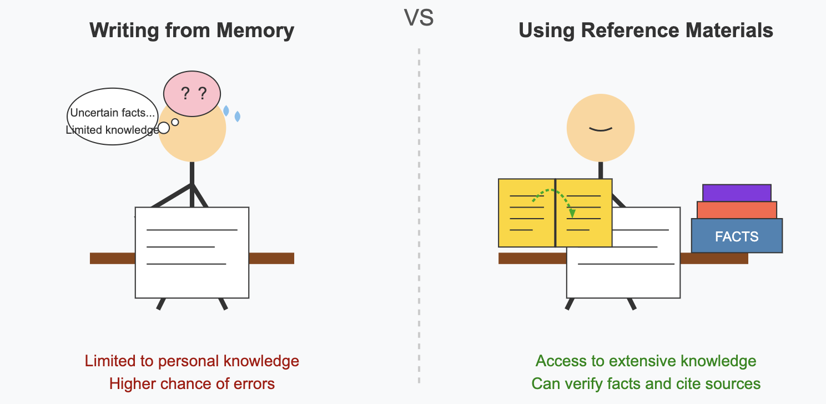
What is RAG?
Traditional LM
LM + RAG
COMPUTER SCIENCE
GRAINGER ENGINEERING
Notes:
Before we dive into the technical details of the REALM paper, let's take a moment to understand what Retrieval-Augmented Generation - or RAG - is all about.
Think about how we as humans handle knowledge. When you need to write a detailed report or answer a complex question, you rarely rely on memory alone. Instead, you probably look things up - in books, articles, or online sources.
Traditional AI language models don't work this way. They're more like someone who had to memorize everything before an exam and can only use what they've committed to memory. They have no way to 'look things up' when answering questions. Whatever knowledge wasn't captured during their training is simply unavailable to them.
RAG takes a fundamentally different approach. These systems combine the reasoning abilities of language models with the ability to retrieve and consult external knowledge. It's like giving the AI a library of reference materials it can search through when needed.

Slide 4
Motivation
Language models store a surprising amount of world knowledge
BERT implicitly learned: “The _____ is the currency of the United Kingdom.” (answer: “pound”)
Difficult to capture those knowledge
The learned world knowledge is stored implicitly in the parameters of the underlying neural network.
Storage space is limited by the size of the network
Updating knowledge requires retraining the entire model
COMPUTER SCIENCE
GRAINGER ENGINEERING
Notes:
To summarize,
Language models like BERT and T5 have showed impressive abilities to capture world knowledge through their parameters. They implicitly learned lots of world knowledge, such as BERT can implicitly learned that pound is the current of the UK.
The knowledge is stored implicitly within model parameters, making it difficult to interpret what knowledge is stored and where
Storage capacity is constrained by network size, requiring ever-larger networks to store more facts
Updating knowledge requires retraining the entire model
REALM addresses these limitations by augmenting language models with a learned retrieval component that can access external knowledge explicitly.

Slide 5
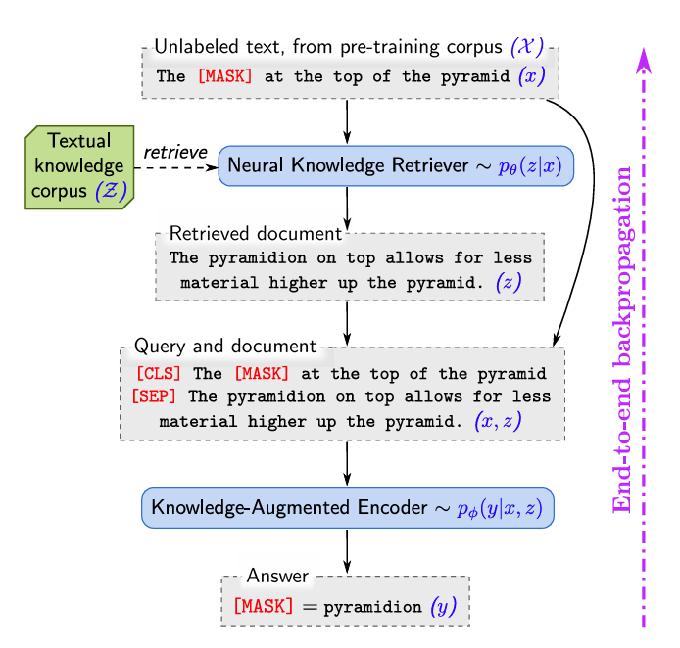
High-level
BERT + knowledge retriever = REALM
BERT:
The [MASK] at the top of the pyramid
=> [MASK] = ?
REALM
The [MASK] at the top of the pyramid
Document: The pyramidion on top …
=> [MASK] = pyramidion
COMPUTER SCIENCE
GRAINGER ENGINEERING
Notes:
Now let's look at what makes REALM special in a more concrete way.
At its core, REALM is a combination of two parts: BERT and a knowledge retriever. That's the key formula you see at the top of this slide.
First, let's understand how regular BERT works with an example. When BERT sees a sentence with a masked word like 'The [MASK] at the top of the pyramid,' it has to guess what goes in that blank space. But BERT only has its internal knowledge to work with - whatever it learned during training. It might not know the answer or might make an incorrect guess because it's limited to what's in its parameters.
REALM, on the other hand, When it sees the same sentence with a masked word, it doesn't just guess immediately. Instead, it searches through a database of documents to find relevant information. In this case, it finds a document that tells us 'The pyramidion on top allows for less material higher up the pyramid.' This external knowledge gives REALM exactly what it needs to correctly fill in the blank with 'pyramidion.'

Slide 6
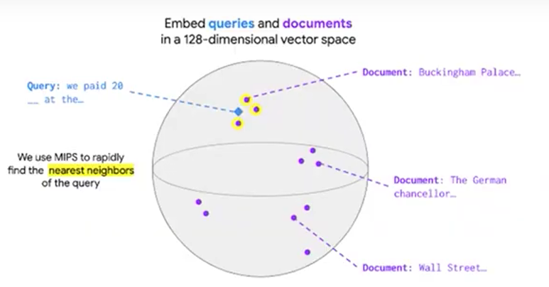
Compared with RAG
Similarities
Separate encoders for input and documents.
Transparency on knowledge source.
Knowledge update without retraining.
Differences
REALM is end-to-end, retriever is jointly optimized with the language model.
RAG's retriever is trained separately.
COMPUTER SCIENCE
GRAINGER ENGINEERING
Notes:
Inference in DeepSeek is broken into two main stages – prefilling and decoding.
During the prefilling stage, attention layers use TP4 with Sequence Parallelism (SP) to ensure smooth operations.
MoE layers use Expert Parallelism (EP32), ensuring that batch sizes remain large while keeping load balanced.
A key innovation here is dynamic redundancy, where redundant experts are deployed based on real-time load statistics.
Micro-batches are overlapped, meaning computation continues while communication happens in the background.
This slide focuses on how the “prefilling” stage is set up:
Attention layers using TP4 with Sequence Parallelism (SP).
MoE layers on EP32 to handle large batch sizes per expert.
Redundant experts deployed dynamically—meaning if one set is busy, another can step in.
They also overlap micro-batches to mask communication costs.
By the time the model finishes this stage, the initial context is loaded and processed, prepping for smooth decoding.

Slide 7
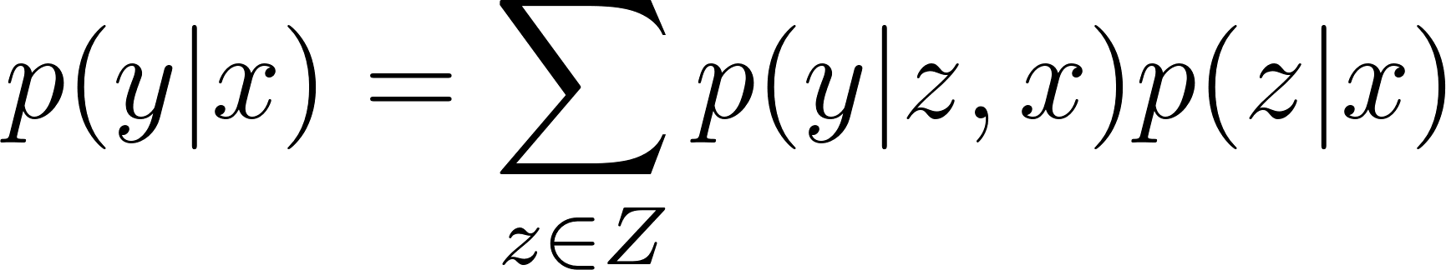
Architecture Overview
Overall Goal:
Learn a distribution p(y|x)
Pre-training: x = masked text, y = missing tokens
Supervised fine-tuning: x = question, y = answer
Two-Step Decomposition:
Knowledge Retriever: p(z|x)
Knowledge-Augmented Encoder: p(y|z, x)
Complete Model:
COMPUTER SCIENCE
GRAINGER ENGINEERING
Notes:
The overall goal of REALM is to learn a distribution of y given x
X and Y have different meanings for different tasks.
REALM is pretrained with a Masked Language Model, which means during pre-training, x is a piece of text with some words masked out, and y represents those missing tokens we're trying to predict.
This can be fined turned to answer some natural questions with more than one token in the answer, where the input the some question, and output is the answer.
What makes REALM special is how it breaks this prediction into two steps by adding a supplementary document, represented as “z”:
First, we have the Knowledge Retriever, which takes our input x and retrieves the most relevant documents z from our knowledge corpus. Instead of using a fixed retrieval system, REALM formulates knowledge retrieval into a learning problem, and jointly train the retriever with the language model.
Second, we have the Knowledge-Augmented Encoder, represented as p(y|z,x). This component takes both our original input x and the retrieved documents z to predict the output y. By seeing both the query and the retrieved knowledge, it can make much better predictions.
Putting them together, we're considering all possible documents we might retrieve, calculating how likely each one is to be relevant and how likely each one is to give us the right answer, and then combining these probabilities.
In practice, we don't actually sum over millions of documents - REALM only takes documents with highest probability. But the key insight is that the entire process, from retrieval to prediction, is learned together as a unified system."

Slide 8
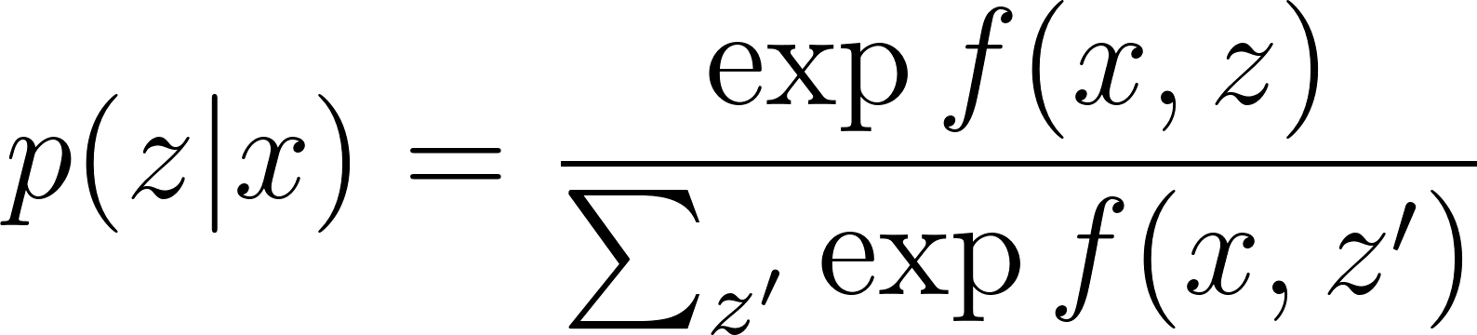
Knowledge Retriever
Dense inner product model:
BERT-Based Embeddings:
Input embedding:
Document embedding:
COMPUTER SCIENCE
GRAINGER ENGINEERING

Slide 9
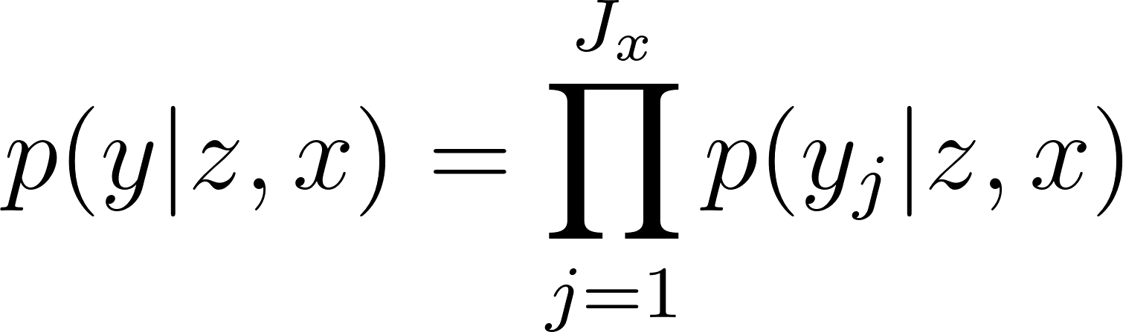
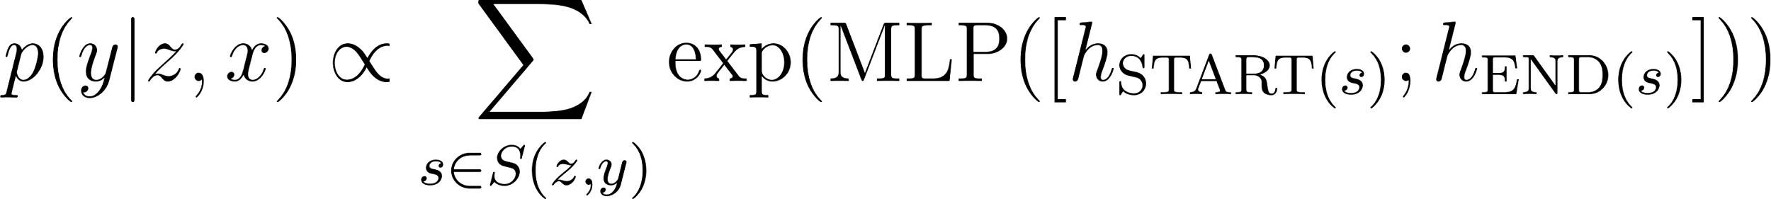
Knowledge-Augmented Encoder
General Approach:
Joins input x and retrieved document z into a single sequence
Feeds into Transformer enabling rich cross-attention between input and document
Pre-training (MLM):
Fine-tuning (Open-QA):
COMPUTER SCIENCE
GRAINGER ENGINEERING

Slide 10
Training
Training Objective:
Maximize log-likelihood: log p(y|x) of correct output y
Optimize parameters retriever and encoder with differentiable neural networks
Computational Challenge:
Expensive for massive corpus z:
Solution: Approximate sum using only top-k documents with highest p(z|x)
Use Maximum Inner Product Search (MIPS) for efficient top-k search
COMPUTER SCIENCE
GRAINGER ENGINEERING

Slide 11
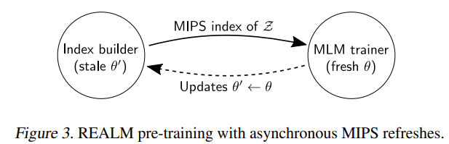
Training - MIPS Indexing
Challenges:
MIPS requires pre-computing embeddings for all documents and build index
Index becomes stale when updating
Solution:
Index refreshed every ~500 steps
Main trainer: continues with fresh parameters (θ)
Index builder: builds index with slightly stale parameters (θ')
Used only during pre-training
Fine-tuning: Index built once with pre-trained parameters
COMPUTER SCIENCE
GRAINGER ENGINEERING

Slide 12
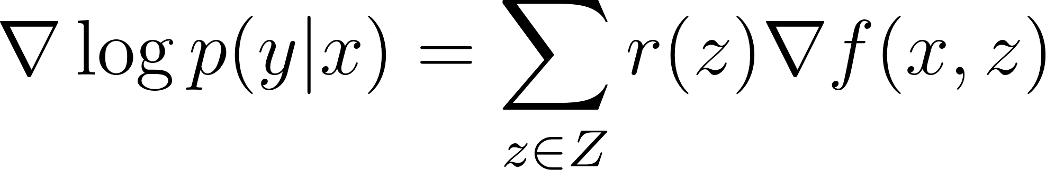
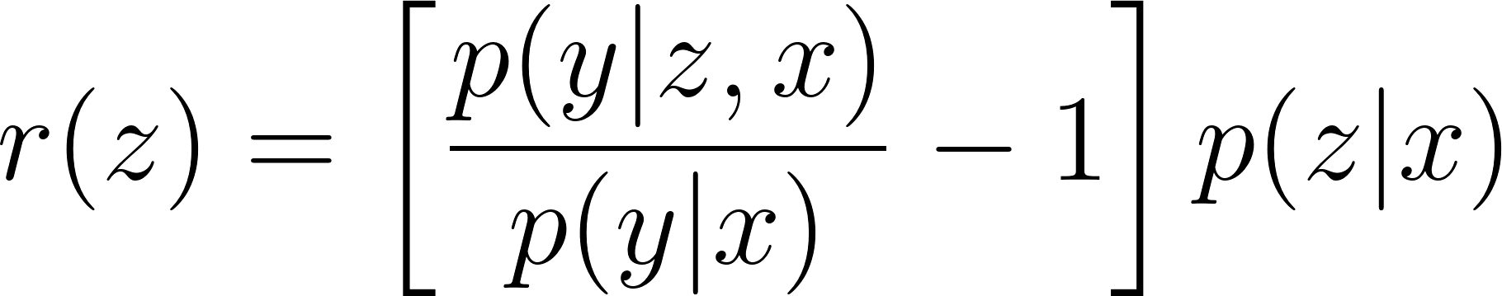
What does the retriever learn?
Gradient Formula
Learning Mechanism
When r(z) > 0: Gradient increases retrieval score f(x,z)
r(z) is positive when: p(y|z, x) > p(y|x)
Document z is rewarded when it helps the model perform better than expected
COMPUTER SCIENCE
GRAINGER ENGINEERING

Slide 13
Injecting inductive biases into pre-training
Salient span masking (SSM)
Mask key entities instead of random tokens
Avoiding information leakage
When training data overlaps with retrieval corpus, avoid directly retrieving the original text of sample
Null document
Some samples don't require external document support
Retriever initialization and cold-start problem
Random initialization of retriever results in irrelevant documents - preventing effective gradients
Use Inverse Cloze Test task to initialize and pre-train the retriever
COMPUTER SCIENCE
GRAINGER ENGINEERING

Slide 14
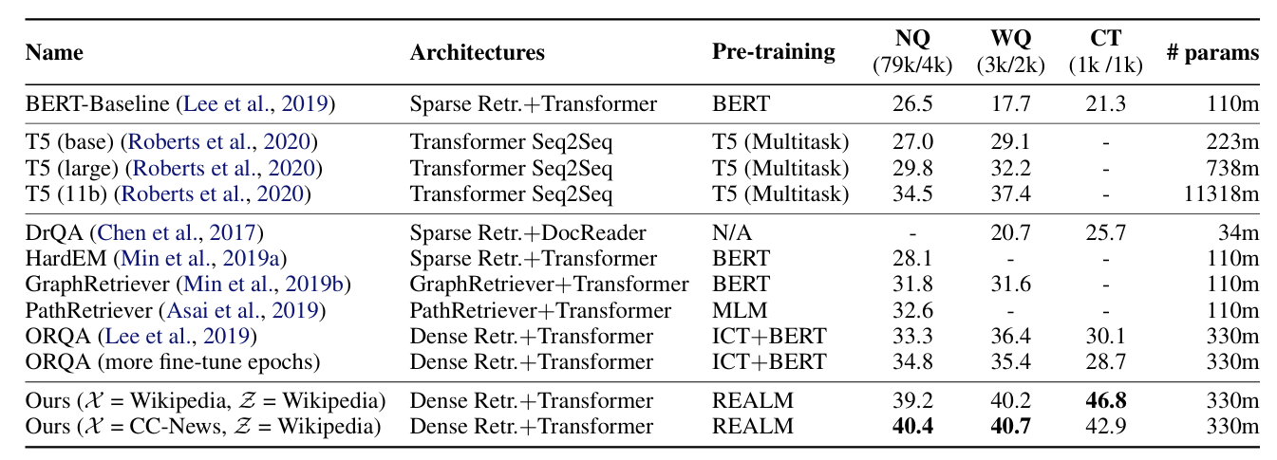
Evaluation
Outperforms T5-11B while being 30× smaller
Improvement over ORQA comes solely from better pre-training methods
Achieves best performance with only 5 documents versus competitors' 20-80
COMPUTER SCIENCE
GRAINGER ENGINEERING

Slide 15
Advantages, Disadvantages & Future Directions
Advantages
Knowledge stored in external corpus rather than model parameters
Makes knowledge transparent and interpretable
Enables modular updates without complete retraining
Disadvantages
Performance degrades with irrelevant documents
Comparing document and input text in single vector space limits semantic matching accuracy
Future Directions
Deploy multi-vector retrieval methods like ColBERT, XTR, Warp
COMPUTER SCIENCE
GRAINGER ENGINEERING

Slide 16
CacheBlend:
Fast Large Language Model Serving for RAG with Cached Knowledge Fusion
Jiayi Yao, Hanchen Li, Yuhan Liu, Siddhant Ray, Yihua Cheng, Qizheng Zhang, Kuntai Du, Shan Lu,
Junchen Jiang
University of Chicago
COMPUTER SCIENCE
GRAINGER ENGINEERING

Slide 17
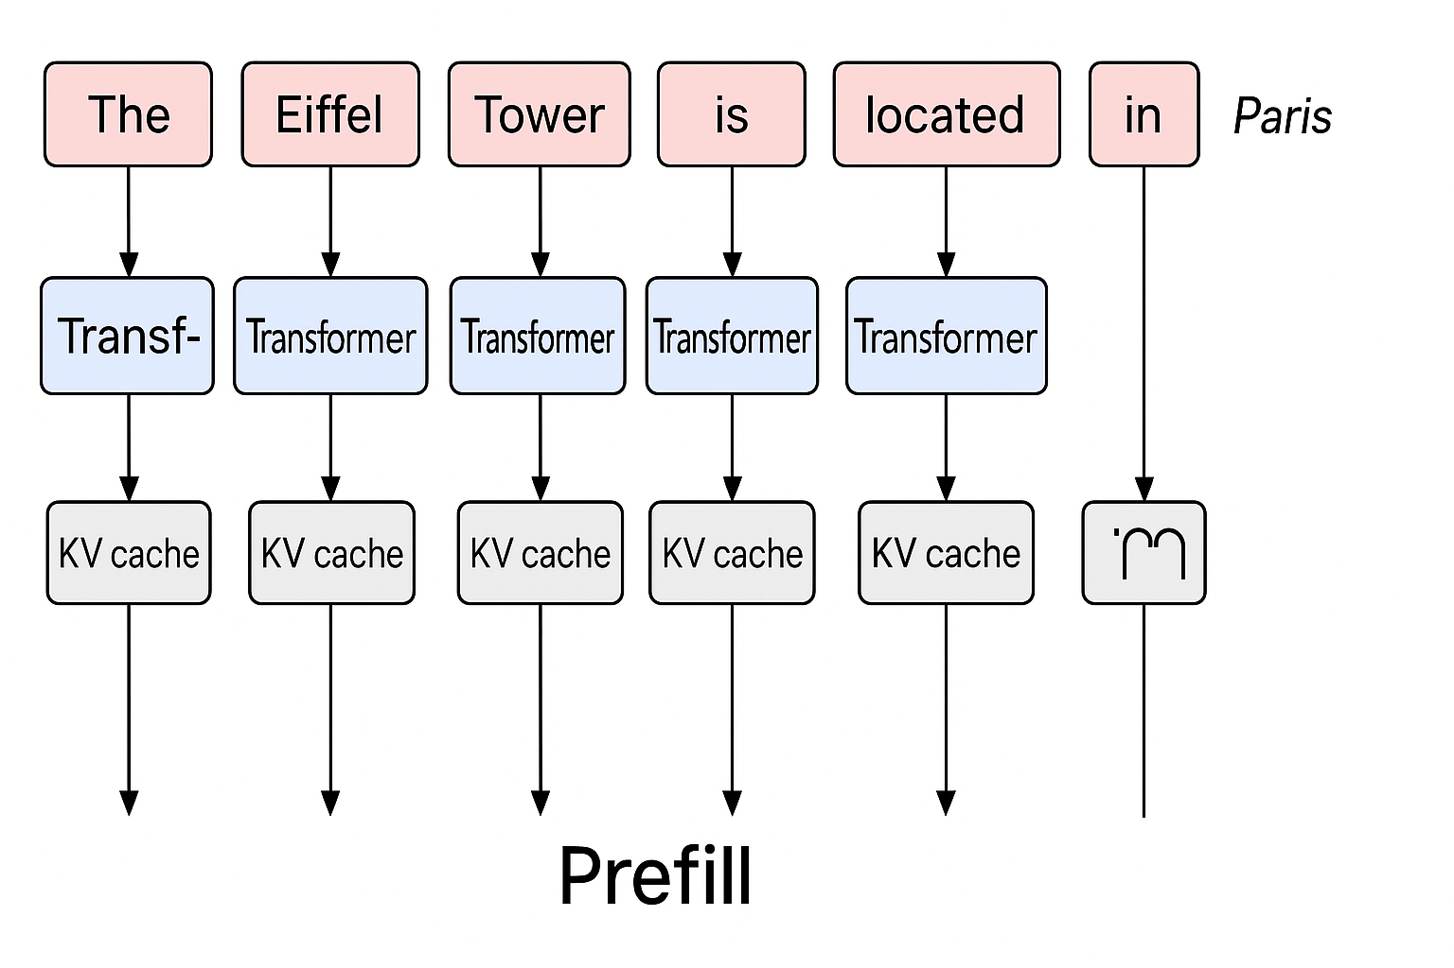
Background: LLM Inference & Prefill
Prefilling is the initial phase in transformer-based LLM inference where the model processes the entire input sequence to compute the key-value (KV) cache for all input tokens before generating any output token.
COMPUTER SCIENCE
GRAINGER ENGINEERING
Notes:
1. Bottlenect as user provide large amt of text chunk along with query

Slide 18
Motivation: Prefix caching & full KV reuse
Prefix Caching: Reuse the KV cache only for the beginning (prefix) of the input
? It only works when the reused chunk is at the start of the input.
Full KV Reuse: Reuse KV caches for any chunk in the input by adjusting positional embeddings
? It allows reuse at any position but ignores cross-attention between chunks.
COMPUTER SCIENCE
GRAINGER ENGINEERING
Notes:
prefix: other chunks’ kv will not be used as they are not at prefix
Full kv reuse: solution to prefix bc When you reuse a cached chunk not at the start of the input, you can shift its positional embeddings to match the new location.
a chunk’s KV cache is precomputed in isolation, it only contains attention between tokens within that chunk . No info to others

Slide 19
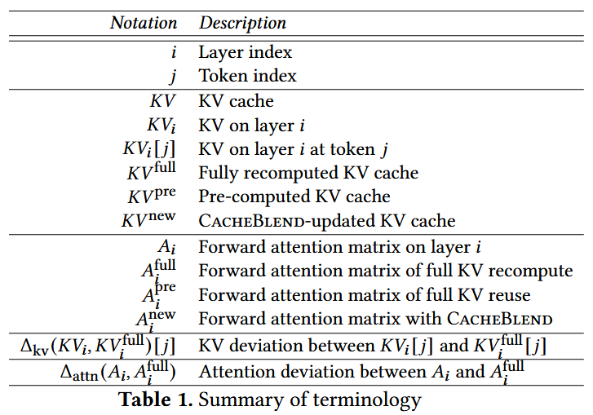
Method: FastKVCacheFusing
•Goal: Updating the pre-computed KV cache such that the forward attention matrix has minimum difference with that by full KV recompute.
•Idea: Recomputing the KV of a selective subset of tokens on each layer while reusing other tokens’ KV.
•Terminology:
COMPUTER SCIENCE
GRAINGER ENGINEERING
Notes:
Inference in DeepSeek is broken into two main stages – prefilling and decoding.
During the prefilling stage, attention layers use TP4 with Sequence Parallelism (SP) to ensure smooth operations.
MoE layers use Expert Parallelism (EP32), ensuring that batch sizes remain large while keeping load balanced.
A key innovation here is dynamic redundancy, where redundant experts are deployed based on real-time load statistics.
Micro-batches are overlapped, meaning computation continues while communication happens in the background.
This slide focuses on how the “prefilling” stage is set up:
Attention layers using TP4 with Sequence Parallelism (SP).
MoE layers on EP32 to handle large batch sizes per expert.
Redundant experts deployed dynamically—meaning if one set is busy, another can step in.
They also overlap micro-batches to mask communication costs.
By the time the model finishes this stage, the initial context is loaded and processed, prepping for smooth decoding.

Slide 20
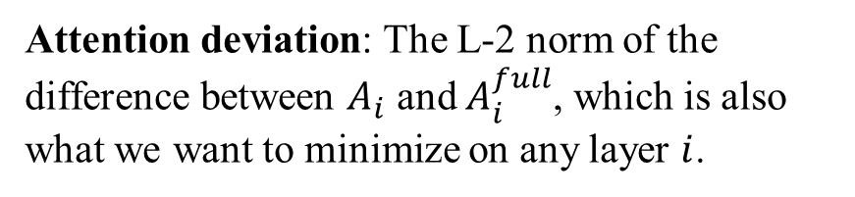
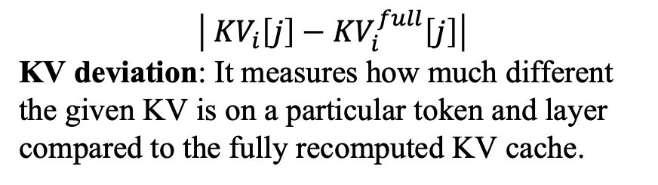
Method: FastKVCacheFusing
$$\left| {KV}_{i}\left[j\right]−{KV}_{i}^{full}\left[j\right]\right|$$
KV deviation: It measures how much different the given KV is on a particular token and layer compared to the fully recomputed KV cache.
Attention deviation: The L-2 norm of the difference between $A_{i}$ and $A_{i}^{full}$, which is also what we want to minimize on any layer $i$.
COMPUTER SCIENCE
GRAINGER ENGINEERING

Slide 21
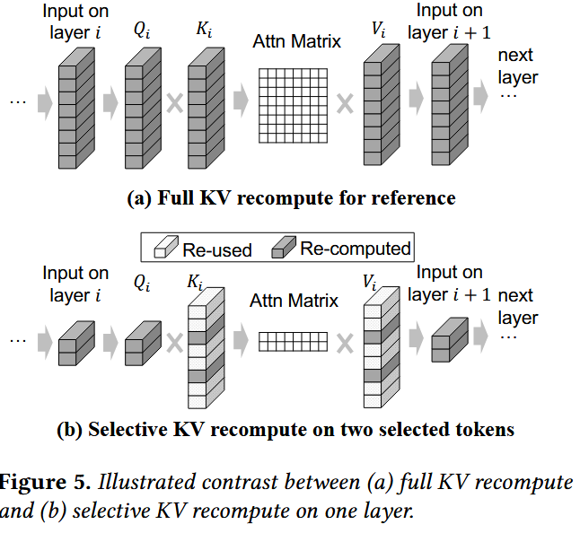
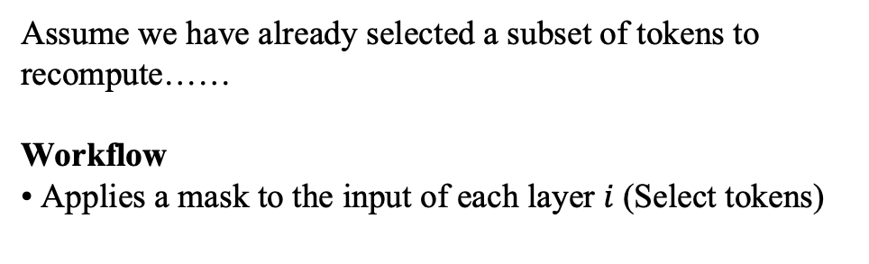
Selective recomputing KV cache
Assume we have already selected a subset of tokens to recompute……
Workflow
• Applies a mask to the input of each layer $i$(Select tokens)
COMPUTER SCIENCE
GRAINGER ENGINEERING

Slide 22
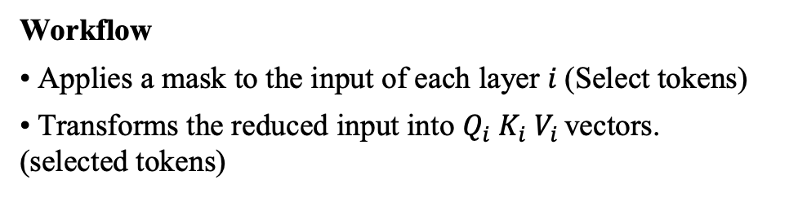
Selective recomputing KV cache
Workflow
• Applies a mask to the input of each layer $i$(Select tokens)
• Transforms the reduced input into $Q_{i} K_{i} V_{i }$vectors. (selected tokens)
COMPUTER SCIENCE
GRAINGER ENGINEERING

Slide 23
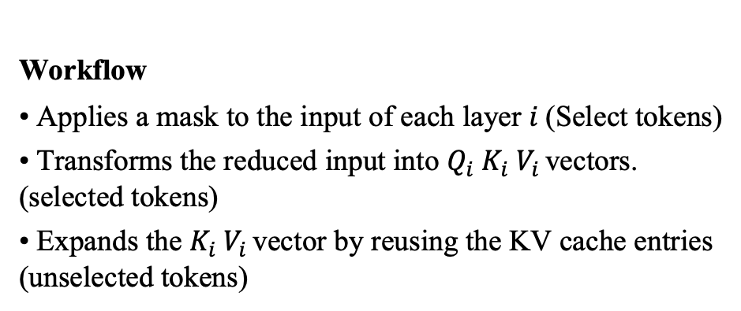
Selective recomputing KV cache
Workflow
• Applies a mask to the input of each layer $i$(Select tokens)
• Transforms the reduced input into $Q_{i} K_{i} V_{i }$vectors. (selected tokens)
• Expands the $K_{i} V_{i }$vector by reusing the KV cache entries (unselected tokens)
COMPUTER SCIENCE
GRAINGER ENGINEERING

Slide 24
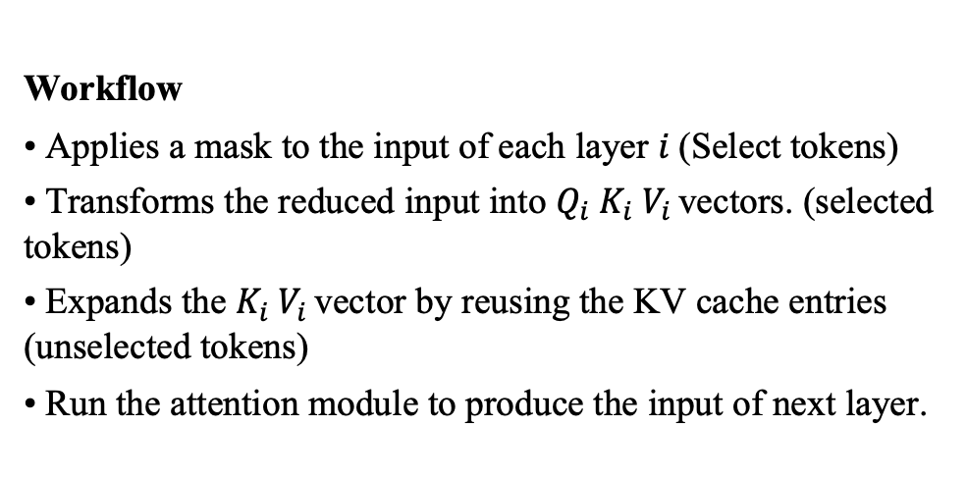
Selective recomputing KV cache
Workflow
• Applies a mask to the input of each layer $i$(Select tokens)
• Transforms the reduced input into $Q_{i} K_{i} V_{i }$vectors. (selected tokens)
• Expands the $K_{i} V_{i }$vector by reusing the KV cache entries (unselected tokens)
• Run the attention module to produce the input of next layer.
COMPUTER SCIENCE
GRAINGER ENGINEERING

Slide 25
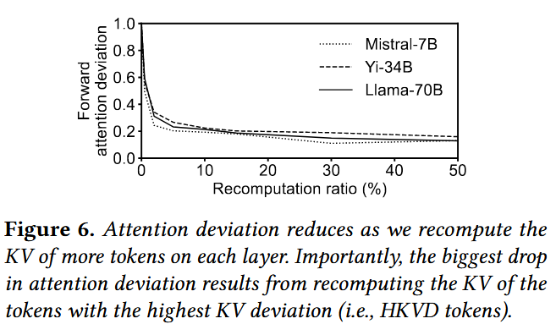
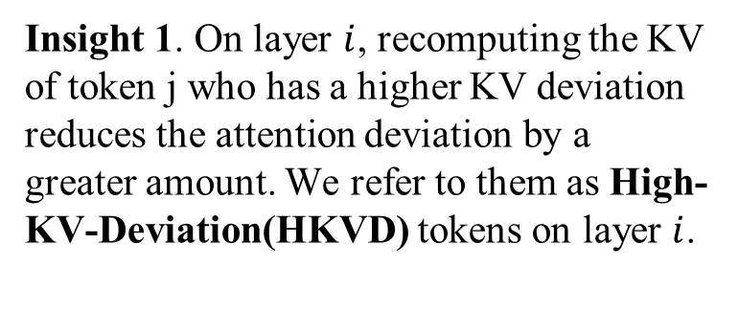
Selecting which tokens to recompute
Intuition: prioritizing recomputing KV of tokens with high KV deviations……
Insight 1. On layer $i$, recomputing the KV of token j who has a higher KV deviation reduces the attention deviation by a greater amount. We refer to them as High-KV-Deviation(HKVD) tokens on layer $i$.
COMPUTER SCIENCE
GRAINGER ENGINEERING

Slide 26
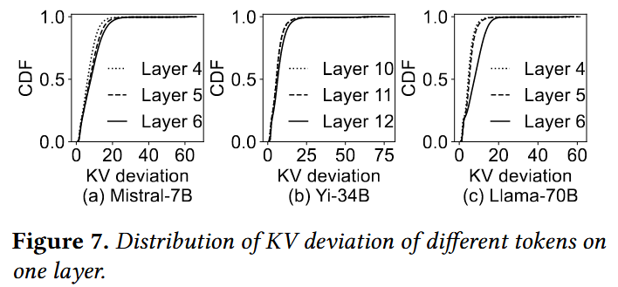
4.3 Selecting which tokens to recompute
?Do we need to recompute KV for most tokens
The paper empirically show that choosing 10%-20% tokens as HKVD tokens suffices.
According to attention sparsity, high attention typically only occurs between a small number of tokens and their preceding tokens.
COMPUTER SCIENCE
GRAINGER ENGINEERING

Slide 27
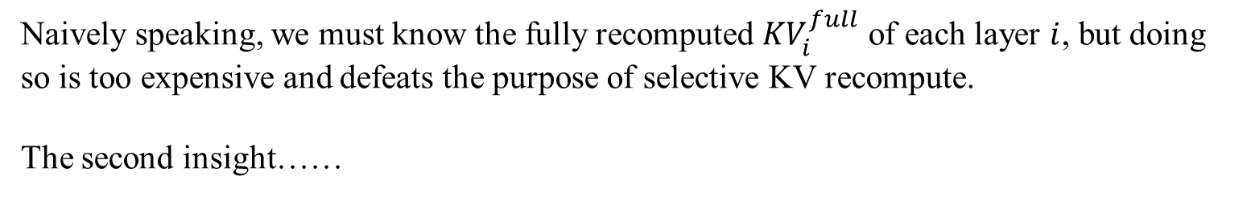
4.3 Selecting which tokens to recompute
?How do we identify the HKVD tokens without knowing the true KV values or attention matrix
Naively speaking, we must know the fully recomputed ${KV}_{i}^{full}$ of each layer $i$, but doing so is too expensive and defeats the purpose of selective KV recompute.
The second insight……
COMPUTER SCIENCE
GRAINGER ENGINEERING

Slide 28
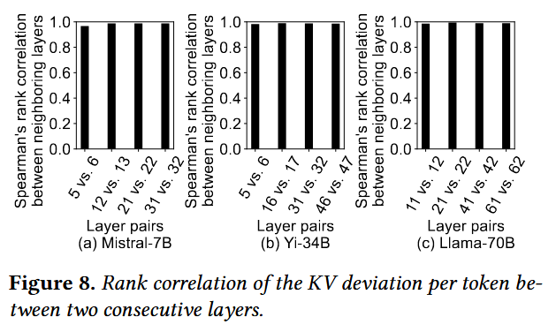
Selecting which tokens to recompute
Intuition: prioritizing recomputing KV of tokens with high KV deviations……
Insight 2. Tokens with the highest KV deviations on one layer are likely to have the highest KV deviations on the next layer.
Figure 8 shows a consistently high similarity of HKVD tokens between different layers. Perhaps because token changes slowly between layers in transformer models.
COMPUTER SCIENCE
GRAINGER ENGINEERING

Slide 29
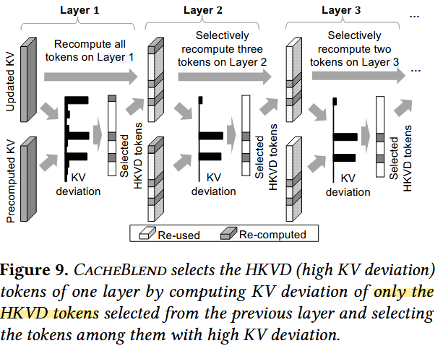
Selecting which tokens to recompute
The gradual filtering scheme
•Layer 1: recompute all tokens and select top 3 tokens in terms of KV deviation.
This scheme picks HKVD tokens based on observations on multiple layers instead of first layer only.
COMPUTER SCIENCE
GRAINGER ENGINEERING

Slide 30
Selecting which tokens to recompute
The gradual filtering scheme
•Layer 1: recompute all tokens and select top 3 tokens in terms of KV deviation.
•Layer 2: recompute only that three selected tokens and select top 2 in terms of KV deviation.
This scheme picks HKVD tokens based on observations on multiple layers instead of first layer only.
COMPUTER SCIENCE
GRAINGER ENGINEERING

Slide 31
Selecting which tokens to recompute
The gradual filtering scheme
•Layer 1: recompute all tokens and select top 3 tokens in terms of KV deviation.
•Layer 2: recompute only that three selected tokens and select top 2 in terms of KV deviation.
•Layer 3: recompute only that two selected tokens and select top 2 in terms of KV deviation……
This scheme picks HKVD tokens based on observations on multiple layers instead of first layer only.
COMPUTER SCIENCE
GRAINGER ENGINEERING

Slide 32
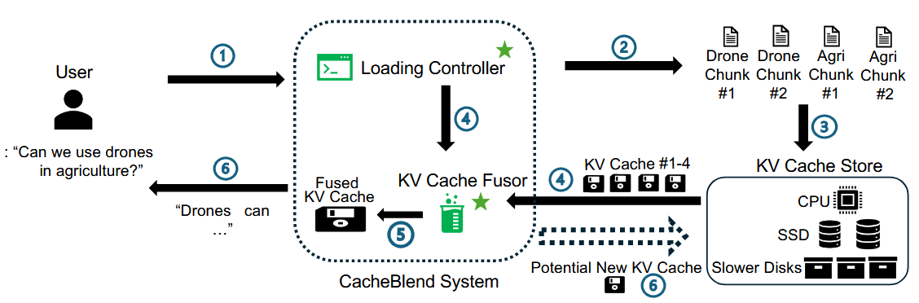
CACHEBLEND System Design
Basic insight: If the delay for selective KV recompute is faster than the loading of KV into GPU memory, then properly pipelining the selective KV recompute and KV loading makes the extra delay of KV recompute negligible
COMPUTER SCIENCE
GRAINGER ENGINEERING

Slide 33

Design Question 1. How to choose a recompute ratio without incurring extra delay?
• We use the recompute delay estimator to estimate the expected KV recompute delay
• We use the latency estimator to estimate the loading delay of the KV cache on one layer
• We first pick a r such that
• We then take max(r, r*)
$$T_{recompute}(r\%, LLM, L)$$
$$T_{load}(LLM, L, storage_device)$$
$$T_{load}(LLM, L, storage_device)$$
$$T_{recompute}(r\%, LLM, L)$$
=
$r^{∗}\%$ is the minimal recompute ratio that empirically has low negligible quality drop from full KV recompute, which was set to 15% in practice
COMPUTER SCIENCE
GRAINGER ENGINEERING

Slide 34
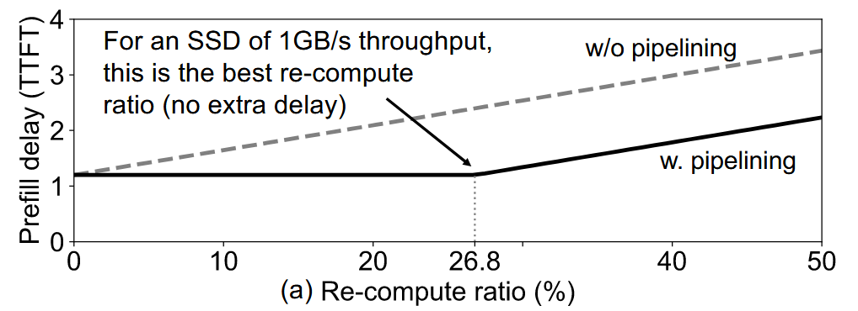
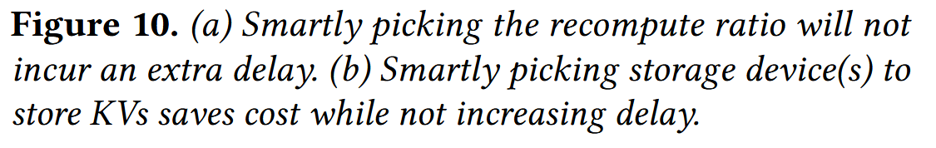
Design Question 1. How to choose a recompute ratio without incurring extra delay?
COMPUTER SCIENCE
GRAINGER ENGINEERING

Slide 35
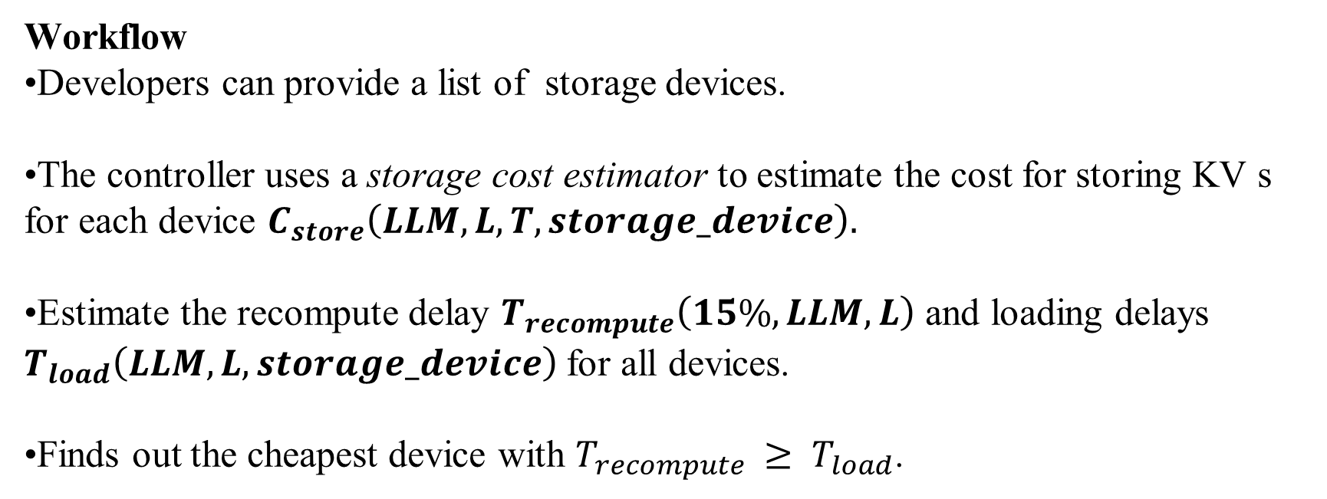
Design Question 2. How to choose right devices given fixed r
Workflow
•Developers can provide a list of storage devices.
•The controller uses a storage cost estimator to estimate the cost for storing KV s for each device $C_{store}\left(LLM,L,T,storage_device\right).$
•Estimate the recompute delay $T_{recompute}\left(15\%,LLM,L\right)$ and loading delays $T_{load}\left(LLM,L,storage_device\right)$for all devices.
•Finds out the cheapest device with $T_{recompute }≥ T_{load}$.
COMPUTER SCIENCE
GRAINGER ENGINEERING

Slide 36
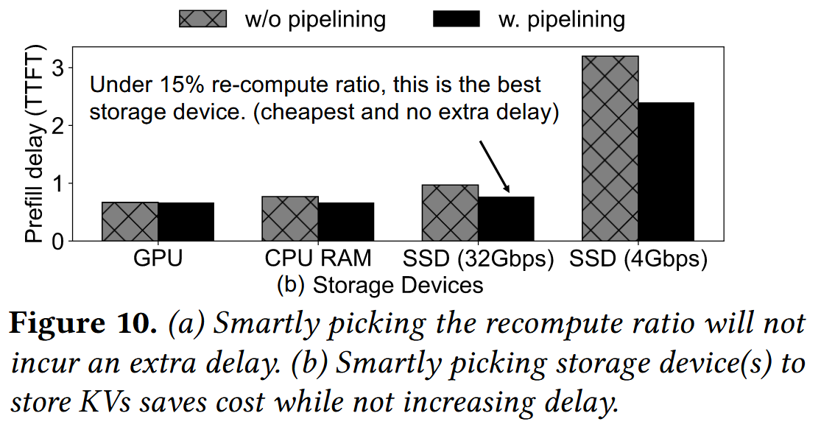
Design Question 2. How to choose right devices given fixed r
COMPUTER SCIENCE
GRAINGER ENGINEERING

Slide 37
Key Components: KV cache Store(LLM input KV caches)
•The KV cache store splits an LLM input into multiple text chunks.
•Each split input text chunk is hashed to find their corresponding KV cache.
•The KV caches of new chunks by the fusor are added to the devices. Least recently used KV caches are evicted when full.
COMPUTER SCIENCE
GRAINGER ENGINEERING

Slide 38
Key Components: Fusor
Workflow
•The fusor waits until: recompute for the previous layer is done & KV caches for layer L are loaded.
•The fusor performs selective recompute using r% calculated by the load controller.
•Repeats until all layers are recomputed.
COMPUTER SCIENCE
GRAINGER ENGINEERING

Slide 39
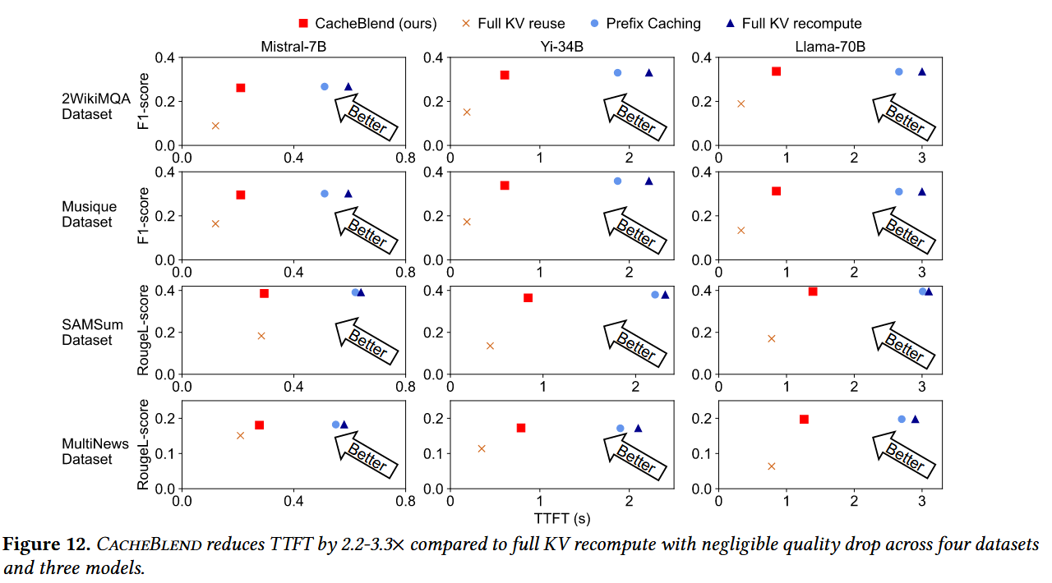
Evaluation
COMPUTER SCIENCE
GRAINGER ENGINEERING

Slide 40
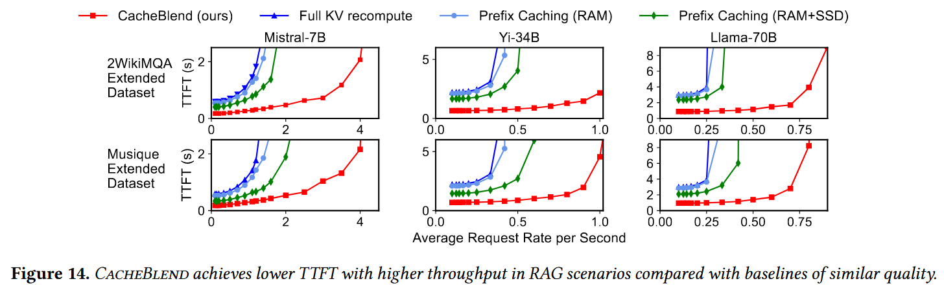
Evaluation
COMPUTER SCIENCE
GRAINGER ENGINEERING

Slide 41
Pro / Con Discussion
Compared To Pros
•Full KV recompute
•Full KV reuse
•Prefix caching
Much lower delay and higher throughput due to only a small amount of tokens are recomputed.
Maintains cross attention between different chunks.
Higher throughput, lower delay and lower miss rate since prefix caching simply store multiple versions of the same chunk.
COMPUTER SCIENCE
GRAINGER ENGINEERING

Slide 42
Pro / Con Discussion
Cons
•It may not apply to language models with architectures other than transformers, such Mamba or Griffin.
•CacheBlend has not yet been examined on latest serving engines like Distserve or StableGen.
COMPUTER SCIENCE
GRAINGER ENGINEERING

Slide 43
Thanks for your listening
April 9th, 2025

