Slide 1
Systems for RLHF (Reinforcement Learning from Human Feedback)
Dan Nguyen, Nishk Patel, Arthur Wang, Yash Telang, Sunskar Dhanker

Slide 2
​​Training language models to follow instructions with human feedback
Ouyang et. al. - OpenAI (March 2022)

Slide 3
Motivation
LLMs have continued to increase in size, which has improved their overall capabilities
However, alignment is still an issue for these models, as sometimes, they can:
Make up facts
Generate biased text
Ignore user instructions
You may have seen this when using publicly available LLMs, such as ChatGPT
The reason for this misalignment is because many LLMs are trained using next-token prediction - predict the most probable word given prior context
However, our objective is for these models to be:
Helpful: Help the user solve their task
Honest: Shouldn't fabricate information or mislead user
Harmless: Should not cause any harm to people or the environment
Notes:
Yash

Slide 4
Related Work
Focus on fine-tuning approaches to solve the issue of LLM misalignment: Creating "InstructGPT"
Builds upon existing research in reinforcement learning from human feedback (RLHF)
Combining human evaluations with reinforcement learning (more details ahead)
Training LLMs to follow instructions
Ensuring generalization by training on a large range of datasets (ex - differently formatted instructions)
Evaluating and minimizing potential harms
Reducing misinformation, biased outputs, toxic outputs, etc.
FIltering pre training data to remove harmful text/phrases
Notes:
Yash

Slide 5
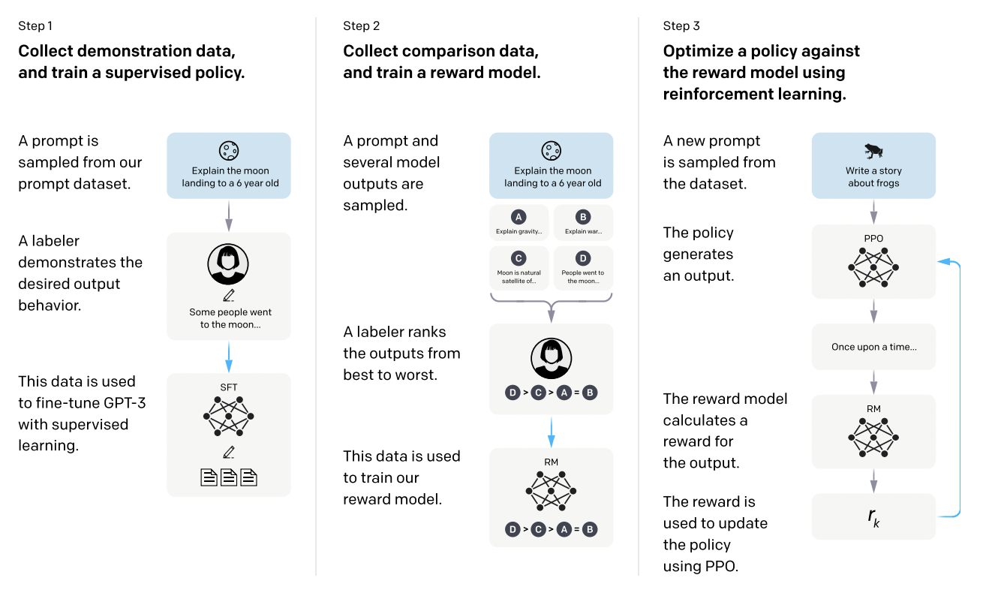
High-level Methodology
Notes:
Yash

Slide 6
Dataset
Initial instruction-like prompts created by a diverse group of pre-screened labelers that were
Plain: Diverse set of arbitrary tasks
Few-shot: Multiple query/response pairs for one instruction
User-based: Prompts related to use-cases in waitlist applications to the OpenAI API
Additional text prompts submitted by users to earlier versions of InstructGPT through the "Playground" interface (through the OpenAI API)
Users were informed that their data could be used to train further models
Heuristically deduplicate prompts by checking for a long common prefix
Limit number of prompts to 200 per user ID and filter prompts for personally identifiable information (PII)
Train, validation, and test splits created based on user ID, so no user data from training set is in validation/test set
Notes:
Yash

Slide 7
Dataset
3 datasets created from this data:
SFT (Supervised Fine-Tuning) Dataset:
13k training prompts from both OpenAI API and labeler-written data
Used to train the supervised models
RM (Reward Model) Dataset:
33k training prompts from both OpenAI API and labeler-written data
Used to train reward models based on labeler ranking of model outputs
PPO (Proximal Policy Optimization) Dataset:
31k training prompts only from OpenAI API
Used for RLHF fine-tuning
Prompts are diverse, and include tasks such as:
Generation
Question answering
Dialogue
Summarization
Other natural language tasks
Notes:
Yash

Slide 8
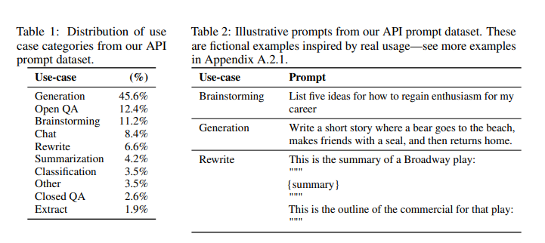
Dataset
Notes:
Yash

Slide 9
Model/Training Details
Start with GPT-3 pretrained language models
Trained on a broad distribution of Internet data
Adaptable to a wide range of tasks
Step 1: Supervised fine-tuning (SFT)
Fine-tune GPT-3 using supervised learning
16 epochs, cosine learning rate decay, residual dropout of 0.2
Final model is chosen based on Reward Modeling Score on validation set
Step 2: Reward Modeling (RM)
SFT model is trained to take in a prompt and response, and output a scalar reward
Cross-entropy loss function is used for the reward model
Notes:
Yash

Slide 10
Model/Training Details
Step 3: Reinforcement Learning (RL)
RLHF is used to fine-tune the model further to the desired alignment
Uses Proximal Policy Optimization (PPO) to optimize the model's policy (how it generates responses to prompts) by adjusting its parameters (Schulman et al., 2017)
Reward model's scores are used alongside PPO to lead the model to produce outputs that have a higher chance of being ranked higher by human labelers
Experimentation with mixing pre-training gradients alongside PPO gradients to create "PPO-ptx" models
Baseline Comparisons:
Comparing PPO models to Supervised fine-tuned models and GPT-3
Also compared to a "prompted GPT-3" that is given a few-shot prefix before the user-specified instruction
Lastly, also compared to fine-tuned GPT-3 on FLAN and T0 datasets (contain a variety of NLP tasks)
Notes:
Yash

Slide 11
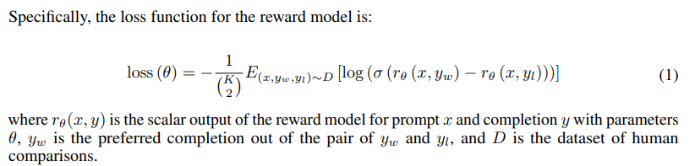
Model/Training Details
Notes:
Yash

Slide 12
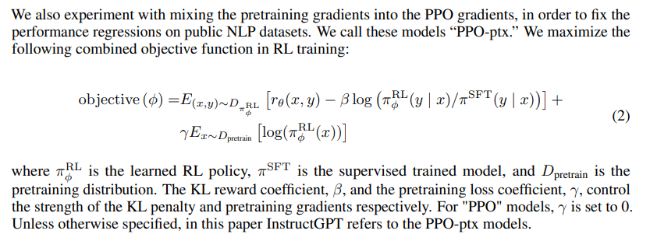
Model/Training Details
Notes:
Yash

Slide 13
Evaluation
Alignment: process of training language models to act in accordance with user intentions
Models are aligned if they are helpful, honest, and harmless
Helpfulness: model should follow instructions, but also be able to infer intention
Labeler preference ratings are heavily relied on
Truthfulness: evaluate tendencies to hallucinate
Harmfulness: evaluate whether an output is inappropriate
Specifically, in context of customer assistant, denigrates a protected class, or contains sexual or violent content

Slide 14
Evaluation
API Distribution
User queries
Test on both instruct-type and GPT-3 prompts
Calculate how often its outputs are preferred to a baseline (175B SFT)
Ask labelers to judge the overall quality of each response
Public NLP Datasets
Benchmark datasets in NLP research
Capture an aspect of language model safety, particularly truthfulness, toxicity, and bias
Capture zero-shot performance on traditional NLP tasks like question answering, reading comprehension, and summarization

Slide 15
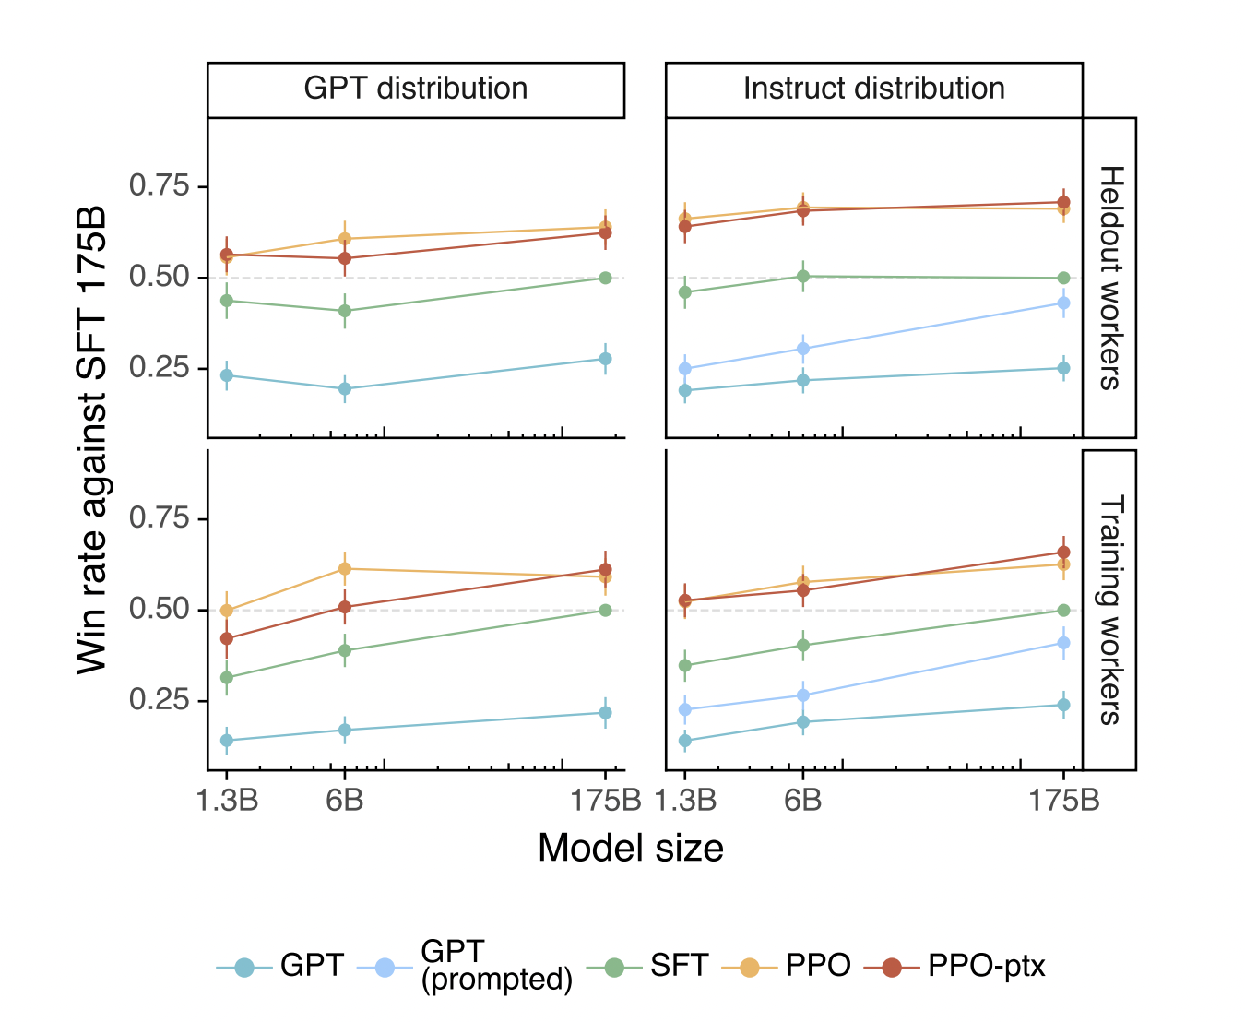
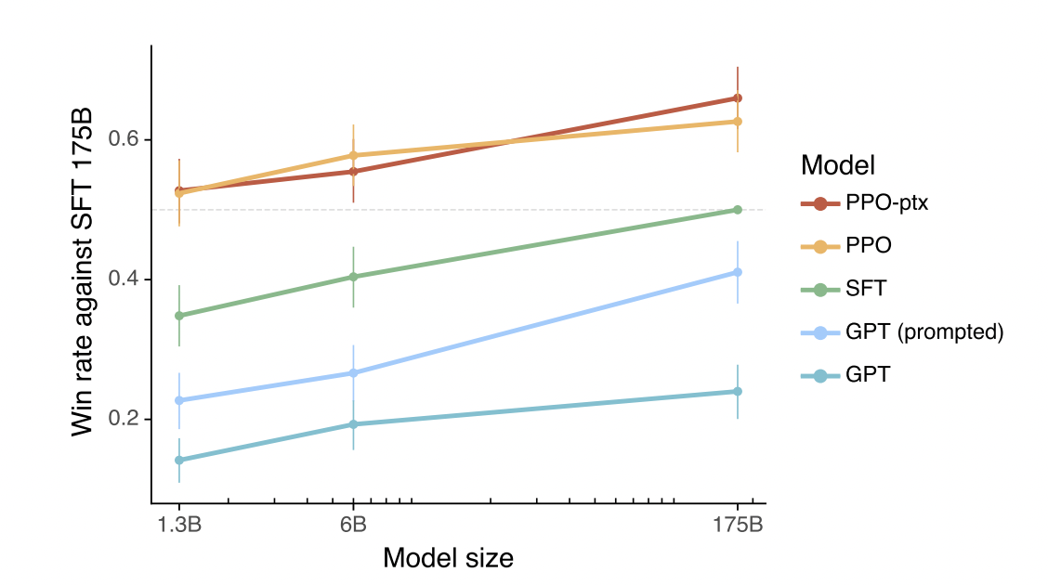
Results - API Distribution
Notes:
InstructGPT > GPT-3
Outputs from our 175B
InstructGPT are preferred to 175B GPT-3 outputs 85 ± 3% of the time, and preferred 71 ± 4% of the time to few-shot 175B GPT-3
models generalize to the preferences of "held-out" labelers that did not produce any training data

Slide 16
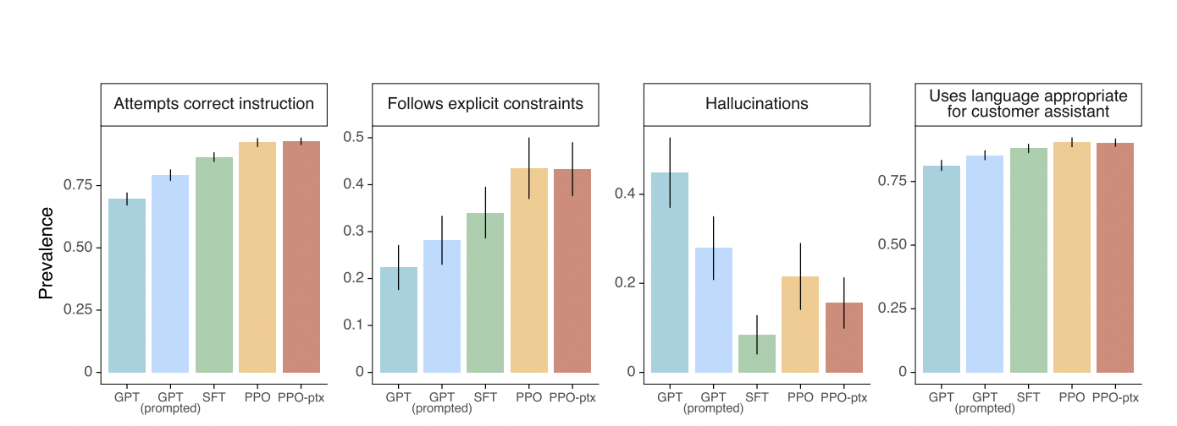
Results - API Distribution
Notes:
InstructGPT outputs favorable

Slide 17
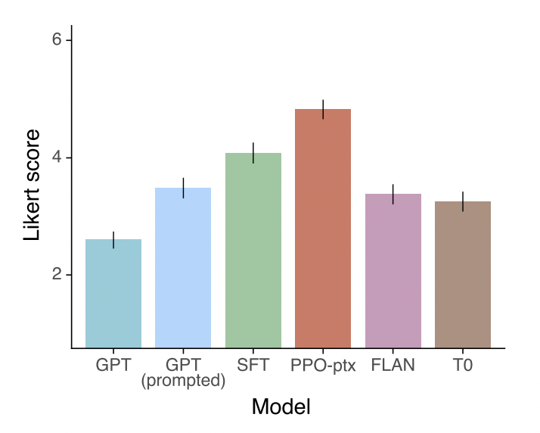
Results - API Distribution
FLAN and T0 baselines obtained by fine-tuning a 175B GPT-3 model on the FLAN and T0 datasets
InstructGPT outperforms FLAN and T0
Not sufficiently diverse to improve performance
Notes:
Public NLP datasets are not reflective of how our language models are used

Slide 18
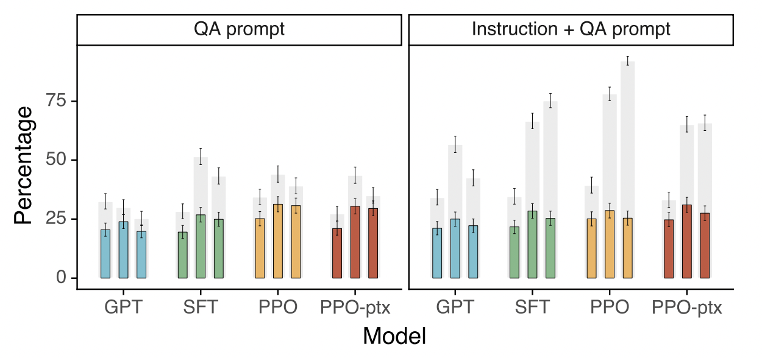
Results - Public NLP Datasets
Notes:
Figure 6: Results on the TruthfulQA dataset. Gray bars indicate ratings of truthfulness; colored bars indicate ratings of truthfulness and informativeness.
InstructGPT models show improvements in truthfulness over GPT-3.

Slide 19
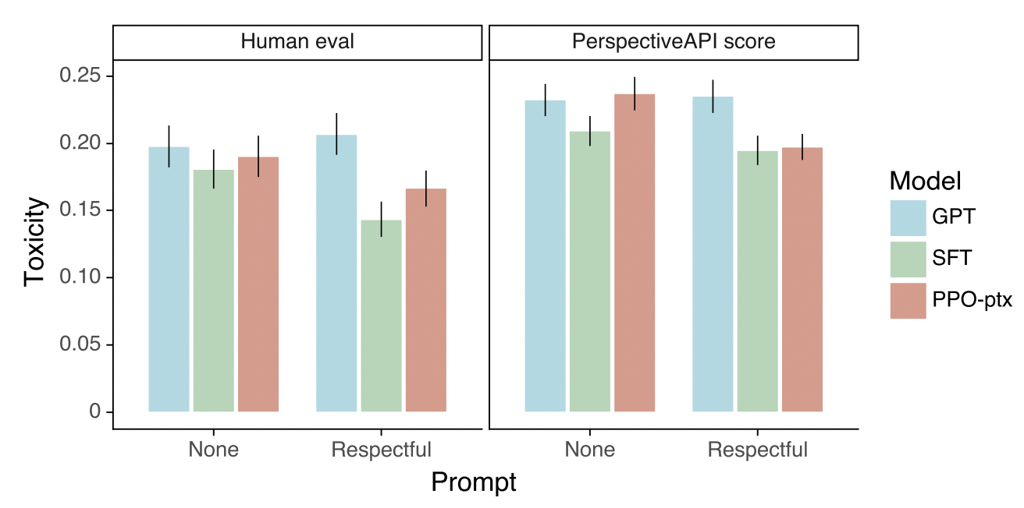
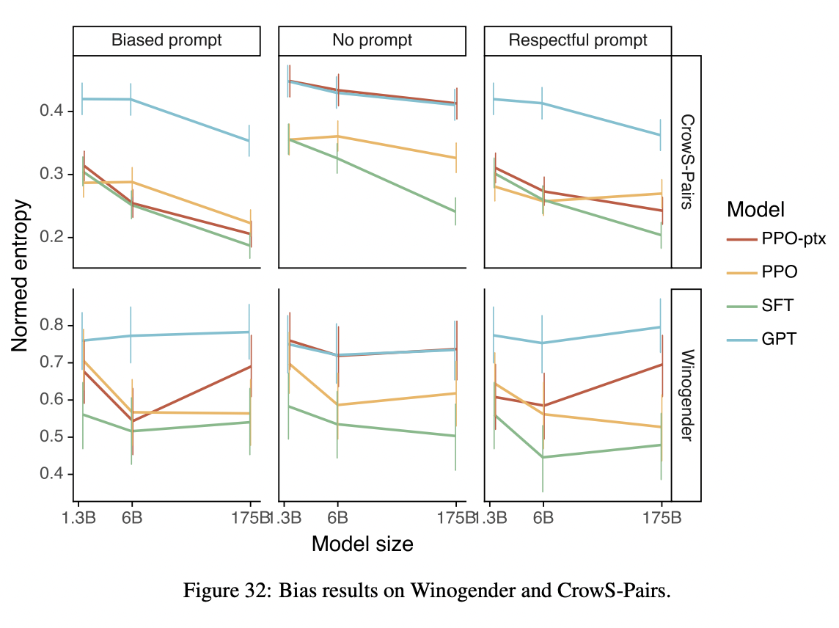
Results - Public NLP Datasets
Notes:
InstructGPT shows small improvements in toxicity over GPT-3, but not bias
Perspective API to obtain automatic toxicity scores, which is the standard evaluation procedure for RealToxicityPrompts dataset
InstructGPT models generate less toxic outputs than those from GPT-3 according to the Perspective API

Slide 20
Results - Qualitative Results
InstructGPT models show promising generalization to instructions outside of the RLHF fine tuning distribution
Can follow instructions in non-English languages
Can summarize and answer questions about code
InstructGPT still makes simple mistakes
Model sometimes incorrectly assumes a false premise from the prompt is true
Model sometimes gives multiple possible answers to simple questions
More constraints pose a challenge

Slide 21
Discussion
Implications
Cost of increasing model alignment is modest relative to pretraining
Potential for models to generalize the process of “following instructions”
Can minimize performance regressions on public NLP datasets by adding pretraining updates
Alignment Drawbacks
Models are being aligned to the preferences of the specific group of researchers
Acknowledges that there is no correct preference
Limitations
Labeling tasks may have been impacted by group of contractors
Models can still make mistakes or hallucinate

Slide 22
RLHFuse: Efficient RLHF Training for Large Language Models with Inter- and Intra-Stage Fusion

Slide 23
Main Issues in Current RLHF
Data Skewness in Generation Stage
GPUs are idle while longer texts are processed
Pipeline bubbles in Training Stage
GPUs are idle due to inefficiencies cause by higher pipeline parallelism
These Issues arise because existing systems treat each task as the smallest execution unit, thus over-looking opportunities for subtask level optimization

Slide 24
RLHF Workflow
Generation Stage
Actor Model generates response for input prompts
Processes the prompt (prefill phase)
Generates token sequentially (decode phase)
Inference Stage
Reference, Reward, and Critic Model perform forward pass
Calculates values for training stage
Training Stage
Samples divided into mini-batches
Actor and Critic update after training
Follows Proximal Policy Optimization algorithm

Slide 25
LLM Parallelism
Data Parallelism: Replicate Model weights and distribute data among replicas
Tensor Parallelism: Partitioning computationally intensive operators across multiple GPUs
Pipeline Parallelism: Organizing LLM layers into stages running on separate device or nodes

Slide 26
Proposed Solution
Data-Aware inter-stage fusion
Splits generation and inference task into sample level subtasks allowing for efficient overlap between stages
Model-Aware intra-stage fusion
Breaks training tasks into micro-batch subtasks and enable concurrent execution through a fused pipeline schedule

Slide 27
Data-Aware Inter-Stage Fusion
Improves GPU utilization by overlapping the execution of generation and inference stages
Migration triggering: Detect when generation stage enters the long-tail decoding phase, where most samples have finished but a few are still processing
Sample migration: Consolidating remaining long-tailed samples to a few designated instances, free up resources for inference tasks
Resource repurposing: Launching inference tasks on the released resources while long-tailed samples are still being processed

Slide 28
Optimizing Migration Strategy
Timing is determined by a threshold that triggers migration when the number of sample falls below this value
Choose best m generation instances to handle remaining samples based on both computational characteristics and memory constraints
Transfer the generated key-value cache over the network over transmitting generated tokens and rerunning the prefill phase

Slide 29
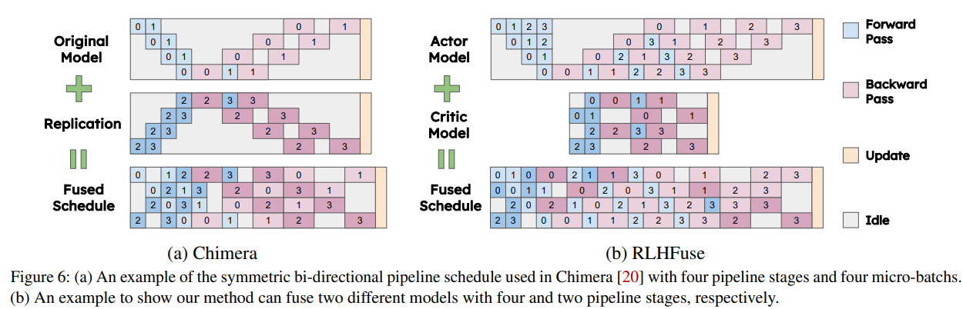
Intra-Stage Fusion
Chimera: Replication-based scheduling (1F1B)
Symmetric Execution Flow
RLHFuse: Interleaves forward and backward passes from different models
Different models with different optimal execution strategies
Notes:
RLHF consists of multiple independent tasks, such as:
Policy model training
Reward model inference
Value function optimization
These tasks are not tightly coupled, meaning they can run in parallel rather than waiting for each other.
Instead of processing one large batch at a time, RLHFuse uses smaller micro-batches to allow overlapping execution
Baseline RLHF: Runs all forward passes before computing backward passes.
RLHFuse: Interleaves forward and backward passes, so backward computation can start before all forward passes are completed. Instead of replicating model stages, RLHFuse dynamically schedules execution to minimize idle time.
RLHFuse adapts to different training architectures, making it more flexible than Chimera.

Slide 30
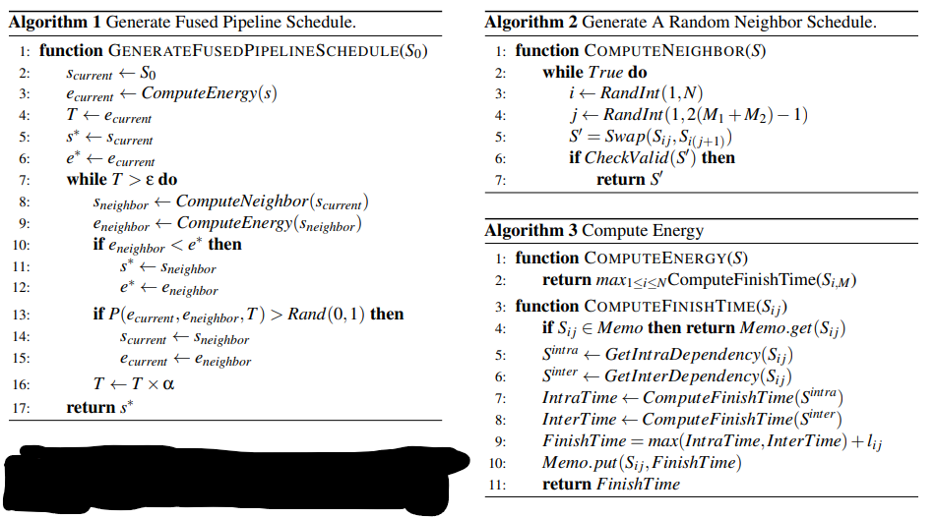
Simulated Annealing Algorithm
Notes:
This algorithm optimizes the fused pipeline schedule by iteratively improving a candidate solution
Simulated Annealing Algorithm
Approximate global optimum
2. Initial schedule
3. Heuristic measure
8. Generate neighboring schedule
9. Neighboring heuristic measure
10. Neighbor is “better”, accept
13. Neighbor is not “better”, accept with probability P
16. Reduce T (cooling schedule)
Once an optimized schedule S* is found, algorithm is run again, with S* as the initial, set P to 0 (no latency increasing moves), and replace the ComputeEnergy function with one that computes peak activation memory usage
Results in “optimal” latency schedule with promising memory usage

Slide 31
Implementation
NVIDIA’s Megatron-LM
Uses similar ideas to ReaLHF for optimization
Built a simulator to predict performance
Brute-Force Searching for optimal configuration
Simulator re-used for inter-stage fusion migration threshold
Annealing algorithm with random seeds (MPI)
Generation Stage: Optimized CUDA engine
Inference Stage: Converts recursive computations to single matrix multiplication
Training Stage: Balances work distribution across DP groups
Task Switching: All-to-all communication approach to reload weights across devices

Slide 32
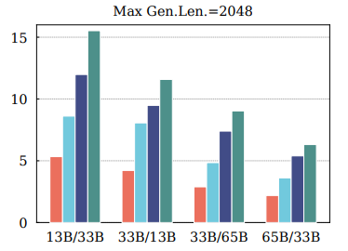
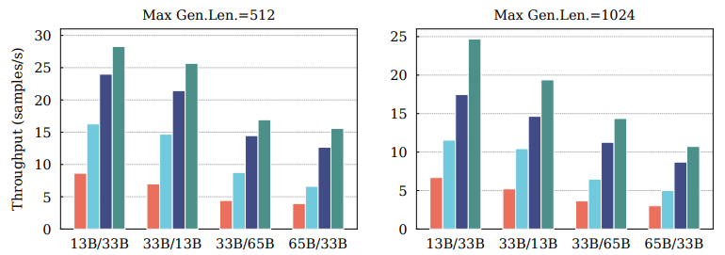
Evaluation
Baselines:
ReaLHF
RLHFuse-Base
DeepSpeed-Chat
Throughput Metric (samples/s)
Different Actor/Critic pair model sizes
Different output lengths
Notes:
2.5×–3.7× higher throughput vs. DSChat
1.4×–2.4× higher throughput vs. ReaLHF
1.2×–1.4× higher throughput vs. RLHFuse-Base

Slide 33
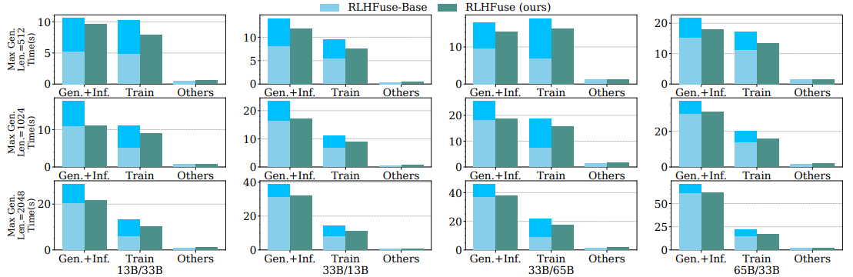
Evaluation
Notes:
Darker Color: Generation Stage Lighter Color: Inference Stage
It can be seen that as the maximum generation length increases, the processing time of longtailed samples is long enough for RLHFuse to fully overlap the inference stage execution, achieving 1.2x–1.6x speedup
Through intra-stage fusion, RLHFuse greatly mitigates pipeline bubbles and reduces the execution time of the training stage by 1.2x–1.3x

Slide 34
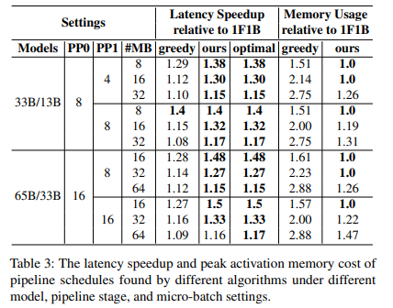
Stage Fusion Improvements
Inter-Stage
Higher Rt -> more fused
Too high Rt -> overloads long-tail tasks -> Slowdown
Optimal Inter-Stage Fusion Threshold: ~20%
Intra-Stage
RLHFuse Latency Speedup matches lower bound
RLHFuse Memory Efficiency close to lower bound
Outperforms Greedy
Optimal Schedule is HARD to manually create
RLHFuse automates this
Notes:
Balances speedup while avoiding overload - migration threshold
Latency Speedup: RLHFuse matches the theoretical lower bound
Memory Efficiency: RLHFuse uses memory close to the serial execution lower bound

Slide 35
Improvements on Prior Work
Builds upon RLHF training and LLM generation
Subtask-level Optimization
Previous methods do not address data skewness and pipeline bubbles
Primary focus: model -> optimization
Leverages RLHF specific characteristics (Actor/Critic)
While incorporating LLM generation techniques, not its primary focus
RLHF is system-level optimization
Integration into existing RLHF architecture
Training, Latency, Memory
Notes:
Addresses data skewness & pipeline bubbles, which previous approaches overlook

Slide 36
Direct Preference Optimization:
Your Language Model is Secretly a Reward Model

Slide 37
How RLHF changes to DPO?
Existing methods, like Reinforcement Learning from Human Feedback (RLHF), aim to align LMs with human preferences but involve complex and often unstable procedures.
RLHF involves two main steps:
Fitting a reward model that reflects human preferences
Fine-tuning the LM using reinforcement learning to maximize this estimated reward
Pros:
Fitting a reward model that aligns AI with Human Preference
Improves Response Quality
Cons:
Stability Challenges
Computationally Expensive

Slide 38
Why Direct Preference Optimization (DPO)?
DPO offers a novel parameterization of the reward model in RLHF.
It enables the extraction of the corresponding optimal policy in closed form.
This approach allows solving the standard RLHF problem using a simple classification loss, eliminating the need for complex reinforcement learning procedures.

Slide 39
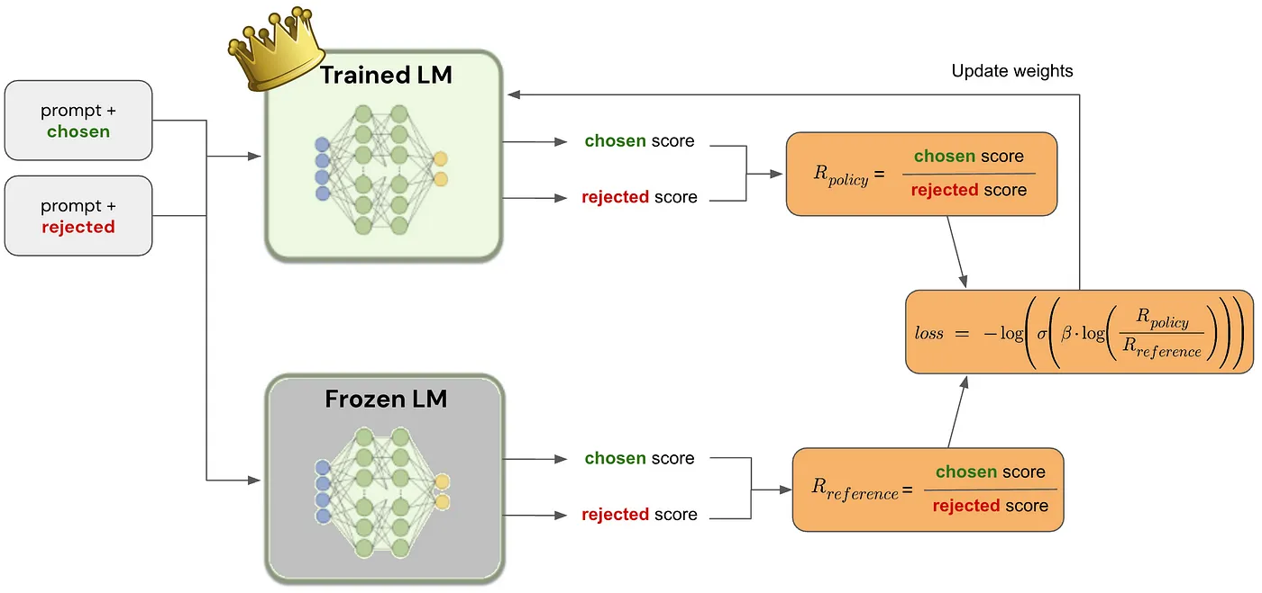
Two copies of the model are created:
Trained LM (updated during training).
Frozen LM (remains unchanged as a baseline).
Given a prompt, two responses are compared:
Chosen response (preferred by humans).
Rejected response (less preferred).
Each model (trained and frozen) computes a score.
Score Calculation:
Product of probabilities for each token in the response.

Slide 40
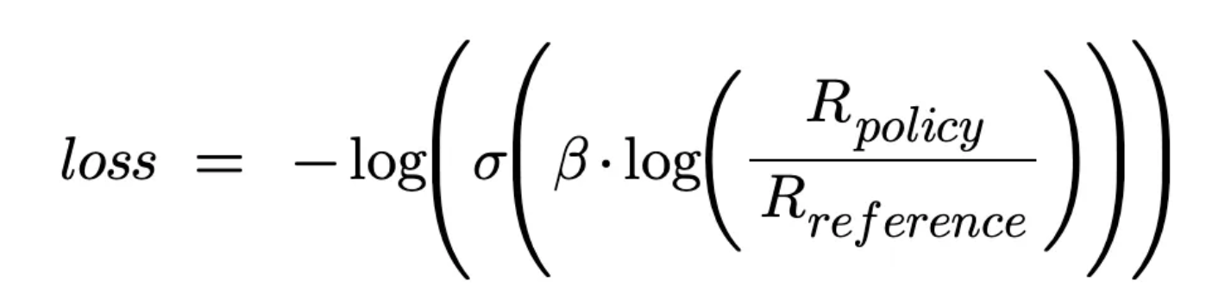
Score ratio formula: R_{policy} / R_{reference}
Interpretation:
If the trained model scores the chosen response higher than the frozen model, it's improving.
Otherwise, more fine-tuning is needed.
Key Components:
σ: Sigmoid function for stability.
β: Scaling hyperparameter (Zephyr used β=0.1\beta = 0.1β=0.1).
The loss function encourages higher scores for chosen responses while maintaining stability.
The computed loss is used to adjust the model’s weights.
The trained model gradually learns to favor the chosen responses over the rejected ones.

Slide 41
DPO > RLHF
No Reinforcement Learning Needed
Simpler than RLHF, no explicit reward model.
Stable & Efficient
Uses a direct loss function instead of complex reward optimization.
Easier Implementation
Works with standard supervised fine-tuning techniques.

Slide 42
Summary

Slide 43
Recap
RLHF: Addresses untruthful or toxic responses in LLMs by fine-tuning them using human feedback, aligning outputs with user intents.
RLHFuse: Enhances RLHF training efficiency through system optimizations, increasing training throughput.
Direct Preference Optimization (DPO): Simplifies RLHF by enabling LLMs to learn human preferences via an auxiliary reward head, allowing stable and computationally efficient fine-tuning without complex reinforcement learning procedures.

