Slide 1
Training Simulation: SimAI and Vidur
Haoyu Chen
haoyuc7@illinois.edu

Slide 2
SimAI: Unifying Architecture Design and Performance Tunning for Large-Scale Large Language Model Training with Scalability and Precision
Wang et al., 2025

Slide 3
Why we need simulators for LLM training?
Training LLM needs massive amount of GPU resources, hinder the validation of new designs and optimizations.
Simulators are important both before and after model investments
Before: estimate the scale
After: performance tuning

Slide 4
Existing Solutions
Use separate simulators for capacity planning and optimizing
Capacity planning simulations is commonly performed at job level, don’t consider packet-level behaviors
Separate simulators for computation simulation, network simulation… Gem5-GPU: a CPU-GPU simulator (Power et al., 2015)

Slide 5
Existing Solutions
Problems of using separate simulators:
Inaccurate cost-performance predictions
Poor performance in simulating large-scale training
Complicated development and testing

Slide 6
Existing Solutions
ASTRA-sim: only comprehensive DNN training simulator to simulate to simulate software hardware co-design stack in distributed training systems (Won et al., 2023)
SimAI is inspired by ASTRA-sim, but with significant improvements

Slide 7
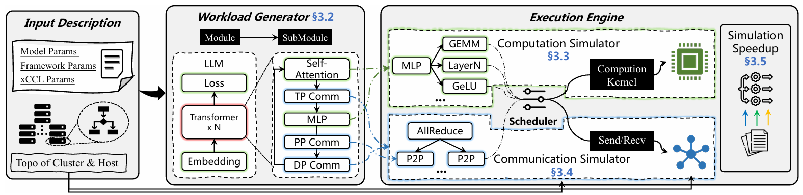
SimAI Overview
SimAI is a unified simulator that handles capacity planning and performance tuning in a single framework.

Slide 8
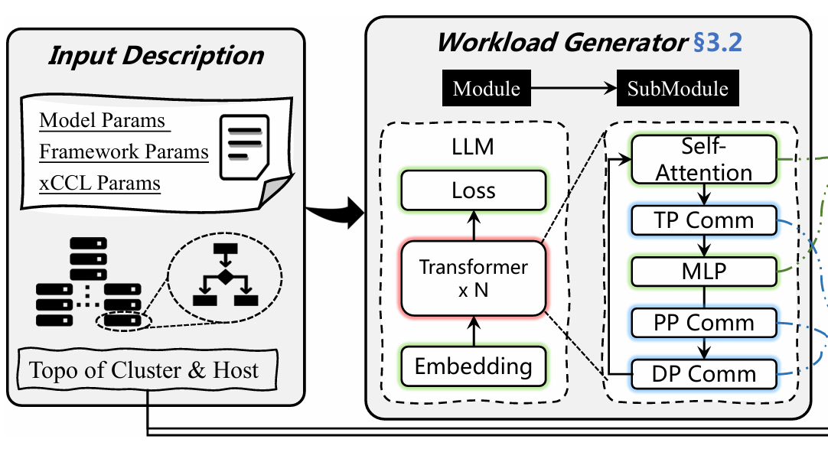
Workload Generator
Input: description of parameters, cluster topology
Output: workload description file, contains algorithm modules, communication operators, used by execution engine

Slide 9
Workload Generator
Traditional trace-based methods: require large-scale physical cluster
SimAI uses “hijacking” method to generate workload on a single host
Use existing training framework (Megatron and DeepSpeed), make the framework believe it runs in a cluster
All real communication in NCCL is skipped

Slide 10
Workload Generator
The generated operations lack dependency specifications, need defining dependency information in workload file
Dependencies are determined by parallelism strategy the framework uses

Slide 11
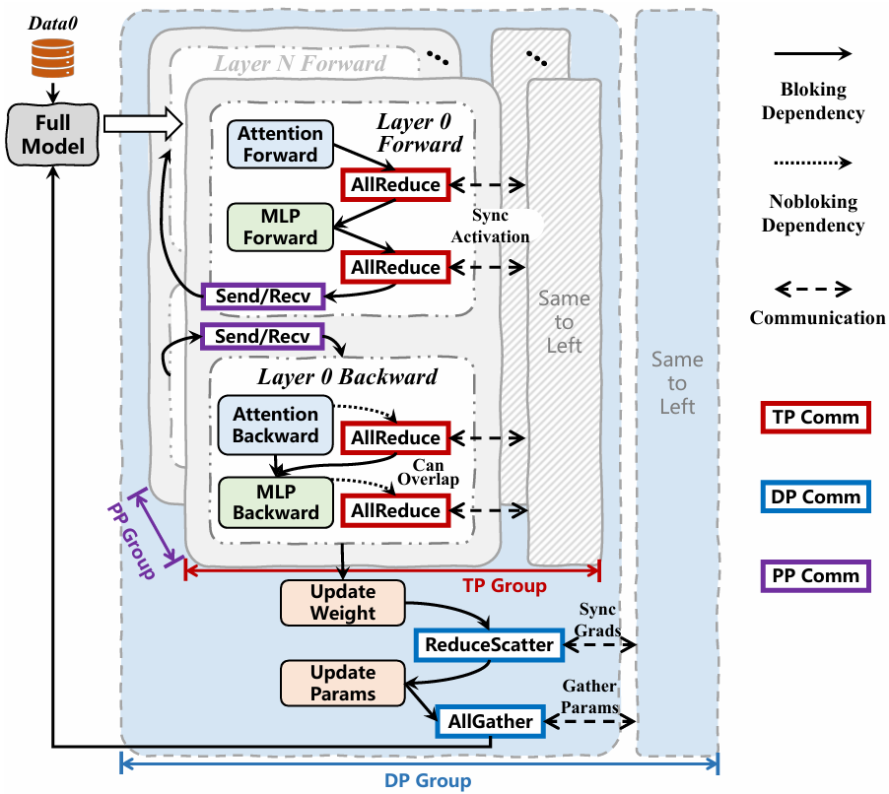
Workload Generator
Example of dependencies when using TP, DP and PP parallelisms.

Slide 12
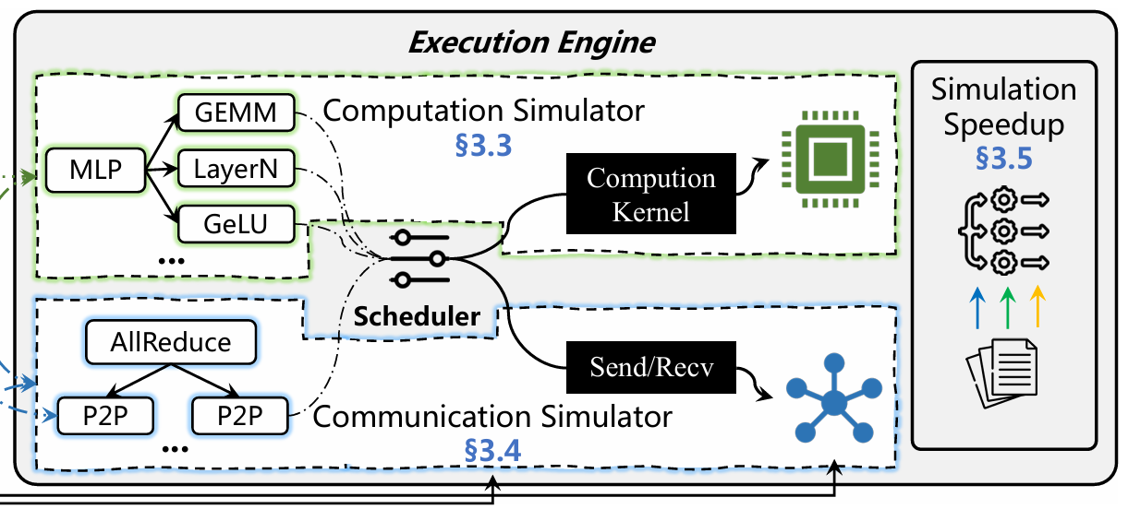
Execution Engine

Slide 13
Computation Simulator
Each GPU is dedicated to a single task, can accurately simulate the entire computation by filling time for each submodule in workload file
Submodule-level simulation not always work, especially for new parallelization strategies or optimizations
SimAI designs a module-kernel converter

Slide 14
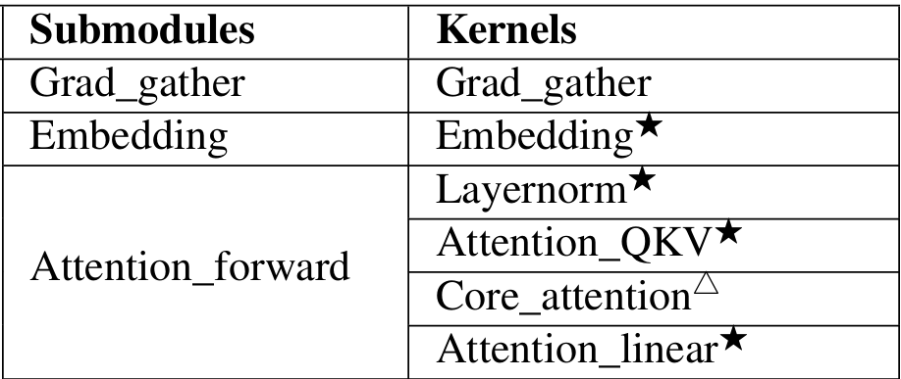
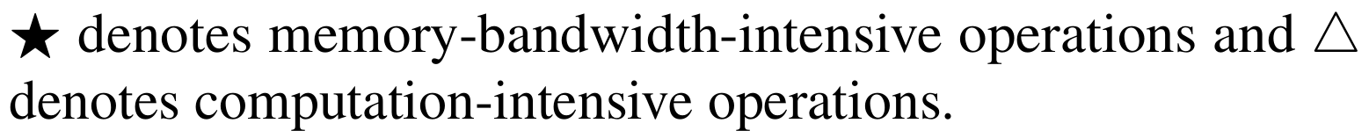
Computation Simulator
Part of module-kernel converter

Slide 15
Computation Simulator
SimAI also supports unreleased GPUs
Need of evaluating whether new GPUs worth the investment
Initial approach: scale values from existing GPUs, inaccurate
New approach: different kernels have different bottlenecks:
computation-intensive, memory-bandwidth-intensive

Slide 16
Communication Simulator
Training framework rely on collective communication library, like NCCL
NCCL translates collective communication operations (AllReduce, AllGather, ReduceScatter) into network-level operations (Send, Receive)
SimAI uses a modified version of NCCL, called SimCCL
SimCCL uses “hijacking” method, run on a single host

Slide 17
Simulation Speedup
SimAI implemented multithread version to speed up simulation
Integrate UNISON to automatically distribute network topologies across different processes (Bai et al., 2024)
23x speedup compared to single-thread version

Slide 18
Evaluation
Evaluate SimAI based on precision and scalability
Performance is compared with ASTRA-sim and ground truth
Communication, computation, end-to-end precision tests

Slide 19
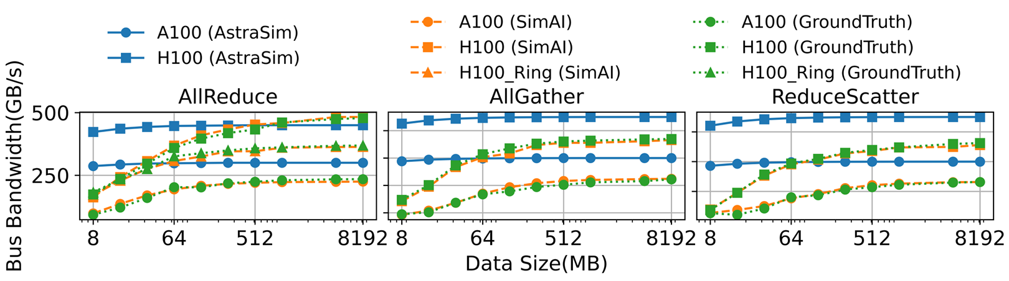
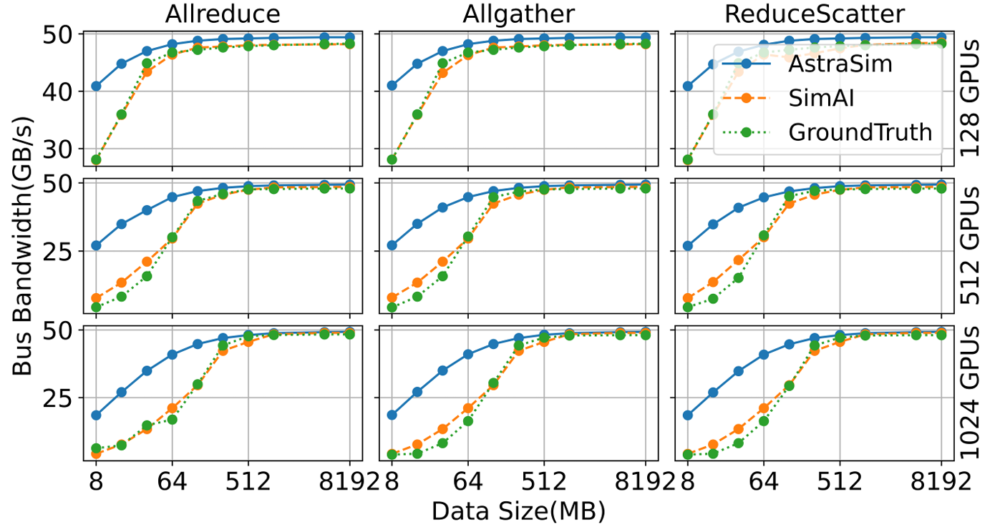
Evaluation of Communication Simulation
Intra-host and inter-host communication simulation
Average deviation (A100):
SimAI 3.9%, ASTRA-sim 74.8%

Slide 20
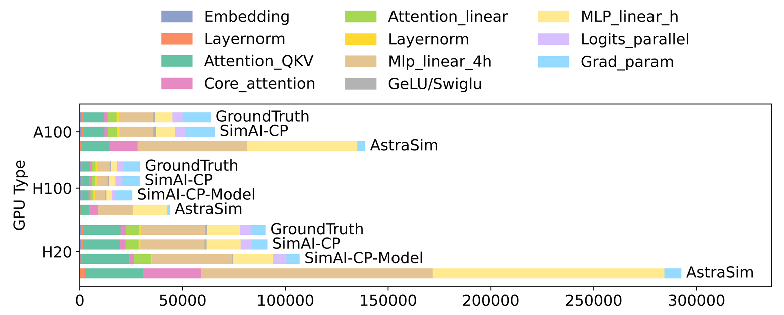
Evaluation of Computation Simulation
Execution time deviation: SimAI: 0.5% - 3.1%; ASTRA-sim: 49.8% - 224%

Slide 21
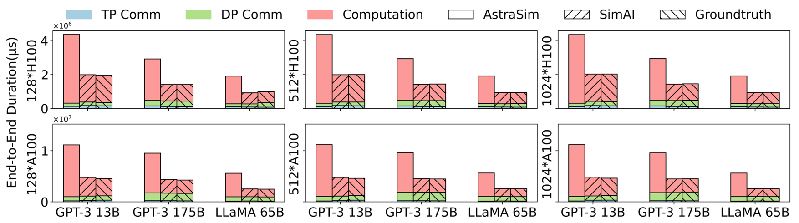
Evaluation of End-to-end Simulation
Deviation between SimAI and ground truth < 4%

Slide 22
Vidur: A Large-Scale Simulation Framework For LLM Inference
Agrawal et al., 2024

Slide 23
What is LLM Inference?
LLM Inference: process of using LLM to produce some natural language outputs based on some inputs
LLM Inference contains two phases:
prefill: process the entire input and produce first output token
decode: generate next token based on previous token until a special “end-of-sequence” token is generated

Slide 24
Why we need simulators for LLM Inference?
The cost of LLM Inference serving is expensive
Example: cost of serving ChatGPT is estimated $694K per day
To optimize LLM Inference, provider need decide model parallelization strategy, scheduling algorithms, many parameters
Systematically deploy and test these options is expensive

Slide 25
Challenges of Simulating LLM Inference
Unique challenges of simulating LLM inference compared to training
LLM inference predictions have to be accurate in finer time scale
Input size can vary drastically
Small errors cascade over time and lead to aggregated errors

Slide 26
Related Works
Previous works focus on training simulations
Daydream simulates training performance under various system optimizations in different deployment scenarios (Zhu et al., 2020)
Vidur is the first simulator for properties of LLM Inference

Slide 27
Solution
The paper presents Vidur, Vidur-Bench and Vidur-Search:
Vidur: a large-scale, high-fidelity, easily extensible simulation framework for LLM inference performance
Vidur-Bench: a collection of workload traces for LLM inference
Vidur-Search: a tool that uses Vidur to automatically search the best configuration for a given model and workload

Slide 28
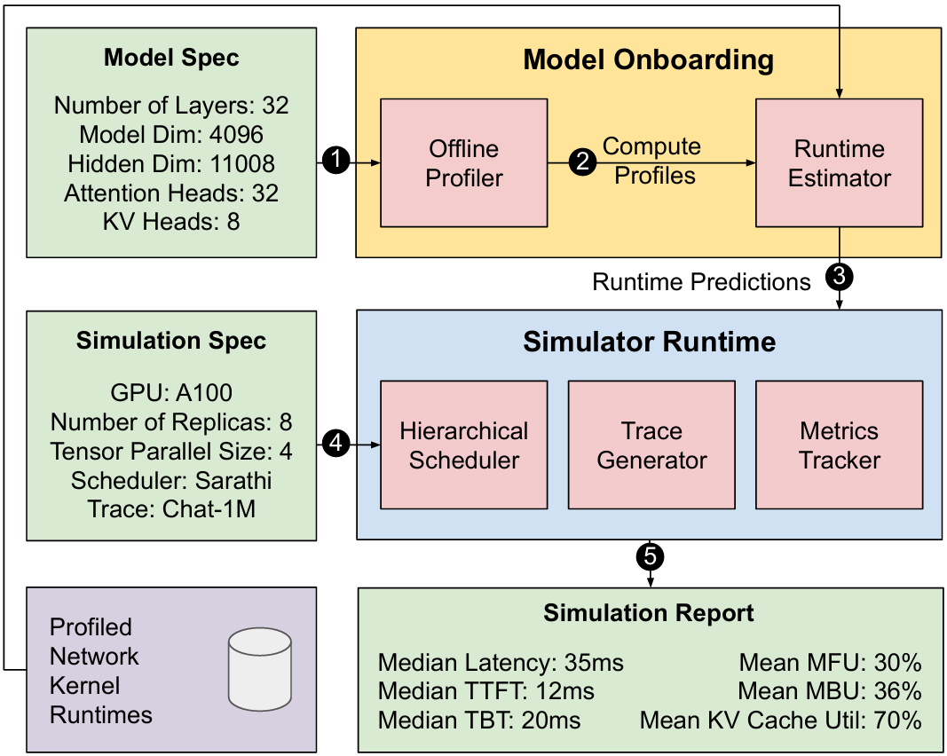
Vidur

Slide 29
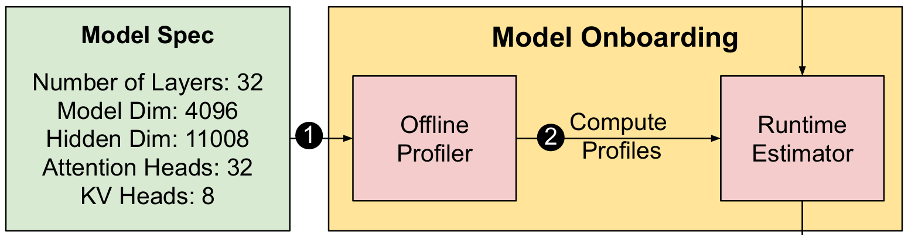
Profiler
Profiler takes model specification as input, compute the profiled runtimes for different operations
LLM share common architectures, allow Vidur to use a common model specification format

Slide 30
Profiler
Profiler divides operators into three types based on dependencies:
Token-level: depend on number of tokens generated (addition)
Sequence-level: depend on number of tokens generated and length of input request (attention kernel)
Communication: depend on amount of data to transfer (all-reduce)

Slide 31
Runtime Estimator
Operation runtime depends on query length, number of KV caches, …
Impossible to profile all combinations in the input space
Runtime Estimator collects a limited set of data from Profiler, train small machine-learning models to estimate runtime
Choose random forest models to capture non-linear runtime characteristics

Slide 32
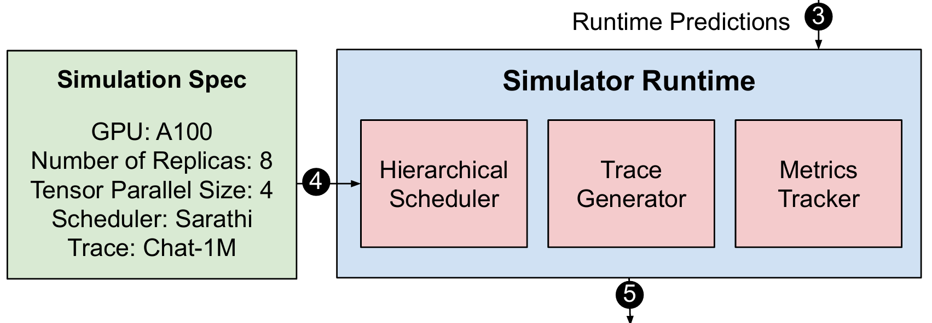
Hierarchical Scheduler
Vidur uses a three-tier hierarchical scheduler:
global scheduler: responsible for request routing, support different scheduling policies
replica scheduler: responsible for batching and memory management, support different memory size and batching policies
replica stage scheduler: handle pipeline schedule of micro-batches

Slide 33
Vidur-Bench
The LLM inference performance is highly sensitive to workload type, such as the length of input and output
There’s no standardized benchmark for LLM inference
Vidur-Bench provides a set of workloads for different request types, arrival rates, and a set of performance metrics

Slide 34
Vidur-Search
Vidur Search is a tool that uses Vidur to automatically search the optimal cost configuration while satisfying SLO (service level objective) constraints
Inputs: LLM model, workload, GPU specifications, SLO contraints
Search Space: parallelism strategy, parallelism degree, scheduling policy, batch size, …

Slide 35
Vidur-Search
Optimization Objective: QPS per dollar
QPS: maximum number of queries per second that the system can support without queuing delay aggregates
For each configuration in the search space, Vidur-Search performs a binary search to find the maximum QPS that the queuing delay doesn’t exceed a threshold

Slide 36
Evaluation
Different types of workloads:
LMSys-Chat-1M: one million real-world conversations with many state-of-the-art LLMs
Arxiv-Summarization: a collection of publications from arXiv and their summaries
Bilingual-Web-Book: a collection of Chinese online novels and their corresponding English translations

Slide 37
Evaluation
Different types of workloads:
Static workloads: all requests are assumed to arrive before the system starts, measure the execution time
Dynamic workloads: requests arrive based on a Poisson distribution, measure normalized end-to-end latency

Slide 38
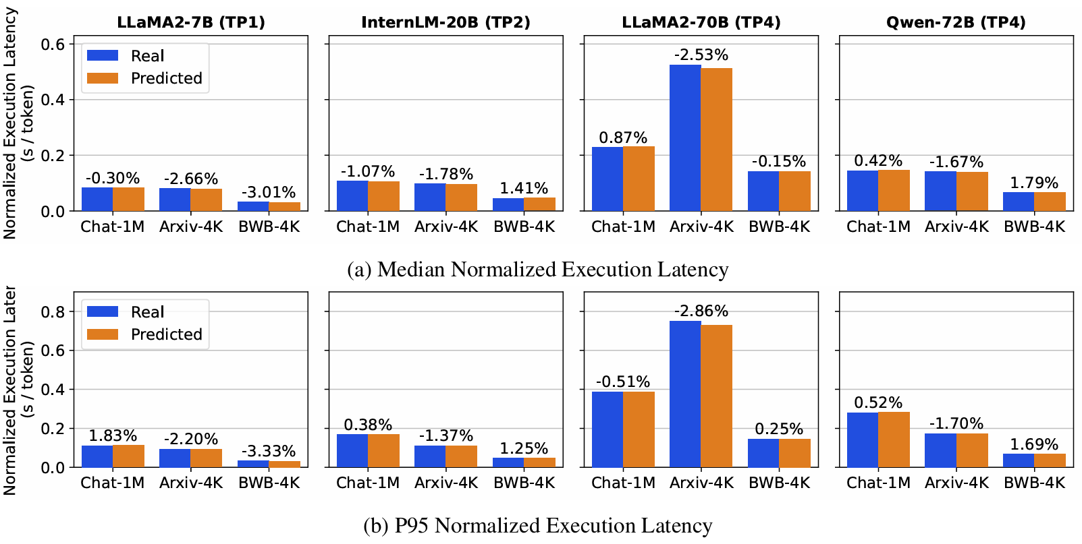
Evaluation
Static workloads: < 3.33% error across four models and three datasets

Slide 39
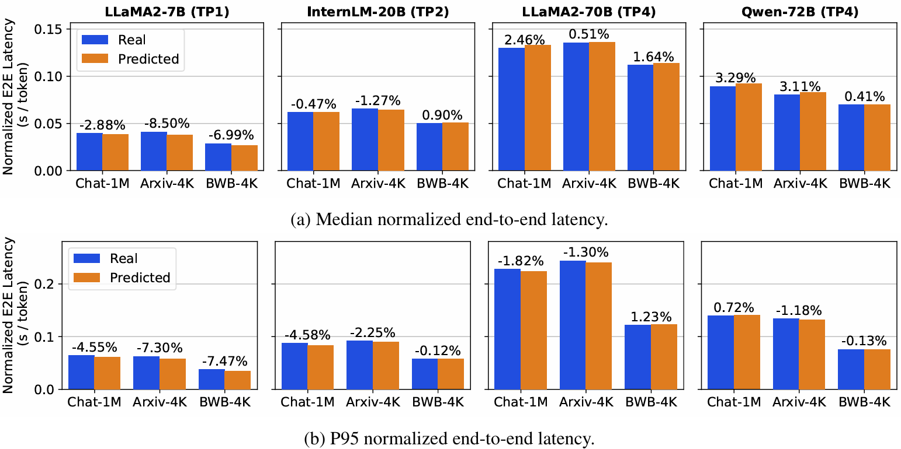
Evaluation
Dynamic workloads: < 5% error in almost all scenarios

Slide 40
Thank you!

