Slide 1
UNIX Shell Scripting
Only for BEGINNERS

Slide 2
Topics Covered
Overview of Unix Shell
Shell Types
Shell Scripting
Working with Vi Editor
Shell Scripting Comments & Variables
Echo Command
Executing Script

Slide 3
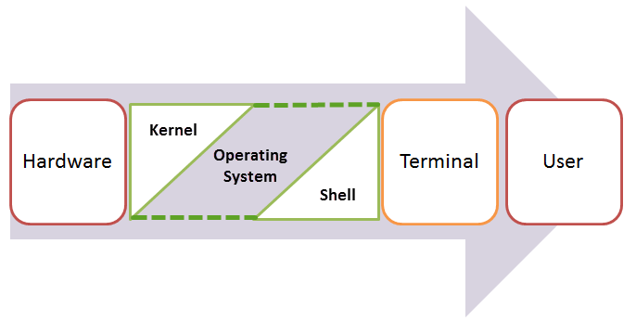
Overview OF UNIX SHell
An Operating is made of many components, but its two prime components are -
Kernel
Shell
A Kernel is at the nucleus of a computer. It makes the communication between the hardware and software possible. While the Kernel is the innermost part of an operating system, a shell is the outermost one.
A shell in a Unix operating system takes input from you in the form of commands, processes it, and then gives an output. It is the interface through which a user works on the programs, commands, and scripts. A shell is accessed by a terminal which runs it.
When you run the terminal, the Shell issues a command prompt (usually $), where you can type your input, which is then executed when you hit the Enter key. The output or the result is thereafter displayed on the terminal.

Slide 4
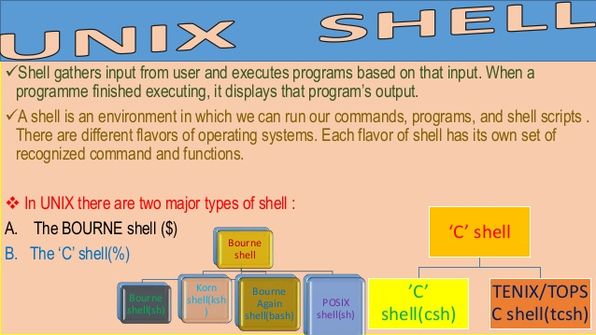
Shell Types
There are two main shells in Unix:
The Bourne Shell: The prompt for this shell is $ and its derivatives are listed below:
1. POSIX shell also is known as sh
2. Korn Shell also knew as ksh
3. Bourne Again SHell also knew as bash (most popular)
The C shell: The prompt for this shell is %, and its subcategories are:
1. C shell also is known as csh
2. Tops C shell also is known as tcsh

Slide 5
SHELL SCRIPTING
Shell scripting is writing a series of command for the shell to execute. It can combine lengthy and repetitive sequences of commands into a single and simple script, which can be stored and executed anytime. This reduces the effort required by the end user.
Normally shells are interactive. It means shell accept command from you (via keyboard) and execute them. But if you use command one by one (sequence of 'n' number of commands) , you can store this sequence of command to text file and tell the shell to execute this text file instead of entering the commands. This is know as shell script.
Shell scripts can be used for a variety of tasks from customizing your environments to automating your daily tasks.
In a single line we can define it as “Shell Script is series of command written in plain text file.”
Why to Write Shell Script?
- Shell script can take input from user and output them on screen.
- Useful to create our own commands.
- Save lots of time.
- To automate some task of day to day life.
- System Administration part can be also automated.

Slide 6
Working With Vi Editor
The default editor that comes with the UNIX operating system is called vi (visual editor).
Vi is the standard editor, most popular and classic text editor that is available on Unix system.
Use the vi editor to edit an existing file or to create a new file from scratch. And also use this editor to just read a text file.
To work on VI editor , Need to understand the its operation modes.
Modes of Operation in vi editor
There are three modes of operation in Vi - the command mode, the insert mode, and the ex-command mode.
1. Command mode: In this mode, all the keys work as commands. These keys are used for inserting, appending, deleting, opening new lines, moving the cursor over the paragraphs and sentences, etc.
In this mode, the keys are not displayed but each key performs an operation. By default the vi editor is in command mode, hence we cannot type text in command mode. In order to write programs or text in vi editor, we need to switch to the insert mode which can be done by pressing the escape button.
2. Insert mode: In this mode, we can insert, append, edit or replace texts. We can switch from the command mode to Insert mode by pressing the escape button and then press I or A to enter into insert mode.
3. Ex command mode: This mode is used for entering commands at the bottom line of the vi editor called as a command line. To switch to Ex command mode press escape key then type: (colon). In order to save the contents and quit from the vi editor press wq after the : (colon). i.e :wq.

Slide 7
Shell Scripting Comments & Variables
Any line starting with a hash (#) becomes comment. Comment means, that line will not take part in script execution.
What are Shell Variables?
Variables store data in the form of characters and numbers. Similarly, Shell variables are used to store information
For example:
variable ="Hello"
echo $variable
small script which will use a variable.
#!/bin/sh
echo "what is your name?"
read name
echo "How do you do, $name?"
read remark
echo "I am $remark too!"

Slide 8
ECHO Command
echo command in unix is used to display line of text/string that are passed as an argument . This is a built in command that is mostly used in shell scripts and batch files to output status text to the screen or a file.
The syntax for echo is:
echo [option(s)] [string(s)]
Echo Options:
Options | Description
-n | do not print the trailing newline.
-e | enable interpretation of backslash escapes.
\b | backspace
\\ | backslash
\n | new line
\r | carriage return
\t | horizontal tab
\v | vertical tab

Slide 9
How to Execute a SCript
Steps to write and execute a script
Open the terminal. Go to the directory where you want to create your script.
Create a file with .sh extension.
Write the script in the file using an editor.
Make the script executable with command chmod +x <fileName>.
Run the script using ./<fileName>.
Note: In the last step you have to mention the path of the script if your script is in other directory.

Slide 10
UNIX SHELL SCRIPTING TUTORIAL ENDS
Only for BEGINNERS

